Slide 1
COMPASS: Community Partnerships and Social Services for People Living with HIV Leaving the Jail Setting
Emily Patry, BS
The Miriam Hospital, Providence, RI

Slide 2
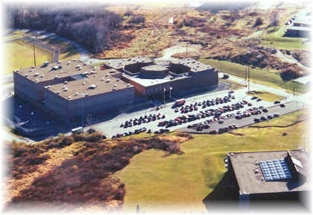
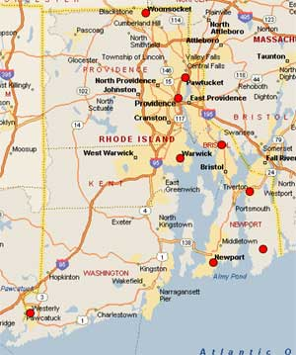
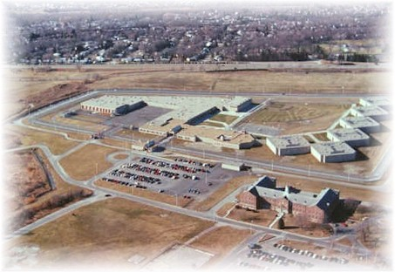
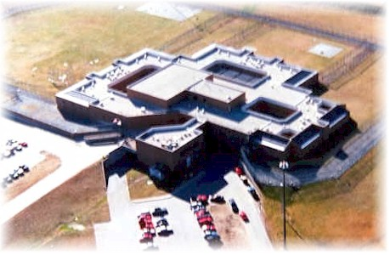
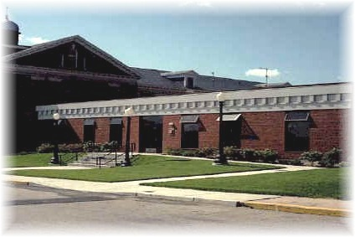
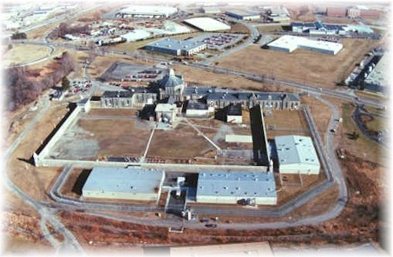
The Landscape in Rhode Island
Rhode Island Department of Corrections (RIDOC)
single unified system: jail and prison serving the entire state
Intake Service Center (jail)
Medium Security
High Security
Minimum Security
Maximum Security
Women’s Facilities

Slide 3
The Landscape in Rhode Island
RIDOC and Brown University have worked together for almost 25 years
Continuum of staff providing HIV services in the correctional facility and in the community
HIV testing program in effect since 1989
Sharp decreases in the numbers of persons newly diagnosed with HIV at RIDOC
Over a decade ago, 30% of all positive HIV tests in RI were from RIDOC (AIDS Educ Prev 2002; 14: 45-52)
In recent years, approximately 10 new cases a year have been identified at RIDOC
Concomitantly, there has been an 80% decrease in IDU-related HIV in Rhode Island

Slide 4
Project Bridge
Project Bridge has served HIV-infected persons leaving the RIDOC for almost 15 years
Originally a SPNS-funded demonstration project, Project Bridge has been sustained by the Rhode Island Department of Health through RW funding
Using a social work model, the program provides prison outreach and intensive case management to HIV-positive persons being released from the RIDOC facilities to facilitate community re-entry and retention in medical care.
Project Bridge team:
engages clients within three months of prison release
creates a discharge plan that links clients to medical care at provider of their choice and social services following release
provides supportive services to retain clients in care

Slide 5
Self-reported needs of Project Bridge clients

Slide 6
COMPASS addressed need to expand Project Bridge
Challenges related to the provision of services for shorter-term JAIL detainees
Short and unpredictable lengths of stay, high rates of turnover, and recidivism
Risky population
Expansion of services to those incarcerated at an additional facility (Bristol County House of Corrections) in the contiguous area of southeastern Massachusetts

Slide 7
Overarching COMPASS goal: enhancement of existing services
Enhance existing services through the implementation of:
a jail-release program of jail-based case mangers and community-based case managers combined with intensive community outreach
To lead to:
improved HIV treatment, substance abuse and social stabilization outcomes for recently released HIV+ jail detainees

Slide 8
COMPASS Program Goals and Objectives
To enhance the ability of jail facilities in Rhode Island and Bristol County, Massachusetts to promptly identify HIV-infected individuals
To determine the medical and social needs of HIV-infected jail detainees in Rhode Island and Bristol County, Massachusetts
To expeditiously link HIV-infected jail detainees in Rhode Island and Bristol County, Massachusetts to HIV primary care and other medical and social services in the community upon release

Slide 9
Target Population
All HIV-infected individuals incarcerated at the jail facilities of RIDOC and BCHOC eligible for participation
Newly diagnosed individuals
Previously diagnosed individuals, not in active care in the community
Previously diagnosed individuals, in active care in the community
Most detainees are from the urban areas of Providence, New Bedford, and Fall River

Slide 10
Socio-demographic profile of COMPASS participants (N=84)
Gender:
80% Male
Age:
Median 44 (range 21-71)
Race/ethnicity:
35% Hispanic; 26% White; 23% Black; 16% other
Homelessness:
36% considered themselves homeless
Substance use:
45% used cocaine at least once in the 30 days prior to incarceration
31% used heroin and/or other opiates at least once in the 30 days prior to incarceration

Slide 11
COMPASS services provided (jail)
Jail-based encounters
81% of participants received at least one service encounter from jail-based project staff while incarcerated [median 1 (range: 1-35)]
Most common services provided:

Slide 12
COMPASS services provided (community)
Community-based encounters
74% of participants received at least one service encounter from community-based project staff after release median 16.5 (range: 1-130)]
Most common services provided:

Slide 13
Linkage to care
Linkage to HIV care was documented for 52% of participants enrolled (broadly defined by self-report, any documented visit with health care provider, or documented PVL/CD4 test in community)
Mean/median days to care after release: 36/24 (range: 2-164)
35% linked within 30 days
14% linked between 31-90 days
6% linked between 91-180 days
Those linked to care within 6 months of release were significantly more likely to have reported a usual health care provider or place where s/he got HIV care at baseline (p=0.01)

Slide 14
General findings
It appears that, in general, local data are consistent with findings from the multi-site evaluation (which are being reported in a supplemental issue of AIDS and Behavior)
population is impacted by substance use, mental illness, lower educational attainment, and overall instability
Gender, race, and insurance status influence engagement in care and outcomes
Services inside the jail, such as HIV education and discharge planning, can make a difference
Experience in RI over time also shows value of community-based intervention during the transition period
Engagement in care and viral suppression are possible but interventions may require more than a “one-size-fits-all”

Slide 15
Acknowledgements:
Project Bridge
Helen Loewenthal, MSW
Brianne Buckley, BA
Holly Perry, MSW, LCSW

