Slide 1
Potential Impact of the Affordable Care Act on the Ryan White HIV/AIDS Program
November 27, 2012
All Grantee Meeting Presentation: HIV/AIDS Bureau, HRSA
Margaret Hargreaves and Charles Henley

Slide 2
Study Goals
Assess the potential impact of the Affordable Care Act (ACA) on the Ryan White HIV/AIDS Program (RWHAP)
How can the Health Resources and Services Administration help the RWHAP community with the ACA transition?

Slide 3
Comprehensive Literature Scan
Identified topics in six broad areas
Reviewed ACA-related reports
Reviewed more than 250 documents
February 2012 preliminary report
Findings updated in final report

Slide 4
Expert Consultations
Scan informed discussions with topic experts in the ACA, HIV/AIDS, Medicaid, and RWHAP
Discussions with 15 experts in April and May 2012
Experts asked to prioritize issues and identify innovative ACA implementation practices
Notes:
Experts asked to prioritize issues offering greatest challenges and opportunities for RWHAP and PLWHA, and identify innovators

Slide 5
State Medicaid Program Interviews
Seven state Medicaid programs selected
States represented a range of early ACA implementation experiences, HIV/AIDS demographics, and Medicaid policies
Group interviews conducted in July and August
States: Colorado, Iowa, Maryland, Massachusetts, New York, Oregon, and Texas

Slide 6
Findings and Recommendations

Slide 7
Six Topic Areas
Eligibility
Exchanges
Benefits
Costs
Services
Payments

Slide 8
Eligibility Reforms
Guaranteed issue and pre-existing condition insurance plans (PCIPs):
ACA prohibits denial of coverage based on pre-existing conditions (takes effect for adults in 2014)
Created PCIPs to provide temporary coverage
People living with HIV/AIDS (PLWHA) have faced barriers accessing PCIPs
RWHAP can help PLWHA access PCIPs and transition to other health insurance in 2014

Slide 9
Eligibility Reforms, cont.
Individual insurance mandate and exemptions:
Most legal residents required to purchase insurance or pay a penalty
Two types of exemptions:
Requirement to purchase insurance
Requirement to pay penalty
Requirement upheld by Supreme Court

Slide 10
Eligibility Reforms, cont.
Expansion of Medicaid eligibility:
National Medicaid income eligibility threshold of 133% of the federal poverty level (FPL)
Effective rate is 138% due to standardized 5% income disregard
Challenged and struck down by the Supreme Court
Expansion is now effectively optional for states

Slide 11
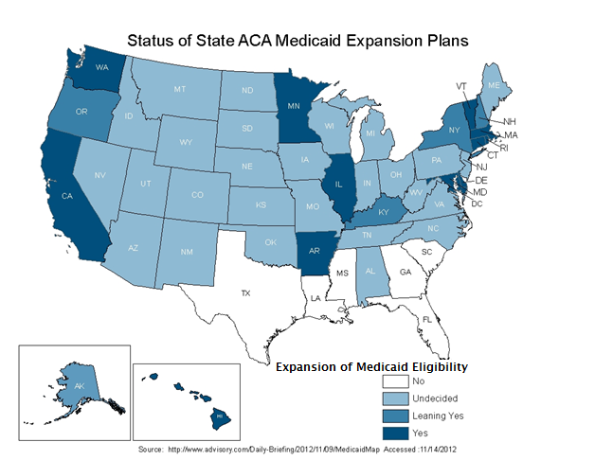
State ACA Medicaid Expansion Plans

Slide 12
Eligibility Reform Recommendations
Work with states on Medicaid expansion policy
Maintain and increase outreach to ineligible groups

Slide 13
Health Insurance Exchanges
Creation of affordable insurance exchanges:
Those with incomes from 100 to 400% of the FPL (if ineligible for Medicaid) can receive assistance to purchase private insurance
November deadline to submit plans for state-based exchanges
Exchanges open for enrollment in October 2013
Coverage starts in January 2014
Exchanges will provide new source of coverage for PLWHA
Might face more cost-sharing requirements (e.g., for drugs)
Some needed services might not be covered
Need to improve exchange navigation and streamline enrollment for PLWHA

Slide 14
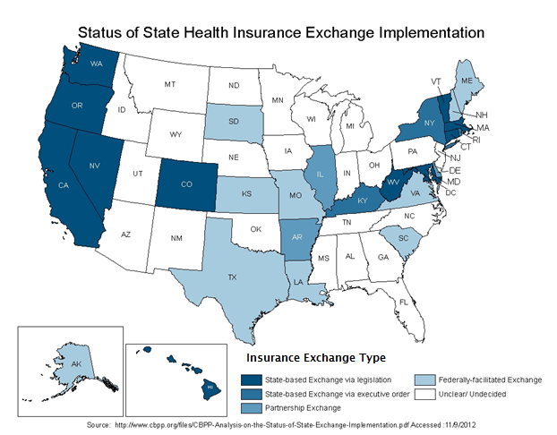
State Health Exchange Plans

Slide 15
Health Insurance Exchanges, cont.
ACA citizenship requirements:
Undocumented immigrants and “lawfully present” immigrants within 5 years of residency barred from receipt of federal benefits
Under ACA, lawfully present immigrants
Still barred from Medicaid for first five years
Can purchase insurance in Exchanges
Can qualify for private insurance tax credits and cost sharing reductions
PLWHA who do not meet eligibility requirements will still need services from RWHAP
Other groups are also likely to require RWHAP services

Slide 16
Exchange Reform Recommendations
Help PLWHA through the eligibility and enrollment process, and make informed Medicaid and private insurance choices
Train RWHAP case managers to serve as Exchange patient navigators and transition coordinators for RWHAP clients
Carefully plan the transition of newly eligible PLWHA into expanded Medicaid and private insurance

Slide 17
Insurance Benefits
Essential health benefits (EHBs) and benchmark plans:
EHBs are 10 categories of “items and services” specified in the ACA
Insurance offered through Medicaid expansion, Exchanges, and state Basic Health Plans (BHPs) must meet EHB requirements
States given right to define state-specific EHBs
Will result in significant state variation in benefits
Could lead to
Inadequate coverage for PLWHA in some states
Service disruptions for PLWHA moving across states

Slide 18
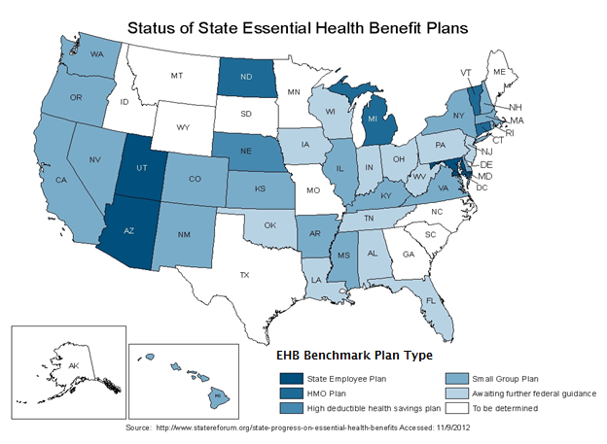
State Essential Health Benefit Plans

Slide 19
Insurance Benefits, cont.
Basic Health Plan:
State plan option for people with incomes from 133 to 200% of the FPL
Otherwise eligible for premium tax subsidies
Benefits must be at least as generous as state’s EHBs
Potential BHP benefits:
Provide lower costs for consumers who cannot afford other qualified health plans
Prevent churning between Medicaid and private insurance for PLWHA with income fluctuations in this range

Slide 20
Benefit Reform Recommendations
Comprehensive EHBs that meets the complex health care needs of PLWHA
Continuity of access to ART medications
Identification of state-specific service gaps for reallocating Part A and B funding from direct medical care to premium supports and services not covered by Medicaid or private insurance

Slide 21
Insurance Costs
Private health insurance subsidies:
Citizens and lawfully present residents (with incomes from 100 to 400% of the FPL if otherwise ineligible for Medicaid) are eligible for advance tax credits
Cost-sharing reductions are available for people with incomes from 100 to 250% of the FPL
Will cover copayments, deductibles, and co-insurance
Available to low-income people with high out-of-pocket costs
Not clear what assistance, if any, will be available to PLWHA with incomes less than 100% of the FPL in non-Medicaid expansion states

Slide 22
Insurance Costs, cont.
Preventive service cost-sharing:
ACA covers preventive care without cost-sharing for services graded A or B by the U.S. Preventive Services Task Force (UPSTF)
Currently covers HIV testing in high-risk settings
In Medicaid, HIV testing without cost sharing will be available as a state plan option on January 1, 2013
USPSTF issued draft recommendation for routine HIV testing for teens and adults in November 2012
HIV testing is not always included in bundled payments to providers, which could limit provider uptake

Slide 23
Insurance Costs, cont.
Medicare Part D prescription drug coverage gap:
Donut hole to be phased out by 2020, until then
AIDS Drug Assistance program (ADAP) payments count toward true-out-of-pocket costs
Beneficiaries also receive a 50% discount on name-brand drugs
Medicare cost-sharing requirements still apply (25% cost of medications)
Reform could reduce costs for HIV medications and reliance on ADAP for medication coverage
PLWHA on Medicare will still need cost-sharing subsidies to help cover their out-of-pocket costs

Slide 24
Cost Reform Recommendations
Allocate RWHAP funds to cover cost-sharing
Educate RWHAP community about tax credits, cost-sharing reductions and out-of-pocket expense limits

Slide 25
Service Delivery
Medicaid managed care:
More than 70% of Medicaid enrollees served through managed care
Aged, blind, and disabled enrollees traditionally exempted, but states have started mandating managed care for them
Expansion of Medicaid means more people covered through managed care organizations (MCOs)
MCOs might not have capacity to provide HIV care for PLWHA newly covered by Medicaid
Lack of experienced HIV providers within networks
Inadequate pharmacy coverage
Potential for care disruptions

Slide 26
Service Delivery, cont.
Patient Centered Medical Homes (PCMH):
ACA provisions promote expansion of PCMH model
Medicaid health homes:
New state plan option (1/1/12) to develop Medicaid health home programs for people with complex health needs
At least 2 chronic conditions
One condition and at risk for developing second
At least one serious and persistent mental health condition
Conditions covered include HIV
Potential for incorporating comprehensive HIV care into PCMH and Medicaid health home models

Slide 27
Service Delivery, cont.
HIV workforce capacity:
Increased demand for HIV care under ACA
Many community-based providers do not have HIV expertise
Health plans have limited access to HIV pharmacies
RWHAP clients might have to transfer to new clinics
ACA reforms
Expand initiatives to increase cultural competency of providers
Include essential community providers in qualified health plans
Double community health center capacity
AIDS Education and Training Centers (AETCs) can help train PCPs in HIV care

Slide 28
Service Delivery Reform Recommendations
Ensure that experienced HIV providers are included as HIV primary care providers (PCPs) in provider networks
Tailor PCMH and health home program models to address HIV care needs
Provide more AETC training for primary care providers working in community health centers and other settings to build their expertise providing HIV treatment and care to PLWHA

Slide 29
Payment Reforms
Provider reimbursement rate:
Medicaid reimbursement rate for PCPs up to 100% of Medicare reimbursement rate in 2013 and 2014
Includes HIV specialists
Applies to both fee-for-service (FFS) and managed care plans
Set to expire after 2014
Some RWHAP providers will need help getting third-party payments
Have to be certified as Medicaid providers and in managed care provider networks
Lack internal systems to manage the documentation and reporting associated with billing multiple insurance plans

Slide 30
Payment Reforms, cont.
Other integrated payment reforms
ACA funds accountable care organizations (ACOs), bundled payment reforms, and demonstration programs for duals
ACOs change financial incentives for how doctors and hospitals work together
Bundled payments designed to minimize patient cost while improving care
The Centers for Medicare & Medicaid Services (CMS) is working on integrated payment models for dual-eligible beneficiaries
Potential for RWHAP to share its comprehensive HIV care expertise to help create new Medicaid models

Slide 31
Payment Recommendations
Work with stakeholders on permanent Medicaid reimbursement rate increase issue
Provide information about new non-FFS payment models
Help medical providers and community-based organizations build insurance screening, eligibility and enrollment, billing, and reporting capacity to manage increased volume of clients on Medicaid or private insurance

Slide 32
State/Local ACA Experiences

Slide 33
State/Local Experiences: Houston EMA
TX has highest rate of uninsured persons (24%)
25% of all Houston residents are uninsured
62% of Houston EMA RW clients are uninsured
87% of Houston EMA RW clients earn <100% of FPL.
76% of PLWHA in Houston EMA are unemployed

Slide 34
State/Local Experiences: Eligibility
Houston EMA
So far Texas has not committed to expansion
Difficult for PLWHA to qualify under existing state rules
Consumers & others joining Statewide advocacy efforts
State Healthcare Access Research Project (SHARP)
Texas HIV/AIDS Coalition
Policy Development
National Academy of State Health Policy (NASHP) Medicaid Safety Net Learning Collaborative
1115 Transformation Waiver

Slide 35
State/Local Experiences: Exchanges
Houston EMA
Texas has not elected to implement its own Exchange
Approximately 20% of Houston EMA PLWHA may be eligible to purchase coverage through an Exchange
Nurture & develop capacity to assist Exchange-eligible consumers in choosing best plan for their needs
RW-funded agencies offering core services must be Providers with all plans PLWHA may enroll in

Slide 36
State/Local Experiences: Benefits
Houston EMA
Essential Health Benefit (EHB) remains work in progress
Houston EMA has “bundled” RW-funded Primary Care, Medications, Medical Case Management and Service Linkage (non-medical CM) into a single local category
Will assist Planning Council, Grantee and Providers in quickly retooling RW-funded services to best wrap-around EHB to ensure access to and retention in care
Local Pharmacy Assistance Program (LPAP) may be able to wrap-around expanded benefits as with ADAP
Ongoing training for CMs, patient navigators & eligibility workers on new benefits available to PLWHA

Slide 37
State/Local Experiences: Costs
Houston EMA
RW-eligible PLWHA will likely need more assistance with premiums, co-insurance and co-payments
RW Health Insurance Assistance allocation may need increase to meet the needs of Exchange-eligible PLWHA (now receives 5th largest allocation of funds in EMA)
Increased need for wrap-around services
Linkage to care, system navigation, case management
Dental, medications & other services not fully covered under expanded Medicaid or insurance policies available via the Insurance Exchange

Slide 38
State/Local Experiences: Services
Houston EMA
Texas Medicaid program already in transition from Traditional to Managed Care Organizations (MCO)
Grantees must ensure RW-funded core medical service agencies are enrolled with multiple MCOs
RW agencies often need increased capacity in back-office operations to integrate new benefits into RW continuum of care
Electronic benefit eligibility/verification systems
HealthHIV Fiscal Sustainability T/A
NASHP Medicaid-Safety Net Learning Collaborative

Slide 39
State/Local Experiences: Payments
Houston EMA
Fee-for-Service reimbursement model
Aligns with enhanced Medicaid rates (FQHC rate)
Includes HIV specialists and Sub-specialty providers
Local continuum of care includes most wrap-around services needed by PLWHA including
Medical & Non-medical case management*
HIV and HIV-related medications*
Oral Health
Mental Health and Substance Abuse Treatment
Medical Nutritional Assessment & Therapy*
*bundled with Primary Care services – 1 Stop Shopping

Slide 40
Conclusions

Slide 41
National Transition Leadership
Address anxiety about RWHAP’s future
Provide more transparent and visible HAB leadership in transition process
Offer clear guidance to support the transition
Tailor RWHAP to operate in divided Medicaid expansion environment – “tale of two cities”
Expansion and non-expansion states
States on track or delayed in ACA implementation

Slide 42
Collaborative Transition Planning
Engage the RWHAP community now in state-level ACA planning and implementation
Identify critical state agencies, decision makers, and decision points, and deadlines
Gain a seat at the state policy table to develop or revisit policy decisions

Slide 43
Education and Technical Assistance
Recognize the significant change in billing practices for RWHAP providers
Recognize the significant change in Medicaid and insurance status for RWHAP clients
Implement outreach and enrollment of PLWHA
Increase coordination among states, medical providers, insurance plans, and MCOs

Slide 44
Acknowledgements
Contracting officer’s technical representative: Alice Litwinowicz
Mathematica team: Ann Bagchi, Vanessa Oddo, Boyd Gilman, Debra Lipson, and ACA expert, Deborah Bachrach (Manatt Health Solutions)
For more information please contact:
Meg Hargreaves
mhargreaves@mathematica-mpr.com

