Slide 1
The Future Arrives The Intersection of Ryan White & Health Reform in a California EMA
Kathleen Clanon, MD
Clinical Director, Pacific AETC
Medical Director, LIHP

Slide 2
Agenda
Brief update on Health Reform implementation
Description of California waiver and challenges uncovered:
Conflict with RWP Payer of Last Resort
Confusion among patients, providers
Formulary and drug costs
Data sharing, confidentiality and transition

Slide 3
Affordable Care Act Farthest reaching health law since Medicare and Medicaid in the 1960s.
Notes:
KAC

Slide 4
Impact of Health Reform on Insurance for PLWH
Notes:
Additional numbers of people who will be entering care in 2014.

Slide 5
Problems galore……
Reimbursement:
Full federal funding for Medicaid expansion is temporary, although it continues at 90%
Routine HIV testing not covered
Inadequate provider reimbursement rates, not fully addressed
Affordability:
Exchange subsidies, caps and tax credits could be insufficient for some living with HIV or other high cost conditions
Coverage:
No mandatory dental or vision coverage
Notes:
Donna

Slide 6
Health Care Reform & Immigrants
Undocumented immigrant populations are left out of health care reform entirely
Legal Immigrants have a five year waiting period for coverage
Notes:
Donna

Slide 7
HIV and Health Reform: the Dream Holistic Care and More Choices
Medical Care:
Choose an HIV expert Medical Home
All HIV and other care at one site
ER and inpatient costs covered, and medical equipment
Mental health included
Dental, CM still covered by ADAP
Meds:
Medically necessary meds (ARVs) all covered. No more waiting lists!
Medicare Part D donut hole closing
Family/ HIV negative partners now insured, have own meds!

Slide 8
HIV and Health Reform: the Nightmare Lost in the Managed Care Crowd
HIV specialty clinics unable to compete and close
People with HIV lost in the crowd
Stigma results in bad customer service in “vanilla” primary care clinics
PWHIV get disconnected from care
Treatment interruptions

Slide 9
HIV & Health Reform: The Nightmare Lost in the Managed Care Crowd
HIV specialty clinics unable to compete & close
People with HIV lost in the crowd
Stigma results in bad customer service in “vanilla” primary care clinics
PWHIV get disconnected from care
Treatment interruptions

Slide 10
California’s Early Bridge to Reform: Low Income Health Program (LIHP)
So, why did California do this?
Prepare PATIENTS, providers for 2014
Bring Federal $$ into the County
Up to $30,000,000 in new money in Alameda County alone
IMPROVE the integration of care.
Cover many of the uninsured now.
Notes:
10

Slide 11
California’s Early Bridge to Reform: Low Income Health Program (LIHP)
So, why is California doing this?
PREPARE PATIENTS, providers for 2014
Bring FEDERAL $$$ into the County
Up to $30,000,000 in new money.
IMPROVE the INTEGRATION of care.
COVER many of the UNINSURED now.
11
Notes:
11

Slide 12
Health Program of Alameda County
HealthPAC
82,000 Members
Enroll via:
Clinics
ED
GA
Notes:
HCSA submitted and was approved to operate a LIHP; adopted local name of HealthPAC
Program started July 1, 2011 and runs for three years
Additional federal dollars will be available to allow for expansion of services under HealthPAC
HCSA expects to leverage $40 million through program of which $30 million is new funding
Alameda County selected the highest income level possible – 200% of poverty, to maximize the target population

Slide 13
HealthPAC Programs
County $$ (no immigration restrictions)
Federal $$
LIHP

Slide 14
What Have the Challenges Been? Health Reform and Ryan White
Payer of Last Resort- where are the overlaps?
Formulary Management
Data and Privacy
Patient Choice
Measuring and Monitoring transition

Slide 15
Ryan White, Payer of Last Resort
Introduced in the 1990 authorization of the CARE Act and is found in Parts A, B, C, and F of the Act
“CARE Act grant funds cannot be used to make payments for any item or service if payment has been made, or can reasonably be expected to be made, with respect to that item or service under any State compensation program, under an insurance policy, or under any Federal or State health benefits program; or by an entity that provides prepaid health care.”

Slide 16
LIHP and Ryan White
Decision: July 2011 HRSA/HAB determined LIHP counts as a payer for all services it covers.
Ryan White clients who are eligible for the LIHP must be enrolled in LIHP and are no longer eligible for ADAP and other primary care assoc. services that are covered by LIHP.
Aftermath in CA:
LIHPs assume financial responsibility for Ryan White funded services for eligible clients
A direct cost shift from the State/federal government to counties, drug cost by far the biggest hit…..
Continuity of care concerns for Ryan White clients

Slide 17
Determining the Overlaps
Oakland EMA/HealthPAC Service Coverage Crosswalk.
Let’s go to the full-size document on screen……

Slide 18
How Does this Compare to Your Area?
What services are currently covered by RWP?
Which are essential health benefits and likely to violate payer of last resort provisions?
How will this issue change your continuum of services, if PLR stays as a provision of the RW legislation?

Slide 19
Can the CARE Act Program survive politically as…….

Slide 20
ADAP and Drug Coverage
Enrollment in LIHP requires ADAP termination
Cost shifts to County
No rebate deals – 600 pts = $6.3 million in our county
Difficulty of reaching pts to alert them.

Slide 21
Who Pays?
Since the 8/1/2012 HealthPAC HIV Program start-up thru 10/27/12:
25 patients
114 prescriptions for 48 different medications
69 ARVs Rxs (60% of all meds dispensed)
Total cost: $36,265 (98% attributed to ARVs Rx)

Slide 22
Formulary Ethics A Mini Debate
Should the LIHP pay for all meds that were on ADAP?
Match ADAP for Now
Push generics- help patients and programs get ready for managed care….

Slide 23
Data and Privacy
CA law since 1990’s prevented State OA from sharing ADAP lists with
LIHP
Providers
EMA did not have resources to directly contact clients
Law prohibited use of temp employees
Notes:
Donna

Slide 24
Data and Privacy Proposed Transition Outcome Measures
1. Enrollment: 90% of patients disenrolled by ADAP for LIHP eligibility are successfully enrolled in HPAC within 90 days.
2. Linkage to HIV care: 90% of patients enrolled in LIHP have a medical visit (regardless of site) within 90 days of enrollment.
3. Medication Access: 95% of patients enrolled in LIHP who were on ARVs prior to LIHP enrollment have medication dispensed covering at least 60/90 days in the 3 months after LIHP enrollment.
#1 and 3 could not be directly measured under current CA law.

Slide 25
Legal Change
(c) Notwithstanding any other law, for the purpose of implementing LIHP, pursuant to this part, the State Department of Public Health may share relevant data related to a beneficiary's enrollment in federal Ryan White Act funded programs who may be eligible for LIHP services with the participating entity, as defined in Section 15909.1, operating a LIHP, and the participating entity may share relevant data relating to persons diagnosed with HIV/AIDS with the State Department of Public Health.
Partnership with local and State AIDS offices.

Slide 26
“Leave No One Behind” Tracking and Transition Effort
Grace Period: There is a 90 day grace period offered by the State ADAP.
Intensive information campaign to providers and patients: Starting in February 2012, there have been informational sessions, webinars, and an FAQ for patients and providers describing the new system.
Direct notification to patients: Letters are sent to patients by Office of AIDS in the month prior to their ADAP expiration month. For those whose letters are returned due to a bad address, providers are notified by OAA to follow up with patients.
$50,000 Transition Support grants to HIV agencies.

Slide 27
Patient Choice
LIHP patients now have “insurance card” and choice of care sites.
Customer service more a priority
Long waits for service and long clinic appts no longer desireable.

Slide 28
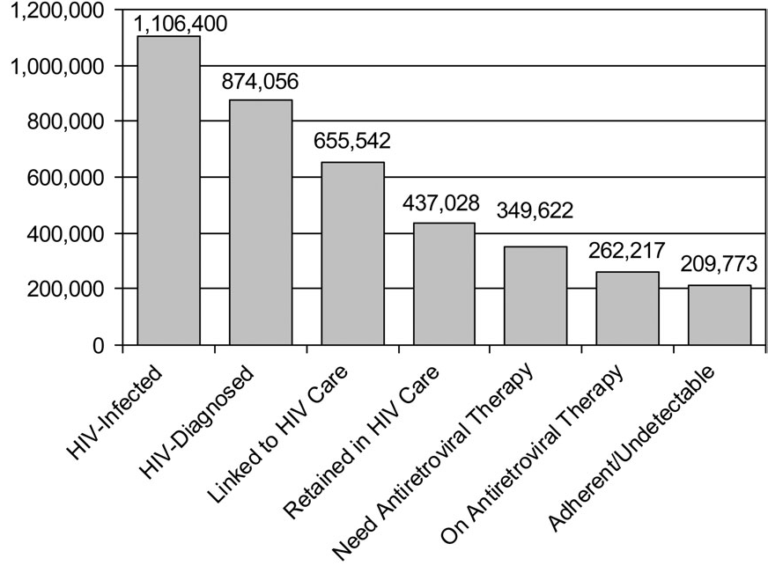
“Gardner Cascade”
Notes:
KAC
The Spectrum of Engagement in HIV Care and its
Relevance to Test-and-Treat Strategies for
Prevention of HIV Infection
Edward M. Gardner,1,3 Margaret P. McLees,1,3 John F. Steiner,2 Carlos del Rio,4,5 and William J. Burman1,3
1Denver Public Health and 2Kaiser Permanente Colorado, Denver, 3University of Colorado Denver, Aurora, Colorado, and 4Rollins School of Public Health
of Emory University, and 5Emory Center for AIDS Research, Atlanta, Georgia
(See the editorial commentary by Lange, on pages 801–802.)
For individuals with human immunodeficiency virus (HIV) infection to fully benefit from

Slide 29
Preparing for Change in HIV Care EMAs and Counties
Double down on collaborations
Re-fund benefits advocacy
Prepare for an insured client base with choices
Look at data sharing law in your state and invest in maximizing your IT
Strategize about when and where Ryan White must fill gaps – create a crosswalk of what is covered in your area
Keep your policy advocates on speed dial –they help you stay abreast of changes as things evolve

Slide 30
Preparing for Change in HIV Care Clinics and Hospitals
Ensure HIV providers are part of the managed care network and can be identified as HIV specialists by health plans and patients
Consider applying for state – specific enhanced reimbursement strategies (Chronic Disease programs – only 2 years of enhanced $$ though)
Work with your pharmacy networks as well as medical providers
Work toward FQHC status

Slide 31
Health Care Reform & Disparities: Long-term — Positive; Short-term — Challenges

Slide 32
Health Care Reform Implementation
“The causes of today’s problems are complex and interconnected. There are no simple answers, and no one individual can possibly know what to do - it is time to stop waiting for someone to save us.
We’re all in this together, we all have a voice in how we go forward.”
Meg Wheatley
Slide Courtesy Anne Donnelly

Slide 33
Ryan White vs Insurance
RW Pros
HealthPAC Pros
Expert medical care free.
ADAP drugs all avail
Can change provider/pharmacy visit-by-visit
Familiar with paperwork and program
Stigma less in program?
Dental and case management covered
All diseases and prevention tests covered, not just HIV
Hospital and ED covered
Mental health part of benefit
Entitlement, not grant
29 medical providers to choose from vs 10
Ryan White still can cover CM, dental, etc
Uninsured family members now insured!

Slide 34
Resources
www.hivhealthreform.org | Community based website with California sub-site
FamiliesUSA http://www.familiesusa.org/health-reform-central/ | Summaries, fact sheets, issue briefs; Join listserv for information updates, including periodic national conference calls on health reform topics
Kaiser Family Foundation http://healthreform.kff.org/ | Summaries and implementation timeline; Fact sheets on Part D, exchanges and subsidies
Treatment Access Expansion Project http://www.taepusa.org/ | Analysis of HIV-related provisions, including presentations
HealthReform.gov http://www.healthreform.gov/ | Administration website with information on the new law, including an ongoing Q&A forum and state-specific information
Center for Medicare Advocacy http://www.medicareadvocacy.org/ | Policy analysis and beneficiary information on the new law’s impact on Medicare, including Part D

