Slide 1
Ryan White Conference-Wishard ED Early Intervention Guidance Two Unique Models, Two Success Stories Nancy J. Miles, MSW, LSW: Emergency Department HIV Program Manager

Slide 2
Objectives
2
Participants will learn two unique programming styles for implementing EIS.
Participant will explore resources that contribute to successful programming and barriers to anticipate.
Participants will learn about practical, in the field experience from using this method as well as stumbling blocks and successes.

Slide 3
Wishard Hospital
Opened in 1859-City Hospital
One of the largest 5 safety net hospitals
Indiana’s first hospital
First Community Mental Health Center
First hospital to serve communities of color
Offered the first Palliative Care Program dedicated to serving the indigent in Indiana
Hosts the only Center of Excellence in Women’s Health in Indiana
10 community health centers
Home to the region’s only adult burn center
45.2% patients are uninsured
3
Notes:
Wishard’s mission is to serve
Marion County’s most vulnerable
populations with the highest
standard of care, regardless of their
ability to pay

Slide 4
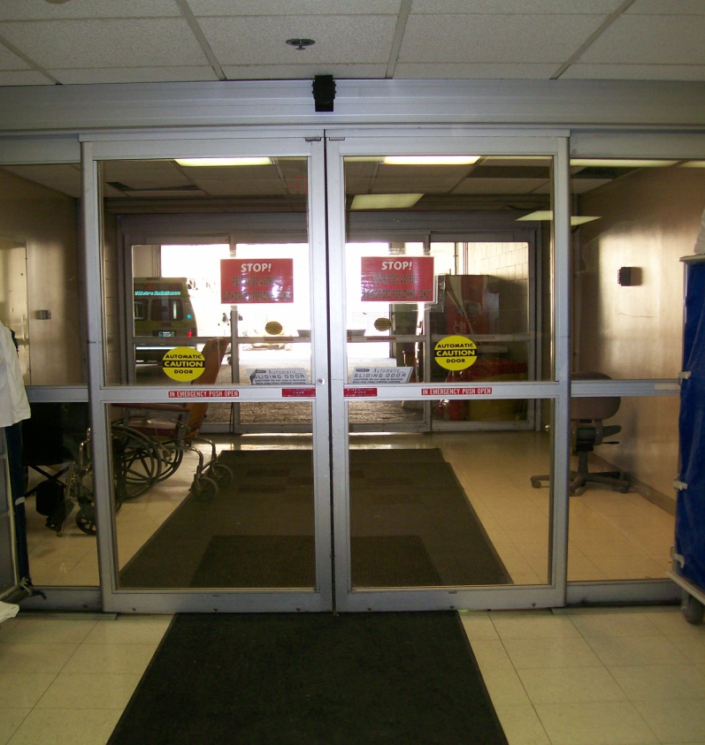
Wishard’s Emergency Department
Level 1 trauma center
1st in Indiana
Only 2 in Indiana
One of the busiest EDs in the state of Indiana
Over 100K yearly
Over 2000 traumas per year
Highest penetrating trauma percentage
93 total beds
4

Slide 5
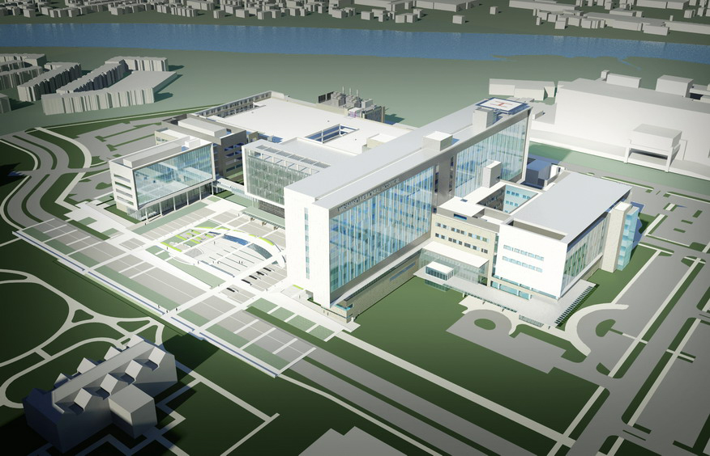
The New Wishard Emergency Department, Eskenazi Health
Opening December 2013
90 individual treatment rooms
Over 200 exam rooms
20 bed clinical decision unit
HIV testing office
5

Slide 6
Purpose of Testing in an Emergency Department
6
To comply with the CDC’s 2006 Revised Recommendations for HIV testing in Health Care Settings
Early detection, intervention, and prevention
Increase in screening
Decrease stigma
Linkage-to-care
High-risk area
Notes:
Recommendations
Opt-Out
Pretest info replaces counseling
No post-test counseling needed for negative
Early Detection
While an HIV status
Link to care earlier

Slide 7
Emergency Department HIV Testing Program
Piloted in 2008
4 week pilot
No interruption to the ED flow
Staff buy-in
Funding
Marion County Public Health Department
Ryan White Part A-HRSA
Indiana State Department of Health
Expansion-CDC funding
Indirect Funding
Staff
HIV Testers/Counselors
Interns
AmeriCorps
Manager
Medical Director
Operation
Hours
Patient Identification
Protocol

Slide 8
Identifying Patients
Pre-programmed to identify:
Patients ages 13-64
Patients without a known HIV positive diagnosis
Patients not tested in the past year
Eligible patients populate a “greaseboard” once registered
Room/bed location and reason for service is available
Specific patients are not eligible for testing

Slide 9
Patient Eligibility
Rapid Sort
Test
Intake
AT (Ambulance Triage)
Do Not Test
Holding Rooms
New patient
Registered
Location
Observation (High Acuity)
Shock Rooms
Annex
UVC/Low Acuity 2
Physicians are able to order a rapid test from the lab.
9

Slide 10
Rapid HIV Test
OraQuick Advance Test by OraSure Technologies, Inc.
Detects antibodies for HIV 1 and HIV 2
Takes 20 minutes
Method
Orally
Fingerstick
Venipuncture
99% accurate
10
Notes:
Do we even need this? Usually used for general discussions.

Slide 11
Testing Process
Patient approached and offered test
Accept/Consent
Reactive
Non-Reactive
Decline
Enter reason into EMR
Post-test Counseling
Counsel patient
Western Blot-Confirmatory Test
Schedule appointment/Intake (Positive)
Enter Results in EMR
Enter Results in EMR
Verbal consent will be replacing written consent
11
Notes:
In the process of moving to a verbal consent

Slide 12
Reactive Patient Flow
Deliver non-reactive results
Notify physician of results
Deliver results/Counsel & education
Nurse/Tester draws blood
Deliver blood sample to lab
Appointment is scheduled before patient leaves

Slide 13
After a Reactive
13
Confirmatory test results appointment
Indiana State Department of Health Adult HIV/AIDS Confidential Case Report
Duty-to-Warn
Partner Notification Form
Hand-off to Infectious Disease Care
Monitor ID attendance
Patients that do not complete appointments are contacted and assessed
Notes:
Reviewed/Completed with patient

Slide 14
Results Through 9/30/2012
Year | EIS Testing | Positive | Positivity Rate | Linked-to-Care
2008 | 1,052 | 1 | N/A | 1
2009 | 2,229 | 5 | N/A | 2
2010 | 4,591 | 17 | N/A | 10
2011 | 4,080 | 20¹ | .49% | 19
2012 | 3,042 | 14² | .46% (.62%) | 11³(14)
Total | 17,994 | 57 | .48% (2011-2012) | 43
1-Addition reactive patient refused Western Blot
2-19 Total identified with prior confirmed diagnosis at earlier dates, but reported did not know status
3-Three patients passed away before linked-to-care, one additional patient referred to care
14

Slide 15
Barriers
15
Funding
Operations based on a 12 hour cycle
Volume
Testing minors
Patients’ perceived risk
Routine vs. Targeted Testing
Follow-up counseling
Staffing
Certifications

Slide 16
Questions

Slide 17
Contact Information
Nancy J. Miles MSW, LSW
HIV Program Manager
Emergency Department
Wishard Hospital
1001 W. 10th St.
Indianapolis, IN 46202
317-287-3013 (phone)
317-656-4216 (fax)
miles.nj@gmail.com
nancy.miles@wishard.edu

