Slide 1


Early Intervention Services- Two Unique Models,
Two Success Stories
Ryan Nix
Prevention Coordinator
Step-Up, Inc.

Slide 2
Overview
Agency/Population Overview
Rethinking Prevention as a Tool to Testing
Collaboration
New Ideas
Ideas to steal
Testing in New Venues
Lessons Learned

Slide 3
Step-Up, Inc
Services
Training
Education
Prevention
Step-Up’s mission is to promote health and well-being among underserved and hard to reach populations by providing services, education, training and advocacy.

Slide 4
The Programs
Community Action Group (CAG)
Indianapolis Men Advancing Prevention (IMAP)
Women Taking Charge
Youth At Risk (YAR)
Youth And Diversity (YAD)
Case Management
IN-Shape
Consultant Services
Thresholds & Transitions (T&T)

Slide 5
INDIANA EPI DATA FOR MSM Population (Marion Co.)
Men in Marion County 3485 compared to 822 women. *Indiana State Department of Health as of June 2012
The overwhelming majority of risk categories were Men Having Sex with Men (MSM). Its rate of 155.0 per 100,000 people of the population is between 6 to 10 times higher than the other risk categories for all diagnosed people.

Slide 6
YOU MUST BE CREATIVE
“If we give them a good product they’ll come back for more. So we know who the market is and what they want to buy, you know, and then we sell it to them…. We’re selling self esteem, we’re selling activism, we’re selling hope for the future…We are selling HIV prevention”
Taken from: Learning from the Community. September 2000, CDC

Slide 7
A Model That Works
Establish relationships
  Community/HD/Other Non-profits
Look at community needs and wants
Consumers
Providers (bars etc)
Look outside the box be creative to find new outlets
Reframe topic
Use current resources
Notes:
These are some tools that I have learned to be highly effective.

Slide 8
Relationships
Establish relationships – Collaborators
  Start with who you know is out there
  Make sure you know agencies reputation within community
  When starting partnerships be clear on roles/expectations
Establish relationships – Owners AND staff
  Throw out the “I NEED” ideas
  Connect from current contacts
  Personal meetings
    Go to them
    On their schedules
Notes:
In addition show your reliability and punctuality
STAFF HIGHLY IMPORTANT: referrals and image to name a few

Slide 9
Relationships Continued
Establish relationships – Community
  Meetings (community, CPG, bars, etc.)
  Focus groups and interviews
  Continue ongoing communication and get feedback

Slide 10
Look at community needs and wants
Providers
  What events are they hosting
  Day to day events
  Supplies
  Advertising
Consumers
  What are they doing?
  What are they using?
  Likes/Dislikes
Notes:
Now you have established your relationship
start to get to know what they are doing (ask how you can get involved)
this can even be some easy day to day events that they already have going on
example some prize giveaway during event for trivia questions etc
Supplies- what are they using napkins, karoke cards, books, key rings, membership cards
what are their current advertising needs- how could you help with that
Consumers
What are they doing in the establishments (school, bar, hang outs, etc)
What are they using
how could you tie prevention into that.
We are now going to go into some of the things we did in our community

Slide 11

Don’t Limit Yourself Look outside the box be creative to find new outlets
ADVERTISE! PROMOTE! VISIBILITY!
Humor – (kits, costumes, and presentation)
Add new venues- (learning from community)
Add to current programming
  CTR (lifesaver, travel, prizes)
  Other incentives
Providers Needs
  Karaoke
  Events AD Cards
  Trick cards
  Bathhouses
  Unicorn Club
Notes:
Anyway and everyway you can get involved. I’ve had numerous bar owners and community members say, “You’re Everywhere” and that’s what got me into certain places- Bathhouse
I think humor is a great tool to use. How many people came in when they saw the inflatable penis?
Don’t limit yourself on venues learn from the people around don’t get stuck with what others have done
What your doing is NOT BAD lets just find new ways to look at it and make it fun for you and them
-give out lifesaver cards
-talk about bingo prizes
Provider needs
Pass out card packs.
Event AD Cards- 90 for 1000 or 200 for 5,000
Bathhouse key ring

Slide 12
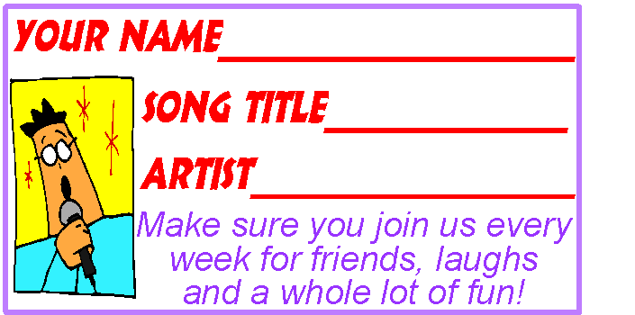
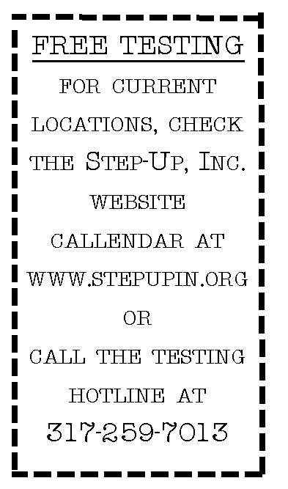
Karaoke Cards
Unicorn Club Cards

Slide 13
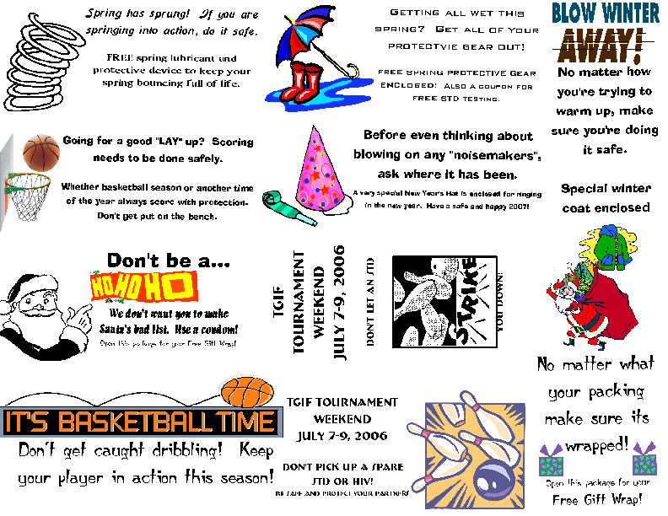

Slide 14

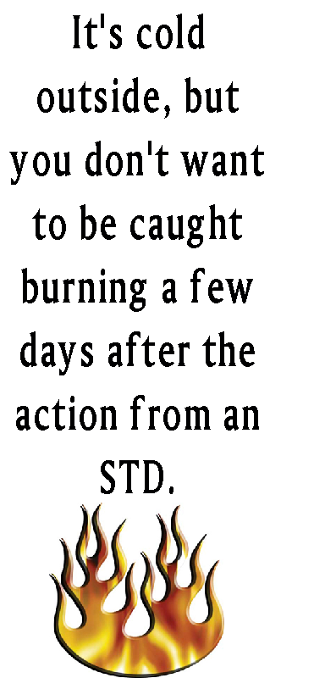
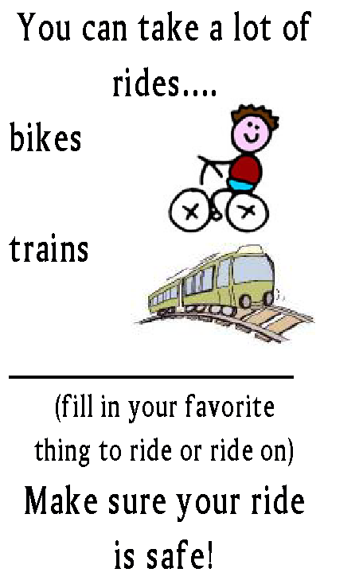
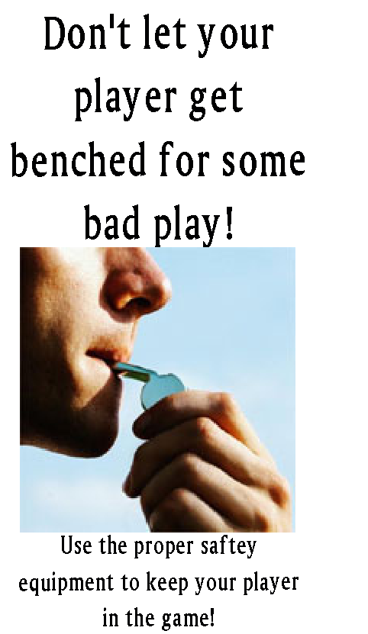

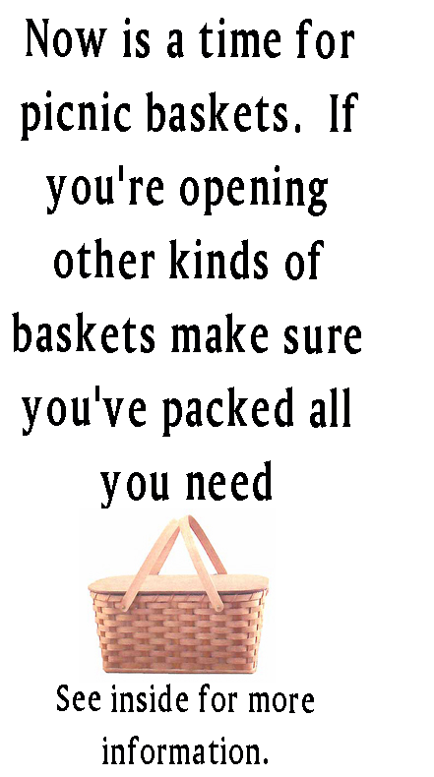

Slide 15
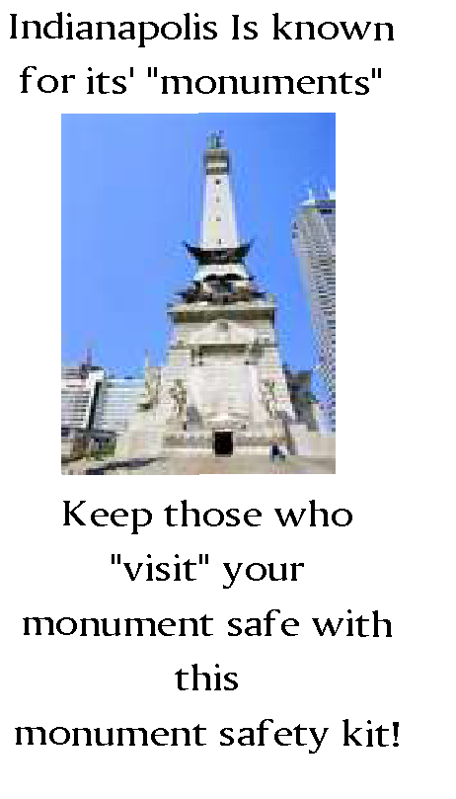

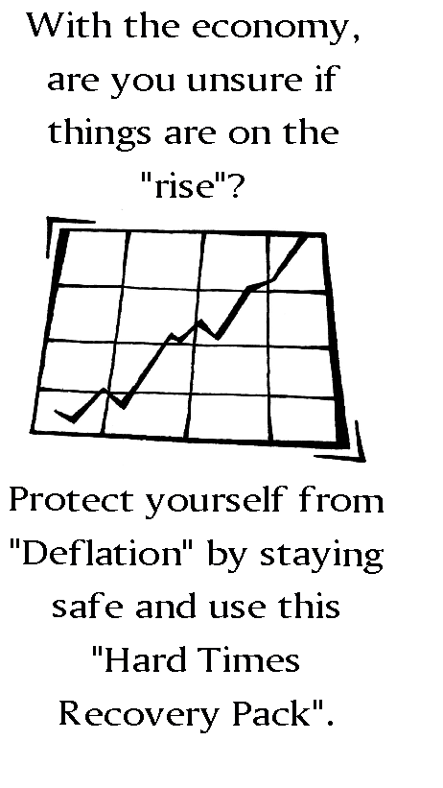
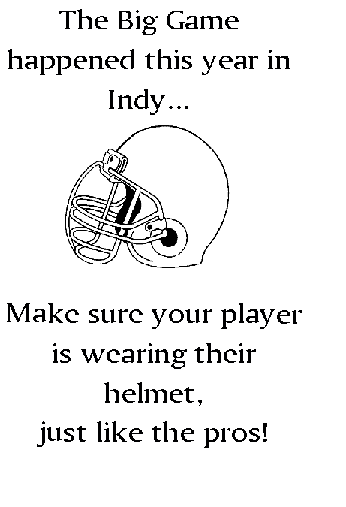

Slide 16
Reframing FUNdational Keys
Holidays
  Special kits
  Bar referral prizes
Numerous locations targeted differently
Events
  Safer Sex Summer Socials
  BINGO
  Fundraisers
  Midwest Pride Events
    Special Condom kits
    Advertising
    Resources

Slide 17
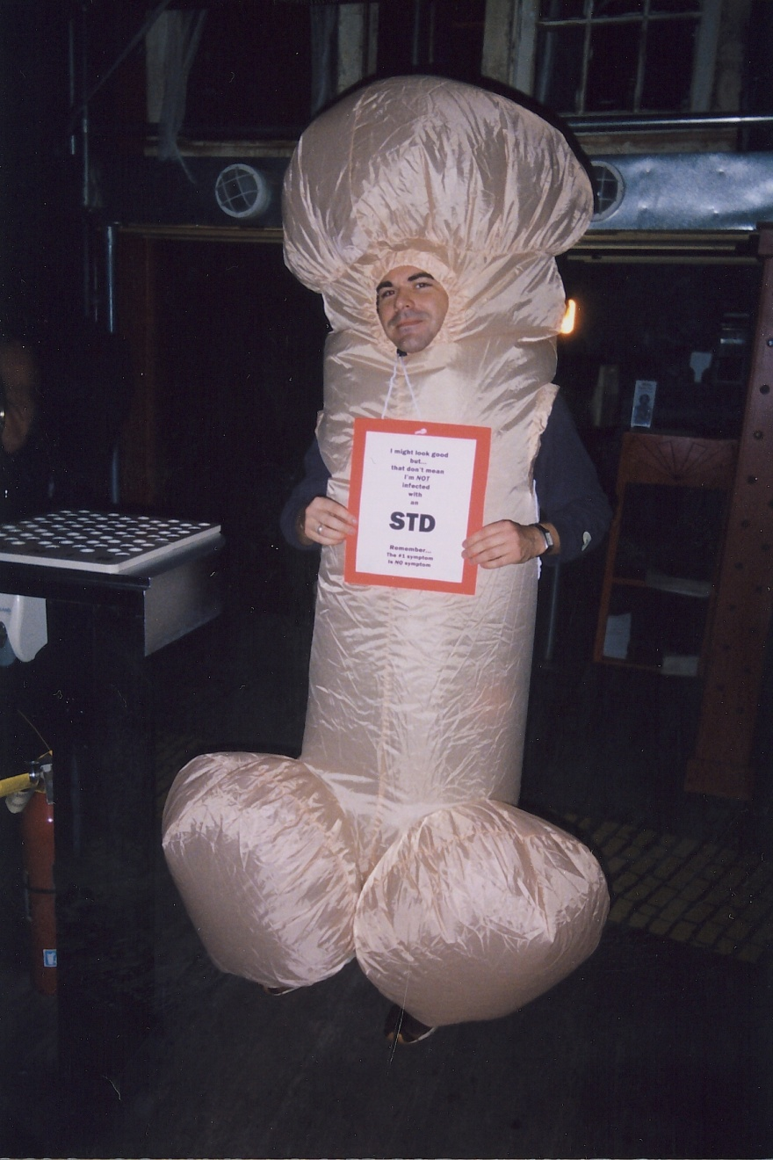
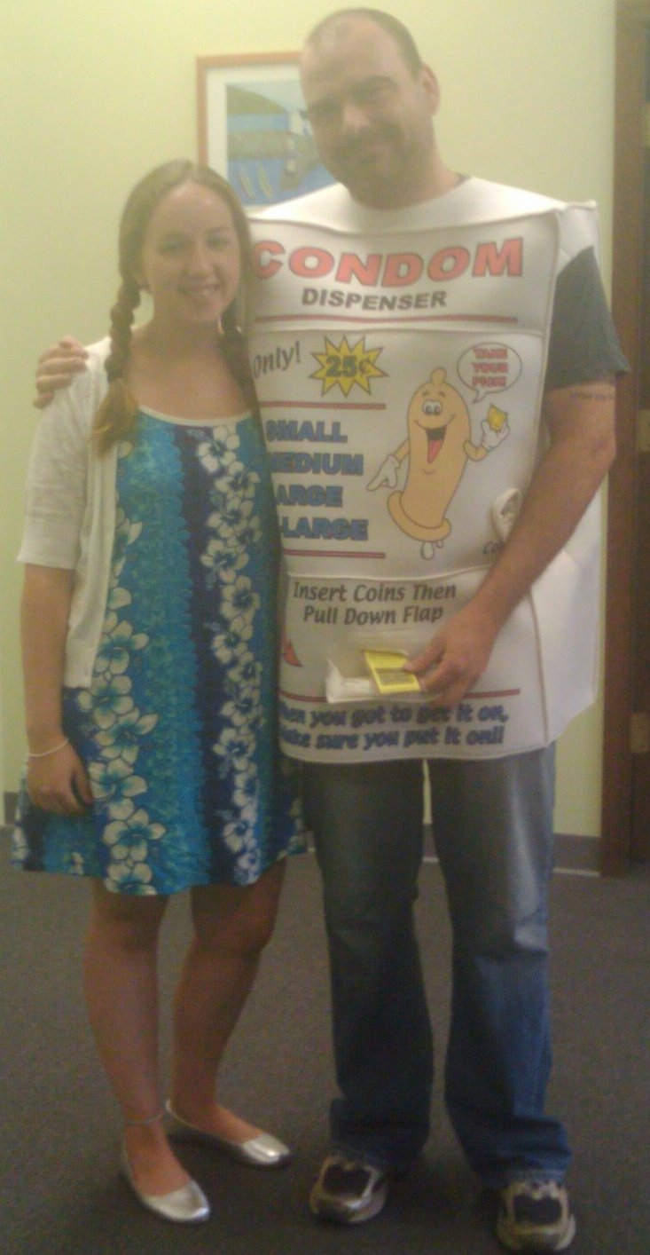

Slide 18
Use Current Resources
Collaborate (establishments/health dept/groups)
Focus on ways that HIV prevention doesn’t have to be expensive
Notes:
Examples of groups SOS drug free MC
Cheep cards (business cards, flyers, costume)

Slide 19
Who goes to bathhouses
Men who have sex with men
Survey results on website show
  43% report being single
  35% report being married with a wife
  22% report being in a male relationship

Slide 20
A Model That Works
When Step-Up started the I-MAP program, The Works was our first partner
  Provide resources
  Free HIV testing/ syphilis screening
  Safer sex kits
A lot of community members want to blame bathhouses for the spread of disease, when for many men it is many other things.
  Recreation-working out or relaxing
  Use for a sense of community
Notes:
These are some tools that I have learned to be highly effective.

Slide 21
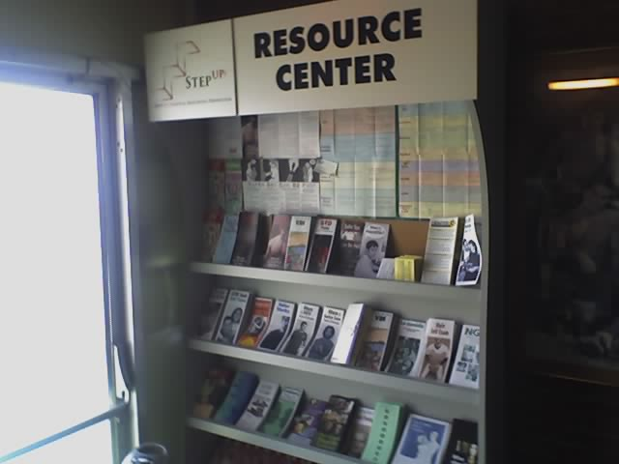
What are we doing to stay on target?
Notes:
Now you have established your relationship
start to get to know what they are doing (ask how you can get involved)
this can even be some easy day to day events that they already have going on
example some prize giveaway during event for trivia questions etc
Supplies- what are they using napkins, karoke cards, books, key rings, membership cards
what are their current advertising needs- how could you help with that
Consumers
What are they doing in the establishments (school, bar, hang outs, etc)
What are they using
how could you tie prevention into that.
We are now going to go into some of the things we did in our community

Slide 22
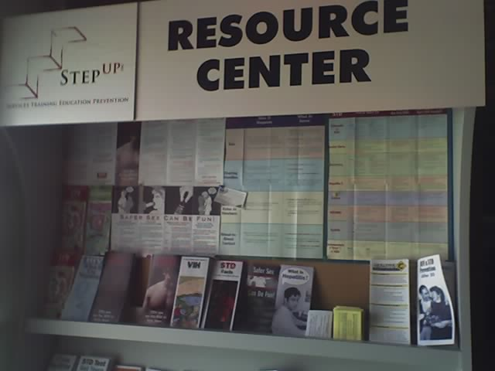
What are we doing to stay on target?
Notes:
Now you have established your relationship
start to get to know what they are doing (ask how you can get involved)
this can even be some easy day to day events that they already have going on
example some prize giveaway during event for trivia questions etc
Supplies- what are they using napkins, karoke cards, books, key rings, membership cards
what are their current advertising needs- how could you help with that
Consumers
What are they doing in the establishments (school, bar, hang outs, etc)
What are they using
how could you tie prevention into that.
We are now going to go into some of the things we did in our community

Slide 23
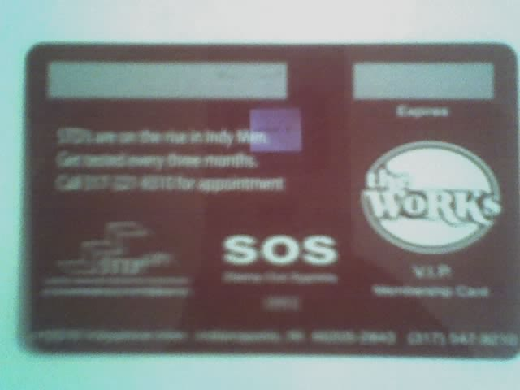
What are we doing to stay on target?
Notes:
Now you have established your relationship
start to get to know what they are doing (ask how you can get involved)
this can even be some easy day to day events that they already have going on
example some prize giveaway during event for trivia questions etc
Supplies- what are they using napkins, karoke cards, books, key rings, membership cards
what are their current advertising needs- how could you help with that
Consumers
What are they doing in the establishments (school, bar, hang outs, etc)
What are they using
how could you tie prevention into that.
We are now going to go into some of the things we did in our community

Slide 24
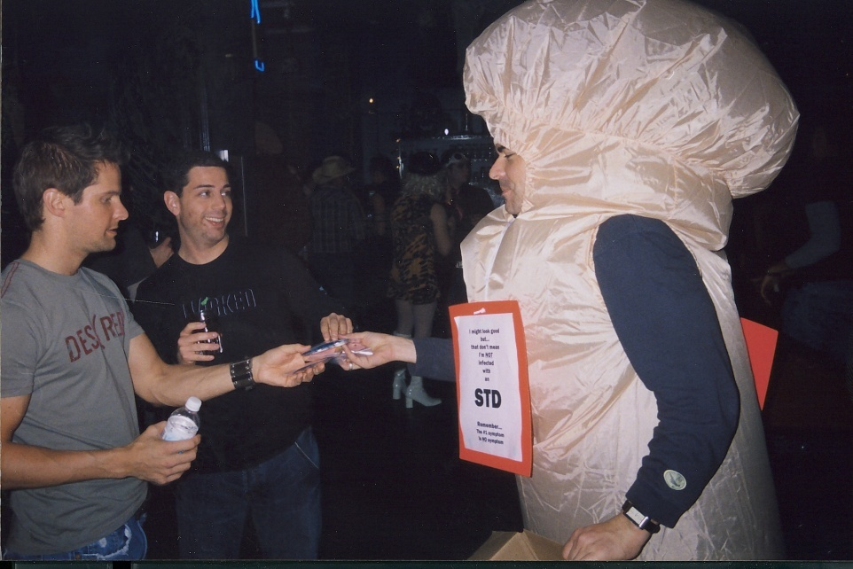
Rapid Testing in a bar or bathhouse?!?!

Slide 25
Where do we even start?
Assessment
How do we do this in the field
Working with venues
Supplies
QA

Slide 26

Assessment
Internal Agency
  Supportive top to bottom
  Policy/Procedures changed to match new venues
Look at your Sites/Venues
  Location
    Safety
    Security
    Support from staff
    Lighting

Slide 27
Assessment
Equipment
  What all will you need to get, to make this work?
Community
  Garner support where possible

Slide 28
How do we do this in the field?
Location (our examples)
Consent - intoxication
Equipment
Safety of our clients
Transportation of records
Partnerships
Referrals

Slide 29
So what do you need?
Everything that you use for rapid testing in the office (traveling office)
Min/Max thermometer
Special considerations for lighting
Confirmatory method
Step-Up tub example

Slide 30
Working with Venues
Some may take time
Work with them on their schedule
Education of bar owner/manager/staff
  ONGOING!
  Community Partner Letter
Considerations
  Lighting (Do controls)… Magnifiers
  Space

Slide 31
QA
Back up your buddy!
Min/Max thermometer
Logs- Temp/Controls/Tests
Record keeping
Tubs
  Centralized
  Point person

Slide 32
DOES IT EVEN WORK?

Slide 34
Statewide Data
Agency Type | Total Tests | Positive Results | Positivity Rate
CBO | 1782 | 16 | 0.90%
LHD | 1100 | 7 | 0.64%
ED | 1823 | 9 | 0.49%
TOTAL | 4705 | 32 | 0.68%

Slide 35
Why not stay where we are?
Since program inception, 2005, the I-MAP program has conducted 4320 HIV tests, with an overall positivity rate of 1.64%.
The overall positivity rates are as follows (current lowest to highest):
IYG is 0% (0/163) Youth Group
Gregs is 1.36% (15/1105) Bar
The Works is 1.46% (11/753) Bathhouse
The 501 is 1.46% (13/892) Bar
The Club is 2.58% (25/969) Bathhouse
The Varsity is 3.40% (5/147) Bar
Bear Fest is 3.57% (3/84) Event
Just Bar- 33/2144=1.54 Just Bathhouse – 36/1722=2.09

Slide 36
GRINDR
The world’s biggest mobile network of guys
Grindr, which first launched in 2009, has exploded into the largest and most popular all-male location-based social network out there. With more than 3.5 million guys in 192 countries around the world -- and approximately 10,000 more new users downloading the app every day -- you’ll always find a new date, buddy, or friend on Grindr.
Grindr is quick, convenient, and discreet. And it’s as anonymous as you want it to be. Grindr is a simple app that uses your mobile device’s location-based services to show you the guys closest to you who are also on Grindr.
How much of your info they see is entirely your call.
http://grindr.com/

Slide 37
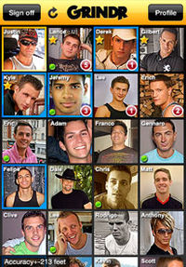

Slide 38
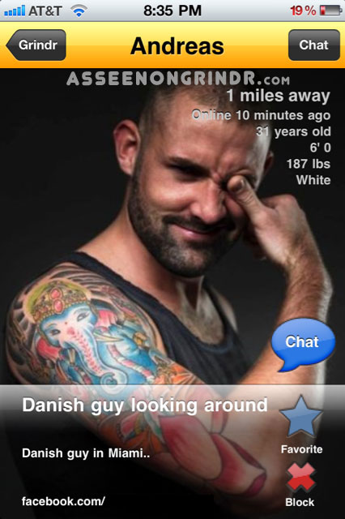
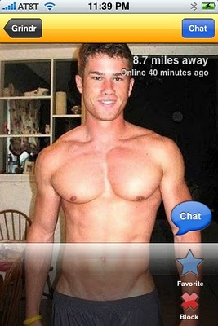
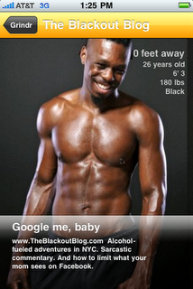

Slide 39
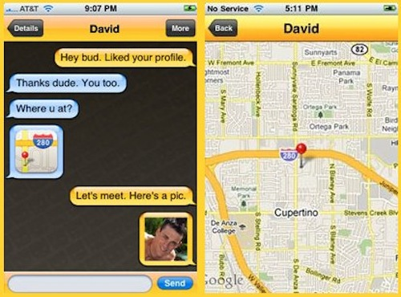

Slide 40
How do we use it and pay off
Used when slow or dead
Tester finds closest guys and invites to testing
Averaging 5% of our testing a month
Averaging 10% positivity rate.

Slide 41
Wrap up
Try to take a step back and look at the whole picture
  Take an assessment of where you really are
  Don’t be afraid to restart or add
  Think of new ways you can work with others
  Try not to stick to the same keep changing

Slide 42
Contact Information
Ryan Nix
Prevention Coordinator
Step-Up, Inc.
850 North Meridian St
Indianapolis, IN 46204
Phone: (317) 259-7013
Fax: (317) 259-7034
rynix@stepupin.org

Slide 43
Thank You!!

