Slide 1






Slide 2
Using Online Evidence Based Needs Assessments To Plan, To Fund and To Actuate Care and Prevention Services
November 27, 2012
Washington, D.C.
Facilitated by:
Jesse Thomas, RDE Systems, Patterson, New Jersey
Tim Sullivan, Hennepin County Human Services and Public Health Department
Claire Husted, Health Planning & Grant Writing Consultant
Michael McNeill, Wake County Human Services, Raleigh, North Carolina
Slides will be available at: USCA.e2community.com

Slide 3
Disclosures
This continuing education activity is managed and accredited by Professional Education Service Group. The information presented in this activity represents the opinion of the author(s) or faculty. Neither PESG, nor any accrediting organization endorses any commercial products displayed or mentioned in conjunction with this activity.
Commercial Support was not received for this activity.

Slide 4
Disclosures
Jesse Thomas, Employee, RDE Systems, Inc.
Claire Hustead, Self-employed consultant.
Tim Sullivan has no financial interest or relationship to disclose.
Michael McNeill has no financial interest or relationship to disclose.
Professional Education Services Group staff have no financial interest or relationships to disclose.

Slide 5
Learning Objectives
At the conclusion of this activity, the participant will be able to:
1. see how a paradigm of improved data collection strengthens grant applications, provides answers to community planning bodies, illuminates counterintuitive insights important for the description of barriers and helps positively to influence health planning and policy recommendations.
2. Describe both how to adopt and to adapt strategies and tools to deliver web-based technology to the community and planning bodies while overcoming digital divides and perceptions of digital divides.
3. understand the challenges and benefits of an innovative program for web-based data collection and build upon lessons learned by modifying tools used by other programs.

Slide 6
Obtaining CME / CE Credit
If you would like to receive continuing education credit for this activity, please visit:
http://www.pesgce.com/RyanWhite2012

Slide 7
National HIV/AIDS Strategy
Goals:
Reducing new HIV infections
Increasing access to care and improving health outcomes for people living with HIV
Reducing HIV related disparities
(Implementation Plan: Achieving a more coordinated National response to the HIV/AIDS epidemic in the U.S.)

Slide 8
How Do We Achieve the NHAS?
Through our programs and services:
  Outreach to find HIV positive individuals who are “unaware” of their HIV status and persons who are HIV positive “aware but not in care”
  HIV counseling and testing
  Linkage to care programs (e.g., ARTAS)
  HIV care services (e.g., medical, mental health, substance abuse, transportation, etc.)
  Treatment adherence and retention programs

Slide 9
How Do We Know What Services to Provide?
Evidence-based planning for HIV prevention and care services begins with:
NEEDS ASSESSMENT
The “Justification of Need” is included in every grant application that you write.
Developing an effective needs assessment process is vital to organizational sustainability and delivering high quality, effective programs.

Slide 10

Health Planning:
A Tale of Two Era’s
Paper
Web

Slide 11
Pioneering Web-Based Tools for Consumers, Providers, and Grantees
10-year Journey from Bergen-Passaic TGA, NJ…

Slide 12

Notes:
12

Slide 13
Hennepin County / Minnesota’s Comprehensive Needs Assessment Web-Audio Surveys

Slide 14

Traditional Needs Assessment Process

Slide 15
Problem Statement
Too much time spent managing paperwork
Delay from data collection to action
Validating surveys a challenge
Too costly and inefficient
Paper reports are not interactive
  Questions people have about the data result in health planners having to manually re-analyze the data

Slide 16
Our Vision

Slide 17
Vision
Have a fully Web-Based system that was multi-lingual and audio-assisted self interview (ACASI) with no software to install or manage.
Save paper and the time spent managing it
Allow consumers to self-interview at comfort of home or provider site
Utilize netbooks for efficient outreach efforts in collecting completed surveys
Realize cost-savings

Slide 18
Vision
Have real-time access to data
Use real-time access to monitor gaps in data collection so we can target outreach efforts to ensure a representative sample
Allow consumers redeem incentives through an incentive code automatically generated at survey completion
Allow incentives to be distributed in person, or mailed to consumer.
Utilize Visual Analytics to make data more actionable in real-time for better planning, decision making, and grant applications.

Slide 19
Vision Accomplished?
Yes!
With some unanticipated benefits too…

Slide 20
How did we do it?
Attended the 2008 HRSA AGM Meeting and saw a presentation on “Innovative Planning Bodies Technology” presented by the Bergen-Passaic TGA, City of Paterson
Collaborated with the Bergen-Passaic TGA on revised needs assessment instrument.
Contracted with RDE Systems, LLC makers of eCOMPAS and the e2 Community Platform
Utilized the e2 Comprehensive Needs Assessment Module that Paterson New Jersey pioneered and presented
RDE adapted software to Minnesota’s unique needs and vision.

Slide 21
How did we do it?
RDE walked the Minnesota team through the process.
RDE produced a pilot site for us to pilot with a focus group of consumers, the planning council, and staff.
Revisions were made to the system.
With minimal training, our staff completed Spanish translations and voice-overs with no special equipment using the systems web-based admin module.
System was launched smoothly
System continued to be enhanced with ideas that RDE had (free of charge).

Slide 22



Social Marketing

Slide 23
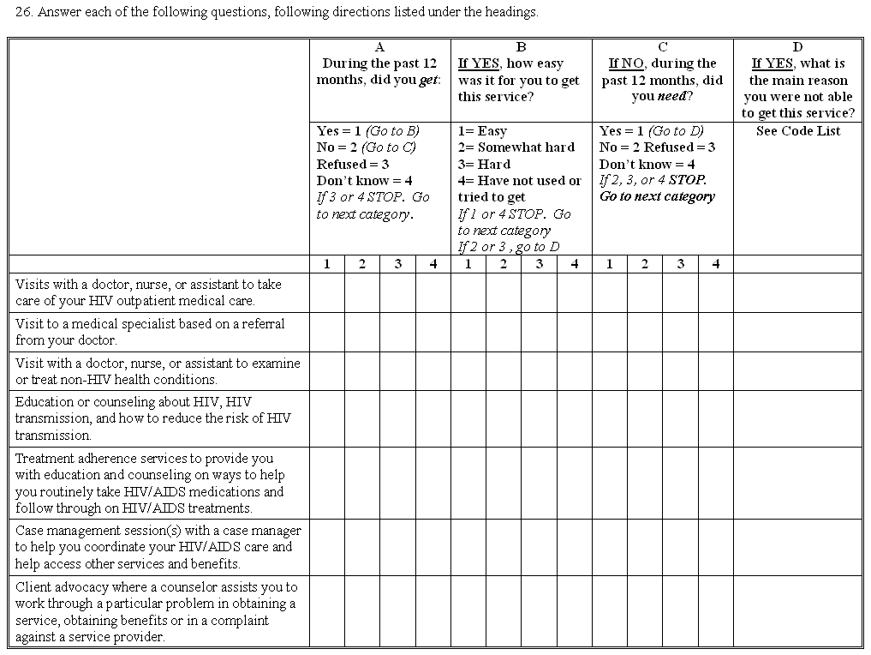
The Old Way

Slide 24
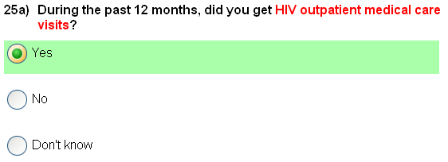
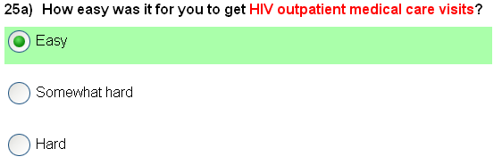
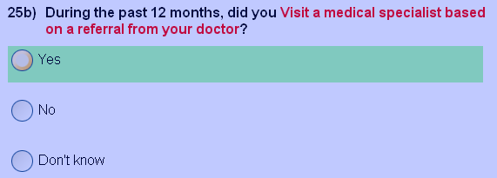
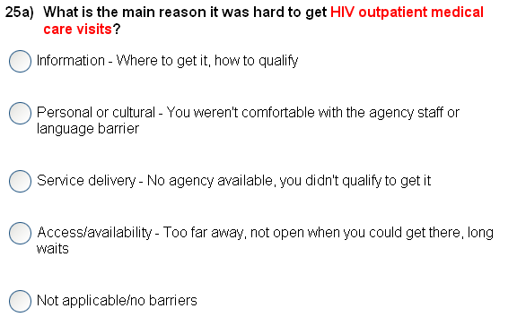
Next
Question
Next
Question
The New Way
- The System does all the work behind the scenes.

Slide 25
Demo

Slide 26
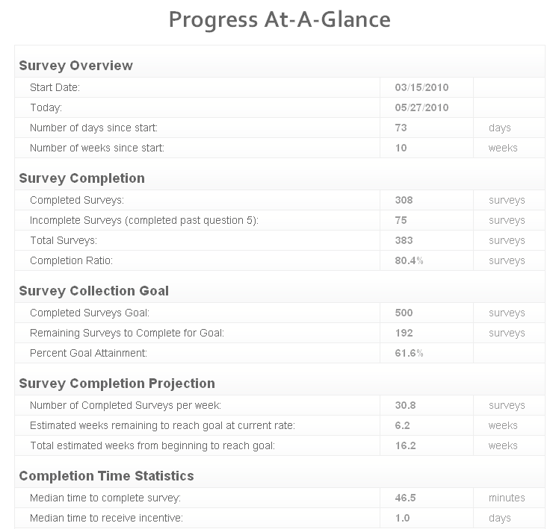
Reporting – Progress at a Glance

Slide 27
Visual Analytics

Slide 28
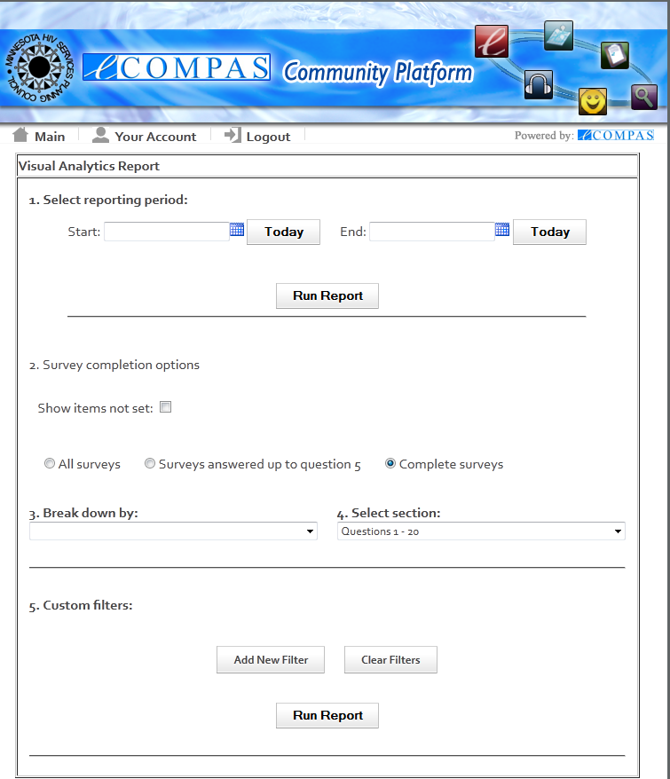

Slide 29
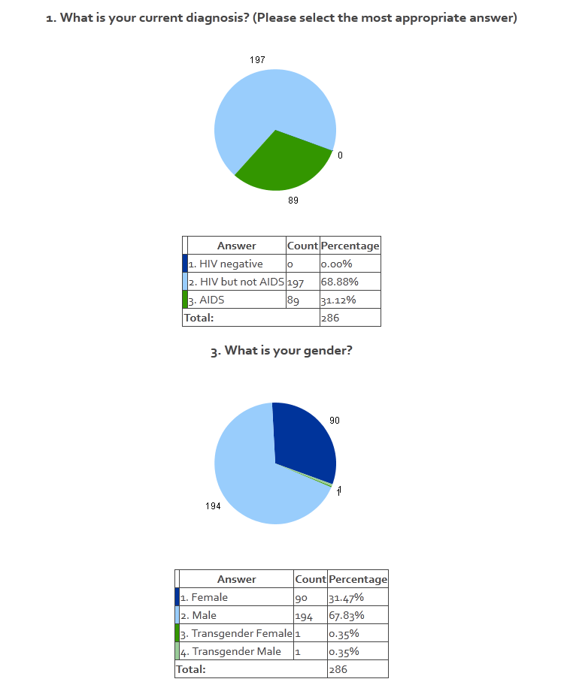

Slide 30
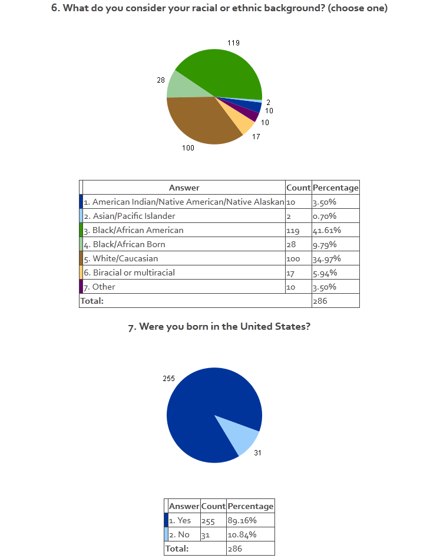

Slide 31
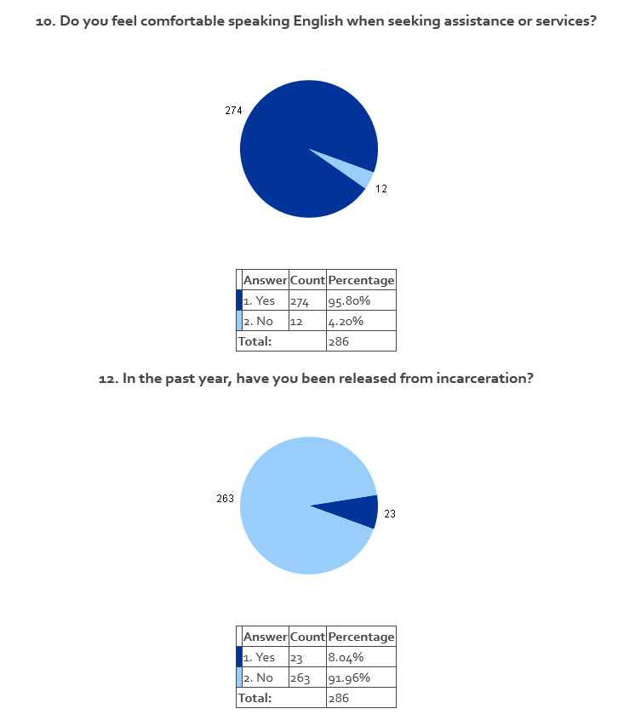

Slide 32
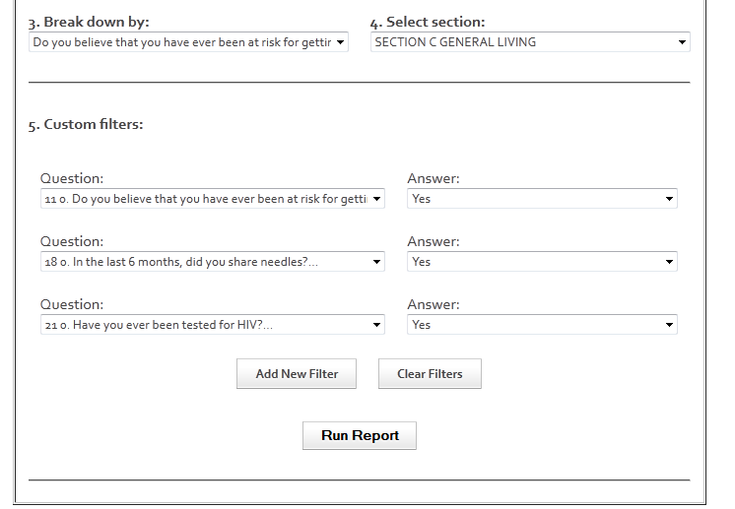

Slide 33
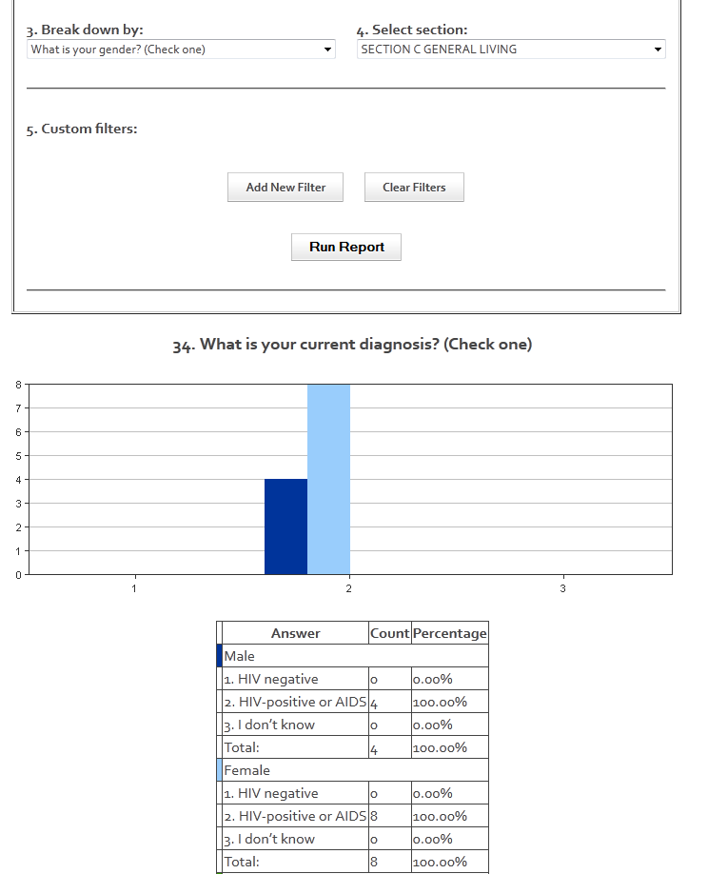

Slide 34
Excel Data Extract

Slide 35
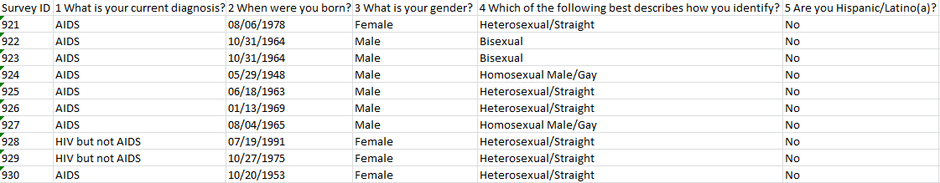

Slide 36
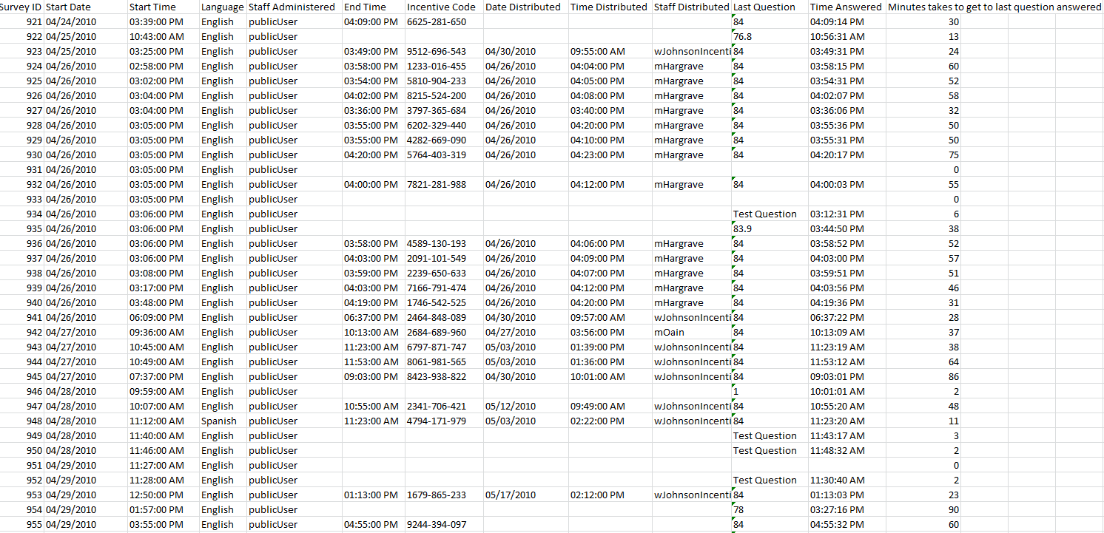

Slide 37
Results

Slide 38
MHSPC Success Stories
Web (eCOMPAS)
Paper
Number of surveys completed
2003 (paper) = 242 (8 months)
2010 (web-based) = 421 to date (5 months with a goal of 500 surveys)

Slide 39
MHSPC Success Stories
Web
(eCOMPAS)
Paper
Number of surveys completed
2003 (paper) = 242 (8 months)
2010 (web-based) = 421 to date (5 months with a goal of 500 surveys)

Slide 40
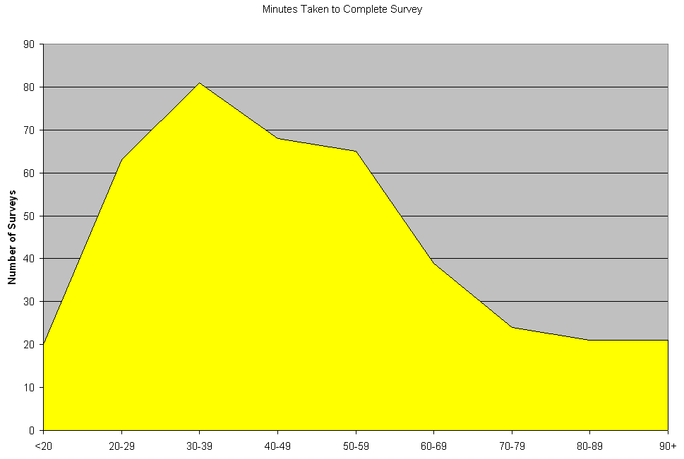
Survey Completion Time Distribution
Most complete survey quickly.

Slide 41
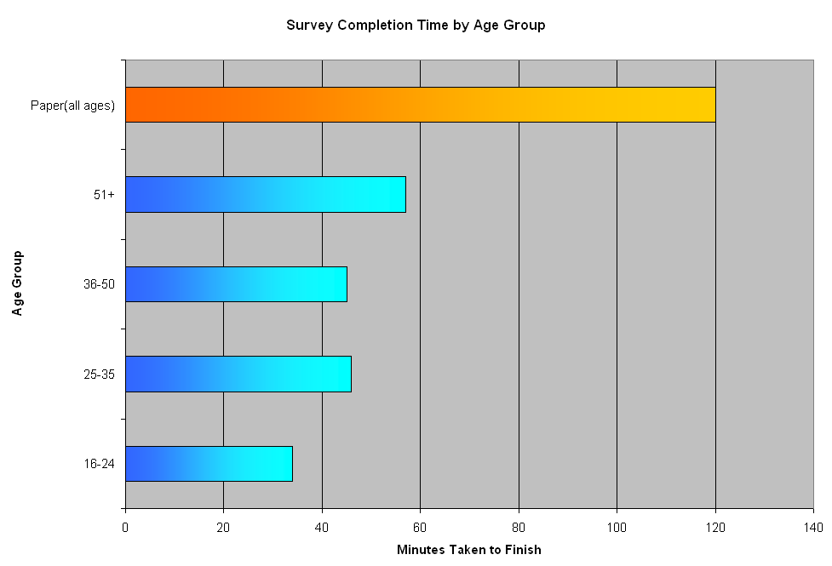
Compared to 2003, big difference!
Paper
Web
Web
Web
Web

Slide 42
Innovative Use of Inexpensive Netbooks

Slide 43




Before
Netbooks and eCOMPAS
After
Netbooks and eCOMPAS
2010: Majority of respondents (69%) did so from a private/public computer.
The remaining 21% participated in a session led by one of six volunteer consumer ambassadors
2003: Survey required
6 interviewers to conduct
face-to-face interviews

Slide 44

Unanticipated Benefit:
Needed to do translation only once on the web.
Instead of needing a translator for each consumer who needed it.

Slide 45
MHSPC Cost Savings Analysis
Significant Cost Savings Using Web
(eCOMPAS)
?
Cost:
2003 (paper) = $48,980 ($202.40 per completed survey)
2010 (web) = $38,162 ($90.65 per completed survey and dropping)

Slide 46
Lessons Learned
Networking and collaborating with colleagues is a rewarding experience.
User friendly systems make the world of difference and the e2 Web Survey system is very easy to use.
It’s important to work with a technology partner who can work well with others and who are “user friendly” and not too techie for us.
Target your outreach to hard to reach populations early on to increase success.
Think outside the box!

Slide 47

Riverside-San Bernardino, California
Transitional Grant Area (TGA)

Slide 48
Purpose of TGA’s Needs Assessment
Understand the needs of persons living with HIV (PLWH) in order to plan service delivery
Identify:
  Service needs
  Barriers to Care
  Gaps in Care
Use data to set priorities, allocate resources, and support other funding efforts
Understand the needs of persons who are unaware of their HIV statustatus

Slide 49
The TGA’s 2011 Process
Hired consultant who had done the 2008 needs assessment (January 2011)
Utilized 2008 needs assessment survey as starting point for revisions
Met with health department staff to discuss “prevention questions” to be added
RDE Systems input survey questions into eCompas
Pilot of survey and revisions
Go live (March 15, 2011)

Slide 50
The TGA’s 2011 Process, continued
A graphic designer created a marketing flier and business card for broad distribution with community input focusing on being attractive especially to Latinos and African Americans
TGA had a press release announcing the survey in local newspapers
Worked with traditional CBOs to get the word out
Survey closed May 15, 2011
Preliminary data analysis showed an underrepresentation of non-Hispanic African Americans/Blacks and we re-opened the survey for 1 week in June to address this.

Slide 51
Business Card

Slide 52
Business Card: Spanish Version

Slide 53
The “Nitty Gritty”
Daily tracked the demographic characteristics and regional location of respondents
Provided on site access to survey via WiFi hotspot and two laptop computers for respondents
Traveled extensively throughout the two counties providing on-site access for persons without a computer
Increased promotion efforts and targeted specific geographic regions as well as populations based on review of real time demographics

Slide 54
Unique Characteristics
First time the TGA included prevention questions targeting a non-HIV positive population
Anyone responding to the survey was able to call a dedicated number provided at the end of the survey to enroll in a drawing for the 2 laptop computers
PLWH received a different dedicated number to call to receive a $10 gift voucher
Walgreens’ community program printed (with their logo) and distributed fliers in select locations

Slide 55
Unique Survey Questions
Three questions used to identify “unmet need” as defined by HRSA (i.e., HIV positive persons who are aware of their HIV status but not in care.
HIV positive persons identified location of residence at time of HIV diagnosis and AIDS diagnosis to identify the migration patterns of people.
Embedded validated instruments to assess for mental health (PIC/RAND Depression Screener) and substance use (RAPS4-QF) problems.
Included stigma scale developed by UCLA Center for HIV Identification, Prevention, and Treatment Services (CHIPTS).
HIV positive persons identified co-morbid health conditions (e.g., diabetes, high blood pressure, STDs, etc.).
Questions asked HIV positive individuals about what led them to being tested in the first place and if they had ever had an HIV test prior to testing positive

Slide 56
RAPS4-QF
During the last year have you had a feeling of guilt or remorse after drinking? (Remorse)
During the last year has a friend or a family member ever told you about things you said or did while you were drinking that you could not remember? (Amnesia)
During the last year have you failed to do what was normally expected from you because of drinking? (Perform)
Do you sometime take a drink when you first get up in the morning? (Starter) OR
During the last year do you drink as often as once a month? (Frequency) AND
During the last year have you had 5 or more drinks on at least one occasion (Quantity)
Source: Cherpitel CJ. Alcoholism: Clinical and Experimental Research. Rapid Alcohol Problems Screen – Quantity Frequency (RAPS4-QF), 2002; 26:1686-1691.

Slide 57
Results
627 total respondents through Question #33 (end of the “prevention” related questions)
119 HIV negative or unaware persons
471 HIV positive individuals
  3 persons who were hearing impaired responded
  1 visually impaired person responded
  15 Native Americans (comprised 2.9% of responses yet 1% of PLWH)
  56 recently diagnosed respondents (past 3 years)
  10 persons identified as “out of care” (i.e., unmet need)

Slide 58
RAND (PIC) Depression Screener
Category | Positive Screen
 | Number | Percent
Major depression | 176 | 37.4%
Dysthymia | 84 | 17.8%

Slide 59
Race/Ethnicity of Respondents

Slide 60
Geographic Distribution

Slide 61
Lessons Learned: Benefits
An entirely online survey allows complete anonymity for the respondent as well as convenience to complete the survey in the comfort of his/her own home.
Eliminates the need for data entry of a paper survey into a spreadsheet or database in order to conduct analysis of the data;
Fewer people are needed to assist with the survey administration; however there is an increased need for promotion;
Tracking demographic data of survey respondents is real-time and simplified to enhance ability to target underrepresented populations; and
Even though the survey incentive was reduced to $10 from previous surveys ($25) due to limited resources, respondents were appreciative of the incentive and some level of incentive should continue in future surveys.

Slide 62
Lessons Learned: Challenges
Not everyone has computer access or skills and so there is still a need to provide community-based access and computer assistance for the survey.
There is still a need for “cleaning” the data as some respondents provide inconsistent responses. For example, several respondents chose “Other” to identify race or ethnicity and when asked to clarify “Other,” they wrote Black or Latino.
The incentive process required respondents to call in to a “safe” telephone number, which was only answered by the consultant. This was effective for 99% of respondents but was very time consuming and a few people were uncomfortable providing their names.
It was difficult effectively combining HIV prevention and testing questions targeting an HIV negative or HIV unaware population with the HIV positive population. This was an area of questions that PLWHA respondents commented that the questions did not seem to apply to them.

Slide 63
For Future Needs Assessments
Allow sufficient lead time to develop and pilot test the survey, both English and Spanish versions .
Utilize a shorter consent form (a full-page was too long).
Create a few “practice” questions in the introduction so that respondents can get used to how to use the computer in answering the questions.
When using an online format, identify and test all the appropriate “skip logic” so that respondents do not have to answer questions that do not apply to them.
Survey fatigue is a very important consideration even though a person may opt to close the survey and come back to it using a unique code (i.e., a shorter survey is better and would recommend reducing the number of questions to 125 question range).

Slide 64
Region 6, North Carolina

Slide 65
Region 6 Process: Network Needs
The “Access Network of Care” is comprised of 11 counties in the northern-central part of North Carolina and includes Raleigh, Durham and Chapel Hill.
The region is home to 21.5% of the state’s PLWHA (state’s highest concentration) AND is home to the highest number of HIV Providers.
Region 6 is also the medical destination for a large number of PLWHA who come into the region for care both from across N.C. as well as from other parts of the U.S.
Network needed a mechanism for being able to gather data on a large scale, across multiple counties and with multiple providers.
Network needed a mechanism for being able to gather data with minimal staff time/involvement. Involving survey facilitators was estimated to take more than 5 months to collect our target survey collection of 250 surveys representing clients of all counties, of all service providers, of all socio-economic backgrounds, etc.
Factoring in the need for bi-lingual staff only added to the length of time necessary to gather a sufficient amount of data

Slide 66
Region 6 Process: Network Needs
Spanish surveys would also mean Spanish language results. The network would need someone to translate the results.
The network would need a system into which the surveys could be entered and then analyzed ---- translation, the network needed both a database as well as data entry time/staff
Projected number of staff hours required JUST to get the surveys collected, translated (if necessary) and into a system for analysis = > 1,500
Immediate problem – the needs assessment would be required to be “maintain[ed], updat[ed] and utiliz[ed]”
SOOO, we were going to have to repeat this process…. Another extended period of staff time, costs, etc. Translation – the network needed something that could be ongoing

Slide 67
Region 6 Process: A History
July 2010 – Identified consultant; presented plan for focus groups and survey solicitation at July 2010 All Networks’ Meeting.
Summer/Fall of 2010 – Consultant met with network/identified focus group target populations (6 groups identified)/began work on survey instrument/held training for survey facilitators
Held 1 focus group
Created a 21 question survey
January 2011, discontinued relationship with consultant

Slide 68
Region 6 Process: A History
Refocused efforts. Hired consultants to complete remaining 5 focus groups
Reviewed our 21 question survey. Survey was lacking in a number of areas important to regional providers: incarceration information, pediatric/youth information, housing info, nutrition, HIV counseling and testing, prevention, etc. were missing from the survey.
Referenced All Grantees’ Meeting presentations on On-line Needs Assessments – with the help of the software vendor that presented at the All Grantees’ Meeting we contacted Hennepin County Minnesota (one of the programs featured at the AGM session on Needs Assessments)
Reviewed Survey questionnaire Hennepin County (which had conducted a statewide needs assessment survey for Minnesota)
Extracted relevant questions from Hennepin County’s instrument. Created an 82 question survey for our region.

Slide 69
Region 6 Process: A History
Network reviewed survey – too long
Trimmed to 76 questions – still considered too long – no agreement on what to cut.
Survey finalized / everyone still agreeing that it was too long.
Focus Groups Completed / consultant writes portion of needs assessment documenting focus group data
Hired consultant to write Epidemiological Profile section of needs assessment.
Now, just needed a way to capture surveys…..

Slide 70

Region 6 Process: Our solution
Technology. The network understood that it needed something electronic in order to accomplish our needs assessment obligations in a way that met our “deliverable” but also gave us useful data to shape our care delivery system.

Slide 71
Region 6 Process: Fears in using technology / online system
Clients do not have access to the internet/computers
Older clients do not understand how to use computers
Clients have low literacy rates and will not be able to read/take an online survey without someone there to assist them – where is the savings in staff time?
Any online system will still need to be bi-lingual and interpret Spanish language results.
Clients will not trust the program
The survey (at more than 70 questions) is too long – clients will not complete it.
Installing computer software on multiple computers at multiple locations would take too long, involve too many I.T. Departments and probably would not be allowed at all locations.

Slide 72
Region 6 Process: How we did it
Remembered the 2010 HRSA AGM Meeting presentation on “Using Web Audio Surveys and Other Electronic Tools for Cost-Effective Health Planning and Tracking of Outreach Outcomes” presented by the Bergen-Passaic TGA, City of Paterson and Hennepin County Minnesota
Collaborated with the Hennepin County Minnesota on revised needs assessment instrument.
Contracted with RDE Systems, LLC makers of eCOMPAS and the e2 Community Platform (as presented at the 2010 AGM)
Utilized the e2 Comprehensive Needs Assessment Module that Minnesota utilized (but with our own spin/questions)
RDE adapted software to Region 6’s unique needs and vision.

Slide 73
Region 6 Process: How we did it
RDE walked us through the process – created our survey online, walked us through the recording process (for the audio feature of the survey).
RDE produced a pilot site for us to pilot with a focus group of consumers, the network, and staff.
Revisions were made to the system.
Coordinated with two regional individuals to record the questions/answers --- one recorded them in English, one in Spanish.
Added our own spin by recording “welcome videos” utilizing individuals known locally and trusted by anticipated survey participants.
System was launched smoothly

Slide 74
Social Marketing
Created Postcards on which clients could record their survey completion code, mail in, and then have their incentive mailed to them.
Postcards were created in both English and Spanish
Postcards were given to each network provider along with Raleigh Infectious Diseases, prevention and testing programs, Gay and Lesbian Center in Raleigh, Raleigh nightclubs/bars (to help us reach the “positively unaware”)

Slide 75
Results
We EXCEEDED our goal of 250 surveys (we topped 100 completed surveys within 1 month). Our needs assessment document was based upon 397 completed surveys.

Slide 76

Projected 1,000 Hours of Staff Time Saved

Slide 77
Results/Myths dispelled
Clients do not have access to the internet/computers
  Nearly 400 clients completed the survey… 180% more than our goal!!!!
Older clients do not understand how to use computers
  68.7% of those completing the survey were 40 and older. 36.7% were 50 and older. The oldest was over 80.
Clients have low literacy rates and will not be able to read/take an online survey without someone to assist them – where is the savings in staff time?
  System read aloud to the clients. Limited need for assistance. Savings in staff time ABUNDANT!

Slide 78
Results/Myths dispelled
Any online system will still need to be bi-lingual and interpret Spanish language results.
The questions and answers appear and are read in both Spanish and English languages.
Clients will not trust the program
  No reported client fears. More than 450 have completed the survey to date.
The survey is too long – clients will not complete it.
  82.1% of those beginning the survey completed the survey. The median time necessary to complete the survey is 21 minutes…. About 7-9 minutes longer than it averaged a focus group to take the 21 question paper survey.
Installing computer software is going to be a problem.
    Web-based system. Nothing to install.

Slide 79
Results/Myths dispelled
Clients will not complete the survey without an incentive.
> 11% of those completing the survey declined their incentive – totaling $520 – which was extended to other survey participants.

Slide 80
Results/Actual Data That We Can Use!!!
Information is no longer anecdotal. Many of our beliefs were upheld while many were surprising.
Example: Transporation
Belief: Clients need transportation services especially in the rural areas.
Results (confirmation): Clients indeed identified Transportation as the 8th most important service in the treatment of HIV (31.71%). Within rural counties, the farther away clients were from a clinic, the greater the concentration of those indicating that transportation was important.
Results (surprising): While rural residents showed a greater need for transportation the farther they lived from an HIV clinic, urban residents were much more likely to identify the service as important. Urban residents under the age of 24 were the most likely to state that the service was needed/important.

Slide 81
Success Stories
Improved Prioritization and Allocations processes
Ability to track demographic goals to ensure a reflective sample
Ability to access and use portions of the data as needed in “real time” for multiple purposes (grant applications, training, Service Area Reviews
Able to pull up graphs interactively during meetings (committee meetings, Council meetings, etc.)

Slide 82

Survey and Results available at….
www.accessnetworkofcare.net

Slide 83

132,000 pages of paper saved
and counting…
Thanks!
Thanks!

Slide 84

Where We Are Going
Client Satisfaction
Rolling Needs Assessment
Tailored Action Buttons
Online, Interactive Resource Guide
The Collaboration Continues… (e.g., screenings added to next round)

Slide 85


Slide 86
Practical Lessons for Replication
Find a few key champions on the planning body, grantee, and quality team.
Utilize a web-based architecture to minimize management and maintenance headaches and costs.
Choose a systems partner and consultant who operates on a human-centered approach (not technical approach) and has experience with surveying special populations.
Just do it. Don’t be paralyzed with logistics. Evolve protocol and system based on experience.

Slide 87

Lesson: How did we accomplish this?
One bite at a time.

Slide 88
Q&A

Slide 89

Thank you for your time!

Slide 90
Jesse Thomas
Jesse@rde.org
Claire Husted cehusted@gmail.com
Michael McNeill
Michael.McNeill@wakegov.com
Tim Sullivan
Tim.D.Sullivan@co.hennepin.mn.us

