Slide 1
How do we get from model…
© 2012 Epic Systems Corporation. Confidential.

Slide 2
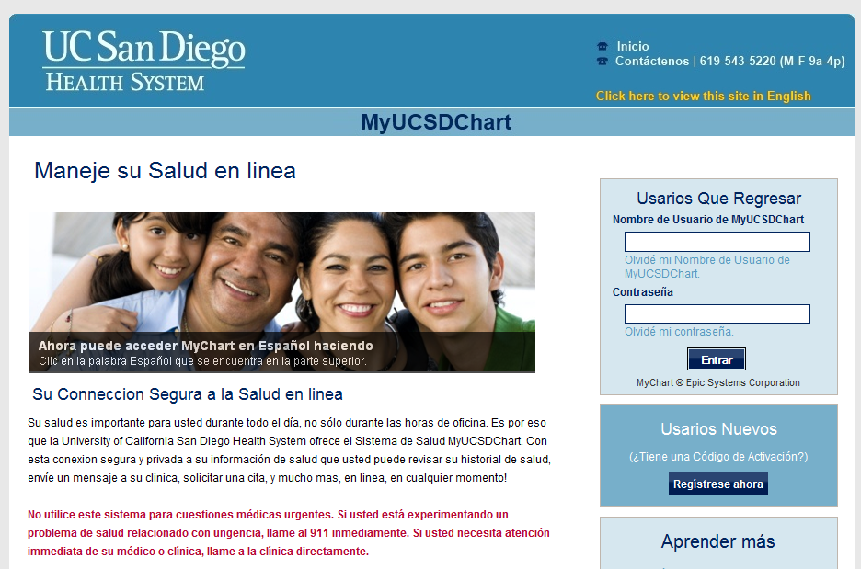
To a customized, branded MyChart?
© 2012 Epic Systems Corporation. Confidential.

Slide 3
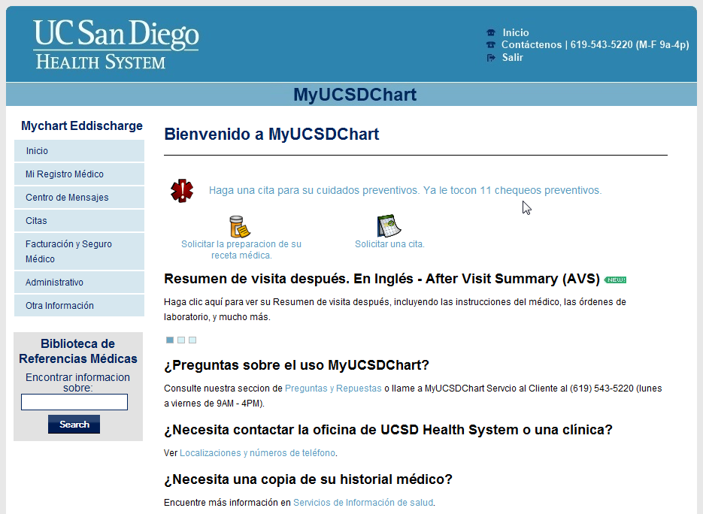
Static content – translate once
© 2012 Epic Systems Corporation. Confidential.
Notes:
Question: If I define static content as those text elements that only need to be translated once.
I counted 34 pages of content and figured that when we complete those…done!
I can tell you that there are 4 types of static content in MyChart. All changed in different places.
How many can you come up with?

Slide 4
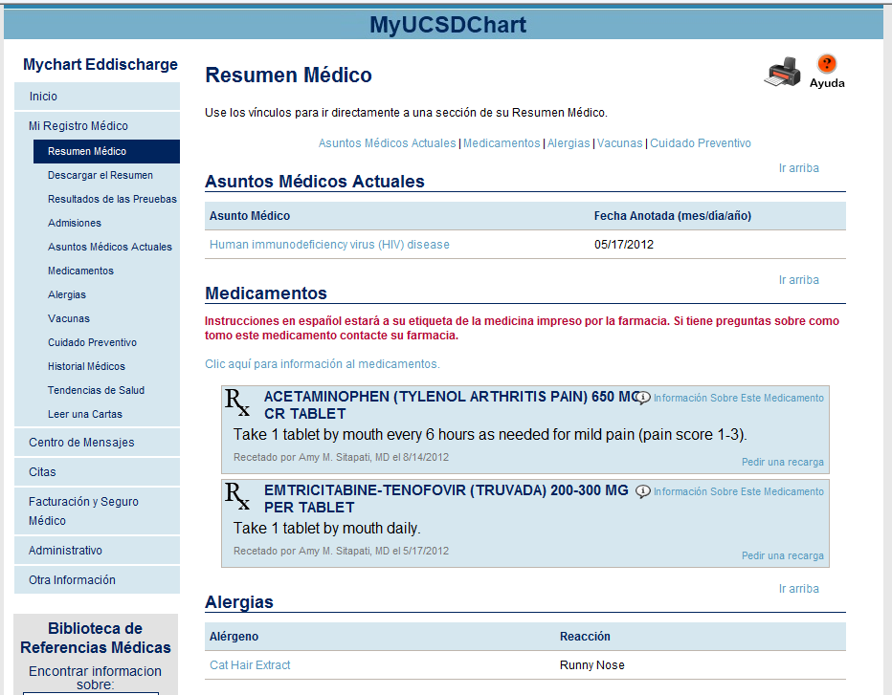
Medical Record Content is Dynamic
© 2012 Epic Systems Corporation. Confidential.
Notes:
Medical Record Data - What should be Translated? And Who should do it?
Problem List (Diagnoses)
Allergies
Vaccinations
Medications
Lab Tests
After Visit Summaries
Letters

Slide 5
Spanish instructions will be on your medicine labels printed by the pharmacy. If you have questions about this medicine contact your pharmacy.
© 2012 Epic Systems Corporation. Confidential.

Slide 6
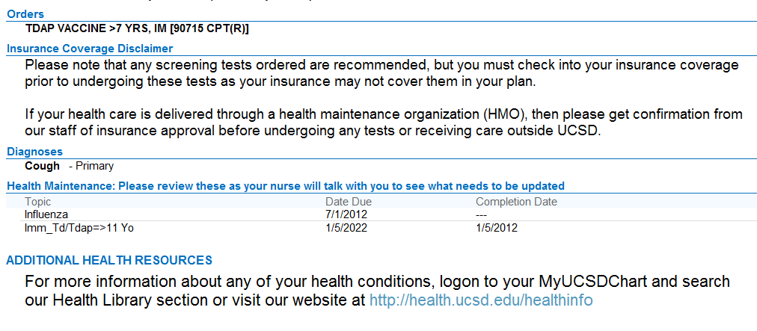
After Visit Summary – What goes in is what comes
© 2012 Epic Systems Corporation. Confidential.

Slide 7
Don’t forget links to external English-only sites
Links for Driving Directions and Medical Records landed on English Only Sites

