Slide 1

Interdisciplinary Models of HIV Care
2012 Ryan White Grantee Meeting Workshop
November 27, 2012
Jeremy Holman, PhD
Lisa Hirschhorn, MD, MPH

Slide 2
Disclosures
This continuing education activity is managed and accredited by Professional Education Service Group. The information presented in this activity represents the opinion of the author(s) or faculty. Neither PESG, nor any accrediting organization, endorses any commercial products displayed or mentioned in conjunction with this activity.
Commercial support was not received for this activity.
Presenters Jeremy Holman, PhD; Lisa Hirschhorn, MD, MPH; Marwan Hassad, MD; Robert Murayama, MD; and Kathy Gaddis, MSW, LCSW, PIP have no financial interest or relationships to disclose.

Slide 3
Learning Objectives
At the conclusion of this workshop, participants will be able to
  Identify key factors that make interdisciplinary HIV care models most effective
  Understand how interdisciplinary HIV care models have been implemented in a range of care settings, including common elements, challenges, and how these models might be adapted for their settings
  Understand the implications of health care reform for interdisciplinary HIV care and the models of care which they have in place

Slide 4
Workshop Structure
Summary of results of HRSA/HAB study conducted by JSI
Comments from the field from participating grantees
Discussion with audience

Slide 5
Study Background
Background
HRSA/HAB interested in understanding essential factors of successful interdisciplinary models HIV care
Affordable care act (ACA), other health care reform, expanded testing, and aging client population require innovative approaches
Questions
What services are well suited for interdisciplinary models?
What characteristics and skills make these models successful?
Methods
Literature review
Expert consultations
Site visits with Ryan White Program grantees

Slide 6
Literature Review: Methods
Included:
  English-language literature since 1995
  Medical and nursing conferences, 2009 - 2011
222 articles and 16 conference abstracts identified
  110 reviewed
  28 abstracted for analysis
21 programs included analysis
  9 medical-focused
  12 behavioral health-focused

Slide 7
Literature Review: Findings
Majority of programs relied on federal funding
  10 of 21 had RWHAP support
Models that integrate specialty medical and behavior health services appear most promising
Case management or other care coordination services critical
Effective EHRs facilitate care coordination and communication
Evaluation data were process focused and not standardized
Behavioral health programs had more rigorous study designs, and results supported positive outcomes
Cost and finance data were lacking for most programs
No programs with negative outcomes were identified

Slide 8
Expert Consultations: Methods
Phone interviews with 8 key informants
  Providers, managers, PLWH
Focus on:
  Essential program components for success in HIV care
    Impact on care setting and targeted population(s)
  Core staff competencies needed for interdisciplinary care
  Potential barriers to implementation
  Supportive management structures
  Defining and measuring success, quality, and cost effectiveness
  Benefits to and potential concerns of patients

Slide 9
Expert Consultations: Themes
Ideal model is:
  co-located (if not, then closely coordinated)
  client-centered HIV medical and related services ,
  delivered by multidisciplinary team of primary and HIV care providers (MDs, NPs and PAs), behavioral health professionals, social workers, case managers/care coordinators, other selected specialists.
Communication, cross training, team decision making, and solid leadership critical to success.
Financing is a significant challenge and potential barrier.
Quality routinely measured
  Information on cost and cost-effectiveness is lacking.

Slide 10
Grantee Site Visits: Methods
Identified 12 potential RWHAP grantees
  Based on literature review, consultations, team member experience, and other recommendations
Selected nine for site visits
  Reflected geographic, client, and programmatic diversity
Conducted 1-2 day site visits, May – July 2012
  Discussions with leadership, staff, and consumers

Slide 11
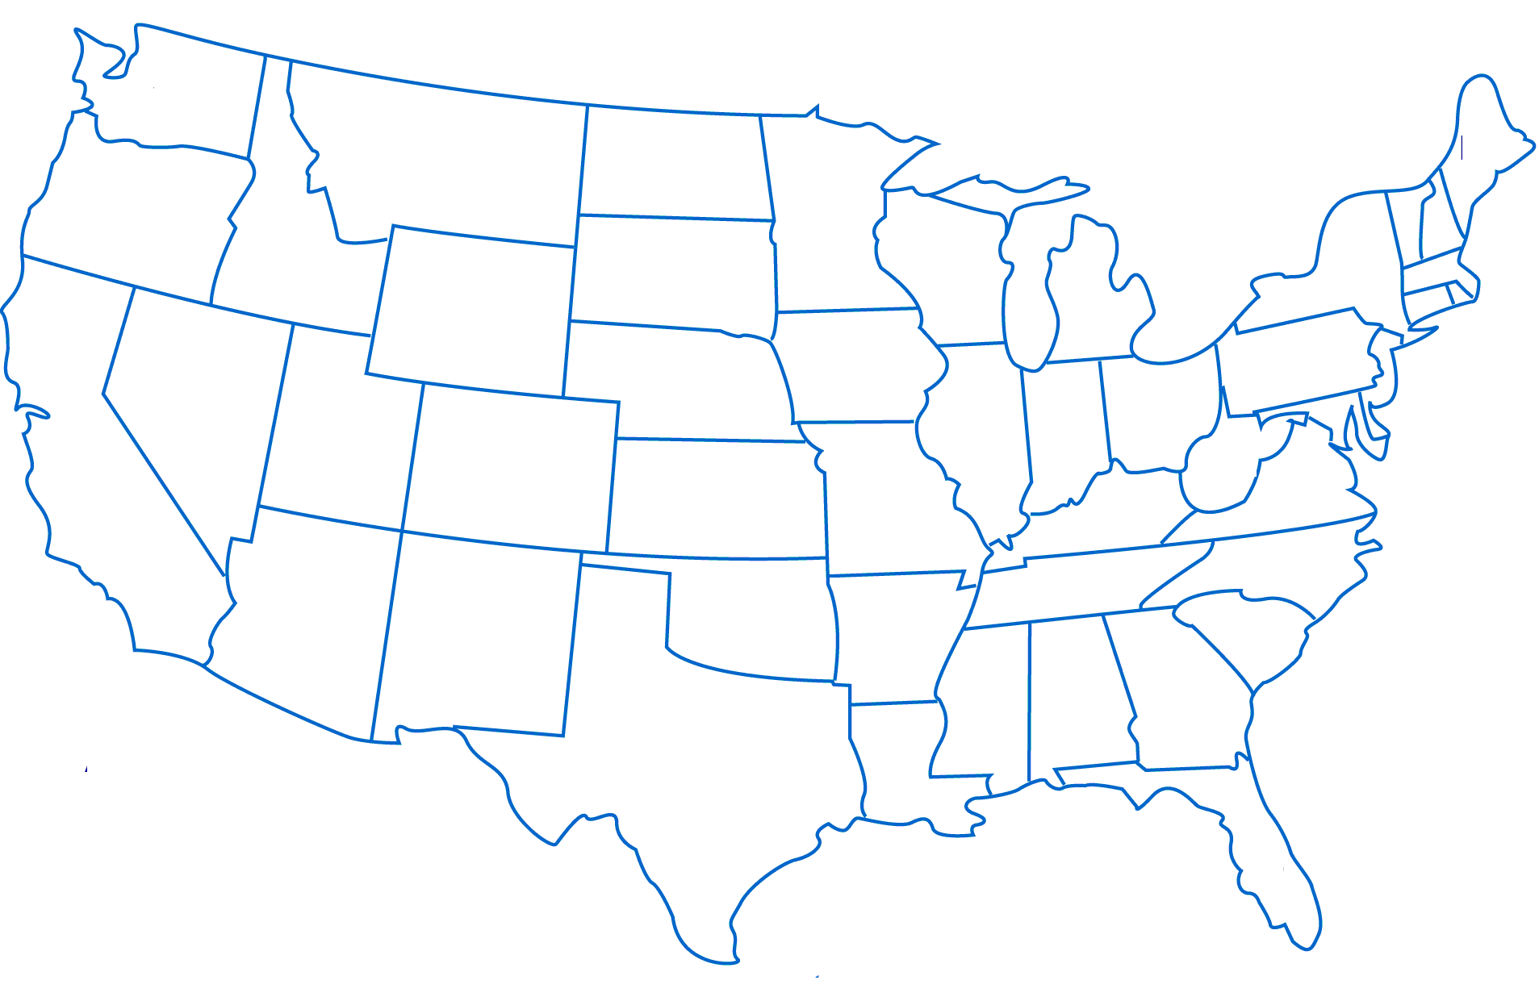
Grantee Site Visits
Community Health Center, Inc.
Harborview Medical Center
Kansas City
Free Clinic
Philadelphia Fight
APICHA CHC
Family & Medical Counseling Services
UAB 1917 Clinic
AIDS Arms, Peabody Health Center
Chatham County Health Dept. CARE Program

Slide 12
Site Visits: Findings
Context
  Local and historic context is important, and may limit replicability
  Models developed over time, in response to needs of community and patients
  Began either as ASO/CBO or clinical care site, and evolved into current model

Slide 13
Site Visits: Findings
Models of Care
  Most were “patient-centered, one-stop shop”
  Variations in level of physician vs. nurse/NP-centered
  Case managers served critical roles on team
  Ancillary services must remain integrated into the model and coordinated with clinical services
  Availability of onsite specialty services varied
  External referrals presented challenges
  Culture of program as important as components

Slide 14
Site Visits: Findings
Leadership, Staffing, Team
  Leadership and team building is essential to model
  Staffing included core medical team, supplemented by staff from other disciplines with varying credentials
  Team meetings are critical for communication and effective care

Slide 15
Site Visits: Findings
EHRs
  Functional EHR are critical tool for effective implementation of models
  Among sites with EHRs, staff access and inclusion of different components (e.g., behavioral health, case management) varied
Quality
  Strong focus on quality, integrated into model

Slide 16
Site Visits: Findings
Fiscal and Sustainability
  RWHAP is essential, given clients’ socio-economic status
  Enrollment and eligibility requirements are challenging and affect consistency of services
  There was concern about ACA and focus on CHCs to provide HIV care
  There were challenges related to Medicaid eligibility, coverage, and reimbursement in many states

Slide 17
Site Visits: Findings
Consumer Perspectives
  Strong support for models, esp. one-stop-shop
  Case management services are critical component
  Facilitators: Expanded hours, walk-in appointments, and multi-lingual staff
  Barriers: Clinic growth increasing wait times, transportation, stigma, bad experiences with some service providers (e.g., phlebotomists)

Slide 18
Insights from Grantees
Community Health Center, Inc.
  Adaptation and implementation of ECHO model
APICHA Community Health Center
  Evolution of ASO to clinical care site
1917 Clinic, University of Alabama
  Role of the interdisciplinary team

Slide 19

November 27, 2012
Marwan Haddad, MD, MPH, AAHIVS
Medical Director for HIV, HCV, and Buprenorphine Services
Community Health Center Inc., Connecticut

Slide 20

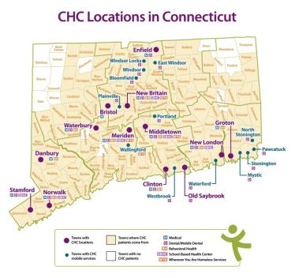





Community Health Center, Inc.
Our Vision: Since 1972, Community Health Center, Inc. has been building a world-class primary health care system committed to caring for underserved and uninsured populations and focused on improving health outcomes, as well as building healthy communities.
CHC Inc. Profile:
Founding Year - 1972
Primary Care Hubs – 13
No. of Service Locations - 218
Licensed SBHC locations – 24
Organization Staff – 500
Providers (all) – 170
Patient Number – 130,000
Healthcare visits – 410,000/yr
Innovations
Meaningful Use Stage 1
Integrated primary care disciplines
Fully integrated EHR
Patient portal and HIE
Extensive school-based care system
“Wherever You Are” Health Care
Centering Pregnancy model
Residency training for nurse practitioners
New residency training for psychologists
Three Foundational Pillars
Clinical Excellence
Research & Development
Training the Next Generation

Slide 21
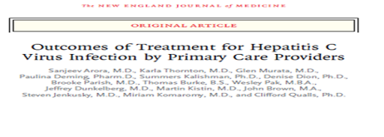
Project ECHOTM
Evidence-based:
Current model:
ECHOTM Model
Specialist
Specialist
Specialist
Specialist
Specialist
PCP
Patient
Specialist
Specialist
Patient

Slide 22
Potential Benefits & Expected Outcomes of Implementation of Project ECHO™
For Patients
Increased access to treatment options for underserved patients
  More patients initiating treatments
More patients completing treatments
  Cost effective care—avoid excessive testing and travel
  Prevent cost of untreated disease
More treatment options at their medical home
For Providers
Self-efficacy increases
Improving profession satisfaction and retention
Workforce training and force multiplier
Integration of public health into treatment paradigm
Notes:
What is the Expected Impact? What will be the outcomes, and what metrics will be used? It is important to discuss outcomes, and not just outputs. Please be sure to read this article about the crucial difference between outputs and outcomes: http://www.uniteforsight.org/global-health-university/outcomes

Slide 23
Implementation
Faculty Specialist Recruitment
Replication Visit
Joining Project ECHO™ New Mexico
Technical Capability
PCP recruitment
Administrative Support
Funding

Slide 24
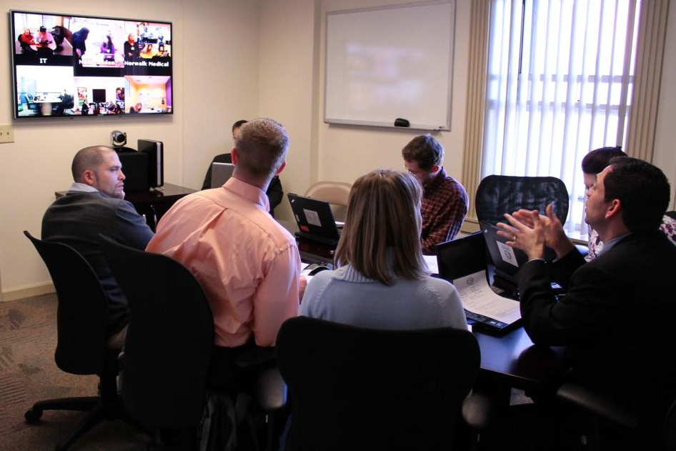

Slide 25
Successes
Successful replication of Project ECHO at a large, multisite FQHC
Full EHR integration/paperless system
Multipoint videoconferencing technology
Improved knowledge and self efficacy for PCPs
Multiple HIV and HCV patients being managed by their PCPs
  84 patients managed (55 HCV and 29 HIV)
  HIV: 100% on ARVs
    83% stayed on same ARVs, 10% required change, 7% new starts
  HCV: 9% started treatment

Slide 26
Challenges
Recruitment
  Provider
  Patient
Administrative
  Time/Productivity
  IT
  Agency Buy-in
Care Management
  Provider/Patient Readiness
  Ancillary Services
Feedback

Slide 27

Robert Murayama, MD, MPH
Chief Medical Officer

Slide 28
APICHA’s Mission Statement
To improve the health of our community and to increase access to comprehensive primary care, preventive health services, mental health and supportive services. We are committed to excellence and to providing culturally competent services that enhance the quality of life.
APICHA advocates for and provides a welcoming environment for underserved and vulnerable people, especially Asians & Pacific Islanders, the LGBT community and individuals living with and affected by HIV/AIDS.
(revised 2010)
Notes:
In 2010, APICHA’s Board of Directors approved to expand the agency’s mission from an HIV-focus to one that address the health of the community. This mission statement was affirmed the following year when the Board approved a 3-year strategic plan that directs APICHA’s management to pursue a designation as a Federally Qualified Health Center. Agency certified name changed from Asian & Pacific Islander Coalition on HIV/AIDS to APICHA Community Health Center.
The Board and staff preserves its commitment to combating HIV/AIDS and to providing health services to populations we have served over the years, particularly the LGBT community, Asians & Pacific Islanders and other communities of color.

Slide 29
Evolution of APICHA
2012
FQHC Look Alike
LGBT Primary Care
HIV Primary Care
Trans Health Care
Bilingual CM
HIV Test
Outreach
2010
2009
2001
RW EIS
2000
1996
RW SPNS
1989

Slide 30
APICHA Community Health Center Medical Home Model
Enabling Services
Care Management
Ancillary Services
Prevention
Health promotion
Disease prevention
Medical
Services
Mental Health
Policy Advocacy
Community Engagement
Community-based research Partnerships
Notes:
Support

Slide 31
How to sustain multidisciplinary work?
RW-C EIS Program
RW-A funded Care Coordination program
Medicaid funded Health Home (Care Manager)
Integrating HIV prevention work with clinic services
FQHC Look Alike designation for better reimbursement and enrolment to various Medicaid managed care plan
Plan to apply for FQHC New Access Point

Slide 32
Key to Success
Morning Huddle with PCP, clinic support staff, CMs, MH
Weekly multidisciplinary meeting
Monthly case conference: MH, CMs, PCP
MH and PCP meeting twice a month
Use of EMR (APICHA CHC is Patient Centered Medical Home Level 3)
Participation of HIV prevention staff at multidisciplinary meeting to ensure access to care for HIV positive and very high risk.

Slide 33
Success
Expanding HIV model of care to other population and sustaining services to HIV infected and high risk patients
Volume increase
  99 HIV patients in 2007 to 305 HIV patients in 2011
Quality indicators (HIVQUAL)
  83.3% of patients are retained in care
  93.3% of patients are on ARV
  Viral load suppression: 81.4% of those on ARV

Slide 34
Challenges
Current FQHC model does not recognize LGBT and HIV as special population
HIV Medical Care is not recognized as Specialty Care. The reimbursement rate is low (same as Primary Care) although HIV requires more complicated management than general primary care
Staff re-orientation and training is on going

Slide 35
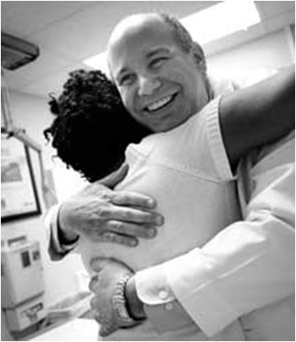

1917 Clinic Established
1988
Dr. Michael Saag
Kathy Gaddis, MSW, LCSW
Coordinator of Social Services

Slide 36

Clinic “Composition”
34 Medical Providers
39 Clinic Staff
7 Dental Staff
2,100 Patients
12 Research Staff

Slide 37
Medical Team “Composition”
Patient
Nurse Practioner or ID Fellow
Registered
Nurse
Social
Worker
Attending Physician

Slide 38
Orchestra Sections
Social Work | Linkage to Care Medication Acquisition | Case Management Adherence
Nursing | Manage Clinic Flow Triage | Symptom Analysis
Front Office | Registration Phone Triage | Scheduling Courier
Providers | Infectious Disease Specialists | Endocrinology, Palliative, Psychiatry, Dermatology, Neurology, Nephrology
Mental Health | Counseling Case Management | Substance Abuse Treatment
Oral Health Care | Restorative Preventative | Complex Endodontics
Education | Prevention Outreach | Testing Training for Staff and Patients
Research | ACTG Clinical Trials Behavioral Science Trials | Pharmaceutical Trials
IT (Technology) | Desktop Support Network Support | Clinical Informatics
Medical Records | Release of Protected Information
Cross Functionality

Slide 39
Orchestrating a Culture of Teamwork
Management that appreciates EVERY role
Staff meetings with time for public appreciation
Gold Star Clinics
Staff meetings where the monthly accomplishments of each team is recognized
Leadership modeling “stepping out of assigned role to pitch in”
Reviewing Outcome of Quality Indicators with staff

Slide 40
Successes:
Quality Indicators
Controlling for CD4 count of >500, 97% are on antiretroviral therapy
For patients with CD4 <200, 99% are currently receiving PCP Prophylaxis
91% of patients seen within the last 24 months have been seen within the last 12 months
77% of patients have a Viral Load <50
94% of clinic population is receiving Antiretroviral Therapy

Slide 41

Consumer Survey:
Sample size was 10% of patient population.
91% of the patients feel strongly that they will return for care and will recommend the clinic to others.
92.91% satisfied with their
office visit.

Slide 42
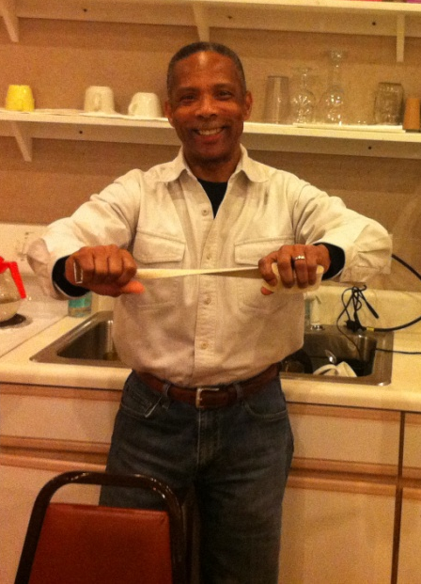

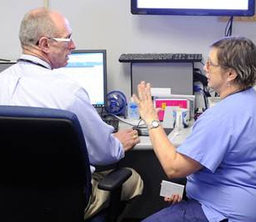
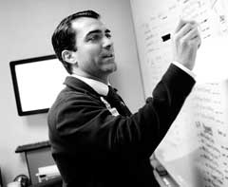
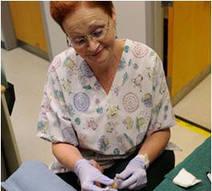

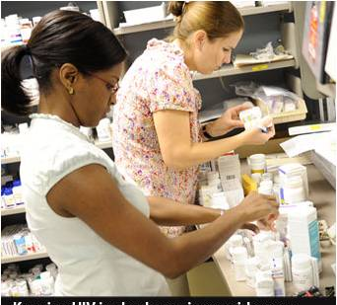

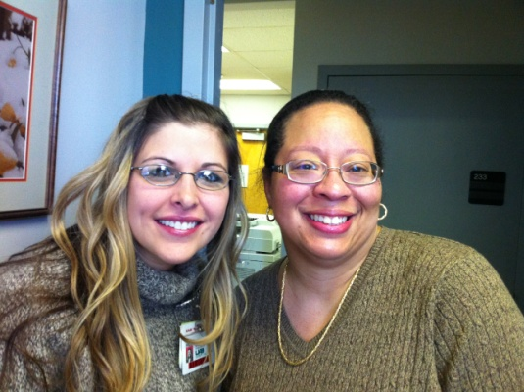
You can't play a symphony alone, it
takes an orchestra to play it.
- Navjot Singh Sidhu

Slide 43
Discussion

Slide 44
Conclusion

Slide 45
Acknowledgements
JSI would like to acknowledge the support and guidance of:
Dr. Gregory Fant, PhD, MSHS, MPA
HRSA/HAB, Division of Science and Policy
            This research was funded by HRSA/HAB
            Task Order #HHSH25034006T
Stop by Poster #P-74 Interdisciplinary Models of HIV Care: Findings from a Literature Review and Expert Consultations

Slide 46
Contact
Lisa Hirschhorn, MD, MPH
Senior Clinical Advisor on HIV/AIDS, Co-PI
lhirschhorn@jsi.com
Jeremy Holman, PhD
Senior Consultant, Project Director
jholman@jsi.com
John Snow, Inc.
44 Farnsworth Street
Boston, MA 02210
www.jsi.com

