Slide 1
“Technical Assistance to Ryan White Sites Providing Care to Women of Color: Survival Stories of Women of Color Living with HIV / AIDS in Texas”
Nancy S. Young, LCDC
Emmerentie Oliphant, D Litt et Phil (Soc. SC)
Nancy Amodei, PhD
Women’s HEART
San Antonio

Slide 2
Enhancing Linkage to HIV Care for Women of Color
SPNS WoC Project
Funded by: Health Resources and Services Administration
Special Projects of National Significance
Enhancing Access to and Retention in Quality HIV Care for Women of Color (WOC)
Grant Period : September 1, 2009 – August 31, 2014
National HIV/AIDS Strategy Goals:
Reduce HIV incidence
2) Increase access to care & optimize health outcomes
3) Reduce HIV-related health disparities

Slide 3
Enhancing Linkage to HIV Care for Women of Color
SPNS Collaboration
Women’s HEART
San Antonio
HRSA / WOCEC
SHRT
East Texas

Slide 4
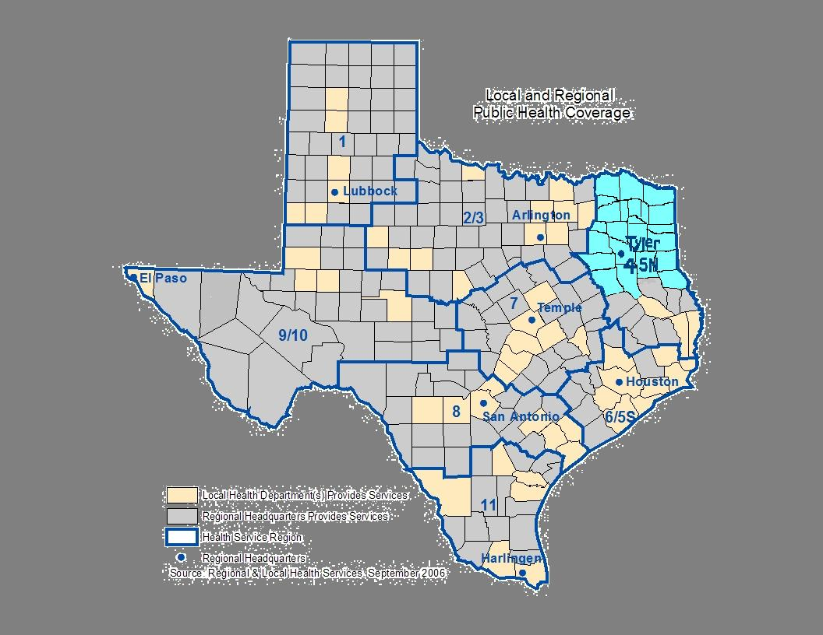
Enhancing Linkage to HIV Care for Women of Color
URBAN and RURAL TEXAS
Women’s HEART
SAN ANTONIO

Slide 5
Enhancing Linkage to HIV Care for Women of Color
Special Health Resources for Texas, Inc.
SHRT is a non-profit Community-Based Agency, the primary testing, prevention, education, and treatment provider for HIV/AIDS in the region for over 15 years.
SHRT has a “one stop shop” model of care to serve over 1000 HIV infected persons by providing medical, case management, dental, transportation, and housing services at 4 locations: Longview, Tyler, Texarkana, and Paris.
This region has 1 million residents, spread out across 23 rural East Texas counties.

Slide 6
Enhancing Linkage to HIV Care for Women of Color
SHRT Project - ‘Survival of the Fittest’ Implementation
Engage 60 Women Of Color who have dropped out of, or are sporadic in their care.
Newly diagnosed HIV positive WOC will receive same day initial appointment and labs.
500 Clients, family members/significant others and the community at large will receive HIV Health education.
60 Clients and their family members/significant others will be included in support groups.
After engagement in care, an intensive case management model is used based upon a strengths perspective theoretical foundation.
This approach views the client as a partner in treatment, not the object of treatment.
Client’s goals are met utilizing their individual strengths, instead of using a problem-based perspective.
Adherence to medical appointments and medication regimen are key measures to success.

Slide 7
Enhancing Linkage to HIV Care for Women of Color
Eligibility
Minority females ages 18 and over who have been identified as:
HIV/AIDS infected
Newly Diagnosed with HIV/AIDS
New-to-Care: patients that have never had any contact with the medical provider
Sporadic Users of Care: patients who have had only one visit in the last twelve months with the medical provider
Lost-to-Care: patients who have had no contact with the medical provider in the last twelve months

Slide 8
Enhancing Linkage to HIV Care for Women of Color
Target Population
Minority females ages 18 and over who are HIV/AIDS infected and have been identified as:
Newly Diagnosed
New-to-Care
Sporadic Users of Care
Lost-to-Care
Year | HEART | SHRT
1 | 11 | -
2 | 51 | 41
3 | 54 | 40
4 | - | -
5 | - | -
 | 116 | 81

Slide 9
Enhancing Linkage to HIV Care for Women of Color
Women’s HEART HIV Entry, Access and Retention in Treatment
UT Health Science Center at San Antonio Division of Community Pediatrics
University Health System – FFACTS Clinic
Alamo Area Resource Center

Slide 10
Enhancing Linkage to HIV Care for Women of Color
Patient Navigation
Each participant is assigned a Patient Navigator who assists in accessing HIV treatment services at the FFACTS Clinic as well as other HIV service organizations. The Patient Navigator will work closely with your Primary Case Manager to ensure that you receive the HIV treatment services that you need.
Patient Coordination
The Patient Coordinator at FFACTS works closely with the Patient Navigator to provide each participant with 6-months of intense support.
Educational and Support Groups
Each participant takes part in an individual and group HIV education classes. The individual sessions will cover such topics as HIV basics, nutrition, and women’s health topics. The group sessions will cover topics that are generated by the study participants.
Outreach Services
The Outreach Specialists assist clients who are not ready to enter HIV treatment at the FFACTS Clinic or receive Patient Navigation services.

Slide 11
Enhancing Linkage to HIV Care for Women of Color
Research Method and Strategies
Participatory Action Model
Local and National (Multi-site data)
Qualitative and Quantitative Research
Narratives – Local Survival Stories
Research café
Urban/Rural Themes of Survival
Similarities | Differences
Program Delivery | Staffing

Slide 12
Enhancing Linkage to HIV Care for Women of Color
Participatory Action Model (PAR)
Strengths
PAR implemented
Planning
Intervention and
Evaluation
Quantitative
And
Qualitative
Evaluation
Reflection
Intervention
Model
Development

Slide 13
Enhancing Linkage to HIV Care for Women of Color
Initial Themes in East Texas
Theme Discussion:
The ability to survive is strengthened by an active spiritual life, a positive connection with significant others, a sense of belonging, a positive attitude towards the future
Theme 1
Focus on spirituality, maintaining positive relations with God and on forgiving the person who infected them
Theme 2
Sense of purpose gives meaning to life (meaning also having HIV) and is faith-based
Theme 3
Surviving everyday difficulties by feeling they belong because of e.g. an accepting family or community
Theme 4
Family provides the necessary support - building positive connections with future partners

Slide 14
Enhancing Linkage to HIV Care for Women of Color
Themes
Theme discussion:
Experiencing a range of feelings related to HIV/AIDS. These feelings strengthen or weaken survival of everyday difficulties
Theme 5
Upon disclosure of diagnosis, experience hurt and anger towards the partner who infected them
Theme 6
Experience initial denial – followed by feelings of depression, fear, loneliness and hate
Theme 7
Gratefulness for still being alive influences treatment and generates hope

Slide 15
Enhancing Linkage to HIV Care for Women of Color
Themes
Theme discussion:
Negative social relationships influence ability to survive and progress
Theme 8
Scared to connect with people they do not know - including service providers
Theme 9
Ignorance of people (friends, colleagues, significant others) influences staying positive

Slide 16
Enhancing Linkage to HIV Care for Women of Color
Themes
Theme discussion:
Survival is the result of positive and negative experiences. Negative –lies, blaming others/God, not taking care of self, hating person who transmitted the disease and negative self talk. Positive – facing problems, being honest with significant others, being grateful for progress
Theme 10
Self-acceptance is the basis of survival -understanding that she is still the person she was before she was diagnosed with HIV/AIDS
Theme 11
Survival is strengthened by a positive attitude about the future
Theme 12
Secrecy and Depression are isolating
Theme 13
Suicidal thoughts- result in questioning ability to survive
Theme 14
Structure/ritual: daily schedule of activities promotes day to day survival

Slide 17
Enhancing Linkage to HIV Care for Women of Color
Moderator:
Melinda Tinsley, HAB SPNS Project Officer
Speakers:
Nancy Young, LCDC (Special Projects Administrator, Special Health Resources for Texas, Inc.)
E-mail: nyoung@shrt.net
Nancy Amodei, Ph.D. (Clinical Professor, University of Texas Health Science Center at San Antonio, Texas)
E-mail: Amodei@uthsca.edu
Emmerentie Oliphant (D Litt et Phil (Soc. SC)).
Professor, Director of School of Social Work, Stephen F. Austin State University
E-mail: oliphante@sfasu.edu

