Slide 1
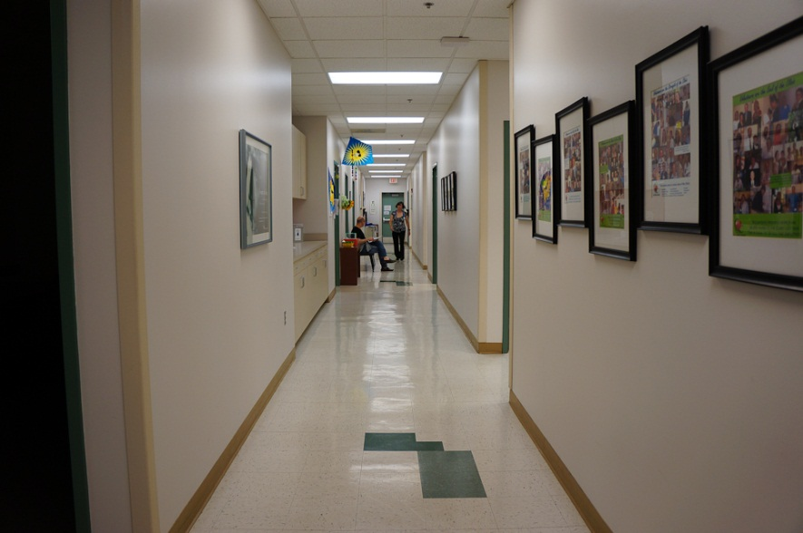
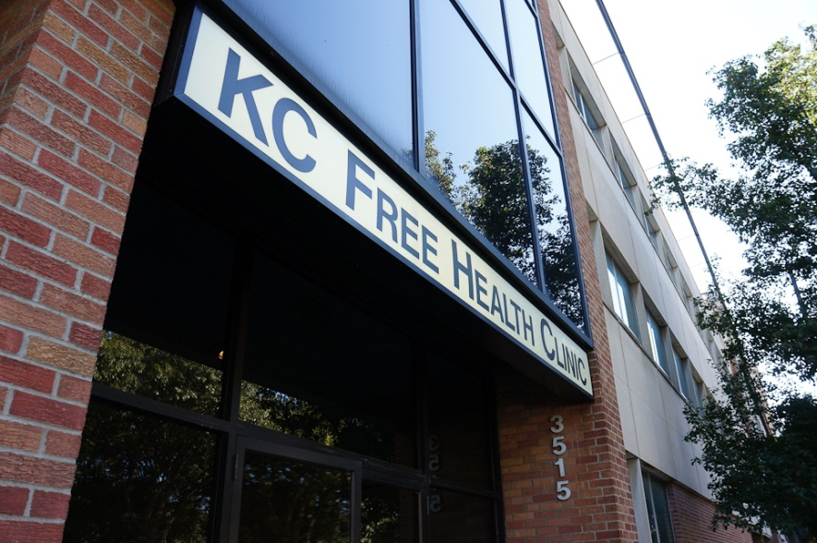
Guidance to using peer educators in response to the National AIDS Strategy
Ryan White All Grantee Meeting 2012
Alicia Downes, LMSW
HIV Education Manager

Slide 2
Learning Objectives:
At the conclusion of this activity, the participant will be able to:
Increase understanding of the peer educator’s role in response to the national AIDS Strategy at the Kansas City Free Health Clinic’s peer program.
Identify and share methods peer educators utilize to improve retention in medical care while working with the multi-disciplinary team.
Outline strategies to embrace peer educators in health care teams that include providing training and supervision.

Slide 3
Disclosure
This continuing education activity is managed and accredited by Professional Education Service Group. The information presented in this activity represents the opinion of the author(s) or faculty. Neither PESG, nor any accrediting organization endorses any commercial products displayed or mentioned in conjunction with this activity.
Commercial Support was not received for this activity.
Alicia Downes, LMSW
Has no financial interest or relationships to disclose.

Slide 4
Overview of the Clinic – Vision & Mission
Overview of the Clinic – Vision & Mission
The Vision of The Kansas City Free Health Clinic
Creating solutions for a healthy community
The Mission of the Kansas City Free Health Clinic is to promote health and wellness by providing quality services, at no charge, to people without access to basic care.
We accomplish this by:
Respecting the dignity of each individual
Serving a diverse community
Providing outreach services within the community
Working collaboratively with volunteers
Fostering individual and community partnerships
Responding to the changing health and wellness needs of the community
Fostering individual and community partnerships
Maximizing our financial resources

Slide 5
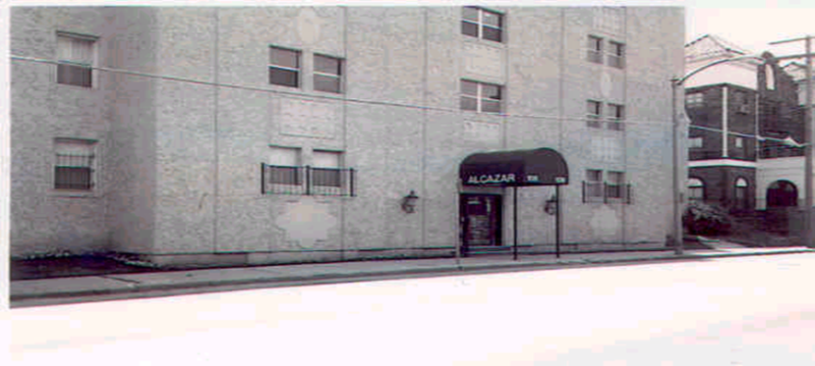
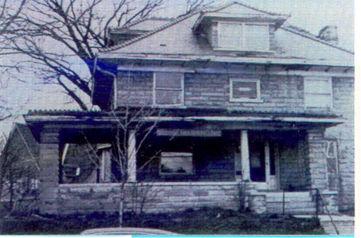
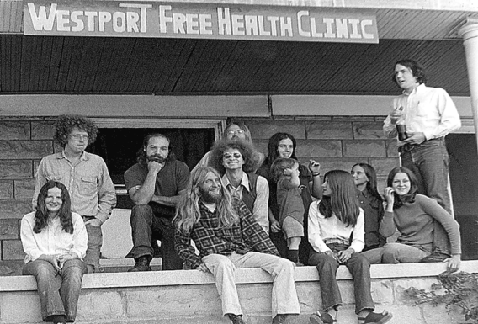
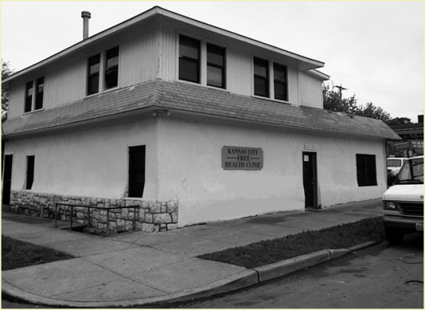
History
History of the Kansas City Free Health Clinic
1969 - Haight Ashbury Clinic founded in San Francisco starting the Free Health Clinic Movement
1971 - Westport Free Health Clinic opens in the Alcazar Hotel
1973 – The city of Kansas City donates a house at 40th & Baltimore – known by many for years as “The Old Stone House”
1986 – “The Old Stone House” is condemned and the clinic moves to the east side and changes name to The Kansas City Free Health Clinic
1986 – When HIV testing became available, the Clinic was contracted by the State of Missouri as the only anonymous HIV counseling and testing site in Western Missouri.

Slide 6
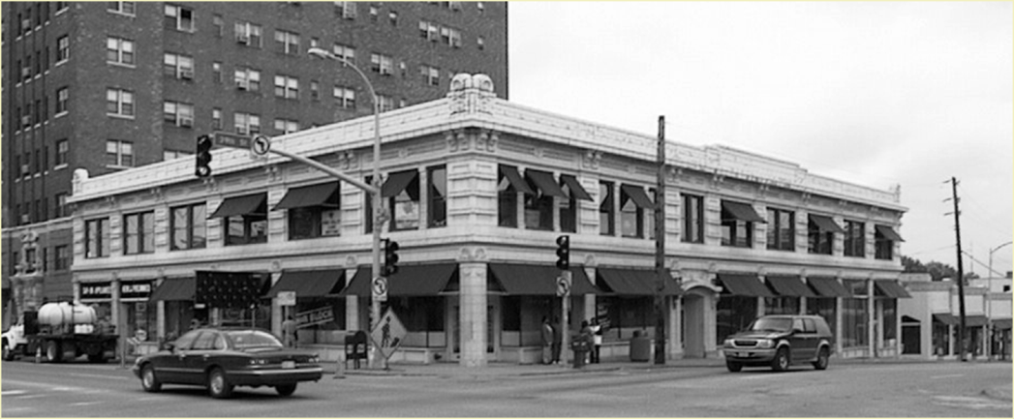
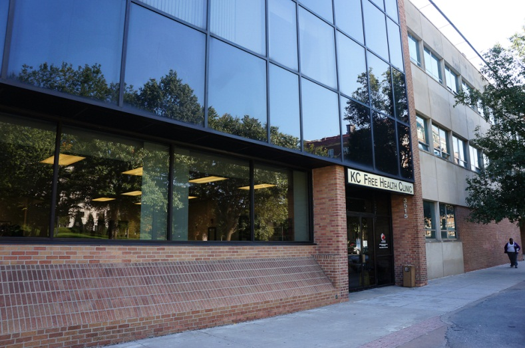
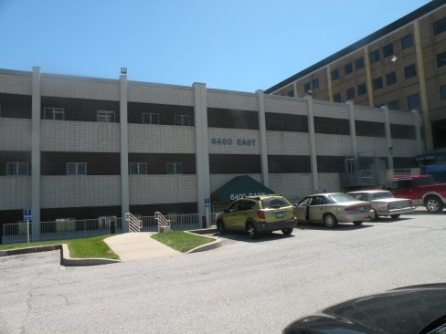
History
History of the Kansas City Free Health Clinic
1993 – The Clinic expands to space at 39th and Main with 8 staff
1993 – Ryan White Title III – first federal funding
1997 - The Clinic has 459 volunteers and an annual budget is $2.5 million
1998 – The clinic grows to 21 employees and expands to two floors
2001 - $2.5m capital campaign moves to our facility at 3515 Broadway
2005 – Building note is retired
2008 – The clinic staff exceeds 100, with over 1000 volunteers
2011 – Dental Clinic at Eastside at 24th and Denver is moved to 6400 Prospect – where we are able to expand our offer to include general medicine and behavioral health services

Slide 7
Current Fast Facts
Current Services
FACTS: Staff: 100+ full & part time
Clinical programs: 6,045 patients received primary care, mental and/or dental services
Prevention intervention and outreach: 2,000+ youth and adults
Case management and peer treatment support: 30,887 client visits per year
Annual appointments: 41,197, average of 792 weekly, 151 daily
Volunteers: 1,286 volunteers donated services valued at more than $1.25M
Volunteer hours: 41,492, equivalent to 20 full-time staff
Student training: 504 students gained 24,689 hours of practical experience
HIV tests: 3,620 through counseling and testing, medical and dental programs
Prescriptions Provided: 26,237
General Medicine
Acute and Chronic Care
Physicals
Health Screenings and STD testing
Specialty Services, including:
Well Women Care
Medication Adherence
Cardiology
Optometry
Hypertension
Dermatology
Pulmonary Care
Nutrition Counseling
Diabetes Care
Complementary Therapies
Acupuncture
Chiropractic Care
Occupational/Physical Therapy
Laboratory Services
Dispensary
HIV Care & Support
Primary Care
Clinical Research
Peer Treatment Adherence
Individual Interventions
Education Groups
Support Groups
Health Care Professional training on prevention and treatment
Dental
X-Rays
Routine Exams
Cleanings
Fillings, Extractions
Community Services
Behavioral Health Individual and Group Therapy
Substance Abuse Counseling
Case Management
HIV Linkage to Care
Wellness and HIV Prevention
HIV Counseling, Testing and Referral

Slide 8
HISTORY OF THE PEER PROGRAM AT KC FREE HEALTH CLINIC

Slide 9
HISTORY OF THE PEER PROGRAM

Slide 10
CONTINUED

Slide 11
ROLE OF PEER EDUCATORS

Slide 12
WHAT IS A PEER?
Accepts Diagnosis
Manages HIV
Has grown & healed
HIV+ people helping other HIV+ people
Notes:
Time: 35 minutes
Objective: Defining emotional readiness
Method: lecture, group discussion, dyads
Process:
Open the session by defining the word “Peer”.
The dictionary definition of a Peer is: ”a person who is equal to another in abilities, qualifications, age, background, or social status”
Review slide with participants and facilitate discussion.
Tell participants that just having HIV isn’t enough to be a Peer.
If a person is in denial about having HIV, how can s/he support another person with HIV?
Generally, it can take a year or many years to grow and heal enough from the experience of learning your HIV status. If a person is still in crisis, has not dealt with the reality of living with HIV, or is not engaged in medical care, s/he is not emotionally ready to be a Peer.
Ask participants if they have received or provided peer support.
Are there experiences in the room of giving or receiving peer support? Allow responses and facilitate discussion.
Dyad exercise instructions
Tell participants that we are going to do an exercise to help us think about our own emotional readiness to be a Peer. Ask them to pair up with someone sitting next to them.
Ask them to discuss with each other the following questions (write these on newsprint for everyone to see):
What helped you accept your status?
How are things different today from when you were first diagnosed?
Where are you in your healing process?
Dyads should be brief in telling their stories, no need to say everything but the highlights.
Allow 10 minutes; go around and make sure that everyone understands the instructions.
Debrief
Ask for volunteers to report out what their partners shared; allow a few to report out and move on.
Summarize
Peers are people who have risen above the grief, fear and hopelessness of learning their HIV status, people who have come to believe that good health and longevity can be achieved despite HIV.
12

Slide 13
Improved health related quality of life
Informational support:
Sharing experiences & information
Modeling effective skills
Self-efficacy
Increased perceived social support
Increased positive mood
Increased understanding of self-care
Improved health behaviors (e.g. weight
monitoring, diet, taking medications
PEER SUPPORT
Emotional support
Encouragement
Reinforcement
Decreased sense of isolation
Mutual reciprocity
Shared problem solving
Both receiving and giving help on shared medical issues
Improved chronic disease control
Decreased hospitalization & mortality
California Healthcare Foundation (2006) Building Peer Support Programs to Manage Chronic Disease: Seven Models of Success
Notes:
13

Slide 14
INFORMATIVE
SUPPORT
PEER ROLES
EMOTIONAL
SUPPORT
INSTRUMENTAL
SUPPORT
AFFILIATIONAL
SUPPORT
Notes:
Time: 20 minutes
Objective: Participants learn 4 broad categories of Peer support and the role of emotional support in facilitating the other 3 categories.
Training method: lecture, discussion
Training materials: Peer Roles handout
Process:
Review slide with participants. Tell them that these are broad categories of what Peers do – within each category there are a number of activities.
Explain emotional support as the essence of Peer support: Providing emotional support creates a connection/bonding between Peer and client, one that helps develop a relationship of trust. This trust makes it easier to provide the other service categories.
Define Informative, Instrumental, and Affiliational
Informative means providing information, mentoring, enlightening, role modeling.
Instrumental means serving as a means or influence, help, assist.
Affiliational means the state of being associated with others, communal, belonging to the people of a community.
Draw participants’ attention to the handout Role of Peers and review together:
Emphasize role modeling: People see you as their leader, as an example that they can follow; not leading by example would make the peer leader seem hypocritical and perceived as having a double standard.
Ask participants and facilitate discussion: How would you feel going to a dentist who has rotten teeth? How would you feel about a peer leader who advocates disclosure but never discloses?
Show Peer-client video and debrief
Key points:
Peers are hired because they have overcome many obstacles, have learned to manage the challenges of HIV and can be a good example to others. This doesn’t mean that Peers have to be perfect or have no challenges of their own.
Peers are part of a broader goal to end the epidemic by helping people with HIV engage in care, stay engaged, and adhere to treatment.
Segue
Tell participants that Peers can have many different roles, however, the role of Peers is unique from that of other service providers.

Slide 15
ORGANIZATION STRUCTURE AND PROCESS
Recruitment/Hiring/Retention
Under the direction of Human Resources
Follows same process as all other hires
Job Description
Essential Functions: Example, Enhance engagement in care and adherence by assembling next day appointment charts, complete patient reminder and DNKA calls. Meet with clients as scheduled and document services delivered
Orientation
Completes orientation with peer mentor and within agency Community Organizations Orientation
Compensation
Full time and part time employees
Accrues fringe benefits

Slide 16
Goals of the National Aids Strategy and implementation at Kc free’s peer program

Slide 17
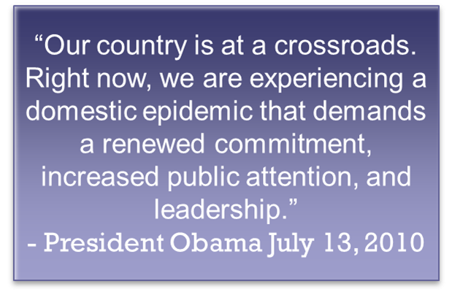
NATIONAL AIDS STRATEGY
Goals:
Reduce HIV incidence
Increase access to care and optimize health outcomes
Reduce HIV-related health disparities

Slide 18
REDUCE HIV INCIDENCE
HIV Testing promotion
Co-Facilitate Evidence Based Interventions (Willow, LIFE, CRCS, Healthy Relationships)
Work collaboratively with HIV Prevention at the clinic to promote testing and EBIs
Community Advocacy
Involvement with Planning Council
Involvement with Black Church Week of Prayer Events

Slide 19
INCREASE ACCESS TO CARE AND IMPROVE HEALTH OUTCOMES FOR PEOPLE LIVING WITH HIV
Newly Diagnosed Clients referred by Linkage to Care Coordinators refer to peer program
Medical Appointment Reminder Phone Calls
IN+ Care Program
Peer Program Core Educational Components
HIV 101
Harm Reduction
HIV Life Cycle and ARV impact to reduce replication
Understanding Lab Values
Understanding of Resistance & Testing Impact
Member of Multi-disciplinary Weekly Team Meeting
Part of the Medication Clinic Team

Slide 20
REDUCE HIV-RELATED HEALTH DISPARITIES
Community Advocacy
Peer Program Core Educational Components
HIV 101
Harm Reduction
HIV Life Cycle and ARV impact to reduce replication
Understanding Lab Values
Understanding of Resistance & Testing Impact
Educational Groups-Adhering to Wellness
Support Groups
Self-Management Educational Group
Co-facilitate Substance Abuse Group

Slide 21
Benefits of the peer program

Slide 22
“The Peer Program Makes a Big Difference”
http://hdwg.org/sites/default/files/video/leo-jerry-digital-story-final.wmv

Slide 23
SUCCESSES 2011-2012

Slide 24
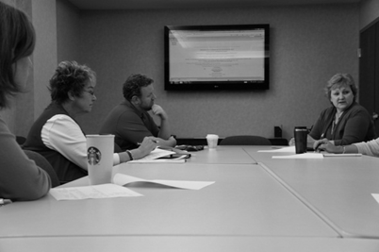
SUCCESSES 2011-2012
Examples of Individual Client Directed Sessions
Receive emotional support
Increase understanding of Lab Values
Increase understanding of HIV Viral Life Cycle and medications
Problem solve medication adherence strategies
Referral to prevention services
28 Group Level Interventions
Adhering to Wellness (12)
Support Group (12)
HIV Self-Management group (2)
Community Educational Forums (2)

Slide 25
WORKING WITH THE MULTI DISCIPLINARY TEAM
Doctor
Nurses
Mental Health
Client
Peer
Educator
Social Worker

Slide 26
WORKING WITH THE MULTIDISCIPLINARY TEAM
Partnership
Part of the HIV Primary Care Team
Communication
Weekly Multi-Disciplinary Team Meeting
(Client Case conference with Staff)
Client Referrals
Behavioral Health Support
IN+ Care Campaign
Access to medical records
Documentation
SCOUT Database (integrated case management dbase)
Access to system wide case management database
Documentation in database
Database is a communication tool with CMs

Slide 27
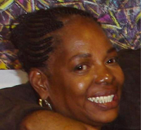
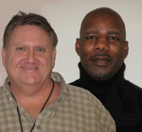
Impact on Peer Educators:
“You have to let the client know that you are like them, that you have gone through these things before and that if you can go through it, they can go through it. And you will go through it with them.”
“I think this is the most rewarding job. It means so much to me that I would do it even if I didn’t get paid. I would be here.”

Slide 28
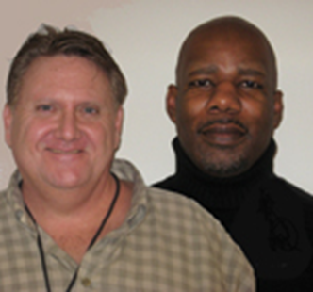
Patient Impact
“It seems like everything bad is happening all at once,” the client said. Jay’s partner had been ill for sometime, did not tell him he was living with AIDS and had recently died from complications. Jay himself was dealing with significant complications from a brain tumor and was having frequent seizures. He was still being followed by a neurologist. Jay explained to the Ryan White Linkage to Care Case Manager, “What else?” The LTC case manager told him that it would be good to talk to a Peer Educator about HIV disease and just get some support during this difficult and emotional time he was going through. Jay met with a peer that day and described the visit to the case manager as “hopeful”.

Slide 29
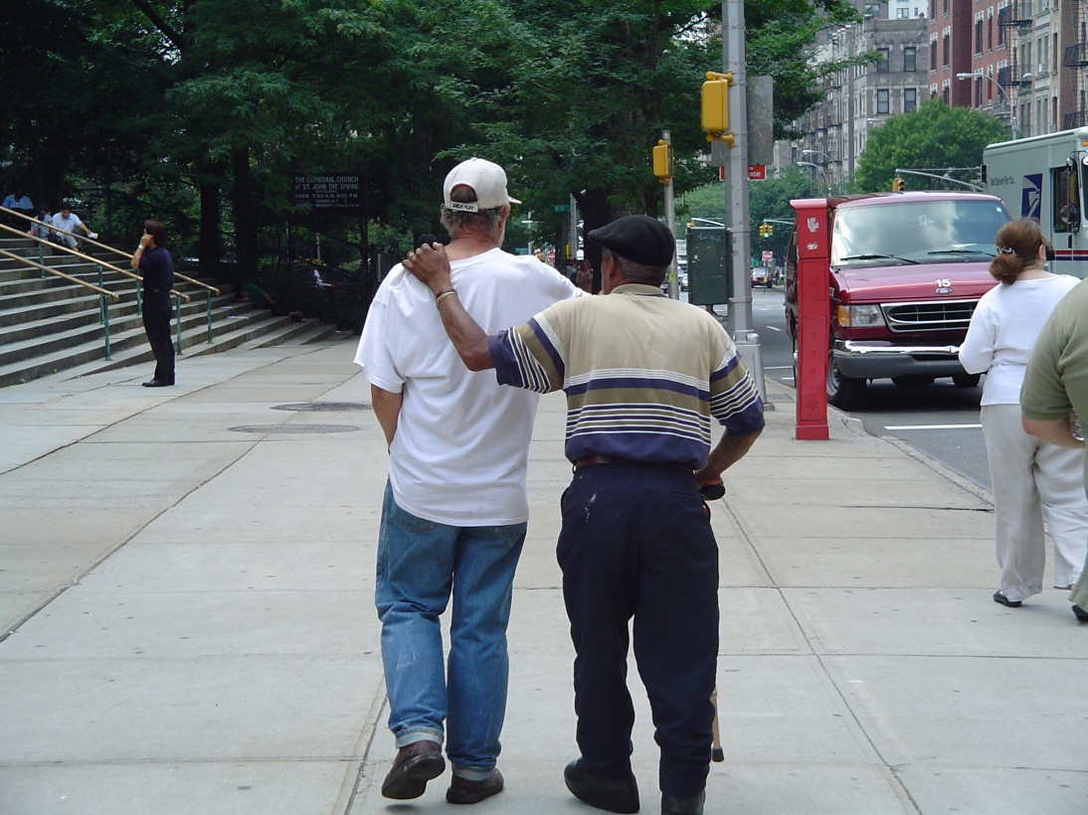
What services could be offered to Jay?
Specific Services include:
Individual session to provide emotional support
HIV 101, VLC, Labs,
Reminder phone calls for medical appointments
Support Groups

Slide 30
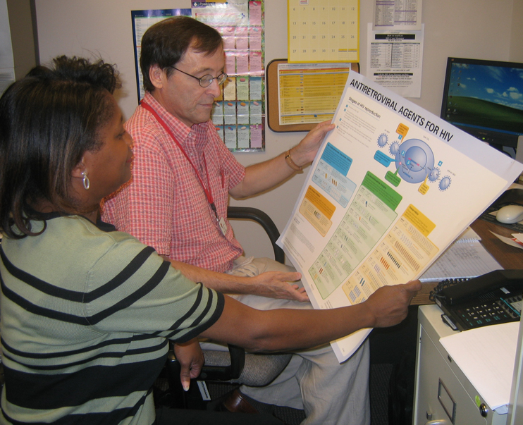
Today, Jay lives hopeful. He has become a champion in advocating for his own health care. Working with his neurologist, his seizures have mostly resolved. His CD4 is up to almost 500 and his VL is less than 20 according to his most recent lab results. jay is also emotionally stable. He is working with a national organization Campaign to End AIDS (C2EA) and recently had the courage to speak to the Ryan White Planning Council concerning how the Peer Program has been life changing for him. Jay is singer, and says, “Thanks to the Peer Program I have a lot to sing about, I didn’t know that then, I’m confident about it now.”

Slide 31
Training peers and supervising

Slide 32
VIRAL LIFE CYCLE
EXAMPLE OF EDUCATIONAL COMPONENT

Slide 33
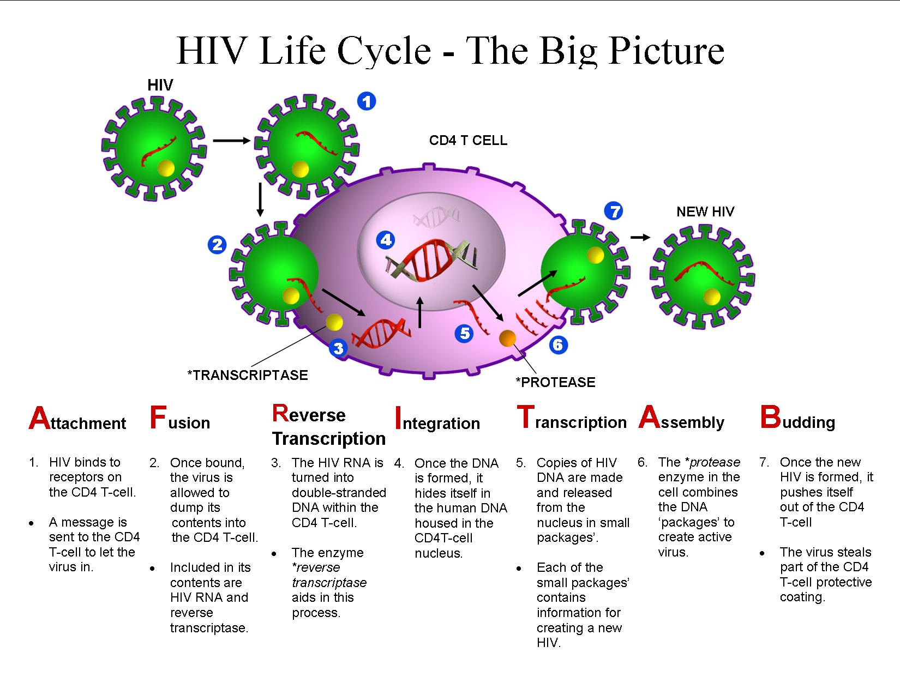
Viral Life Cycle - The Big Picture
(CD and Handout)

Slide 34
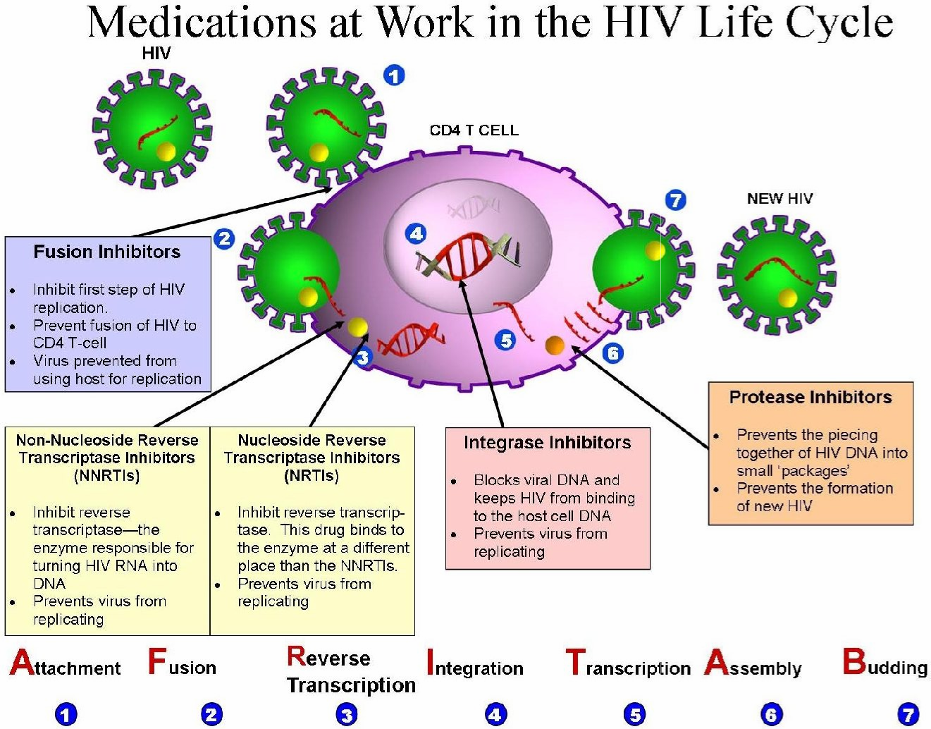
Notes:
Most of the handouts recommended in the module are actually attached to the module – like this beautiful chart on how Medications Work in the HIV Life Cycle.
A few handouts or videos are not attached, but can be downloaded from the internet. The website addresses are listed in the Materials Needed section of the module.

Slide 35
http://www.hdwg.org/peer_center/training_toolkit/
Training Available for Peer Educators

Slide 36
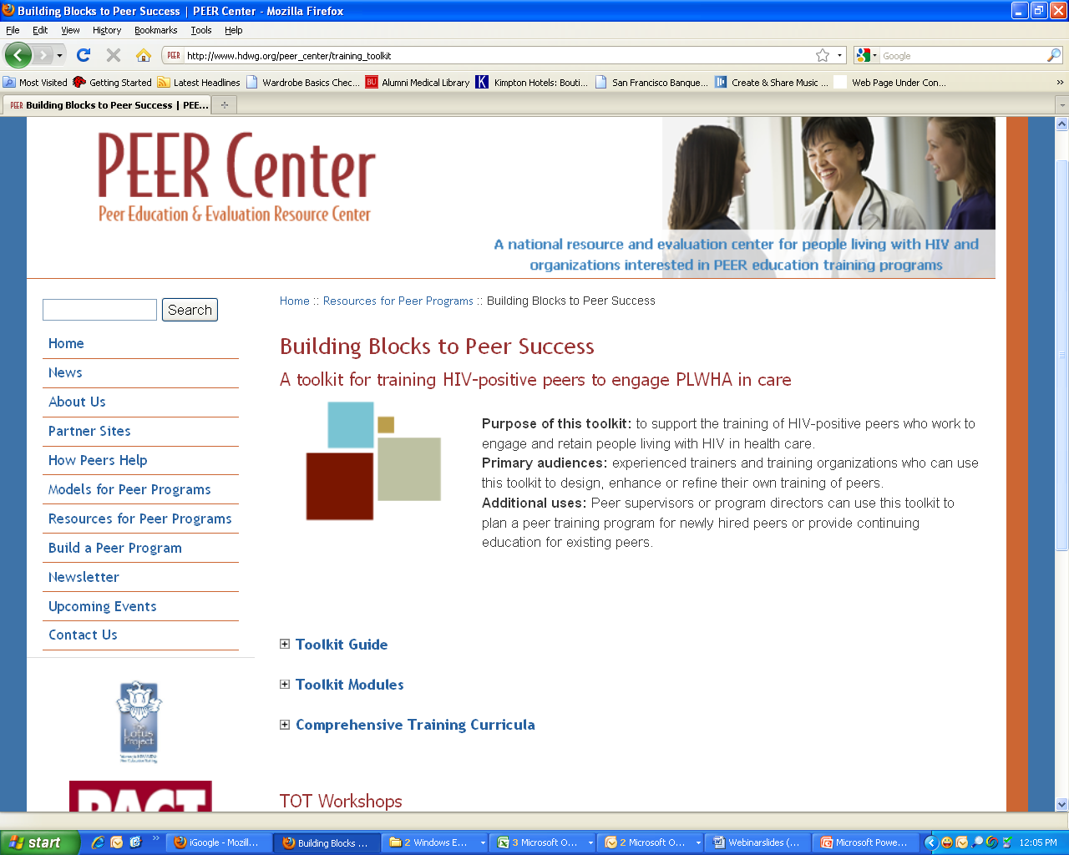
Notes:
This is the web page for the training toolkit.
Three sections – guide, modules, and comprehensive training curricula.
Let’s click on the Toolkit guide

Slide 37
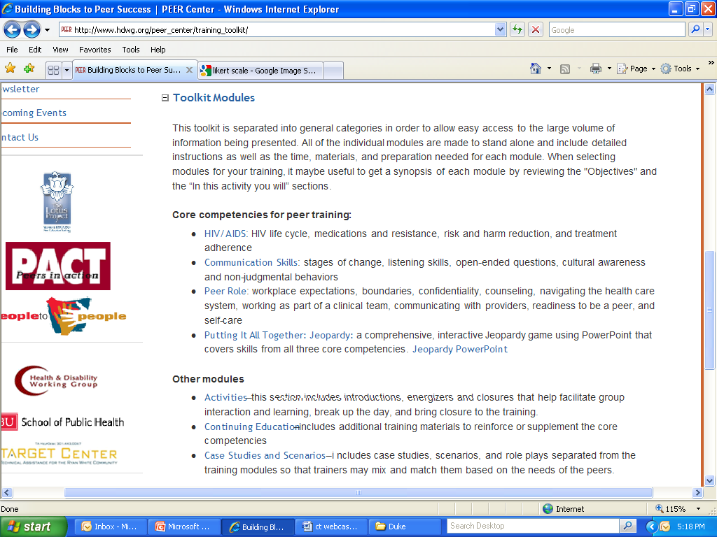
Notes:
And here’s what you will find – two major sections.
One section we call Core Competencies and the other is Other.

Slide 38
PEER SUPERVISION
First Line supervisor
Administrative
Supportive
Clinical supervision (shared with LMSW)
Peer educator/advocacy experience
Individual and group supervision
(weekly/bi-weekly)
Program manager – LMSW
Provides clinical /supportive supervision
Important in dealing with clients

Slide 39
Program evaluation

Slide 40
QUALITY MANAGEMENT TREATMENT ADHERENCE INDICATORS
100% New primary care patients who have at least 2 medical appointments will meet with a peer educator within 3 months of their first appointment.
80% Patients on any medication will have an adherence assessment completed at
their last medical visit.
75% TA clients engaged in individual interventions will have a CD4 count and viral load completed at least 3 months and not greater than 6 months after previous CD4 and viral load during the measurement period.
75% TA clients engaged in individual interventions will have a primary care
appointment at least 3 months and not greater than 6 months after previous
appointment during the measurement period.
Demographics
Client satisfaction Surveys

Slide 41
Now what???????????????????
What is your plan when you leave here?

Slide 42
GETTING STAFF BUY IN

Slide 43
INFORMATIVE
SUPPORT
ACTIVITY
PEER ROLES
EMOTIONAL
SUPPORT
INSTRUMENTAL
SUPPORT
AFFILIATIONAL
SUPPORT
Notes:
Time: 20 minutes
Objective: Participants learn 4 broad categories of Peer support and the role of emotional support in facilitating the other 3 categories.
Training method: lecture, discussion
Training materials: Peer Roles handout
Process:
Review slide with participants. Tell them that these are broad categories of what Peers do – within each category there are a number of activities.
Explain emotional support as the essence of Peer support: Providing emotional support creates a connection/bonding between Peer and client, one that helps develop a relationship of trust. This trust makes it easier to provide the other service categories.
Define Informative, Instrumental, and Affiliational
Informative means providing information, mentoring, enlightening, role modeling.
Instrumental means serving as a means or influence, help, assist.
Affiliational means the state of being associated with others, communal, belonging to the people of a community.
Draw participants’ attention to the handout Role of Peers and review together:
Emphasize role modeling: People see you as their leader, as an example that they can follow; not leading by example would make the peer leader seem hypocritical and perceived as having a double standard.
Ask participants and facilitate discussion: How would you feel going to a dentist who has rotten teeth? How would you feel about a peer leader who advocates disclosure but never discloses?
Show Peer-client video and debrief
Key points:
Peers are hired because they have overcome many obstacles, have learned to manage the challenges of HIV and can be a good example to others. This doesn’t mean that Peers have to be perfect or have no challenges of their own.
Peers are part of a broader goal to end the epidemic by helping people with HIV engage in care, stay engaged, and adhere to treatment.
Segue
Tell participants that Peers can have many different roles, however, the role of Peers is unique from that of other service providers.

Slide 44
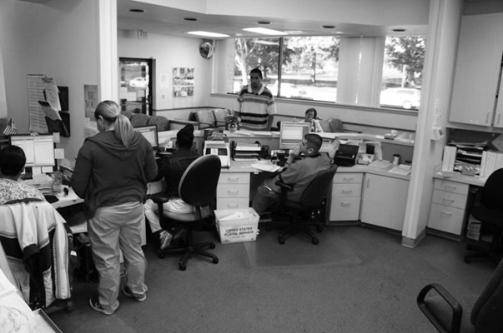
PEER Center: www.hdwg.org/peer_center
ORGANIZATIONAL CAPACITY BUILDING TOOLKIT

Slide 45
Main goals addressed by peer program:
Capacity-building activities:
Peer program funding source(s):
Increase the number of HIV-positive individuals presenting for medical care
Increase number of clients who are adherent to HAART
Expand the network of collaborating agencies
Frequent communication with People to People staff via email, face-to-face meetings and phone throughout the process of developing the program
Training to educate physicians, case managers, nurses and other clinic staff about how peer services can be integrated into HIV care
Level 1 and 2 training of five peers by People to People
Peer/peer supervisor shadowing at Kansas City Free Health Clinic
Participation in peer retreats, training-of-trainers and capacity-building workshops
Support for replication of peer training
Funding is provided by Ryan White HIV/AIDS Program Part A through the Saint Louis Targeted Goal Area, City of St. Louis Department of Health, and Ryan White HIV/AIDS Program Part D through Washington University-Project ARK.

Slide 46
CASE STUDY: EXPANDING PEER ROLES TO PROVIDE TREATMENT AND ADHERENCE SUPPORT IN A
UNIVERSITY HOSPITAL SETTING
Results:
Benefits to patients:
Advice for organizations developing peer programs:
Met grant goal for number of minutes of care with clients (a total of 414 hours)
Referrals to peer services grew from 80 to 120 in the last grant year
Improvement in peer and staff skills
Lower turnover rate among peers
Increase in number of collaborating agencies
Improved peer supervision capacity
Improved ability to track and document outcomes
Better linkage to care and support at time of diagnosis
Clients lost to care have returned, increased engagement in care and treatment
Better-informed clients take charge of their own care
Educate the clinic systems and staff to make sure stakeholders understand the peer’s role.
Find the right peers, train those peers, and create opportunities for peers to network with each other and continue their educational development
Don’t reinvent the wheel—use the resources provided through the Peer Education and Training Sites/ Resource and Evaluation Center (PETS/REC)
Initiate and call other agencies to ask for help.

Slide 47
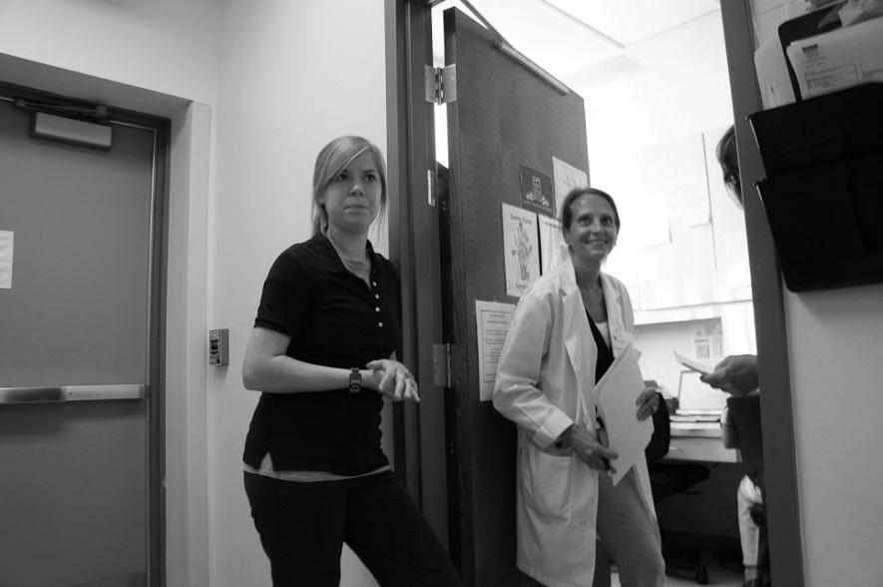
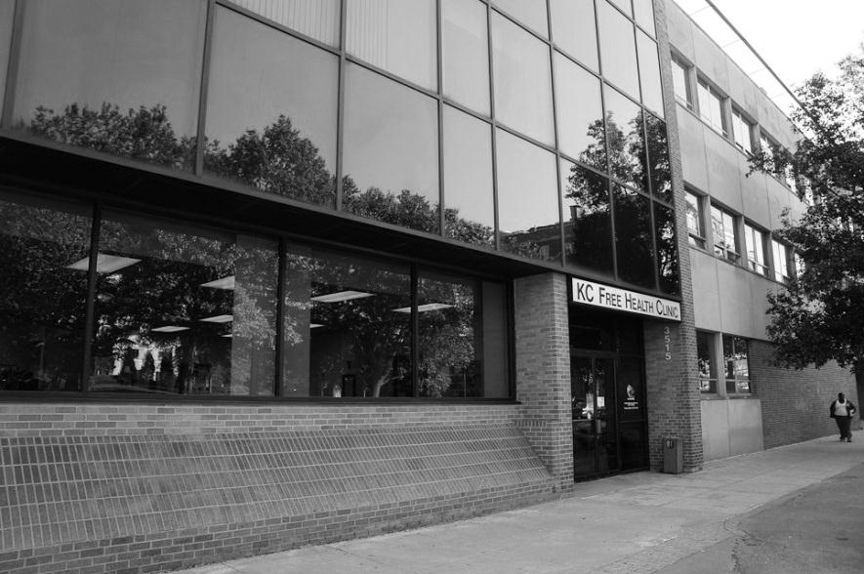
QUESTIONS

Slide 48
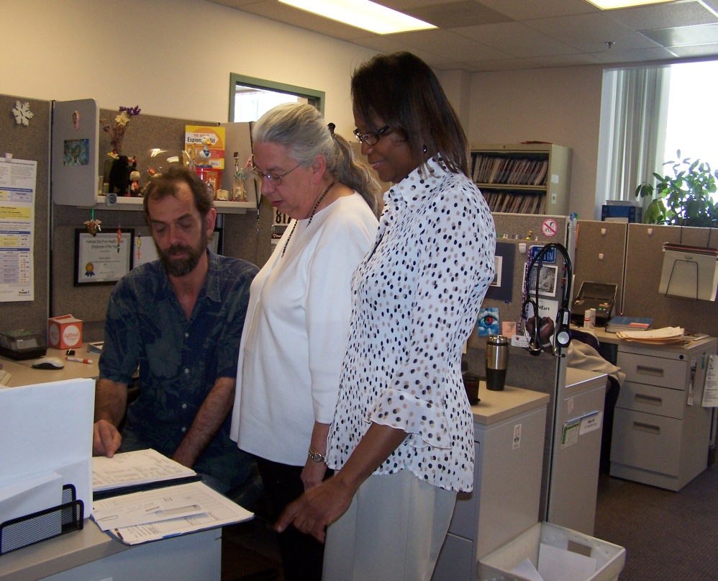
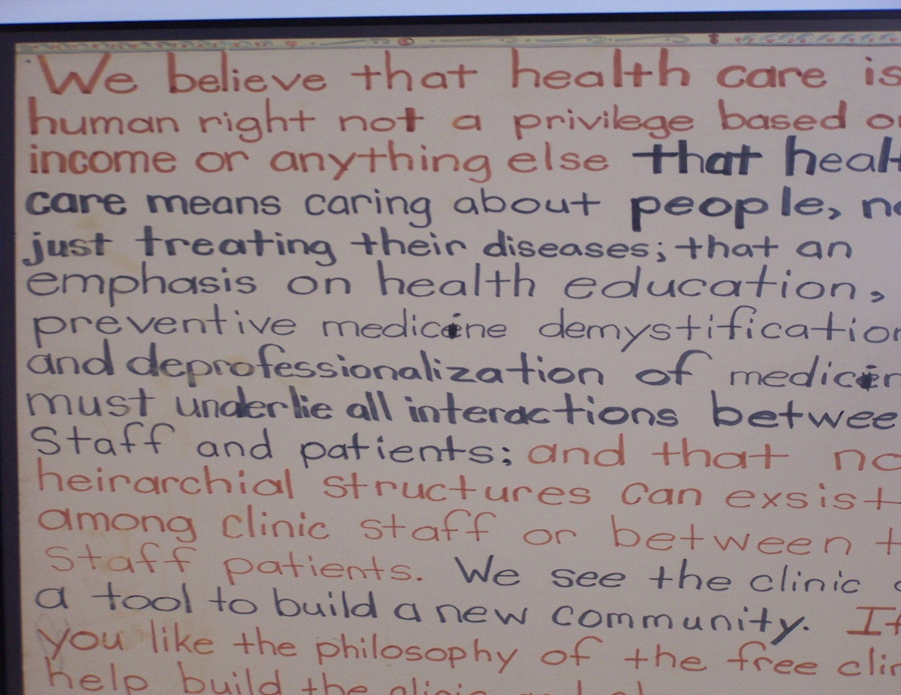
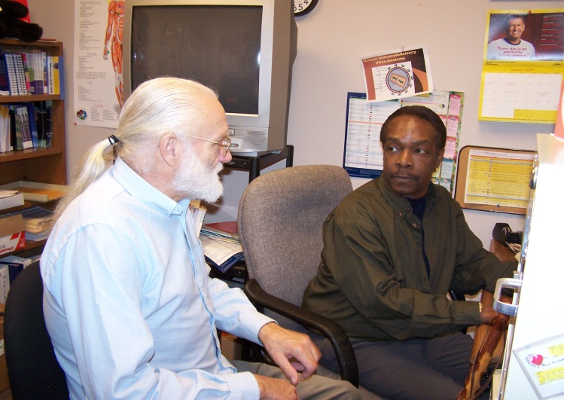
Thanks to my team:

Slide 49
Obtaining CME/CE Credit
If you would like to receive continuing education credit for this activity, please visit:
http://222.pesgce.com/RyanWhite 2012
ALICIA DOWNES
KANSAS CITY FREE HEALTH CLINIC
aliciad@kcfree.org
816-777-2746

