Slide 1
Technical assistance for data collection and data management
The New York State Experience
Notes:
Welcome, I’d like to introduce our panel today: I’m Vida Chernoff. Joining me are Dmitry Kopstev, Application Administrator for NYSDOH/AI/OSD and Ric Yanes, Data manager for the Montefiore Bronx Healthcare Network, a Part C grantee.

Slide 2
Brief History
The NYSDOH AIDS Institute has collected client level data for Ryan White contracts since 1995
Model is a distributed, custom built relational database product installed at each agency
Concept is agency ownership of data within a structured data collection and data entry environment
Notes:
The Institute decided to go with a statewide client level solution in 1994, in response to HRSA’s launch of the Standard Annual Aggregate Report. An RFP for programming and TA was issued and Defran Systems Inc. was chosen to custom build the URS system and provide technical support and training on software use.

Slide 3
URS and AIRSNY
Brief History, continued
Original database design of the NYS URS based on data needed for Ryan White AAR
Expanded to include CDC grant requirements in 1996
Updated to the AIRSNY system in 2007
De-Identified and de-duplicated client level data exported from provider agencies to NYS via XML on NY State’s secure Health Commerce System
RSR file generated from provider systems, not State level database
Notes:
The emphasis of the project has always been on providing our contract agencies with a local solution. Since the system pre-dates many other initiatives such as implementation of EMRs and even electronic registration and billing systems, this was often the first experience with a standardized agency-wide data collection system for many of our providers. Organizational readiness for any form centralized data entry was a significant hurdle.

Slide 4
ELEMENTS OF TECHNICAL ASSISTANCE
I. Structure and validations in software to enhance accuracy and completeness and reflect grant monitoring standards
II. Technical Assistance and Training via phone, web-based systems and webinars, and in-person classroom training and user groups
III. Feedback via local reports and analysis of data submitted to the State
Notes:
There are three major elements of technical assistance. With software customization, requirements that might otherwise be communicated in forms, instructions, directions and report feedback can be handled at the front end of data collection and data entry, identifying and trapping problems at the source. Technical Assistance and Training is needed with or without a software solution. Providers need ongoing support on data content, requirements, protocols such as data security, confidentiality, data management and reporting regardless of the platform used. The last tier of technical assistance is feedback on RSR extract content, such as completeness reports. If these are run on a regular basis, they can be effective but if left to the end of the reporting cycle, they allow little time for turnaround and correction.

Slide 5
Software Design, Technical Support and Training, and Feedback on Data Submissions must be balanced to ensure Accurate and Complete Data
Feedback on Data Submissions
Technical Support and Training
Accuracy and Completeness
Software Design
Notes:
This graphic summarizes the relationship of the three TA elements

Slide 6
I. ELEMENTS OF SOFTWARE DESIGN
Supporting Accuracy and Completeness

Slide 7
VALIDATIONS ON DATA ENTRY
Elements of Software Design
De-duplication: trapping duplicate client registrations on entry vs. analysis and review after the fact based on identifiers: prevention is better than treatment
Initial client registrations should at minimum check against existing records for name, gender, date of birth matches
Checks after the fact can look for name/gender/DOB matches, eUCI or URN matches. Issue becomes consolidating service records and other histories when dups are found
Notes:
De-duplication is a centerpiece of accurate data, and is easiest to catch at the intake process given the right tools. If left unchecked, histories become attached to multiple intake records and the data for a single client is dispersed. Matching records after the fact is a very time-consuming process.

Slide 8
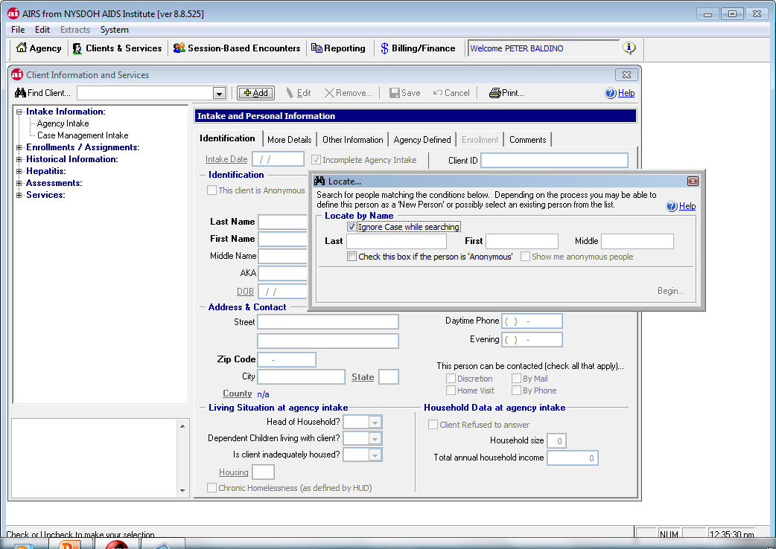
Example: Adding an Intake pulls up a search utility to identify matches
Notes:
Example of a common method to check for duplicates on data entry of intake

Slide 9
VALIDATIONS ON DATA ENTRY
Elements of Software Design
Inconsistent dates and information: Issues such as DOB later than intake date, first service prior to intake, biological males with pregnancies, and other likely entry errors
Software should check dates and content for consistency on save and alert user
Information out of the realm of the possible should be prohibited
Probable errors should result in an alert message
Notes:
Software validations are an excellent way to trap inconsistent entries. It can be very easy to make a data entry error on a date field and not notice until report output is not what was expected. This also improves quality of data for client care management.

Slide 10
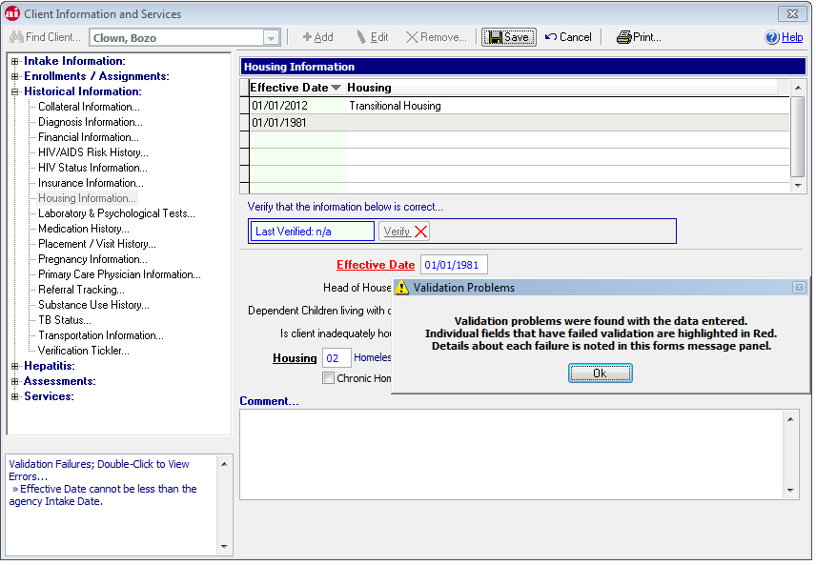
Each invalid entry returns a message and requests correction – detail on errors also appears in the information box on left
Notes:
An example of error trapping (date of housing status less than intake date). There are many of these validations throughout AIRS

Slide 11
MISSING DATA
Elements of Software Design
Missing Data on Demographics easier to trap by adding required fields to save
Missing Data that is part of the sequence of services or status changes cannot be trapped on data entry, require reports and other analysis of data
Software can help to identify gaps but good data collection and data entry are critical to success
Notes:
No software can ensure a report-ready record on save. Each element is checked at point of entry for consistency, but gaps are more difficult to identify.

Slide 12
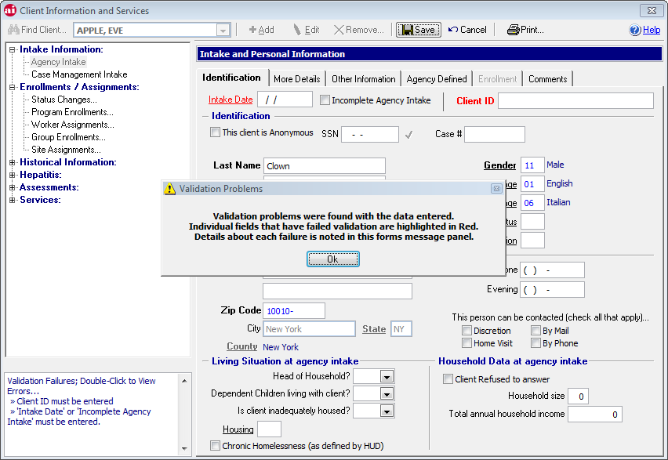
Highlighting skipped fields and preventing save of incomplete data
Notes:
The more visible the highlight of missing elements, the easier it is to focus on issues. Companion forms, if used, should highlight the same requirements for data collection staff

Slide 13
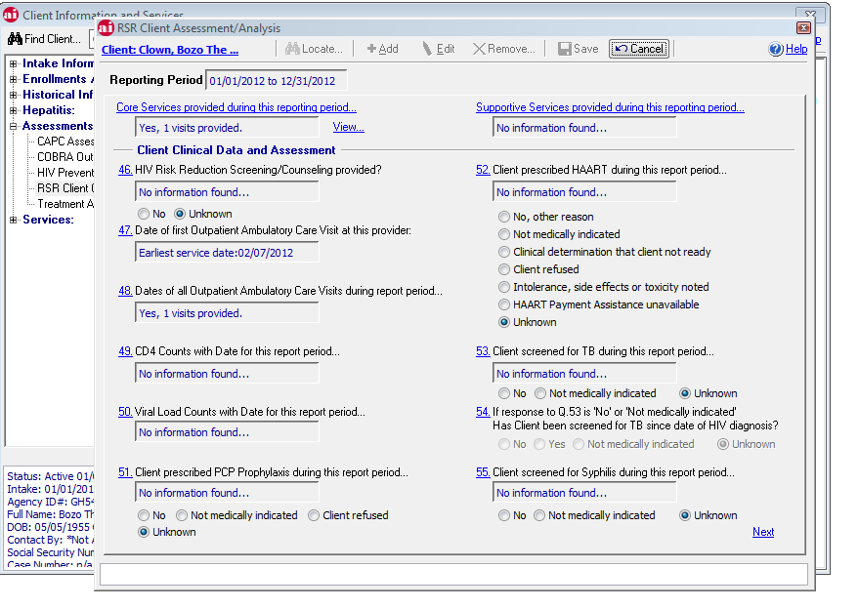
Identify gaps in data using a report-based assessment
Notes:
The RSR Assessment is a tool in AIRS that functions both as a report (displaying current data for the client) and an interface to provide explanation of missing data if applicable.

Slide 14
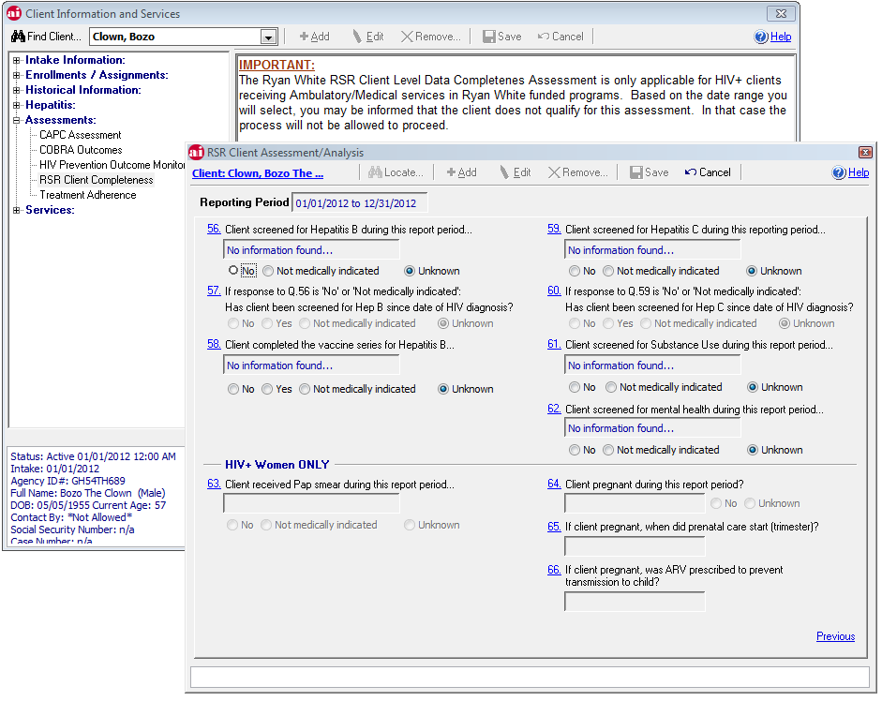
Completeness Assessment covers all clinical questions in RSR order
Notes:
The RSR Assessment provides a run through of all the clinical questions, and is only available if the client has received a medical visit during the report period.

Slide 15
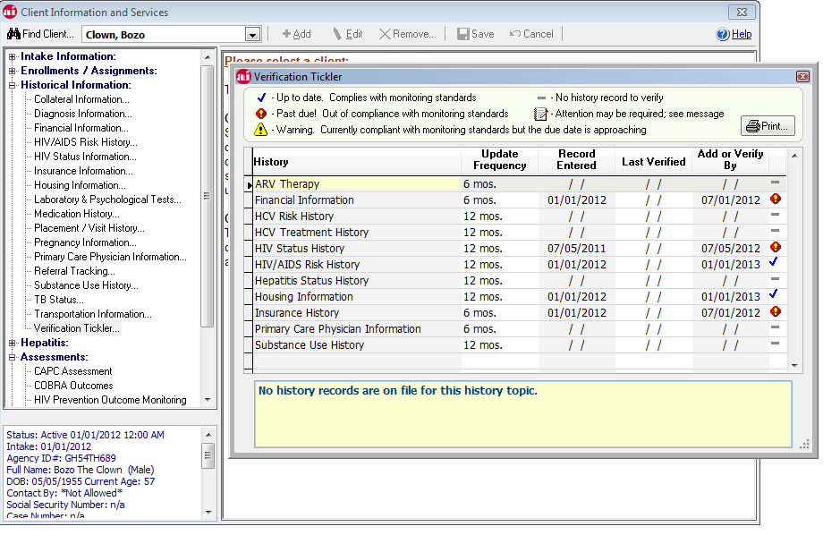
A tickler or reminder system on major report components and monitoring standards is a tool to assist staff in managing client data
Notes:
The Verification Tickler in AIRS provides an overview of how current critical information is within the histories. Agencies are expected to either verify that data is still correct, or enter a new record with updates. Only a specific number of verifications are allowed, when they are exhausted a new history record should be added. Update frequencies can be adjusted to reflect monitoring standards.

Slide 16
USING REPORTS TO MANAGE DATA QUALITY
Elements of Software Design
Reports that filter clients according to grant requirements allow efficient focus
Mimic report logic of the desired output as much as possible
Provide ability to drill down to client data that has identified issues or gaps
Information from reports can be used to work collaboratively with program staff to improve data collection and entry
Notes:
Reports are critical to ongoing data management feedback loops within organizations (internal vs. feedback from funders), from client specific to program specific to agency-wide.

Slide 17
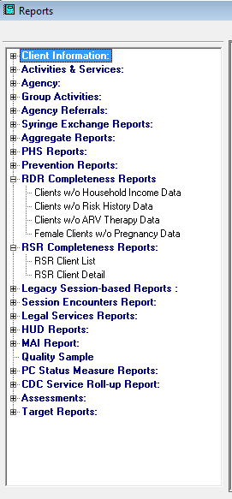
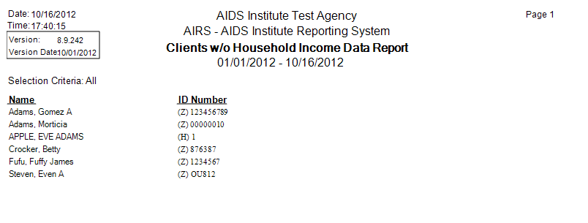
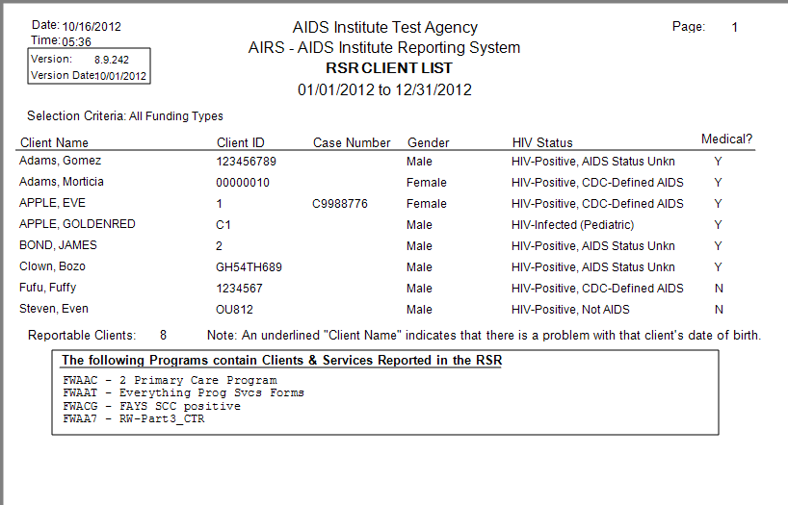
Reports can highlight issues or provide detail on content
Notes:
Being able to see specific clients to confirm content and troubleshoot gaps is critical to data management. This allows confirmation of the population being included in the report. Improving overall rates of completeness depends on identifying which client records have gaps.

Slide 18
MEETING RSR REQUIREMENTS FOR CONTRACT/FUNDING SPECIFIC REPORTING
Elements of Software Design
A. Structuring systems to identify RW eligible clients and RW funded services
B. Organizing data within systems that contain non-RW clients and services
C. Ensuring that reports are selecting only the clients and services that meet criteria for the RSR
Notes:
Some of the great challenges of the RSR are selecting only reportable clients; ensuring that the services are delivered within RW funded programs and reflect last dollar requirements, and that your reports are selecting these clients and services accurately.

Slide 19
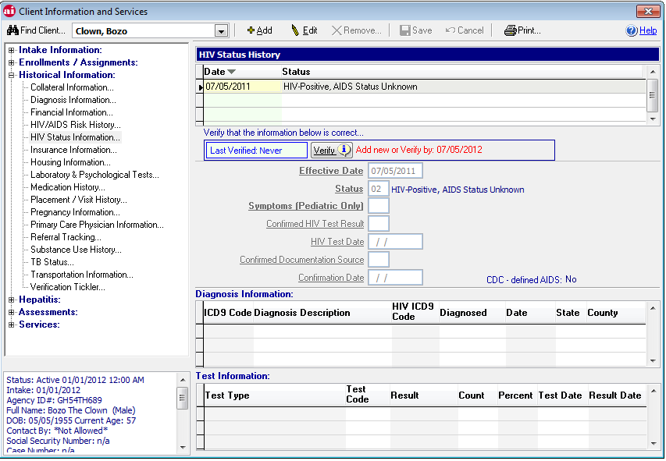
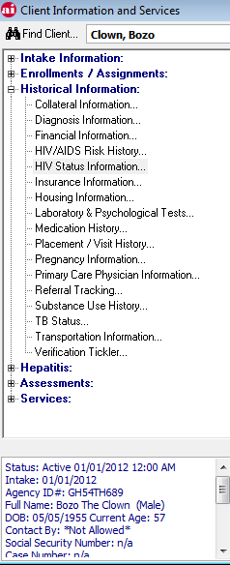
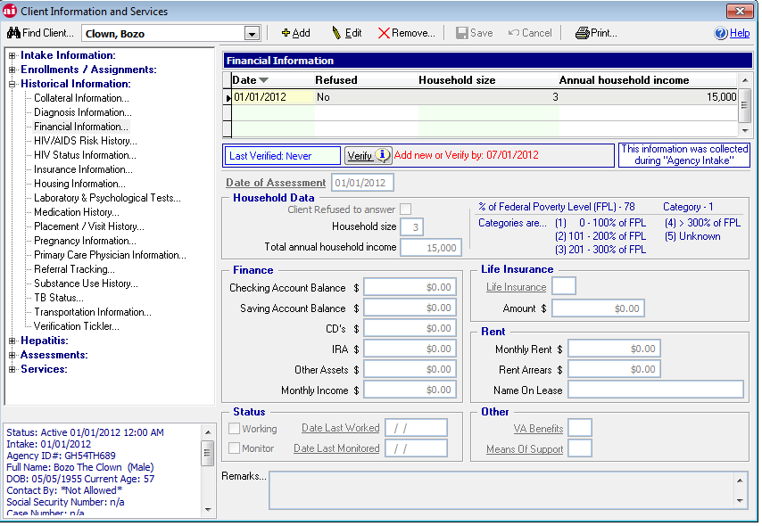
A: Identifying Reportable Clients: Histories on HIV Status and Service dates, Financial data, Insurance and other critical data
Notes:
This slide highlights two essential histories, HIV Status and Financial data. Other critical histories include Insurance, Housing, ARV Medications, TB status, Pregnancy, Substance Use and Referrals. These are needed for the RSR and also to support monitoring requirements.

Slide 20
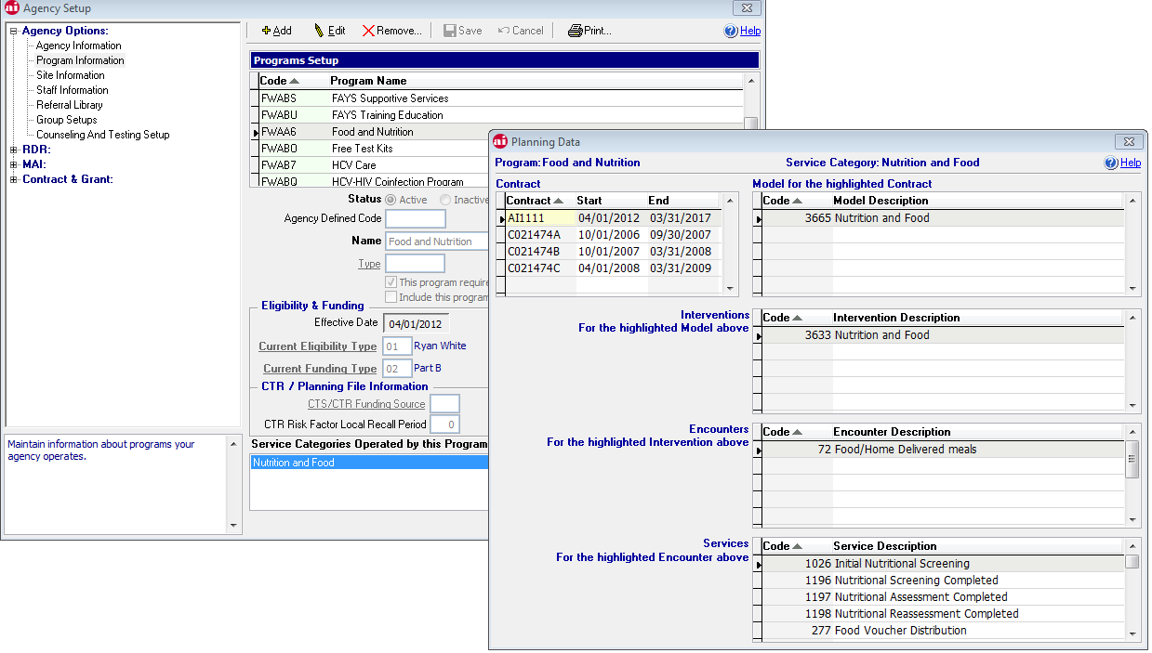
B: Organizing Data: Establishing Programs and Services for RW Funded Contracts and Managing Client Enrollments
Notes:
In order to ensure that only RW funded services are included, each RW contract is assigned a program for data collection, that program has a pre-identified set of encounters and services that restrict the program to only funded services. A file is sent from the state for each agency’s programs that sets up the service portfolio for the year.

Slide 21
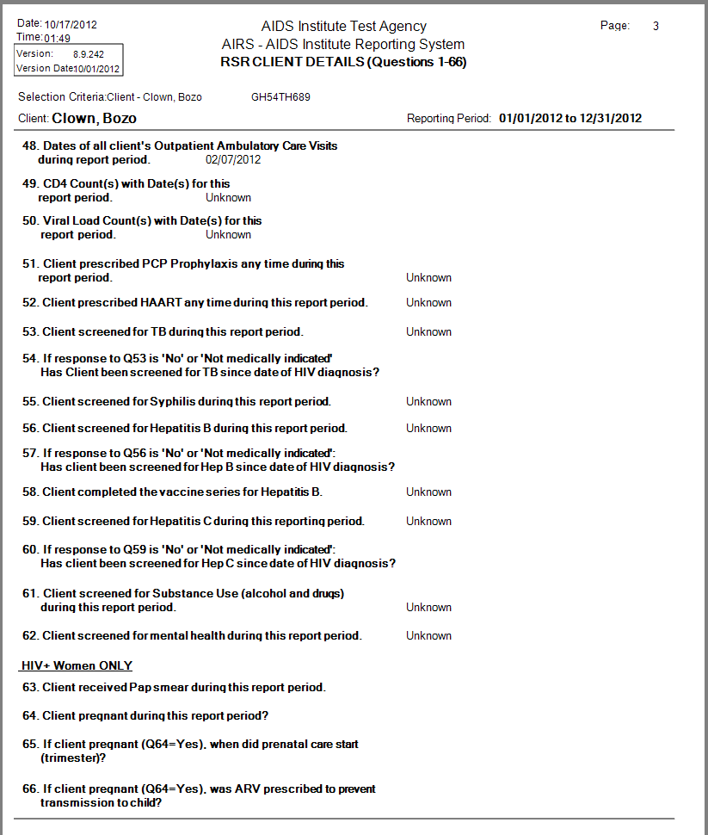
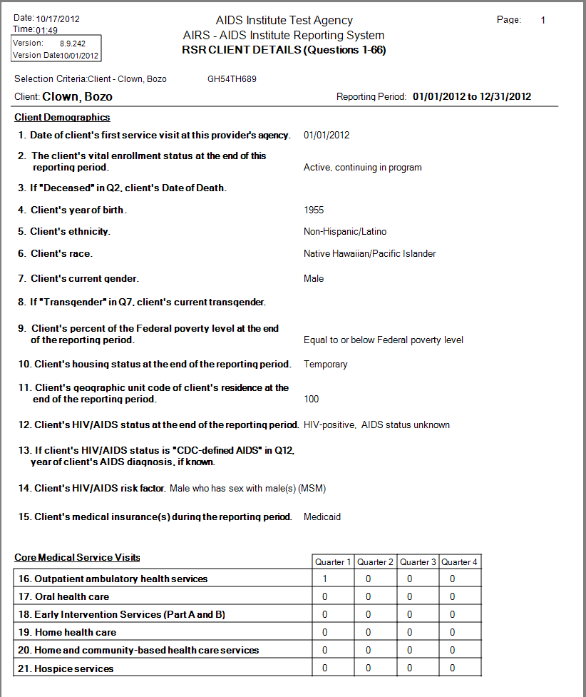
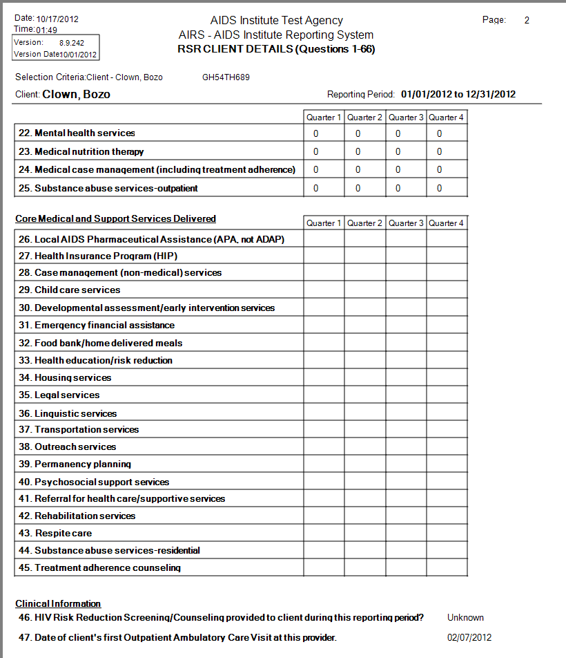
C: Using items A and B to ensure proper client selection and providing detailed review for accuracy
Notes:
Client specific reports that review the full RSR content that will be included in their CLD allow for ongoing data review and update. These reports can be run at any time during the report period as a status check.

Slide 22
Questions regarding Software Design as a tool for TA?

Slide 23
II. TRAINING AND TECHNICAL SUPPORT
From Niagara to Montauk:
Supporting Accuracy and Completeness

Slide 24
Training
Significant challenges to offering training across a large geographic area and diverse provider types
Level of experience and expertise with data entry and data management varies
Turnover at the agency level requires an ongoing training presence
Training specific to the RSR is offered to our Part B providers
Notes:
Delivering training in NYS has to address challenges of both geography and volume.

Slide 25
In-Person vs. Web Based
Opportunity for interaction, observation and feedback
Ease of communication between participants
Enhanced relationship with training staff
Opportunity for DOH staff to observe and interact
Less resource intensive at both DOH and provider level
Ease of access – no travel
Flexible on-demand schedule
Broad geographic coverage
“the personal touch”
“ease of implementation”
Notes:
Each approach, classroom training and web based, has their advantages.

Slide 26
NYSDOH does both
In-person trainings are offered in NYC on an on-going basis; Upstate trainings are offered twice per year
An in-person User Group meets monthly in NYC
A web-based User Group meets monthly
On-demand training videos are available on the support website AIRSNY.org
Special purpose web trainings are offered as needed (e.g. at RSR season)
Notes:
By combining training modes, and offering both on-demand and scheduled live web training, we are able to optimize our outreach and provide broader access while still providing direct interaction.

Slide 27
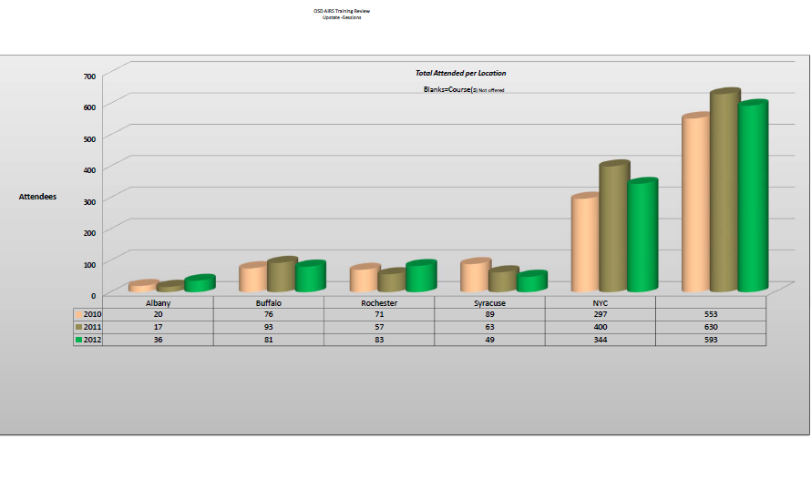
In-Person Training volume in NYS from 2010 - 2012
Notes:
In person training is offered statewide, and reaches between 500 and 600 persons per year. Basic training on data entry is one of the most popular courses due to turnover of data entry staff.

Slide 28
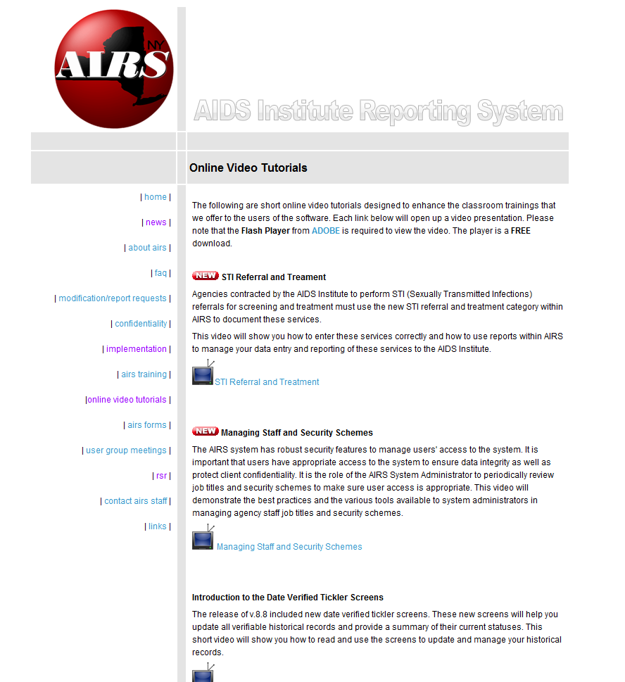
Web-based Training Videos are Available On-Demand at AIRSNY.org
Notes:
Several on-demand training videos are offered on AIRSNY.org. These provide both an opportunity for staff who can’t travel to trainings and a refresher for existing end-users. They also give an opportunity to highlight special topics or new programmatic initiatives.

Slide 29
Technical Support
Technical support is critical for all steps in the data collection, data entry and data reporting process
The level of support can range from basic (providing forms, instructions, documentation) to advanced (one-on-one phone support, site visits, web-based support on specific issues)
Technical Support is resource-intensive
Notes:
Technical support for NYS focuses primarily on effective use of the AIRS software and good data management practices. Without a specific software platform, technical support has to focus on requirements, documentation, and review of output from multiple sources.

Slide 30
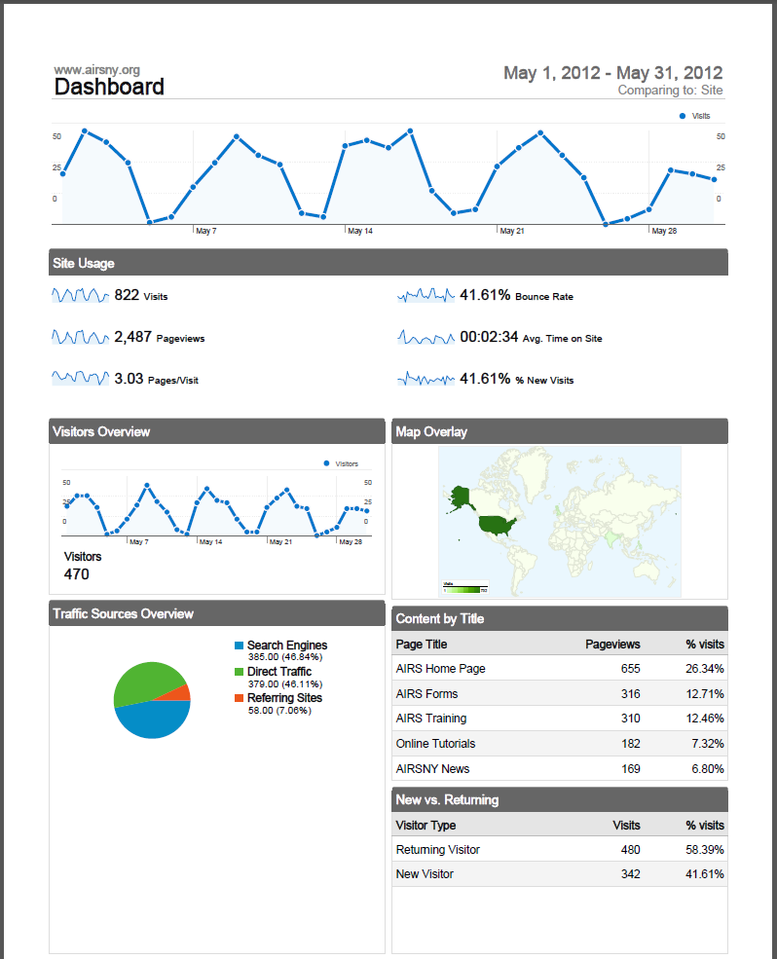
Traffic on the AIRSNY website shows providers are using the resource to obtain forms, sign up for training, and view video tutorials
Notes:
Use of the AIRSNY website as a platform for basic technical support (forms, tutorials, documentation) has enhanced our ability to get information out efficiently. Challenges include ensuring that everyone who should be reviewing and downloading content is doing so (keeping alert and distribution lists up to date, monitoring use).

Slide 31
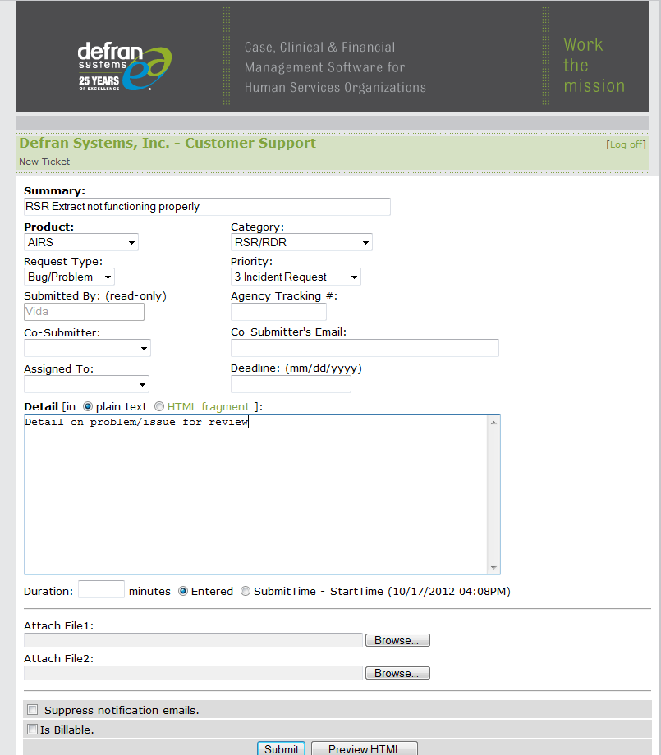
On-line technical support is available for all registered providers and staffed by the programming contractor under NYSDOH/AI funding
Notes:
Technical support for software use is essential. Monitoring issues identifies both software problems and areas of confusion that require training and documentation.

Slide 32
RESOURCES
Technical Support
Technical support combines all available resources: AIDS Institute staff responsible for data monitoring and reports; subcontracted TA/training staff; web based; phone based; in person
As resources decline, ability to perform one-on-one and on-site support declines and emphasis shifts to web resources and centralized TA
Use of web based or group TA alone is least resource intensive but has limited effectiveness due to limits of feedback, communication and assessment
Use of one-on-one support (phone or in person) has limited effectiveness due to lack of immediate response and availability
Notes:
The optimal approach is to provide as much in-person training and phone-based one on one support as possible given resources, and supplement these with webinars, group calls, and on-line resources.

Slide 33
Questions regarding Training and Technical Support?

Slide 34
III. FEEDBACK VIA DATA SUBMISSION AND REVIEW
Supporting Accuracy and Completeness

Slide 35
Methods for Feedback
Ongoing monitoring of reports and/or data submissions on key variables
Periodic review of complete YTD reports
Year end review prior to submission
Notes:
An ounce of prevention is worth a pound of cure. Ongoing monitoring saves a great deal of time troubleshooting problems at the end of the year, but can be extremely challenging given declining resources. Access to disparate systems to review a combined report can also be a challenge and very time consuming.

Slide 36
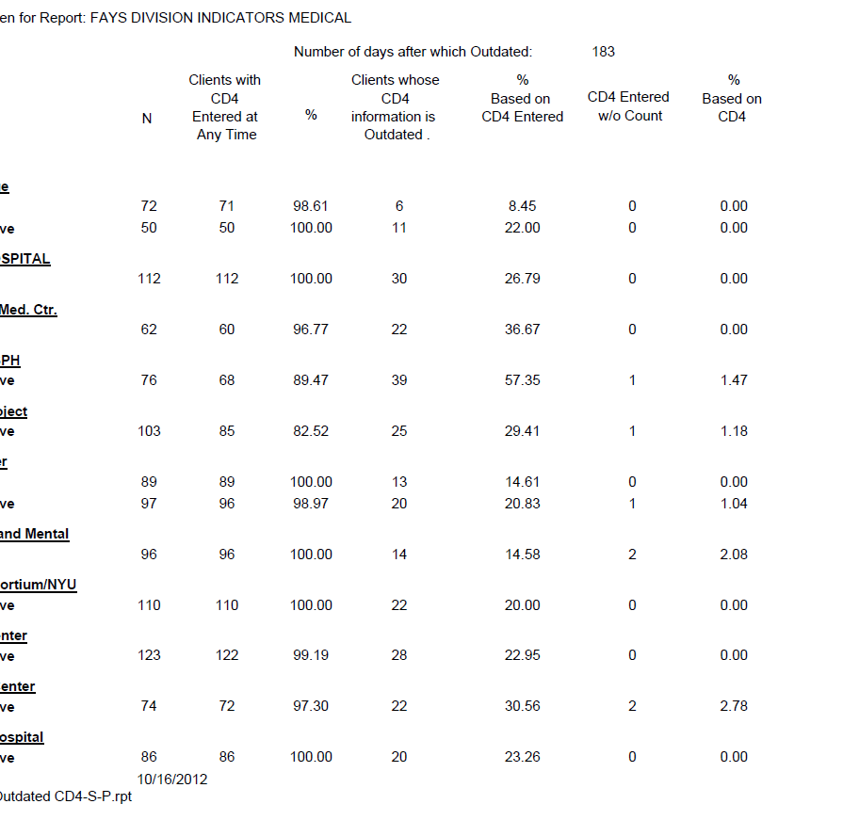
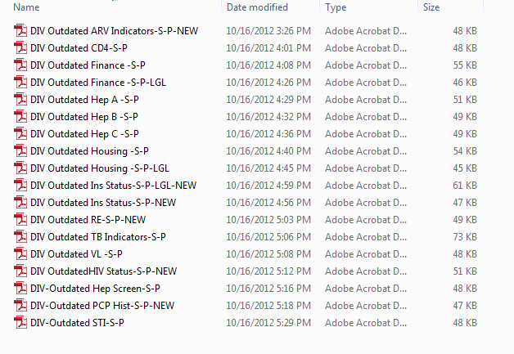
Program-specific Reports on CLD submitted to NYSDOH AIDS Institute Generated Quarterly
Notes:
Because the AIDS Institute collects CLD from all programs (RW included) on a monthly basis, we are able to monitor data completeness on an ongoing basis and provide feedback via contract management staff.

Slide 37
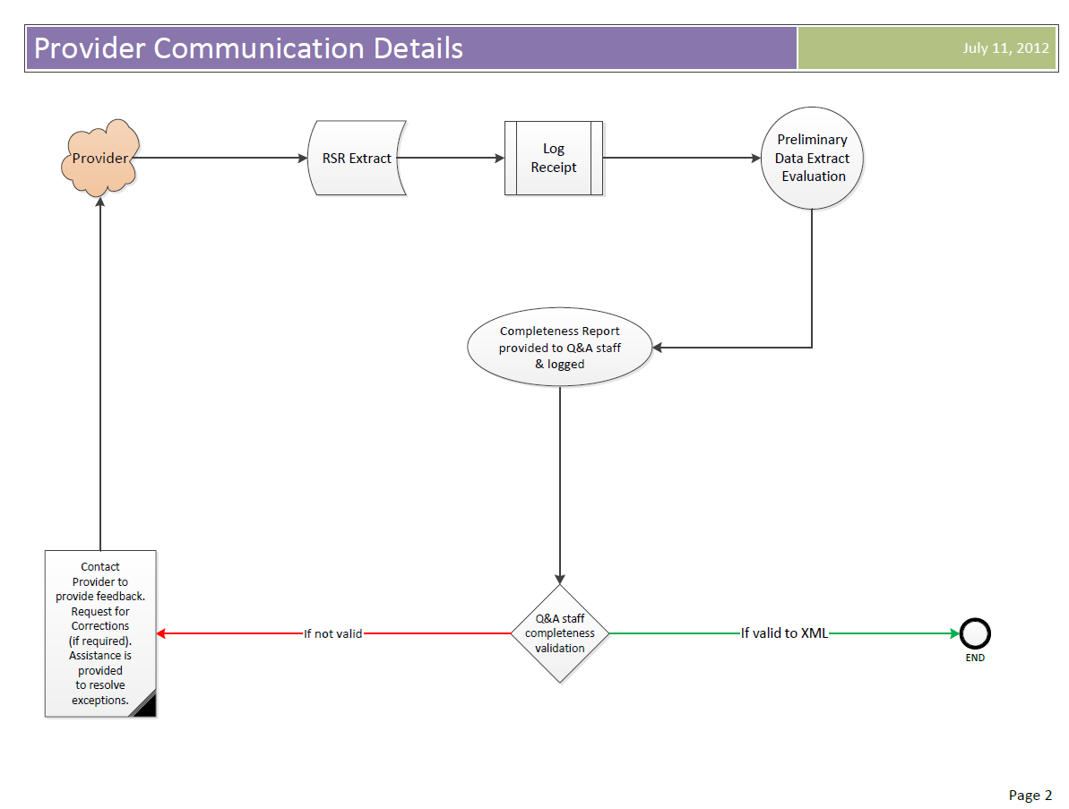
Feedback loop on Provider RSR Interim (and year end) Submission
Notes:
In addition, an interim RSR is collected once per year prior to the final report, to give providers a heads up on potential issues. A completeness report that mimics the HRSA report is generated.

Slide 38
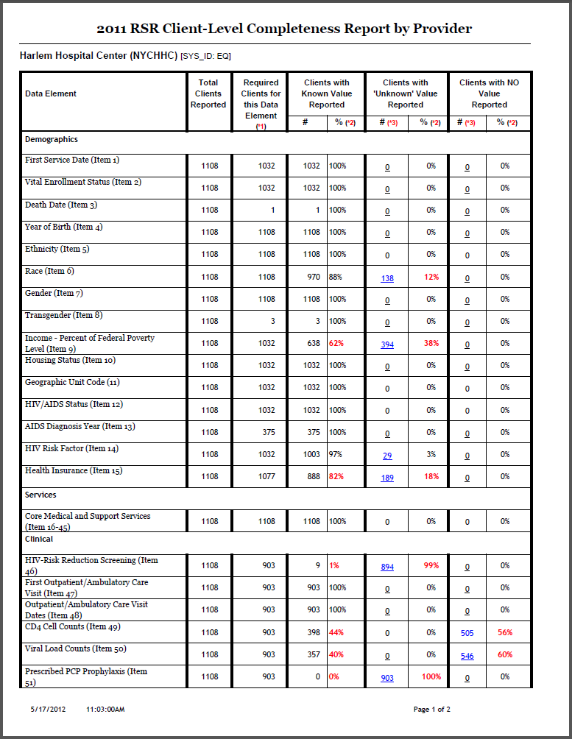
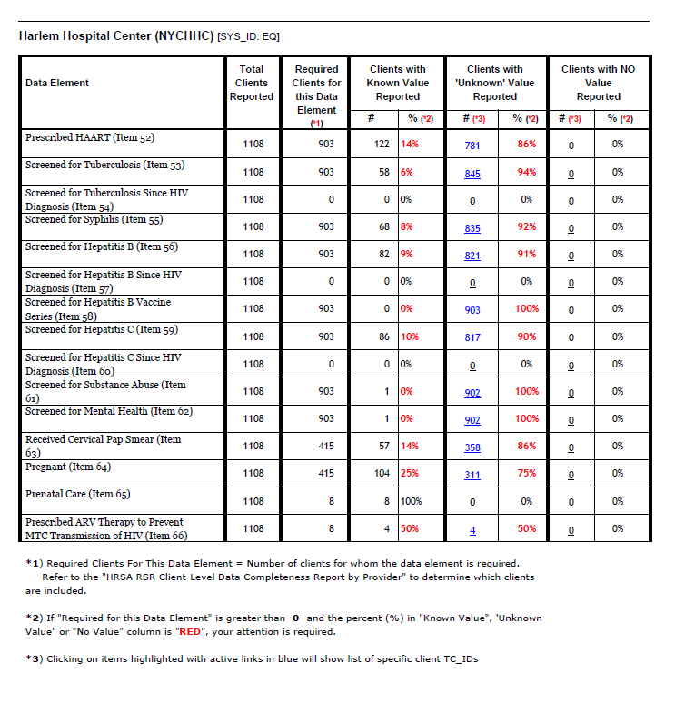
RSR Completeness Reports are Generated by the AIDS Institute (mimic HRSA reports)
Notes:
We are able to highlight areas of concern, and set standards that are at minimum as stringent as HRSA rules. Each provider that submits an interim RSR receives a completeness report within two days.

Slide 39
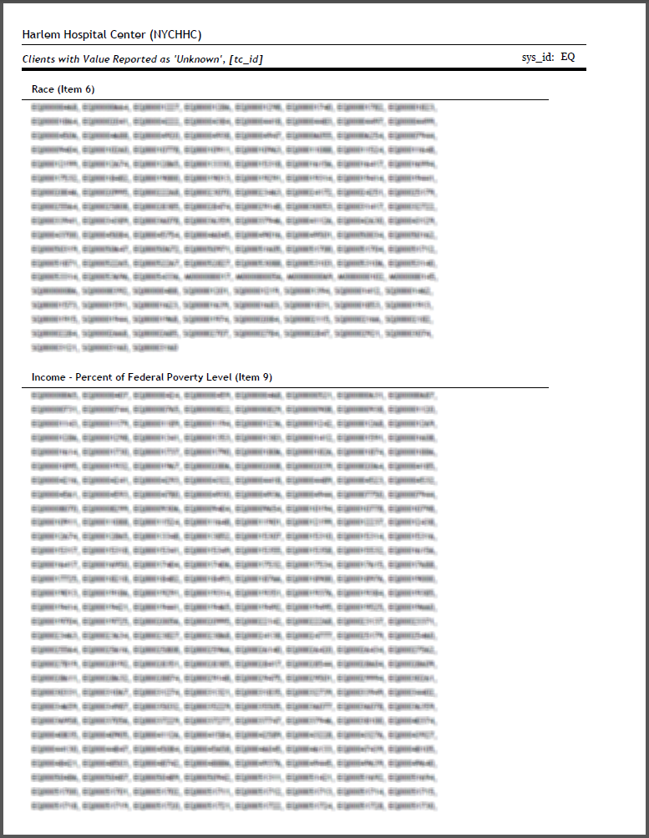
Detailed lists of the system level client ID (non identifiable) of clients with missing data can be sent back to the provider for troubleshooting, if the data comes from AIRSNY.
Notes:
The completeness report is only useful to providers if they can identify the client records that are missing information. The report generates lists of system IDs for each client with suspect data in the field indicated.

Slide 40
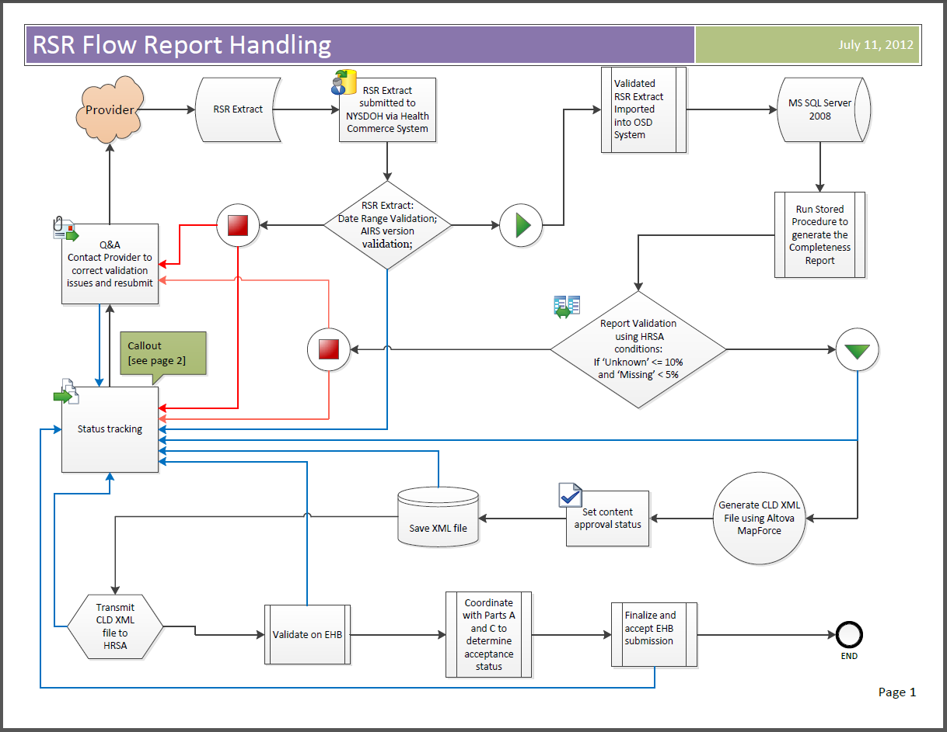
Grantee level RSR data handling and review – Feedback Loops
Notes:
For the final RSR submission, the feedback loop includes applying validations, ensuring that providers correct what they can, relaying the data to the EHB and coordinating submissions with other Grantees. Two levels of validation are applied.

Slide 41
Challenges to Feedback
Data from multiple systems outside of the influence of NYSDOH
Validation errors on data outside of NYS systems
Multiple points of contact within provider agencies
“Detective Work” in locating sources of issues in multiple systems at provider level with limited time
Notes:
Processing feedback, coordination of submissions, and handling errors are all resource-intensive. Data ‘silos’ make this even more challenging, and they exist at almost every level.

Slide 42
In Summary
Accurate and Complete Data depends on good systems for data collection, data entry and data management (software characteristics).
Using those systems effectively depends on training and technical support.
Review of submissions is the last stand of data completeness and cannot stand alone.

Slide 43
Final Q&A

Slide 44
FOR FURTHER INFORMATION, PLEASE CONTACT:
VIDA BEHN CHERNOFF, NYSDOH AIDS INSTITUTE vab01@health.state.ny.us
OR VISIT AIRSNY.org

