Slide 1
Expanding Access to HIV Oral Health Care: Measuring Performance and Achieving Outcomes
Jane Fox
Carol Tobias
David Reznik

Slide 2
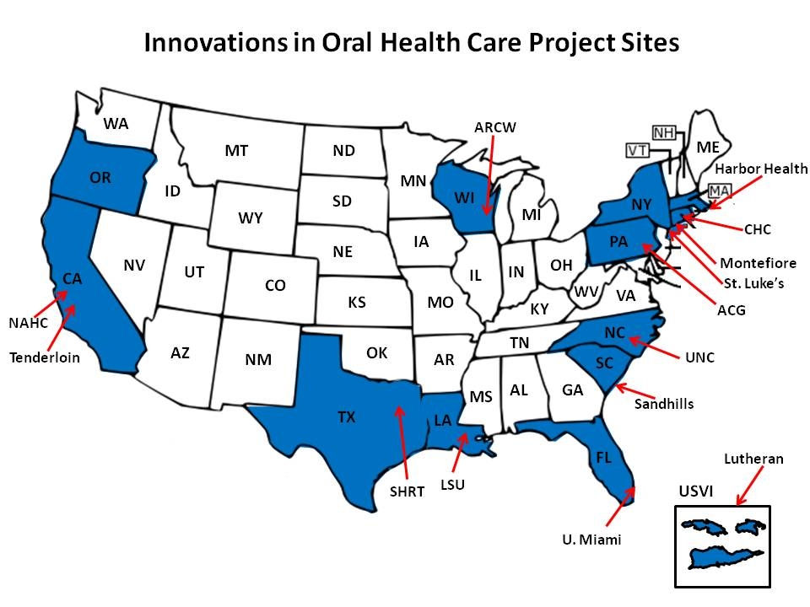
SPNS Sites
Notes:
Funded by HRSA in 2006 to increase access to oral health care for PLWHA
15 sites across the US.
2 in NYC, 2 in CA and one in USVI. The remainder are scattered.
BU was funded as the evaluation and technical assistance center

Slide 3
Models of care
Program Name | Program Model
AIDS Care Group | ASO with new satellite dental clinic
AIDS Resource Center of Wisconsin | ASO with new satellite dental clinic
Community Health Center of CT | CHC with new dental clinic
Harbor Health | CHC expanding dental services at existing site and creating a new clinic.
HIV Alliance | ASO/dental hygiene school collaboration with rural dental satellite clinics
Louisiana State University | University based program using a mobile dental unit
Lutheran Medical Center | University based training program creating a satellite clinic in the
Montefiore Medical Center | University based dental program using a mobile dental unit
Native American Health Center | FQHC medical and dental program expanding existing dental services
Sandhills Medical Foundation | CHC using a mobile dental unit
Special Health Resources for Texas | ASO with satellite clinics – expanded capacity
St. Luke’s Roosevelt Hospital | Hospital based HIV dental center expanding existing services
Tenderloin Health Center | CBO working in collaboration with SF Dept of Health to create a new dental clinic at the
University of Miami | University based program using a mobile dental unit
University of North Carolina | University hospital based dental clinic expanding existing services

Slide 4
Innovative Models
Dental Case Management
Person
Dental Assistant
HIV Case Manager
Tasks
Impact
Notes:
participants receiving more dental case management encounters were significantly more likely to complete their Phase 1 treatment plan at 12 months, be retained in oral care, and experience improvements in their overall oral health and mental health status.
Participants who received the most encounters (5 or more) were 2.73 times more likely to complete their treatment plan as compared to those who had the least number of encounters (one encounter) and nearly twice as likely to be retained in care

Slide 5
Innovative Models
Co-location of services
With medical care
With other essential services
Coordination with dental hygiene school
Address transportation barriers

Slide 6
Innovative Models
Coordination with dental hygiene school
Address transportation barriers
Notes:
One other notable method included the geographic location of services at private dental offices to reduce patient stigma in accessing care.

Slide 7
Patient Education
Formalized program
Patient education video and individual session
Other methods
Chairside
Travelling
Notes:
Video and session was NC
Chairside occurred but not consistent across sites.
Some sites trained their hygienist and/dental assistant in MI to better conduct Pt Ed
Sites who provided van transportation of patients to appts used the time in the van to conduct informal patient education sessions on OH self care and HIV topics.

Slide 8
Success & Sustainability
Success
Multiple strategies to address patient barriers to engage and retain in oral health
Sustainability
10 of 15 projects
Level of sustainability varied
3 of the 4 van projects were not sustained
Notes:
Those sites that were most successful in engaging and retaining patients in oral health care, were the sites that used multiple strategies – patient navigation, transportation, co-location of services both medical and social services.
Sustainability past the project period varied by site.

Slide 9
Sustainability
Methods of sustainability
Ryan White
Foundation funding
Expansion of services to a paying/insured population

Slide 10
How did we measure performance?
Lack of validated performance measures in the field
Consensus indicators
Receipt of a comprehensive exam
Phase 1 Treatment Plan completion
Patient placed on recall

Slide 11
Phase 1 Treatment Plan Treatment of active dental and periodontal disease, including
Restorative care (e.g. fillings)
Basic periodontal care (non-surgical)
Simple extractions and biopsies
Non-surgical endodontic therapy
Space maintenance and tooth eruption guidance

Slide 12
What happened?
*33% of patients completed treatment plans in the first year
Notes:
Most of the patients enrolled in care and the study received a comprehensive exam – 89%. Which is good. About 350 people – 17% of the sample – came in for care once and never came back, so it may be that these individuals came in for the relief of pain and when that was taken care of, did not come back for a comprehensive exam, which would include xrays, an oral exam and a cleaning.
42% of the patients completed their phase 1 treatment plan, 33% of them in the first 12 months. This is a new HRSA performance standard.
And 37% were placed on recall, after their treatment plan was completed, and came back in for routine care.

Slide 13
Wide Variation in Phase 1 Treatment Plan Completion Rates
Notes:
Wide variation across sites in terms of treatment plan completion rates – from 3% on the low end to 73% on the high end.
Clearly, tx. Plan completion was not an explicit goal for some of the programs, rather, getting people in and alleviating immediate problems was a more important goal. Where there are limited resources and so much unmet need there is a real struggle between the priorities of reaching the maximum number of people and providing the highest quality of care to those you are able to treat.

Slide 14
Access to Care
60% came in for treatment of a problem
29% to have teeth filled or replaced, 21% for relief of pain
40% came in just for an exam or cleaning
Notes:
This 40% reported having no other problem, they just wanted a cleaning or checkup

Slide 15
Changes in Oral Health Habits (N=1391)
Habit | Baseline | 12 mos | p value
Daily brushing | 83% | 82% | .407
Flossing at all in past 6 months | 53% | 62% | <.001
Current smoker | 50% | 45% | <.001
Eating candy or chewing gum with sugar | 61% | 52% | <.001
Drinking soda with sugar | 64% | 31% | <.001
Grinding teeth | 31% | 25% | <.001
Notes:
Carol
We saw some significant changes in habits related to oral health over a 12 month period.
No significant change in brushing habits, but flossing habits increased significantly. Still not great, but an improvement.
A small but significant change in smoking.
Larger changes in sugar consumption – via candy, gum or soda, and a significant change in teeth grinding.

Slide 16
Significant Changes in Outcomes at 12 Months
Outcome | Baseline | 12 Mos.
Report unmet need for oral health care | 48% | 17%
Report good/excellent health of teeth and gums | 38% | 67%
Oral health symptoms: mean (SD) | 3.35 (2.34) | 1.78 (1.93)
Notes:
Other significant changes included a reduction in unmet need for oral health, improvement in the overall health of peoples’ teeth or gums and the total reduction in symptoms.

Slide 17
Changes in Oral Health Symptoms at 12 Months (N=1391)
Notes:
We also found significant reductions in oral health symptoms over 12 months, as we would hope to find. All of these were significant at p<.001

Slide 18
Retention in Care
64% of patients were retained in care
Those retained in care were:
More likely to complete their treatment plan
More likely to have a recall visit
Reported less pain, fewer symptoms at follow up
Factors significantly associated with retention
Older age, better physical health, on HIV medications, more recent dental visit
Receipt of patient education – 6 times as likely to be retained in care
Notes:
Retention defined as 2 or more dental visits at least 12 months apart during an 18 month or greater observation period
Interestingly, in the field of dental care as compared to medical care – retention in care does not have the same stature as a goal of practice or service delivery. Filling appointment slots and reducing no-shows is an important goal, but retention of any individual patient is less so.
In multivariate analysis controlling for clustering by site and other factors significantly associated with retention in bivariate analysis, a number of factors were significantly associated with retention in care, but one really stood out – the receipt of patient education.

Slide 19
The question…
Studies have looked at how several systemic conditions affect Oral Health Related Quality of Life (OHRQOL), including HIV/AIDS.
This is the first study to look at how access to dental care over a period of time impacts OHRQOL as well as mental and physical well-being
Notes:
David

Slide 20
SPNS Oral Health Initiative Oral Health Related Quality of Life (OHRQOL)
Study eligibility: HIV+, > 18 years old and not having received dental care for at least one year – except emergencies.
Patients received dental services at no cost.
Data were collected from 783 HIV-infected adults who received care at one of the HRSA SPNS oral health initiative sites.

Slide 21
SPNS Oral Health Initiative Oral Health Related Quality of Life (OHRQOL)
All individuals who reported “poor” or “fair” oral health in response to the question “How would you rate the overall health of your teeth and gums?” at baseline, and had a complete answer to this question at twelve month follow up, were included.

Slide 22
Variables
The primary dependent variable was improvement or no improvement in OHRQOL
Secondary dependent variables included change in physical health status as measured by the physical component score (PCS) of the SF-8 and change in the mental health component score (MCS) of the SF-8.

Slide 23
Variables – Oral Health Status
Oral health status was measured on a 4 point likert scale from poor to excellent. Then dichotomized as “improvement” or “no improvement” over time.

Slide 24
Variables - Dental Service Utilization
Dental Service utilization variables consisted of a continuous measure of the number of clinic visits.
Also included was whether or not the patient completed the Phase 1 portion of their treatment plan (elimination of pain and infection).

Slide 25
Variables - Dental Service Utilization
The number of the following services provided were included due to their importance in eliminating pain and infection, restoring function, and improving appearance.
Cleanings
Restorative care (i.e. fillings)
Periodontal services (gum work)
Oral surgery services (e.g. extractions)
Crowns and fixed bridgework
Removable prosthodontic services (e.g. complete and partial dentures)

Slide 26
Description of the Sample
Male 73%
Non-white 65%
Born in the continental U.S. 77%
High school education or greater 76%.
Income of less than $850/month (FPL for an individual) 54%
Stably housed 58%
Mean age was 44 years.
Smoked cigarettes at baseline 59%
A history of using crack/cocaine, crystal methamphetamine or marijuana 73%

Slide 27
Description of the Sample
Participants reported a mean of 4.1 dental symptoms in the year prior to the study.
Reported knowing their HIV status for over 125 months (10 ½ years).
53% had an undetectable HIV viral load
The mean PCS was 46.5 at baseline and the mean MCS was 45.2, both below the normed average of 50 at baseline.

Slide 28
Results of the Bivariate Analysis
69% reported an improvement in their OHRQOL!
31% reported no improvement or a decline in OHRQOL.
Of the 31%, the vast majority (87%) experienced no change and 13% experienced a decline in OHRQOL

Slide 29
Factors Associated with Significant Improvement in OHRQOL
Being born outside of the U.S.
A high school education or more
Not smoking
No history of illicit drug use
Having fewer dental symptoms
Having an undetectable viral load

Slide 30
Factors Associated with Significant Improvement in ORHRQOL
Individuals with higher PCS and MCS at baseline
Those whose PCS score improved significantly at 12 months.

Slide 31
Relationship Between change in OHRQOL and HRQOL in Multivariate Analysis
Improvement in OHRQOL at 12 months was significantly associated with improvement in both physical and mental health status at 12 months, as measured by the PCS and MCS after controlling for all other variables.

Slide 32
Relationship Between change in OHRQOL and HRQOL in Multivariate Analysis
Individuals whose OHRQOL improved showed a substantial improvement in their PCS of 3.7 points as compared to individuals whose OHRQOL did not improve and an improvement in their MCS of 4.3 points as compared to those whose OHRQOL did not improve.

Slide 33
Relationship Between change in OHRQOL and HRQOL in Multivariate Analysis
Individuals born in the U.S. experienced a 1.6 point improvement in their PCS and a 2 point improvement in their MCS, compared to individuals from other countries.
Prior use of illicit drugs and having an undetectable viral load at baseline were the only other factors that resulted in more than one unit change in MCS or PCS.

Slide 34
Dental Service Utilization and OHRQOL at 12 Months
Individuals who received more extractions, restorative procedures, full or partial dentures, periodontal procedures, and cleanings were significantly more likely to experience improvement in their OHRQOL.

Slide 35
Dental Service Utilization and OHRQOL at 12 Months
Number of extractions | 1.10 (1.04, 1.16) | ≤0.001
Number of full denture procedures | 3.33 (1.88, 5.91) | ≤0.001
Number of restorative procedures | 1.13 (1.07, 1.21) | ≤0.001
Number of periodontal procedures | 1.16 (1.04, 1.29) | 0.009
Number of partial denture procedures | 1.44 (1.07, 1.94) | 0.017
Number of dental cleanings | 1.25 (1.01, 1.55) | 0.038
Notes:
The number of crowns or bridges, the number of clinic visits a person received, and the completion of a Phase 1 treatment plan were not significantly associated with improvement in OHRQOL.

Slide 36
Conclusion
This is the first study of PLWHA that measured OHRQOL prior to and after receipt of dental care.
Receipt of certain services, including removable prosthetics, extractions, restorative care and cleanings were significantly associated with improved OHRQOL.
Improvement in OHRQOL was significantly associated with improvements in mental health and physical well-being!

Slide 37
Contact Information
Jane Fox, MPH | Boston University | 617-638-1937 | janefox@bu.edu
David Reznik, DDS | Grady Health Systems | 404-616-9770 | dreznik@mindspring.com
Carol Tobias, MMHS | Boston University | 617-638-1932 | tcarol@bu.edu

