Slide 1
YES, SIRR! Creatively Collaborating to Serve the Incarcerated and Recently Released Ryan White 2012 Grantee Meeting: Navigating A New Era In Care Washington, D.C. November 27, 2012
Notes:
Steven

Slide 2
Welcome! Meet the Speakers
Steven Vargas-Moderator
Volunteer /Community Liaison/CBO Provider
Anna Henry
Planner
The Resource Group
Jennifer Hadayia
Health Planner
Ryan White Grants Administration/Office of Support
Janina Vasquez
Care Services Coordinator
Texas Department of State Health Services
Notes:
Steven

Slide 3
WHY ARE YOU HERE? Meeting your expectations
What Are You Expecting From This Workshop?
What Will Make This Workshop A Success For You?
Notes:
Steven

Slide 4
Why Should You Care?
HIV prevalence is still 3.8 times higher in correctional facilities compared to the general population.
Texas rates 3rd in number of HIV-infected inmates (in the states reporting data).
Notes:
Steven

Slide 5
Show of Hands
How many have worked with a client recently released from incarceration?
How many of you have received that client through a referral from HCJ or TDCJ/UTMB?
How many of you feel equipped to handle the added issues of your client’s criminal history?
Notes:
Anna

Slide 6
Challenges of Linking the RR Into Care
Culture of incarcerated system is much different than the expected self advocacy of the “free world”
Most Social Services Require Identification (Birth Certificate, Social Security Card, State ID, License)
Housing Options
Alcohol/Substance Abuse Issues
Lack of Social Support
Transportation
Language Barriers
Low Literacy
Maintaining Confidentiality Post Release
Unemployment
Mental Health Conditions
Notes:
Steven

Slide 7
Creatively Collaborating to Serve the Incarcerated and Recently Released: Mobilizing the HIV Provider Community
Anna Henry
Planner, East Texas HIV Administrative Service Area
Notes:
Anna

Slide 8
Background on SIRR
Born from the Linkage To Care Pilot Project
During the 2009 Standards of Care workshop, HCJ requested TRG facilitate a community meeting to increase the partners in the Linkage to Care Project.
In December 2009, TRG facilitated a stakeholders meeting at its office to discuss the expansion of the pilot project. Little did we know that 28 providers and community members showed up including representatives from DSHS.
Since then, the stakeholders meeting became the Serving the Incarcerated and Recently Released (SIRR) Partnership of Greater Houston.
Notes:
Steven

Slide 9
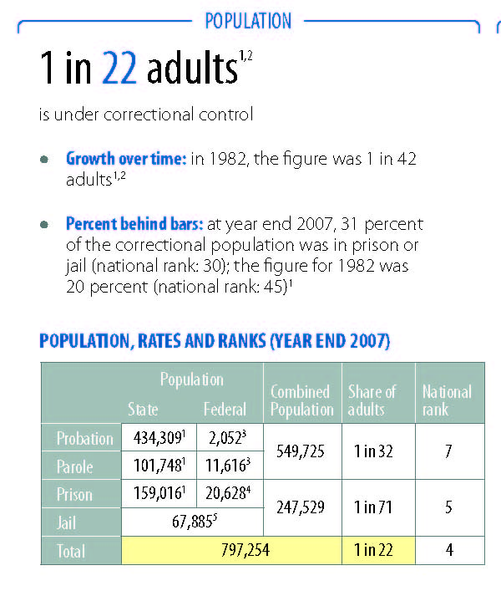
Corrections In Texas
1 in 22 Texans are under correctional control:
1 in 32 on Parole or Probation
1 in 71 in Prison or Jail
2.96 Billion spent on Corrections
One In 31: The Long Reach of American Corrections, The Pew Center On the States, March 2009: http://www.pewcenteronthestates.org/report_detail.aspx?id=49382
Notes:
Anna

Slide 10
Corrections In Texas: TDCJ
The Texas Department of Criminal Justice (TDCJ) manages one hundred and fourteen (114) facilities including seven (7) privately operated correctional centers, five (5) privately operated state jails, two (2) privately operated Pre-Parole Transfer (PPT) facilities, and five (5) intermediate sanction facilities.

Slide 11
Corrections In Texas: HCSO
The Harris County Sheriff's Office is the largest sheriff's office in Texas and the third largest in the United States.
HCSO operates three facilities including:
The 701 Jail (also known as 701 North San Jacinto) is one of the largest detention facilities in the United States,
The 1307 Jail (also known as the 1307 Baker Street facility)
The 1200 Jail (as known as the 1200 Baker Street facility)
On average, the census of the HCSO facilities is approximately 10,000.

Slide 12
Mental Health At HCJ
There are approximately 500,000 adult Harris County residents who experience a mental health condition each year;
Approximately 140,000 of those suffer a severe mental illness, such as severe depression, bipolar disease and/or schizophrenia;
Almost half of adult Harris County residents who suffer from a severe mental illness could not access treatment;
And approximately 20 percent of inmates in the Harris County Jails have a history of mental illness.

Slide 13
THE HCJ EIS PROGRAM
Starting in 2001, The Resource Group funded two positions through State HIV Services funds to ensure that HIV-positive inmates received appropriate care while incarcerated.
The two care coordinators work for HCJ and coordinate with the contract medical providers.
In September 2010, a discharge planner position was added (a direct result of SIRR).
Notes:
Anna

Slide 14
Who Are We Serving
Texas Department of Criminal Justice (TDCJ)*
Harris County Jail (HCJ)*
*TDCJ Monthly Provider Report,
Month/Year | HIV+ Inmates
August 2011 | 2343
Year | HIV+ Inmates
2011 | 1097
Notes:
Anna

Slide 15
Who Are We Serving
Texas Department of Criminal Justice (TDCJ)*
Harris County Jail (HCJ)*
*TDCJ Monthly Provider Report,
Month/Year | HIV+ Inmates
August 2011 | 2343
Year | HIV+ Inmates
2011 | 1097
Notes:
Anna

Slide 16
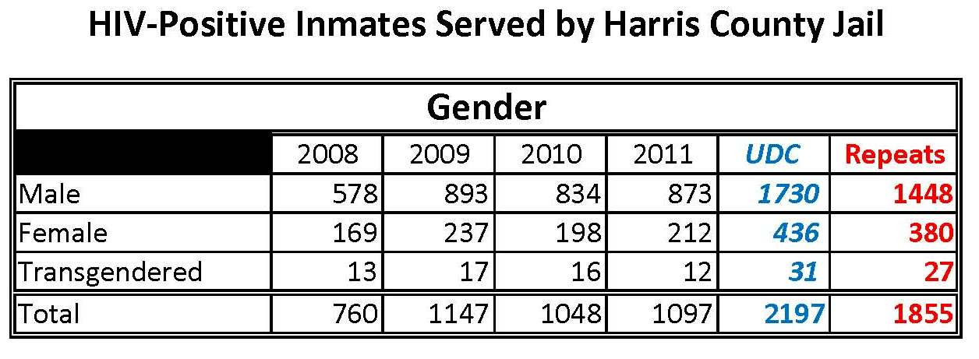
Who Are We Serving
Harris County Jail (HCJ)*
**AIDS Regional Information and Evaluation System (ARIES) 2012
Notes:
Anna

Slide 17
Care Services
Harris County Jail | Texas Department of Criminal Justice
In the event of a positive test result, the individual is offered treatment while at HCJ and meets with a Ryan White funded staff person who links the individual with care post release. Additional services include: Coordination of post release services is conducted Mini Blue Books are issued Community Service Linkages Workers meet with the inmate while incarcerated. Texas HIV Medication Program applications are completed | In the event of a positive test result, the individual is offered treatment while at TDCJ. 60-90 days prior to discharge a DSHS funded Linkage Worker starts pre-release coordination of services. Additional services include: Mini Blue Books are issued Texas HIV Medication Program applications are completed. Community Service Linkages Workers meet with the inmate while incarcerated.
Notes:
Anna

Slide 18
Prevention Services
Harris County Jail conducts Opt Out HIV testing at the 14 day inmate physical
Texas Department of Criminal Justice offers HIV testing upon entry and before release. Testing is also available by request. Peer Based HIV education programs are conducted (such as Wall Talk)
Notes:
Anna

Slide 19
Prevention Services
Testing at Texas Department of Criminal Justice*
Testing at Harris County Jail
*Data used with permission, Dr. David Paar TDCJ 2011
Year | Tests Conducted | Positive Tests Results
2009 | 119,939 | 673
2010 | 126,692 | 603
Notes:
Anna

Slide 20
Successes of SIRR
Mini Blue Books
SIRR Network
Active, engaged community advocates meeting monthly to help identify local gaps and barriers
Improved Outcomes
470/1108 or 42% (22%) accessed medical care after incarceration. This included 90 individuals who accessed medical care for the first time.
88/1108 or 8% of the clients utilized RW funds for medications.
Notes:
Anna

Slide 21
Creatively Collaborating to Serve the Incarcerated and Recently Released: The Role of Part B and State Health Departments
Janina Vasquez
Care Services Group Manager
Texas Department of State Health Services
Notes:
Jen

Slide 22
DSHS’S EFFORTS
Collaboration with SIRR
The SIRR Conference
Presentations at SIRR Meetings
Encouragement of DSHS-funded agencies to participate.
Local collaboration to engage recently released to develop Shell-Book life stories
Pocket Resource guides State wide
Notes:
Steven

Slide 23
Supportive Funding
HERR position in HCJ
Positions funded in TDCJ to conduct discharge planning and Medical HERR
Support of education- development of curriculum at TDCJ
Positions funded locally to support linkage to HIV medications and medical care.

Slide 24
Supportive Funding
More than just lip services:
MAI funds targeted to working with minorities released from prison/jail to effectively link into care and maintain medications
Mental Health/Substance Abuse funds (non-Ryan White) targeted to assisting individuals being released from prison/jail to effectively link into care and maintain medications

Slide 25
Texas HIV Medication Program
Healthy ADAP program
No wait list in Texas
Focus on maintaining medications
THMP Application
New application released June 1, 2012
Expedited applications for recently released
THMP Number on TDCJ scripts for refill
TDCJ allows 90-days of refill scripts
On-line ADAP 101 on TRAIN system

Slide 26
Creatively Collaborating to Serve the Incarcerated and Recently Released: The Role of Part A and the Planning Council
Jennifer M. Hadayia, MPA
Health Planner, Houston EMA/Part A
Harris County Judge’s Office
Ryan White Planning Council, Office of Support
Houston Area HIV Services Ryan White Planning Council
Notes:
Jen

Slide 27
Collaboration Timeline
Figure 1: Timeline of Core Collaborations between SIRR and Part A/Ryan White Planning Council for the Post-Release Offender (PRO) Population
FY09
FY11
FY12
Current
Service Definition
Funding Allocation
Monitoring
2011 HIV/AIDS Needs Assessment
“Mini Blue Book” and Interjurisdictional Resource Guides
Comprehensive Plan Design
Comprehensive Plan Activities
Consumer Survey
Provider Survey
Establishment of a PRO Linkage to Care System
Tailored Assessment of PRO Needs
Systems-Wide Improvement Planning for PRO
Evaluation of PRO Linkage System
Notes:
Jen

Slide 28
Establishment of Linkage to Care System
Local tailoring of the Early Intervention Services (EIS) Service Category
Focus on PLWHA in Harris County Jail
Purpose: to facilitate linkage to care at community-based ASOs post-release
Planning Council annually approved allocation ($166,211) of State of Texas Matching Funds (State Services) for EIS Service Category (FY09 to present)
Service utilization data collection and monitoring via Part A centralized data management system/CPCDMS
Review of UDC and other service utilization reports by RWPC in ongoing planning activities
Figure 2: Total Client Utilization of EIS Targeted to the Incarcerated in Harris County Jail, Per Year
*Reporting time period changed from fiscal year (FY) to calendar year (CY)
Notes:
Jen

Slide 29
Tailored Assessment of PRO Needs
Inclusion of and analysis by PRO population in community-wide HIV/AIDS Needs Assessment (beginning 2011)
“During the past year, have you been released from jail or prison?”
19% met definition of PRO
72% reported it was easy to get HIV medical services; 17% said they had difficulty
61% reported that it was easy to get HIV medications; 22% said they had difficulty
60% reported it was easy to get case management; 20% said they had some difficulty
Of all services queried, the PRO population reported difficulties accessing medical nutritional therapy, mental health services, and substance abuse treatment more often than other groups
Design and production of “Mini Blue Book” and interjurisdictional resource guides for PRO
Notes:
Jen

Slide 30
Systems-Wide Improvement Planning
HRSA guidance for 2012 Comprehensive HIV plans (May 2011)
Grantees must include “[s]trategy, plan, activities (including responsible parties) for addressing the needs of special populations including but not limited to: adolescents, injection drug users, homeless, and transgender.”
Special Populations Workgroup expanded focus and composition
Figure 3: Structure Used to Develop the Houston Area Comprehensive HIV Prevention and Care Services Plan for 2012 - 2014
Notes:
Jen

Slide 31
Systems-Wide Improvement Planning
Strategy 3: Strategy to Address the Needs of Special Populations
Goals
Prevent New HIV Infections among the Special Populations of Adolescents, Homeless, IRR from jail or prison, IDU, MSM, and Transgender
Reduce Barriers to HIV Prevention and Care for the Special Populations of Adolescents, Homeless, IRR from jail or prison, IDU, MSM, and Transgender
Strengthen the Cultural and Linguistic Competence of the HIV Prevention and Care System
Solutions
Infuse the HIV prevention and care system with policies, procedures, and other structural solutions that ensure equal treatment of all people living with or at risk for HIV
Fill gaps in targeted interventions and services to better meet the HIV prevention and care needs of vulnerable populations
Improve data management systems to better reveal information on the HIV epidemiology, risks, outcomes, and needs of historically under-sampled populations
Activities
Notes:
Jen

Slide 32
Systems-Wide Improvement Planning
Benchmarks
Reduce the number of new HIV infections diagnosed among each Special Population by 25 percent:
IRR from jail, from 1,097 to 822
IRR from prison, from 137 to 102
Increase the proportion of newly-diagnosed individuals within each Special Population linked to HIV clinical care within three months of their HIV diagnosis to at least 85 percent:
Incarcerated in jail, maintain at 100 percent
Recently released from jail, from 62.0 percent to 85 percent
IRR from prison, baseline to be developed
Prevent increases in the proportion of individuals within each Special Population who have tested positive for HIV but who are not in care (Ryan White HIV/AIDS Program Unmet Need Framework):
IRR from jail, baseline to be developed
IRR from prison, baseline to be developed
Maintain the percentage of frontline HIV prevention and care staff receiving annual cultural competence training at 100 percent
Notes:
Jen

Slide 33
SIRR Survey
SIRR is conducting a survey of consumers and providers in October and November. The survey will be used to evaluate outcomes of the linkage to care project from the community and provider perspective.
Consumers: Individuals released from prison or jail in the last 12 months
Providers: Agencies who have served the recently released in the last 12 months and members of the correctional system who would have made community referrals.
Notes:
Anna

Slide 34
SIRR SURVEY PRELIMARY DATA To be inserted later
Notes:
Anna

Slide 35
CONTACT INFORMATION
Steven Vargas
svargas@aama.org
Anna Henry
Ahenry@hivresourcegroup.org
Jennifer Hadayia
Jennifer.Hadayia@cjo.hctx.net
Janina Vasquez
Janina.Vazquez@dshs.state.tx.us
Notes:
Steven

Slide 36
Q & A
Notes:
Steven

