Slide 1
Psychotherapeutic
Support Group for Women
A Ten Year Retrospective
Bruce Schaffer, MA
Ann Ferguson, MSN, RN
AIDS Care Group

Slide 2
History of the group
ACG began in 1998
Leadership support for MH services from the start
Volunteer psychiatrist for 2 years
Funding from Part C allowed for growth of Mental Health Services
Funding then followed from Part D

Slide 3
History of Group
Major leadership support for psychosocial services from the agency’s inception in 1998
Dr. Berman suggested group for women – saw need for disenfranchised women to form group / community / support system

Slide 4
Group design
Dr. Berman defined the need for group
Identified co-facilitators
1 male / 1 female
1 therapist / 1 nurse
Women showed the greatest need

Slide 5
May 2003
Met at medical office
Set rules
Established format:
  Trained facilitator
  Transportation
  Food
  Reminder calls / letters

Slide 6
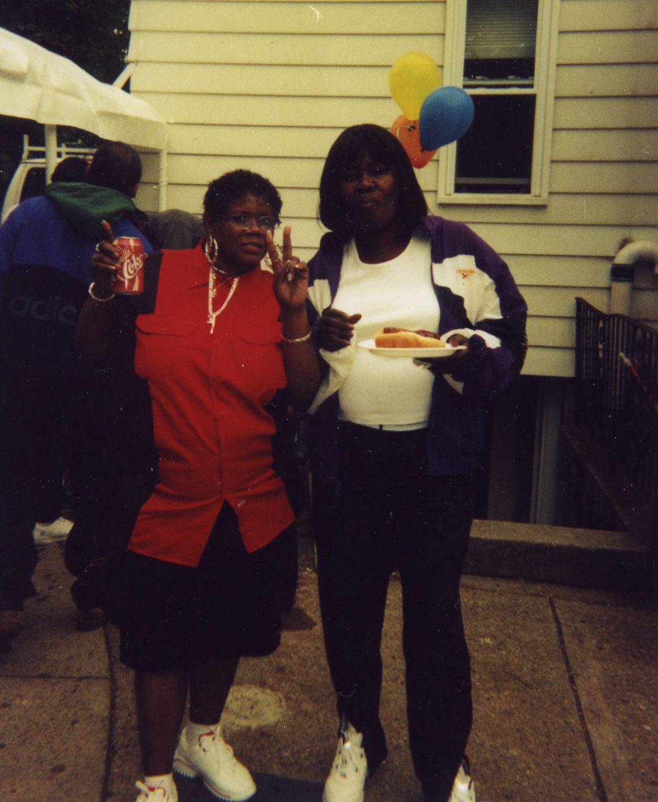

Slide 7
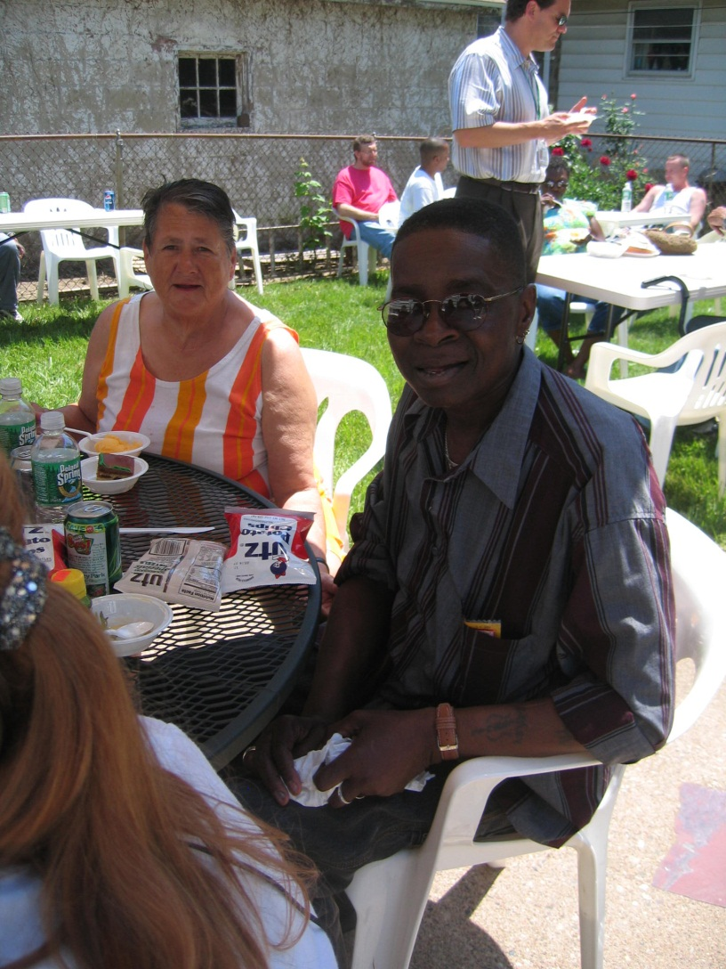

Slide 8
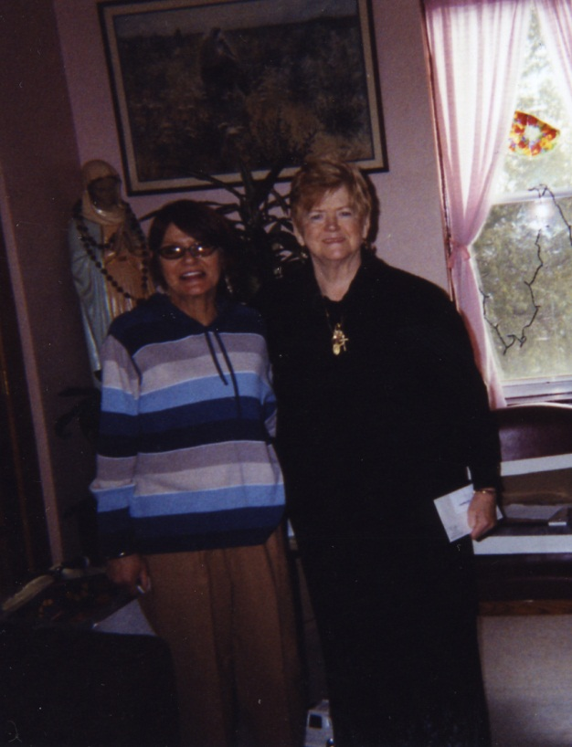

Slide 9
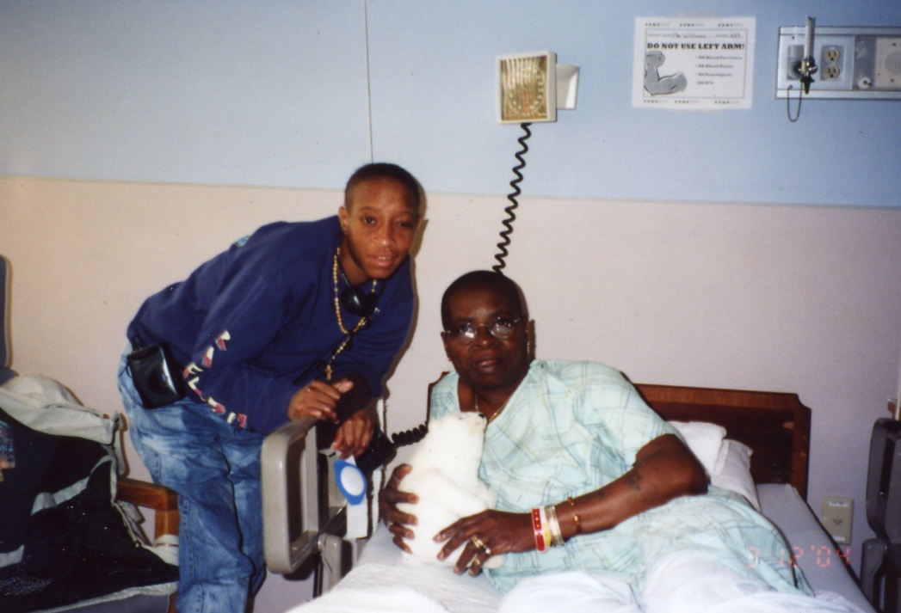

Slide 10
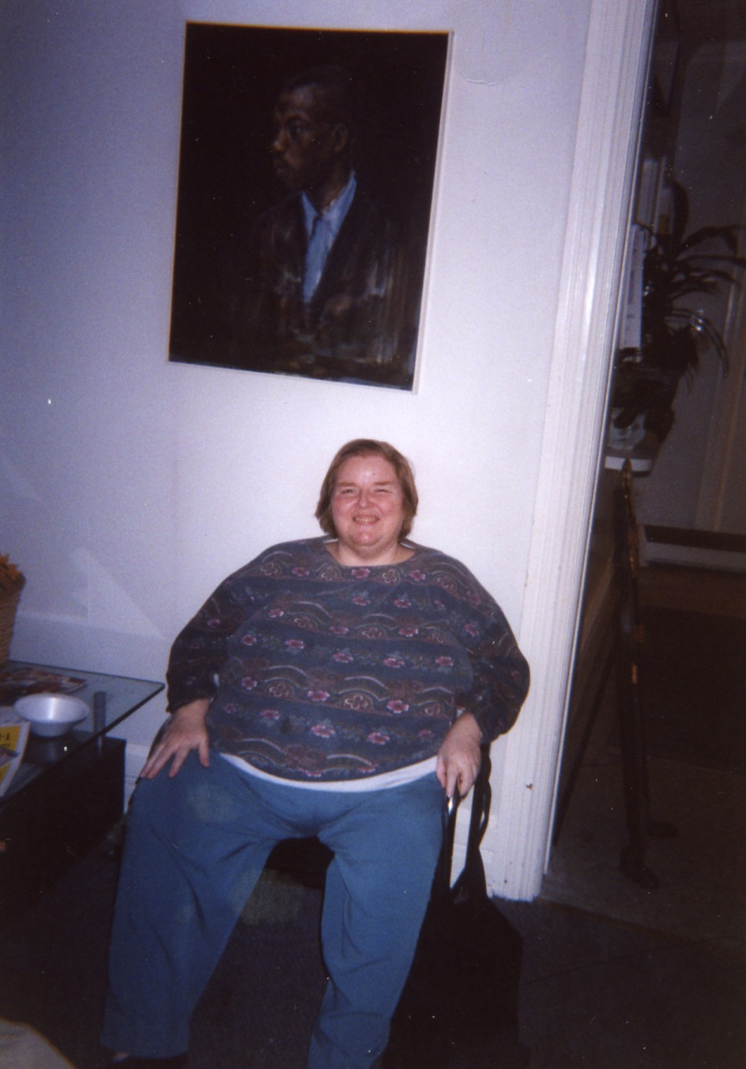

Slide 11
Goals
Facilitate self-improvement
Encourage behavioral change
Adherence to care
Help client understand consequences or potential consequences of behavior
Educate about disease
Educate about prevention
Empower consumers

Slide 12
Objectives
Primary therapeutic modality: group therapy
Additional: individual therapy
Client, family and community focus
Focus: values, attitudes, behavioral change
Self care, responsibility, accountability, respect of self and others, commitment

Slide 13
Structure
Provide:
  Transportation
  Food
  Support
  Reminders

Slide 14
Group Format
Ground rules:
Respect for each other
Confidentiality
“I” statements – not “we” statements
Constructive criticism / feedback
Providing alternatives
Overlap with addictions groups

Slide 15
Format
Why male to co-facilitate women’s group?
Why bi-weekly?
Why format / rules?
Teach them to be group members

Slide 16

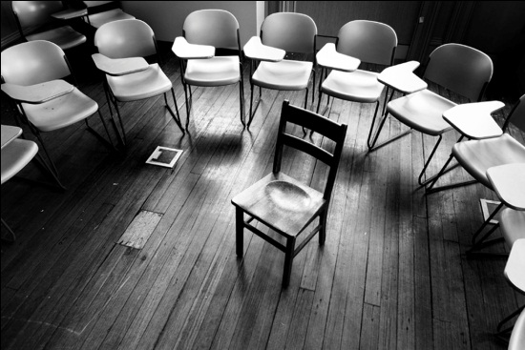
Format
Introduction to group rules
Rocks
Phone lists / contact information shared

Slide 17
Format
Food before group
Celebration of anniversaries, birthdays
Children attend when they need to
End with holding hands, serenity prayer and hugs

Slide 18
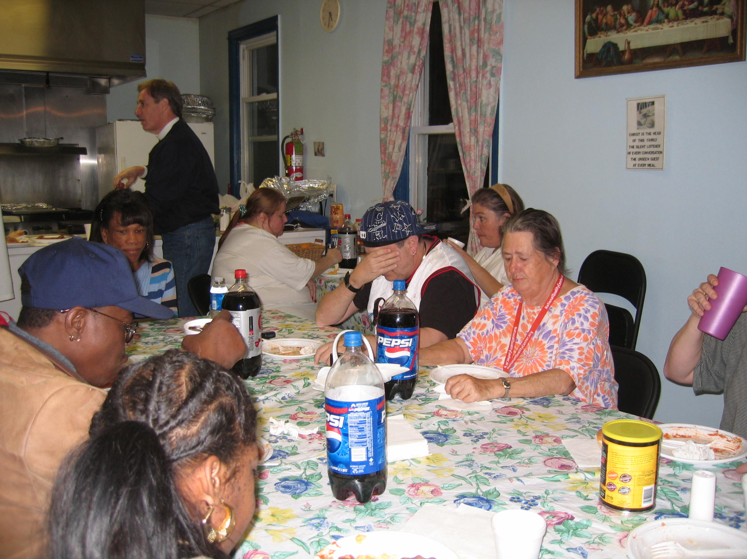

Slide 19
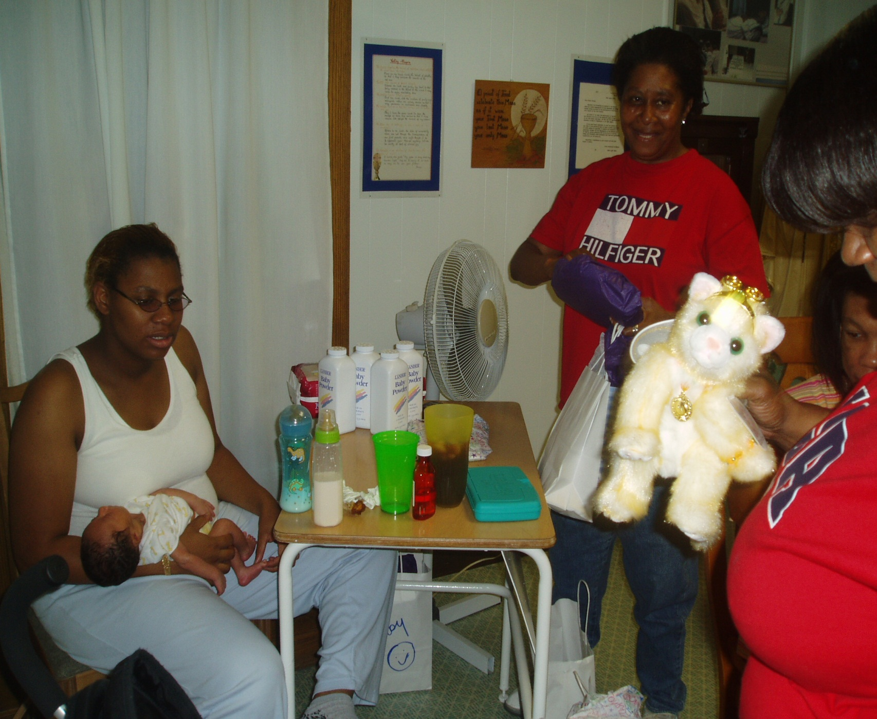

Slide 20
Group structure
Open with poem
Moment of silence
Introductions
Introduction of new members
Who needs to talk?
Who wants to talk?
Update on group members not attending
Focus on new members first

Slide 21
Group rules
What happens in the group stays in the group.
Respect other people’s time
Provide feedback

Slide 22
Action Steps
Unconditional positive regard
Conducive environment for relating, sharing and becoming open to being educated
Navigation of client resistors
Validation, encouragement and support of self-efficacy

Slide 23
Principles/strategies modified from motivational interviewing
Express Empathy – listen without judgment
Facilitator: genuine, real and always aware of maintaining a safe environment
Conducive for individual expression and group connectedness

Slide 24
Develop Discrepancy
Help consumers identify, understand and develop a plan to make behavioral changes
Use: exploration, examination to point out discrepancies and explore consequences
Result: action plan for consumer

Slide 25
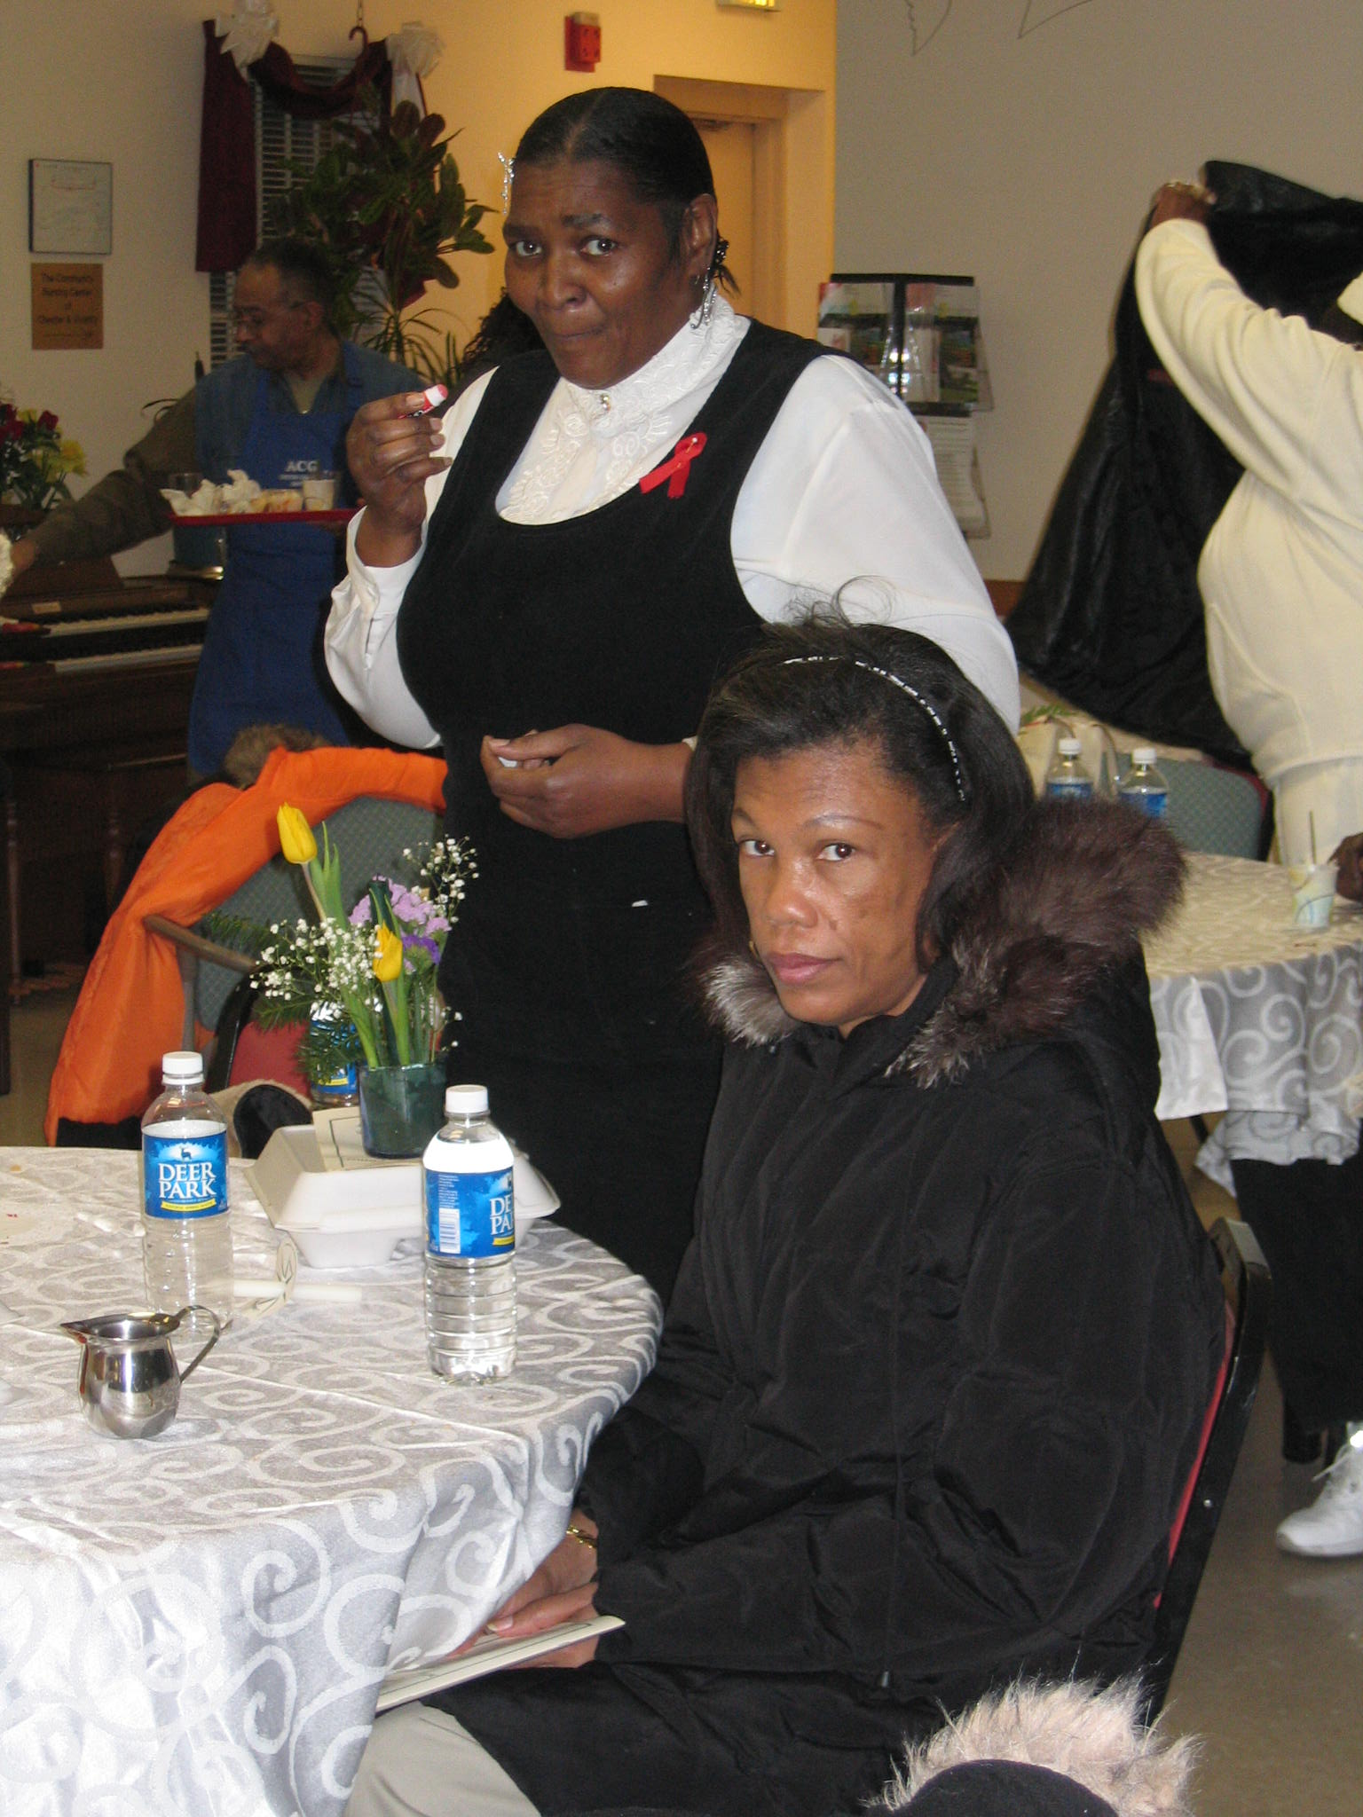

Slide 26
Avoid Argumentation
If resistance is sensed – shift strategies
Important to maintain motivation
Most people will not be motivated to change if they feel they are not supported – or must defend their actions

Slide 27
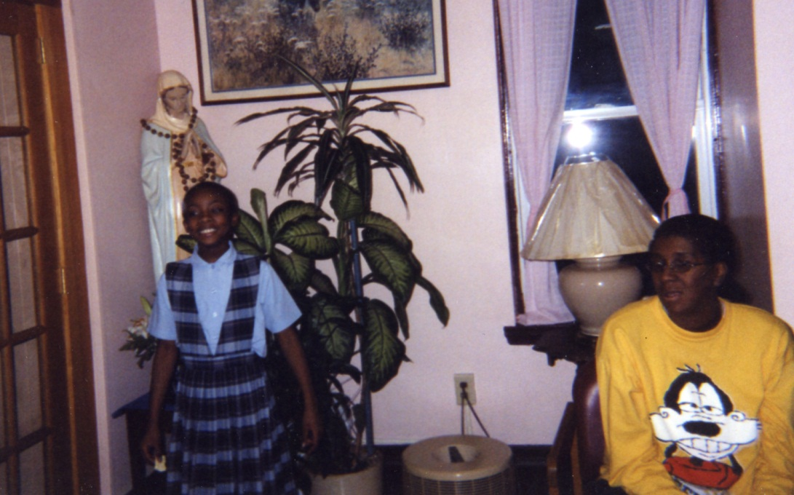

Slide 28
Roll with the Resistance
If there is resistance: face it don’t fight it
Employ empathetic communication skills:
Open ended questions, reflective listening, interpretation, feedback, alternatives
If consumer is less resistant – facilitator might educate or coach (role plays)

Slide 29

Support self-efficacy
Facilitator will support consumer’s confidence in her ability to make and maintain positive changes
Will present consumers with examples of positive changes; praise, validate and affirm

Slide 30
Major successes
Group cohesiveness
Sense of community
Support through:
  Deaths
  Incarcerations
  Anniversaries
  Relapses
  Bad relationships
  Hard times

Slide 31
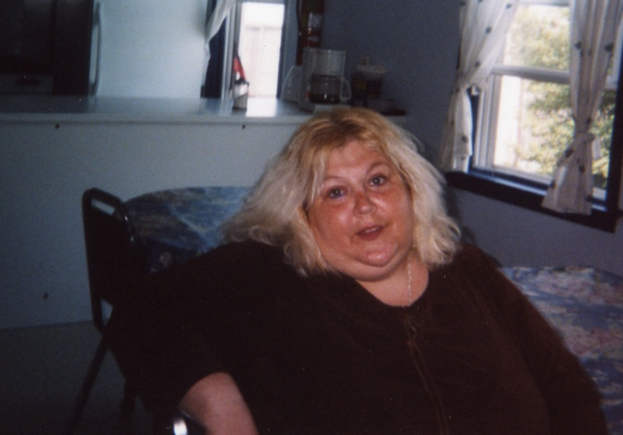

Slide 32
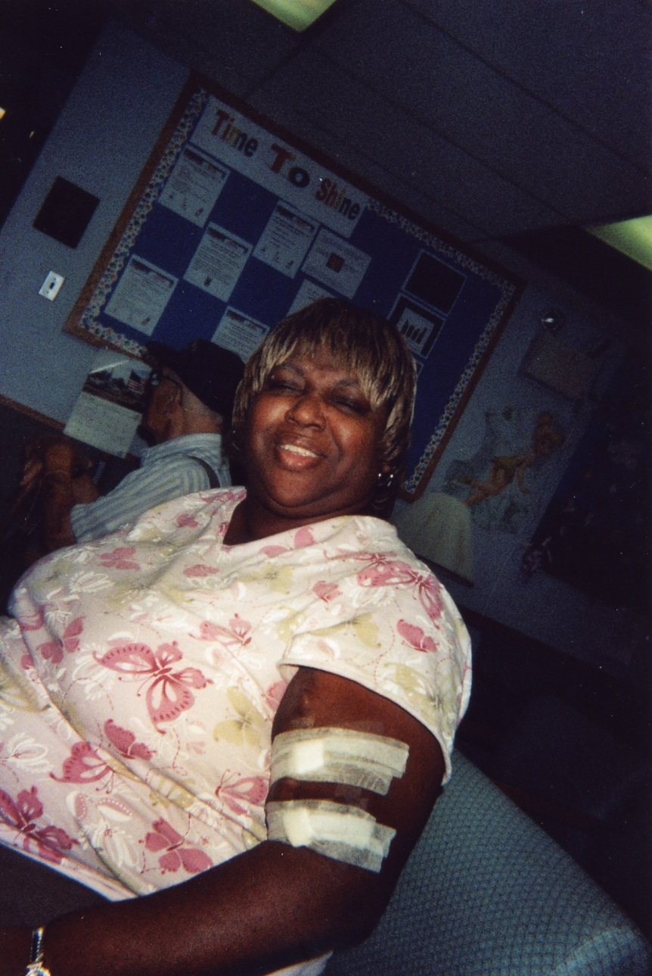

Slide 33
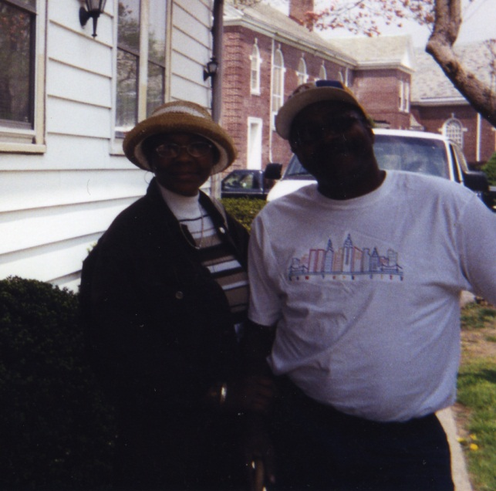

Slide 34
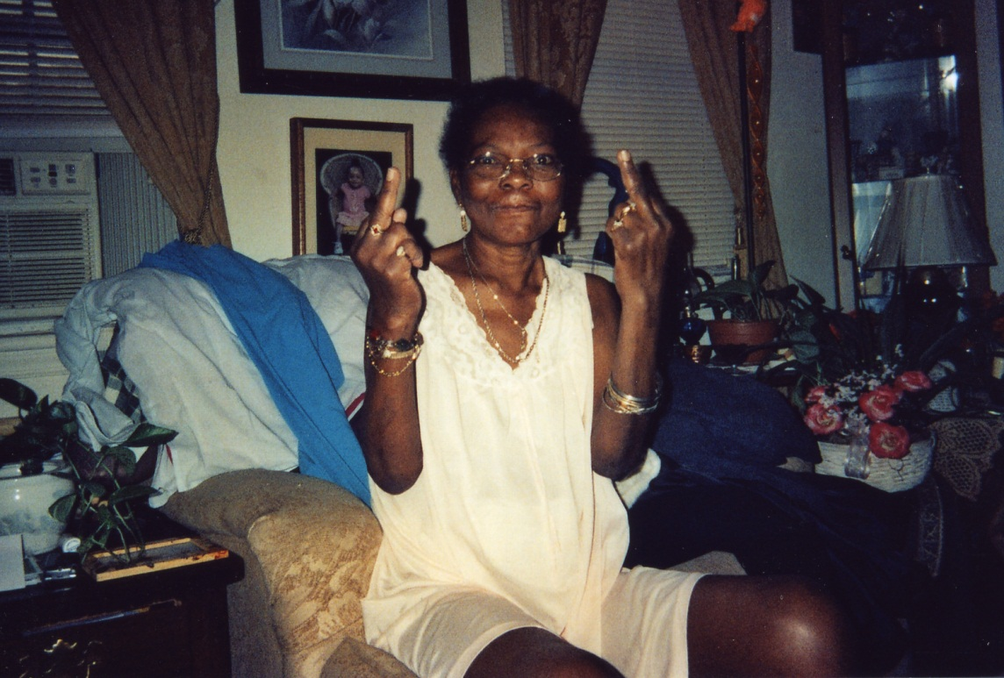

Slide 35
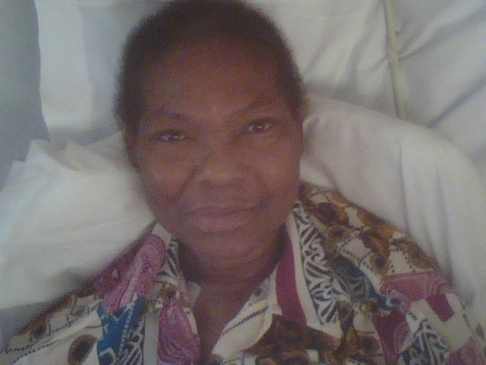

Slide 36
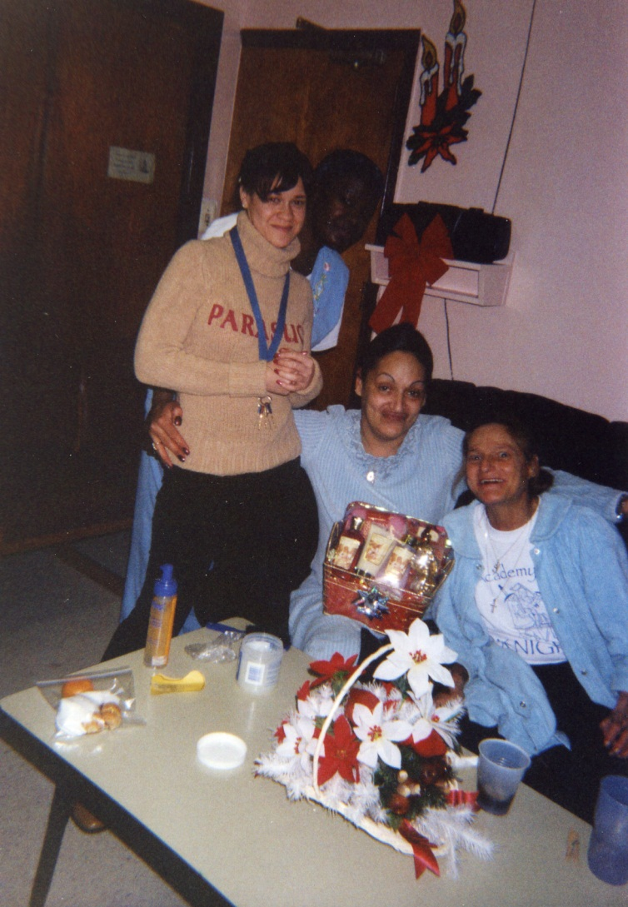

Slide 37
Consumer Advisory Board
The group has also functioned as a Consumer Advisory Board
Consistent forum for feedback on programs
Consumer Satisfaction Surveys run through the group
Focus group function throughout the years (nutrition, risk reduction and Hepatitis C)
Piloted risk reduction education with group

Slide 38
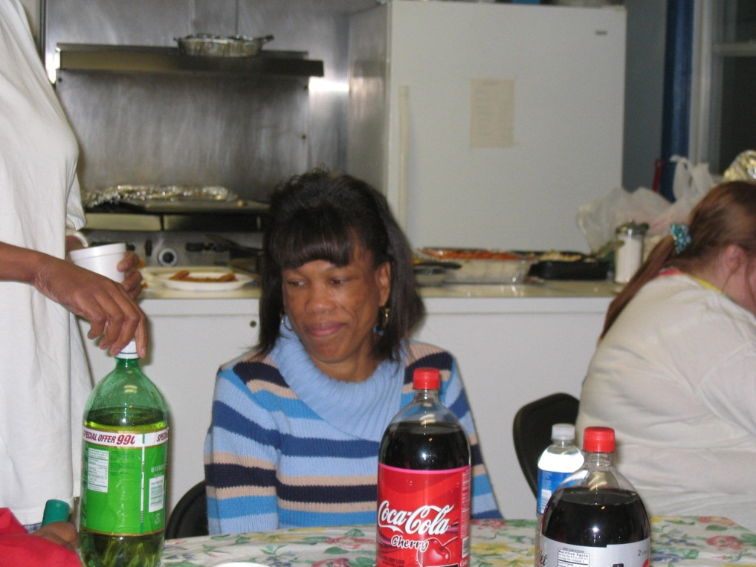

Slide 39
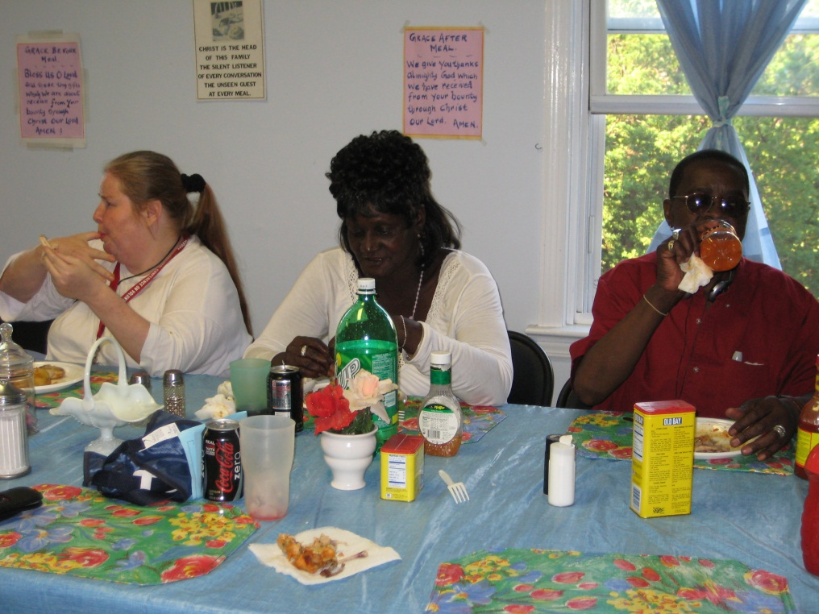
Survivors

Slide 40
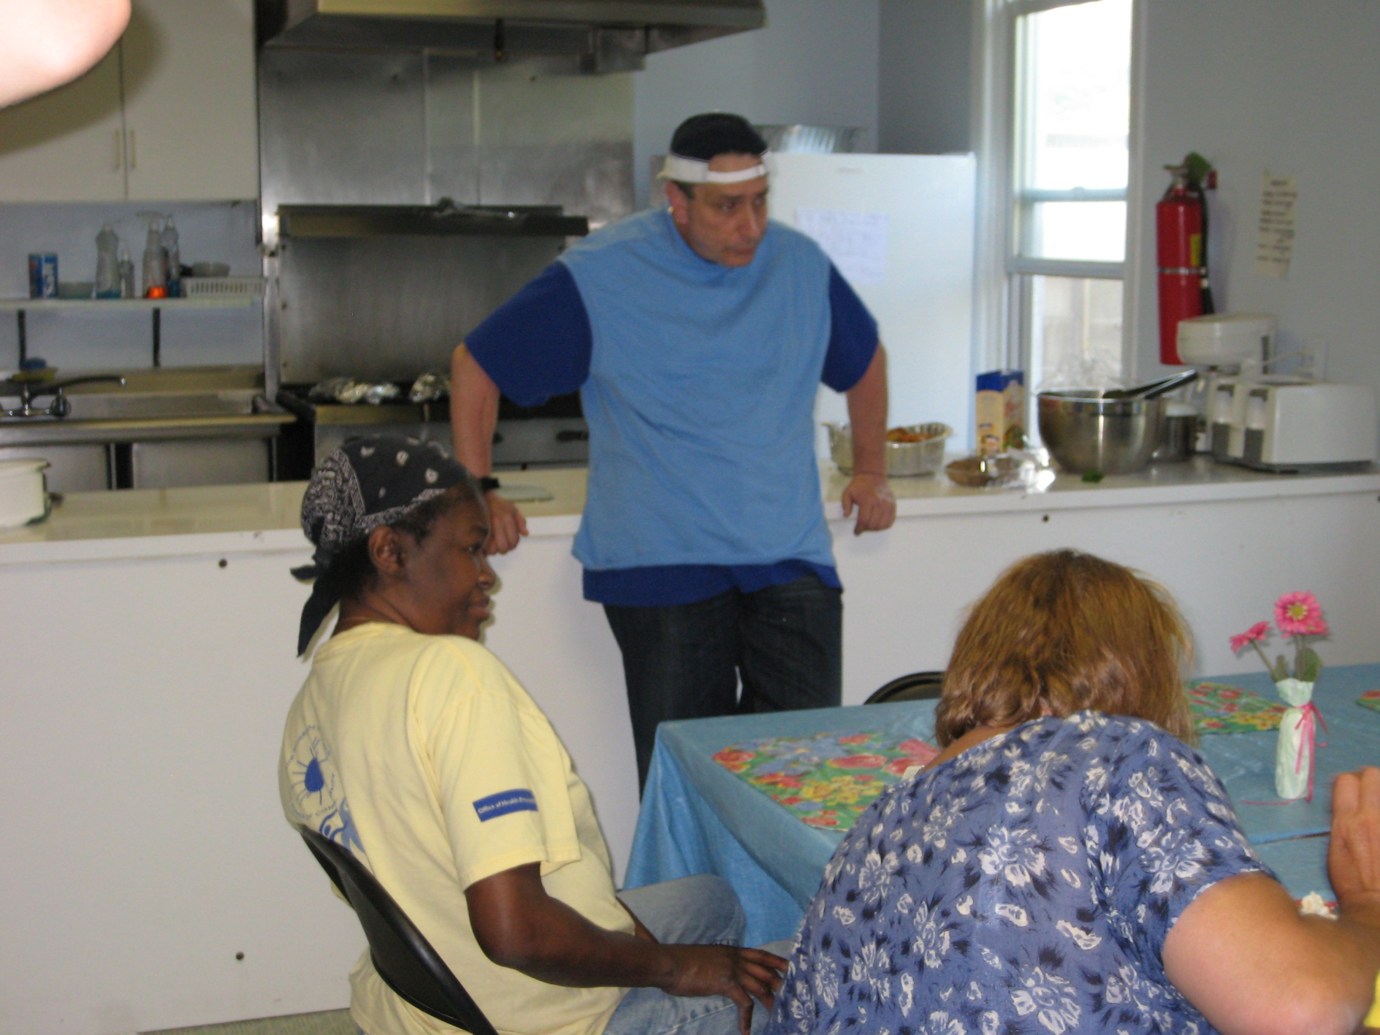

Slide 41
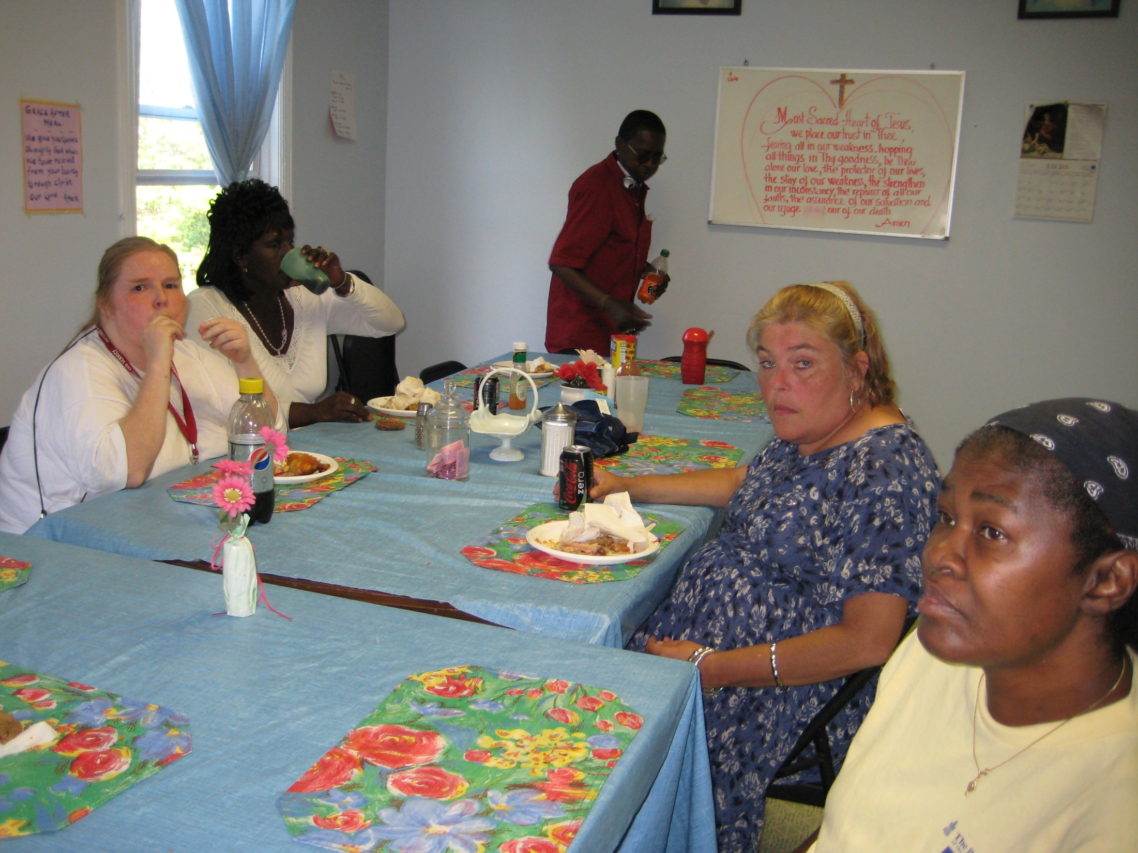

Slide 42
Challenges
Group cohesiveness
Attention span of group
Funding to continue
Need for new groups
Confidentiality
Space
Staff Burnout

Slide 43
Poem
Do not stand by my burial site and weep;
I am not there; I do not sleep,
I am a thousand winds that blow,
I am the diamond’s glitter on the snow,
I am the sunlight that shines on the flowers and your face
I am the gentle autumn’s rain, when you awake in the morning’s hush,
I am the swift uplifting rush of air as the birds circle in flight.
I am the stars that shine brightly in the night.
Do not stand by my burial site and weep,
I am not there.
But please don’t forget me. Keep your memories of me alive.

