Slide 1
Perinatal HIV Transmission Prevention
Missed Opportunities
Ryan White 2012 Conference
Andrew Helfgott, MD
Robert Lawrence, MD
JoNell Potter, PhD, RN
Yvette Rivero, MPH

Slide 2
Workshop Facilitators
Andrew Helfgott, MD High Risk Obstetrical Services All Children’s Hospital, FL Faculty of Florida / Caribbean AETC
Robert M. Lawrence, MD Clinical Professor Pediatric Infectious Diseases, UF Faculty of Florida / Caribbean AETC
JoNell Potter, PhD, RN Associate Professor, OB/GYN & Pediatrics Chief, Women's HIV Service, University of Miami Miller School of Medicine Faculty- Florida / Caribbean AETC
Yvette Rivero, MPH University of Miami, Miller School of Medicine
Southeast Regional Perinatal Coordinator Florida / Caribbean AETC

Slide 3
Disclosures
This continuing education activity is managed and accredited by Professional Education Service Group. The information presented in this activity represents the opinion of the author(s) or faculty. Neither PSEG, nor any accrediting organization endorses any commercial products displayed or mentioned in conjunction with this activity.
Commercial Support was not received for this activity.

Slide 4
Disclosures
Andrew Helfgott, MD
Has no financial interest or relationships to disclose
Robert Lawrence, MD Has no financial interest or relationships to disclose
JoNell Potter, PhD, RN Has no financial interest or relationships to disclose
Yvette Rivero, MPH Has no financial interest or relationships to disclose

Slide 5
Obtaining CME / CE Credit
If you would like to receive continuing education credit for this activity, please visit:
http://www.pesgce.com/RyanWhite2012

Slide 6
Workshop Format
I. Introductions- Review of Objectives & Workshop Format
II. Reaching the Goal of Eliminating Perinatal HIV Transmission
III. “Fishbone” Analysis-“5 WHYS” of Root Cause Analysis
IV. Break-Out Groups Working on Root Cause Analysis & Solutions
V. Formulation of Strategies based on Discussion from Work Groups

Slide 7
Learning Objectives
At the completion attendees should be able to:
1. Identify missed opportunities in failed Perinatal HIV Transmission Prevention. (Knowledge)
Predict potential missed opportunities & prescribe individualized plans to correct in “real patient care time”. (Comprehension, Practice)
3. Formulate plans to solve the issues of specific missed opportunities on a systems level in their own health care system. (Synthesis)

Slide 8
Overview
Major Achievements in Perinatal HIV
Pediatric AIDS Clinical Trials Group 076
Reduced Perinatal HIV Transmission by 70%
Increased HIV Testing in Pregnancy
Combination ARV Prophylaxis during Pregnancy
Notes:
Major Achievement in HIV research
Showed administration of zidovudine (ZDV) to pregnant women and their infants could reduce perinatal transmission by 70%

Slide 9
Introduction
ARVs for HIV-infected women during pregnancy
  *Continuous maternal antiretroviral (cARV) treatment
  *ARV in pregnancy, L&D and for the neonate
Perinatal HIV infection = <2% in the US
*prenatal HIV counseling and testing
*preconception care,
*ARV prophylaxis,
*scheduled C-section delivery (if indicated), and
*avoidance of breast-feeding,

Slide 10
Lessons Learned
From Trials of Short-Course ARV Regimes
Combination antenatal prophylaxis
Combination infant ARV prophylaxis
Single-dose intrapartum nevirapine not recommended
In the US Breastfeeding is not recommended
Notes:
Combination antenatal prophylaxis taken over longer duration is more effective then a short-course single drug regimen in reducing perinatal transmission.
Combination infant ARV prophylaxis is recommended in the US for infants whose mothers have not received antenatal ARV drugs.
Adding single-dose intrapartum nevirapine (NVP) is not recommended for women in the US who are receiving standard recommended antenatal ARV prophylaxis.
In the US Breastfeeding is not recommended.

Slide 11
Perinatal Transmission & HIV RNA Copy Number
During Pregnancy - all HIV-infected women should be counseled & administered ARV regardless of HIV RNA levels (AI)
  Mother-to child transmission observed at very low or undetectable maternal HIV RNA levels
  Discordance btw plasma RNA levels & cervico-vaginal viral shedding; particularly in the presence of genital tract co-infections

Slide 12
Recommendations for Use of Antiretroviral Drugs in Pregnant HIV-1-Infected Women for Maternal Health and Interventions to
Reduce Perinatal HIV Transmission in the United States
Update and Revision
Recommendations for Use of Antiretroviral Drugs in Pregnant HIV-1-Infected Women for Maternal Health and Interventions to Reduce Perinatal HIV Transmission in the United States
Last updated July 31, 2012; last reviewed July 31, 2012

Slide 13
Reproductive Options
HIV-Concordant & Sero-Discordant Couples
(Last updated July 31, 2012; last reviewed July 31, 2012)
Treat Sero-discordant Couples with ARVs
Maximal Suppression before Conception
Preconception Pre-Exposure Prophylaxis
The utility of PrEP for sero-discordant couples
Notes:
For serodiscordant couples who want to conceive, initiation of antiretroviral therapy (ART) for the HIV-infected partner is recommended (AI for CD4 T-lymphocyte (CD4-cell) count ≤550 cells/mm3, BIII for CD4-cell count >550 cells/mm3).
If therapy is initiated, maximal viral suppression is recommended before conception is attempted (AIII).
Periconception administration of antiretroviral pre-exposure prophylaxis (PrEP) for HIV-uninfected partners may offer an additional tool to reduce the risk of sexual transmission (CIII).
The utility of PrEP of the uninfected partner when the infected partner is receiving ART has not been studied.

Slide 14
Antepartum Care & ARV Naive
(Last updated July 31, 2012; last reviewed July 31, 2012)
ARV drug-resistance studies before starting or modifying ARV drug regimens in HIV RNA levels above the threshold for resistance testing (that is, >500 to 1,000 copies/mL) Antiretroviral Drug Resistance & Resistance Testing in Pregnancy) (AIII)
When HIV is diagnosed later in pregnancy, cARV should be initiated w/o waiting for results of resistance testing (BIII).

Slide 15
HIV-Infected Pregnant Women Who Have Never Received ARV Drugs
(Antiretroviral- ARV Naive)
(Last updated July 31, 2012; last reviewed July 31, 2012)
All HIV-infected pregnant women should receive a potent combination antiretroviral (ARV) regimen to reduce the risk of perinatal transmission of HIV (AI).
The choice of regimen should take into account current adult treatment guidelines,what is known about the use of specific drugs in pregnancy, and the risk of teratogenicity (Table 5).

Slide 16
HIV-Infected Pregnant Women Who Have Never Received Antiretroviral Drugs
(Antiretroviral Naive)
(Last updated July 31, 2012; last reviewed July 31, 2012)
Combination ARV regimens should include a dual nucleoside reverse transcriptase inhibitor (NRTI) backbone that includes one or more NRTIs with high levels of transplacental passage (zidovudine, lamivudine, emtricitabine, tenofovir, or abacavir) (AIII).

Slide 17
Antiretroviral Drug Resistance and Resistance Testing in Pregnancy
(Last updated July 31, 2012; last reviewed July 31, 2012)
HIV drug resistance studies
Documented ZDV resistance
Minimize development of resistance
Presenting late in Pregnancy
Notes:
Women who have documented zidovudine resistance and are on regimens that do not include zidovudine for their own health should still receive intravenous zidovudine during labor along with their established ARV regimens if they have HIV RNA levels >400 copies/mL near delivery (see Intrapartum Antiretroviral Prophylaxis/Therapy), unless a history of hypersensitivity is documented (AII).

Slide 18
Intrapartum Care Intrapartum Antiretroviral Therapy/Prophylaxis
(Last updated July 31, 2012; Last reviewed July 31, 2012)
When should IV AZT be administered?
Intravenous (IV) zidovudine should be administered to HIV-infected women with HIV RNA ≥400 copies/mL (or unknown HIV RNA) near delivery, regardless of antepartum regimen or mode of delivery (AI).
When is it NOT required?
IV zidovudine is not required for HIV-infected women receiving combination ARV regimens who have HIV RNA <400 copies/mL near delivery (BII).

Slide 19
Transmission and Mode of Delivery
(Last updated July 31, 2012; last reviewed July 31, 2012)
Data are insufficient to evaluate the potential benefit of cesarean delivery used solely for prevention of PT with HIV RNA levels <1,000 copies/mL.
Given the low rate of transmission, it is unclear whether scheduled cesarean delivery would confer additional benefit in reducing transmission.
In women with HIV RNA levels <1,000 copies/mL, cesarean delivery performed for standard obstetrical indications should be scheduled for 39 weeks’ EGA.

Slide 20
Other Intrapartum Management Considerations
(Last updated July 31, 2012; last reviewed July 31, 2012)
The following should generally be avoided unless there are clear obstetric indications because of a potential increased risk of transmission:
  Artificial rupture of membranes (BIII)
  Routine use of fetal scalp electrodes for fetal monitoring (BIII)
  Operative delivery with forceps or a vacuum extractor and/or episiotomy (BIII)

Slide 21
Postpartum Care
Postpartum Follow-Up of HIV-Infected Women
(Last updated July 31, 2012; last reviewed July 31, 2012)
Women with a positive rapid HIV antibody test during labor require immediate linkage to HIV care
Breastfeeding is not recommended for HIV-infected women in the US, including those receiving ART (AII).

Slide 22
Improving Linkage to Care in Pregnant Women
Address any reasons for declining testing
Test as early as possible during pregnancy; women who decline testing should be offered it at subsequent visits
High-risk women should be retested in third trimester[1]
Women with undocumented HIV status at time of labor should be screened with rapid HIV test
Many women with undocumented HIV status in late pregnancy or in delivery are black, poor, unemployed, with many life stressors
Linkage to care requires intensive resources, great caring[2]
1. Branson BM, et al. MMWR Recomm Rep. 2006;55:1-17.2. Cohen MH, et al. Matern Child Health J. 2008;12:258-576.

Slide 23
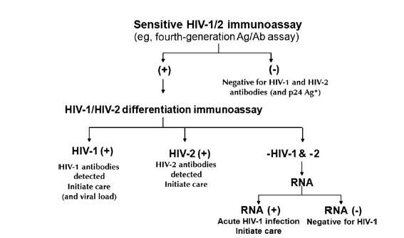

Slide 24
5 “Whys” of Root Cause Analysis
5 Whys
How to Complete Them
Use when problems involve human factors or interactions
Identify related factors
Why
Why
Why
Why
Why
Write down specific problem.
Describe it completely.
Ask Why the problem happened → answer.
If answer doesn’t identify the “root cause”; ask Why again.
Repeat until the “root cause” is identified.

Slide 25
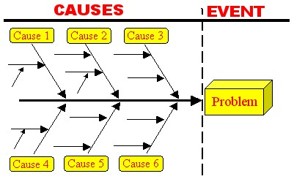
Fishbone Diagram / Analysis

Slide 26
Problem →5 Whys → Causes
6 Ms
5 Ps
Method
Machine
Man
Mother nature
Material
Measurement
Policies
Plans
Procedures
People
Plant

Slide 27
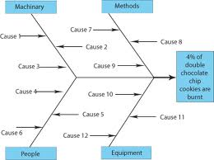
Example
Oven temperature variability
Less power to the ovens in the daytime
Each baker uses their own timer
The bakers don’t measure the ingredients exactly
Both liquid and solid butter sticks are used in the mix
Some of the bakers like soft cookies and others crisp cookies
Certain bakers always add more chocolate chunks
The same baker does not “follow” their batch of cookies to completion
There are new and “really old” cooking sheets

Slide 28
Cause and Effect
Can Cause be written as a complete sentence?
Is connection btw cause & effect convincing?
Does the cause “exist” in reality?
Does the cause, in fact, result in the effect?
Does it make sense? If X….; then Y….
Does the cause result in the effect on its own?
Is this the only cause?
If cause eliminated-other circumstances in which effect would still be present or occur?

Slide 29
Systems
Diagnosis
Labor and Delivery
HIV (+) Infant
A Missed Opportunity
Maternal Health
Information Disclosure
Infant Postnatal care

Slide 30
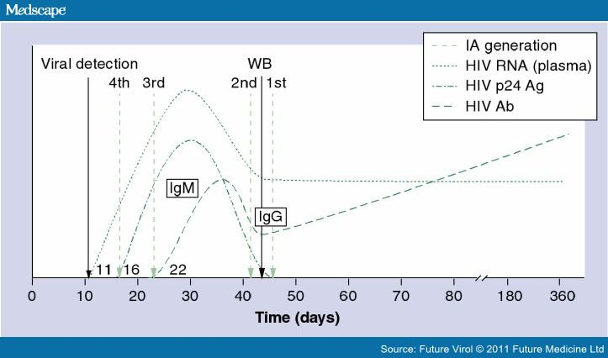
HIV Testing in Acute Infection
Medscape News HIV/AIDS, HIV Testing: The Cornerstone of HIV Prevention Efforts

Slide 31
ART in Pregnancy
ARV Drug | FDA Preg Class | Recommendation | Concerns
Lamivudine | C | R, extensive use
Zidovudine | C | R, extensive use* | mtDNA
Abacavir | C | Alternate | Hypersensitivity
Didanosine^ | B | Alternate | Lactic acidosis
Emtricitabine | B | Alternate
Stavudine | C | Alternate, not + ZDV | Lactic acidosis
Nevirapine | B | R, CD4 Ct < 250 | Hepatotoxicity (CD4 > 250)
Lopinavir / r | C | R | Dose in 3rd Trim.
Atazanavir /r | B | Alternate | Indir. Hyperbili.
Indinavir / r | C | Alternate
Nelfinavir^ | B | Alternate, ext. use
Guidelines for ART in Pregnancy - Sept. 14, 2011 http://aidsinfo.nih.gov/

Slide 32
Care of the HIV Exposed Infant
Age of infant | Birth | 2-4 Weeks | 4-8 Weeks | 4-6 Months | > 18 Months
History and Physical Exam | X | X | X | X | X
Antiretroviral Therapy | X | X | X – stop at 6 weeks
CBC + differential | X | X | X | X | X
HIV DNA PCR or RNA PCR | + /- | X | X | + / - | If ELISA +
Consider PCP prophylaxis |  |  | X | X
ELISA |  |  |  |  | X
Recommendations for the Use of ARV Drugs in Pregnancy and Interventions to Reduce Perinatal HIV Transmission 9/14/11 http://aidsinfo.nih.gov

Slide 33
Post Partum Zidovudine
Prophylaxis for Infants
New Recommended Zidovudine Regimen 9/14/11
4 mg/kg PO every 12 hours for 6 weeks
(previously 2 mg/kg PO every 6 hours for 6 weeks)
Transient anemia, Mitochondrial abnormalities
Recommendations for the Use of Antiretroviral Drugs in Pregnant HIV-1-Infected Women for Maternal Health and Interventions to Reduce Perinatal HIV Transmission in the United States. (9/14/11) http://aidsinfo.nih.gov/guidelines downloaded 3/30/2012

Slide 34
Correlates of Perinatal HIV Transmission
Adjusted Odds Ratio
Population Attributable Risk %
Characteristic | aOR (95% CI)
Injection drug use | 1.7 (1.1-2.7)*
Substance abuse | 2.0 (1.4-2.9)*
Maternal CD4 <200 | 2.4 (1.4-4.2)*
Maternal Dx. – late+ | 2.5 (1.5-4.0)*
ARVs in pregnancy | 3.5 (2.0-6.4)*
+ Breastfed^ | 4.6 (2.2-9.8)*
Prenatal care = unknown | 3.2 (1.5-7.0)*
No ARV medication delivery | 1.2 (0.7-1.9)
No Neonatal ARVs | 1.4 (0.7-2.7)
Characteristic | PAR%
Prenatal care - unknown | 24%
Maternal Dx. – late | 26%
ARVs in pregnancy (no) | 45%
ARVs during delivery (no) | 30%
Neonatal ARV medication (no) | 12%
Breastfed (yes) | 10%
Missed Opportunities >= 1 | 52%
Whitmore AK et al.
Pediatrics 2012;129:e74-e81.
+Late = in L & D, or after delivery
^Breastfeeding – not well delineated

Slide 35
Case #1
A 24 yr old pregnant women presents to L & D at 36 weeks gestational age.
She reportedly has had no prenatal care since the first trimester. She says her HIV test was initially positive in this pregnancy. This is the first time she has been tested for HIV. She “could not believe she was positive”.
She does not have or know the exact results of her tests. She does not know her viral load or CD4 count numbers.
She is somewhat evasive when you ask about method of acquisition of HIV, ARV medications, compliance with medications and follow-up prenatal care, substance use, etc..
IV Zidovudine is begun, delivery occurs in 2 hours, the infant is given Zidovudine as indicated.
The infant is HIV DNA PCR + at 2 weeks and 4 weeks.
Analysis
Contributing Factors
Potential Solutions
Recommendations

Slide 36
Case #2
A 17 year old perinatally infected pregnant female goes to High-Risk OB clinic at 26 weeks EGA.
You have not seen her since you referred her.
The providers recommend a Cesarean section because she has not been compliant with her ARV medications. She is crying and refusing the medications & the C-section.
At 38 wks she delivers at another hospital w/o disclosing her HIV status because she doesn’t want a C-section.
Infant is HIV DNA PCR positive at 4 wks & confirmed positive at 6 wks of age.
Analysis
Contributing Factors
Potential Solutions
Recommendations

Slide 37
CASE # 3
20 yo woman presents to L & D in active labor.
No prenatal care and HIV status unknown.
Mother states she thinks she was HIV negative ~ 18 months ago.
Rapid HIV testing is done. Positive result.
Intrapartum AZT is begun and the infant receives postnatal AZT for 6 weeks.
The infant is HIV DNA PCR positive twice in the first 8 weeks of life.
Analysis
Contributing Factors
Potential Solutions
Recommendations

Slide 38
CASE # 4
27 yo mother received prenatal care including a negative HIV test reported in the first trimester.
She did not have any risk factors for HIV.
The infant was born full term without complications or problems.
At 5 months of age the infant is admitted with PCP Pneumonia.
The infant is HIV positive.
Analysis
Contributing Factors
Potential Solutions
Recommendations

Slide 39
CASE # 5
31 yo mother with known mental illness is diagnosed with HIV in the 1st trimester.
She is prescribed medications but refuses to take them.
Intrapartum and postnatal AZT are given.
The child is HIV positive at 4 months of age.
Analysis
Contributing Factors
Potential Solutions
Recommendations

