Slide 1
The Patient-Centered Medical Home: How Will We Know When We Get There? – 301 Session Steve Bromer, MD Denise Anderson-Carr, MPH, RD
Ryan White 2012 Grantee Meeting

Slide 2
Disclosures
This continuing education activity is managed and accredited by Professional Education Service Group. The information presented in this activity represents the opinion of the author(s) or faculty. Neither PESG, nor any accrediting organization endorses any commercial products displayed or mentioned in conjunction with this activity.
Commercial Support was not received for this activity.

Slide 3
Disclosures
Steven Bromer, MD
Has no financial interest or relationships to disclose.
Denise Anderson-Carr, MPH, RD
Has no financial interest or relationships to disclose.
CME Staff Disclosures
Professional Education Services Group staff have no financial interest or relationships to disclose

Slide 4
Learning Objectives
At the conclusion of this activity, the participant will be able to:
Describe the components of the eight change concepts
Compare the similarities and differences of the change concepts to current model of care in Ryan White agencies
Identify the most appropriate next change to focus on in participant’s practice setting in moving toward PCMH transformation

Slide 5
Obtaining CME/CE Credit
If you would like to receive continuing education credit for this activity, please visit:
http://www.pesgce.com/RyanWhite2012

Slide 6
Patient-Centered Medical Home Institute Ryan White All Grantees Meeting 2012
101 Session | The Patient Centered Medical Home Guidance: A Model of Care Delivery for People Living with HIV | Tuesday 11/27/12 10 am
201 Session | The Patient Centered Medical Home: Lessons from Ryan White Grantees | Tuesday 11/27/12 1:30 pm
301 Session | The Patient Centered Medical Home: How Will We Know When We Get There? | Wednesday 11/28/12 10 am

Slide 7
Ryan White: an Unintentional Home Builder
“An unintended consequence…. of the RW Care Act has been the establishment of the comprehensive delivery of multiple services for patients with a complex disease….medical homes for the HIV-infected person…..”
Notes:
Back in 2009 Michael Saag wrote this in a beautiful article in the AIDS reader. It is a strong statement and I think part of our job in providing TA is to see if it is really true, if there are gaps, how can we support filling those gaps and if we are there, how we move to certification as efficiently as possible.

Slide 8
Change Concepts | Building Blocks | NCQA Recognition
Engaged Leadership | Data for Improvement | Enhance Access/Continuity
Quality Improvement Strategy | Empanelment, Panel size management | Identify/Manage Patient Populations
Empanelment | Team-based Care | Plan/Manage Care
Continuous and Team-based Healing Relationships | Population Management | Provide Self-Care Support/Community Resources
Organized Evidence-based Care | Continuity of Care | Track/Coordinate Care
Patient-Centered Interaction | Prompt Access to Care | Measure/Improve Performance
Enhanced Access | Expanded Access
Care Coordination | Mission with objectives and goals
 | Care coordination with Medical Neighborhood
 | Trained Leaders
Notes:
This is a busy slide and not meant to be read , I am using it to make a point about medical home concepts– I have listed the key concepts for the PCMH from several sources. The first are the Change Concepts by Ed Wagner, The second column is the building block identified in Tom Bodenheimer’s article and the third

Slide 9
Change Concepts for the PCMH
Engaged Leadership
Quality Improvement Strategy
Empanelment
Continuous and Team-based Healing Relationship
Organized, Evidence-Based Care
Patient-Centered Interactions
Enhanced Access
Care Coordination
Notes:
So lets take the change concepts from Ed Wagner and compare them side by side with requirements of RWCA grantees

Slide 10
Quality Improvement Strategy
Formal QI model
Establish metrics
Involve patients, families and staff in QI
Optimize HIT
Quality Management Plan required in all RWCA sites
HAB measures/HIVQual
Consumer involvement central
Registries, client-level data

Slide 11
Empanelment
Assign all patients to provider panel
Balance supply and demand
Use panel data to manage population
Frequently done, not specific requirement
Panel size usually limited
Management at practice level vs. panel level

Slide 12
Continuous and Team-based Healing Relationships
Establish care delivery in teams
Link patients to providers and care teams
Assure patients see PCP
Role and task distribution in teams
Multi-disciplinary teams central to RWCA
Linkage to care
Not a requirement of RWCA
Variable

Slide 15
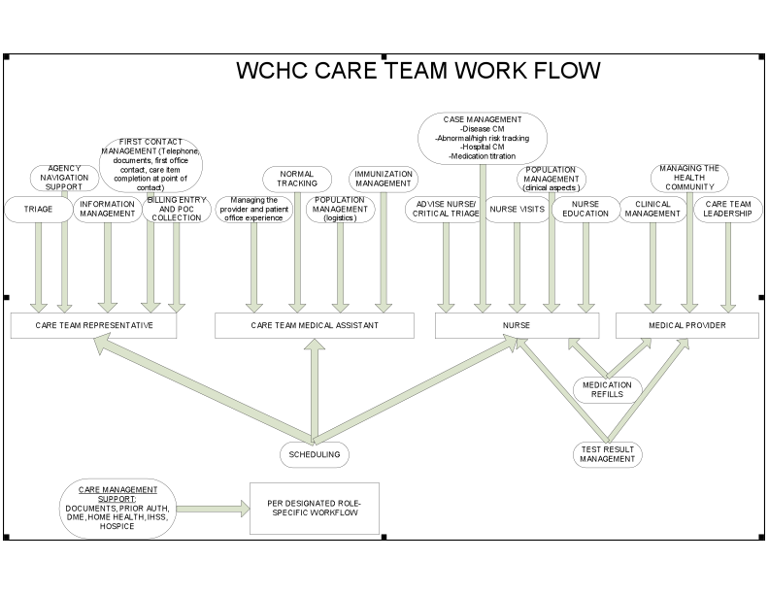

Slide 16
Team-based care
Culture shift: share the care
Stable teamlets
Co-location
Staffing ratios
Standing orders/protocols
Defined workflows and roles – workflow mapping
Training, skills checks, and cross training
Ground rules
Communication – healthy huddles, terrific team meetings and constant conversation

Slide 17
Team-based care: stable teamlets
Patient
panel
Patient
panel
Patient
panel
Clinician/MA
teamlet
Clinician/MA
teamlet
Clinician/MA
teamlet
Health coach, behavioral health professional, social worker, RN, pharmacist, panel manager, complex care manager
1 team, 3 teamlets

Slide 18
Organized, Evidence-Based Care
Use planned care according to patient need
Manage care for high-risk patients
Use point-of-care reminders
Use patient data to enable planned interactions
Included in Standards for Case Management
Acuity assessments part of Care Plan
Variable – influenced by EMR penetration
Is data collected for grants also used in patient care?

Slide 19
Patient-Centered Interactions
Respect patient and family values. Cultural competency
Encourage patient involvement in health care
Every interaction supports Self-management
Patient and family feedback in QI
Core value for RWCA
Consumer involvement core value and legislative mandate for RWCA
Strong self-management support in many RWCA clinics
Use of consumer and family feedback in QI encouraged

Slide 20
Enhanced Access
Ensure 24/7 access to care team
Provide scheduling options
Help patients access insurance
After hours and weekend coverage a grant requirement
Inconsistent use of enhanced access tools
Legislative mandate that RW be payer of last resort; benefits counseling part of support services

Slide 21
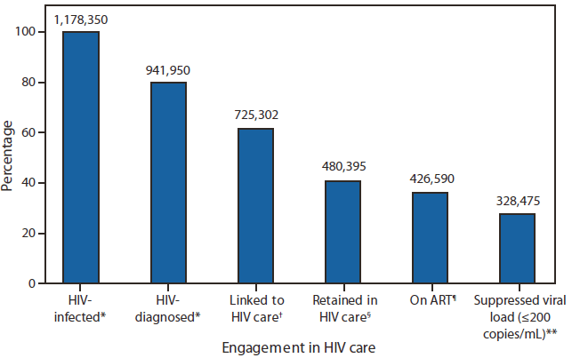
Engagement in HIV Care
Vital Signs: HIV Prevention Through Care and Treatment -- United States. MMWR December 2, 2011/60(47);1618-1623

Slide 22
Care Coordination
Link patient with community resources
Integrate specialty care with co-location
Referral tracking
ED/hospital care transitions
Communicate test results/care plans with patients
Frequently strong collaboration with community resources
Comprehensive care, often under “one roof”
Requirement of RWCA
Expectation that transitions are tracked
Variable capacity/Grant expectation that care plans are collaborative

Slide 23
https://dl.dropbox.com/u/31784176/BTWInformingChange_DrCunningham_V2.1.mov

Slide 24
Engaged Leadership
Visible leadership for culture change and QI
Ensure time and resources for transformation
PCMH values in staff hiring and training
Transformation led or grant requirement?
Resources for QI built into RWCA budgets
?????

Slide 25
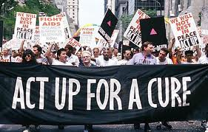

Slide 26
Roadmap for Medical Home Resource Center
PCMH concepts in RWCA Clinics– Action Planning
Change Management of Improvement Opportunities
PCMH Certification
Strategic Planning Workshops
TA and coaching for practice change
TA to support certification
Year 1 Year 2 Year 3

Slide 27
Enhanced Access Scenario – Patient Perspective
You are a patient at the Stanley Jackson Family Clinic, a FQHC with an integrated Ryan White funded HIV Program. You and your three children receive their medical care at the Health Center. You are a single mother raising 3 children and work as an In-home Health Aide for two elderly clients. You have been stable on the same ARV regimen for about 5 years. You rarely miss a dose but juggling the challenges of a job and being a single mother makes it hard to get into the health center. You are due for your labs and need refills on your medications. Your 8-year-old child was recently exposed to poison oak and has a rash on one arm.
As a Patient Centered Medical Home, The Stanley Jackson Clinic has advanced access options for visits and email access for questions. Describe a creative way to address this patient’s needs keeping in mind her busy schedule.
Notes:
Who will the patient call to find out about labs and refills?
Can you imagine ways for this patient to address her needs without having to come to the clinic?
If she needs an appointment, how will that appointment be made and during what hours?
Since this patient has a hard time getting into clinic can you imagine alternative ways for her to access nutritional counseling or adherence support from a pharmacist?
What about peer support? Is there a way for this busy mom to access peer support? Could she use social networking?

Slide 28
Continuous Team Based Care Scenario – Medical Assistant Perspective
You are a Medical Assistant at the Stanley Jackson Family Health Center, a FQHC with an integrated Ryan White funded HIV program. You are the MA on one of the HIV Care Teams. After a successful transformation to a PCMH, describe a typical day at the health center from the MA’s perspective.
Notes:
What was your role in prepping for the clinic on this day?
What role do you play in the morning huddle?
How much time do you have in the day to proactively look at your panel of patients and contact patients who were due for labs, immunizations or other preventive health interventions?
What parts of the patient history and exam do you complete before the provider enters the room? Do you help patients set health goals or start action plans?
How are you involved in discharging the patient?
Do you have any contact with patients in between visits to check on health goals?
Are you more satisfied with your job now?

Slide 29
Patient-Centered Interactions Scenario – Infectious Disease Physicians
You are one of the Infectious Disease Physicians at the Stanley Jackson Family Health Center, a FQHC with an integrated Ryan White funded HIV program. You are the MD on one of the HIV Care Teams.
Carla Diaz is a 38 year old woman who was diagnosed with HIV during her pregnancy four years ago. Although she was on ARV prophylaxis during her pregnancy, it was discontinued after the pregnancy because her CD4 count was high. Based on the current treatment recommendations, you would like her to start on an ARV regimen.
Ms. Diaz is continuing to do well. She works an evening shift at a manufacturing company. Her family speaks Spanish primarily at home, but she is comfortable speaking English with the Health Center staff. Her husband and sister know her diagnosis but her extended family and mother-in-law, who provides childcare for her son, do not. Ms. Diaz is deeply religious and is not sure that she needs man-made interventions like HIV medications to stay healthy.
Notes:
As her HIV clinician, how will you begin to talk with her about starting ARVs?
What information do you need from her as you and she are developing a plan?
What strategies does SJFHC offer that could support both self-management/patient-centered care and the goal of adherence to the ARV regimen?
What are the peer resources available to Ms. Diaz?
When she is ready to start ARVs, how will the members of the team work with Ms. Diaz to support adherence?

Slide 30
Care Coordination Scenario – Registered Nurse
You are a Registered Nurse at the Stanley Jackson Family Health Center, a FQHC with an integrated Ryan White funded HIV program. You are the RN on one of the HIV Care Teams.
Mr. Jones, one of your clients living with HIV has recently tested positive for hepatitis C. Although many patients co-infected with HIV and hepatitis C are managed at SJFHC, the protocol is to refer the newly diagnosed patient to the hepatologist for initial staging and recommendation for treatment.
The hepatologist scheduled a liver biopsy for Mr. Jones as part of his staging. Usually this is an outpatient procedure but Mr. Jones suffered a complication from the procedure and required a two-day hospitalization for stabilization and observation.
SJFHC has recently undergone a successful transformation to a PCMH. Describe your role as the RN Case Manager in these care transitions for Mr. Jones.
Notes:
How will you contact Mr. Jones and educate him about the results of the hepatitis C test and the needed follow-up?
How will you work with Mr. Jones and your Front Desk team colleague to assure that Mr. Jones get the appointment he needs?
What procedures are in place to insure that the laboratory and clinical findings from SJFHC are sent to the hepatologist and that the hepatologist’s report is returned to SJFHC?
What role will you play in the transition from an inpatient to an outpatient?

Slide 31
Quality Improvement Strategy Scenario – Social Worker Perspective
You are a social worker in the Main Street Clinic, a large HIV specialty clinic in Academic Medical Center that has Ryan White HIV/AIDS program funding. For many years you have also been the clinic’s data guru and have led the QI program. The Medical Center’s ambulatory care program has been working on transformation to a PCMH, and 3 clinics, including the Main Street Clinic, have achieved PMCH recognition.
Consider how the transformation to a PCMH has affected the quality improvement strategy in your clinic and your institution.
Notes:
How has the quality improvement program changed to address issues related to comprehensive primary care in addition to HIV-related care?
How has your role as Quality Manager changed now that the Care Teams are actively involved in Quality Improvement initiates and using Quality data on a daily basis?
How are patients involved in quality improvement?
How are the results of QI activities disseminated and used?
What types of resources/systems facilitate and increase the effectiveness of quality improvement efforts?
How does the clinic identify opportunities for performance improvement?

Slide 32
Empanelment Scenario – Front Office Coordinator Perspective
You are the Front Office Coordinator for the Stanley Jackson Family Clinic and you successfully led the PCMH transformation team for the HIV practice. Describe the role empanelment played in this transformation. Your goal was to make sure that every patient belonged to one care team and each care team was balanced so that there was a match between patient demand for visits and provider resources. How did you succeed in creating these patient panels?
Notes:
How did you work with patients to help them identify a primary provider?
How did you handle situations where more than one provider thought they were the primary provider and also those cases where no provider claimed responsibility for a patient?
How did you balance acuity level and other patient factors in deciding on the size of a provider’s panel?
What role did empanelment play in Open Access?
What role did empanelment play in tracking clinical quality measures or operational performance measures
How did empanelment change the front office’s role in being the first contact for patients with their care team?
How has empanelment helped you negotiate with administration for MA, RN and front office staffing levels?

Slide 33
Organized, Evidence-Based Care Scenario – Infectious Disease Physician Perspective
You are an Infectious Disease physician at the Main Street Clinic, a large HIV specialty clinic in Academic Medical Center that has Ryan White HIV/AIDS program funding. The Medical Center’s ambulatory care program has been working on transformation to a PCMH, and 3 clinics, including the Main Street Clinic, have achieved PCMH recognition. You are scheduled for a very busy Monday morning clinic that includes a diverse group of patients, e.g., a young mother who was diagnosed with HIV during a recent pregnancy, a 60 year old man with diabetes and high blood pressure who has been HIV positive for many years, and a 35 year old man with HIV and HCV who had adherence problems identified at his last visit.
Consider how the transformation to a PCMH has affected the delivery of organized, evidence-based care in your clinic and your institution.
Notes:
How do you prepare for clinic on this day and what helps you to prepare?
What are the challenges you face in delivering comprehensive primary care as an Infectious Disease specialist in an HIV specialty clinic and what facilitates delivery of primary care?
How does the Care Team help prepare patients for their visit with you to optimize your time with the patient?
How do you know you’re delivering evidence based care? How do you have access to quality data in the clinic?
How does your Care Team make sure the highest acuity patients have appropriate resources?
How do you use registries to prepare for your clinic?
How does your Electronic Health Record (EHR) help with Decision-support tools?
If you have a question about diabetes management, how do you access expertise in a way that is seamless for the patient?
How do you interact with other care team members when you need support for the delivery of evidence-based adherence support?

Slide 34
Engaged Leadership Scenario – Consumer Perspective
You are a consumer member of the Board of Directors of your local FQHC, The Stanley Jackson Family Health Center. The SJHC has an integrated Ryan White funded HIV program as part of the comprehensive array of services offered to the community. You are HIV + and receive your HIV care at the SJHC. Your wife and three children, all HIV negative, also receive their medical care at the SJHC.
Imagine that the SJHC as recently undergone a successful transformation to a PCMH. Describe what Engaged Leadership around transformation to the PCMH looks like to this Board member.
Notes:
How is PCMH transformation important to clinical, operational and administrative leadership?
How was the Board engaged in moving the agency toward this model of care?
How did the leadership respond to Board members and staff who were upset by the changes?
What role can the Board play in supporting this transformation?
How are community and patient perspectives aligned with goals of the PCMH?
How are the PCMH changes communicated to different community partners and how are they engaged in the transformation efforts.

