Slide 1
Guidance to Different Approaches to Clinical Capacity Building on the United States/Mexico Border
Wednesday November 28, 2012
3:30-5:00 pm
Nathan Hale Room
AETCBorderHealth.org

Slide 2
Educational Objectives At the end of this workshop, you will be able to:
Describe health and economic disparities in the border region and challenges faced by the border HIV and health care workforces.
Discuss the impact that new modalities and technology can have on collaborative organizing and dissemination efforts, and for delivering HIV training and technical assistance.
Apply best practices for interagency collaboration to serve a common underserved constituency.
Notes:
Diana

Slide 3
Who are we?
Diana Palow, MPH, MS, RN HRSA HIV/AIDS Bureau
Lucy Bradley-Springer, PhD, RN, ACRN, FAAN Mountain-Plains AETC
Tom Donohoe, MBA Pacific AETC, UCLA
Nicolé Mandel AETC National Resource Center
Martha Guerrero Texas/Oklahoma AETC
Tracy Tessman, MA Mountain-Plains AETC, New Mexico
Mona Bernstein, MPH Pacific AETC
Notes:
Diana

Slide 4
Agenda
Welcome and Introductions
Who are you? Why are you here?
What is “the border”? What are challenges on the border?
Why a FTCC border collaborative?
How the FTCC Border Collaborative uses technology to help Maria (and how these border efforts can help and inform your HIV work)
Using AETCBorderHealth.org
Using webinars to expand training and collaboration
Using distance learning: Project ECHO
Using MCN and other FTCs (note: Meth fact sheets)
Notes:
Diana

Slide 5
Agenda (cont)
Clinical Capacity Skills-Building Workshops
Enhancing Engagement in HIV Care on the US/Mexico Border (a micro, interactive workshop example)
Questions and Evaluation
How can our FTCC Border Collaborative help you?
Identify ‘one thing’ to do when you get home
Notes:
Action steps:
“HIV resources should be targeted to include support for linkage coordinators in a range of settings where at risk populations receive health and social services”
“All levels of government should increase collaboration between HIV medical care providers and agencies providing HIV counseling and testing services, mental health treatment, substance abuse treatment, housing and supportive services to link people with HIV to care.”
“Clinical care providers should ensure that all eligible HIV+ persons have access to ART. Those who start therapy need to be maintained on a medication regiment, as recommended by the HHS treatment guidelines.”

Slide 6
Welcome & Introductions
Who are you
Why did you attend this session?
Notes:
Lucy Bradley-Springer

Slide 7
What is the border?
Tom Donohoe, MBA
Pacific AETC, UCLA

Slide 8
The HRSA/Federal definition of ‘the U.S. border region’ is how many miles from Mexico?
5
75
62
100
I have no idea!

Slide 9
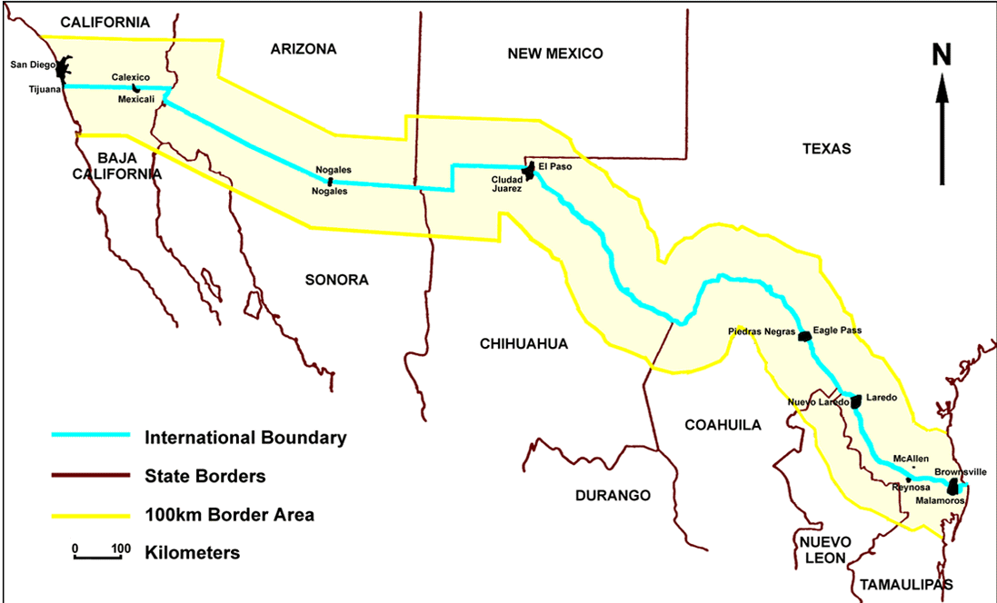
The Border

Slide 10
U.S. Border Challenges
3 of the 10 poorest counties in the U.S.
21 counties designated as economically distressed areas
Unemployment rate 250-300% higher than U.S. average
432,000 people live in 1,200 colonias in TX & NM; unincorporated, semi-rural communities, often with unsafe water supplies and substandard housing
United States Mexico Border Health Commission, 2008 http://www.borderhealth.org/border_region.php

Slide 11
U.S. Border Challenges
Higher incidence of infectious diseases compared with U.S. average
If made a state, border region would rank:
Last in access to health care
2nd in death rates due to hepatitis
3rd in deaths related to diabetes
Last in per capita income
1st in number of school children living in poverty
1st in number of uninsured children

Slide 12
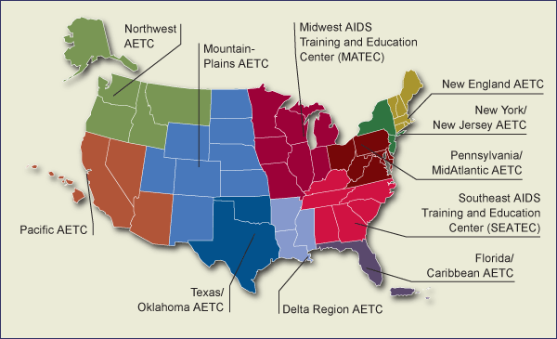
Regional AETCs
L

Slide 13
Federal Training Centers Border Collaborative
AIDS Education and Training Center (HRSA)
Prevention Training Centers (CDC)
TB Training Centers (CDC)
Addiction Technology Transfer Centers (SAMHSA)
CARDEA Services (Office of Population Affairs)

Slide 14
Notes:
Engagement is the most challenge aspect.
Less well studied than linkage and retention
Typically focuses on patients with prior HIV care lost-to-follow-up
Recently incarcerated represents another priority population for re-engagement
Engagement in care is vital for HIV treatment success at individual & population level
Engagement worse in groups bearing a disproportionate burden of US HIV epidemic
Critical role of nursing, outreach & supportive services in improving engagement in care

Slide 15
Clinical Capacity Building & Technology Using the Internet for collaborating, sharing and learning…and helping Maria
Notes:
Viral suppression using ART reduces morbidity and mortality for PLWHA, and has been shown to decrease sexual transmission of HIV by over 95%. However, most persons with HIV infection in the U.S. are not taking ART, either because they have not yet tested positive, or they encounter barriers to linkage and engagement in care and treatment. This slide shows a model of the spectrum of engagement in care.
In December 2011, the CDC reported findings from a analysis, which used 3 surveillance datasets with data reported thru 2010 to estimate percentages of adults living with HIV along this continuum of care. CDC’s estimate was that 28% of all HIV-infected persons in the U.S. have a suppressed viral load.
Interventions at all points along this spectrum are needed to slow the rate of HIV transmission.

Slide 16
AETCBorderHealth.org
Training and technical assistance resource library
Fact sheets, curricula, reports, links
Calendar of training events for border providers
Directory of border HIV/AIDS treatment and prevention agencies
Border Blog
Summaries of HIV/AIDS in the border states and counties

Slide 18
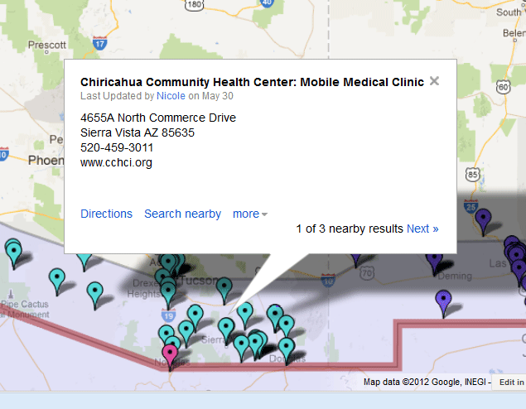
Resource Map on Google

Slide 19
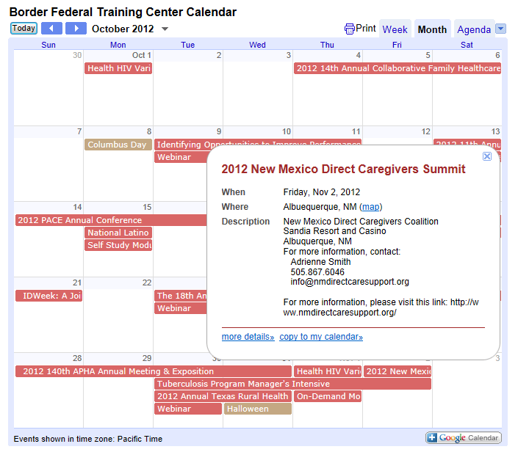

Slide 21
For Maria
Directly
She can find an HIV care provider on the map
Indirectly
The quality of care that she receives will be better with a well-trained health workforce
Her providers can use the map to find referrals to other community services

Slide 22
Online Education
Online Trainings/Education
What we can offer Maria’s providers
Online registration/viewing of trainings
Marketing: e-mail, social media, target, cross collaboration
LIVE vs. Recordings vs. On demand modules
Use of pods allow “chatting” and “speaker questions”
Encourage interaction/engagement (polling questions)
Immediate marketing and posting of recordings
Notes:
MARIA’S PROVIDERS HAVE LIMITED TIME TO RECEIVE HIV UPDATES & TRAINING.
Social media – twitter, facebook

Slide 23
Lessons Learned
Border challenge … limited time to attend continuing education & training events.
Distance learning = effective delivery of needed HIV updates, education on recipient’s schedule.
Notes:
Border challenge = Health Professional Shortage Area (HPSA), clinicians are limited in time.
Distance learning = opportunity to obtain information based on their schedule/availability.

Slide 24
Using Distance Learning
Project ECHO (Extension for Community Healthcare Outcomes)
Mission: to expand access to specialized care for vulnerable populations and underserved areas
Uses telehealth technology to reach providers
Use of technology to leverage specialized resources
Teaching best-practices care
Case-based learning
Outcomes monitoring
Notes:
“The patient-centered medical home is a model for care provided by primary care clinician practices that seeks to strengthen the clinician-patient relationship by replacing episodic care based on illnesses and patient complaints with coordinated care and a long-term healing relationship.” NCQA (www.ncqa.org)

Slide 26
Outcomes and Lessons Learned
HIV knowledge test scores improved from 68.5% to 76.4% (p= 0.03).
95% reported using information received
89% reported they believed attending the sessions influenced their practice.
Participants reported increased self-efficacy to treat PLWHA.
Perceived benefits of participating in the clinics included readily available expert consultation and continual practice.
How can we use this program to help Maria?
Notes:
Support for Medical Home: The National Committee for Quality Assurance released a set of voluntary standards for the recognition of physician practices as medical homes. Updated January 2011
There are other agencies that also have developed standards for PCMH recognition (JACHO; State programs)

Slide 27
Keeping Mobile Patients in Care Across and Between Borders Focus on HIV, STD, TB, Addiction, family planning, and others
Federal Training Centers Collaborative (FTCC) for the US/Mexico Border Region
Webinar
Wednesday May 30, 2012
AETCBorderHealth.org

Slide 28
Using the Migrant Clinicians’ Network and other Federal Training Centers …to help Maria
Notes:
“The patient-centered medical home is a model for care provided by primary care clinician practices that seeks to strengthen the clinician-patient relationship by replacing episodic care based on illnesses and patient complaints with coordinated care and a long-term healing relationship.” NCQA (www.ncqa.org)

Slide 29
Migrant Clinicians Network
Founded 1984
Force for justice in health for the mobile poor
Clinical focus
>10,000 constituents
MCN’s Health Network
Bridge Case Management
Continuity of Care for mobile patients
National/International

Slide 30
How Does Health Network Work?
Free!
Clinicians enroll patients
Records transfer when a patient moves
Contacting patients on a scheduled basis. Diabetes patients are contacted every three months, TB patients monthly, etc.
Providing patients with test results
Assisting patients in locating services and resources
Reporting back to the enrolling clinic and notifying of patient status.

Slide 31
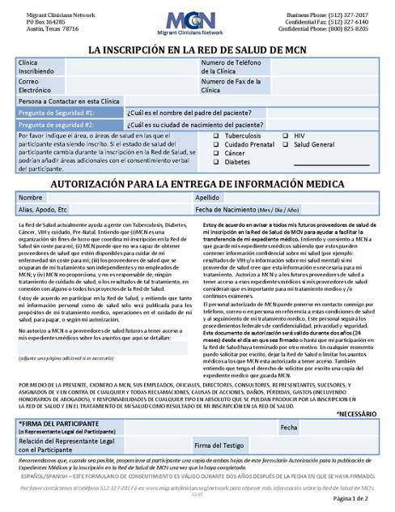
Two easy options for enrollment
31
Notes:
31

Slide 32
Contact Health Network
1-800-825-8205 (U.S.)
01-800-681-9508 (from Mexico)
http://www.migrantclinician.org
If you have additional questions about the program, you may also contact Ricardo Garay: 512-579-4508 or rgaray@migrantclinician.org

Slide 33
Continuity of Care and Substance Use
Pacific Southwest ATTC (CA, AZ)
In California: pacificsoutwestca@attcnetwork.org
In Arizona: pacificsouthwestaz@attcnetwork.org
South Southwest ATTC (NM, TX)
gulfcoast@attcnetwork.org
Notes:
The Substance Abuse and Mental Health Services Administration (or ‘SAMHSA’) funds regional Addiction Technology Transfer Centers, or ATTCs. The 2 ATTCs serving the 4 US border states are the Pacific Southwest ATTC and the Guld Coast ATTC. For more information on these ATTCs and what they can offer your programs, please visit their websites.

Slide 34
Continuity of Care and Substance Use
SBIRT
Screen for a history of or current substance use
AUDIT, CAGE, ASSIST, DAST, etc.
Brief intervention to reduce risky substance use
Referral to SUD treatment, if indicated by results of screening
Patient Engagement Strategies
Same day SUD assessment
Reminder calls for scheduled appointments
Linking to a primary counselor immediately
Orientation groups (before enrolled in formal treatment)
Incentives to enter and continue in treatment
Notes:
How can the ATTCs help this clinic address Maria’s issues?
Before she fell out of care:
The ATTCs can, for example, offer trainings in SBIRT, to help reduce the harm from Maria’s drug use and help refer her to evidence-based treatment interventions. The ATTCs can also offer trainings on linking and keeping patients in substance abuse treatment programs, including maintenance programs. They can also help you locate programs in different US cities and connect Maria to services in her new city.
Also, the PS ATTC and the PAETC have developed a specific tool for HIV clinicians working with Methamphetamine Users. Please look on the resources page for a link to this updated tool called “Tips for HIV Clinicians Working with Meth Users.”
You can find all these resources at AETCBorderHealth.org

Slide 35
Continuity of Care and Substance Use
Searching for Available Treatment Programs
SAMHSA’s Treatment Locator: http://findtreatment.samhsa.gov/
HRSA’s FQHC Program Locator: http://www.bphc.hrsa.gov/
Types of services Maria could be referred to: 12-Step Meetings, Outpatient counseling, residential treatment
Notes:
These slide sets list SAMHSA and HRSA substance abuse treatment and FQHC locator sites, if you are helping Maria connect to services in a new US city.
What if Maria is returning to Mexico?
Unfortunately substance abuse treatment services are not offered as part of routine HIV care at the CAPASITS clinics in Mexico. However, it may be very useful to point out to Maria that 12-step programs are available throughout Mexico, often including small towns and rural areas. If she is connected to a 12-step program in the US she ill likely be able to connect to a new program in Mexico.
These resources are also available at AETCBorderHealth.org

Slide 37
In MY OPINION, the #1 reason patients keep coming back is…
Better Health Outcomes
Strong Clinic Relationships
Ancillary Services at Clinic
Fear of declining health
Other

Slide 38
Engagement in HIV Care on the United States-Mexico Border
MICRO WORKSHOP

Slide 39
HRSA Continuum of Engagement
Not in Care
Fully engaged
Unaware of HIV status | Aware of HIV status | May be receiving other medical care but not HIV care | Entered HIV medical care but dropped out | In and out of HIV care or infrequent user | Fully engaged in HIV medical care
Source: Cheever. Clin Infect Dis 2007;44:1500-1502
What about the Border?
Notes:
Most challenging aspect of engagement
Less well studied than linkage and retention
Typically focuses on patients with prior HIV care lost-to-follow-up
Recently incarcerated represents another priority population for re-engagement
Notes from another slide:
Linkage, retention, and re-engagement in care are distinct processes
Engagement in care is vital for HIV treatment success at individual & population level
Early missed visits may identify patients at risk for poor health outcomes
Engagement worse in groups bearing a disproportionate burden of US HIV epidemic
Critical role of nursing, outreach & supportive services in improving engagement in care

Slide 40
National HIV/AIDS Strategy for the U.S. The White House Office of National AIDS Policy (July 2010)
Primary goals:
Reduce new HIV infections
Increase access to care and improve health outcomes for people living with HIV
Reduce HIV-related health disparities

Slide 41
Have you ever lost contact with an HIV client/patient (or they fell out of care)?
I’m not involved in HIV care.
Nope, never.
Yes, once
Yes, 2-5 patients
Yes, more than 5 patients

Slide 42
If this were your agency, who would be responsible for (re)contacting Maria?
Case manager
Front office staff
Nobody
Nurse
Other/unsure

Slide 43
Do you think the community clinic would have an email address for Maria?
YES
NO
I’m not sure

Slide 44
Do you think Maria could access HIV medications in the ICE facility?
YES
NO
I’m not sure

Slide 45
Do you think Maria could access HIV medications in Mexico?
YES
NO
I’m not sure

Slide 46
How can the border-region Federal Training Centers help you?

Slide 47
Questions & Evaluation AETCBorderHealth.org
Notes:
** EVERY INTERACTION IS AN INTERVENTION **

