Slide 1
HIV and HPV:
What’s New for Men & Women
Karla Maguire MD, MPH
Jorge Garcia, MD
Isabella Rosa-Cunha MD
JoNell Potter PhD, RN
University of Miami, Miller School of Medicine

Slide 2
Epidemiology of HPV and HIV & SCREENING FOR CERVICAL CANCER
Karla Maguire MD, MPH

Slide 3
Financial Disclosures
None

Slide 4
Objectives
Discuss HPV and its association with cancer
Describe the ways HPV is different in HIV positive women
Understand screening for cervical cancer in HIV negative and HIV positive women

Slide 5
Human Papilloma Virus (HPV)
Common sexually transmitted infection
> 100 types
  40 infect cervix
  13 oncogenic (16, 18, 31, 33…) → cancer
  6, 11 → genital warts
CDC Guidelines for Prevention and Treatment of Opportunistic Infections
in HIV-infected adults and adolescents, MMWR, 2009.
Notes:
HPV 16 – 50% of cervical cancers
HPV 18 – 10-15%
HPV 6, 11 – 90% genital warts

Slide 6
HPV is common
Estimated Incidence: 6.2 million/year¹
Estimated prevalence: 20 million¹
Women 50 years of age: 80% will have acquired genital HPV infection²
Sexually active,15-24 years old, currently infected: 9.2 million³
1. CDC National prevention Information network, 2004. 2. Cates W, Sex Transm Dis, 1999.
3. Weinstock H, Perspect Sex Reprod Health, 2004.

Slide 7
HPV and HIV
HPV is more persistent in HIV positive women
Higher levels of HPV are detected in HIV positive women
Multiple HPV infections are more common in HIV positive women

Slide 8
HPV and HIV - Persistence
HPV Type | HIV Positive : Persistent HPV Infection (%) | HIV Negative : Persistent HPV Infection (%)
High risk: HPV 16 associated | 14.1 | 3.0
High risk: HPV 18 associated | 8.2 | 0
Intermediate risk | 6.4 | 0.9
Low risk | 1.8 | 0.4
Any | 24.1 | 3.9
Sun XW, NEJM, 1997.

Slide 9
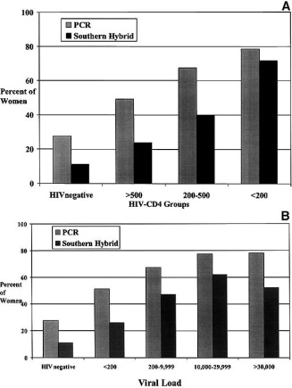
HPV and HIV - Persistence
Jamieson DJ, AJOG, 2012.

Slide 10
HPV and HIV – Higher levels
Measure of Expression | HIV positive | HIV negative | PR (95 CI)
PCR signal intensity (3 or 4) | 80.6% | 62.6% | 1.3 (1.1 – 1.5)
Jamieson DJ, AJOG, 2012.

Slide 11
HPV and HIV – Multiple infections
Measure of Expression | HIV positive | HIV negative | PR (95 CI)
≥ 2 HPV infections by PCR | 37.8% | 19.6% | 1.9 (1.3 – 2.9)
Jamieson DJ, AJOG, 2012.

Slide 12
Audience Response Question
Which cancer is NOT associated with HPV infection?
  Cervix
  Vulva
  Vagina
  Ovary
  Penis
  Oral cavity
  Oropharynx
CDC Guidelines for Prevention and Treatment of Opportunistic Infections
in HIV-infected adults and adolescents, MMWR, 2009.
Notes:
Right answer d) ovary

Slide 13
HPV
Persistent HPV infection can lead to:
  Warts
    Genital
    Anal
    Oral
  Cancer precursors
    CIN
    VIN
    VAIN
    AIN
  Cancer (squamous and adeno)
    Cervix
    Vulva
    Vagina
    Oral cavity
    Penis
    Oropharynx

Slide 14
HPV Symptoms
Warts
  Flat, papular, pedunculated growths
  Millimeters to centimeters
  Multiple or single
  Asymptomatic, itching, discomfort
Cancer precursors
  Asymptomatic
Cancer
  Asymptomatic, bleeding, pain, mass
CDC Guidelines for Prevention and Treatment of Opportunistic Infections
in HIV-infected adults and adolescents, MMWR, 2009.

Slide 15
HPV and Cancer
Anatomic site | Total cancers* | % estimated HPV attributable fraction†
Cervix | 11,820 | 100
Anus | 4,187 | 85
Vulva/vagina | 4,577 | 40
Penis | 1,059 | 40
Oral/pharyngeal | 29,627 | 15
* CDC. Quadrivalent human papillomavirus vaccine: recommendations of the Advisory Committee on Immunization Practices. MMWR 2007;56(No. RR-2):1–24. † Parkin M. Presented at the International Papillomavirus Conference, Vancouver, Canada, 2005
U.S. Cancer Statistics Working Group, http://www.cdc.gov/vaccines/pubs/surv-manual/chpt05-hpv.pdf

Slide 16
Audience Response Question
The incidence rate of cervical cancer in women with AIDS is how many times more than the general population?
  2
  3
  5
  9
  20
Mbulaiteye SM, J Acquir Immune Defic Syndr, 2003.
Notes:
Right answer:d (9)

Slide 17
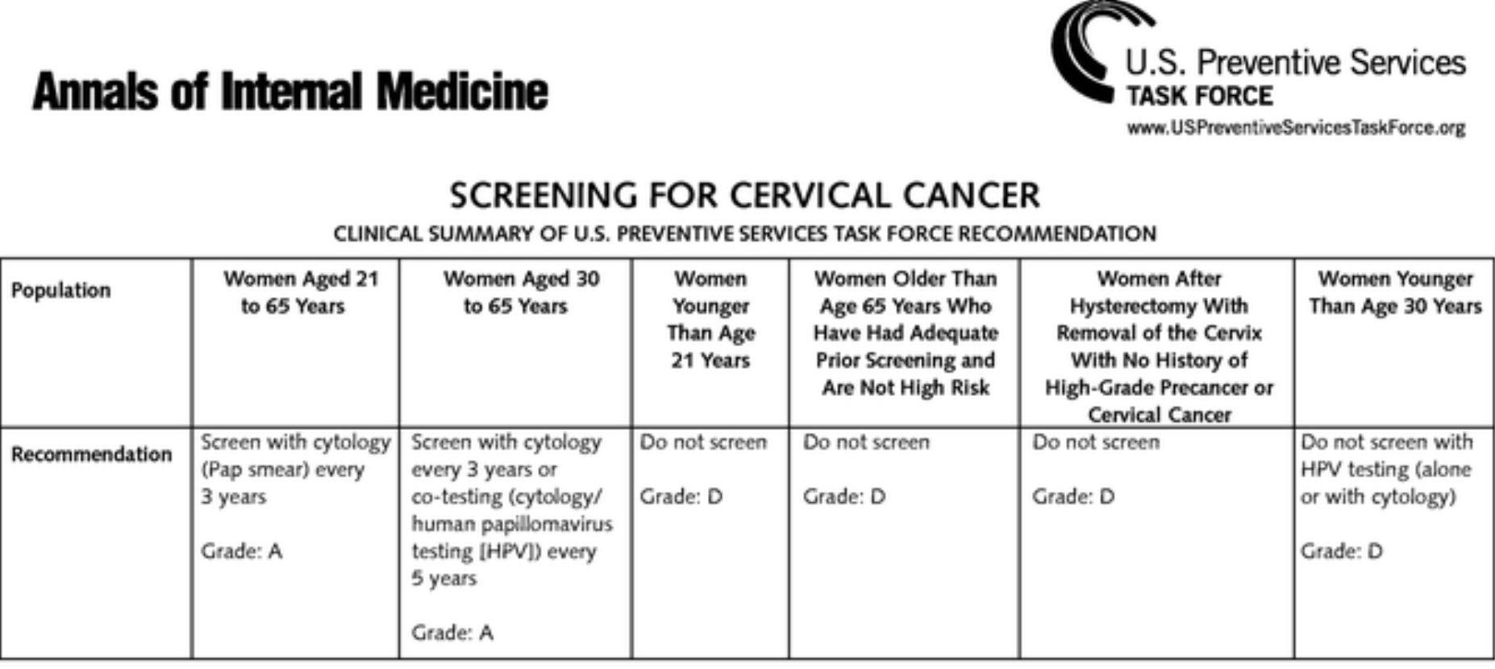
Cervical Cancer Screening
USPTF recommendations for routine screening
Moyer VA, Ann Intern Med, 2012.
Notes:
Patient Population Under Consideration
This recommendation statement applies to all women
who have a cervix, regardless of sexual history. This recommendation
statement does not apply to women who have
received a diagnosis of a high-grade precancerous cervical
lesion or cervical cancer, women with in utero exposure to
diethylstilbestrol, or women who are immunocompromised
(such as those who are HIV positive).

Slide 18
Screening
However, these new recommendations do not apply to:
  Women who have received a diagnosis of high grade precancerous cervical lesion or cancer
  In utero exposure to DES
  Immunocompromised women
Moyer VA, Ann Intern Med, 2012.

Slide 19
Screening
Screening for HIV positive women
  Twice the first year after diagnosis
  Annually thereafter
CDC Guidelines for Prevention and Treatment of Opportunistic Infections
in HIV-infected adults and adolescents, MMWR, 2009.

Slide 20
Screening
HIV positive women should be referred to colposcopy if their pap result is:
  ASCUS
  ASC-H
  AGC
  LSIL
  HSIL
Currently insufficient evidence for use of HPV as an adjunct to testing
CDC Guidelines for Prevention and Treatment of Opportunistic Infections
in HIV-infected adults and adolescents, MMWR, 2009.

Slide 21
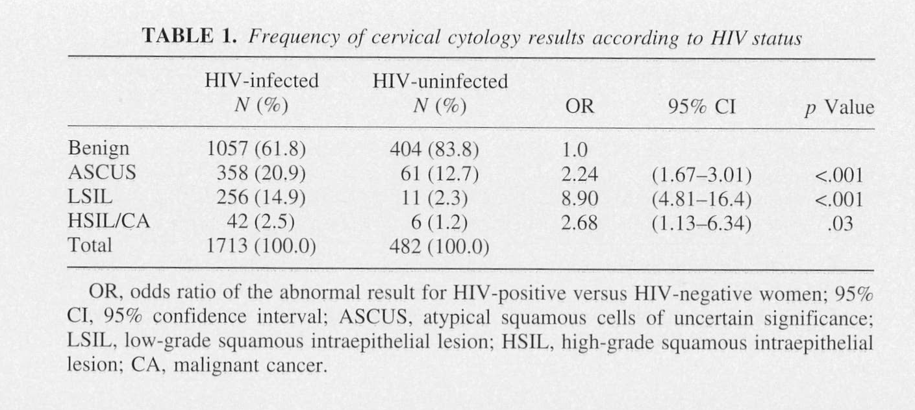
Screening
Massad LS, JAIDS, 1999.

Slide 22
Results of screening
Approximately 40 percent of HIV positive women will need follow-up with colposcopy!

Slide 23
EVALUATION AND TREATMENT OF ANOGENITAL HPV INFECTIONS IN HIV POSITIVE WOMEN
Jorge J GaRCIA MD

Slide 24
Objectives
Identify the clinical findings associated with anogenital HPV infections
Understand the histologic basis of abnormal colposcopic/anoscopic patterns
Discuss treatment options for managing anogenital intraepithelial neoplasia

Slide 25
Goals of Anogenital Cancer
Screening
Identify and treat high-grade cancer precursors.
Reduce a woman’s risk of developing invasive cancer.
Prevent unnecessary and potentially hazardous evaluations and treatment.
Minimize costs to healthcare system.

Slide 26
Current Approach to Anogenital Cancer Prevention
Requires 3 separate but linked components
  Screening (cytology with or without HPV DNA testing)
  Evaluation of screen positive women using colposcopy/anoscopy and biopsy
  Treatment of women with biopsy-confirmed high-grade cancer precursors
Wright T, Obst Gynecol, 2004.

Slide 27

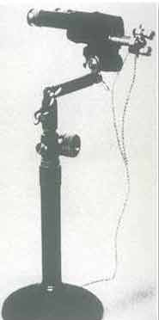
Hans Hinselmann
http://commons.wikimedia.org/wiki/File.HansHinselmann.png

Slide 28
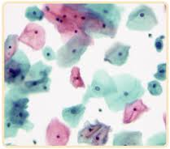
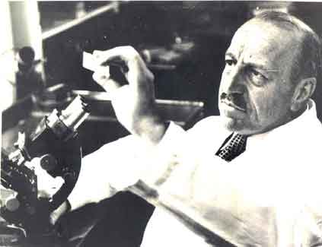

Georgios N. Papanikolaou
http://medicalhistory.blogspot.com

Slide 29

Harald zur Hausen
http://www.bestontop10.org/?p=636

Slide 30
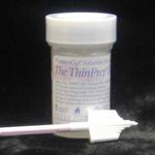

Anogenital Cancer Screening Today
Liquid media and sampling devices
Bethesda Classification
HPV testing
New screening guidelines
ASCCP algorithms
Anal screening- no guidelines
http://www.wcpl.com/physician_supplies.asp

Slide 31
Evaluation
Inspection
Bimanual examination
DRE (digital rectal examination)
Colposcopy
Digital imagining
Biopsies

Slide 32
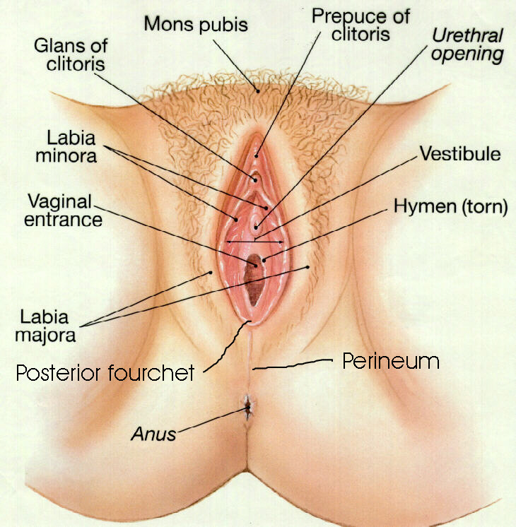
Anatomy
http://healthy-life-for-all.blogspot.com

Slide 33
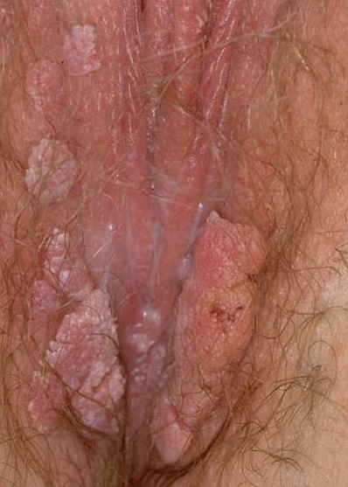
Clinical Findings
http://genital-warts-medication.com

Slide 34
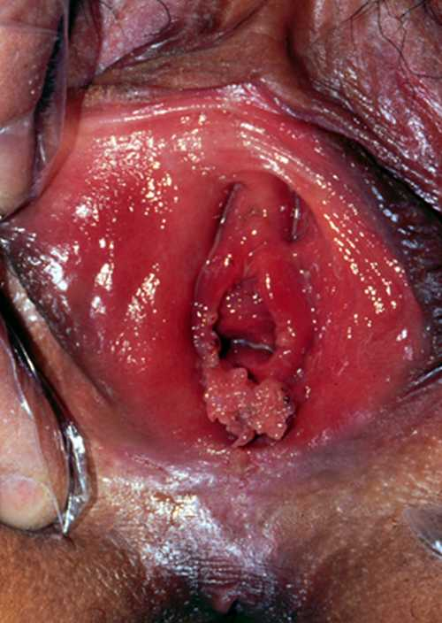
Clinical Findings
http://genital-warts-medication.com

Slide 35
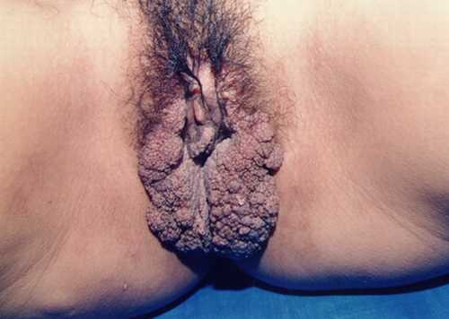
Clinical Findings
http://genital-warts-medication.com

Slide 36
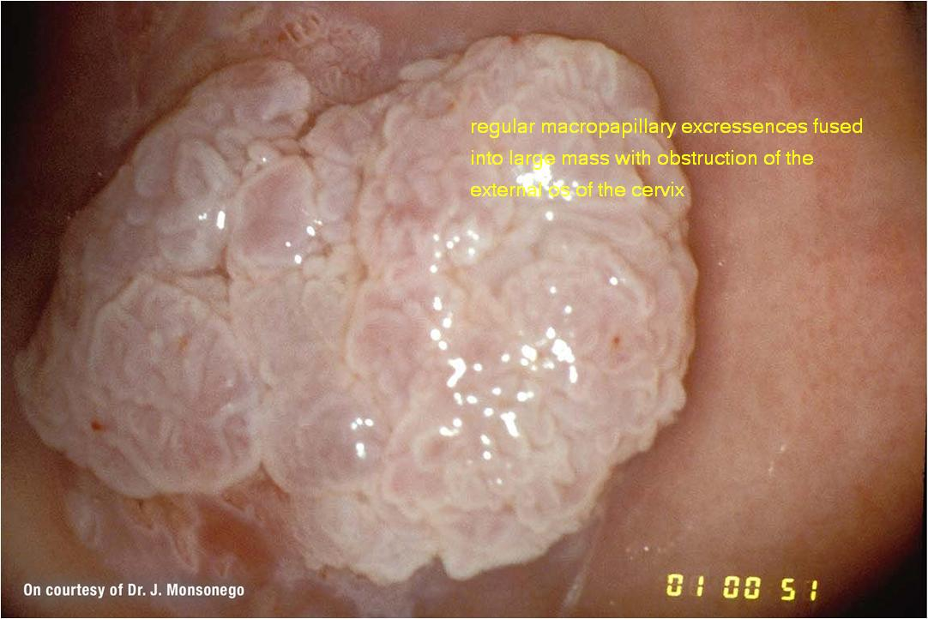
Clinical Findings
http://www.shifa2006.net

Slide 37
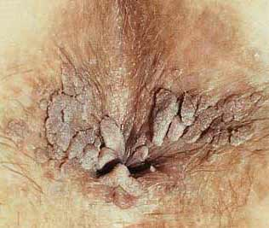
Clinical Findings
http://genital-warts-medication.com

Slide 38
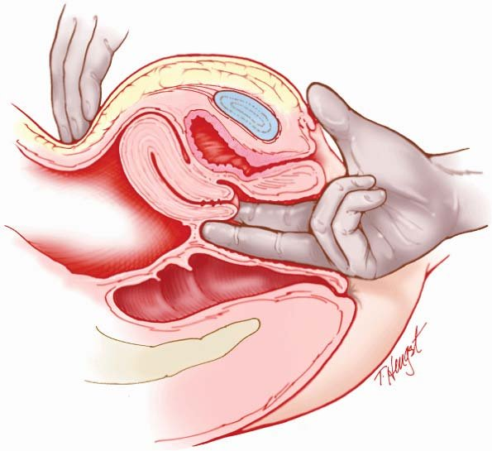
Bimanual Exam
http://www.epubbud.com/read.php?g=XWL9CAZ3&p=1

Slide 39

DRE (digital rectal exam)
http://artofanesthesia.blogspot.com

Slide 40
Colposcopy
Localize the T-zone (squamo-columnar junction.
Evaluate the extent of the disease.
Locate the area most suspicious (for biopsy).
Determine if invasive cancer exists.

Slide 41
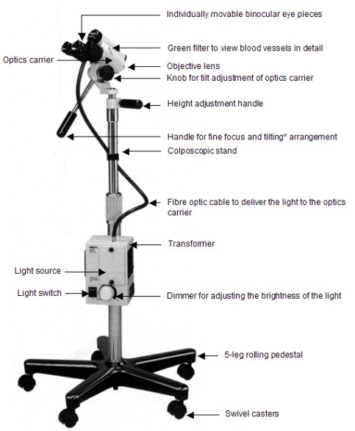
Colposcope
http://screening.iarc.fr/colpo.php

Slide 42
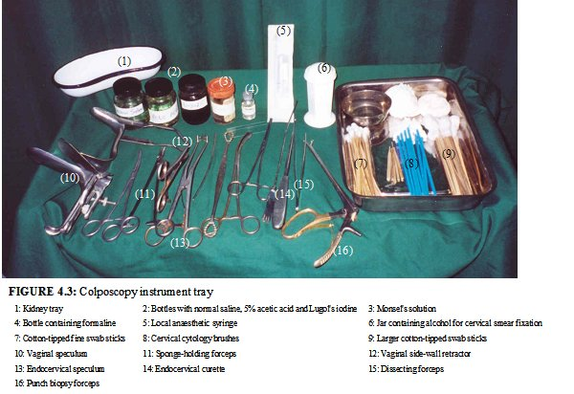
http://screening.iarc.fr/colpo.php

Slide 43
Audience Response Question
Acetic acid has all of the following properties except:
Coagulates and clears the mucous
Causes swelling of tissue
Is glycophilic
Causes a reversible coagulation and precipitation of the nuclear proteins and cytokeratins
Notes:
Correct answer #3 (c) is glycophilic

Slide 44
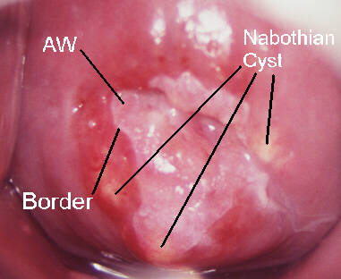
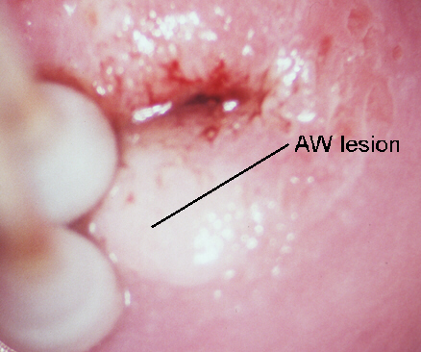
Acetic Acid
3-5 %
Reversible precipitation of nuclear proteins and cytokeratins.
  Reaction known as Acetowhitening.
  Directly related to the nuclear density
Vazquez E. General Principles of Colposcopy, Residents Academic Day 7/22/2010 #7

Slide 45
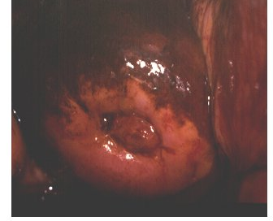
Schiller’s (Lugol’s) iodine test
Mature squamous epithelium = glycogen
CIN and invasive Cancer = no glycogen
Iodine is glycophilic
No uptake looks yellow (mustard color)
Vazquez E. General Principles of Colposcopy, Residents Academic Day 7/22/2010 #7

Slide 46
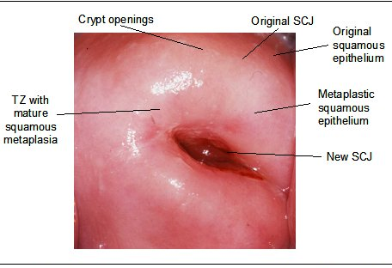
Colposcopy
Normal Cervix
http://screening.iarc.fr/colpo.php

Slide 47
Squamocolumnar Junction
Intersection between cervical glandular columnar epithelium and squamous epithelium
Exposed columnar epithelium undergoes gradual replacement by squamous epithelium (squamous metaplasia)= Transformation Zone
Location of neoplastic change
Important landmark for
colposcopy
Auerbach R, www.coopersurgical.com/pages/residencyprograms.aspx

Slide 48
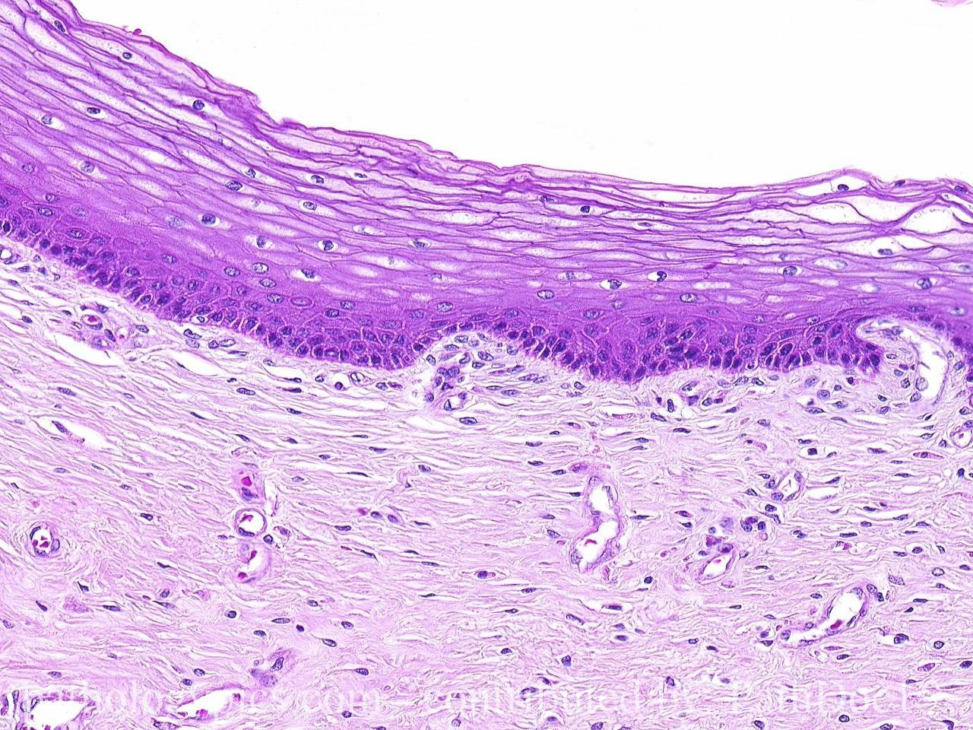
Stratified Squamous Epithelium
Vazquez E. General Principles of Colposcopy, Residents Academic Day 7/22/2010 #7

Slide 49
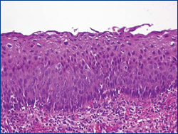
Dysplasia
Vazquez E. General Principles of Colposcopy, Residents Academic Day 7/22/2010 #7

Slide 50
Colposcopic Findings
The colposcopic diagnosis of cervical neoplasia depends on the recognition of four main features:
Intensity (color tone) of acetowhitening
Margins and surface contour of acetowhite areas
Vascular features
Color changes after iodine application

Slide 51
Aceto-White Epithelium
Auerbach R, www.coopersurgical.com/pages/residencyprograms.aspx

Slide 52
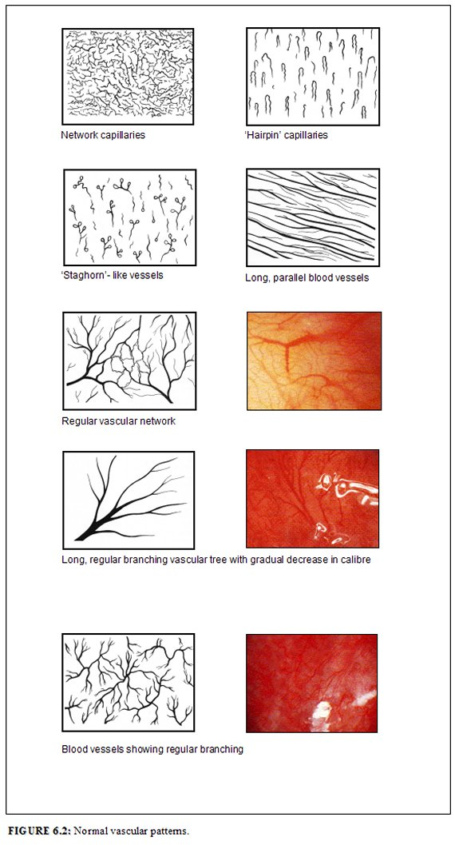
Normal Vascular Patterns
http://screening.iarc.fr/colpo.php

Slide 53
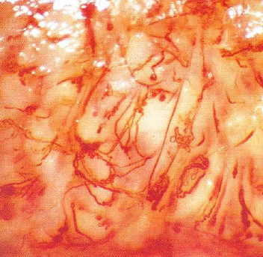
Abnormal Vascular Patterns
Auerbach R, www.coopersurgical.com/pages/residencyprograms.aspx

Slide 54
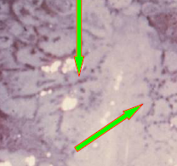
Punctations
Auerbach R, www.coopersurgical.com/pages/residencyprograms.aspx

Slide 55
Mosaicism
Auerbach R, www.coopersurgical.com/pages/residencyprograms.aspx

Slide 56
Schiller’s test
Vazquez E. General Principles of Colposcopy, Residents Academic Day 7/22/2010 #7

Slide 57
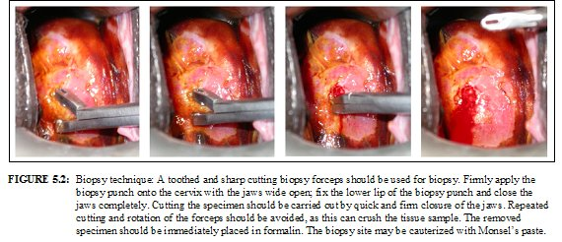
Cervical Biopsy
http://screening.iarc.fr/colpo.php

Slide 58
Audience Response Question
All of the following are treatment options for cervical dysplasia except:
Cryotherapy
Trichloroacetic acid
LEEP (loop electrocoagulation excision procedure)
Laser vaporization
CKC (cold knife conization)
Notes:
Correct answer #2 (b) Trichloroacetic acid

Slide 59
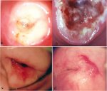
Cryotherapy
http://screening.iarc.fr/colpo.php

Slide 60
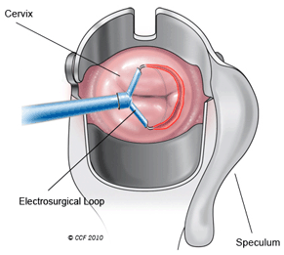
Loop Electrocoagulation
Excision Procedure
LEEP
http://my.clevelandclinic.org

Slide 61
Audience Response Question
New technologies likely to play a significant role in anogenital cancer screening in the future are:
p16 staining
Digital imaging and computerized wavelength analysis
Viral DNA methylation
Anal cytology and anoscopy for high risk patients
All of the above
Notes:
Correct answer #5 (e) all of the above

Slide 62
Anal Screening
Women with CIN, VIN, VAIN, and EGW may also present with AIN.
We should consider AIN as part of a
multicentric disease of the lower genital tract .
Anal cytologic screening should be offered to these women.

Slide 63
Anal HPV and HIV isabella Rosa-Cunha, Md

Slide 64
Financial Disclosures
None

Slide 65
OBJECTIVES
Anal Dysplasia and HIV
Screening anal dysplasia
Setting up anal dysplasia clinic

Slide 66
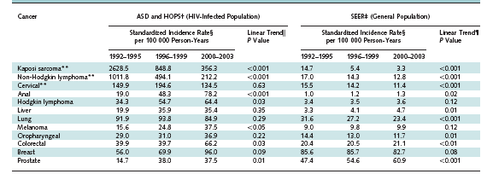
Patel P et al. Annals of Int Med 2008.

Slide 67
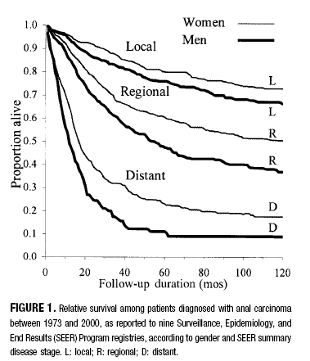
Johnson et al. Cancer 2004.

Slide 68
Audience Response Question
HIV-infected individuals at risk for anal dysplasia are…
  HIV-infected men who have sex with men.
  HIV-infected men and women engaging in anal sex.
  HIV-infected men and women.
  A+B.
Notes:
Right answer: C

Slide 69
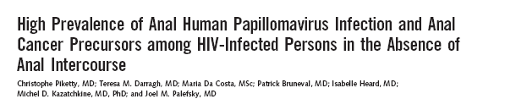
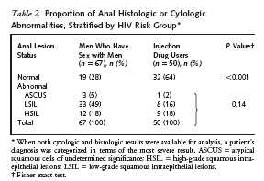
Piketty C et al. Ann Inter Med 2003.

Slide 70
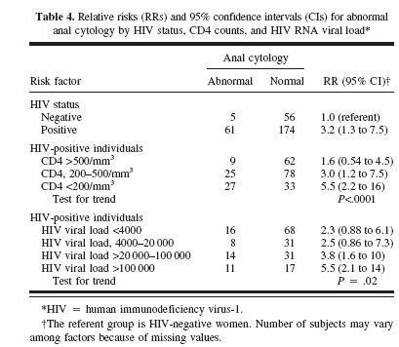
Holly E et al. J Natl Cancer Inst 2001.

Slide 71
ANAL HPV DISEASE
ANAL
HPV INFECTION
CONDYLOMA
ANAL INTRAEPITHELIAL NEOPLASIA
AIN I,II,III
ANAL CANCER

Slide 72
ANAL INTRAEPITHELIAL NEOPLASIA (AIN)
IN A STUDY FROM SAN FRANCISCO
277 HIV-positive, 211 HIV-negative MSM
4 year follow up
Baseline anal cytology: normal, ASCUS or Low grade dysplasia.
49% HIV-positive progressed to high grade dysplasia.
17% HIV-negative progressed to high grade dysplasia.
IN A STUDY FROM SEATTLE
158 HIV-positive, 147 HIV-negative MSM
No anal dysplasia at baseline
21 months follow up
15% HIV-positive developed high grade dysplasia.
5 % HIV-negative developed high grade dysplasia.
Palefsky AIDS 1998; Critchlow AIDS 1995.

Slide 73
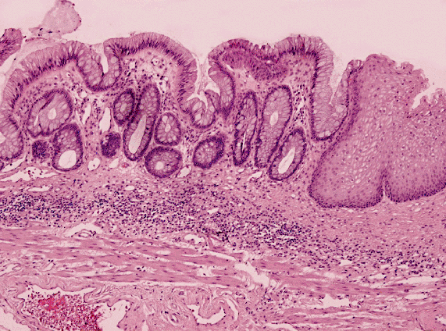
CERVICAL/ANAL CANCER
Caused by HPV.
Arise at the transitional
zone from columnar to
squamous epithelium.
http//www.lab.anhb.uwa.edu.

Slide 74
Anal cancer like cervical cancer is a potentially preventable disease…

Slide 75
Audience Response Question
Does your HIV practice offer anal dysplasia/cancer screening?
  Yes
  No
Mbulaiteye SM, J Acquir Immune Defic Syndr, 2003.
Notes:
Both answers are acceptable.

Slide 76
There are no national and/
or international guidelines…

Slide 77
New York HIV Clinical guidelines
In order to receive state or Federal HIV funding, health centers
must perform routine anal pap smear in HIV-infected individuals:
MSM, h/o anogenital condyloma and women with abnormal
cervical and/or vulvar histology.
Newly established society
International Anal Neoplasia Society (IANS).
http://ians.memberlodge.org

Slide 78

Joel Palefsky, MD. UCSF Medical Center
www.ucsfhealth.org/images/doctors

Slide 79
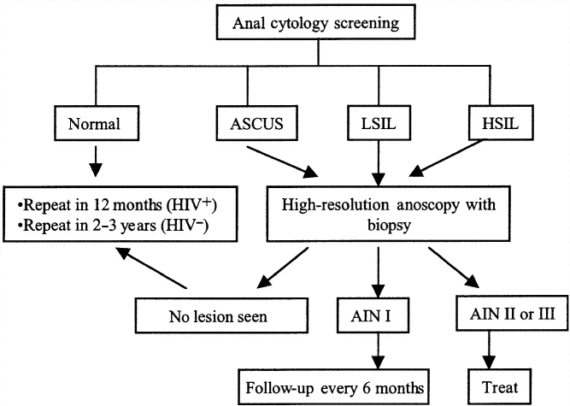
Anal Pap Smear Screening
Chin-Hong and Palefsky 2006.

Slide 80
DRE (digital rectal exam)
http://artofanesthesia.blogspot.com.

Slide 81
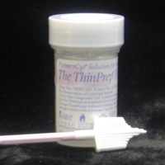


ANAL PAP SMEAR
Liquid Media
Polyester Swab

Slide 82
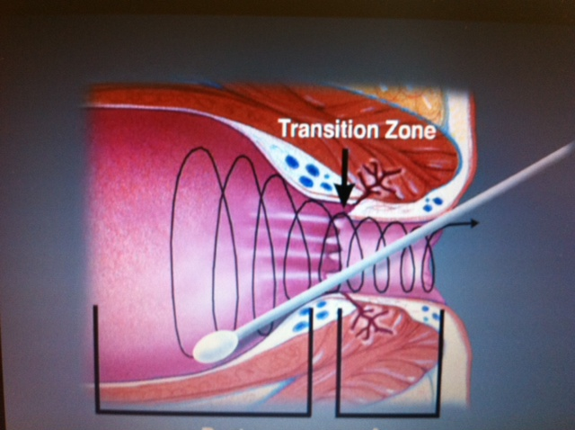
Pennsylvania/MidAtlantic AETC.

Slide 83

Anal Pap Smear: A Simple, Fast and Easy Procedure
Source: Pennsylvania/MidAtlantic AETC
Instructional video on performing anal Pap smears.
Available on CD-ROM. Call the Johns Hopkins Local Performance site
to order: 888-333-2855 (toll-free).

Slide 84
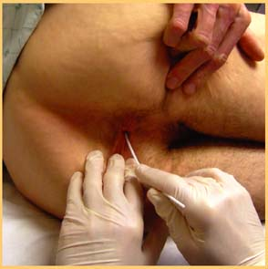
ANAL CYTOLOGY
http://5minuteconsult.com

Slide 85
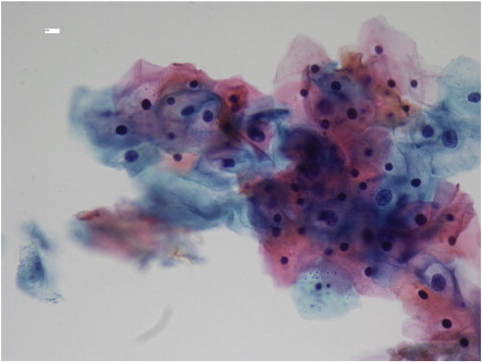
Bethesda Criteria: no malignant cells, AS-CUS, LSIL, HSIL.
Adam et al. Gynecol Oncol 2012.

Slide 86
ANAL CYTOLOGY
Sensitivity- 69% to 93%
Specificity- 32% to 59%
Palefsky et al. J Acquir Immune Defic Synd Hum Retrovirol 1997; Mathews et al. J Acquir Immune Defic Syndr 2004;
Lee et al. Int Conf AIDS 2004; Panther et al. CID 2004; Fox et al. Sex Transm Infect 2005; Salit at al. Annual Conference in Retroviruses
and Opportunistic Infections 2005.

Slide 87
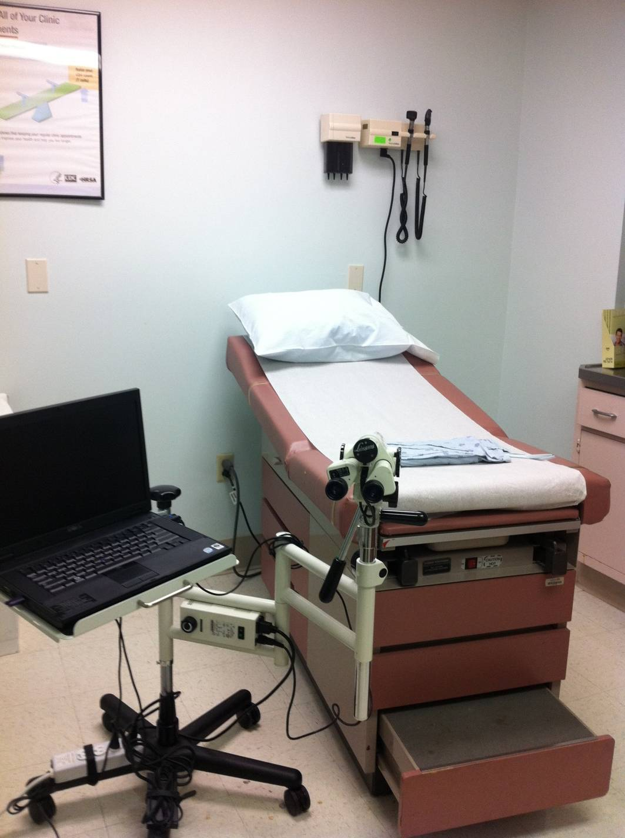

Slide 88
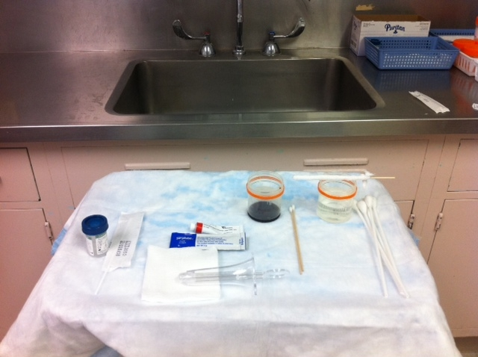

Slide 89
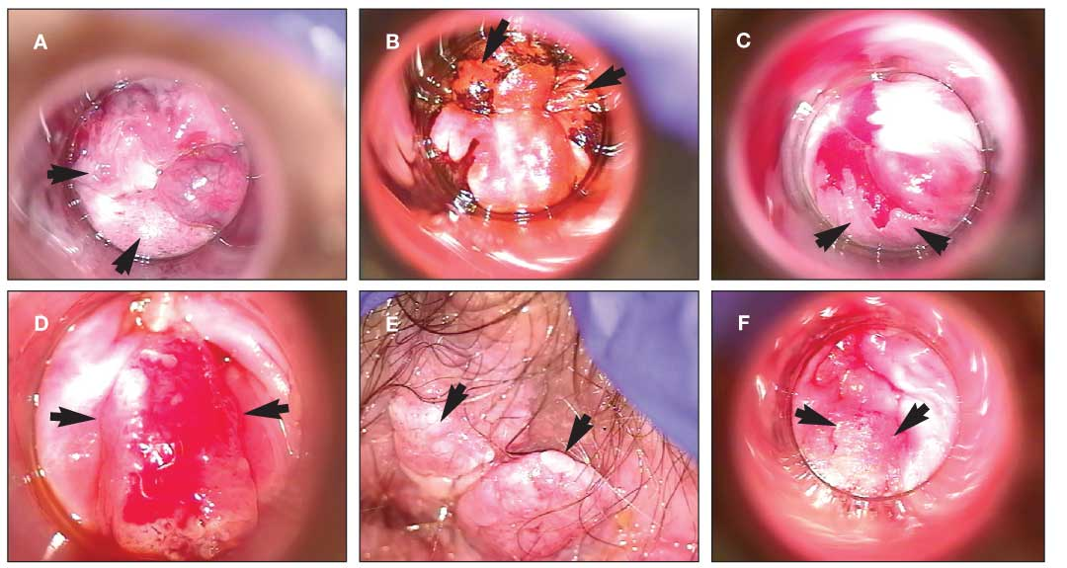
AIDS Reader 2009. vol19 No5.

Slide 90
HISTOLOGY
Low-grade
squamous lesion
(LGAIN)
AIN I (mild dysplasia)
AIN II (moderate dysplasia)
AIN III (severe dysplasia or carcinoma in situ (CIS))
High-grade
squamous lesions
(HGAIN)

Slide 91
TREATMENT
Patient-applied:
5% imiquimod
0.5% podofilox gel
5% fluoracil cream
Clinician-applied:
Cryotherapy
Infra red coagulation
Electrocautery
Laser ablation

Slide 92
COST- EFFECTIVENESS
Anal cytology has previously been shown to be a cost-effective screening method
for the detection of squamous intraepithelial lesions
in populations at high-risk for developing anal carcinoma.
Annual screening of HIV-positive MSM with anal Pap tests
provided an incremental cost-effectiveness ratio of $16,600 per quality-adjusted
life year saved.
This ratio is comparable with other widely accepted
screening procedures, such as screening for colon cancer in the general population.
Goldie SJ et al. JAMA 1999; 281:1822–1829; Inadomi. Curr Opin Gatroenterol 2003.

Slide 93
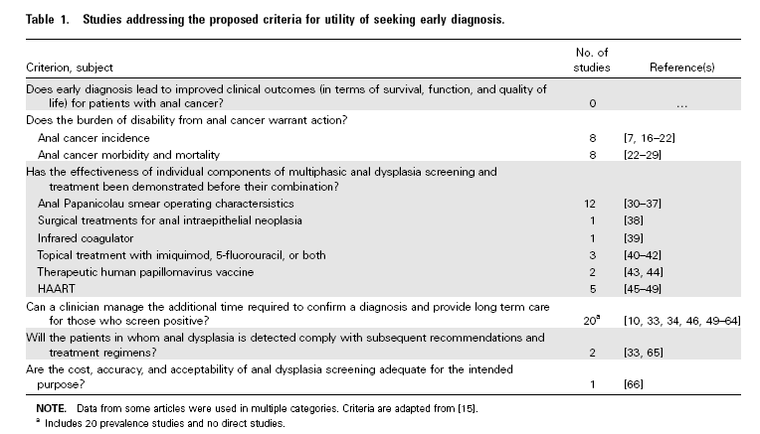
DOES IT MAKE A DIFFERENCE?
Chiao EY et al. CID 2006: 43(15 July).

Slide 94
CERTIFICATION
Currently there are no national and/or international specific requirements
or board certification to perform HRA.
You will need to work with your institution to request privilege.
There are colposcopy and HRA courses by ASCCP.

Slide 95
BILLING
There is no billing code for a visit for anal cytology collection.
There are billing codes for the cytology billing:
88108 for liquid based cytology.
88104 for conventional brushing.
88160 for anal-rectal smears using Dacron® swab.
88112 for selective cellular enhancement technique with interpretation.

Slide 96
BILLING
High resolution Anoscopy CPT Codes:
Category I
46600- Anoscopy w/wo collection specimen.
46606- Anoscopy w/Biopsy, single or multiple.
Category III
0226T- anoscopy High Resolution w/specimen collection.
0227T- anoscopy High Resolution w/biopsy.

Slide 97
The goal of screening is to detect anal dysplasia early and eradicate AIN, preventing the progression of such lesions to invasive squamous cell carcinoma.

Slide 98
The optimum use of HPV testing,
alternative screening methods
and impact of HPV vaccination on anogenital HPV infection
are yet to be defined.
Notes:
alternative screening methods such as direct visualization or ‘optical biopsy’ of the anal mucosa (e.g. akin to digital cervicography and speculoscopy),

Slide 99
A heighted awareness of anal cancer among HIV-infected
individuals is warranted and anal health should be an issue
of priority in HIV care.

Slide 100
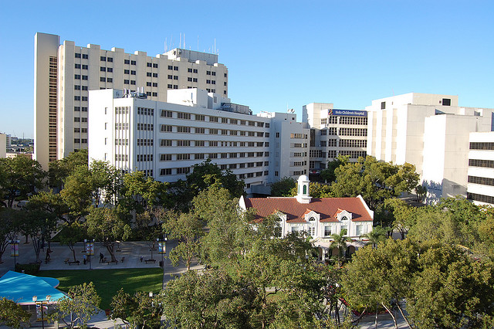
Thank you!

