Slide 1
The Impact of the Community-Based Dental Partnership Program on Changes in Dental Student HIV Knowledge, Attitudes and Clinical Practice
Presenters:
Jane Fox, MPH, Boston University
Jill York, DDS, MAS, University of Medical and Dental Medicine, New Jersey
Theresa Mayfield, DDS, University of Louisville
Aki Papatzimas, DDS, Nova Southeastern University
Serena Rajabiun, MA, MPH, Boston University

Slide 2
Project Background
HRSA/Ryan White HIV/AIDS program Part F funded since 2002
Expand the Nation’s capacity to deliver oral health care to PLWHA
12 grantees training dental professionals (4th yr students and residents) while providing oral health care to PLWHA
Notes:
Session Learning Objectives:
Describe the CBDP program’s role in training dental students in working with HIV infected patients in the dental setting.
Discuss findings related to changes in students’ attitudes and knowledge in providing dental care to HIV-infected patients.
Review recommendations for educational methodologies in training future dentists to provide oral health care to HIV-infected patients.

Slide 3
Evaluation
HDWG/ECHO project supplemental grant in 2010
Year one = 5 sites
UMDNJ
University of Louisville
Nova Southeastern
Columbia
Bu
Year two = 6 sites
Loma Linda

Slide 4
Methodology
Pre test prior to starting the CBDP experience
Assessment of knowledge attitudes and practices
Assessment of preparation
Post test after completing the CBDP experience
Changes in knowledge attitudes and practices
Post assessment of preparation
Post graduation survey

Slide 5
Methodology (cont)
Qualitative interviews
Group interview with project staff
Length of rotation
Methods for teaching about HIV
Supervised clinical experience for the students
Perceptions of this program on students
Suggestions for modification of their CBDP program or curriculum

Slide 6
University of Medical and Dental Medicine of New Jersey
Jill York, DDS, MAS

Slide 7
UMDNJ CBDPP Overview
NJDS: Only dental school in the state
Partner Organization: Access One, Inc.
Collaborative Initiatives
UMDNJ-School of Osteopathic Medicine
Cooper Health Systems Early Intervention Program
Kennedy Health Systems Early Intervention Program
South Jersey AIDS Alliance
Metropolitan Area Neighborhood Nutrition Alliance
New York/New Jersey AIDS Education and Training Center
Community Based Dental Centers

Slide 8
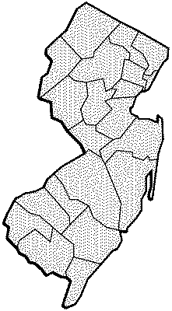
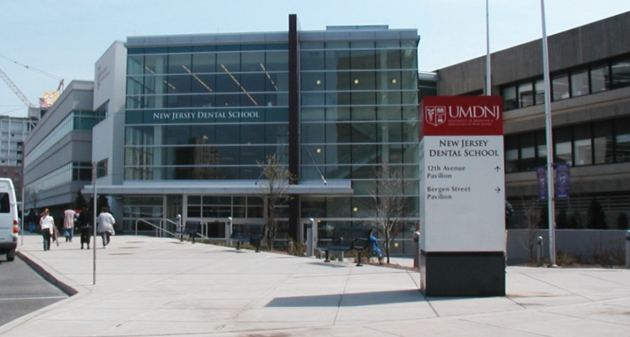
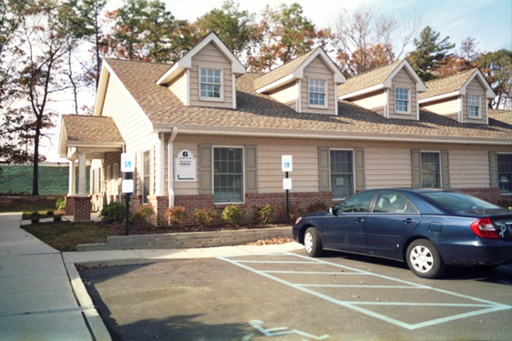
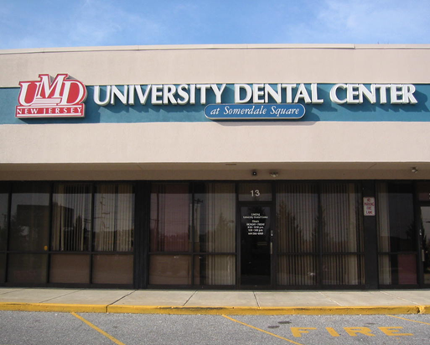
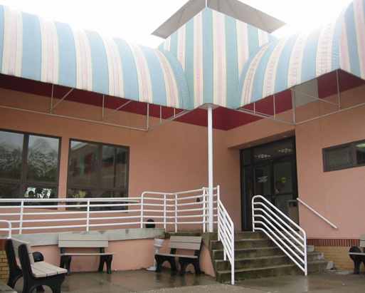
●
●
●
●

Slide 9
Service Learning Experience
Purpose:
To educate the fourth-year dental students to care for the HIV-infected patient in the clinical setting
To better understand the broader medical and social challenges affecting this population
Programs:
CODE (1994-Present) – majority of the academic year (37.5 hours per week for approximately 32 weeks) at community based site
CODE II (2008-Present) – a minimum of two consecutive weeks (75 hours) at a community based site

Slide 10
Objectives
Understand dental needs of HIV/AIDS patients in a broader medical/social context
Provide comprehensive care to patients with HIV/AIDS
Evaluate medical information (including lab reports) to render dental care in a safe manner
Develop an enhanced comfort level and understanding of the population of HIV/AIDS individuals

Slide 11
Curriculum
First-year: Cultural Dynamics and Humanism in Dentistry Course
Second-year: Communication in Health Care
Third-year: Dentistry in the Community
Fourth-year: Ryan White Program Orientation
CODE (minimum of 10 hours of didactic training)
Substance Abuse and the HIV Patient
HIV: Politics, Gender and Religion -- A Global View
30 Years of Research…and the Berlin Patient
HIV in Persons Over 50
HIV and Oral Medicine: Case Reports
Update on HIV Medications

Slide 12
Clinical Rotations
Direct patient care at one of the School’s community based dental centers
Delivering a full range of services
Full mix of patients
Patient population

Slide 13
Evaluation
Attendance
Clinical Sessions – Performance Based
Participation during Lectures
Pre- and Post-Test Surveys
Reflective Assignment

Slide 14
Lessons Learned - Students
“Probably seeing an 11 year old boy who was HIV positive. It’s one of those things, you only read about, but it definitively changed me for the better.”
“The diversity in the patient need base and how each patient has different priorities with respect to their dental health, or in some cases, lack thereof.”
“I took her (28 year old habitual drug user, HIV+, HEP C female) to a mirror and she started to cry. ‘You really gave me a second chance at life… I’m a new person.’ I felt her sincere reaction and it changed me.”
“The dental practice is a team work between patient, doctor and staff. This understanding will help me in my future practice.”

Slide 15
Lessons Learned - UMDNJ
Substantial potential for affecting the values and behaviors for dental students relative to health care access for underserved populations.
Effective integration requires specific student preparation in cultural awareness, communication skills, and the social and behavioral sciences.
Reflective components, evaluation, and highly organized community-based experiences ensure that student learning is maximized.
Provides dentistry with an opportunity to guide values of the dental faculty and students and orient them towards public service, engagement, ethics, and the health of the public.

Slide 17
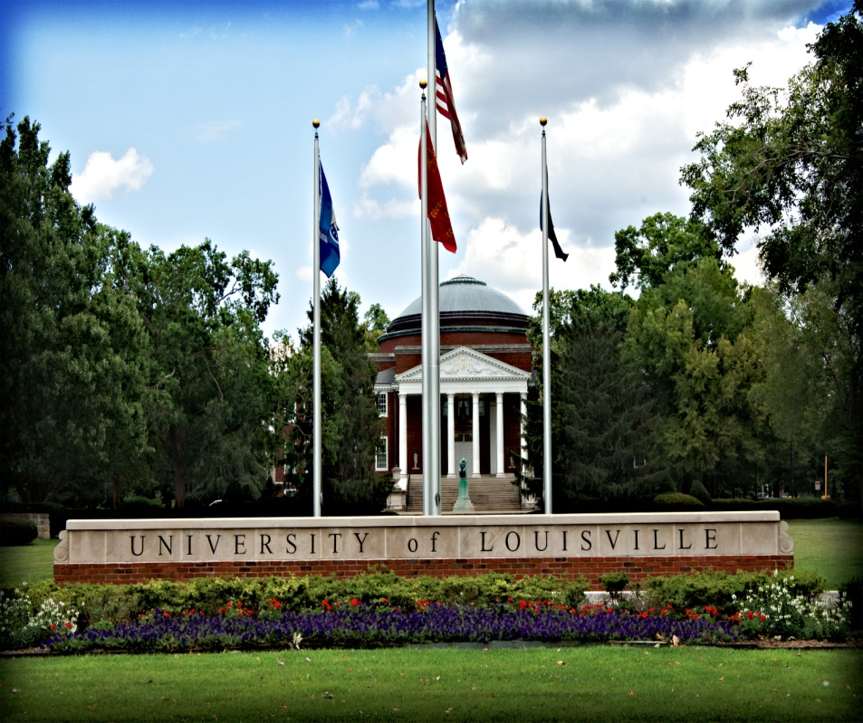
University of Louisville School of Dentistry
Theresa G. Mayfield, D.M.D.

Slide 18
University of Louisville School of Dentistry Community-Based Dental Partnership Program
Dental Service Delivery Sites
Louisville, KY – Family Health Centers, Portland Dental Clinic and Phoenix Health Center
Elizabethtown, KY - Richard L. Miller Oral Health Clinic
Co-Educators and Partners
WINGS (Part C)
Kentucky AIDS Education and Training Center (Part F)
Family Health Centers, Inc. (Federally Qualified Health Center)
Referral and Outreach Partners
WINGS (Part C and D)
Volunteers of America (Part B)
Matthew 25 (Part B and C)
Northern KY Health Department (Part B)
Referral Area
Louisville, Henderson, Owensboro, Nashville, Evansville, Bowling Green

Slide 19
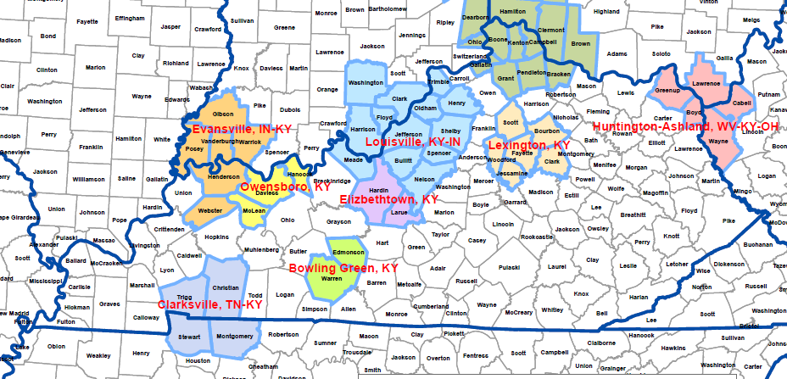
University of Louisville School of Dentistry Community-Based Dental Partnership Program
Family Health Centers
Portland Dental Clinic
Louisville, KY
Family Health Centers
Phoenix Health Center
Louisville, KY
Richard L. Miller
Oral Health Clinic
Elizabethtown, KY

Slide 20
Educational Methodology
Our goal is to provide educational experiences to dental students, dental hygiene students, post-graduate general practice residents and community dentists in providing culturally competent, quality oral health care in urban and rural community-based settings for persons living with HIV/AIDS.
Program Objectives for Competency in Providing Care for Persons Living With HIV/AIDS:
Understand how HIV infection effects oral health
Competently evaluate and diagnosis common oral manifestations associated with HIV infection
Manage oral complications commonly encountered in persons living with HIV
Gain increased knowledge of HIV medications and possible drug interactions when treating HIV and oral disease in combination
Understand occupational exposure management and follow-up
Feel positive and comfortable providing care consistent with an individual’s cultural belief

Slide 21
Educational Methodology
Dental Students and Dental Hygiene Students
Didactic courses
Infection Control
Basic Science Courses – Microbiology, Biochemistry, Physiology
General Pathology and Oral Pathology
Cultural Competency Day
Clinical Care
School-based and community-based clinics
General Practice Residents
Pre and post assessment of knowledge, skills, and attitudes
Orientation Day
Oral medicine and treatment planning seminars
Qualitative assessment of experience – exit interview

Slide 22
Rotations
Dental Hygiene Students
30 fourth year dental hygiene students
Each student has 8-16 hours of clinical experience at the community-based sites
Dental Students
8 Students per year in the Community Outreach Scholars Program
Each student has 8-16 hours of clinical experience at the community-based sites
General Practice Residents
6 General Practice Residents
Each resident has 6-8 weeks of rotation to the Miller Clinic community-based site
∗∗Note: All dental hygiene, dental students, and post graduate residents have the opportunity to care for patients living with HIV in the school-based clinics as well as the community-based clinics.

Slide 23
Lessons Learned as an Educator
Didactic Education
Baseline Knowledge
Inter-professional
Team Member
Clinical Education
Patient-Centered Care
Educating Future Dentists in the Provision of Oral Care
For Persons Living With HIV/AIDS

Slide 24
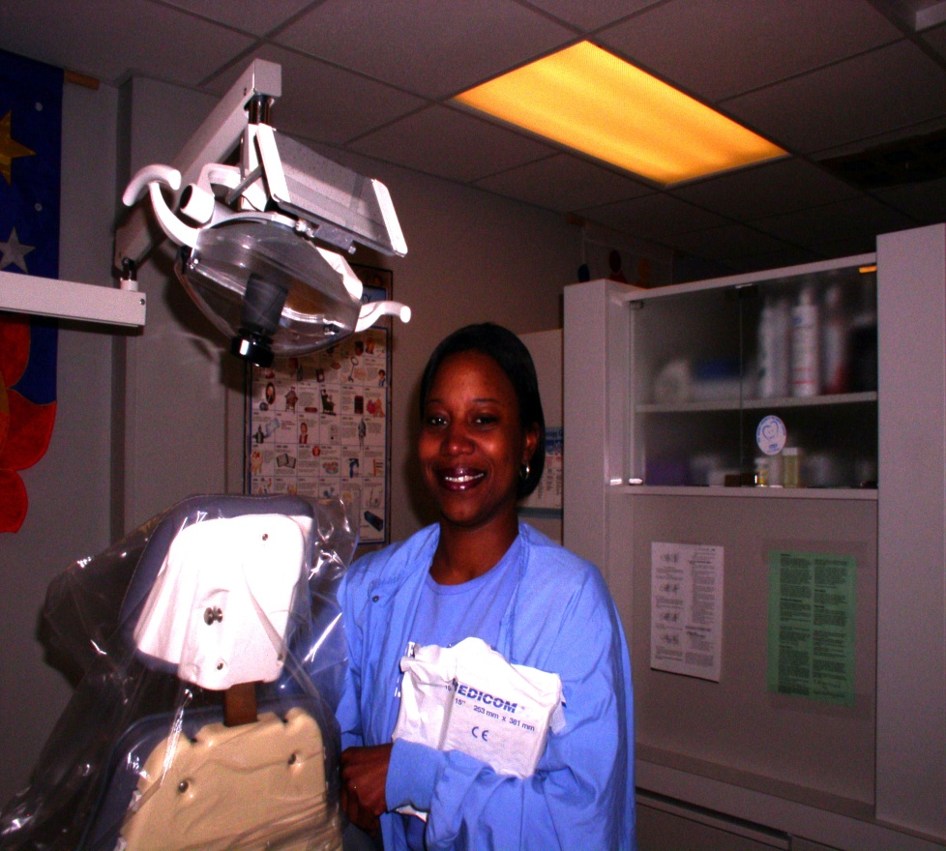
Lessons Learned - Reflections
“All patients are treated with respect and encouraged to take ownership in their oral health. The Miller Clinic provides quality care and makes each patient feel comfortable, welcome, and confident in the clinic. The most important strength is that the patients want to come in for their treatment.”

Slide 25
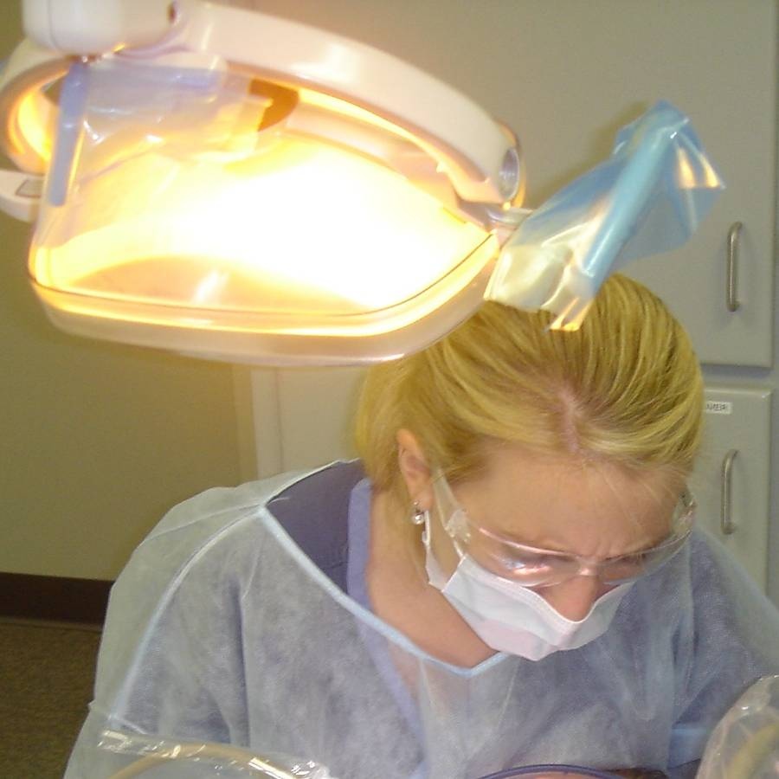
Lessons Learned - Reflections
“I have had the opportunity to meet a population of people that I might not have otherwise had the privilege of meeting. The patients have shared stories that help put life in perspective and focus. Having this experience, I’m more comfortable treating the (HIV) patients’ dental needs. As I go forward in my career this will help me with every patient I treat.”

Slide 26
University of Louisville School of Dentistry Community-Based Dental Partnership Program
“You must be the change you wish to see in the world.” Mahatma Gandhi

Slide 27
Nova Southeastern University College of Dental Medicine Aki Papatzimas, DDS

Slide 28
Dental School: How do they learn?
DIDACTIC Component:
Lectures on campus for Four years.
MANNEQUIN SIMULATION Component:
Practicing in lab on campus Freshman/Sophomore years.
CLINICAL Component:
Campus /School Clinic in Junior year (100 dental chairs)
Extramural Rotation Clinics only in Senior year.
(reality based?)

Slide 29
What are extramural rotations?
Students sent to off campus dental clinics to treat patients
Goals:
Expose students to different segments of population
Encourage students to think ‘outside the box’
Experience different methods of delivering dental treatment
Reality based vs. textbook based

Slide 30
Various Extramural Dental Sites
Domestic Violence Survivors
Pediatric Autism Disorder
HIV Population
Pediatric Special Needs
Inmate Population

Slide 31
HRSA/Community Based Dental Partnership Three Way Partnership
NSU College of Dental Medicine
Fort Lauderdale, FL
CARE RESOURCE
Fort Lauderdale, FL
Community Based
HIV Non–Profit Organization
Four Chair Dental Clinic
ALBANY MEDICAL CENTER
Albany, NY
Hospital Based
HIV Treatment Center
Three Chair Dental Clinic
Notes:
Wonderful grant from HRSA helping add extramural for reality based learning etc

Slide 32
CARE RESOURCE CLINIC
Mandatory Rotation
60 students total (out of 120 class)
Once a week
Six consecutive weeks
ALBANY MEDICAL CENTER
Optional Rotation
6 students total
One full week
Once a month

Slide 33
CARE RESOURCE CLINIC
Treat four patients per day instead of one or two
Reality Shock!
All types of general dentistry performed.
Allowed to return for more than the required 6 days thus:
Finishing complex procedures (dentures/crowns/root canal)
A) Receiving full graduation credit for these procedures
B) Continuity of care for our patients by seeing same student.
EVERYONE IS HAPPY!
Notes:
More of a private practice setting,

Slide 34
“LUNCH n LEARN” IN CLINIC
“HIV 101” PowerPoint:
What/Who is Ryan White and his legacy.
Definitions: Viral Load, CD4 count, Lypodystrophy, etc.
Interpretation of Blood Lab Reports.
HAART Principles (when start, why fail, toxicities, etc.)
Medication overview and via what pathways they work.
Basic principles of pt. management (abx prophy, etc.)
PEP vs. PrEP.
Hep C vs. HIV transmission stats & facts
(taking the fear out of HIV!)
Statistical Graphs: US vs. Florida.
Notes:
2 students at a time, informal learning/ Undetectable, range of values, bringing attention to South Florida’s high rates,

Slide 35
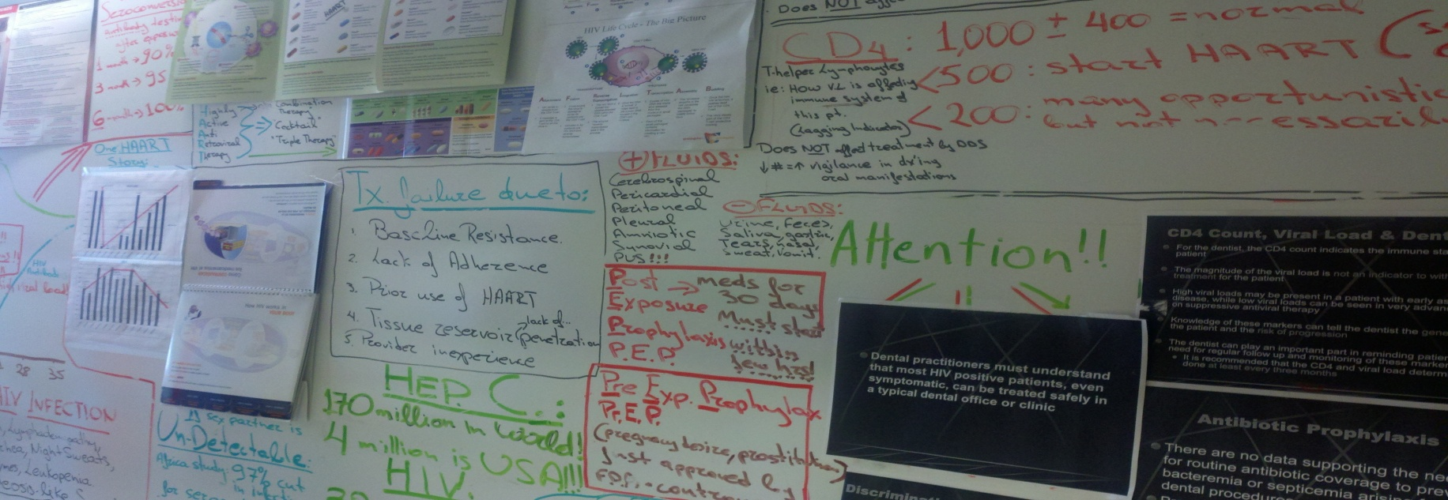
INFORMATION WALL IN CLINIC
Permanent whiteboard exhibiting:
definitions/facts/stats/pictures/drawings
Constant visual exposure!
Reinforcing previously learned concepts!

Slide 36
LESSONS LEARNED How do we know?
Reflective Essay:
Mandatory feedback from students!
They are asked to reflect on the impact of the rotation and how it influenced their thinking regarding patient care.
They must contemplate how this rotation helped to mold them as a health professional.
Research Questionnaire :
Voluntary participation.
Pre and Post clinical rotation survey.
Measuring changes in students attitudes and knowledge.
Notes:
Lessons learned by us via two tools ….

Slide 37
Reflective Essay:
“I enjoyed experiencing the strong sense of community in this unique clinic atmosphere... I can say that I learned more about dentistry there in 6 days than I did in months at the Campus clinic. There is something very effective about being thrust into a schedule of delivering focused, quality care to appreciative patients”.
“During lunch, he gave an informal lecture regarding HIV, for example, the infection's rates, what to do after a needle stick, the meaning of CD4 count and viral load.

Slide 38
Reflective Essay
“I learned a lot on this rotation through Dr. Aki: in general about AIDS/HIV, and what it would be like to see a higher volume of patients and being efficient, how to interact with patients... I have a great experience on this particular rotation and I only wish it was longer. I must take the time to mention the learning board in the back of the clinic. Dr. Aki does a great job of keeping the information current and relevant. It was a great tool in helping me understand a lot of the misconceptions that even I personally had about HIV. I was able to learn a lot about HIV and the progress in treatment it has made in the past few decades. In summary, this rotation is one of the best the school has to offer.”

Slide 39
Reflective Essay
“I expected to find people dying looking for the last source of oral care. I also expected to see in all my patients Kaposi Sarcoma. Maybe my mind took me a little too far from reality. But it was the opposite. Very nice people, full of hope and normal life. People taking care of themselves, making me think about the fortune of being healthy. As the days went by, I realized that all my fears were based in ignorance… As part of the rotation, I learned many details about AIDS….after understanding that my probabilities of getting the disease via a needle stick were minimal, I felt more comfortable treating these patients. My only regret is that I only had this rotation for 6 days. I wish I could attend this rotation every day.”

Slide 40
Reflective Essay
“To see a young woman like her going through that, while knowing the burden that she bore with her disease stuck a cord in me. I was glad that the Ryan White grant existed for her, which helped to overcome some of the animosity which I had previously held. These experiences helped me to learn those principles.”
“When I went to Broward Care Resource I was a little afraid because I felt insecure and I did not want any kind of contact with HIV patient. After talking with Dr. Aki Papatzimas I started to feeling more confident and secure about how I can treat patient with and without infectious diseases. I want to Thanks Dr. Papatzimas for all the information he gave regarding HIV/ AIDS patients words cannot express how wonderful experience I had

Slide 41
Care Resource Dental Clinic

Slide 42
Care Resource Dental Clinic (cont.)

Slide 43
Results of multisite evaluation of Community-based partnership programs
Serena Rajabiun, MA, MPH
Boston University School of Public Health

Slide 44
Sample size
Baseline sample: | Year 2
Total survey sample: | 229
Completed entries (both baseline and follow-up surveys): | 207
Post grad survey: | pending
Site sample sizes
BU Goldman School of Dental Medicine | 6
Columbia School of Dental Medicine | 9
Loma Linda | 74
Nova Southeastern University | 49
University of Louisville School of Dentistry | 20
University of Medicine & Dentistry of New Jersey | 49

Slide 45
Participant characteristics (n=207)
Characteristic | Frequency (%)
Gender Male Female | 119 (57.5) 88 (42.5)
Age (n=205) Less than 30 years 30-39 years 40+ years | 157 (76.6) 46 (22.4) 2 (1.0)
Race (n=206) Asian Black Hispanic White Native/Pacific Islander Other (Egyptian) | 73 (35.4) 12 (5.8) 16 (7.8) 100 (48.5) 3 (1.5)
Country of origin (n=206) US Other | 131(63.6) 75 (36.4)

Slide 46
Participant characteristics (n=207)
Characteristic | Frequency (%)
Primary Language (n=206) English Korean Other | 150 (72.8) 15 (7.3) 41 (19.9)
Prior dental experience (n=206) | 19 (9.2)
Prior HIV/AIDS training or education (n=206) | 142 (68.9)
Prior work experience with persons living with HIV/AIDS (n=206) | 16 (7.8)

Slide 47
Changes in knowledge by item
Knowledge item | % Correct Pre Post
Saliva is a vehicle for the transmission of HIV. | 82.1 | 87.4
All patients should be considered potentially infectious. | 98.1 | 100.0
Standard universal precautions provide minimal protection against the transmission of HIV and other blood-born pathogens. | 65.7 | 71.0
Oral lesions found in HIV patients may also be found in other immune-compromised patients. | 97.1 | 97.6
The risk of HIV infection after a needle stick injury involving an HIV-positive patient is about 45 – 50%. | 78.3 | 78.3
Hepatitis C is more infectious than is HIV/AIDS as a blood-born pathogen. | 89.4 | 96.1
The decision whether or not to prescribe antibiotic prophylaxis to HIV+ patients prior to invasive dental care is best determined by the patient’s CD4 count and viral load. | 15.5 | 23.2
The normal CD4 range for a healthy person is 300 – 500 mm³. | 50.2 | 68.6
It is important to review an HIV+ patient’s diagnostic lab values, platelet and neutrophil count before providing invasive treatment. | 95.7 | 96.6
A patient’s health, in general, is improving when his CD4 count is decreased and his viral load is increased. | 92.3 | 95.2
According to the CDC, women of color represent the majority of new HIV infections and AIDS cases among women in the United States. | 49.3 | 57.5
Protease inhibitors prevent cells from creating new HIV virus by blocking the attachment of HIV to the healthy cell. | 26.1 | 34.8
Thrush is an HIV-related opportunistic infection. | 79.7 | 88.4
Notes:
There was a significant change in knowledge. The overall pre-test mean score was 8.6 and the overall post-test score was 9.5.
Examined these changes in knowledge by prior work experience in HIV and training in HIV and there was not difference between those who had prior work experience or training and improved knowledge.

Slide 48
Changes in Attitude by item
Attitude item (n=207) (*Significant p-value for McNemar test) | Disagree % Pre Post |  | Neutral % Pre Post |  | Agree % Pre Post
It is important for patients to disclose their HIV/AIDS status to their dental providers. | 1.5 | 1.0 | 7.8 | 7.3 | 90.7 | 91.7
*I am comfortable providing dental treatment for a person with a chemical dependency. | 10.2 | 11.2 | 33.7 | 18.9 | 56.1 | 69.9
I am comfortable providing dental treatment for a person who is gay/bisexual/transgender. | 3.9 | 1.0 | 11.7 | 9.7 | 84.5 | 89.3
*I am comfortable providing dental treatment for a person with HIV infection (but not AIDS). | 9.7 | 5.8 | 23.8 | 14.1 | 66.5 | 80.1
*I am comfortable providing dental treatment for a person diagnosed with AIDS. | 14.6 | 8.7 | 28.6 | 19.4 | 56.8 | 71.8
If it became known that patients with HIV/AIDS are treated in my dental practice, some patients might leave my practice. | 23.3 | 21.5 | 37.4 | 37.1 | 39.3 | 41.5
I am very concerned about contracting HIV from a patient. | 29.1 | 39.2 | 32.0 | 28.9 | 38.8 | 31.9
*I am not concerned about treating patients with HIV/AIDS but members of my family are concerned about it. | 23.8 | 16.5 | 40.3 | 35.0 | 35.9 | 48.5
*My knowledge of infection control procedures make me more confident in treating HIV-positive patients. | 4.9 | 0.5 | 22.3 | 11.7 | 72.8 | 87.9
Dentists have a professional obligation to treat patients with blood-borne infectious diseases such as HIV/AIDS. | 2.5 | 1.9 | 7.4 | 8.3 | 90.2 | 89.8
I am comfortable asking patients about their health history. | 2.0 | 1.4 | 5.9 | 6.8 | 92.2 | 91.8
I am comfortable asking patients about their HIV-related risk behaviors. | 20.4 | 13.5 | 17.5 | 17.4 | 62.1 | 69.1
Notes:
Although not significant from per to post very interesting findings for
If it became known that patients with HIV/AIDS are treated in my dental practice, some patients might leave my practice.
I am very concerned about contracting HIV from a patient.

Slide 49
Changes in Attitude by item
Attitudes toward future employment (n=207) | Disagree % Post | Neutral % Post | Agree % Post
I would like to pursue a job that allows me to treat HIV/AIDS patients in a specialty care setting (i.e. public health dentistry) | 28.6% | 47.6% | 23.8%
I will pursue a job in the private sector, but I will accept patients with HIV/AIDS | 1.4% | 15.9% | 82.6%
Notes:
Looked at students with an overall POSITVE attitude and we did find a significant difference between those who had prior work experience and those who did not. (p<.05) So again may show the program attracts the students who may be more inclined to working in public health dentistry but the CBDP experience maybe contributing to working with this population.

Slide 50
Clinical & Education Methodology (all sites)
Item | Disagree % Pre Post |  | Neutral % Pre Post |  | Agree % Pre Post
To date, my classes prepared me well for treating patients from backgrounds different from mine. | 4.8 | 1.9 | 27.1 | 16.0 | 68.1 | 82.0
To date, my classes prepared me well for treating patients with HIV/AIDS. | 11.2 | 2.4 | 32.5 | 18.5 | 56.3 | 79.0
I know what to do in the event of an occupational exposure to blood. | 6.3 | .5 | 17.6 | 10.2 | 76.1 | 89.3
Meeting an individual who is HIV+ would influence my decision to treat HIV+ patients. | 33.7 | 25.2 | 30.7 | 28.2 | 35.6 | 46.6
Treating a known HIV+ patient with clinical supervision would give me more confidence treating HIV+ patients in the future. | 6.3 | 6.8 | 19.9 | 19.9 | 73.8 | 73.3

Slide 51
Findings from interviews with faculty & staff on CBDP curriculum
Challenges
Students
Fears about treating HIV patient or substance use treatment
Limited resources and time for students to learn HIV treatment side
Ability to cope with vulnerable population (patient no shows; poor compliance with treatment; homeless issues)
Comfort and ability with taking a medical history to assess risk factors
System/organizational
Matching patient needs with student interests (i.e. need to fulfill a requirement of X extractions but not have the patient need)
Documentation and quality assessment of student work and practice
Potential Strategies
Developing quality assurance tools to improve dental service indicators
Developing a tool that assesses dental competencies and complements the reflective essay

Slide 52
Findings from interviews with faculty & staff on CBDP curriculum
Recommendations
Topics to be addressed for students
Managing a complex patient with variety of needs not just HIV, but co-infection with Hepatitis C, mental health substance use, homelessness
Linking medical and dental care—importance of understand lab values
Implementing rapid testing; share with patients at risk for HIV
Educating about risk groups (i.e. youth)
Continuing emphasis on infection control procedures
Identifying medications and contraindications to dental prescriptions
Structural changes
Full clinical rotations
Graduation requirements
Notes:
Clinical training should be full days- at least full week or a day/semester

Slide 53
Findings from interviews with faculty & staff on CBDP curriculum
Create a Resource tool box (web-based)
Student conference calls
Build capacity of clinical dental faculty practitioners
Continue/additional funding to support demand for students to have external opportunities
Notes:
Create a Resource tool box: Organized training modules on HIV outside of oral health care; case studies; self-teaching tools
Build capacity of dental faculty and practitioners: continuing education courses on HIV; create checklist flowcharts what to discuss with students (i.e. lab data) BU offers a conference for externship faculty

Slide 54
Contact information
Jane Fox, MPH | 617-638-1937 | janefox@bu.edu
Jill York, DDS,MAS | 973-972-0190 | yorkja@umdnj.edu
Theresa G. Mayfield, DMD | 502-852-5128 | tgmayf01@louisville.edu
Aki Papatzimas, DDS | 917-583-0440 | papatzim@nova.edu
Serena Rajabiun, MA, MPH | 617-638-1934 | rajabiun@bu.edu

