Slide 1
Guidance for Preparing for the RSR: A Year Long Approach
Washington, DC
11/28/2012

Slide 2
Session Overview
Overview of Terms
Introduction to the RSR
Overview of the Grantee Report
Overview of the Provider Report
Overview of the Client Report
Sequence of activities required to submit the RSR

Slide 3
Housekeeping
Please set your cell phones to vibrate or silent.
Please hold your questions until the designated Q&A segments.
Please try to attend some of the other RSR sessions.

Slide 4
Learning Objectives
Gain general knowledge of the three components of the RSR
Understand the RSR process for data collection to preparation to submission
Know what technical assistance resources are available to grantees and providers

Slide 5
Participant Expectations

Slide 6
Overview of Terms

Slide 7
Grantee
Receives Federal funding directly from HRSA
May provide RWHAP-funded services
May contract with another agency to provide RWHAP-funded services

Slide 8
Provider
Provide Core Medical or Support Services to clients
Provide Administrative and Technical Support Services to the grantee of record
Provide HIV Counseling and Testing Services
May be funded through subcontracts with HRSA grantees
May be a grantee (grantee-provider)

Slide 9
Multiply-funded Agency
Receives funding under more than one Program Part
Receives funding from more than one source

Slide 10
Service Provider Categories
First-level Providers
Second-level Providers
Multilevel Providers

Slide 11
First-Level Provider

Slide 12
Second-Level Provider
Fiscal Intermediary Provider

Slide 13
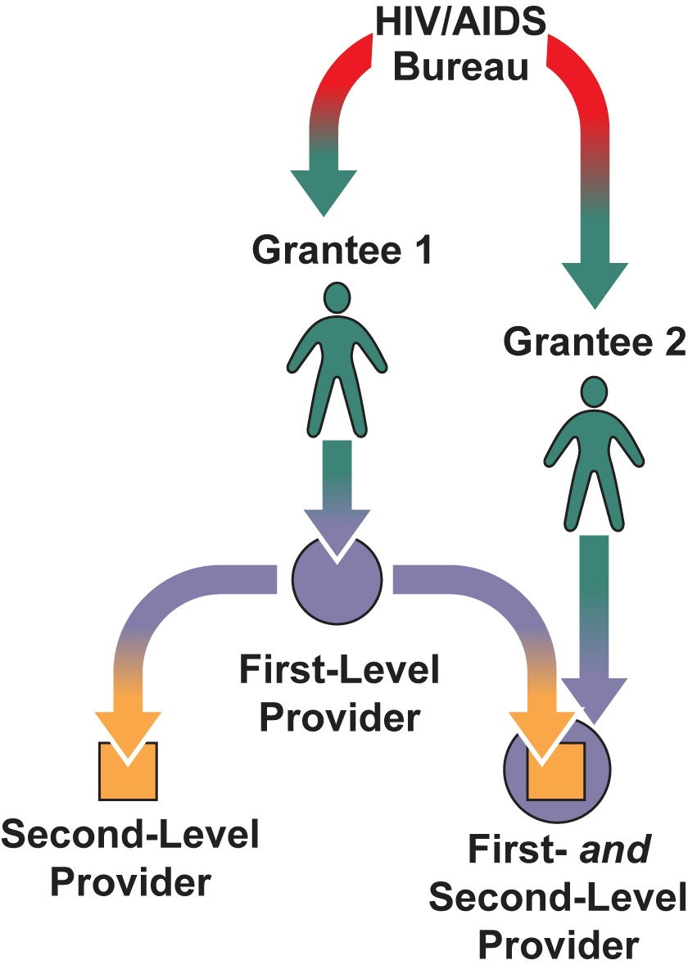
Multilevel Provider
Multilevel
Provider

Slide 14
Questions
14

Slide 15
Test Your Knowledge!
What do we call the agency that receives its funding directly from the HIV/AIDS Bureau?
A grantee
What do we call the agency that delivers services with Ryan White HIV/AIDS Program funds?
A Provider

Slide 16
Test Your Knowledge! (continued)
What do we call agencies with a direct funding relationship with a HAB grantee?
A first-level provider
What do we call agencies with an indirect funding relationship with a HAB grantee?
A second-level provider

Slide 17
Test Your Knowledge! (continued)
These agencies receive Ryan White HIV/AIDS Program funds from more than one part?
Multiply-funded agencies

Slide 18
Test Your Knowledge (continued)
The Wellness Institute is a:
First-level provider only
Second-level provider only
Multiply-funded provider
Grantee-provider
All of the above
None of the above
Notes:
18

Slide 19
Introduction to the RSR

Slide 20
Ryan White HIV/AIDS Program Services Report (RSR)
A client-level report documenting the individuals served and services provided to RWHAP clients
3 components of the RSR:
Grantee Report
Provider Report
Client-Level Data (Client Report)

Slide 21
Overview of the Grantee Report
Grantees complete a separate Grantee Report for each grant they receive.
3 Sections:
Basic Agency Information (4 Items)
Providers Funded By Your Grant
Providers Funded Through Your Fiscal Intermediaries
Notes:
21

Slide 22
Basic Agency Information
Agency Address
DUNS Number
Contact information for the person completing the report
Clinical quality management program status
Notes:
22

Slide 23
Providers to Include on Your Contract Lists
Include first-level providers on the “Providers Funded (Directly) by Your Grant” contract list.
Include second-level providers on the “Providers Funded through Your Fiscal Intermediaries” contract list.
Notes:
RSR

Slide 24
Active Provider Contracts
A service provider contract that was active during the reporting period is a contract under which the following things happen:
Services were delivered by the service provider during the reporting period; and/or
Any portion of the contract period falls within the reporting period.

Slide 25
Setting Up the Contract Lists (Part 1)
List all contracts that were active during the reporting period.
If more than one contract was active with a provider, list those multiple contracts.
If your agency provides RWHAP‒funded services, you must include a contract with your own agency.
Grantees can’t be their own fiscal intermediaries!

Slide 26
Setting Up the Contract Lists (Part 2)
Report only contracts associated with your grant—not services contracted under another Program Part.
Fiscal intermediary grantee-providers should not include second-level providers on their contract lists unless those providers also receive funds from its program.

Slide 27
Setting Up the Contract Lists (Part 3)
Enter the actual start date and end date for each contract.
Enter the total contract award amount for each contract.
Select the provider’s contracted services.
Provider Name | Contract Reference | Contract Start Date | Contract End Date | Contact Amount | Services
Happiness Clinic | Contract 1 | 04/01/2011 | 3/31/2012 | $809,216 | Services
Happiness Clinic | Contract 2 | 04/01/2012 | 3/31/2013 | $812,989 | Services

Slide 28
Validating the Grantee Report
You must validate your Grantee Report before you can certify it.
You cannot submit the Grantee Report with errors.

Slide 29
Certifying the Grantee Report
Grantee Reports must be certified before the information will be reflected in the Provider Reports.
Grantee Reports must be certified before a provider can submit its Provider Report.
Grantee Reports can be modified any time before February 4, 2013.

Slide 30
Grantee Report Questions
30

Slide 31
Test Your RSR Knowledge: RSR Grantee Report
Notes:
If there are no more questions, let’s move on the next round of “Test Your RSR Knowledge” questions.

Slide 32
Test Your RSR Knowledge
List the contracts for Superior Care Clinic that will appear in the 2012 RSR Grantee Report contract list for Part A assuming:
The contract periods begin on April 1 (This is the third option year of a five year contract.)
Superior Care Clinic offers Outpatient/ambulatory medical care (OAMC), Medical case management (MCM), and Medical transportation services
Superior Care Clinic’s budget is $55,000 per year
Provider | Amount | Start Date | End Date | Services
Notes:
Note: The answer is worth 50 points per block that is filled in correctly.

Slide 33
Test Your RSR Knowledge (cont.)
List the contracts for Superior Care Clinic that will appear in the 2012 RSR Grantee Report contract list for Part A assuming:
The contract periods begin on April 1 (This is the third option year of a five year contract.)
Superior Care Clinic offers Outpatient/ambulatory medical care (OAMC), Medical case management (MCM), and Medical transportation services
Superior Care Clinic’s budget is $55,000 per year
Provider | Amount | Start Date | End Date | Services
Superior Care | $55,000 | 04/01/2011 | 03/31/2012 | OAMC, MCM, Medical Transportation
Superior Care | $55,000 | 04/01/2012 | 03/31/2013 | OAMC, MCM, Medical Transportation
Notes:
Note: The answer is worth 50 points per block that is filled in correctly.

Slide 34
Test Your RSR Knowledge (cont.)
Notes: Part B does not provide direct client services. Part A only provides fiscal intermediary services.
Notes:
This is the final question in this segment. And, it’s another chance to increase the number of points you hold by a little or a lot. You can also loose everything. Like before, please take a moment to think about your wager.

Slide 35
Test Your RSR Knowledge (cont.)
Study the diagram on the previous slide and write the names of the providers that will appear on the Part A and Part B grantees’ contract list in their Grantee Reports.
Grantee | Providers Funded by Your Grant | Providers Funded through Your Fiscal Intermediaries
Part A
Part B
Notes:
[Read questions on the slide. Allow approximately 30 seconds for people to get the answers written down. Then, display the answer and respond to any follow-up questions.]

Slide 36
Test Your RSR Knowledge (cont.)
Study the diagram on the previous slide and write the names of the providers that will appear on the Part A and Part B grantees’ contract list in their Grantee Reports.
Grantee | Providers Funded by Your Grant | Providers Funded through Your Fiscal Intermediaries
Part A | John Doe University Clinic The Wellness Institute Superior Care Clinic
Part B | Part A Grantee (Fiscal Intermediary Provider) | John Doe University Clinic Health & Happiness Project The Wellness Institute
Notes:
Unlike the previous question, you must enter the information in each block correctly to win your points. It’s all or nothing!
Note:
Health and Happiness Project is not included in Part A’s grantee report because it does not receive Part A funds.

Slide 37
RSR Provider Report
19 Items
2 Sections
Basic agency information
HIV Counseling and Testing information
Notes:
RSR

Slide 38
Provider Report: Item 8
Contract data are pre-populated with data from the Grantee Report(s).
Indicate the services delivered with Ryan White funding:
Services provided to clients with Ryan White funds; and/or
Services provided by clinicians whose salaries are paid for with Ryan White funds.
If you provide only administrative and technical services, you are now done with data entry!

Slide 39
Provider Report HIV Counseling and Testing (HC&T) Section
If you used RWHAP funds to provide HC&T services, you must complete this section.
Report ALL individuals tested regardless of funding source.

Slide 40
RSR Provider Report
Every agency listed on a Grantee Report is expected to submit a Provider Report!
All providers complete one Provider Report.
Accessing the Provider Report:
All grantees access Provider Reports via the Electronic Handbooks (EHBs).
Providers access their Provider Reports directly through the RSR Web system.

Slide 41
RSR Provider Report
Data may be entered in two ways:
Manually using the online forms; or
Via XML file upload.

Slide 42
Provider Report Questions
42

Slide 43
Test Your RSR Knowledge: RSR Provider Report
Notes:
If there are no more questions, let’s move on the next round of “Test Your RSR Knowledge” questions.

Slide 44
Test Your RSR Knowledge
True or False: All agencies listed on a Grantee Report must submit a Provider Report.
True
The Health Clinic is funded by 3 RWHAP grants. How many provider reports are they required to submit?
One RSR Provider Report which includes information on all of their contracts.
Notes:
[Read questions on the slide. Allow approximately 10 seconds for people to get the answers written down. Then, display the answer and respond to any follow-up questions.]

Slide 45
Test Your RSR Knowledge
The Health and Happiness Program uses RWHAP funds to deliver HC&T services.
True or False: They must complete the HC&T section?
True
True or False: They will only report the individuals tested with RWHAP funds?
False. If they use RWHAP funds to provide HC&T services, the provider must report everyone they test.
Notes:
[Read questions on the slide. Allow approximately 10 seconds for people to get the answers written down. Then, display the answer and respond to any follow-up questions.]

Slide 46
Test Your RSR Knowledge
Agencies that provide only administrative and technical services:
Are required to upload client-level data.
Do not need to submit a Provider Report at all.
Submit a Provider Report but stop after completing Item 8.
Submit a Provider Report but stop after Item 11.
True or False: If a grantee exempts a provider from submitting a Provider Report, the grantee must ensure that the provider’s data are still submitted to HAB.
True
Notes:
[Read questions on the slide. Allow approximately 10 seconds for people to get the answers written down. Then, display the answer and respond to any follow-up questions.]

Slide 47
Test Your RSR Knowledge
True or False: A provider may select all of the services it delivers with RWHAP funds in Item 8 of its report, including the services funded by third-party payers if the salary of the clinician or staff member providing the service is RWHAP funded.
True
Notes:
This is the final question in this segment. And, it’s another chance to pull ahead of your colleagues. As before, please take a moment to think about your wager.
[Read the question on the slide. Allow approximately 10 seconds for people to get their answers written down. Then, display the answer and respond to any follow-up questions.]

Slide 48
Client Report (Client-Level Data)
Providers of core medical and support services must upload a client-level data file.
The client-level data file should contain one record for each client who received a RWHAP-funded service during the reporting period.

Slide 49
Client Records
Each record will include up to 66 data elements, including these:
Encrypted Unique Client Identifier (eUCI)
Demographic Information
RWHAP-funded Services
Clinical Information

Slide 50
Encrypted Unique Client Identifier (eUCI)
Distinguishes one Ryan White client from all others
Is the same across all provider settings
To learn more, visit the TARGET Center at http://www.careacttarget.org/topics/rsr.asp
Notes:
50

Slide 51
Demographic Information Reporting Requirements
See Appendix A of the RSR Instruction Manual to determine the minimum Client-Level Data elements that must be reported for each client.
Report all demographic data for recipients of outpatient/ambulatory medical care (OAMC), medical case management (MCM), and non-medical case management (NMCM) services.
Only report basic demographic information for recipients of other services.
Notes:
51

Slide 53
RWHAP-Funded Services
Report at least one core or support service for each client.
Only report RWHAP-funded services.
Do not report services that are paid for entirely by another third-party payer.
Report any RWHAP-funded service that is not otherwise reimbursed.
Do not balance bill the RWHAP.
Report service visits that are initially paid for with RWHAP funds as RWHAP-funded service visits.
Notes:
53

Slide 54
RWHAP–Funded Services
Reporting RWHAP-funded Core Medical Services
Report the number of visits (days of service) the client had during each quarter of the reporting period.
Reporting RWHAP-funded Support Services
Report whether or not the support service was received during each quarter of the reporting period.

Slide 55
Clinical Information Reporting Requirements
Clinical information is only required for HIV-positive clients who received a RWHAP-funded outpatient/ambulatory medical care service.
Report all clinical information for each client, regardless of who paid for or delivered those clinical services.
Notes:
55

Slide 56
Completing the RSR Provider Report
Upload your client-level data.
Validate your data:
Review your client-level data upload confirmation report; and
Resolve all errors and warnings.
Submit your report.

Slide 57
RSR Questions
57

Slide 58
Test Your RSR Knowledge: RSR Client Report
Notes:
If there are no more questions, let’s move on the final round of “Test Your RSR Knowledge” questions.

Slide 59
Test Your RSR Knowledge (cont.)
True or False: Every client record must include an eUCI?
True
True or False: Providers only need to report ALL of the demographic data elements for recipients of OAMC and MCM services.
False. Provider report all demographic data elements for recipients of OAMC, MCM, and NMCM services.
Notes:
[Read questions on the slide. Allow approximately 10 seconds for people to get the answers written down. Then, display the answer and respond to any follow-up questions.]

Slide 60
Test Your RSR Knowledge (cont.)
True or False: Providers should only report RWHAP-funded services for Items 16-45.
True
True or False: For Items 16-45, a provider may report all of the services it delivers with RWHAP funds in its client‐level data file, including the services funded by third-party payers if the salary of the clinician or staff member providing the service is RWHAP funded.
False. Providers should only report the services that were paid for with RWHAP funds–without consideration for the clinician's salary–for CLD Items 16-45.
Notes:
[Read questions on the slide. Allow approximately 10 seconds for people to get the answers written down. Then, display the answer and respond to any follow-up questions.]

Slide 61
Test Your RSR Knowledge (cont.)
True or False: Clinical information is only reported for HIV-positive clients who receive core medical services.
False. Clinical information is only reported for HIV-positive clients who receive a RWHAP-funded OAMC service.
What type of file is used to submit client-level data to HAB?
An XML file
Notes:
[Read question 25 on the slide. Allow approximately 10 seconds for people to get the answers written down. Then, display the answer and respond to any follow-up questions.]
And, here it is. The final question of the final section. This is your last chance to win this lovely “Bragging Rights” certificate and this tiny bag of chocolates. Please, write down your wager.
[Read question 26 on the slide. Allow approximately 10 seconds for people to get the answers written down. Then, display the answer and respond to any follow-up questions.]
Before we find out who the winner is, let’s wrap up.

Slide 62
Preparing for the RSR

Slide 63
Preparing for the RSR
2011 RSR
Collection
Submission
2012 RSR
Preparation
Collection
Submission
2013 RSR
Preparation
Collection
Submission

Slide 64
Preparing for the RSR: Timeline of Activities–Preparation
Review RSR Instruction Manual & HAB Policy Notices
Confirm you are collecting the required client-level data
Train your staff on data entry

Slide 65
Preparing for the RSR: Timeline of Activities–Collection
Begin/continue collecting client-­level data
Review and clean your data at regular intervals (e.g., Monthly or Quarterly)
Prepare your list of provider contracts (No later than November)

Slide 66
Preparing for the RSR: Timeline of Activities–Submission
Complete your Grantee Report and notify your providers about the RSR (December)
Create your Provider Report* (January/February)
Review your submission (January–March)
Submit the RSR†
Last Monday in March 6:00 PM ET
* Includes uploading client-level data.
† Do not wait until the last minute to submit your RSR!

Slide 67
2012 RSR Submission Deadlines
December 3, 2012: RSR System opens for grantees.
January 7, 2013 RSR System opens for providers
February 4, 2013: RSR Grantee Reports due
March 4, 2013: Target submission date for all RSR Provider Reports and client-level data
March 18, 2013: Last day to return a Provider Report and client-level data to your providers for corrections or changes
March 25, 2013: All RSRs must be in “Submitted” status by 6 p.m., ET

Slide 68
Preparing for the 2012 RSR: Submission DOs . . .
. . . work with providers and other grantees to develop a mutually agreed-upon deadline to ensure that providers have sufficient time to submit their RSR.
. . . ensure providers begin their data reports on or soon after the RSR Web system opens in January 7, 2013.
. . . check the status of your providers’ RSRs regularly through the EHBs.

Slide 69
Preparing for the 2012 RSR: Submission DOs . . .
. . . review each provider’s RSR to ensure accuracy and completeness.
. . . return RSRs with incorrect data early enough to allow your providers time to revise and resubmit their client-level data.
. . . approve Web submissions before the final deadline on March 25, 2013.

Slide 70
Questions
70

Slide 71
Getting Ready for the RSR: Setting Up Your Schedule

Slide 72
Technical Assistance Web Resources
HAB Web Site:
http://hab.hrsa.gov
Instructions, Forms, and HAB Information E-mails/Policy Notices
TARGET Center Web Site:
http://www.careacttarget.org
Important Notices, Dates to Remember, Training Materials

Slide 73
For More Information
HAB Project Officer
Division of Metropolitan HIV/AIDS Programs (Part A): (301) 443-7136
Division of State HIV/AIDS Programs (Part B): (301) 443-3613
Division of Community-based HIV/AIDS Programs (Parts C & D): (301) 443-1380
Notes:
If you have program questions, please contact your Project Officer. Please note that HAB has reorganized. The Part A and Part B programs are now housed in separate divisions.

Slide 74
Technical Assistance Resources
Data Support (WRMA/CSR):
(888) 640-9356, 9:00 a.m.–5:30 p.m., ET
ryanwhitedatasupport.wrma@csrincorporated.com
DART Team (Cicatelli/Mission/Abt):
Data.TA@Cicatelli.org
HRSA Contact Center:
(877) 464-4772
CallCenter@HRSA.gov
Notes:
74

Slide 75
Questions
75

Slide 76
Summary
There is nothing to fear about the RSR.
Read the instruction manual and other online TA resources.
Start early!
If you need help, call us!

