Slide 1
Model Interventions for Statewide Improvement of Linkage to and Retention in Care
DeAnn Gruber, PhD
Evelyn Byrd Quinlivan, MD
Casey Schumann, MS
Wayne Steward, PhD, MPH

Slide 2
Disclosures
  This continuing education activity is managed and accredited by Professional Education Service Group. The information presented in this activity represents the opinion of the author(s) or faculty. Neither PESG, nor any accrediting organization endorses any commercial product displayed or mentioned in conjunction with this activity.
  Commercial Support was not received for this activity.

Slide 3
Disclosures
  DeAnn Gruber, PhD
  Has no financial interest or relationships to disclose
  Evelyn Byrd Quinlivan, MD
  Has no financial interest or relationships to disclose
  Casey Schumann, MS
  Has no financial interest or relationships to disclose
  Wayne Steward, PhD, MPH
  Has no financial interest or relationships to disclose

Slide 4
Learning Objectives
  At the conclusion of this activity, the participant will be able to:
  Describe why improvements in linkage to and retention in HIV care are critical to improve the US response to the epidemic.
  Identify the major categories of interventions for improving linkage and retention outcomes.
  Develop a set of questions to help determine what kinds of interventions would best address linkage and retention challenges in their local epidemic.

Slide 5
Overview of Session
  Introduction to the SPNS Systems Linkages and Access to Care Initiative
  Background: Importance of Linkage and Retention
  Implementing linkage/retention interventions in three states
  Summary
  Question-and-Answer Period

Slide 6
Introduction to the SPNS Systems Linkages and Access to Care Initiative
Wayne T. Steward, PhD, MPH
Co-Principal Investigator
Evaluation & Technical Assistance Center*
Center for AIDS Prevention Studies
University of California, San Francisco
*Funded by HRSA SPNS Grant U90HA22702

Slide 7
Systems Linkages Initiative
  Four-year Special Project of National Significance
  Purpose: To identify, implement, & evaluate successful for improving linkage to and retention in high quality HIV care

Slide 8
Populations of Interest
  Those who are aware of HIV-positive status but have yet to be linked to HIV care
  Those who may be receiving other medical care but not HIV care
  Those who entered HIV care but later dropped out of care
  Those who are in and out of HIV care

Slide 9
Primary Outcomes
  Increase in number of people living with HIV who know their status
  Increase in number of newly-diagnosed linked to care
  Increase in number of HIV-positive individuals who are virally suppressed
  Increase in number of HIV-positive individuals retained in quality HIV care

Slide 10
Unique SPNS Design
  Large in Scope
    Demonstration project funding was awarded to states’ Part B grantee
    Intention is to facilitate linkage and retention by creating interventions that span systems of care

Slide 11
Unique SPNS Design
  Hybrid design
    Initial two years use the Learning Collaborative Model to pilot test and select ideal systems linkage interventions
    Latter two years follow a traditional SPNS approach, with a wider-scale test of a set of systems linkage interventions in each state

Slide 12
Grantees
  Demonstration States
    Louisiana
    Massachusetts
    New York
    North Carolina
    Pennsylvania
    Virginia
    Wisconsin
  Evaluation and Technical Assistance Center
    University of California, San Francisco (UCSF)

Slide 13
Evaluation & Technical Assistance Center
  ETAC Leadership
    Janet Myers, Principal Investigator
    Wayne Steward, Co-PI
    Steve Morin, Senior Scientist
  Learning Collaborative Implementation
    Lori DeLorenzo, Jane Fox, William Woods, Marliese Warren, Cara Safon
  Evaluation
    Edwin Charlebois, Kimberly Koester, Andre Maiorana, Hong-Ha Truong, Katerina Christopoulos, Shane Collins, Moupali Das

Slide 14
Background
The Importance of Linkage and Retention Efforts

Slide 15
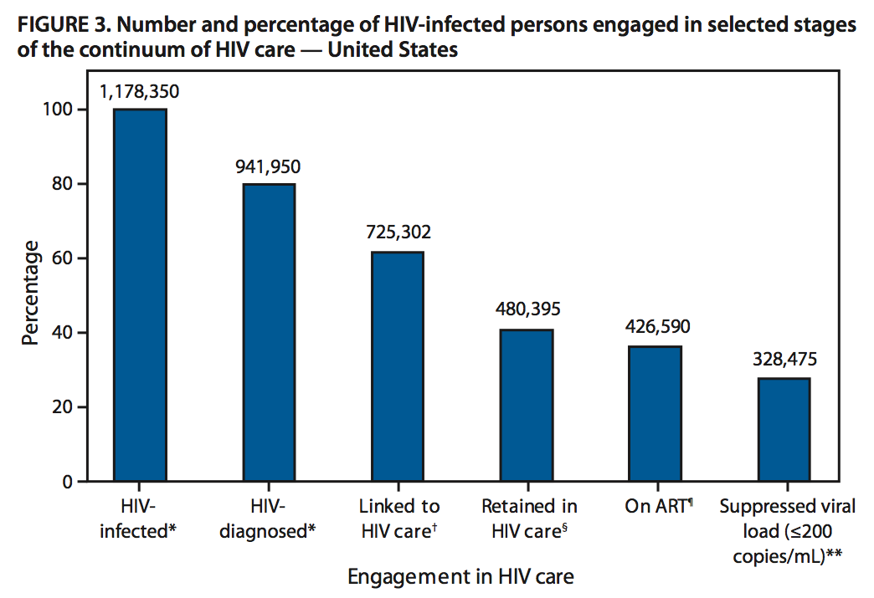
Gaps in Care
MMWR / December 2, 2011 / Vol. 60 / No. 47 1621
Notes:
Many of you have likely see this figure or something very similar. It represents the so called “cascade” or continuum of care. The left starts with the total number of individuals thought to be HIV-infected in the country. Of those, there is a percentage that has been diagnosed, of those a percentage linked to care, of those a percentage retained in care, of those a percentage on ART, and of those a percentage who have suppressed viral load. Ultimately, we are looking to have all HIV-infected people contained in the bars of the right side of the chart. But as evidence by the ever smaller bars, we currently lose a subset of HIV-infected individuals at each step along this continuum.

Slide 16
Gaps in Care
Gaps
MMWR / December 2, 2011 / Vol. 60 / No. 47 1621
Notes:
Ultimately, we are looking to have all HIV-infected people contained in the bars of the right side of the chart. But as evidence by the ever smaller bars, we currently lose a subset of HIV-infected individuals at each step along this continuum.

Slide 17
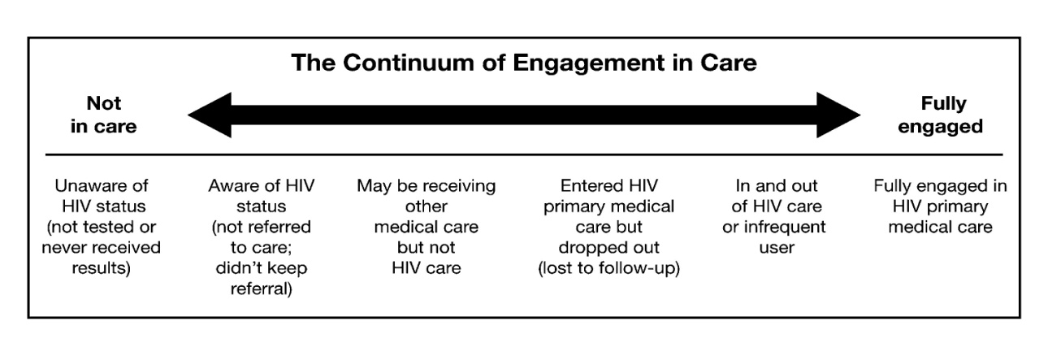
Engagement in Care
Cheever / 2007/Clinical Infectious Diseases/ Vol. 44 / pp 1500-1502
Notes:
The preceding gaps in the so-called cascade can be viewed from another lens, specifically, that of people’s engagement in care. We have at one end individuals who are not in care and not even aware that they need care. At the other end are those who are fully engaged in care. And in the middle are those who not fully engaged and but not fully disengaged. This includes people who were diagnosed but not referred to care or who didn’t keep their referral; those receiving medical services but not HIV care; those who entered HIV care by dropped out, and those in and out of care.

Slide 18
Engagement in Care
Cheever / 2007/Clinical Infectious Diseases/ Vol. 44 / pp 1500-1502
SPNS
Notes:
These middle four categories correspond to the populations of interest for the SPNS initiative.

Slide 19
Example Approaches:
Ensuring People are Tested
  Structural/Policy Approaches (bring testing to clients)
    Implementing routine testing (e.g., in ERs, STI clinics)
    Routine testing in primary care
    Ensuring HIV testing is covered by insurance
    Partner referral and counseling
  Motivational (raise awareness about HIV and testing)
    Social network approaches
    Educational and social support programs

Slide 20
Example Approaches:
Promoting Linkage/Retention
  Improving system integration
    Co-location of services
    Developing procedures and programs that link multiple providers
    Use of electronic technologies to share patient health information
  Helping clients navigate the care system
    Linking newly diagnosed clients to care that they need
    Connecting clients to support services
    Helping clients understand care plans

Slide 21
Implementing Linkage and Retention Interventions in Three States

Slide 22
Louisiana SPNS:
Systems Linkages Project
DeAnn Gruber, PhD
Louisiana Office of Public Health STD/HIV Program
Ryan White All Grantees Meeting
November 28, 2012

Slide 23
Program Need – 2010 National Rankings
Among all 50 States
Louisiana ranked 4th highest in state AIDS case rates
  20.0 AIDS Cases diagnosed in 2010 per 100,000 people
Among large US cities (>500,000 people)
Baton Rouge metro area ranked 1st in AIDS Case Rates
  33.7 AIDS Cases diagnosed in 2010 per 100,000 people in BR MSA
New Orleans metro area ranked 5th in AIDS Case Rates
  26.2 AIDS Cases diagnosed in 2010 per 100,000 people in NO MSA

Slide 24
Louisiana and Baton Rouge Region:
Persons Living with HIV
In Louisiana, as of December 31, 2010:
17,679 persons were known to be living with HIV infection
  4,402 (25%) in Baton Rouge Region
    2,391 (54%) have an AIDS Diagnosis

Slide 25
Late Testers
Baton Rouge Region, 2010
Persons who are diagnosed with AIDS within 6 months of having their initial HIV diagnosis
  In 2010, 34% of persons newly diagnosed with HIV in the Baton Rouge Region had an AIDS diagnosis within 6 months
    25% had AIDS at the time of their initial HIV diagnosis

Slide 26
Unmet Need
Baton Rouge Region, 2010
Unmet need/Out of Care – Did not have a viral load or CD4 test reported in 2010
  30% of all persons living with HIV infection in the Baton Rouge Region had unmet need in 2010
  In the Baton Rouge Region, 77% of all new HIV diagnoses entered care within 3 months.

Slide 27
Entry into Care Following Release from Prison
From 2009 through July 2011, there were 318 PLWH released from a State correctional facility
  36.8% entered into HIV-related care within 30 days
  22.3% entered within 31-90 days
  12.6% entered within 91-180 days
  13.5% entered over 180 days
  15.4% never entered into care
59.1% within 90 days

Slide 28
Linked to Care w/in 90 Days After Release from Baton Rouge-area Prison
Facility | Released | LTC within 90 days | % Linked to Care
Dixon Corr Ctr | 40 | 23 | 57.5%
Hunt Corr Ctr | 67 | 38 | 56.7%
LA Corr Inst for Women | 64 | 42 | 65.6%
LA State Penitentiary | 3 | 3 | 100%
TOTAL | 174 | 106 | 60.9%

Slide 29
Video Conferencing
Prior to release, HIV infected persons in DOC prison or parish jail will utilize video consultation to connect to case management and medical care services
  DOC and jail have existing video conferencing equipment for telemedicine
  Equipment to be implemented in CM agencies
Familiarity with case management agency prior to release will improve linkage to care and services since offenders will be informed of available resources and have a virtual “connection” to at least one provider in area

Slide 30
Video Conferencing
Successes
  Surveyed RW agencies across state to determine IT capabilities
  Reviewed discharge data from DOC to determine regions with highest need
    Most offenders return to New Orleans or Baton Rouge area
  Selected and purchased equipment
  Created implementation plan
    Phase I - RW CM agencies in New Orleans and Baton Rouge
    Phase II – Remaining RW agencies in state
    Phase III – Connect to other prisons in state

Slide 31
Video Conferencing
Challenges
      Not all agencies have adequate bandwidth to support video conferencing
      Not all agencies have space or need for large equipment (Polycom)
      Purchase and installation of equipment is lengthy process

Slide 32
HIV Testing in Correctional Settings
Increase testing at EBR Parish Jail
  Increase offering of opt-in testing for HIV at intake
  Offer syphilis test concurrent with HIV test
  Increase staff time to conduct tests
Increase testing at DOC facilities
  All offenders tested at intake – data confirmed practice
  Parolees – mandatory testing already in place, but no set timeframe of when test given before release
  “Good time” & “Full time” - Provide opt-out HIV testing prior to release with sufficient time to establish linkage to care – policy change

Slide 33
HIV Testing in Correctional Settings
Successes
  EBR Parish Jail
    Introduced 2nd tester
    Eliminated 2-week wait time to be tested
    Offer HIV and syphilis tests at same time
    Use one blood specimen for both HIV and syphilis test
    Implemented screening protocol vs. counseling
    Tested 197 offenders in first month; 16 tested positive for syphilis, 2 tested positive for HIV
Challenges
  EBR Parish Jail
    Testers are sometimes working faster than jail staff can enter test requests in EMR
  DOC facilities
    Due to DOC modifications and facility closures, limited progress

Slide 34
LaPHIE Expansion
LA Public Health Information Exchange
  Former SPNS project with LSU, OPH, and LPHI partnership
Real time identification of persons with HIV who are out of care based on OPH’s HIV surveillance data
Electronic Medical Record bi-directional alert system
3 populations
  not in care > 12 mos
  test results not received
  exposed infants needing follow up
Prompts physicians, et al. medical staff to discuss HIV care and encourage patient to link to HIV care
Already in place at eight LSU hospitals (public)

Slide 35




LaPHIE
OPH- SHP
LSU Registration
LSU Clinical

Slide 36
LaPHIE Replication
Implement LaPHIE at Our Lady of the Lake Hospital in Baton Rouge (private facility)
Successes
  Formed and convened two work groups (Clinical and Technical)
  Established LaPHIE messaging and protocols
  Shared technical interface specs
  Introduced ability for OLOL lab data to automatically feed into OPH’s surveillance system due to these activities
Challenges
  OLOL technical group presently busy with pre-EMR work
  Modifying the LaPHIE “bolt on” to properly communicate with their new EMR system

Slide 37
Partner Services/DIS
Enhanced Partner Services
  Locate partners of incarcerated individuals
  Provide HIV testing and linkage to care
  Follow-up with persons identified through LaPHIE
Successes
  Established position in State system
Challenges
  State hiring freeze
  Extended leave of staff – disruption in transition of duties

Slide 38
Structure: Core Planning Group
Representatives from all Partner Org
Learning Sessions – Collaborative Learning Approach
  Two sessions held (April and November)
  PDSA approach
Next Steps for Project
  Continue to review PDSA data
  Fully implement all interventions
  Determine expansion
  Be patient!

Slide 39
Acknowledgements
DHH OPH STD/HIV Program
  Karissa Page
  Kira Radtke
  Sam Burgess
  Amy Busby
  Debbie Wendell
LSU HCSD
Policy and Research Group
LPHI
City of Baton Rouge
E. Baton Rouge Parish Jail
Department of Corrections
Our Lady of the Lake Hospital
UCSF ETAC
HRSA HIV/AIDS Bureau

Slide 40
Questions?
DeAnn Gruber, PhD
  Administrative Director
  504-568-7474
  deann.gruber@la.gov
Karissa Page, MPH
  Project Coordinator
  225-925-4746
  karissa.page@la.gov

Slide 41


North Carolina
NC-LINK
Principal Investigator - Jacquelyn Clymore, MS¹
Principal Investigator - E. Byrd Quinlivan, MD²
Principal Investigator – Kristen Sullivan, PhD³
Project Coordinator - Heather Parnell, MSW³
Project Coordinator – Elisa Klein, MSW³
¹NC HIV/STD Prevention and Care Unit, ²UNC- Infectious Diseases Clinic, ³Duke Global Health Institute, Center for Health Policy and Inequalities Research
Presentation made possible through HRSA SPNS funded grant H97HA2695

Slide 42
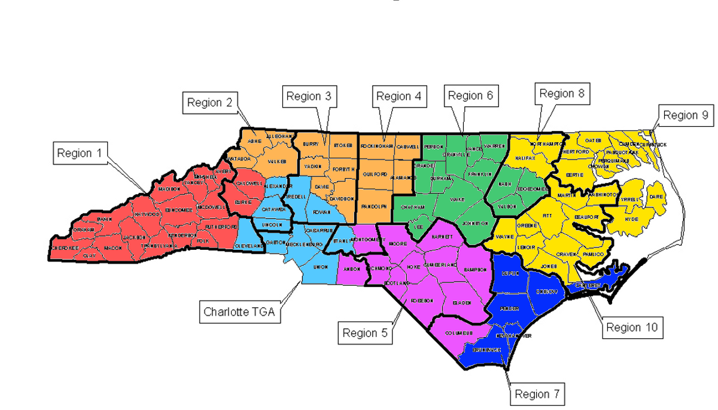
NC-LINK Teams
Care Region 3 – Winston-Salem
Care Region 10 - Greenville
Region 3
PI: Aimee Wilkin, MD
PC: Jennifer Keller
Region 10
PI: Dianne Campbell, MD
PC: LaWanda Todd
Content Faculty
Cindy Gay, MD
Amy Heine, NP
Lisa Hightow-Weidman,MD
Arlene Sena, MD
Heidi Swygard, MD

Slide 43
PLWHA
DATA
CONTINUUMS OF CARE AND DATA
NORTH CAROLINA 2010
1st GAP
The unaware
24 hour reporting of HIV+
Laboratory ( and “other”
Provider-based HIV reports
Testing and Reporting
Disease Intervention Specialists
Notification,
Partner counseling, referral
Card to Care
HIV/AIDS Reporting System (eHARS)
2nd GAP
Newly Aware
Not in Care
One-Time Combined Dataset
eHARS, Meds: Medicaid, Medicare, ADAP, CAREWare
Regional Networks of Care
Regional Bridge Counselors
Unmet Need Determination
HIV+: VL, CD4, MEDS >12M
No follow-up
3rd GAP
HIV+ Lost-to-Care
4th GAP
HIV+ Sporadic Care
CAREWare
Reports
CAREWare
Reports
HIV providers
Quality Care

Slide 44
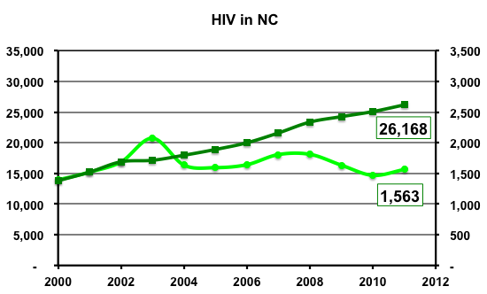
North Carolina Epidemiology
Infected
New Cases / Year --
Cummulative Cases --
Notes:
DATA ** Epi and Care All 2012

Slide 45
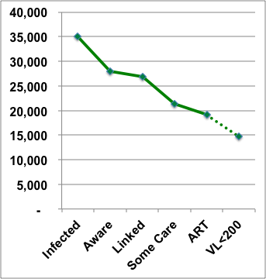
NC 2010 Cascade of Care
-- 35000 = Living in NC
-- 28,000 = Aware
-- 21,000 = Some Care
[1 lab in 2009]
-- 89% in Care w/ ART
-- 77% on ART w/ VL<200
est. from USA data
-- 14,500 w/ VL <200
14,500 VL<200
Notes:
Using data from the Epi Profile for calendar year 2010:
-- 35000 individuals are believed to be alive, infected with HIV and living in NC
-- 28,000 have been diagnosed
-- 21,000 have had 1 or more lab results reported to Public health data bases.
The purple line indicated the 100% of the HIV+ population at each cascade point in 2010.
-- these are estimates based on the USA cascade, where I did not have NC data, I used USA projections
-- about 28% of the HIV+ are diagnosed, in care and have a viral load < 200.
To get to 50% of the population with a viral load of <200,
-- we have to reduce the unaware from 21% to 10%
-- get 95% of the diagnosed linked to care
-- get 90% retained in care
-- use ART in 90%
-- have 75% of those on ART w/ VL < 200.

Slide 46
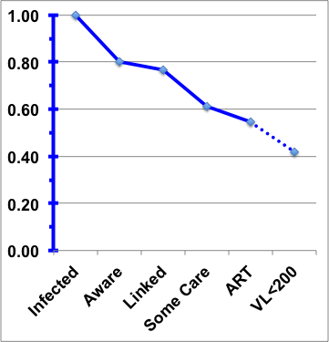
NC 2010 Cascade of Care
-- 100% Infected
-- 80% Aware
-- 96% Linked
-- 62% Some Care
-- 58% ART
-- 42% VL <200
42% VL<200
Notes:
Using data from the Epi Profile for calendar year 2010:
-- 35000 individuals are believed to be alive, infected with HIV and living in NC
-- 28,000 have been diagnosed
-- 21,000 have had 1 or more lab results reported to Public health data bases.
The purple line indicated the 100% of the HIV+ population at each cascade point in 2010.
-- these are estimates based on the USA cascade, where I did not have NC data, I used USA projections
-- about 28% of the HIV+ are diagnosed, in care and have a viral load < 200.
To get to 50% of the population with a viral load of <200,
-- we have to reduce the unaware from 21% to 10%
-- get 95% of the diagnosed linked to care
-- get 90% retained in care
-- use ART in 90%
-- have 75% of those on ART w/ VL < 200.

Slide 47
Purpose Statement
The goals of NC – LINK are to increase the number of people living with HIV (PLWH) who are engaged in consistent care:
-receiving ART
-VL <200

Slide 48
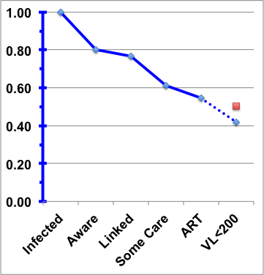
National HIV/AIDS Strategy
2015
Reduce unaware
Link to Care
Reduce disparity in care by 20%
20% increase in VL <200
50% of NC HIV infected
How do we get there?
TARGET
50% with VL<200
Notes:
Using data from the Epi Profile for calendar year 2010:
-- 35000 individuals are believed to be alive, infected with HIV and living in NC
-- 28,000 have been diagnosed
-- 21,000 have had 1 or more lab results reported to Public health data bases.
The purple line indicated the 100% of the HIV+ population at each cascade point in 2010.
-- these are estimates based on the USA cascade, where I did not have NC data, I used USA projections
-- about 28% of the HIV+ are diagnosed, in care and have a viral load < 200.
To get to 50% of the population with a viral load of <200,
-- we have to reduce the unaware from 21% to 10%
-- get 95% of the diagnosed linked to care
-- get 90% retained in care
-- use ART in 90%
-- have 75% of those on ART w/ VL < 200.

Slide 49
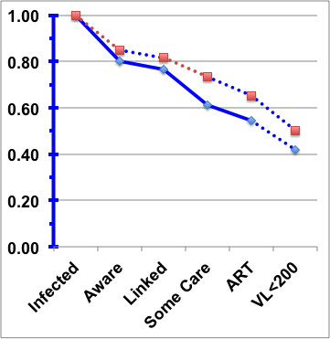
Getting to 50%
Reductions of
25% in unaware
  = 85% Aware
50% in out-of-care
  =73% with some care
1
2
3
4
5
TARGET
50% with VL<200
Continue
  96% Linked
  89% ART
  77% VL <200
Notes:
Using data from the Epi Profile for calendar year 2010:
-- 35000 individuals are believed to be alive, infected with HIV and living in NC
-- 28,000 have been diagnosed
-- 21,000 have had 1 or more lab results reported to Public health data bases.
The purple line indicated the 100% of the HIV+ population at each cascade point in 2010.
-- these are estimates based on the USA cascade, where I did not have NC data, I used USA projections
-- about 28% of the HIV+ are diagnosed, in care and have a viral load < 200.
To get to 50% of the population with a viral load of <200,
-- we have to reduce the unaware from 21% to 10%
-- get 95% of the diagnosed linked to care
-- get 90% retained in care
-- use ART in 90%
-- have 75% of those on ART w/ VL < 200.

Slide 50

Target Population
  Primary Population:
    Persons unaware of their HIV status
    HIV+ persons with known status not receiving consistent HIV care
Secondary Population:
  Young Minority MSM
  All HIV+ persons living and receiving care in NC

Slide 51
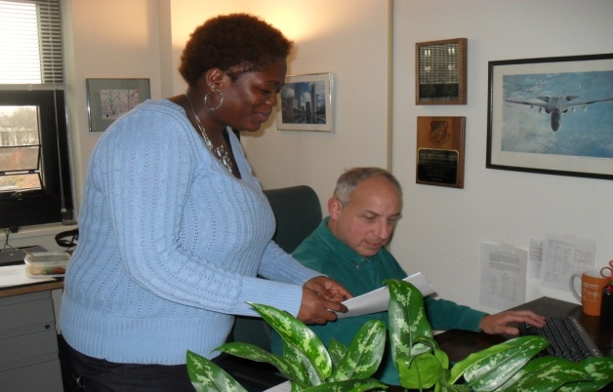

Proposed Interventions
Goal 1: To promote surveillance of HIV care as well as cases, CD4 count and HIV viral load reporting throughout the state will be increased and used for surveillance of care.
Goal 4: To improve the delivery of quality care by multiple providers, shared data systems for service documentation will be implemented so that at a minimum lab results are available to all providers for the purpose of delivering coordinated care.
Intervention: Electronic interfaces will be created between lab result datasets and HIV case report data to make surveillance data available for public health use as well provide patient level data to HIV care providers.
NC CAREWare Team: Meika McEachern and Brian Berte
Duke Team members: Renee Huffaker, heather Parnell

Slide 52
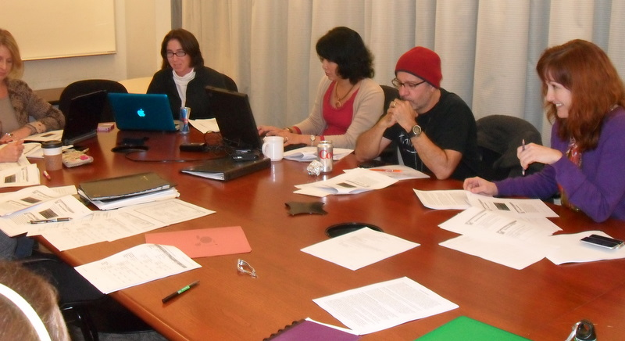

Proposed Interventions
Cindy Gay, Lisa Hightow-Weidman, Arlene Sena- Soberano,
Peter Leone, and Heidi Swygard
Goal 2: To reduce the number of people who are unaware of their HIV infection, the most-at-risk social and sexual networks of PLWH and high-risk patients in healthcare settings will be targeted for testing.
Intervention: Novel and enhanced internet-based prevention services including contact tracing and testing will be offered. Targeted HIV testing efforts in healthcare settings will also be increased.

Slide 53
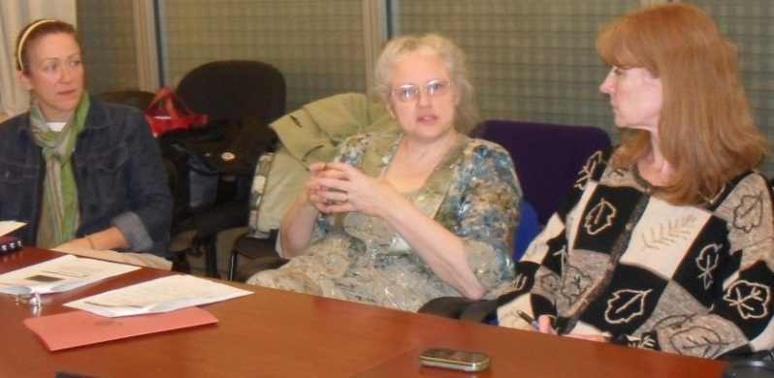
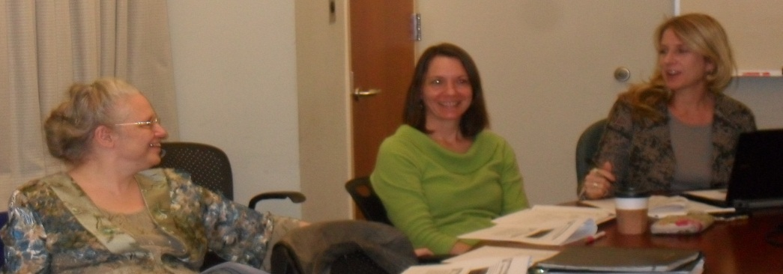
Proposed Interventions
Goal 3: To reduce the number of PLWH who do not enter care for more than 3 months, rapid referrals to care will be established.
Intervention: A statewide nurse advice hotline and a bridge counselor team to facilitate linkage of newly diagnosed persons to HIV care within 15 days of diagnosis.
Amy Heine, Cindy Gay
Lynne Messer, Byrd Quinlivan, Jacquelyn Clymore

Slide 54
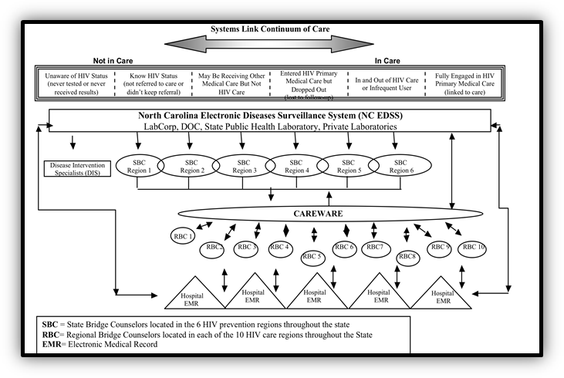
Proposed Interventions
Goal 5: To reduce the number of PLWH who do not receive a minimal level of continuous care, providers will be notified about patients without labs in the last 6 or 12 months using patient-level surveillance data.
Intervention: NCEDSS and Regional CAREWare databases will be used to generate “insufficient care” reports for each patient care network. Providers will use these data for outreach activities including working with regional bridge counselors to re-engage patients in care.

Slide 55
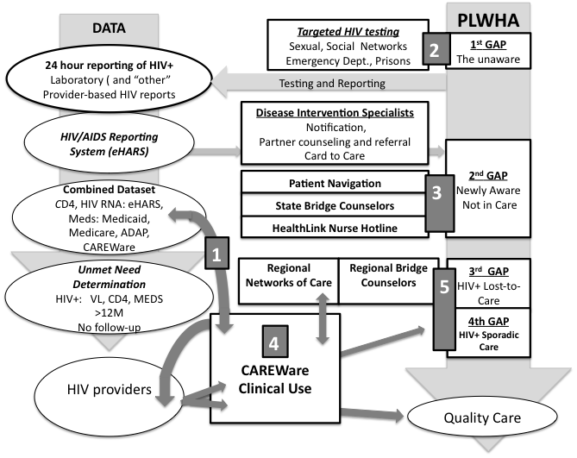
Overview of Project
N.C. Communicable Disease Branch HIV Databases and Linkages

Slide 56
GAP | INTERVENTION | PROGRESS
 | 1. Surveillance data Bridges between surveillance and care data | Design change Expansion of partners Buy-in from new partners
1 Unaware | 2. Targeted Testing HIV Testing in Networks Healthcare testing | Testing at house parties Procedures for ED, clinic testing
2 Newly Aware | 3. Rapid Linkage to Care Bridge Counseling Nurse Call Center | Bridge Counseling Training Procedures Pilot testing RN Hotline Procedures
3 Lost-to-Care | 4. Care Ware Links BC use Creation of regional networks | Shared CareWare Regional Usage SBC use
4 Sporadic care | 5. Out-of-Care Surveillance | Active Search Procedures Pilot testing

Slide 57
Lessons Learned
Staffing
  Need for more partnerships
  Build time for staffing changes and hires
Designs
  Flexibility
  Modifications
Unexpected events
  EMR change disrupts entire system
Communications
  More participants on steering committee
  Dual representations
  Email summaries

Slide 58

Wisconsin SPNS: Systems Interventions to Improve Linkage and Retention to Care
Casey Schumann, MS
AIDS/HIV Program, Wisconsin Division of Public Health

Slide 59
Presentation Outline
Need for improved linkage and retention in Wisconsin
Intervention Descriptions
  Linkage to Care Specialists
  Enhanced HIV Testing
    Acute HIV Testing
    Improved Social Networks Testing
  Using data to promote linkage and retention
Lessons Learned

Slide 60
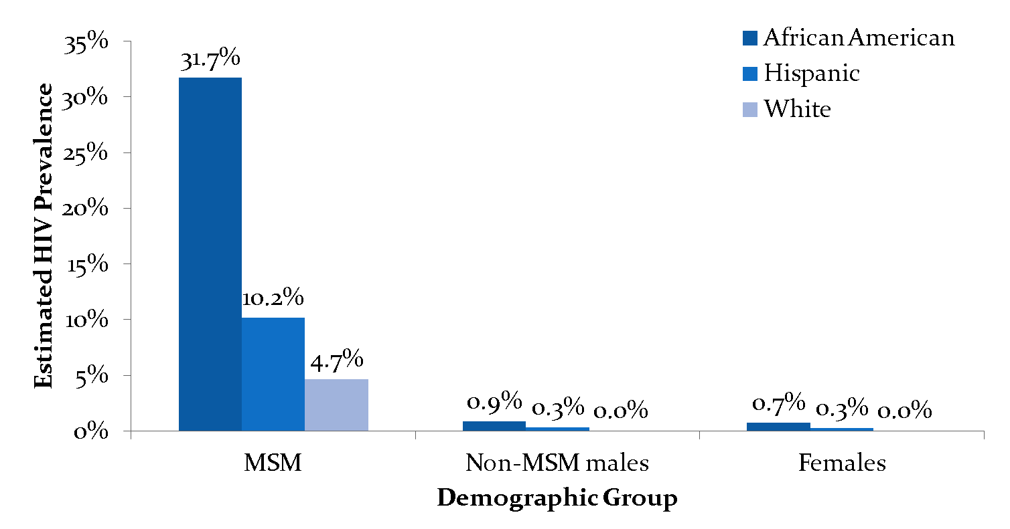
Estimated HIV Prevalence within Risk Groups, ages 15-59 years, Wisconsin, as of 12/31/2011
* The estimated prevalence is adjusted to account for the CDC’s estimate that 21% of HIV-infected persons are unaware of their infection and therefore not reported. The MSM population for each racial ethnic group uses the CDC’s estimate that 4% of adult males are MSM.
Notes:
Add rate to notes

Slide 61
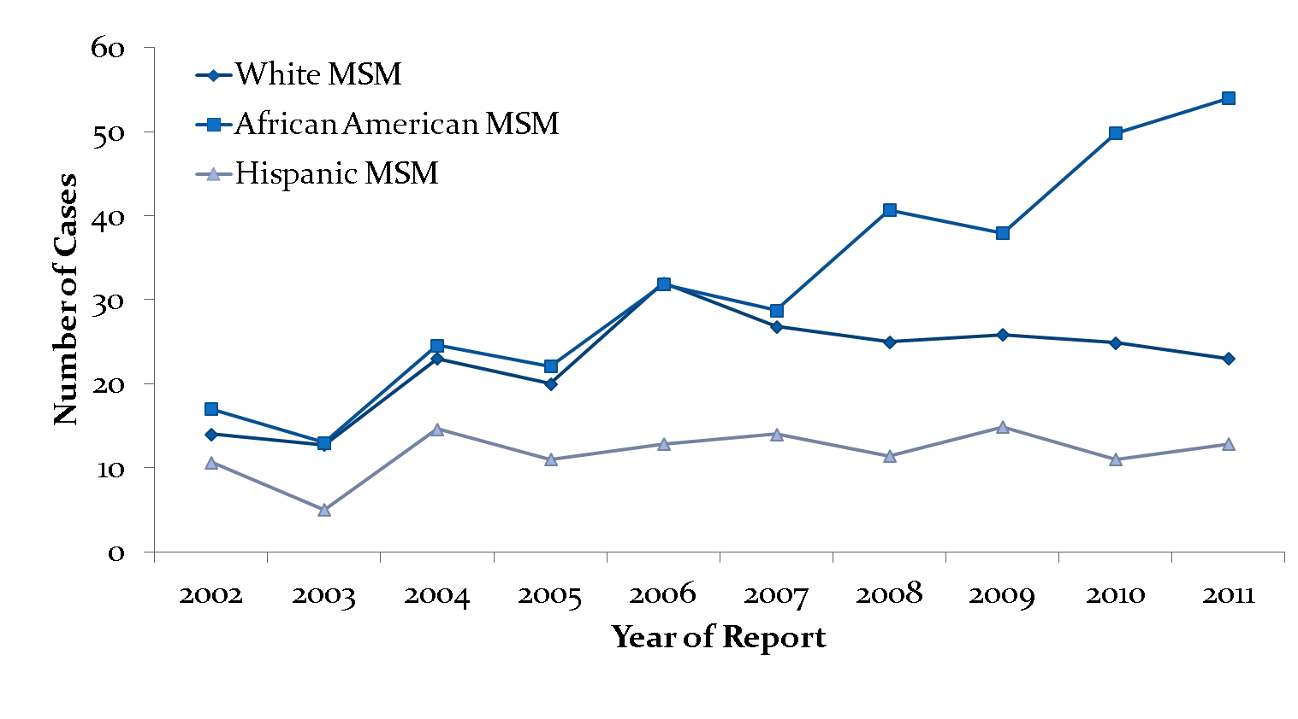
Reported cases of HIV infection, MSM ages 15-29 years, by race/ethnicity, Wisconsin, 2002-2011
Data have been statistically adjusted to account for unknown risk.
Notes:
Add rate to notes

Slide 62
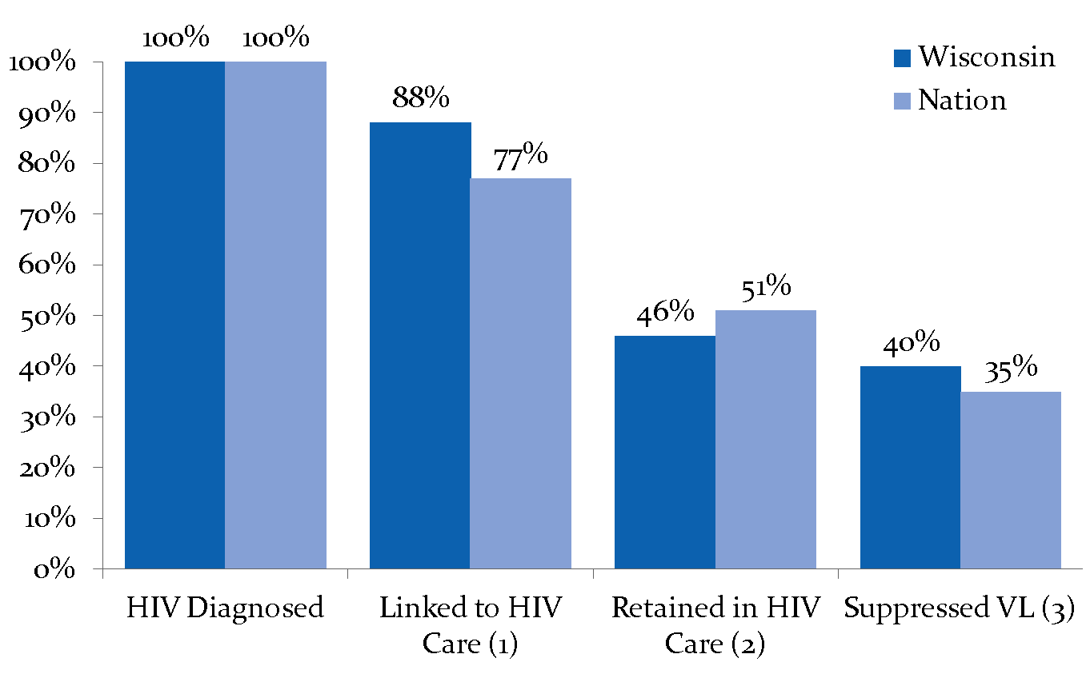
HIV Cascade: WI vs. Nation
Linkage based on individuals diagnosed in Wisconsin during 2010 and linked to care within 12 months of diagnosis.
Retention based on two or more visits during 2011 among 2010 prevalent cases.
VL suppression based on 2010 prevalent cases whose last VL test during 2011 was ≤ 200 copies/mL.
Notes:
Takes same MMWR data and looks at everything as a percentage of those diagnosed with HIV instead of as a percentage of the entire HIV infected population
Better at linkage
Worse at retention
Better at viral load suppression

Slide 63
Linkage to Care Specialists (LTCS)
Goal: Provide time-limited, intensive navigation services and work with client to reduce barriers to care.
Intervention Characteristics:
  Work with clients who have fallen out of care or are at risk of falling out of care to address barriers and re-engage in care (includes Corrections release).
  Link newly diagnosed and out of care clients to care and supportive services.
  Assist clients in developing the skills and knowledge needed to successfully adhere to care.
  Transition clients to case management or self-management.
Notes:
Partners: 10 LTCS at 5 agencies (3 clinical sites, 2 non-clinical sites) in Southern and Southeastern Wisconsin

Slide 64
LTCS Successes & Challenges
Successes
Challenges
LTCS brochure to market new service.
Partnership with Department of Corrections and high acceptance rate (38 of 39 offered).
85% of active clients linked to care, ¾ within 3 weeks of enrollment.
Engagement of non-Ryan White providers.
Support of the Ryan White provider community.
Identifying target demographic.
Best locations for the LTCS: clinical vs. non-clinical.
Difficulty reaching retention clients to offer the service.
Defining interactions with medical and non-medical case managers.
Promoting client self-management.
The need to share client information vs. HIV statutes and HIPAA.
Notes:
Corrections partnership and high corrections acceptance rate (38/39)
Acceptance of the service
Linkage to care rate:

Slide 65
Enhanced HIV Testing
Acute Testing
  Goal: implement acute HIV testing to identify individuals in acute HIV infection and link them to care and partner services earlier in the disease course.
  Intervention characteristics: offer the target population antigen/antibody (Ag/Ab) testing in addition to or as an alternative to rapid HIV antibody testing.
Improved Social Networks (SNS) Testing
  Goals:
    Better reach MSM sexual networks .
    Better engage Latinos in Social Networks testing.
  Intervention Characteristics: work with two agencies to implement new strategies to reach desired populations.
Notes:
Acute Partners: 9 agencies offering acute testing in Southern and SE WI
SNS Partners: 9 agencies in Southern and SE WI, funded outside of this grant
Acute target popn: MSM, non-identified MSM, MTF transgendered, female partners of known MSM or anyone with high risk behaviors within past 3 months

Slide 66
Testing Successes & Challenges
Successes
Challenges
New acute HIV testing protocol.
Greater community awareness of HIV testing technologies and acute HIV infection.
High return rates for Ag/Ab test despite receipt of rapid test results.
Use of PDSA cycle to evaluate changes: impact on agency creativity and engagement.
Increased proportion of SNS tests among all HIV tests.
Identifying additional venues to conduct HIV testing.
Access to “House” scene.
Client acceptance of blood draws for Ag/Ab test.
No acute positives identified: cost/benefit of acute HIV testing.
Participating in SNS testing for incentives.
Managing SNS recruiters.
Identifying highest risk individuals for SNS testing.
Some new testing venues taking longer to be successful.
Notes:
Other clinics
Planned parenthood

Slide 67
Data Systems
Goal: improve use of data to measure, monitor, evaluate, and support linkage and retention to HIV care.
Intervention Characteristics:
  Develop mechanisms to routinely monitor linkage and retention to care at the clinical level.
  Develop mechanisms to routinely monitor linkage and retention to care using data available at the State.
  Use State data sources (e.g., ADAP, HIV surveillance, Partner Services) to assist clinics in classifying patients as out of care, deceased, out of state or transferred care.

Slide 68
Data Successes & Challenges
Successes
Challenges
Clinics regularly looking for out of care patients.
State able to provide some indication of care status.
State developing an analysis tool to use surveillance laboratory data to identify HIV cases who were never linked to care or are out of care.
Flaws in using laboratory data as a proxy to medical care.
Re-linking patients to care post- hospitalization, institutionalization.
Next steps for those identified by State as out of care or never linked to care.
Notes:
Using lab data:
Patients get labs but don’t see provider. How do we know that a lab really equals care?

Slide 69
Lessons Learned
Know the barriers well so that interventions can be tailored to address the specific barriers.
Ensure that you have buy-in of key community partners and providers prior to initiating the intervention.
Develop a protocol for the intervention in advance, if possible.
Have a mechanism for checking in regularly with the partners implementing the intervention; be flexible based on their feedback.
Think about how patient data can be shared across providers.
Develop a formal or informal (PDSA) plan for determining whether your intervention was successful overall, and what parts of the intervention made it successful.
Notes:
Acute testing- identify people earlier, but then takes long to report to surveillance and assign partner services, so are we really missing the systems gap?
WI had over 80 prevention and care providers at a kick-off meeting to highlight the need and introduce the new ideas
Lack of protocol for LTCS means that no one knew what they were doing
Lack of regular check in for LTCS means we didn’t know what they were doing nor could we give them guidance
Need for data sharing across providers who are also tracking the person’s linkage and retention, e.g. partner services, CTR sites, previous medical provider, case manager, etc.
Partner with PREVENTION!!!

Slide 70
Acknowledgements
Wisconsin Department of Health Services
  Jim Vergeront, MD
  Mari Ruetten
  Leslie Anderson
  Kathleen Krchnavek
  Jim Stodola
  Karen Johnson
  Christina Hanna
Partnering Agencies
Jane Fox and ETAC
Center for AIDS Intervention Research
HRSA
Steering Committee

Slide 71
Summary

Slide 72
Identifying the Gaps
  Each state or locality has its own HIV disease profile
  Key questions to consider:
    Who has HIV in your area?
    Who is being missed by the current systems of care?

Slide 73
Identifying the Resources
  Linkage and retention challenges ideally addressed through systemic interventions
    Involving multiple partners increases chances of identifying and intervening with those not in care
  Key question: Who are the critical partners in your area?

Slide 74
Selecting the Interventions
  Multiple potential strategies
  Most ideal strategy affected by:
    Target population characteristics
    Available resources
    Characteristics of environment (e.g., rural vs. urban)
  Key questions: Which interventions are best for your community? Which interventions are feasible?

Slide 75
Overcoming Challenges
  Systemic interventions have unique challenges. Require:
    Common vision
    Complementary protocols
    Common or compatible infrastructures (e.g., IT systems)
    Supportive policies and laws
  Key questions: What are the key challenges in your community? What are the potential solutions?

Slide 76
Question-&-Answer Period

Slide 77
Obtaining CME/CE Credit
If you would like to receive continuing education credit for this activity, please visit:
http://www.pesgce.com/RyanWhite2012

