Slide 1
The Ryan White Program and Health Care Reform
Ann Lefert, National Alliance of state & Territorial AIDS directors
Bill McColl, AIDS United
Ryan white HIV/AIDS Grantee Meeting
October 20, 2012

Slide 2
Presentation Overview
History of Ryan White
Overview of 2009 community consensus process
Overview of changes made in 2009 Ryan White extension
Issues for consideration
Ryan White post-FY13 paths forward
Partners in process
Congress
Administration
Next steps

Slide 3
History of Ryan White
1985 - AIDS/HIV Service Demonstration Project - funds urban areas, such as New
York, San Francisco, and Los Angeles in need of emergency relief
1987 - Three community health centers funded to provide HIV treatment services
1987 - “One time” assistance fund to provide AZT
1988 - HIV Planning Grants - statewide planning system in 11 states (and ten cities)
1988 - Pediatric AIDS Demonstration Grant program
1988 - AIDS Education and Training Centers
1989 - Home and Community Based Care grant program
1990 – Ryan White CARE Act

Slide 4
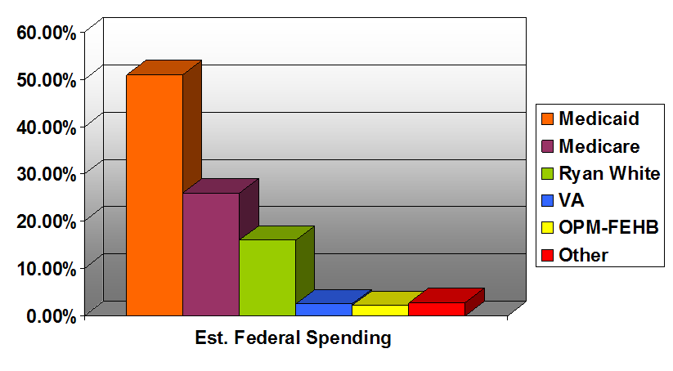
Federal Funding for HIV

Slide 5
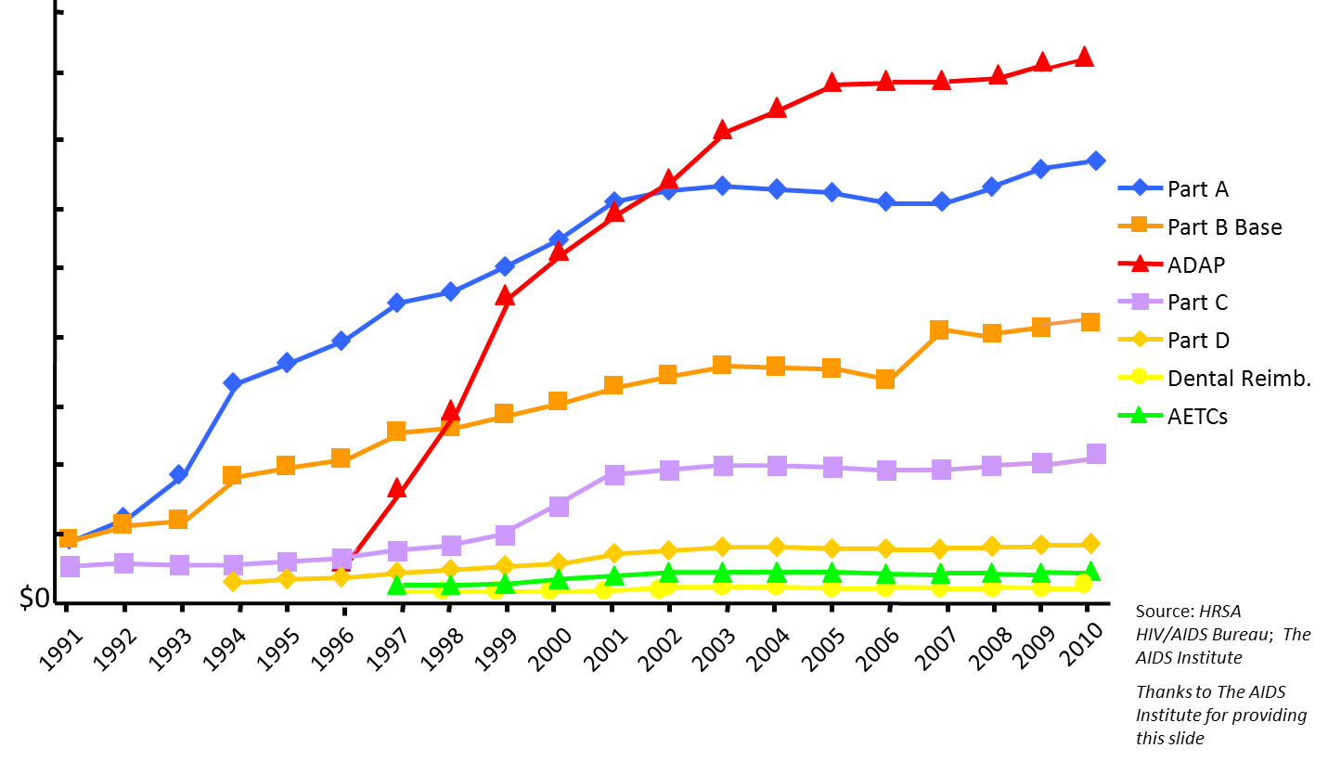
Ryan White Funding History
$900 m

Slide 6
Community Consensus Process
Ryan White Work Group
Original Working Group of the Federal AIDS Policy Partnership (FAPP) (2003)
Coalition of national, local and community-based service providers and HIV/AIDS organizations
HIV/AIDS service and medical providers
Public health advocates
People living with HIV/AIDS
Consensus/Sign-on Process

Slide 7
Community Consensus Process
2006 reauthorization process was very difficult
Late political and community compromise
Multiple position statements
Lack of community process
Implementation issues
Switch to HIV/AIDS data
Late grants for Minority AIDS Initiative
Housing
Sunset provision meant that action had to be taken before September 30, 2009

Slide 8
Community Consensus Process
Organizations committed to a united approach to reauthorization/extension
Face-to-face meeting convened in September, 2008
Implementation issues – case by case
Sorted issues into “baskets”
Agreement to develop sign-on consensus document
Operating under extension for three years
Agreement to revisit after elections
Subgroups on hold harmless, core services, etc.
Additional meetings through December

Slide 9
Community Consensus Process
Issue Division:
Implementation fixes needed before extension
Legislative or “technical” fixes
Regulatory fixes
Issues to address in extension
Issues for full reauthorization (2012)
Issues addressed through other processes
1st 100 Days – new Obama Administration
National HIV/AIDS Strategy
Health reform
Notes:
Full Reauthorization – at that time assumed would be in different place

Slide 10
Community Consensus Process
Consensus Document Agreement
Final document six specific extension requests and four “technical fixes”
Initial release on March 10, 2009
Technical fixes previously released
323 organizations signed on
Had support from almost every state
Unprecedented level of support

Slide 11
Community Consensus Process
In September 2009, HRSA testified before Congress and recommended essentially the same changes made by the community
Biggest difference was four year authorization period
Consensus document became basis for legislation introduced by Senator Harkin and Representative Waxman
Signed into law Oct 30, 2009
Signing ceremony with HIV community leaders

Slide 12
Ryan White Extension of 2009
“Ryan White HIV/AIDS Treatment Extension Act of 2009”
Authorized the program for four years (FY10-FY13)
Removed “sunset” provision allowing program to remain funded at end of authorization period
Extended hold harmless protections
Extended protection for code-based states during final transition to name-based HIV reporting
Increased unobligated amounts from 2 to 5 percent
Included ADAP rebate language

Slide 13
Ryan White Extension of 2009
Included prevention provisions: EIIHA, 1/3 of Part A supplemental criteria
Changes to Ryan White Program with FY13 awards
Hold harmless will decrease to 92.5 percent of FY12 award
FY13 funding distributed on names-based cases reported to CDC. States can no longer report cases directly to HRSA and 5 percent penalty and cap will be eliminated.

Slide 14
Issues for Consideration
November 2012 election
Results will affect many organizations’ and Congressional offices’ thoughts on Ryan White action
Less and less appetite in Congress to work on disease-specific legislation
Fiscal environment continues to be quite constrained and Members looking at all programs for funds
Discretionary health programs continue to be target for offices not supportive of health reform
Impacts of sequestration and deficit reduction

Slide 15
Issues for Consideration
Implementation of health reform is not a magic bullet and will not be actualized over night
Systems will not be fully functioning with kinks worked out for some time
Not all services currently provided through Ryan White will be covered
Gaps will not be immediately visible
There will still be a need for a mechanism to provide care to those unable to access health insurance as well as “wrap-around” services to cover high costs of insurance

Slide 16
Issues for Consideration
Many unknowns with health reform implementation
How many states will expand Medicaid
Opting out could magnify differences in care between states
Essential health benefits
Drug coverage – one drug per class, cost-sharing levels
Inclusion of Ryan White providers in insurance networks

Slide 17
Ryan White Post-FY13 Paths Forward
Full reauthorization
Would open up legislation completely for changes from community and Congress
Potentially risky as Members of Congress may think there’s no need for Ryan White post-health reform
Do nothing
Since current law does not contain sunset provision it is possible to do nothing
Congress can still appropriate funding
Potentially risky in this fiscal environment

Slide 18
Ryan White Post-FY13 Paths Forward
Extension with a few minor agreed upon modifications
Would allow Congress to weigh-in, but hopefully with community input on changes
Would entail much work with community to ensure modifications were well crafted and virtually non-controversial
“Less is more” approach

Slide 19
Partners in Process
Key Congressional Offices
Senate HELP Committee
Tom Harkin (D-IA), Chair
Mike Enzi (R-WY), Ranking Member
House Energy & Commerce Committee
Fred Upton (R-MI), Chair
Henry Waxman (D-CA), Ranking Member
House E&C Health Subcommittee
Joe Pitts (R-PA), Chair
Frank Pallone (D-NJ), Ranking Member

Slide 20
Partners in Process
Administration (White House, HHS, HRSA):
The HRSA HIV/AIDS Bureau (HAB) has begun process to engage community in future of Ryan White
Over 200 comments received in response to Federal Register notice
4 listening sessions held over summer
HAB currently compiling information received
Both HRSA and HHS Assistant Secretary for Planning & Evaluation (ASPE) have engaged Mathematica on studies focusing on health reform and future of Ryan White

Slide 21
Partners in Process
ASPE Study, Federal Register Notice
“Will examine the service needs under the Ryan White HIV/AIDS Program as the provisions of the Affordable Care Act are implemented, and identify strategies for ensuring that available federal resources are directed to areas of greatest need
Analysis of existing quantitative data sources, including Ryan White HIV/AIDS Program data, Medicaid enrollment and claims data, and HIV surveillance data
2 year project, data collection via telephone interviews with administrators of Ryan White grants and providers of HIV care services
Interviews will help ASPE understand the potential impact of the Affordable Care Act from the perspectives of Ryan White grantees and service providers”
Notes:
In light of Congressional interest expressed in Senate Report 111-243 concerning how the Ryan White Program will transition into a larger system of care with the implementation of the Affordable Care Act, these interviews will help ASPE to understand the potential impact of the Affordable Care Act from the perspectives of Ryan White grantees and service providers.

Slide 22
Partners in Process
Many organizations having conversations regarding future of Ryan White
Seem to have two-prong strategy:
Short-term - action for 2013
“Less is more” approach
Longer-term – action down the road which would involve larger overhaul of the Program
Could include review of funding formulas, Part structure, etc.

Slide 23
Next Steps
Role of the Ryan White Work Group
Currently meeting monthly to discuss Ryan White Program and possibilities
Will hold day-long meeting on November 30, 2012 to begin “community agreement” process
After HRSA All Grantees Meeting in DC
Will conduct workshop at All Grantees meeting to discuss Ryan White post health reform with Program grantees
Email if interested in joining Ryan White Work Group

Slide 24
Next Steps
Issues for consideration:
What is the minimum that would have to be changed in legislation?
Payer of last resort
75/25 process – can we rework waiver process to make it easier to use
Transition of clients to other forms of coverage
Provision of support services

Slide 25
Ann Lefert
National Alliance of State & Territorial AIDS Directors
Director, Policy & Health Care Access
alefert@nastad.org
202.434.7138
Bill McColl
AIDS United
Director of Political Affairs
wmccoll@aidsunited.org
202.408.4848 x247

