Slide 1
Establishing an HIV Services Internet Portal to Enhance Access and Retention in Care
John Sapero Program Coordinator, Phoenix EMA Ryan White Planning Council November 29, 2012

Slide 2
Purpose
To provide you with an understanding of the experience I have had leading the development of a statewide online HIV resource
Process
I’ll provide an overview of the Phoenix EMA, the rationale used to define the site, the development process, and some takeaway thoughts
Payoff
You’ll be better prepared when you begin to start your own initiative
Notes:
Preface
I am not an expert, but I have knowledge and experience you may find helpful
I have biases, opinions and preferences, and will share these openly and honestly. You may disagree – that’s OK, and it doesn’t make either of us wrong.
Please feel free to ask questions as they come to you, or wait until the end.

Slide 3
Preface
I am not an expert, but I have knowledge and experience you may find helpful
I have biases, opinions and preferences, and will share these openly and honestly. You may disagree – that’s OK, and it doesn’t make either of us wrong
Please feel free to ask questions as they come to you, or wait until the end
Notes:
Preface
I am not an expert, but I have knowledge and experience you may find helpful
I have biases, opinions and preferences, and will share these openly and honestly. You may disagree – that’s OK, and it doesn’t make either of us wrong.
Please feel free to ask questions as they come to you, or wait until the end.
Additionally, I’m not going to discuss web protocols, debate the merits of HTML5, or explain any development tools. This is meant to provide you with a real world example, for you to use as a reference in your future work.

Slide 4
steal
shamelessly
share
seamlessly*
Notes:
This will be a common theme among my presentation. There are many sources of information waiting for us to use – careacttarget.org, AIDS.gov, nationalqualitycenter.org, each other… Do not hesitate utilize what others have done and make it suit your needs!
But when doing so, acknowledge the hard work of others, pay for things that have a cost, and don’t violate copyrights or other protections.

Slide 5
Notes:
The Phoenix EMA is comprised of Maricopa and Pinal Counties, located in central Arizona. The two counties have a combined land area of approximately 15,000 square miles, and a combined estimated population of 4,192,887 in 2010. This represents 66 percent of the state’s total population. To put this into perspective, our Part A service area is about the size of Washington DC, Maryland and Delaware combined. The city of Phoenix alone is five times larger than Philadelphia, despite competing populations.
Despite the EMAs large size, our Ryan White provider base is quite small. We have two Primary medical care clinics (one in central Phoenix and one in Case Grande), and our entire Ryan White continuum has around 19 providers. I say “around” because we are losing some providers due to issues I’ll discuss later on.

Slide 6
Prevalent HIV & AIDS | Cases | %
By Gender
Male | 9086 | 86.6
Female | 1406 | 13.4
By Race/Ethnicity
White Non-Hispanic | 5971 | 56.9
Black Non-Hispanic | 1293 | 12.3
Hispanic | 2678 | 25.5
A/PI/H Non-Hispanic | 135 | 1.3
AI/AN Non-Hispanic | 271 | 2.6
MR/O Non-Hispanic | 144 | 1.4
By Mode of Transmission
MSM | 6397 | 61.0
IDU | 1096 | 10.4
MSM / IDU | 887 | 8.5
Heterosexual | 1014 | 9.7
Other/Hemophilia/Blood Product/Transfusion | 121 | 1.2
No Reported Risk/Unknown Risk | 977 | 9.3
TOTAL | 10492 | 100%
Notes:
Review epi stats on screen.
Over 40% are Out of Care.
There are currently 3,154 Part A clients as of November 2012, with similar demographics. Discuss AA disparity.

Slide 7
time
Once upon a
Notes:
So now that you know a bit about the Phoenix EMA – I’ll tell you my story.

Slide 8
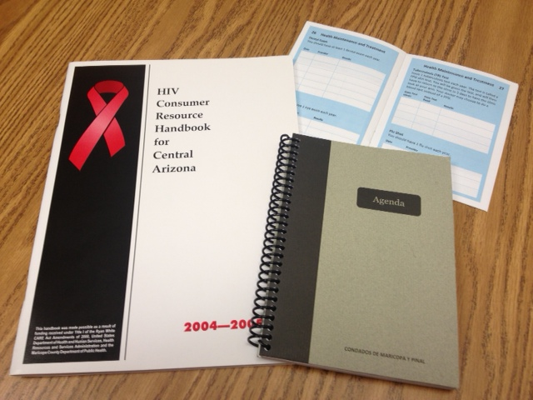
Notes:
It all started when I opened a book. Our original consumer Resource Handbook guide was huge, had a giant red ribbon on the front, plastered with “HIV” on the front and back cover multiple times. Exhaustive, diverse content, 1/3 of the book was non-resource material (How HIV Works, Asset Conversion, Immigration Law, etc.).
Content on both RW-HIV care and other non-HIV services (WIC, etc.)
2007 to 2010: Based on consumer focus groups, I reduced the guide to a smaller 5X7 booklet (green at bottom), lost all references to HIV on the cover, included pockets inside the cover to hold eligibility paperwork, stickers for appointment reminders, tools to track lab values, etc. The Care Planner was so popular we had to reprint 6 months after the first release. I then collaborated with Part B to produce Northern and Southern AZ versions. Each version was fully translated into Spanish (simply called Agenda). Of note, many non-HIV organizations began requesting copies to give to clients, especially prison social workers.
2011: Consumer feedback on the Care Planner was that only about 10-12% were using the health management tools, due in part to the bulkiness of the book. While working with the National Quality Center, I was exposed to a booklet called Choosing Health for Life. It was an expanded version of the tools I had in the Care Planner and I loved it. I contacted NQC to request the ability to use the content (steal shamelessly – share seamlessly), and develop my own version for the Phoenix EMA. My intent was to split the Care Planner into two 4 X 6 booklets – the Health Journal (tracking tools) and a similarly sized Resource Guide (contact info).
Providers and consumers loved the Health Journal. Again, because the book isn’t branded HIV, we had many outside requests as well. I’m already starting to run low on stock. So I began work on the Resource Guide…

Slide 9
July
2011
Notes:
July 2011 – Eligibility changes to Arizona Health Care Cost Containment System (Medicaid) – discuss
Effect: All newly diagnosed that were formerly Medicaid eligible now RY Part A clients
All disenrolled Medicaid clients now RY Part A clients
Result: Since November, 2011, the EMA has experienced growth of an average of 40 new clients/month enrolling in Primary Medical Care, compared to an average of 10/month in the previous year. The additional funding that has been needed for Primary Medical Care in 2012 is approximately $885,990.
As you can guess, funds from the PCS budget were moved to direct service, including those needed to print the new Resource Guide. I had always planned on adding an online component, and would now focus on this exclusively.

Slide 10
☹
=
Notes:
Then I learned that the County was not my friend.

Slide 11
OK
OK
ME
PPIO
OK
OK
CPIO
P
PIT
P
P
CIT
OK
the department of
redundancy
department
Notes:
While I was supported conceptually, there were barriers…
Explain the County process…
Access restrictions to content sites (Youtube, RSS feeds, etc.) won’t support third party programs, and outdated proprietary software for web development..

Slide 12
Notes:
This made me sad. I realized I had to find an outside partner.
But who would I get that would be willing to spend funds on this project?

Slide 13
meanwhile…
Notes:
Consistent themes had emerged from our needs assessments and other studies…
“My doctor told me not to go to _______, because all of their clients were poor and had mental health or drug problems” – newly diagnosed insured client feedback
“We’ve been doing this for 15 years. I’m not training them (a new case mgt org) – they can learn like we did” – provider comment
“I send anyone who is newly diagnosed to _______. I don’t know any other organizations” – non-RW provider
“I don’t want to have to go to a case manager every time I need something.” – client response
We never know about changes to services, guidelines, or other important info. Providers don’t share information. There’s no way to communicate to everyone- all

Slide 14
we all wanted
the same
info
Notes:
Everyone – RW providers, non-RW providers, RW clients, non-RW clients, people in other states – needed access to the same, consistent HIV care info
What was happening – gatekeepers, hoarders, clients tiring of providers and dropping out of care, perceived lack of diversity of services. Etc.
So I added some questions regarding internet access and usage to our next client-based needs assessment.
Popular perception: Clients had no email address, no dedicated computer = no web access or knowledge
Reality: NOT TRUE

Slide 15
90%
had internet access
Notes:
90% of the Ryan White Part A clients we surveyed had internet access of some sort – phone, computer, friends computer, work, library – and some had multiple methods of access.

Slide 16
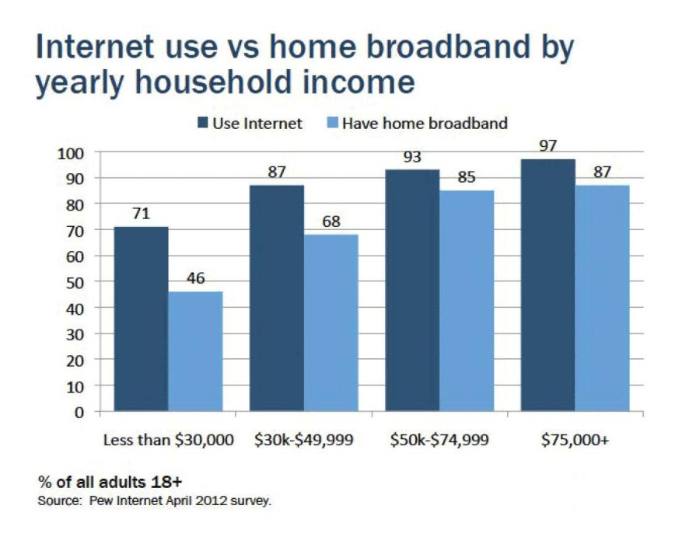
Notes:
Supported by national research
Important to remember that for many people who are economically disadvantaged, mobile devices are now a phone and internet resource – just not constantly active.
AIDS.gov has some great resources about internet use, both from a creator and end-user perspective.

Slide 17
National HIV/AIDS
Strategy
reduce incidence | increase access| reduce disparities
Notes:
Around this time, the National HIV/AIDS Strategy had been released, with three primary goals.
Coincidentally, Part A had released guidelines for Early Intervention Services, which had a similar focus, and the EMA were working hard to implement activities in our community.

Slide 18
Notes:
And also about this time, Aunt Rita’s Foundation approached me.
Aunt Rita’s Foundation was formed in the late 1980s by four friends who witnessed an increasing number of people close to them dying of AIDS. To help offset the care and funeral expenses of these individuals, the friends began to hold bake sales and other small fundraisers at Phoenix area bars and nightclubs. To represent the spirit of this new organization, the friends created Rita – a fictitious, caring “Auntie” that symbolized the compassion of the entire community. Aunt Rita’s Foundation was born.
Today, Aunt Rita’s Foundation offers free fundraising assistance to a coalition of 19 organizations that provide HIV education and prevention services in Maricopa and Pinal Counties.
I was asked to develop the awareness strategy because the Foundation was donors needed the organization to provide direct service in order to grant funds.
Objectives: Increase fundraising opportunities, develop infrastructure, increase local awareness of HIV, create educational programming.

Slide 19
Notes:
ARF’s objectives and mine were perfectly matched. I had found my partner

Slide 20
Notes:
Thoughts began to align – I could create a web-based resource for the EMA that was easily accessible, supported the national HIV/AIDS Strategy, helped people quickly find local resources, established equity of information among our providers and clients, and create infrastructure for ARF’s community education and awareness initiatives.
So, what would that look like?

Slide 21
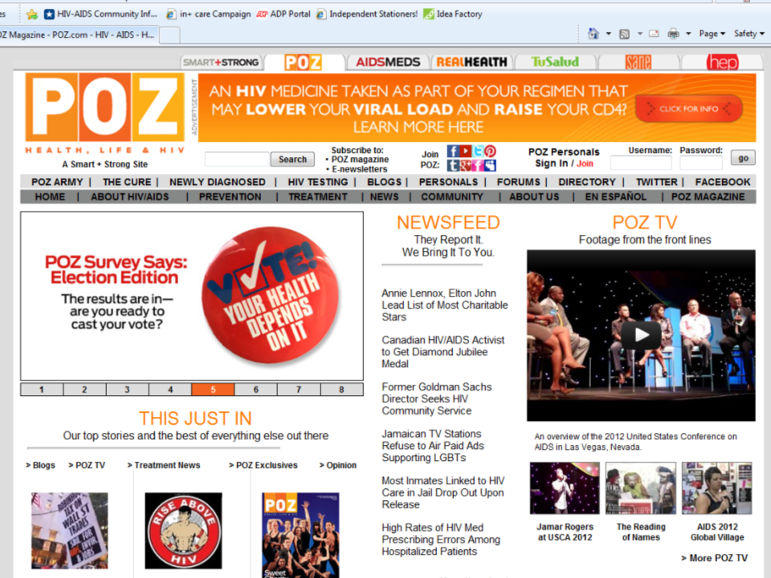
Notes:
Well, it might look like this - and many other well established sites with paid staff, advertisers, and large reference libraries.
Examples: AIDS.gov, theBody.com, HIVLA.org - How was my idea any different than these?

Slide 22
what was my
vision?
Notes:
Establish a unique vision.
Do not reinvent the wheel.
Create based on what you need to do, not what you want to do, or can do.
All too often, I see people reinvent the wheel simply because they want to say they did it themselves.

Slide 23
gateway
a
not a
destination
Notes:
My unique vision: A gateway, not a destination
Consumer centric, connection focused. I wanted them to get just enough information to be engaged to connect to a provider.

Slide 24
Up-to-date local testing/provider locator
Crowd-sourced providers (“Yelpish”)
Info sharing – providers and clients
Streamlined – simple, clean, elegant
Quickly connect to people, not info
Video walk-throughs – appts, testing, etc.
Bilingual
Notes:
Expand on rationale behind these choices

Slide 25
Not a community-wide referral source
Not a forum to bash providers
No personals
No politics
Not meant to the “library of Alexandria”
Notes:
So I had my vision defined… there was just one little problem…

Slide 26
Notes:
No money!
So, using the Project Profile/Planning Worksheet from a grantsmanship essentials training conducted by the Alliance of Arizona Nonprofits, I created a case study for the initiative.
REVIEW WORKSHEET
Make Case Study available at the presentation or info at end of presentation to request a copy.

Slide 27
Goal/Activity | Cost
Content Development: Consumer & Provider Input | $1,300
Content Development: Research/Compilation of Content | $5,000
First Year Project Support: ARF Staff | $4,300
Establish Advisory Board & Conduct Meetings | $650
Development of Policies and Procedures | $100
Website Development | $22,500
Training and Development | $1,250
Marketing and Promotion | $10,500
Translation Services | $3,000
Total Project Budget | $47,350
Notes:
This is the budget that I prepared for the case study, and what was ultimately funded (but not spent – at least not yet).
Anticipated timeline – one year.
Actual timeline: 1.5 years so far…

Slide 28
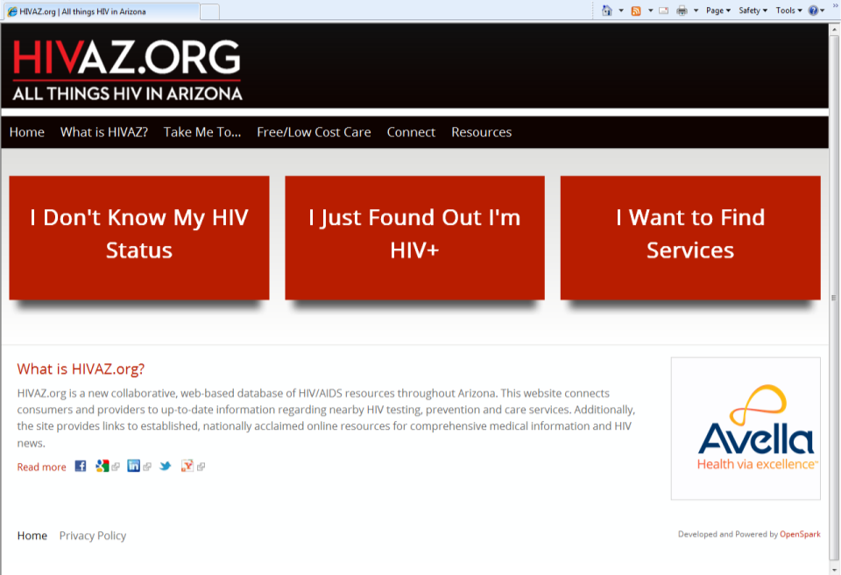
Notes:
Tell the story of the site:
Site Models used
Navigation model – GPS and three clicks
Rationale for content/brevity/statewide inclusion
Telling a story
Data collection/data entry – 16,000 blocks of data entry
Video needs/desires
Identifying the right partners
Training for bloggers
Crowd sourcing
Phone and tablet optimized
For the future
Local video walk throughs
Local peer blogs
Refined calendar
Parternship with AIDS.gov?

Slide 29
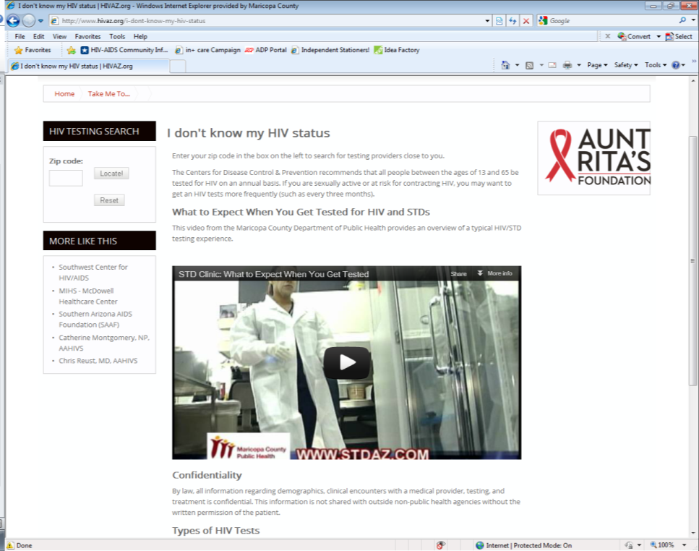
Notes:
Discuss features

Slide 30
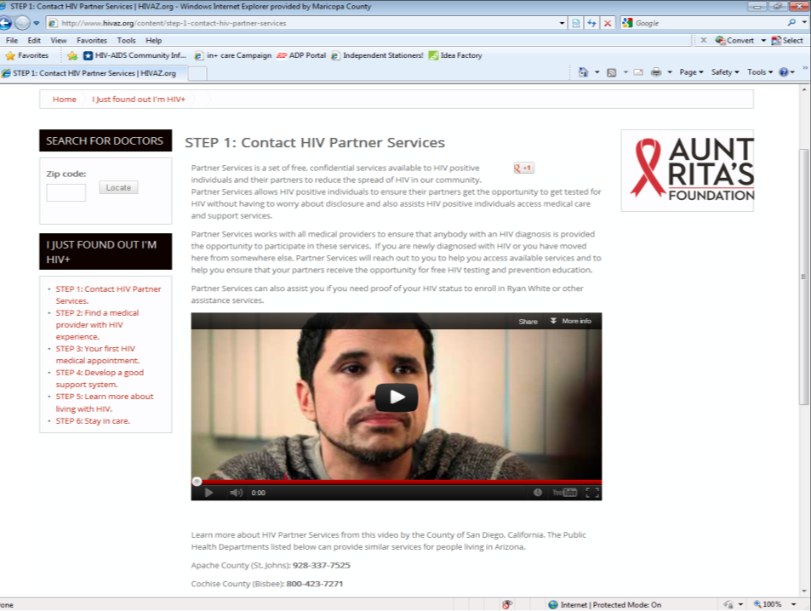
Notes:
Discuss features

Slide 31
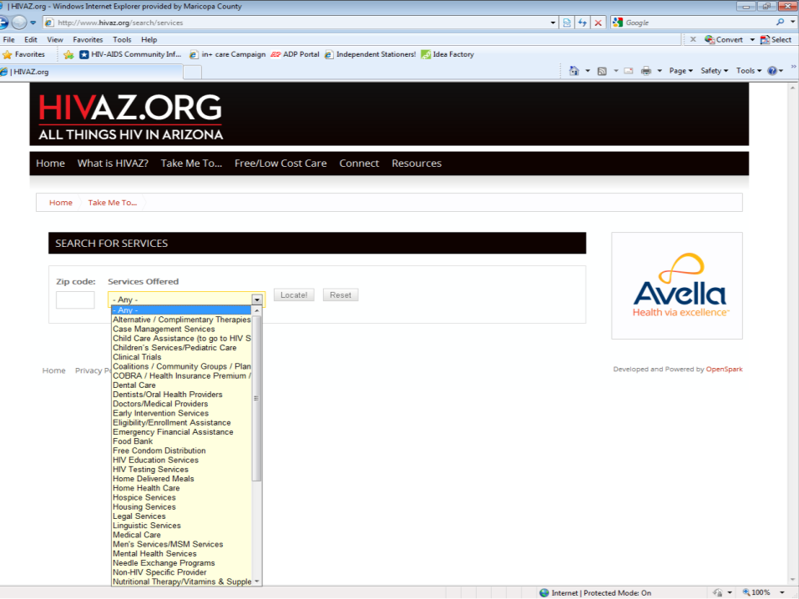
Notes:
Discuss feature

Slide 32
developing your
vision
ToP Strategic Planning ©The Institute of Cultural Affairs
Notes:
Technology of Participation steps to strategic planning

Slide 33
what do you want
to see in
3-5 years?
Notes:
Practical Vision

Slide 34
what is blocking you from your
vision?
No “lack of” statements!
Notes:
Underlying contradictions

Slide 35
what innovative, substantial actions will move you
forward?
Notes:
Strategic Directions

Slide 36
what will be your specific, measurable accomplishments for the
first year?
Notes:
Focused implementation

Slide 37
takeaways

Slide 38
#1
focus!
Notes:
Establish a unique vision.
Do not reinvent the wheel.
Create based on what you need to do, not what you want to do, or can do.
All too often, I see people reinvent the wheel simply because they want to say they did it themselves.

Slide 39
#2 adhere to your
vision
Notes:
Once you have established your vision, do not deviate from it. If people in your guiding coalition do, they need to move on.

Slide 40
#3 white space is your
friend
Notes:
Less is more. Think of a home depot ad and what that looks like. Now imagine a tiffany’s ad. What are the differences between the two?
Discuss the importance of space around your message. Also about limiting text, and reading level

Slide 41
#4
brevity
Notes:
Importance of concise thought. Example: This presentation – pictures, few words.

Slide 42
#5 do only what you
need
Notes:
Discuss addressing your need versus doing everything simply because you can (because often, you can’t).

Slide 43
#6 develop a unique
voice
Notes:
Discuss addressing your need versus doing everything simply because you can (because often, you can’t).

Slide 44
#7 avoid the usual
suspects
Notes:
Keep your guiding group small – mine was only five to eight people who shared a similar vision. Additionally, one of the best parts of this work was involving youth and people outside of my normal sphere of influence. I truly believe we would have been bogged down if the usual suspects had been involved.

Slide 45
#8 define every
process

Slide 46
#9 welcome
failure

Slide 47
#10 celebrate your
success

Slide 48
steal
shamelessly
share
seamlessly*
Notes:
A common theme among my presentation.
But when doing so, acknowledge the hard work of others, pay for things that have a cost, and don’t violate copyrights or other protections.

Slide 49
Questions?
Notes:
Q& A

Slide 50
John Sapero 602-506-6321 JohnSapero@mail.maricopa.gov
Notes:
Bye!

