Slide 1
Early Intervention Services Summit: How to develop, replicate and refine an emerging Service Category
RWA‐0099: Thomas Butcher, M.Ed. Project Director, Ryan White Office, City of New Haven Department of Health Heidi Jenkins, B.S. STD/TB Program Director, CT Department of Public Health (Partner Notification). Tracy Kulik, M.S.P.H. President, Collaborative Research, LLC

Slide 2
Early Intervention Services
HAB defines Early Intervention Services (‘EIS’) as identification of individuals at points of entry and access to services and provision of:
• HIV Testing and Targeted counseling
• Referral services (HIV negative and positive)
• Linkage to care (HIV positive)
• Health education and literacy training that enable clients to navigate the HIV system of care

Slide 3
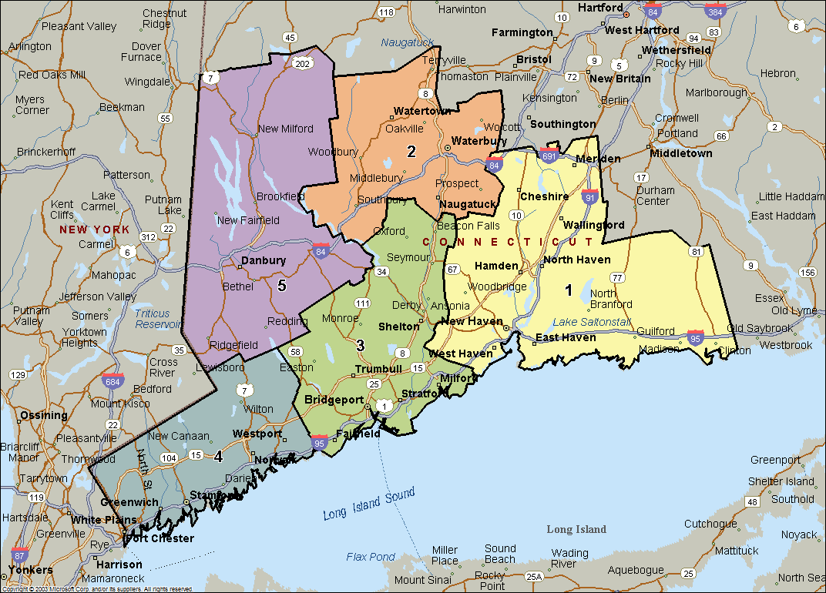

Slide 4
History/ Background
The Ryan White Office in New Haven, CT started the Early Intervention Services (EIS) program in 2010-11 (new service category) despite a delay in funding resulting in slower evolution of this program.
The five strategic planning regions in the two-county EMA in southern Connecticut have differing epidemiologic profiles, including different groups at risk for HIV.
A method to honor the epidemic in each of the five regions while implementing the program was an EIS Summit to share plans, success to date and evaluative measures of progress.

Slide 5
Implementation of New Haven Model
The first EIS summit was held in March 2011 with presentation and review of Plans by each Region to implement this newly funded Service Category
The second EIS summit took place in November of that year with initial results presented in addition to the results of a focused Quality Improvement visit showcasing EIS efforts related to the DRAFT Standard of Care or Evaluative Measure.
The third EIS summit occurred on April 19, 2012 with the first report of at least 6 months of numbers related to identifying newly diagnosed and/or returning Out of Care to HIV medical care.
At the 2nd and 3rd EIS Summits, it became apparent that there needed to be clarity on the roles of DIS, EIS and MCM (Disease Intervention Specialist, Early Intervention Specialist, and Medical Case Managers)

Slide 6
Challenges
Regional review of EIS shows different epidemiologic profiles in this two-county area. (Legend: Red - Bold #1, Red - #2, Blue - #3)
Exposure | New Haven Fairfield EMA | 1- New Haven | 2-Waterbury | 3-Bridgeport | 4-Stamford / Norwalk | 5-Danbury
MSM | 32% | 29% | 23% | 27% | 37% | 39%
IDU | 30% | 34% | 31% | 30% | 31% | 26%
MSM/ IDU | 2% | 2% | 2% | 3% | 1% | 2%
HET SEX | 25% | 25% | 33% | 27% | 21% | 22%
UNKNOWN | 10% | 9% | 10% | 12% | 9% | 10%
PEDIATRIC | 1% | 1% | 1% | 1% | 1% | 1%

Slide 7
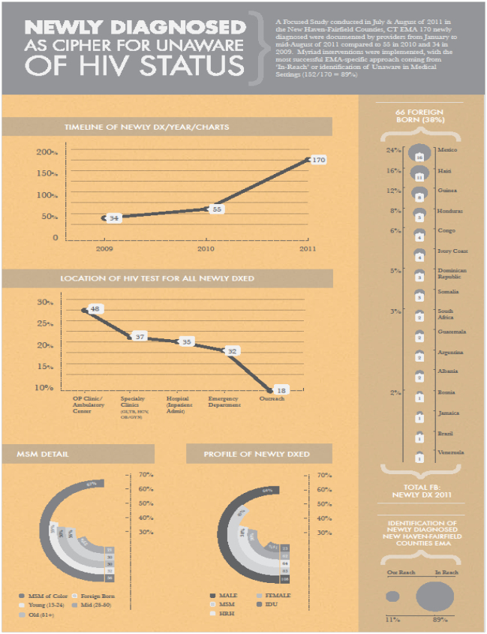
EXPLANATION:
This poster,
provided as a separate handout, showed the amount of newly diagnosed following introduction of EIS as a Service Category
‘What is
Measured is What Matters’

Slide 8
Themes in Implementation of EIS
At the April, 2012 EIS Summit the Director of Partner Services that also serves on the New Haven Planning Council attended with integral input on defining and clarifying the role of Disease Intervention Specialists and EIS Staff
Clarification, Revision and Refinement of the EIS Standard of Care was an immediate result with planned quarterly meetings of each Regions’ DIS and EIS staff.

Slide 9
Integration with Partner Services
What does Partner Services do and why are they so important? Highest seropositivity rate of contacted individuals at high risk of HIV
What is the daily work of a Disease Intervention Specialist?
How do DIS coordinate with EIS?
What data will be shared, collected and how will this help to reshape this service?

Slide 10
SAMPLE DATA FROM PARTNERS SERVICES
TABLE 27. COMPLETED ORIGINAL PARTNER INTERVIEW RISK FACTORS, 2011
RISK FACTORS | # | %
SEXUAL CONTACT:
Male Sexual | 99 | 76%
Female Sexual | 33 | 25%
Male and Female Sexual | 11 | 8%
Anonymous Partner | 50 | 38%
Known Injection Drug User | 26 | 20%
Sex while Intoxicated/High | 28 | 21%
Sex for Drugs/ Money | 10 | 8%
OTHER RISK FACTORS:
Incarcerated | 19 | 15%
Non-Injection Drug Use | 12 | 9%
Met Sex partners via the Internet | 10 | 8%
TOTAL ORIGINAL PARTNERS: COMPLETED INTERVIEW | 131 | 100%
TABLE 28. HIV TESTING DATA FOR ORIGINAL PARTNERS, PARTNER NOTIFICATION, 2011
HIV TESTING DATA | # | %
Received an HIV Test | 87 | 66%
Received Pre-Test Counseling | 75 | 57%
Received Post-Test Counseling | 66 | 50%

Slide 11
SAMPLE DATA FROM PARTNERS SERVICES (2)
TABLE 29. SEX PARTNERS OF ORIGINAL PARTNERS HIV TESTING HISTORY, 2011
N =108 with initiated contact, of that 73 completed the interview | # | %
TESTING HISTORY
Previous Positive Results | 18 | 25%
Previous Negative, New Positive | 9 | 12%
No Previous Test, New Positive | 2 | 3%
Previous Negative/Still Negative | 40 | 55%
No Previous Test, New Negative | 4 | 5%
TOTAL OF COMPLETED INTERVIEWS | 73 | 100%
DATA ON 35 INCOMPLETE INTERVIEWS
Unable to Locate | 28 | 80%
Located, Refused Test | 1 | 3%
Out of Jurisdiction | 5 | 14%
Other | 1 | 3%
TOTAL | 35 | 100%

Slide 12
SAMPLE DATA FROM PARTNERS SERVICES (3)
HIV COUNSELING, TESTING & REFERRAL DATA IN THE NEW HAVEN EMA, 2011
# | INDICATOR | #
i. | Total number of HIV tests conducted | 7,021
ii. | Total number informed of their HIV status (HIV positive and HIV negative) | 6,992
iii. | Total number NOT informed of their HIV status (HIV positive and HIV negative) | 19
iv. | Total number of HIV positive tests | 34
v. | Total number of HIV positive informed of their HIV status | 34
vi | Total number of HIV positive referred to medical care | 34
vii. | Total number of HIV positive linked to medical care | 29
viii. | Total number of HIV positive NOT informed of their HIV status | 0
ix | Total number of negative tests | 6,987
x. | Total number of HIV negative informed of their HIV status | 6,968
xi. | Total number of HIV negative referred to services | 1,447*
xii. | Total number of HIV negative NOT informed of their HIV status | 19
Of those testing HIV negative, 21% or 1,447 were referred for services. These included:
REFERRED SERVICES FOR HIV NEGATIVE INDIVIDUALS IN NEW HAVEN EMA, 2011
 | # | % of Total
Sexually Transmitted Disease Screening | 893 | 62%
Viral Hepatitis Screening | 164 | 11%
Support Services Referral | 147 | 10%
Substance Abuse Screening | 82 | 6%
Mental Health Screening | 82 | 6%
Tuberculosis Screening | 45 | 3%
Gynecology Screening | 34 | 2%
Total number of HIV negative referred to services | 1,447 | 100%

Slide 13
Results
As the Service Category is more developed, a narrowing of approaches is occurring with focus on implementing the Strategy for Early Identification of Individuals with HIV that are Unaware and returning Aware and Not in Care to HIV medical care.
STRATEGY | EVOLUTION | EVALUATION
Awareness | R | 9
Identify | 6 | 6
Inform | R | 9
Refer | R | 9
Link | R | 9
LEGEND: | R-done 6-in process | 9-measured 6-in process

Slide 14
STRUCTURE (‘Who’)
1 | EIS or Unaware Specialist Staff Meet criteria for EIS or Unaware Specialist Qualifications
2 | EIS or Unaware Specialist Staff Orientation & Training 10 hours of HIV-specific training per year for staff serving RW clients? Document quarterly face-to-face meeting of EIS Staff with PS to hand off patients, document collaboration
3 | Recordkeeping Requirements Chart is properly stored & secure; chart is clearly organized; entries legible
4 | Letters of Collaboration with other HIV Prevention & Testing providers
5 | MOUs with key points of entry into care to facilitate access to care
PROCESS (‘How’)
IDENTIFY
6 | Process to Identify Individuals at High Risk of Being HIV+ Process documented to identify and locate individuals at risk of HIV+ (detail of client demographics (race/ethnicity, zip code, gender, risk)
7 | HIV Testing by EIS Staff Number of HIV tests administered with detail by demographics, risk group
INFORM
8 | Results of HIV Tests (obtain data from CT DPH) HIV+ tests Total # of tested (detail by demographics, risk)
9 | Counseling upon testing # total counseled following test Total # of tests
REFER
10 | Referrals to Ambulatory Outpatient Medical Care if HIV+ # & detail (client) referred to AOMC (date, AOMC provider documented) Total HIV+ clients identified
11 | Referrals to Other Services (HIV+) including CRCS* – clarify services HIGH RISK HIV+ for prevention services, list services HIV+ Clients referred to other services (detail by Service, provider, reason) Total # of HIV+ Clients
12 | Referrals to Services to Reduce Risk (HIV-) including CRCS HIV- Clients referred to other services (detail by Service, provider, reason) Total # of HIV- Clients
OUTCOME (‘What’)
LINK
13 | HIV+ Clients Linked to Care (validate AOMC by first Viral Load test result) HIV+ Clients with first Viral Load documented at AOMC provider Total # of HIV+ Clients Referred to Care SPECIFY TIMEFRAME? Suggested: 1 month to be linked to care, 6 months to transition EIS to MCM
14 | Timeliness of AOMC Care Entry (detail by Special Population) Time elapsed from HIV+ diagnosis to first Viral Load (suggested 1 month)

Slide 15
BARRIER IDENTIFICATION & RESOLUTION (detail next page)
Barrier Identification Documentation that barriers to care entry and/or retention are assessed
Barrier Resolution Documentation that barriers to care entry and/or retention are resolved
Health Literacy Evaluation Documentation that health literacy is evaluated
HIV MEDICAL CARE RETENTION
HIV Medical Care Retention Documentation that HIV+ client is retained in AOMC at 3, 6 and 9 months post-linkage
IDENTIFICATION |  | LISTING OF POSSIBLE INVENTORY OF IDENTIFICATION MEANS
19 | ID High Risk of HIV+
A | ID OF HIGH RISK OF HIV-Positive | Partner Notification (integrate with DIS) – STD inclusive
B |  | Diagnosis in Emergency Department
C |  | Diagnosis while Pregnant
D |  | Diagnosis while Inpatient for other reason
E |  | Street Outreach
F |  | Targeted Outreach to Special Populations (list)
G |  | Through CT HIV Counseling & Testing site (list)
H |  | At CT Department of Health
I |  | Through general Health Fair
J |  | Insurance Physical (list what kind)
K |  | Blood or Plasma donation (list when, where)
L |  | Specialty Care provider

Slide 16
BARRIER IDENTIFICATION & RESOLUTION |  | LISTING OF POSSIBLE INVENTORY OF BARRIER
20 | Barrier Identification | Identification of possible barriers to AOMC entry and/or retention
A | Barrier inventory | Homeless
B |  | Recently or serially incarcerated
C |  | Monolingual
D |  | Actively using
E |  | Mental health issues
F |  | Violent
G |  | Physically disabled
H |  | Stigmatized
I |  | Issues with disclosure of status
J |  | No transportation
K |  | Health Literacy (complete #15)
L |  | Other (please specify)

Slide 17
Future Efforts
To solidify approaches throughout the 5 regions despite their varying epidemic with Awareness, Identifying, Informing, Referring & Linking approaches.
To further integrate the roles and approaches of the DIS and EIS staff
To further collaborate on hand-off between EIS and MCM
To reinforce efforts on evidence-based practices to encourage newly identified HIV+ to enter HIV medical care early, and start ART early (‘Test & Treat’)
To work with CT DPH Surveillance to track care entry & retention using Viral Load lab data

Slide 18
CONTACTS:
Thomas Butcher, M.Ed. Project Director, Ryan White Office, City of New Haven Department of Health PH: (203) 946-7388 email: 860-509-7920 Tbutcher@newhavenct.net
Heidi Jenkins, B.S. STD/TB Program Director Connecticut Department of Public Health (Partner Notification) PH: Heidi.Jenkins@ct.gov email: 860-509-7920
Tracy Kulik, M.S.P.H. Collaborative Research, LLC PH: 404-867-4079 email: Tracy@collaborativeresearch.us

