Slide 1
The Magic of MAPP
A Fresh Framework to Guide Comprehensive Planning
New Orleans EMA
11/29/12

Slide 2
Presenters
FRAN LAWLESS, Director, City of New Orleans Health Department, Office of Health Policy [Grantee]
BRANDI BOWEN, Program Director, New Orleans Regional AIDS Planning Council
ERIKA SUGIMORI, Health Planner, New Orleans Regional AIDS Planning Council

Slide 3
Audience Expectations
What are you hoping to get out of this session?

Slide 4
Objectives
Be able to describe key components of the MAPP process and how MAPP can be used to develop and inform comprehensive planning.
Be able to identify additional resources to incorporate the MAPP process into local and state planning processes.
Be able to indicate how using the MAPP process can facilitate developing goals, strategies, and activities aligned to support the National HIV/AIDS Strategy.

Slide 5
NEW ORLEANS STORY August 2011

Slide 6
What’s out there?
MAPP
Mobilizing for Action through Planning
& Partnerships

Slide 7
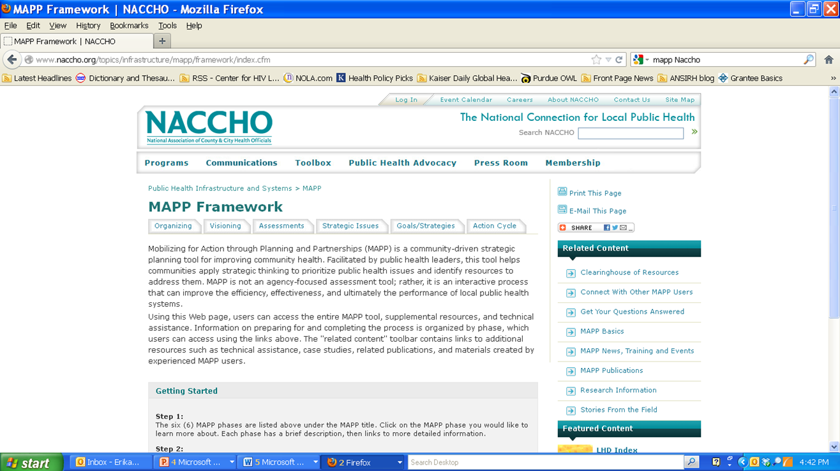

Slide 8
MAPP Process
Phase 1 – Orientation, Timelines, Partnerships
Phase 2 – Visioning
Phase 3 – Community Assessments
Phase 4 – Identifying Strategic Issues
Phase 5 – Identifying Goals and Strategies
Phase 6 – Action and Monitoring
8

Slide 9
MAPP Handbook
Expectations of each specific phase
Key questions
TIPS
Worksheets and other tools to aid discussion, maintain focus and move forward

Slide 10
PHASE 1
Orientation, Timelines, Partnerships
10

Slide 11
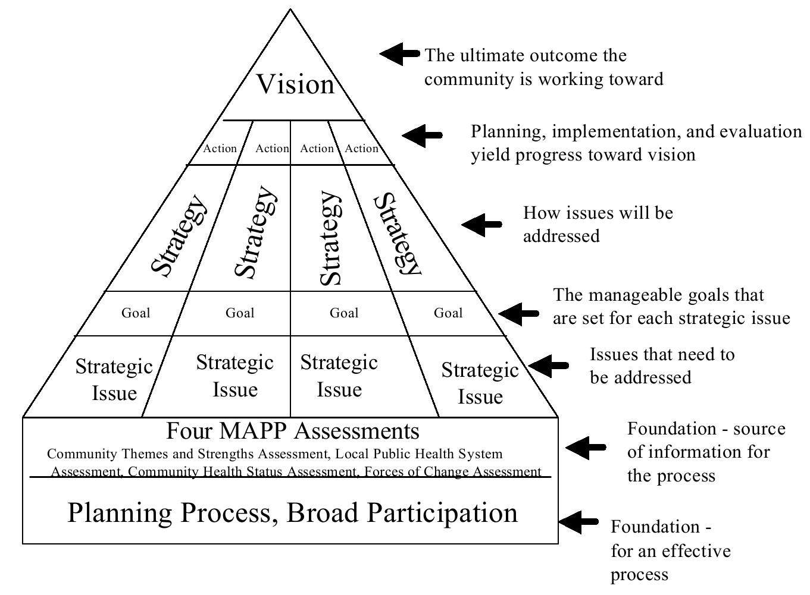
Phase 1 – TAKE YOUR TIME
11
Notes:
As we get to action planning we need to refine our strategies into measurable objectives with timelines and responsible parties.

Slide 12
Types of Stakeholders
Consumers
Planning Council Representatives
Ryan White Part A Grantee
Other Ryan White Parts Grantees
Office of Public Health (CDC Grantee)
HOPWA Representatives
Greater New Orleans Foundation
Other health and housing programs
12
Notes:
As we get to action planning we need to refine our strategies into measurable objectives with timelines and responsible parties.

Slide 13
PHASE 2
Visioning
13

Slide 14
Phase 2 – GUIDING LIGHT
14
Notes:
As we get to action planning we need to refine our strategies into measurable objectives with timelines and responsible parties.

Slide 15
VISION
NOEMA’s vision is a high quality comprehensive coordinated HIV care system to promote improved overall health outcomes, through a care system devoid of stigma and discrimination, free from fragmentation, consistent with consumer empowerment and choices, treatment guidelines, and availability and access for all, ultimately resulting in fewer new infections in the New Orleans area.
15
Notes:
As we get to action planning we need to refine our strategies into measurable objectives with timelines and responsible parties.

Slide 16
VALUES to support the VISION
EXAMPLES:
… providers recognize their strengths and core competencies and have relationships with other agencies to provide specialized services for the overall success of the client.
… community resources and policies meet the needs of PLWHA every day and each one of us support cultural sensitivity and reductions in stigma every day.
… the system of HIV care supports client self-management with seamless transitions across levels of care, the support necessary to graduate to the next level of self-management along with policies that support clients at all levels, even the most low acuity self-managing clients.
16
Notes:
May mean MOUs but it may mean other things to encourage this - including perhaps grantees encouragement.
This means supporting other activities that reduce stigma and promote cultural awareness and sensitivity – for example making sure information makes it to the people who can use it.
This means making sure the messages are not conflicting – designing systems that support self-management if self-management is the goal that is being encouraged.

Slide 17
PHASE 3
Community Assessments
17

Slide 18
Phase 3 – DATA BACKBONE
18
Notes:
As we get to action planning we need to refine our strategies into measurable objectives with timelines and responsible parties.

Slide 19
SAMPLE DATA
Consumer Needs Assessment
Case Manager Survey
Case Manager Focus Group
SWOT
Client Satisfaction Survey
Quality of Life Consumer Focus Group
Health Status Data Compilation
19
Notes:
As we get to action planning we need to refine our strategies into measurable objectives with timelines and responsible parties.

Slide 20
PHASE 4
Strategic Issues
20

Slide 21
Phase 4 – CRITICAL CHALLENGES
21
Notes:
As we get to action planning we need to refine our strategies into measurable objectives with timelines and responsible parties.

Slide 22
SOME CHALLENGES
System fragmentation
Lack of mind/body/health connective opportunities & limited empowerment/ education opportunities
Limited civic engagement among consumers
Lack of comprehensive sexual health education
LGBTQ Stigma
Over incarceration
Economic climate and low priority of health and education on State agenda
22
Notes:
As we get to action planning we need to refine our strategies into measurable objectives with timelines and responsible parties.

Slide 23
PHASE 5
Goals & Strategies
23

Slide 24
Phase 5 – WHAT? & HOW?
24
Notes:
As we get to action planning we need to refine our strategies into measurable objectives with timelines and responsible parties.

Slide 25
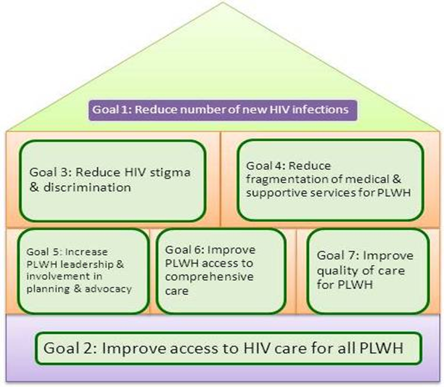
NOEMA’s Transmutation Plan

Slide 26
PHASE 6
Action & Monitoring
26

Slide 27
Phase 6 – JUST DO IT
27
Notes:
As we get to action planning we need to refine our strategies into measurable objectives with timelines and responsible parties.

Slide 28
Goal 1: Reduce the number of new infections
Timeframe | Activities | Parties
Strategy 1.1: Convene a workgroup that includes all key stakeholders (e.g., primary and secondary preventions partners) to develop and implement an Early Identification of Individuals Living with HIV/AIDS (EIIHA) strategy in Years 1, 2 and 3.
By May 2012 | Activity 1.1a: Identify a physical venue to host EIIHA strategy discussions. | Lead: NORAPC [Comprehensive Planning Committee] & OHP Planned Partners: OPH SHP, LPHI, HIV Prevention and Care Providers, Emergency Room testers, Linkage to Care staff , PLWH, HIV Focus
By May 2012 | Activity 1.1b: Invite multilevel partners to form an 'EIIHA Strategy Workgroup' specific to the development and implementation of the EIIHA strategy.
By May 2012 | Activity 1.1c: The 'EIIHA Strategy Workgroup' will adopt a planning framework and meeting schedule.
By September 2012 | Activity 1.1.d: The 'EIIHA Strategy Workgroup' will inform an EIIHA strategy, including an impact evaluation plan.
Quarterly, after September 2012 | Activity 1.1.e: The 'EIIHA Strategy Workgroup' will meet as appropriate to coordinate, regularly assess progress and measure impact.

Slide 29
 |  | FY 2012 (March 2012 - February 2013)
Goal | Strategy | 5 | 6 | 7 | 8 | 9 | 10 | 11 | 12 | 1 | 2
1 | 1.1
 | 1.2
 | 1.4
2 | 2.1
 | 2.2
 | 2.5
3 | 3.1
 | 3.3
4 | 4.1
 | 4.2
5 | 5.1
 | 5.2
 | 5.3
 | 5.4
 | 5.5
 | 5.7
6 | 6.1
 | 6.2
 | 6.6
7 | *7.1
 | *7.2
 | *7.3

Slide 30
Continuum of Care
No wrong or right way, or single way to do it.
Each local area context will determine how the system should be implemented.
Collaboration and coordination is crucial.

Slide 31
Collaboration & Coordination
HRSA expects planning councils and grantees to collaborate and coordinate with key partners providing HIV prevention, treatment and support to implement a responsive and ideal COC.
Key local partners:
Other Ryan White Parts (B, C, D & F)
Medicaid
VA
Other continuums of care (e.g., housing, behavioral health)

Slide 32
Comprehensive Plan Purpose
A living document
Roadmap for the grantee
Continually updated as needed
Reflecting the community’s vision and values
Considers other relevant plans
Considers changing context

Slide 33
Key Items for Inclusion
National HIV/AIDS Strategy
Healthcare Reform
HIV as a chronic disease
Early HIV detection,
Engagement in care,
Reduction in disparities in health outcomes

Slide 34
ROADMAP for Improvement
What are we trying to accomplish?
How will we know that a change is an improvement?
What changes can we make that will result in improvements?

Slide 35
Key Elements of BREAKTHROUGH Improvement
Will to do what it takes to change to a new system
Ideas on which to base the design of an improved system
Execution of the ideas

Slide 36
NOEMA’s Transmutation Plan

Slide 37
Why MAPP worked well for the facilitators…
No consultant fees
Provided added confidence in a plan that was data-driven, and developed directly from community input
Structure already laid out allowing energy to be spent on local flair and focus

Slide 38
Why MAPP worked well for the planning council …
User-Friendly
Wholistic planning process that engaged diverse stakeholders
The process led to a strong viable living document in full support of the National HIV/AIDS Strategy

Slide 39
Why MAPP worked well for the grantee…
Inclusive process that encouraged robust participation
Valued and incorporated input from all key stakeholders
Thought-provoking and stimulating process that led to a measurable and achievable roadmap

Slide 40
TIPS

Slide 41
Share Senselessly & Steal Shamelessly!
“Picasso had a saying – ‘good artists copy, great artists steal’ – and we have always been shameless about stealing great ideas”.
Steve Jobs
Notes:
Creating an innovative culture starts with creating an open culture. An open culture is accepting of ideas regardless of their source – other companies, industries, people – and is willing to implement what they have learned to improve their own performance. A great illustration of this concept from the greatest innovator of our time, Steve Jobs . . . . he obviously had no issue with learning from the best of the best.
From -- http://perpetualinnovationmachine.wordpress.com/2012/02/17/innovation-and-stealing-shamelessly/

Slide 42
HAVE FUN
Transmutation
Shedding the old skin for growth and change
Imbue your process with a fresh perspective for planning, monitoring and evaluation

Slide 43
SET IT UP RIGHT
Give it a home
Ensure those that bought in are involved in implementation
Carry it around with you EVERYWHERE and recruit others

Slide 44
WORK PLAN IMPLEMENTATION
Existing spaces
Partner spaces
Newly created spaces
Peripherally effected spaces

Slide 45
PERMEATION
Community Heavily Involved
In Plan Development
Plan = Compilation of Easy to Follow & Justified Items of Focus -- Reflective of Community Need & Expertise
(If Buy-in is Achieved)
Participants & Organization Members will Share with Others
Individuals Working on Your Goals even Peripherally
TIP: Identify and promote opportunities for people to help
TIP: Frequent Review & Education to Ensure Understanding
TIP: Grantee & PC Staff Involvement
Community(ies) Mobilized
TIP: Flexibility

Slide 46
GRANTEE’S ROADMAP
Implementation
Monitoring
Evaluation

Slide 47
Q & A

Slide 48
NACCHO Site
http://www.naccho.org/topics/
infrastructure/mapp/index.cfm

Slide 49
Contact Info
FRAN LAWLESS – Director, OHP
flawless@nola.gov
(504) 658-2800
BRANDI BOWEN – Program Director, NORAPC
brandi@norapc.org
(504) 821-7334
ERIKA SUGIMORI – Health Planner, NORAPC
erika@norapc.org
(504) 821-7334

