Slide 1
Providing Guidance For Early Identification, Enhance Testing, and Fast Tracking to Care
EIIHA Pilot Projects

Slide 2
EIIHA Pilot Projects
Early Identification
Scale Up Testing
Fast Tracking
Improved Access
Retention

Slide 3
Learning Objectives
Identify opportunities to collaborate and enhance EIIHA efforts
Develop EIIHA outreach and targeted testing
Establish fast track linkage to care
Define goals for EIIHA
Improve individual health outcomes
Reduce community viral load

Slide 4
Project Objectives
New strategies around "early identification of individuals living with HIV/AIDS"
Implement scale up and routine HIV testing.
The resources available for these objectives.
Coordinate a public health clinical services plan to find individuals unaware of their HIV status and connect them to care.
Ways to support/enhance existing efforts.

Slide 5
Background
Unaware into Care
Goal 1: Increase opportunities for testing and diagnosis of HIV among the following populations: 1) Individuals testing for STDs; 2) Men who have sex with men (MSM); 3) Disproportionately affected communities of color, primarily African Americans, African-born and Latino; 4) Partners and social networks of: a) Newly diagnosed PLWH; b) Individuals diagnosed with AIDS within one year of testing; c) Populations with high co-infection rates (i.e., those with syphilis or Hepatitis C); d) High-risk and comorbid populations (e.g., substance abusers, incarcerated, homeless and those with mental health issues).

Slide 6
Background
Unaware into Care
Goal 2: Increase testing among partners and social networks of PLWH who receive Ryan White funded services.
Goal 3: Develop and implement updated standards for all RW outreach services to include formal and functional relationships with testing sites and early intervention programs.

Slide 7
Background
Unaware into Care
Goal 4: Ensure that all publicly funded testing sites and early intervention programs have formal and functional relationships with Points of Entry outside the RW system as well as with primary care and MCM programs to create a seamless system where unaware individuals can flow from testing to diagnosis to care with minimal steps and barriers.

Slide 8
Background
State HIV Surveillance Report, 2011 - Estimated Number of Persons Living with HIV/AIDS in Minnesota
As of December 31, 2011, 7,136* persons are assumed alive and living in Minnesota with HIV/AIDS
3,775 living with HIV infection (non-AIDS)
3,361 living with AIDS

Slide 9
State HIV Surveillance Report, 2011
Race/Ethnicity | Cases | % | Rate
White, non-Hispanic | 143 | 49% | 3.2
Black, African-American | 64 | 22% | 32.6
Black, African-born | 44 | 15% | 60.3
Hispanic | 24 | 8% | 9.6
American Indian | 4 | 1% | 7.2
Asian/Pacific Islander | 8 | 3% | 3.7
Other^ | 5 | 2% | x
Total | 292 | 100%

Slide 10
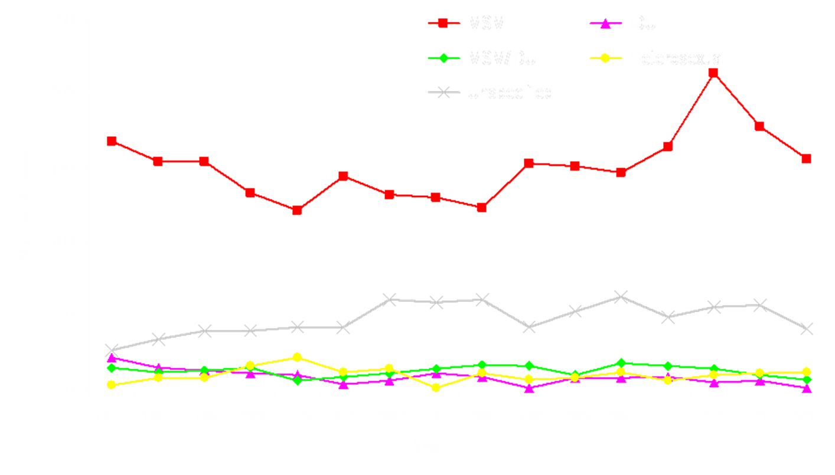
State HIV Surveillance Report, 2011

Slide 11
Multi-Pronged Approach
Engaging Stakeholders
Research & Education
Examining Outreach, EIS, and Services Outside the Ryan White System of Care.

Slide 12
Engaging Stake-Holders
Unaware into Care Workgroup
Public Health Clinics
Red Door
Healthcare for the Homeless
Refugee Health

Slide 13
Research and Education
Literature Review
EMA/TGA Network
Technical Assistance and Training (Scale Up Testing)

Slide 14
Service Areas Reviews
EIS, Outreach, and other opportunities to reach unaware.
EIS Service Area Definition
Program Standards

Slide 15
Bridging The PronGS
Stakeholders
Project Objectives
Program Standards

Slide 16
Testing Unaware- Pilot Projects
Clear goals and objectives
Identify the problem and proposed solution
Flexibility for improvement
Measure and evaluate

Slide 17
Health Care for the Homeless
CTR Training
Routine Testing Procedure
Op-Out

Slide 18
Health Care for the Homeless

Slide 19
Public Health Clinic
Outreach & Testing
Fast Track
Peer Network

Slide 20
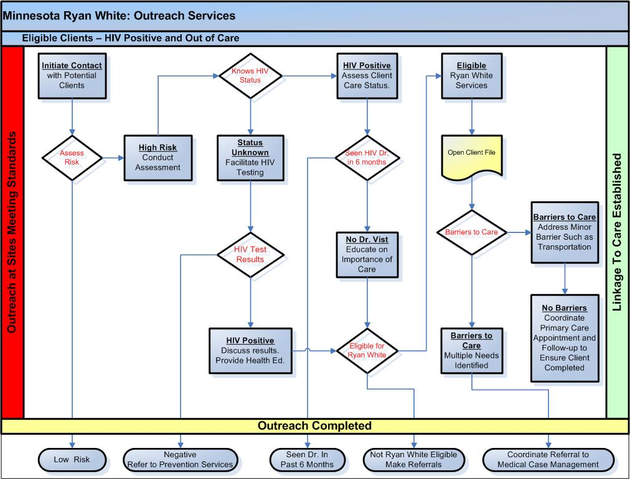
Outreach & Testing Standards

Slide 21
Fast Track

Slide 22
Fast Track

Slide 23
Public Health Clinic Fast Track

Slide 24
Red Door – Public Health Clinic

Slide 25
Outreach & Testing Peer Network
17 Recruiters
20 Associates
Training
Incentives
Setting Goals
Managing Recruiters’ Expectations

Slide 26
Successes
Early Identification
Scale Up Testing
Fast Tracking
Improved Access
Retention

Slide 27
Challenges
Moderate Incidence & Reaching Unaware
Manage Expectations of Peers

Slide 28
Lessons Learned and Modifications
Engage Stakeholders
Beyond Ryan White System of Care
Targeted Scale Up Testing
Set Realistic Expectations
Flexibility is Key

Slide 29
Next Steps
Evaluate
Improve
Repeat

Slide 30
Additional Questions?
Thuan Tran (thuan.d.tran@co.hennepin.mn.us)

