Slide 1
Using the Collaborative Model to Forge a Statewide Consensus on Linkage and Retention Interventions

Slide 2
Overview of Session
  Introduction to the SPNS Systems Linkages and Access to Care Initiative
  Collaborative Learning model
  Application of Collaborative model in three states
  Cross-cutting Themes
  Question-and-Answer Period

Slide 3
Introduction to the SPNS Systems Linkages and Access to Care Initiative
Lori DeLorenzo, RN, MSN
Quality Coach
Evaluation & Technical Assistance Center*
Center for AIDS Prevention Studies
University of California, San Francisco
*Funded by HRSA SPNS Grant U90HA22702

Slide 4
Systems Linkages Initiative
  Four-year Special Project of National Significance
  Purpose: To identify, implement, & evaluate successful strategies for improving linkage to and retention in high quality HIV care

Slide 5
Populations of Interest
  Those individuals who:
    are aware of HIV-positive status but have yet to be linked to HIV care
    may be receiving other medical care but not HIV care
    entered HIV care but later dropped out of care
    are in and out of HIV care

Slide 6
Primary Outcomes
  Increase in number of:
    people living with HIV who know their status
    newly-diagnosed linked to care
    HIV-positive individuals who are virally suppressed
    HIV-positive individuals retained in quality HIV care

Slide 7
Unique SPNS Design
  Large in Scope
    Demonstration project funding was awarded to states’ Part B grantee
    Intention is to facilitate linkage and retention by creating interventions that span systems of care

Slide 8
Unique SPNS Design
  Hybrid design
    Initial two years use the Learning Collaborative Model to pilot test and select ideal systems linkage interventions
    Latter two years follow a traditional SPNS approach, with a wider-scale test of a set of systems linkage interventions in each state

Slide 9
Grantees
  Demonstration States
    Louisiana
    Massachusetts
    New York
    North Carolina
    Pennsylvania
    Virginia
    Wisconsin
  Evaluation and Technical Assistance Center
    University of California, San Francisco (UCSF)

Slide 10
Application of Collaborative Learning Model in SPNS Initiative

Slide 11
Collaborative Learning Model

Slide 12
3 Major Phases
Pre-Work
Learning Sessions
Action Periods

Slide 13
Evolution of Learning Sessions:
1st Learning Session
Faculty-driven
Communicating purpose & aim
Defining parameters & expectations
Establishing buy-in & garnering support
Standardizing language & providing training
Initial exploration of area of focus
  Linkage to care

Slide 14
Evolution of Learning Sessions: Subsequent Sessions
Transition from Faculty-Driven to Peer Facilitation
In-depth Exploration of Data, Analysis & Trends
Advanced Training in Evaluation & Quality Concepts
Deeper Dives in Topical Areas of Focus
Agency Storyboards & Presentations
Group Work
Team Building Exercises

Slide 15
Model for Improvement
What are we trying to
accomplish?
How will we know that a
change is an improvement?
What change can we make that
will result in improvement?
Act
Plan
Study
Do

Slide 16
Repeated Use of Cycle
Changes That Result in Improvement
Learning from Data
A
P
S
D
D
S
Implementation of change
P
A
A
S
P
Wide-scale tests of change
D
A
P
S
D
Follow-up tests
Hunches Theories Ideas
Very small scale test
Notes:
Objective: Emphasize small tests of change that link and gradually get larger and larger.
Explanation: After generating ideas, run Plan-Do-Study-Act (PDSA) cycles to test a change or group of changes on a small scale to see if they result in improvement. If they do, expand the tests and gradually incorporate larger and larger samples until you are confident that the changes should be adopted more widely A team learns from the test — What worked and what didn't work? What should be kept, changed, or abandoned? — and uses the new knowledge to plan the next test. The team continues linking tests in this way, refining the change until it is ready for broader implementation.
At times it seems a waste of time to test. However, even if you have a very high degree of belief in the success of the test, others might not. People are far more willing to test a change when they know that changes can and will be modified as needed. Linking small tests of change helps overcome an organization's natural resistance to change and ensure physician buy-in.
Bridge to next slide: There are several other reasons to test.

Slide 17
Changes in Parallel
A
P
A
P
P
A
P
A
P
P
D
D
A
D
D
A
S
S
S
D
S
S
S
D
D
S
D
S
D
S
D
S
D
S
D
S
A
P
A
P
A
P
A
P
A
P
P
A
A
A
A
A
P
P
A
P
P
A
P
S
S
P
S
S
S
D
D
S
D
D
D
D
P
P
A
P
P
A
P
A
A
P
A
D
A
D
D
S
D
S
D
S
D
S
S
S
Self-
Manage-
ment
Support
Delivery
System
Design
Clinical
Information
Systems
Community Resources
Decision Support
Leadership
Notes:
Teams should be testing more than one change at a time. All of the changes are aimed at achieving the same ultimate goal. Using several linked Plan-Do-Study-Act (PDSA) cycles allows a team to test more than one change simultaneously. The changes in parallel shown in this slide focus on the components of the Chronic Care Model (CCM). By conducting multiple tests of change simultaneously you have the potential to move the organization to system wide more effectively and more timely.

Slide 18
Implementation
….a permanent change to the way work
is done
-Documentation
-Policies & procedures
-Hiring
-Orientation
-Training
-Information flow
-Agreements
-Measurement & feedback system
Notes:
Implementation is a permanent change to the way work is done and, as such, involves building the change into the organization. It might involve documentation, written policies and procedures, hiring, orientation, training, information flow between staff, patients and agencies, agreements between agencies, and a process to continually monitor the work to ensure quality is being made and goals achieved

Slide 19
Two Year Prep for Evaluation
Two-year Collaborative Learning phase of Initiative provides opportunity to:
  Develop capacity
  Pilot test ideas
  Forge cross-agency relationships
  Refine data collection systems

Slide 20

At end of 2 years…
Set of ideal end products to be in place after Initiative’s 1st two years:
  Limited menu of systems linkages interventions
    PDSA cycles will be used to test out acceptability & feasibility of potential linkage interventions for wide-scale implementation
  Systems of measurement
    Existing data systems will be &/or new systems developed modified to measure outcomes & monitor how people move through testing & care systems
    Interventions are expected to cut across traditional funding streams & data monitoring systems

Slide 21
At end of 2 years…(cont.)
  Involvement of key decision makers
    Identify & involve key personnel involved in setting policies & funding for testing & care services
    Identify key data & findings that would sustain linkage interventions
  Change management & evaluation expertise
    Build capacity at the local level in skills related to change management and use of data to guide implementation of new service models

Slide 22
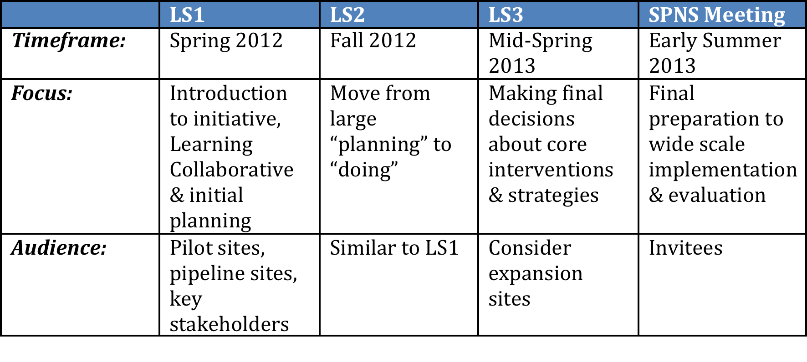
Schedule of Meetings

Slide 23
Application of Collaborative Model in Three States

Slide 24
SPNS Systems Linkages and Access to Care Initiative in Virginia
Jennifer Kienzle, PhD
Ryan White All Grantee Meeting
Workshop
November 29, 2012

Slide 25

Pilot Sites
Richmond
Roanoke

Slide 26
Virginia- SW & Central*
*Based on using Living HIV cases in each region as of 12/31/2010, and applying the percentages from: Gardner, E.M., McLees, M.P., Steiner, J.F., Del Rio, C., and Burman, W.J. (2011) The spectrum of engagement in HIV care and its relevance to test-and-treat strategies for prevention of HIV infection. Clinical Infectious Diseases, 52: 793–800.

Slide 27
Project Objectives for VA
The goals of this project are:
1) Increase the percentage of those newly diagnosed who are engaged in care within 3 months post-diagnosis from 55% to 80%.
2) Increase the retention rate in primary medical care from a current statewide average of 70% to 85%.
3) Develop a referral system for clients that maximizes funding and linkage resources, as well as utilizes statewide data systems efficiently.

Slide 28
Target Population
Newly Diagnosed
Lost to Care
Southwest Region
Central Region
Unaware

Slide 29
Scope of project
Community Level
Provider Level
Client Level

Slide 30
Project Interventions Aims
Active Referral
To establish patient navigation in the Central and Southwest regions to link newly diagnosed and lost to care HIV+ individuals with care and resources available in the area.
Patient Navigation
To establish patient navigation in the Central and Southwest regions to link newly diagnosed and lost to care HIV+ individuals with care and resources available in the area.
Care Coordination
Establish a centrally managed model that facilitates coordinated treatment, care, and support services for released HIV+ inmates from state correctional facilities/Department of Corrections (DOC).
Develop a standardized assessment, referral, and treatment system, addressing the mental health needs of HIV+ individuals towards increasing retention in HIV care and improving HIV/MH care outcomes.
Mental Health Network

Slide 31
Project
Roles & Responsibilities
Planning Group
Guide overall initiative including interventions, Learning Sessions, PDSA cycles.
Faculty/Advisors
Provide input on intervention issues via Learning Sessions & technical assistance.
Participating Agencies
Agencies selected to pilot and/or test interventions during action periods (SW & Central sites).
Stakeholders & Others
Review initial and overall project findings.
Other stakeholders who may be involved in linkages efforts, project funders, etc.
Participate in Learning Sessions, PDSA cycles, document and share results & findings.
Includes newly-formed Community Advisory Committee (CAC).
e.g., Mental Health Consultants.

Slide 32
Timeline of Learning Collaborative Activities
January 2012: Planning Group Orientation meeting (included identifying key stakeholders).
February 2012: Started planning Learning Session 1 (included identifying faculty and advisors).
March 2012: Designed pre-work for strategy groups (strategy groups were populated/assigned at LS1).
April 12-13, 2012: Learning Session 1, in Richmond, VA.

Slide 33
Timeline of Learning Collaborative Activities
May 2012: Strategy group work and PDSA kick-off.
June 2012: Start planning for Learning Session 2.
July 18-19, 2012: ETAC Quantitative Data Site Visit.
August 2012: Four Patient Navigators hired (2 SW, 2 Central).
September 2012: First CAC meeting.
October 17-18, 2012: Learning Session 2, in Roanoke, VA.

Slide 34
Envisioning Scale-Up:
Regional Level
Patient Navigation: Expand within Central and SW regions, potentially move into NW region, and collaborate with other navigator programs in the Northern and Eastern regions.
Mental Health: Expand within Central and SW regions to increase referral sites in Central and MH provider network in SW.

Slide 35
Envisioning Scale-Up:
Statewide
Active Referral: Expand and establish statewide protocol for DIS processes for active referral and coordination with navigators and other linkage personnel.
Care Coordination: Work with central DOC office to expand care coordination model to additional facilities in order to operate as the central channel for state resources on HIV care, treatment and support services.

Slide 36
Anticipated Challenges
Need to build consensus; maintain stakeholder and consumer engagement.
Coordination with other navigation and linkages models in NW, Northern, Eastern Regions.
Ensure that pace of wider scale implementation is aligned with local and national evaluation processes.

Slide 37
New York Links
Steven Sawicki, SPNS Lead
www.newyorklinks.org

Slide 38
Overview of Strategies
NYS is using a ‘from the ground up’ collaborative approach, engaging providers in prioritized geographic regions in the development and testing of interventions related to linkage and retention with the express purpose of identifying interventions that work.
Three collaboratives have been formed to date:
  Upper Manhattan, New York City
  Western New York State
  Queens & Staten Island, New York City

Slide 39
Planning Group
Each collaborative has a planning group. Each group consists of members from NYLinks staff, DOH Staff, NYCDOHMH staff for NYC collaboratives, County Health Departments for non-NYC collaboratives, consumers, providers, Medical Director of the AI, Director of the National Quality Center, Quality Improvement Consultant attached to Collaborative.
Each collaborative planning group holds a conference call weekly.

Slide 40
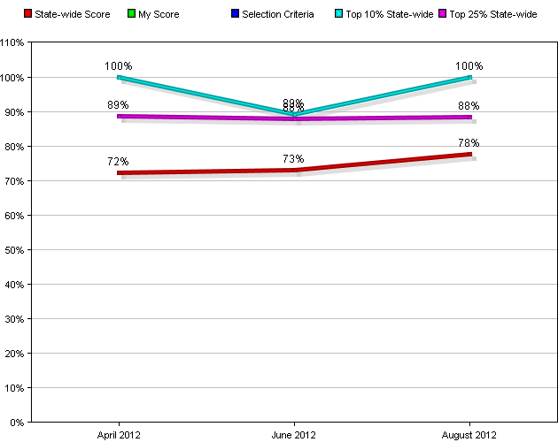
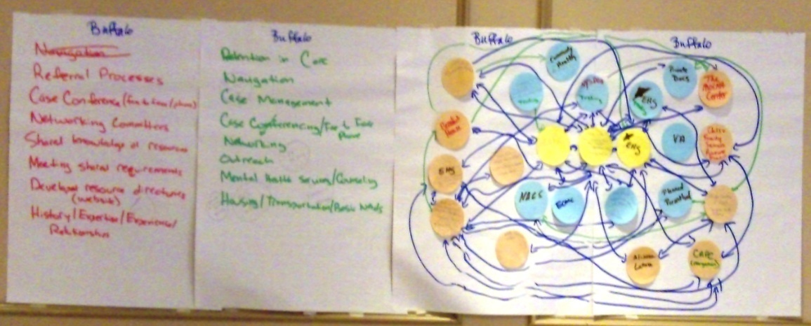
Strategies
  Web page—web based data entry, reporting, charting, resource rich, collaborative based pages. NewYorkLinks.org
Learning Session activities designed to foster networking and communication.

Slide 41
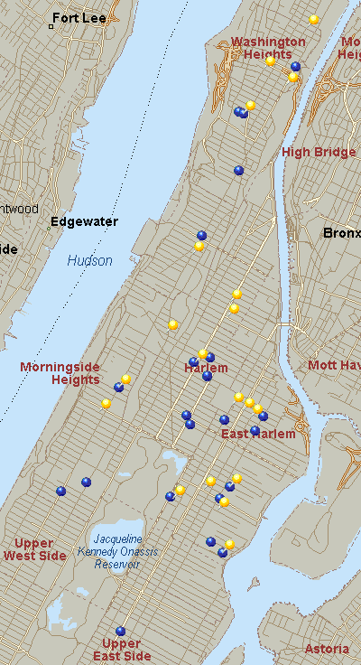
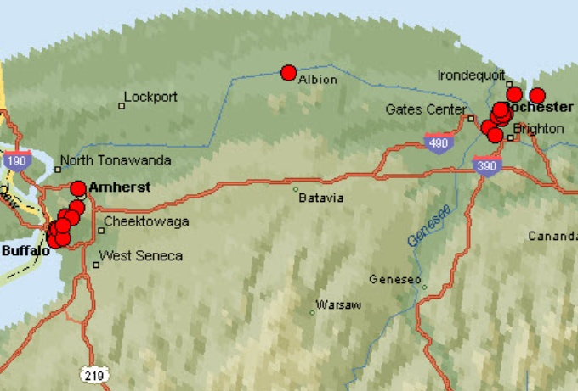
WNYS & UMRG

Slide 42
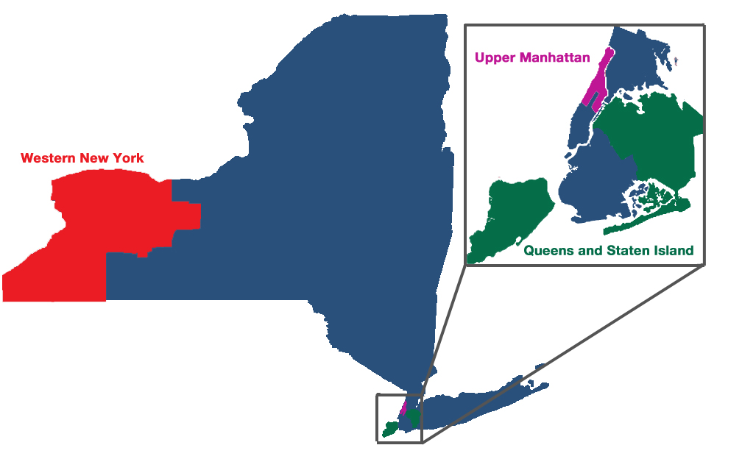
NYS Collaboratives

Slide 43
Collaborative Progress
  Upper Manhattan. Started Jan 12, 4 learning sessions to date, currently identifying and testing interventions. Last LS on 10/31.
  Western New York State. Started May 12, 2 learning sessions to date, establishing baseline data and intervention. Last LS on 10/31.
  Queens & Staten Island. Started Sept 12. Kick off learning session scheduled for early December.

Slide 44
UMRG preliminary results: types of strategies being tested or implemented
Strategy category | # of strategies | # of sites reporting
Developing tracking systems to measure linkage/retention | 3 | 2
Tracking/engagement of those out of care | 3 | 3
Outreach and linkage w/ other organizations | 1 | 1
Case management/Patient navigation | 2 | 2
Streamlining/standardizing referrals | 4 | 3
Other (includes staff engagement, self management and same day service strategies) | 3 | 2
No strategies tested or implemented | N/A | 5
Number of sites not yet know what strategies are being tested/implemented | N/A | 5
Total number of sites known to be testing or implementing strategies: 9
Data excludes 5 sites whose participation status in NY Links is undetermined.
NY Links coaches have detailed description of strategies.
Data Source: Intervention Strategy Tracking Tool, UMRG— August 28, 2012

Slide 45
Envisioning Widerscale
Gather 4-6 interventions that have proven to be effective.
Disseminate interventions utilizing: collaborative structures, learning networks, existing provider groups, state wide conference calls and workshops.
Do presentations at state wide and regional meetings.
Publish on the NYLinks website, the NYS DOH website, the AIDS Institute website, and the National Quality Center website.

Slide 46
NY LINKS CONTACTS
Clemens Steinbock, Director National Quality Center, cms18@health.state.ny.us , 212-417-4730
Steven Sawicki, NYS DOH AI OMD, SPNS Lead, svs03@health.state.ny.us, 518-474-3813
Denis Nash, Evaluator, Hunter College, dnash@hunter.cuny.edu, 718-530-0684
Diane Addison, Evaluation Epidemiologist daddison@hunter.cuny.edu, 212-396-7797
Annelise Herskowitz, Program Assistant, axh18@health.state.ny.us, 212-417-4714

Slide 47


PA SPNS System Linkages
^Kenneth McGarvey
Role: Co-PI/Administrative Project Director
Primary Affiliation: Director, Division of HIV/AIDS , Bureau of Communicable Diseases
Pennsylvania Department of Health, Harrisburg PA
*Benjamin Muthambi, DrPH, MPH
Role: Co-PI/Operations Project Director
Primary Affiliation: Epidemiologist (Public Health Programs on HIV), Bureau of Epidemiology
Pennsylvania Department of Health, Harrisburg PA
Nov. 29, 2012 HRSA/HAB AGM *^co-presenters & *corresponding author: BMuthambi@pa.gov

Slide 48
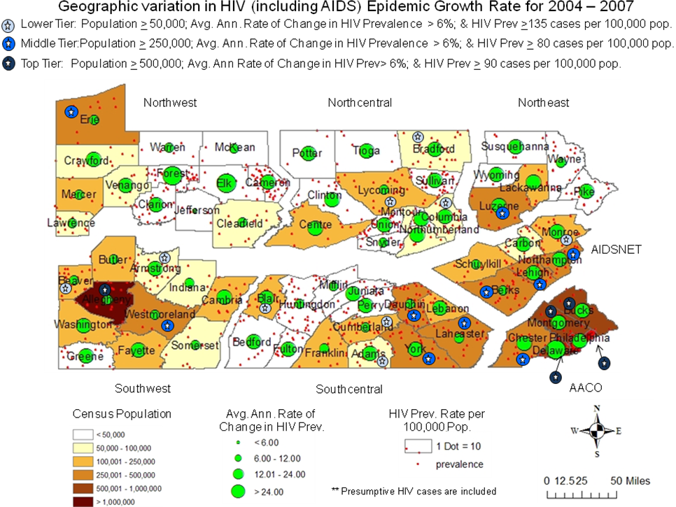
Performance Sites,
Core Project Team/ Performance Site PIs
Linda Frank PhD, RN
Performance Site PI
PAMA-ETC
Eileen Hause, MBA Performance Site PI
Kensington Hospital HIV Program
Deborah McMahon, MD
Performance Site PI
Univ. of Pittsburgh HIV/AIDS Program
Howell Strauss, DMD
Ann Ferguson, RN
Lead Performance Site PIs
AIDS Care Group
Kenneth McGarvey
Benjamin Muthambi, DrPH, MPH
PA Dept of Health – Project Co-PIs
Phillip Goropoulos, MNM
Lead Performance Site PIs
Alder Healthcare
Implementation Collaboration Center
Penn State College of Medicine, Dept of Public Health Sciences
J. Zurlo, MD & T. Crook, MD, MS, DTM&H
Performance Site PIs, HIV Program
Penn State College of Medicine
Laura Brubaker, MSN
Performance Site PI
Pinnacle Health Reacch Clinic

Slide 49
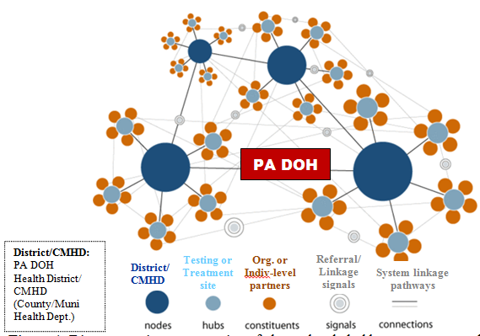
Stakeholder Engagement 1
Cross-system linkages resulting from a health system intervention for engagement of stakeholders through use of PDSAs to progressively build an adaptive hubs and spokes network of partnerships with multiple nodes connected to other nodes and hubs, & organizational or individual-level constituents.
Stakeholder engagement began with engagement of Part C clinical performance sites thru:
  Participation in learning session 1 (LS1);
  Project initiation/training PDSAs, including development of protocols for enhancement of pairings between Part C sites and providers of services in intervention focus areas:
    Testing & referral tracking (TRT); &
    Linkage to & retention in prevention/care (LRP/C);

Slide 50
Stakeholder Engagement 2
  Progressive engagement is continuing through enhancement of pairings between Part C performance sites and providers of services in intervention focus area #1:
  Testing & Referral Tracking (TRT):
    PA DOH health district/local Health Dept DIS: referring newly-diagnosed persons from HIV testing thru Partner Services (PS) and hybridized social network strategy (h-SNS) to Part C clinics , & DIS receiving referrals for PS & h-SNS from Part C;
    Intake Case worker programs: assist with early tracing/referral tracking of PDLWH/A who are indicated by the CPI-TRT system as not returned for test results, not linked to care or lost-to-care; conduct intake unmet needs assessments (UNAs) and address domains of need identified to assure linkage;

Slide 51
Stakeholder Engagement 2
  Progressive engagement is continuing through enhancement of pairings between Part C performance sites and providers of services in intervention focus area #2:
  Linkage to & Retention in Prevention/Care (LRP/C):
    Linkage/Retention Case worker programs: assist with early tracing/finding PDLWH/A (persons diagnosed and living with HIV/AIDS) indicated by the CPI-LRP/C system as lost-to-care; & conduct continuing UNAs and address domains of need identified to assure linkage;
    Correctional & ER clinical care providers: to conduct opt-out testing, & also conduct opt-out referral of PDLWH/A at discharge to Part C clinics;
    Correctional & ER discharge planners: to conduct opt-out referrals of persons who don’t know their status to medical homes/federally qualified health centers(FQHCs) for continuity of primary health care incl. opt-out HIV screening; FQHCs will in turn refer persons diagnosed and living with HIV/AIDS (PDLWH/A) for treatment to Part C clinics;

Slide 52
Key Objectives
& Target Populations
To address critical phases of vulnerability in the continuum of engagement to prevention/care through implementing interventions addressing:
  HIV Testing & Referral Tracking (TRT modules)
  Linkage to & Retention in Prevention/Care (LRP/C modules)
Continuum of Engagement in HIV Prevention/Care
Not in HIV Care Engaged in HIV Care
Hjhjhhjh
Unaware of HIV Infection (~20%)
Aware of HIV Infection (~80%)
HIV-aware: not linked to prevention/care
HIV-aware: varying degrees of linkage to prev/care
Phase A
Vulnerability
Phase B
Vulnerability
Phase C
Vulnerability
Phase D
Vulnerability
Phase E
Vulnerability
Phase F
Vulnerability
At risk persons to be offered HIV testing/in pre-test phase
Post-test phase- Not in HIV or any other prevention/care
Some medical care, but not HIV prevention/care
Entered HIV prevention/care - lost to follow-up
Cyclical or intermittent HIV prevention/care
Fully engaged in prevention/care
Intersection
52
TRT Intervention Modules
LRP/C Intervention Modules

Slide 53
Study Design Framework
&
Use of Learning Collaborative Model to Pilot Interventions & Develop Methods Consensus
Time-Frame | Year-1 | Year-2 | Year-3 | Year -4
Key Objectives | Project startup, intervention focus area & info systems development & training, establish ‘learning collaborative’ framework | Use ‘learning collaborative’ model learning sessions & PDSA cycles to continue training, refine & develop consensus on objectives & methods; develop protocols | Implement interventions at pilot sites; | Scale-up interventions & incl. additional sites;
Comparison/ Control Group | =standard practice➔ | =standard practice =➔ | =standard practice =➔ | =standard practice =➔
Intervention Group 1 (at 6 pilot Sites) | =standard practice➔ (pre-intervention status) | =enhanced practice =➔ = standard practice + interventions =➔ (site training & pilot of interventions thru use of PDSA cycles) | =enhanced practice =➔ = standard practice + interventions =➔ (full implementation of interventions) | =enhanced practice =➔ = standard practice + interventions =➔ (full implementation of interventions)
Intervention Group 2 (at additional scale-up sites, TBD) | =standard practice➔ | =standard practice =➔ | =standard practice =➔ (+site training) | =enhanced practice =➔ = standard practice + interventions =➔ (full implementation of interventions)
Evaluation Framework | Baseline status (pre-intervention) | Monitor PDSA process & assess preliminary outcomes | Monitor & evaluate outcomes | Monitor & evaluate outcomes-post intervention

Slide 54
Study Design &
Evaluation Framework
2 Key Evaluation Strategies to Evaluate Outcomes/Impact of Interventions
Quasi-experimental design comparing potentially non-equivalent comparison groups
Comparison of pre- and post-intervention status
Time-Frame | Year-1 | Year-2 | Year-3 | Year -4
Key Objectives | Project startup, intervention focus area & info systems development & training, establish ‘learning collaborative’ framework | Use ‘learning collaborative’ model learning sessions & PDSA cycles to continue training, refine & develop consensus on objectives & methods; develop protocols | Implement interventions at pilot sites; | Scale-up interventions & incl. additional sites; publish protocols and findings for dissemination;
Comparison/ Control Group | =standard practice➔ | =standard practice =➔ | =standard practice =➔ | =standard practice =➔
Intervention Group 1 (at 6 pilot Sites) | =standard practice➔ | =enhanced practice =➔ = standard practice + interventions =➔ (site training & pilot of interventions thru use of PDSA cycles) | =enhanced practice =➔ = standard practice + interventions =➔ (full implementation of interventions) | =enhanced practice =➔ = standard practice + interventions =➔ (full implementation of interventions)
Intervention Group 2 (at additional scale-up sites, TBD) | =standard practice➔ | =standard practice =➔ | =standard practice =➔ (+site training) | =enhanced practice =➔ = standard practice + interventions =➔ (full implementation of interventions)
Evaluation Framework | Baseline status (pre-intervention) | Monitor PDSA process & assess preliminary outcomes | Monitor & evaluate intermediate outcomes | Monitor & evaluate post intervention outcomes

Slide 55
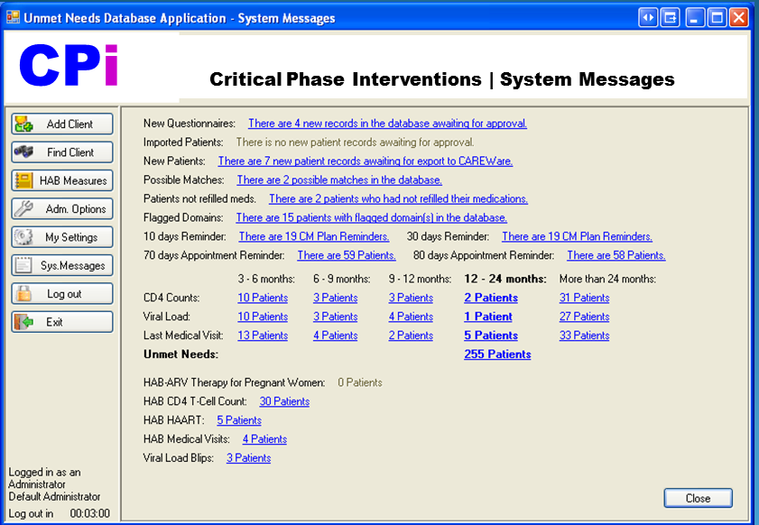
CPI Software Application Administrator Control Panel
(Demonstration of workflow management functionality)

Slide 56
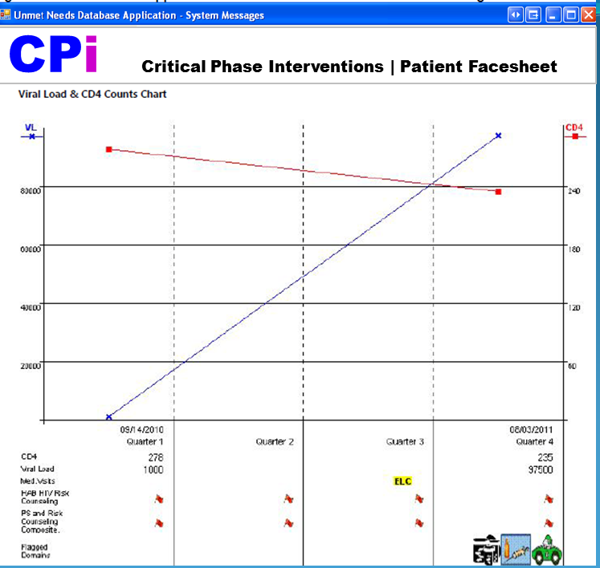
CPI Software Application Administrator Control Panel
(Demonstration of patient “facesheet” showing longitudinal follow-up data)
This CPI software application patient “Facesheet” displays 12 mos. (4 quarters) of patient history showing rising HIV-RNA viral load (VL) and declining CD4 T-lymphocyte (CD4) during a period of loss to follow-up.
Footnotes: On the table below the chart, the patient is ‘flagged’ for loss to follow-up after 6 months since the last medical visit as indicated by the ELC icon (indicating early stage of loss to care). The patient had been ‘flagged’ for HAB HIV and Partner Services (PS) risk counseling since the last medical visit. Upon field investigation to find and link the patient back to prevention/care, a follow-up unmet needs assessment (fUNA) conducted on the 9th month after the last medical visit detected patient unmet needs/difficulties with transportation, injection drug use, and medication adherence as the reasons for the lapse in care as indicated by the icon ‘flags’ for these domains. When the CPI software application is co-installed with CareWare, the HRSA software application used by most RWCA Part C HIV clinics (which only captures clinical information accessed by physicians), the CPI software application automatically imports CareWare clinical data including VL and CD4 and integrates these data with UNA psychosocial status data from the patient re-intake UNA interview (typically collected by case managers on a separate paper/electronic forms), thus allowing a visual display of the correlation of patient clinical and psychosocial status. The Facesheet is an enhanced case management (ECM) tool which facilitates clinician-case manager collaboration by enabling co-management of the patient through a common interface. The CPI application can also be used to document and track ECM actions taken on the flagged domains.

Slide 57




Acknowledgments
The Critical Phase Interventions (CPI) project is a
cross-program collaboration initiative
of the
The CPI project will contribute protocol and info systems tools to the PA SPNS Systems Linkages Project
developed in partnership with
Technical Support | Epidemiology & Health Services Research - Biostatistics & Informatics Team hosted by
Dept. of Public Health Sciences
Funding Support Provided by
This work was supported by grants from CDC and HRSA to Pennsylvania. Opinions expressed do not represent CDC or HRSA policies.

Slide 58
Cross-Cutting Themes

Slide 59
Cross-Cutting Themes Facilitated Discussion
Engagement & buy-in
Communication
Training & support
Oversight
Processes
Consumer Involvement
Data
Core Elements
Sustainability
Notes:
This will be a facilitated discussion where we will explore these different topics. Not every state will be expected to respond to each bullet point. It will draw out lessons learned, successes and challenges.

Slide 60
Final Piece of Advice
Notes:
Each state will be asked to provide one final piece of advice for anyone interested in utilizing the Learning Collaborative model to identify a set of strategies to test and implement across a system

Slide 61
Question-&-Answer Period

