Slide 1
Task-shifting in sub-Saharan Africa ICAP – Global Nurse Capacity Building Program
Mie Okamura
Global Nurse Capacity Building Program – Project Director
ICAP at Columbia University – Mailman School of Public Health
Notes:
Required slide. Please complete

Slide 2
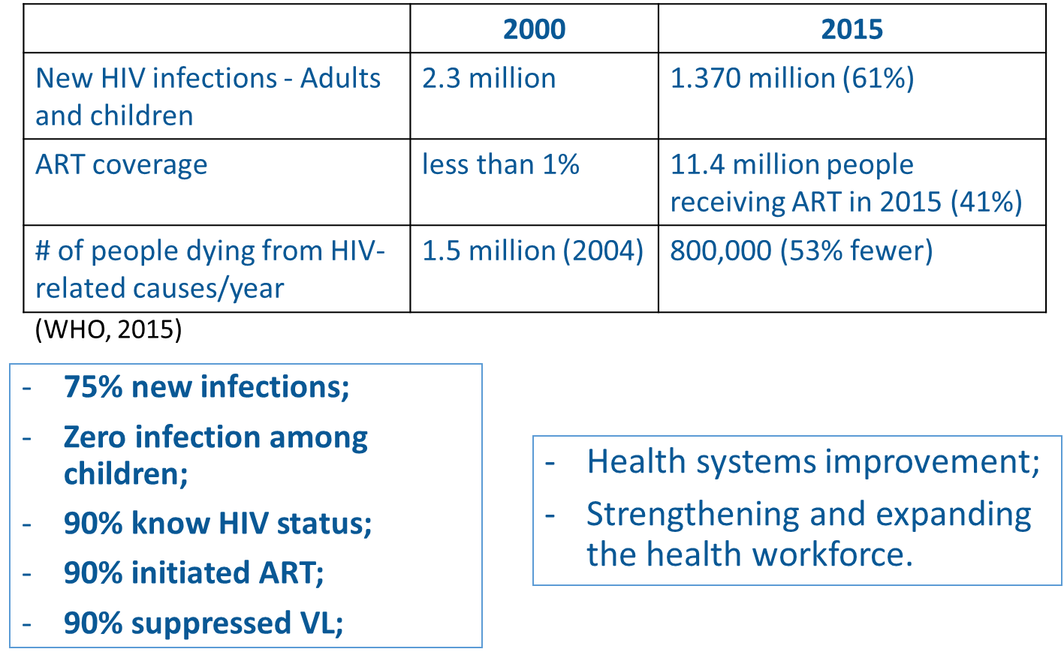
Background – Africa
Notes:
The global health response to HIV represents one of the remarkable public health achievements of recent times. This is result from the tremendous commitment, strong partnerships, generous funding from the US Government and other important players, using evidence based and innovative approaches.
Impressive response has occurred in Africa region where the number of adults and children newly infected with HIV was cut by 61% in 2015 compared to 2000, which means from 2.3 million to approximately 1.4 million.
A continuing treatment scale-up lead to an estimated 11.4 million people receiving ART in mid-2015, so the ART coverage reached 41% in 2015. In 2000 it was less than 1%.
The annual number of people dying from HIV-related causes was almost halved in the past decade. The estimated number of 800 000 people who died from HIV-related causes in the African Region in 2015 were 53% fewer than the 1.5 million people who lost their lives to HIV in 2004, when HIV deaths peaked.
Major challenges remain in Africa, which continues to endure the greatest HIV burden in the world. The coverage and quality of HIV services is insufficient specially in some countries with high HIV prevalence coupled with lack of human resources.
Ending the AIDS epidemic by 2030 is the challenge set by the Sustainable Development Goals.
to achieve the targets to reduce in 75% the annual number of people newly infected with HIV, zero new HIV infections among children; to reduce the annual number of people dying from HIV related causes to less than 500 000; and to achieve the ninety – ninety – ninety by 2020, improvements in the performance of health systems, including significant strengthening of human resources for health are needed.

Slide 3
Task shifting – WHO 2008
“Task-shifting approaches have helped to reduce the shortage of health workers in many countries, but ensuring quality, safety and motivation of those workers remains a challenge.” WHO, 2011.
Nurses are Frontline of health services (80%)
Notes:
WHO has identified a minimum threshold of health workforce density (which is 2.3 physicians, nurses, and midwives per 1000 population) below which coverage of essential interventions is highly unlikely.
Of the 46 countries in the African Region, 36 have critical shortage of HRH, 8 with only about 0.8 physicians, nurses and midwives per 1000 population.
Based on this minimum requirement, 36 countries in the African Region have shortages estimated at 820 000 doctors, nurses and midwives.
To tackle the scarcity of Human resources in 2008, WHO launched global recommendations for rational redistribution of tasks among health workforce teams.
Nurses are the frontline of health services, and provide over the 80% of the health care services worldwide. HIV/AIDS crisis has precipitated an urgent need to reorganize the healthcare team in order for nurses to effectively meet these challenges.

Slide 4
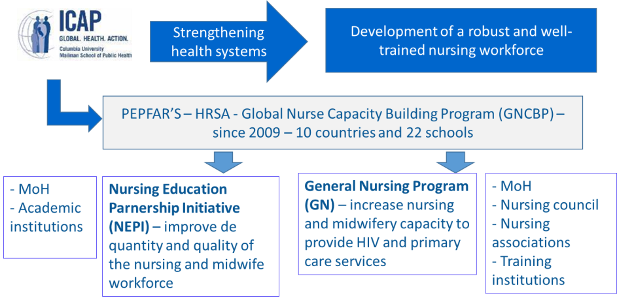
Approach to improving HIV care and treatment – task shifting
Notes:
ICAP is coordinating the Global Nurse Capacity Building Program (GNCBP), funded by HRSA and launched in 2009.
Development of a robust and well-trained nursing and midwifery workforce is central to ICAP’s strategy for strengthening health systems.
Through GNCBP, ICAP aims to improve health in sub-Saharan African countries by fostering individuals, institutions, and networks to expand, enhance, and sustain the nursing and midwifery workforce.
GNCBP consists of two subprojects: The Nursing Education Partnership Initiative to strengthen the capacity of nursing and midwifery educational institutions and ensure the production of sufficient, well-trained, clinically competent graduates; and General Nursing program, to increase nursing and midwifery capacity to provide HIV and primary care services;

Slide 5
Approach to improving HIV care and treatment – task shifting
GN Program (Cameroon, DRC, Ethiopia, Kenya, Mozambique, and Cote d’Ivoire):
Nurse-Initiated and Managed Antiretroviral Treatment (NIMART): Kenya - needs assessment and mentorship;
Campus to clinic training: South Africa;
Nurse-led ART initiation (NARTI) training: Swaziland;
HIV pre-service nursing curriculum: Swaziland;
Option B+ training: Cameroon.
NEPI - DRC, Ethiopia, Lesotho, Malawi, South Africa, and Zambia:
NIMART: Malawi, Lesotho and Zambia (Option B+ e-learning).
Clinical preceptorship program: Malawi (NIMART competencies).
Notes:
In terms of in-service training ICAP has been training nurses and clinical officers as part of task sharing efforts. Once trained, nurses and clinical officers return to ICAP-supported health facilities to further mentor nurses in HIV care and treatment using a combination of innovative online training, hands-on practice in HIV care settings, and group discussion.
ICAP developed an Option B+ E-Learning free module available in English, French, and Portuguese at elearning.icap.columbia.edu. The module facilitates self-directed learning through six online sessions: 1) PMTCT basics, 2) HIV testing for the mother, 3) ART for the mother, 4) Care of the HIV-exposed infant, 5) Early infant diagnosis, and 6) Retention in care. The curriculum is competency-based and interactive, including case studies; So far 1258 nurses and midwives from 32 countries have used the module. (29 are African countries 2 from asia and 1 US)
For pre-service training ICAP has been working with educational and training institutions in revising, updating and developing curricula, including HIV content as Option B+ and NIMART;

Slide 6
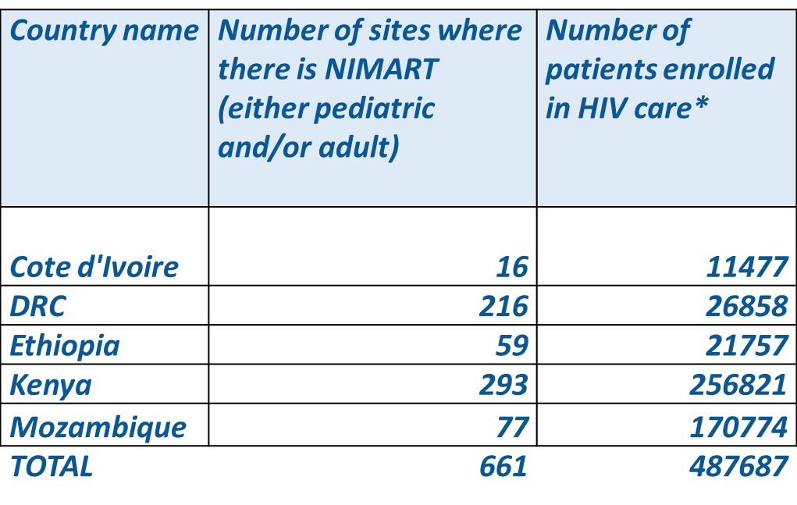
Impact of nursing workforce in HIV care and treatment
*includes adults and pediatric patients
Notes:
As of March 2016, there were 661 ICAP supported sites with NIMART strategy with almost 490.000 patients enrolled in care including adults and pediatric patients; around 430.000 women who ever received ART and a total of 920768 patiens enrolled in adult, ANC and pediatric HIV care.
this figures can show the impact of nursing workforce in increasing the number of patients in ART at NIMART sites and improving the health facilities in providing ART. In Kenya for instance, only ICAP suppported sites provide NIMART.
Task shifting efforts reduced the barriers in different steps of the cascade of pregnant women initiating ART

Slide 7
Success
“Since being trained, I have trained and mentored five nurses who have initiated 30 patients on ART” A.L. a nurse from Katalo Manyatta Health Centre, an ICAP-supported facility in Nyanza region - Kenya.
“We do not have to wait for a clinical officer to start prescribing ART for HIV-infected women at our PMTCT clinic” R.M. a nurse at Athi River Health Centre, an ICAP-supported facility in Eastern region - Kenya.
“ We have benn able to empower the nurse, now they have a voice, they feel more confident as they are providing care and treatment for clients. Nurses were able to reduce the waiting time, improving the adherence and retention” D.N.O. responsible for the nursing program at ICAP- Kenya office.
Notes:
Some testimonials from nurses in Kenya revels the benefits of NIMART. The strategy has improved the early ART initiation and retention.

Slide 8
Challenges
Pre-service education - is not regularly updated with the latest care and treatment guidelines;
In-service trainings - repeat frequently (high rotation of nurses);
Limited support from most experienced clinicians;
Clinical officers/physicians see ART management as their domain;
- Motivation – lack of incentives
Notes:
Although NIMART is recommended by WHO and many countries have developed policies for task shifting, there are often barriers in practice.
Pre-service education is not regularly updated with the latest care and treatment guidelines..
In-service trainings have to be repeated frequently to ensure that nurses in the HIV setting are trained in NIMART since nurses rotate so frequently. Preservice education and in-service training must be updated to ensure that core competencies, training content, teaching and learning methods, and assessment methods include essential HIV care and treatment competencies. Limited support from most experienced clinicians - difficult to include in their regular activities due to work load (mentoring as part of the tasks shifting process);
Sometimes there is push back from clinical officers/physicians who see ART management as their domain. Establishment of legislation, professional regulation, and quality assurance in the nursing practice will enable a favorable environment for nurses to emphasize their capacities. Motivation is a major challenge. More work without any reward make retention very difficult. Programs to increase salary or create incentive packages would be beneficial.

Slide 9
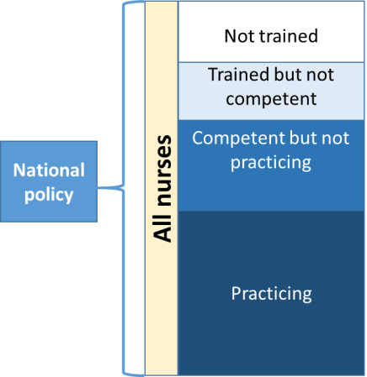
Challenges
Identify barriers and opportunities to bridge the gaps.
Smith et al. Identifying the Gaps: An Assessment of Nurses’ Training, Competency, and Practice in HIV Care and Treatment in Kenya. JOURNAL OF THE ASSOCIATION OF NURSES IN AIDS CARE, Vol. 27, No. 3, May/June 2016, 322-330
Notes:
Also a gap assessment conducted by ICAP regarding Nurses’ Training, Competency, and Practice in HIV Care and Treatment in Kenya showed that of those trained, not all were competent, of those who were competent, not all were practicing.
Findings indicated a need to examine each step along the nurse capacity-building cascade, from policy to training, training to competency, and competency to practice, in order to identify barriers and opportunities to bridge the gaps.

Slide 10
NIMART can change broader health outcomes
Expanded scope of practice for nurses enhances ability to leverage broader health outcomes developed through HIV responses.
NIMART increases access to HIV care and treatment to reach 90 – 90 – 90 goals

Slide 11
Contact
Mie Okamura
mo2350@cumc.columbia.edu
Nursing Capacity Building

