Slide 1
Step by Step: Initiating and/or Enhancing Billable Services
Module 2: The Medical Billing Process
Notes:
Welcome to the Step by Step: Initiating and/or Enhancing Billable Services Module 2: The Medical Billing Process.

Slide 2
RR Health Strategies
Pam D’Apuzzo, CPC, ACS-EM, ACS-MS, CPMA
Jean Davino, DHA, MS, CLT

Slide 3
Learning Objectives
To describe medical billing & revenue cycle management fundamentals
To examine operational workflow
To explore staffing your billing office

Slide 4
Medical Billing and Revenue Cycle Fundamentals

Slide 5
Definitions
Medical Billing is “the process of submitting and following up on claims with health insurance and other companies in order to receive payment for services rendered by a healthcare provider. Medical billing translates a healthcare service into a billing claim. The responsibility of the medical biller in a healthcare facility is to follow the claim to ensure that the practice receives reimbursement for the work the providers perform.” (AAPC)
Revenue Cycle Management is “all administrative and clinical functions that contribute to the capture, management and collection of patient service revenue.” (HFMA)
Notes:
- Efficient medical billing processes optimize returns and shorten the revenue cycle process.

Slide 6
Revenue Cycle Management Overview
Notes:
- Revenue Cycle Management is more than the billing of claims. The process begins at patient registration and the accurate collection of patient data

Slide 7
Start of a Claim
Patient Registration: Pre-registration and accurate information are key initial requirements in optimizing the healthcare revenue cycle management process. During this step, employees create a patient account that details demographics and insurance coverages by phone, patient portal, or registration forms mailed to the practice/clinic
Insurance Eligibility: To help ensure a practice/clinic’s revenue cycle success, it is recommended to verify patient’s insurance eligibility each time an appointment is made
Patient Appointment: Appropriate documentation and effective charge capture procedures allow for faster payment of services
Notes:
- Having specific policies and procedures for patient registration, insurance and benefit verification, charge capture, and claims processing is an essential step to maintaining practice viability.
- Investigate and incorporate automated and software-aided insurance eligibility verification into current practice/clinic work flows.
- The tracking of patient visits is essential for charge reconciliation (e.g., no shows)

Slide 8
Claim Submission
Charge Entry: If the charge entry process is not completed in an accurate, timely manner, reimbursement may be impacted. With electronic billing, some practice management (PM) software may have a front-end edit capability that will confirm required data elements and validate coding edits
Coding: The practice/clinic must determine who will be responsible for coding/verifying the assignment of Current Procedural Terminology (CPT)-4 procedure codes, Internal Classification of Diseases (ICD)-10 diagnosis codes and modifiers
Claim Submission: In contrast to paper claims, clearinghouses are frequently utilized to electronically transmit claims to third-party payers. Reports are generated to alert the practice/clinic if the claims were rejected by the payers
Notes:
- The charge entry process is where claims are actually created.
- Appropriate coding will assist in proper reimbursement.
- Coding is also critical for demographic assessments and studies of disease prevalence, treatment outcomes and accountability-based reimbursement systems (e.g., HEIDIS, MACRA)
- Electronic claims submission vs. manual claims submission
Reduce the amount of time and resources physician practices devote to manual administrative functions—time that can be better spent with patients or focused on other practice efficiencies
Pre-audit claim fields automatically for potential errors prior to submission.

Slide 9
Claims Management
Payment Posting: Whenever possible, electronic remittance should be set-up with payers, as opposed to manual payment posting. The electronic remittance process allows staff members to review and work from an “exception report.” Including payer contract details and fee schedules into the software, will allow for more accurate payment posting
Denial Management: Best practices recommendations include tracking and trending denials at the time of payment posting. Denials should be tracked by payer, denial type, and provider
Appeals: Appealing a denied claim does not guarantee that it will be overturned. However, failing to follow the formal process and associated submission timeline, will guarantee non-payment

Slide 10
Accounts Receivable (A/R) Management
A/R Follow-up: Most insurance carriers are required to pay or deny the claim within 30 days of receipt. Claim follow-up should begin as quickly as 7-10 days following claim submission
Patient Collections: The practice/clinic should establish a policy and associated timeframe for transfer of responsible party from insurance to patient (e.g., 30 or 45 days after the claim is initially submitted). For all patient collection accounts, a timeframe in which the account will be reviewed internally before the account is written off and/or transferred to an external collection agency should also be established
Patient Statements: Due to the large volume of carriers with higher deductibles, coinsurance, and copays, and services considered non-covered, more and more patients have outstanding balances with the practice/clinic. Patient statements should be issued on a regular basis to better manage the patient balances

Slide 11
Analytics
Reporting: Generate claim submission and payment data in real-time to allow for better monitoring and control. The report data should include the provider name, CPT code, payer, facility, and referral information.
Key Performance Indicator (KPI) Reports:
Accounts Receivable Aging by Carrier or Patient
CPT/Volume Billed and Paid by Carrier
Collections by Carrier
Collections by CPT Code
Patient Volume by Month
System Financial Summary
Notes:
- Physicians and practice administrators need to be astute in comparing and analyzing data and should ask for assistance from experienced professionals if there is difficulty in interpreting any practice/clinic financial reports
- Reports aid in determining areas that need the most focus, especially regarding revenue, productivity and efficiency
- Establish a broad spectrum of KPIs for long-term success (e.g., gross collection percentage – total charges/total collections informs a practice of what it collects relative to each dollar charged

Slide 12
Sample Year to Date (YTD) Productivity Report
Notes:
- Productivity reports can expose opportunities for facilitating dialogue among the stakeholders in the practice, serve as a catalyst for changes in the operation such as maximizing revenue through changes in the fee schedule or hours of operation

Slide 13
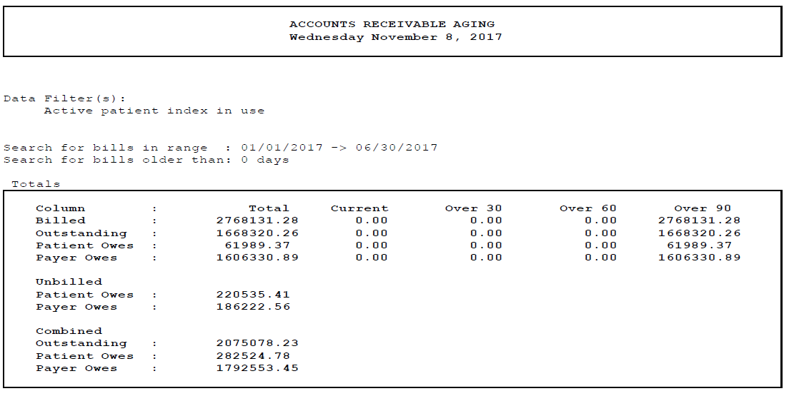
Sample Year to Date (YTD) A/R Totals Report
Notes:
- Each A/R report may be formatted differently
- The 0-30 day bucket for both patient and insurance should be the highest totals. This category represents the most recent claims submitted.
The next highest will be the 31-60 day totals. Typically most of the claims due will fall in the 0-60 day period.
The monies in the 61-90 day bucket should drop off dramatically, especially with insurance balances.
The 91-120 day bucket amount should drop as claims are worked, patients are billed, carrier follow-up is performed and collection efforts are made.
Generating this report monthly, will demonstrate your progress in each area.

Slide 14
Sample System Financial Summary Report
Notes:
- The Financial summary provides high level data of the total charges, adjustment and payment for a specified period of time.
- Provides a quick overview of the practice/clinic’s financial status.

Slide 15
Operational Workflow

Slide 16
Operational Workflow
Workflow and productivity are essential for any practice/clinic’s success.
A well developed and streamlined workflow will improve employee productivity.
The Billing Workflow is one portion of a practice/clinic’s overall operational workflow whose effectiveness must standalone and also work collaboratively and seamlessly with the other Departmental workflows (e.g., front desk, outpatient blood draws, patient check out, etc.).
Notes:
- A better defined regular process will allow for a more efficient team.
- To streamline work processes and improve workflow, assess all workflows, looking for opportunities for improvement in each area.

Slide 17
Medical Billing Workflow
Notes:
There are many steps involved in the medical billing process.
Each step is an integral part of the process and must be performed properly in order for the entire cycle to run smoothly.

Slide 18
Front Desk Operational Workflow
Front Desk operations will have a direct impact on the overall success of your practice/clinic’s medical billing.
Policies and procedures and well-trained staff in the following key areas are imperative:
Appointment scheduling
Patient Demographic Entry
Insurance Verification
Point of service Patient Collections
Notes:
- Front desk is a key and pivotal role in the success of the practice/clinic.
Set goals. For example, patients are to be treated the way you like to be treated; always interact with a person.
Set a goal for patient communication to occur within the first sixty (60) seconds of a phone call or in-person interaction at the front desk.

Slide 19
Front Desk Operational Workflow
The front desk is the first line of communication that a patient has with a practice, and sets the tone for the patient encounter. These important staff members are responsible for:
Incoming telephone calls, including appointment scheduling and other patient related concerns
Performing the initial “pre-registration” including, patient demographics, reason for visit, and insurance verification
Greeting patients and obtaining all pertinent information for demographic data entry
Outgoing telephone calls including appointment confirmation and missed appointment phone calls and documentation
Collecting payments from patients (copay, coinsurance, deductible, past due balances)
Communicating with the clinical staff when patients arrive
Notes:
- Testing your phone system as a user. This is the easiest way to better understand the patient experience.
- Assess the equipment and its functionality.
- Front office staff must be trained and b able to operate each piece of equipment efficiently (e.g., credit card machine, fax, copier, ID scanners, label printers and multi-line phone systems)

Slide 20
Patient Accounts Receivable
Over the past several years, the insurance industry has shifted additional financial responsibility to the patient in the form of:
High deductibles (in and out of network)
Higher copays
Copay plus coinsurance
Catastrophic coverage only plans
High copays and co-insurance levels
Non-covered services which were previously covered
Plan limitations on certain covered services
The front desk and billing staff must be educated and trained on a regular basis. They must also be provided the appropriate tools and policies and procedures to best handle patient collections.
Notes:
- A/R backlog and balances have increased dramatically due to the rise in patient financial responsibility for medical care.
- Many patients are unfamiliar with how their health insurance works or recent changes in their coverage,
- Prioritize insurance verification.

Slide 21
Staffing Your Billing Office

Slide 22
Staffing Model
The appropriate staffing model for a Billing Department is determined by the number of Full Time Equivalent (FTE) billing Providers (MD, NPP, etc.)
Medical Group Management Association (MGMA) provides national staffing data to help determine the appropriate staffing model based on specialty
MGMA’s 2015 Executive Summary Report (based on 2014 data), indicates approximately 2.7 FTE support staff as the average staffing required per Provider (includes front office and business operations support staff for Multi-specialty with Primary and Specialty Care Practices)
Notes:
-The best performing practices/clinics tend to have more staff available to assist with the various tasks.

Slide 23
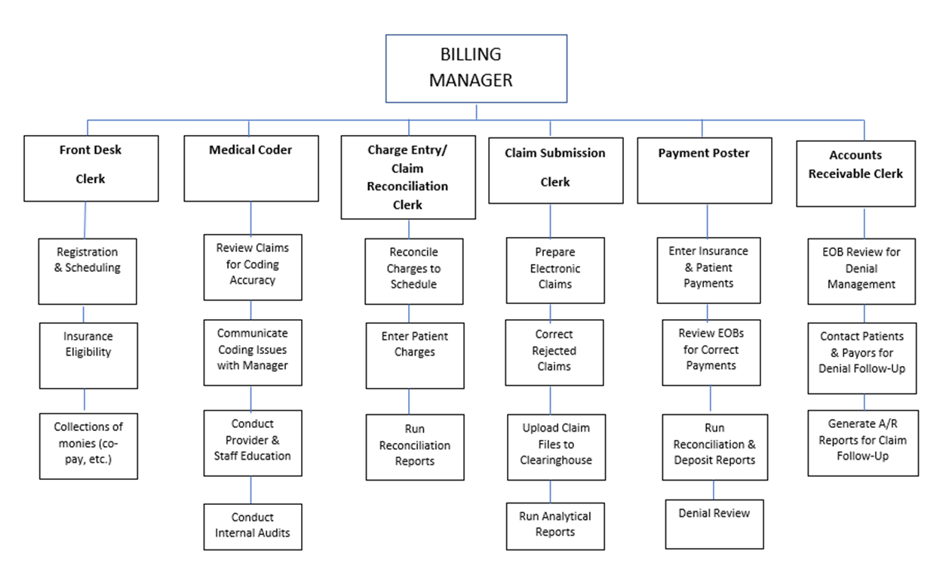
Sample Staffing Model
Notes:
Staffing models are not one size fits all.
Resources will dictate the staffing model.
- Staffing levels will vary based on various factors - size of practice, specialty and services provided.

Slide 24
Key Billing Staff Roles
Billing Manager
Medical Coder
Charge Entry/Claim Reconciliation Clerk
Claim Submission Clerk
Payment Poster
Accounts Receivable Clerk
It is important to note that although the Front Desk Clerk may not be considered part of the Billing Office’s Table of Organization, this role plays a key part in the overall Billing Workflow.
Notes:
- A billing staff is the intermediary of the operations and accounting departments of a practice/clinic.

Slide 25
Billing Manager
This position will have overall responsibility of ensuring the financial health of the practice/clinic.
Key Responsibilities include:
Maintain an extensive knowledge of the PM and EMR system
Ability to design, implement and enforce billing policies and procedures, as well as streamline effective billing processes
Create detailed job descriptions for all billing positions
Create easy to use grids of managed care billing requirements for front desk and other team members
Analyze key billing and financial reports
Motivate, train, coach and provide clear guidance to team members to perform their billing tasks properly and efficiently
Set goals and objectives for the team members
Conduct staff meetings where identified issues and concerns are discussed and reviewed
Ensure staff is trained on all Compliance Programs, including HIPAA
Provide cross-training for staff members
Notes:
Understanding the medical billing process requires specific knowledge coding and collection processes.
The billing manager must understand the entire accounts receivable process, as well as personnel management.

Slide 26
Billing Manager
Skills Required:
Extensive knowledge and skills in many areas of healthcare is required for the success of this position, including:
Understanding of all aspects of medical insurance billing
CPT/ICD-10 coding knowledge
Working knowledge of insurance carrier regulations
EMR/PM system knowledge
Excellent communication skills
Multi-tasking ability
Detail-oriented
Analytical abilities and problem solving skills
Reporting proficiency
Notes:
The billing manager will not likely be involved in transcribing and coding patient services. However, he/she must have a strong understanding of the service being rendered by the practice/clinic and the associated codes.
Some smaller practices/clinics may have only one medical billing representative to manage all accounts receivable.

Slide 27
Medical Coder
Key Responsibilities include:
Review the provider coding for accuracy and compliance with insurance and regulatory guidelines
Communicate with providers and administration regarding coding issues identified
Collaborate with the billing department to ensure all bills are submitted in a timely manner
Assist with insurance denials as it relates to coding issues
Conduct internal audits and coding reviews to ensure all documentation is accurate and meets with CPT and carrier guidelines
Maintain knowledge of the coding industry and associated changes
Conduct provider and staff education
Provide statistical data for analysis and research by other departments
Notes:
Practices/clinics should must submit accurate coding in order to receive proper reimbursement.
Provider education and training can reinforce accurate coding of services.
The practice/clinic should always have internal/external coding reviews to validate documentation and coding.

Slide 28
Medical Coder
Skills Required:
Professional Certification (CPC)
Excellent written and oral communication skills
Ability to conduct educational and training sessions
Exhibit strong knowledge of medical terminology, CPT and ICD-10
Technical and computer skills
Strong analytical skills
Detail oriented
Ability to work in a team environment
Notes:
Although not identical, medical billing clerk and medical coder positions are often combined due to the similarity and required expertise for these roles.

Slide 29
Charge Entry/Claim Reconciliation Clerk
Key Responsibilities include:
Retrieve charge documentation from providers
Reconcile charge documents to appointment schedules
Follow-up on outstanding charges by Providers
Accurately enter CPT and ICD-10 codes in PM software
Reconcile all electronic charges to the appointment schedule to ensure all charts have been closed and billed
Run reconciliation reports following charge entry to ensure all charges have been captured
Work closely with Billing Manager
Notes:
The process requires attention to detail and accuracy of data entry.
When charges are entered, the insurance and patient demographic information should have been entered accurately in the billing system.

Slide 30
Charge Entry/Claim Reconciliation Clerk
Skills Required:
Understanding of medical billing guidelines and regulations
Strong data entry skills
Technical and computer skills
Knowledge of CPT/ICD-10 coding
Insurance knowledge
Attention to detail
Ability to work in a team environment
Notes:
Instituting an effective reconciliation process is important process that should not be overlooked.
Missing charges (e.g., appointments that do not have charges posted, lost encounters, unclosed chart notes in EMR) has a large impact on the practice/clinic’s overall financial performance.

Slide 31
Claim Submission Clerk
Key Responsibilities include:
Responsible for creating electronic claim files in PM system to prepare for submission
Review and correct any claim errors that the PM scrubber reports
Upload the electronic claims file (837 file) to the clearinghouse
Review and correct any claim errors identified in Clearinghouse reports
Review all reports generated by the payers (277 file). Review and correct claims
Generate analytic reports to review:
Claim denial types
Payer denial types
Rejection patterns
Work closely with the Billing Manager to identify trends
Notes:
The Claim Submission Clerk works closely with commercial and government payers to ensure the practice/clinic receives the maximum reimbursement.
Claims must be submitted accurately and timely.

Slide 32
Claim Submission Clerk
Skills Required:
High level understanding of medical billing and the claim cycle
Extensive knowledge of clearinghouse functions and reporting
Technical and computer skills
Knowledge of CPT/ICD-10 coding
Attention to detail
Excellent analytical skills
Highly organized
Ability to work in a team environment
Notes:
- When billing problems arise, the Claim Submission Specialist will assist with rejections, appeals and corrections.

Slide 33
Payment Posting Clerk
Key Responsibilities include:
Data entry of insurance and patient payments in PM system, including point of service collections (copay, coinsurance, deductible, outstanding balances)
Review insurance Explanation of Benefits (EOBs) and post payments in PM system
Ensure allowances, adjustments and write-offs are posted correctly
Prepare documentation and recommendations for refunds
Perform check payment reconciliations and complete deposit reports
Post denials
Investigate unidentified cash and resolve misdirected payments
Generate reports
Notes:
- The payment posting process affects many other functions of the medical office and can have a major impact on patient satisfaction, efficiency, and overall financial performance.

Slide 34
Payment Posting Clerk
Skills Required:
Knowledge of medical billing and coding guidelines
Excellent knowledge of insurance reimbursement guidelines
Ability to analyze insurance reimbursement trends and report concerns to Management
Generate payment reconciliation reports and receipts for reporting and banking purposes
Technical and computer skills
Highly organized
Notes:
- A Payment Posting Clerk must be able to spot trends and issues hidden in the payment amounts and EOB comments.

Slide 35
Accounts Receivable (A/R) Clerk
Key Responsibilities include:
Review insurance carrier EOBs, identify denials, and work claims accordingly
Perform extensive account follow-up activities utilizing the PM system to investigate, analyze and resolve problematic and delinquent accounts with insurance carriers
Review accounts receivable reports and notify management of potential issues and denial trends
Receive and make calls to relevant parties, such as insurance company representative and patients
Establish and maintain effective working relationships with carrier representatives
Utilize relative resources and websites to retrieve pertinent information related to accounts receivable
Generate A/R reports in PM system to allow for appropriate claim follow-up
Notes:
- This position requires attention to detail, organization and the ability to work independently in determining the hierarchy of A/R account follow-up.

Slide 36
Accounts Receivable (A/R) Clerk
Skills Required:
Excellent customer service skills
Knowledge of payer websites
Extensive knowledge of individual insurance carriers reimbursement guidelines
Knowledge of CPT and ICD-10 coding
Understanding of insurance benefit and eligibility guidelines
Proficient in submitting written and online appeals to payers
Excellent organizational skills
Excellent communication skills
Technical and computer skills
Ability to work in a team environment
Notes:
The A/R Clerk has frequent verbal and face-to-face interactions with patients and insurance carrier representatives.
Must have strong customer service skills.

Slide 37
Staffing in a Smaller Office
If the Practice/Clinic Manager is not personally performing the billing operations, he/she should be monitoring the KPI reports.
The KPI reports generally include:
Productivity
Charges/Receipts/Adjustment Detail
Denials
Clearinghouse edits
Practice Management and EMR systems should be utilized to their fullest extent and all office processes should be automated, wherever possible
Ensure the proper staff is hired and adequately trained
Notes:
The quality of the staff is more important than the quantity of staff members available.
A solo physician practice seeing an average of 30 patients per day (without any ancillary services), may have as few as three (3) staff members (e.g., manager, front desk, and MA) and maintain an effective and efficient work flow.

Slide 38
Outsourcing Medical Billing
Many practices/clinics choose to outsource their billing to a professional medical billing company.
PROS | CONS
Reduction in billing errors | Patient satisfaction – dedicated staff to handle billing concerns
Reduction in practice expenses for staffing, benefits, etc. | No direct supervision of staff
Ensure billing compliance | Lack of control of the billing processes and procedures
Additional time to focus on patient care | HIPAA Privacy and Security concerns
Current knowledge of specialty specific billing and coding guidelines | Lack of communication regarding denial trends and other revenue impacting concerns
Detailed financial reporting on a scheduled basis | Hidden Fees and Variable costs
Notes:
A good outsourced medical billing service will provide feedback regarding:
- Ways to increase productivity and profitability
- Monitoring performance standards of staff, both in the office and the outsourced staff
- Ensure the outsourced billing service is performing all the duties as outlined in their contract.

Slide 39
Case Study

Slide 40
Watauga Medical Center
Challenge: The Watauga Medical Center in Boone, N.C. was facing an uphill battle in late 2007. With annual operating losses approaching $3.5 million, the community hospital had only 50 days of cash on hand and accounts receivable were languishing at 77 days. Watauga executives knew their revenue cycle was the cause of their financial difficulties; however they weren’t exactly sure how to correct it.
Solution: The center augmented their patient access process by implementing stringent preregistration processes, verifying insurances prior to appointments and proactively discussing with patients, what associated out of pocket costs would be along with payment options.
Result: Today, Watauga is a healthy institution, posting a $5.5 million operating profit in 2009. Days of cash on hand have increased three-fold to 150. Days in accounts receivable have been cut nearly in half. As a result, Watauga’s operating margin increased from -3.5 percent in 2008 to 5.4 percent in 2009.
Notes:
Reference: Case Studies. (n.d.). Retrieved from http://www.revenuecyclesolutions.com/communications/case-studies/

Slide 41
Session Highlights
Medical Billing: Maximize collection and reduce time to payments with effective workflows and skilled staff.
Revenue Cycle Management Processes
Staff Models: Design cohesive front and back office billing functions
Job descriptions and skill sets for efficient billing operations
Determining the health of your Revenue Cycle through billing reports

Slide 42
Session 2 Mini-Assignments
Review your office policies and procedures. Create a list of deficient front desk and billing operational policies
Compare your current front desk and billing department job descriptions to those outlined in the presentation. Create a list of missing job descriptions
Review the required skills for the job descriptions and evaluate the skills to your current staff members
Assess the training programs available to your staff for certification (e.g.; billing, coding, etc.) and ongoing continuing education
Create an outline of a billing staffing model for your practice/clinic
Review A/R and productivity reports for 2016 and 2017. Identify any significant trends

