Slide 1
PEP, PrEP, and TasP

Slide 2
Objectives
PEP, PrEP & TASP
At the end of this unit participants will be able to:
Understand what PrEP is, who it is for, and how it is paid for
Understand what PEP is, who it is for, and how it is paid for
Understand what TasP is and who it is for
Understand the concept of U = U
Notes:
Review objectives.

Slide 3
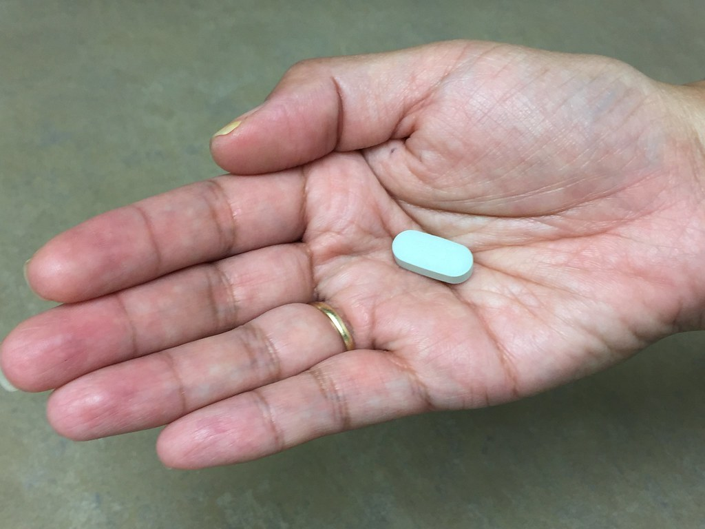
What is PEP?
PEP, PrEP & TasP
PEP: Post-exposure prophylaxis
PEP consists of an HIV regimen (raltegravir (Isentress) and Truvada)
PEP is taken within 24 to 72 hours of being possibly exposed to HIV
Once prescribed, must be taken for 28 days
Notes:
Ask the question, take responses from participants, then review the slide.

Slide 4
When Should PEP Be Taken?
PEP, PrEP & TasP
If the condom broke and you’re unaware of your partner’s status
If you shared needles and works to prepare drugs (cotton balls, cookers, or water)
If you’ve been sexually assaulted
Health care workers – needle stick from drawing blood from someone with HIV
PEP should only be used in an emergency situation
Notes:
Ask the question, take responses from participants, then review the slide.

Slide 5
Is PEP Free?
PEP, PrEP & TasP
Every state is different; refer to your public health department and check with health care provider. Your health care provider may help you find a medication assistance program run by PEP manufacturers
For example, in Los Angeles County PEP is covered under Medi-Cal (Medicaid) and some private insurance
Notes:
Ask the question, take responses from participants, and engage in a discussion about where their clients can receive this service at no cost.

Slide 6
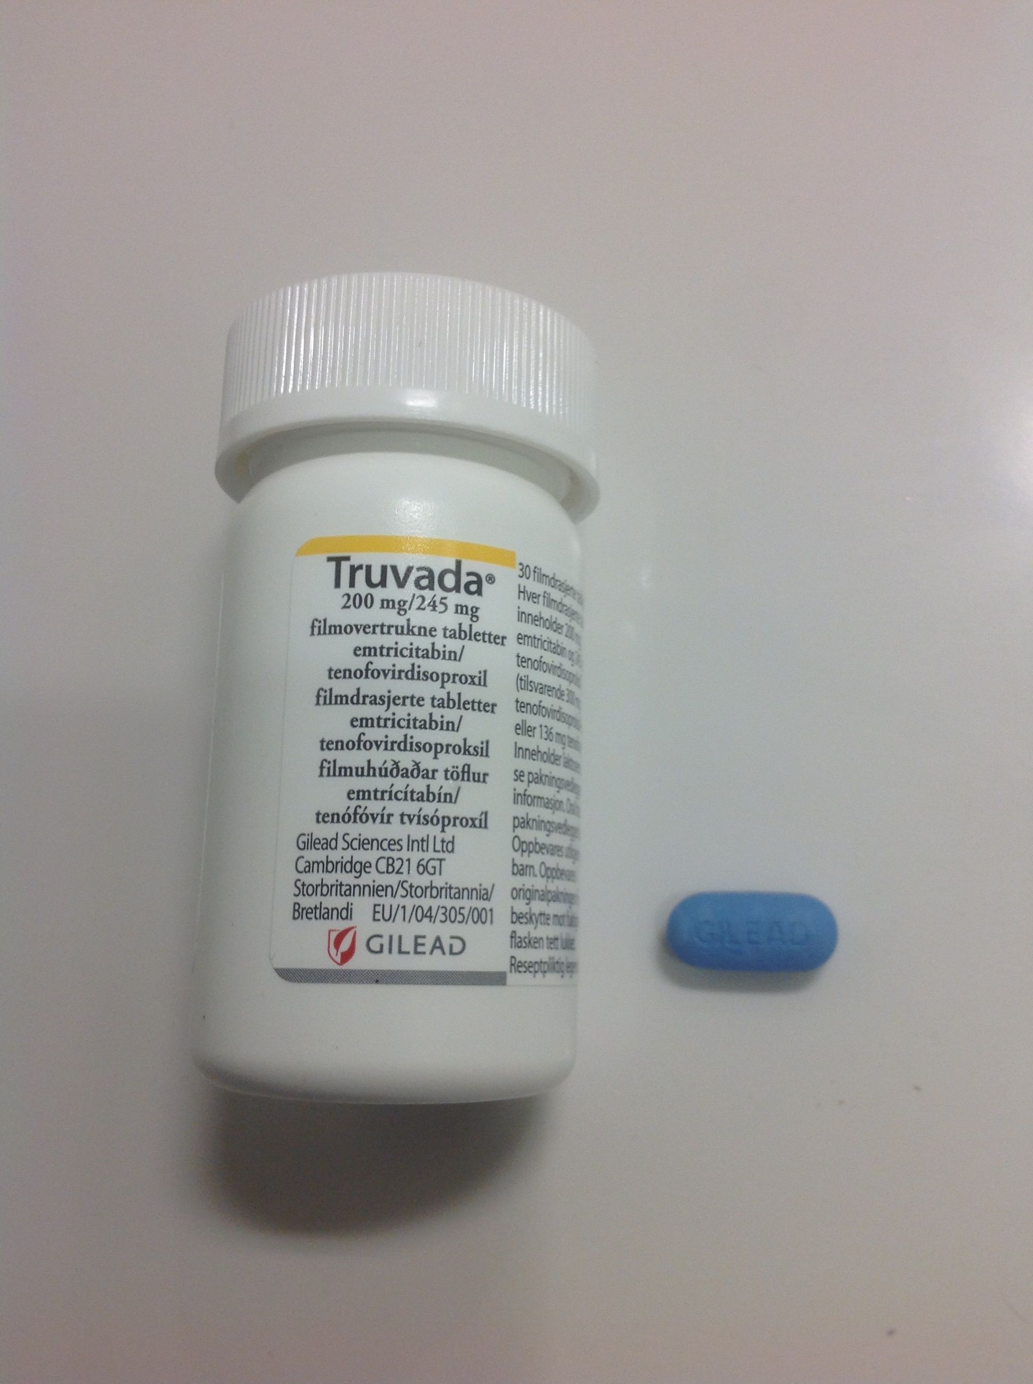
What is PrEP?
PEP, PrEP & TasP
Pre-exposure Prophylaxis
A once-a-day pill called Truvada (tenofovir and emtricitabine)
Can reduce a person’s risk of acquiring HIV
Can also stop from HIV from spreading throughout a person’s body
Notes:
Ask the question, take responses from participants, and then review the slide.

Slide 7
What is PrEP? (continued)
PEP, PrEP & TasP
A 96% chance of not acquiring HIV from sexual contact
Among individuals who inject drugs there’s a 70% of reducing acquisition of HIV
Should be taken along with using condoms
Provides maximum protection when taken daily for 7 days after engaging in anal sex; 20 days of maximum protection when taken daily vaginal sex or if a person is engaging in injection drug use
Notes:
Review the slide.

Slide 8
Who is recommended to take PrEP?
PEP, PrEP & TasP
PrEP is geared towards individuals who are HIV negative
If you’re a heterosexual or gay/bisexual person in a relationship with someone who is HIV positive
Have multiple partners (gay/bisexual or straight) whose HIV status aren’t known
Engaging in unprotected anal sex
Newly diagnosed with an STD
If a person inject drugs, share needles
Recently entered into a drug program
Women who are pregnant or thinking about becoming pregnant should consult with their health care provider.
Notes:
Ask participants why can’t everyone take PreP? Take responses from participants, then review the slide.

Slide 9
Is PrEP Free?
PEP, PrEP & TasP
Medicaid covers PrEP at no cost
Private insurance companies cover PrEP with pre-authorization (client has to pay their co-pays)
Programs such as Gilead Advancing Access (covers co-payments, deductibles, and co-insurance) Patient Access Network (covers co-payments, co-insurance and deductibles) and Patient Advocate Foundation (covers only co-payments)
Resource: https://www.nastad.org/prepcost-resources/prep-assistance-programs
Notes:
Ask the question, take responses from participants, and then review the slide.

Slide 10
Treatment as Prevention (TasP)
PEP, PrEP & TasP
Treatment as Prevention is another form of prevention for people who are HIV positive.
According to a study called HPTN 052, when they’re adherent to their meds with an undetectable viral load and high T-cell count, people who are HIV positive have a 96% chance of not transmitting the virus to their partner and/or partners, which in turn keeps the community viral load undetectable. When clients understand how HIV treatment works in their bodies it positions them to be accountable to themselves, their partners and the community as a whole.
Source: HPTN 052 Study. hptn.org/research/studies/hptn052; Centers for Disease Control and Prevention (CDC). Prevention is Care campaign, https://www.cdc.gov/stophivtogether/campaigns/prevention-is-care/index.html.
Notes:
Ask participants if they have ever heard of Treatment as Prevention. Take responses from participants and then review the slide.

Slide 11
What is U = U?
PEP, PrEP & TasP
U = U Means undetectable viral load equals untransmittable HIV.
This allows people with HIV to not worry about transmitting the virus.
It helps to reduce HIV stigma, fear, and shame.
This is also a prevention strategy that is referred to as Treatment as Prevention (TasP).
It opens up the possibilities of having children without going through alternative means of conceiving.
It encourages people to start and stay on treatment.
Notes:
Ask the question, take responses from participants, and then review the slide.

Slide 12
ACTIVITY: Game Time!
Notes:
Give the game instructions: Each team will have a call bell to ring when they know the answer. The first team to ring the bell-gets a chance to answer the question. If the team get the correct response, they get 1 point. If the team that rings the bell doesn’t get the correct answer, allow for the other team to answer. If neither team gets the correct answer, the facilitator will provide the answer. Record the correct answers and team points on a flip chart sheet.

Slide 13
Question
PEP, PrEP & TasP
What does PEP stand for?
Notes:
Read the question and allow teams to ring in.

Slide 14
Answer
PEP, PrEP & TasP
Post-exposure prophylaxis
Notes:
Review the answer with participants and clarify any confusion.

Slide 15
Question
PEP, PrEP & TasP
True or False: Treatment as Prevention is a form of prevention for people who are HIV negative.
Notes:
Read the question and allow teams to ring in.

Slide 16
Answer
PEP, PrEP & TasP
FALSE: Treatment as Prevention is used to prevent transmission from a person with HIV.
Notes:
Review the answer with participants and clarify any confusion.

Slide 17
Question
PEP, PrEP & TasP
TRUE OR FALSE: If a person take PreP as prescribed, they have a 90% chance of not acquiring HIV.
Notes:
Read the question and allow teams to ring in.

Slide 18
Answer
PEP, PrEP & TasP
TRUE: When a person who is HIV negative takes PrEP as prescribed it lowers the risk of acquisition of HIV by 90%.
Notes:
Review the answer with participants and clarify any confusion.

Slide 19
Question
PEP, PrEP & TasP
For prevention, what can be taken along with using condoms?
Notes:
Read the question and allow teams to ring in.

Slide 20
Answer
PEP, PrEP & TasP
PrEP can be taken along with the use of condoms.
Notes:
Review the answer with participants and clarify any confusion.

Slide 21
Question
PEP, PrEP & TasP
When a person with HIV is adherent to their meds, and has an undetectable viral load and high T-cells, what happens?
Notes:
Read the question and allow teams to ring in.

Slide 22
Answer
PEP, PrEP & TasP
They have a 96% chance of not transmitting the virus to their partner(s).
Notes:
Review the answer with participants and clarify any confusion.

Slide 23
Question
PEP, PrEP & TasP
Is PrEP free?
Notes:
Read the question and allow teams to ring in.

Slide 24
Answer
PEP, PrEP & TasP
Medicaid usually covers it for those who are covered under that insurance. Private insurance companies cover PrEP with pre-authorization (client has to pay their co-pays).
Programs are available like Gilead Advancing Access (cover co-payments, deductibles, and co-insurance), the Patient Access Network (cover co-payments, co-insurance and deductibles) and the Patient Advocate Foundation (covers only co-payments).
Notes:
Review the answer with participants and clarify any confusion.

Slide 25
Question
PEP, PrEP & TasP
What regimen has to be taken within 24 to 72 hours of being possibly exposed to HIV in order to prevent infection?
Notes:
Read the question and allow teams to ring in.

Slide 26
Answer
PEP, PrEP & TasP
Post-exposure prophylaxis (PEP)
Notes:
Review the answer with participants and clarify any confusion.

Slide 27
Question
PEP, PrEP & TasP
Name three times when PEP should be taken?
Notes:
Read the question and allow teams to ring in.

Slide 28
Answer
PEP, PrEP & TasP
If the condom broke and you’re unaware of your partner’s status
If you’ve shared needles and “works” to prepare drugs (cotton balls, cookers, or water)
If you’ve been sexually assaulted
Notes:
Review the answer with participants and clarify any confusion.

Slide 29
Question
PEP, PrEP & TasP
What does TasP stand for?
Notes:
Read the question and allow teams to ring in.

Slide 30
Answer
PEP, PrEP & TasP
Treatment as prevention
Notes:
Review the answer with participants and clarify any confusion.
Add up points for the game and award small prizes to the winning team!

Slide 31
Resources
PEP, PrEP & TasP
Project Inform PrEP Navigation Bootcamp
https://www.projectinform.org/wp-content/uploads/2018/08/Slides-SOA-PrEP-Summit.pdf
Centers for Disease Control (CDC) resources on HIV/AIDS and PEP, PrEP
https://www.cdc.gov/hiv/
https://www.cdc.gov/hiv/basics/prep.html
https://www.cdc.gov/hiv/basics/pep.html
https://www.thewellproject.org/hiv-information/prep-women
Prevention Access Campaign
www.preventionaccess.org/
Medication Assistance Programs
https://www.nastad.org/prepcost-resources/prep-assistance-programs
Notes:
Thank participants and mention additional resources.

