Slide 1
Uso de técnicas de entrevista motivacional en VIH

Slide 2
Objetivos
Usar un enfoque de estudio de caso:
Aplicar técnicas de entrevistas motivacionales y fortalecer las habilidades relacionadas con
Identificar y llegar a las personas con VIH con comorbilidades, y asesorarlas para que reciban atención
Apoyar a los clientes con la revelación del VIH
Apoyar a los clientes con el cumplimiento del tratamiento
Aplicar estudios de caso para aprender cómo analizar casos de clientes con su equipo y cómo solicitar su opinión y apoyo para llevar al cliente hacia la participación en la atención y la supresión viral
Notes:
Review the objectives.

Slide 3
Práctica de entrevista motivacional: cumplimiento del tratamiento y revelación del VIH
Notes:
In this session, you will have the opportunity to practice coaching scenarios involving HIV disclosure, client engagement in care, and medication adherence.

Slide 4
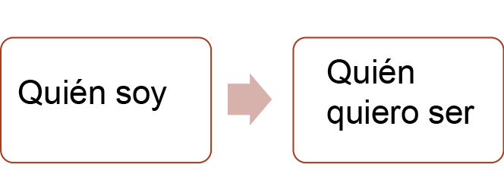
Introducción a la entrevista motivacional (MI)
La entrevista motivacional es un método directivo centrado en el cliente para mejorar la motivación intrínseca para cambiar al explorar y resolver la ambivalencia
La ambivalencia es un estado conflictivo de favorecer el cambio y apoyar el status quo
Ayuda al cliente a “despegarse” de sentimientos ambivalentes
Explora las razones personales del cliente para hacer un cambio
Acerca al cliente a quien quiere ser desde quien es ahora
Notes:
Motivational Interviewing is a client-centered, directive method for enhancing intrinsic motivation to change by exploring and resolving ambivalence.
Define the following terms:
Client-centered approach: A client-centered approach places emphasis on a client's autonomy and right to choose goals and/or interventions based on their identified needs for services.
Intrinsic motivation: Intrinsic motivation can be described as doing something that is motivated from our own passions without the incentive of reward or fear of a negative consequence. Doing the behavior is often its own reward.
Ambivalence: Ambivalence is often described as a state of being “wishy-washy.” It is the gap between who I am and who I want to be. In many cases, people hold expectations for themselves that favor change while simultaneously supporting the status quo. That inner struggle (ambivalence) often drives indecision and a sense of feeling stuck that is common in all people. Motivational Interviewing is a client-centered, skillful practice that aids people in moving beyond ambivalence to get closer to who they want to be.

Slide 5
Definición de entrevista motivacional (MI)
Un enfoque colaborativo, centrado en la persona para extraer y fortalecer la motivación de una persona para cambiar su comportamiento. Una MI implica un conjunto de principios y estrategias, pero lo más importante, es un enfoque que incorpora el espíritu de colaboración, empatía y de encontrar a las personas donde están.
Miller, W.R. and Rollnick, S. (2009). “Ten things that Motivational Interviewing is not”. Behavioural and Cognitive Psychotherapy, 37, 129-140.
Notes:
Ask a participant to read the slide.

Slide 6
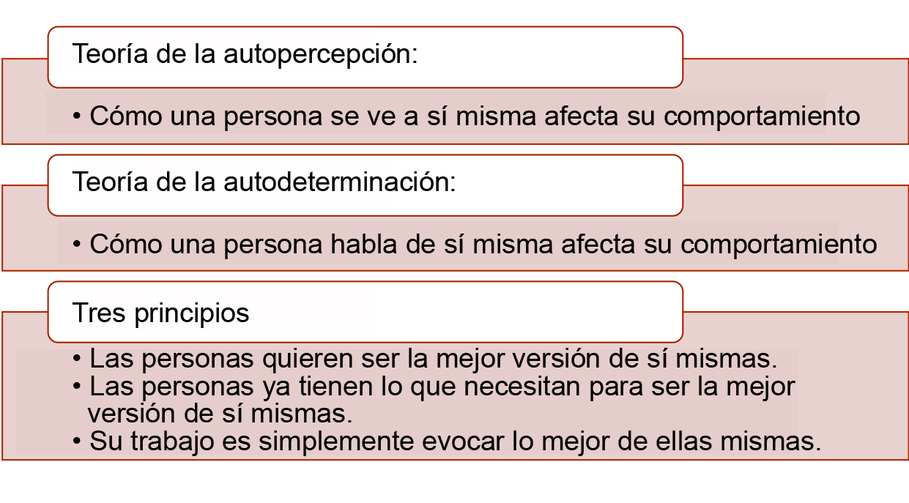
Teoría, principios, desafíos
Notes:
We understand that Motivational Interviewing is a way of working collaboratively with people to support their motivation for and commitment to change. The following two theories and three principles serve as important anchors to ground the CHW’s perspective when working in partnership with clients.
Two major theories:
Self-Perception Theory: A key idea in Self-Perception Theory is how people view themselves impacts their behavior. If a person feels negatively about themselves, they are less likely to take positive action. Consider the influence of your own self-perception and the impact when making changes in your life.
Self-Determination Theory – Self-Determination Theory can be generally described as the way a person talks impacts their behavior. For example, If they speak negatively, they perform negatively.
These two theories underscore the work of the CHW who uses Motivational Interviewing techniques because they help us to see why it is important to support people in talking and feeling more positively about themselves and their challenges when they want to make and sustain changes in their lives.
Three principles:
People want to be their best self.
People already have what they need to be that best self.
Your job is to simply evoke that best self.
CHWs work with people whose lives and experiences can be very complicated. It can be easy to propose solutions or prioritize the client’s circumstances according to our own values. These three principles help to ground the CHW in a client-centered approach by honoring the virtue in each statement and being willing to prioritize viewing the client’s concerns through the eyes of the client and not our own. Strong alignment with these principles can have transformative effects in the CHW/client relationship.

Slide 7
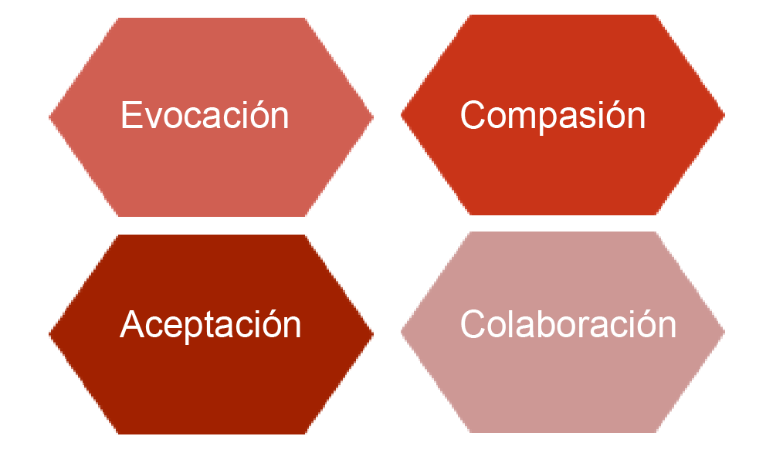
El espíritu de la MI
Notes:
When using Motivational Interviewing skills, the following four qualities should underlie your approach with people. Define each characteristic and briefly explore with participants.
Acceptance: Embody a disposition of acceptance by recognizing that people have the right to make their own choices free of judgment from others.
Compassion: Employ compassion by extending empathic care without judgment.
Evocation: Be intentional about asking the right questions to help people resolve ambivalence.
Collaboration: Work in partnership with people to examine their situations and ways to respond.
Ask participants to give an example of how a CHW might employ each when of these qualities when working with clients or with other care team members.

Slide 8
Estrategias centrales para destacar/apoyar a alguien con ambivalencia
Expresar empatía (el esfuerzo por “ponerse en su lugar” y sentir lo que están pasando)
Desarrollar discrepancias (señalar conflictos entre los objetivos y los comportamientos establecidos)
Responder a posibles desacuerdos (sin discutir ni pelear)
Apoyar la autoeficacia (reforzar la capacidad de las personas para lograr sus objetivos)
Notes:
Express empathy: (your effort to “put yourself in their shoes” and feel what they are going through) Empathy helps to build trusting and supportive relationships that aide in the CHW/client collaboration.
Develop discrepancy: (pointing out conflicts between stated goals and behaviors) Example: You want to be healthier, but you do not show up for your medical appointments.
Respond to potential discord: (don’t argue or fight) Developing discrepancy or responding to potential discord isn’t synonymous with confronting or wrestling with a client about their behavior. The goal is to empathetically shine light on a situation in such a way that the client can view their own behavior.
Support self-efficacy: (reinforcing people’s ability to accomplish their goals) We understand from self-perception theory that how we view ourselves can impact our behavior; thus, reinforcing a client’s belief in their ability can have a positive impact and aid change.

Slide 9
Habilidades de asesoramiento para promover el cambio de comportamiento
O | Open-ended questions (preguntas abiertas)
A | Afirmaciones
R | Reflective listening (escucha reflexiva)
S | Summarizing (resumen)
Notes:
O.A.R.S. is a set of skills that helps to create an open, affirming, accepting environment where the client can explore their feelings, behaviors, and beliefs. O.A.R.S. skills help to move MI conversations forward and allow clients to freely express content that can position them to hear and make progress toward change.
Review O.A.R.S. skills and provide examples. After each skill, invite participants to reflect and share the value of using O.A.R.S. skills.
Open-ended questions
Use open-ended questions that invite elaboration or descriptive information. Open questions usually require more than a yes or no response and encourages the client to talk more. Examples: What helps you stay on track with your medications? Tell me more about…
Affirmations
Using affirmations helps to reinforce the client’s strengths. Affirmations can be used to validate the client’s experience or feelings.
Examples: You’ve accomplished a lot in a short time. I appreciate your honesty.
Reflective listening
Reflective listening is a way to clarify statements and demonstrate that you heard and understood your client.
Examples: It sounds like you… You’re wondering if…
Summarizing
Summarizing statements link material that has been discussed to reinforce what has been said and demonstrates that you have been listening carefully.
Examples: Here’s what I’ve heard… Let me see if I got this right…

Slide 10
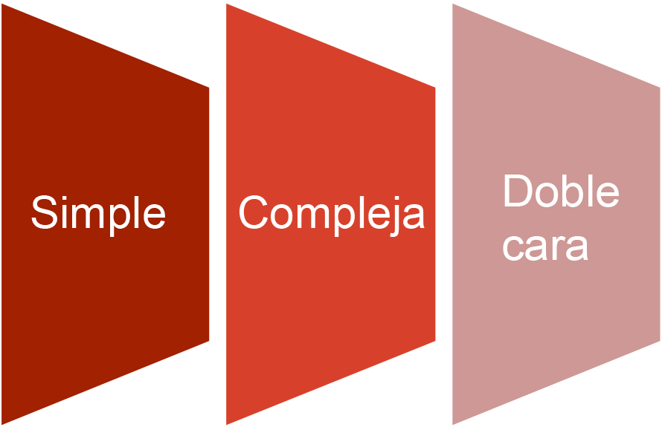
Práctica de declaraciones reflexivas
Notes:
Define the difference between simple, complex, and double-sided reflections.
Simple: Literally using the client’s words and giving it back to them.
Complex: Adds meaning, value, or emotion to the client’s words.
Double-Sided: Highlights discrepancy between client’s words/values and actions.

Slide 11
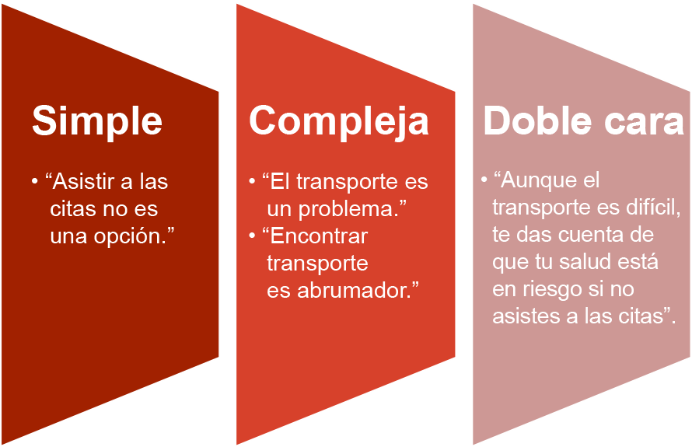
Práctica de declaraciones reflexivas
Declaración del cliente: “Asistir a mis citas no es una opción a menos que pueda darme boletos de autobús”.
Notes:
Simple: A simple reflection is a basic restatement of the client’s own words, being careful to use the client’s language.
Complex: Complex reflections add meaning, value or emotion to the client’s words. In essence, you are reflecting a deeper layer of the simple reflection that helps to open new perspective.
Double-sided: The aim of double-sided reflections is to highlight the discrepancy between the client’s words/values and their actions.
Examples:
Simple: “Getting to your appointments isn’t an option.”
Complex: “Transportation is a problem.” “Finding transportation is overwhelming.”
Double-sided: “Even though transportation it tough, you realize you health is at risk if you don’t make your appointments.”

Slide 12
ACTIVIDAD: PRÁCTICA DE JUEGO DE ROLES
Notes:
CHWs work in a variety of capacities. This role-play activity provides an opportunity to practice MI skills during a client interaction involving HIV disclosure, client engagement, or HIV treatment adherence.
Distribute the handout Case Scenarios: HIV Disclosure, Client Engagement, and Medication Adherence.
Using the scenarios provided, ask participants to form dyads and conduct a role-play of their choosing.
One person will role play the CHW and the other will role-play the community member.
Allow 10-15 minutes for each role-play.
Remind CHWs to use MI skills in their role-play.
At the end of the allotted time, participants should switch roles and select a different scenario.
When complete, reconvene the group and debrief.
Ask, “What MI skills did you recognize when you were in the role of the client?”
Ask, “In your role as the CHW, which skills were easiest and which skills were more difficult?”
Ask, “What can you do to continue to practice and develop your MI skills?”
Remind participants that MI is nuanced and requires patience and practice. Using MI skills helps keep their client interactions client-centered and provides opportunity to address ambivalence, ultimately helping the client change their behavior.
Summarize and close.

