Slide 1
Tool Time!
Notes:
The Center for Quality Improvement & Innovation (CQII) is pleased to bring you the Quality Academy, an online learning opportunity on key quality management concepts. CQII provides no-cost, state-of the-art technical assistance for all Ryan White HIV/AIDS Program grant recipients and subrecipients to improve the quality of HIV care nationwide. CQII is funded through a cooperative agreement with the HRSA HIV/AIDS Bureau.
This tutorial is titles Tool Time; a look at some basic charts to assist you in looking at your data.

Slide 2
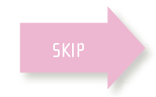
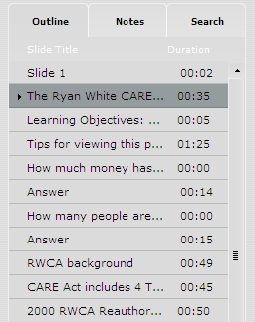
Tips for Viewing This Presentation
Read along with the narrator
Skip to other slides in the presentation
Search for keywords in the presentation
Review current slide
Play, rewind and fast forward
View full screen
Notes:
Before we begin today, please take a moment to familiarize yourself with the available tools that will help you navigate, participate and review the information outlined in this training module. Off to the right of the presentation window you will notice 3 tabs. The outline tab presents you with a complete outline and slide count for this tutorial. You can use this outline to navigate to any specific slide you wish to view again. Adjacent to that is a tab called notes. If you do not have speakers or are in any way hearing impaired, you may select this tab so that you can read along with our narrators. Finally, the search tab is just that. You may search for any keywords in the presentation which will allow you to come back multiple times and easily find specific data that you are looking for. Below the presentation window you will find the player controls for this presentation. If you would like to pause, rewind or fast forward the presentation, you can use the controls located to the left of the player. To rewind or fast forward on a specific slide, just click and grab the icon that you see sliding across the timeline of the slide. If you would like to remove the tabs on the right and watch the presentation in full screen mode, just click this icon on the right side of the player bar. Now sit back, relax, and enjoy today’s training session.

Slide 3
Learning Objectives
By the end of this webinar, you will better understand:
Capturing your data
Using common charts correctly
Charts as a communication tool
How simple charts can help you conform to this requirement in Policy Clarification Notice (PCN) 15-02:*
“Recipients should analyze performance measure data to assess quality of care and health disparities and use the performance measure data to inform quality improvement activities”
*https://hab.hrsa.gov/sites/default/files/hab/Global/HAB-PCN-15-02-CQM.pdf
2
Notes:
This webinar is to introduce some of the basic tools you can use to examine your data. We want to give you ideas on collecting your data and on the correct use of these commonly used charts.
Remember, data is a communication tool. It clarifies the message behind the numbers and helps you and your audience clearly see trends, and the result of your efforts.
Lastly, remember that Policy Clarification Notice 15-02 states that you should analyze your performance data at least quarterly. It states that measures are to be used to inform improvement activities. We know that improvement activities are a group effort so let’s make it easy for the group to understand your data and the act on it.

Slide 4
Check sheets
A simple tool to capture data
Organizes your data to use for graphical analysis
Captures either qualitative or quantitative data
Notes:
Check sheets are a very simple way to collect data. You can use something as simple as a table on a clipboard or build a spreadsheet. Either way, there are no formulas involved, no fancy graphs just something as simple as a mark on a piece of paper.
Most check sheets require no special skills to use and can be used with either quantitative or qualitative data. For instance, we count how many people with HIV came into our facility on a given day. That’s quantitative data. If we ask each person if they are satisfied with their wait time today in your facility, we would give them three to five choices ranging from not happy to very happy.

Slide 5
Check sheet for Qualitative Data
How satisfied were you with your wait time today?
Make one check for each patient as they exit
Only one answer per patient
This gives you an idea of how satisfied your clients are with wait times
Very satisfied | Mostly Satisfied | Neither satisfied nor dissatisfied | Mostly Dissatisfied | Very Dissatisfied
✓
 |  | ✓
 |  |  |  | ✓
 |  | ✓
 | ✓
Continue
Notes:
This is what the check sheet for satisfaction with wait time looks like.
Click continue when done.

Slide 6
Check sheet for Quantitative Data
Numerical data – Intakes by Day
This data gives you an idea of your client load and allows yo to make staff adjustments if necessary
Week | Monday | Tuesday | Wednesday | Thursday | Friday
1 | 3 | 14 | 17 | 10 | 2
2 | 4 | 17 | 22 | 11 | 2
3 | 2 | 16 | 20 | 14 | 3
4 | 1 | 15 | 22 | 15 | 2
Continue
Notes:
And this is what are check sheet looks like for quantitative data looks like.
Click continue when done.

Slide 7
Bar Charts
Notes:
Now let’s move onto another common form of chart – the bar chart.

Slide 8
Choosing a Bar Chart
Compares performance among categories of data
Presenting the data
Horizontally if you have long labels for each data bar or if you have a large number of data categories
Vertically if you want to clearly show data over time or other category
In general, bar charts need to start at zero; called a zero baseline
Notes:
You have probably seen a bar chat before, but you may not know the rules for its proper use. First, you need to start with a zero baseline.
Secondly, you use a bar chat to compare categories. Think of age as a category. But we can break down age into smaller units such as 24 to 35. Sex can be broken down to male and female.
Thirdly, there are two types of bar charts; horizontal and vertical. Horizontal bar charts are typically use when there are long labels for categories. You will see that on a subsequent slide.
Vertical charts will show you data over time. Another use for them is to show increase/decrease data. That example is coming up next.

Slide 9
Vertical Bar Charts
You need a zero baseline
The better choice for displaying negative numbers
The height of the bar makes comparisons easy
The variable you’re comparing here is the enrollment percentages of the age groups between a 2 year period
The trend is clearly visible
Notes:
Here is our vertical bar chart example. You need to have a zero baseline in a vertical bar chart. The vertical bars make it easier to see negative numbers and is the better choice for charts with negative values. You can easily see the height, and direction of the bars in relation to the zero line. In our example chart, you can see the percentage of change in enrollment between two years. You can see the trends in the shifting demographics in patient population breakdowns. Based on this information, wouldn’t you want to think about your programming and make sure it meets the needs of the increasing age demographics?

Slide 10
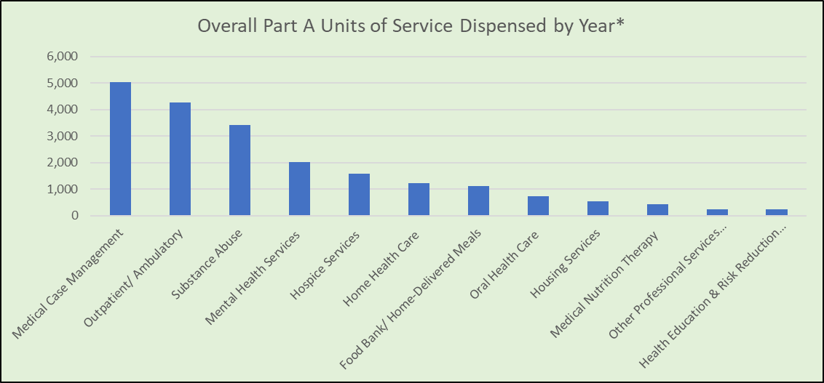
Horizontal Bar Chart
You need a zero baseline
Usually used when the data labels are long
Better for large data sets
Clearly shows relationship between a large number of variables
Vertical Bar Chart
*https://targethiv.org/sites/default/files/supporting-files/module5-QRH_5.1.pdf
Notes:
There are some differences between the vertical and horizontal bar charts. The primary difference is when the labels are long. Horizontal bar charts are useful with long labels. They are typically not used when negative values are in play such as in the vertical chart.
Both vertical and horizontal use a zero base. They both display a range of categories within a variable. In this chart, we look at units of service dispensed by one organization. This is helpful to see if the staff expertise meets the needs of people with HIV. On a larger scale, you would use a chart like this to see if money is being allocated to need.
This is what the chart would look like as a vertical bar chart. Notice how some categories ae truncated.

Slide 11
Horizontal Bar Chart

Slide 12
Stacked Bar Charts
Notes:
Let’s turn our attention to the stacked bar chart.

Slide 13
Stacked Bar Charts
You need to have a zero as baseline
Can be used to convey a lot of information
Should clearly show what you want it to show;
Make sure of the message you want to send
Don’t overload it with variables
This chart compares the intakes by year for each county in our mock Part A program
Notes:
We again start with a zero baseline. The stacked bar chart is a very useful tool as long as it succinctly displays the information you need without being overwhelming.
In the chart you see here, we can easily see the year to year breakdown of the mental health disorders that people present with upon intake. When you look at this, think about how this information can inform future program and staffing decisions. You can see most diagnoses do not vary from year to year except for a slight increase in individuals presenting with some form of bipolar disorders.

Slide 14
Return to slide 4

Slide 15
Line Charts and Run Charts
Notes:
Now we can turn our attention to line charts and their use.

Slide 16
When to Use a Line Chart
A line chart connects observations or data points
A line is used to connect each observation
They are time independent
The graph at the right shows temperatures but you don’t know if its daily, or an average of values
They can be used to compare different things
Line charts show a change in value, not magnitude of value
3
Notes:
Many of you have seen, or even constructed, line charts before. They track a single variable over time. Notice that the line chart is independent of time. In this case, each observation of temperature (a measurement) is plotted and you have the Y axis to tell you the value.
What we do not know is the time period between each observation. So, each measurement could be very hour or every day or the average temperature for an entire month. Hence, they are time independent. You would set the value of the X axis and then record each measurement for the next time period. You will see what this looks like in a minute.
You can plot different variables on a line chart but good practice says that the contrasting variables should make sense and convey a message. Let’s see what that looks like.

Slide 17
When to Use a Line Chart
They can be used to compare different variables. Examples:
Compare the percent of suppressed patients between clinic locations
Compare the percent of individuals with a mental health diagnosis between different organizations
4
Notes:
This chart could be sued to contrast the viral suppression percentages between clinic locations such as the uptown versus the downtown clinic. Or it could be used by a Part B program to look at the number of people with HIV that have mental health diagnoses by region. That would be helpful to determine if there is a need to reallocate program assets between regions.

Slide 18
Run Charts
They record observations over time; they are time dependent
Should have a minimum of 10 observations for fidelity to predictions or trends
Medians are used to determine if there is a “run”
Our mean is 10.1
A “run” is 5 consecutive points above or below the mean
What do you see?
Thursday and Friday are “slow” days
Monday is a peak day
Continue
5
Notes:
A special sort of line chart is the run chart. Run charts are more time dependent. They should incorporate at least 10 observation – or measurement – so you can accurately see if there is a run. In the run chart, we calculate a mean for our time period and to determine if there is a run, we see if there are 5 consecutive points above or below the mean.
Take a look at the chart. What do you see? Reflect on the patterns The run chart is used to look for patterns or trends. Do you think you could spot a trend with only 5 measures?

Slide 19
Run Charts
Useful in seeing or predicting trends (look at the dotted line)
Shows outliers clearly; look at week 5
Do you see a run here?
Our mean in this chart is 16
Look at the results for Weeks 7 through 12
Learn how you can use multiple trend lines to see if you’re improving by watching this YouTube video
6
Notes:
Let’s look at a further benefit of a run chart – the trends it shows. One function in Excel is the ability to add a trend line to a chart. The trend line will tell you in which direction you’re measure is trending. It’s a simple, but very effective way, to see if you’re getting the result you want.
As you become more sophisticated with run charts and trend lines, you may want to measure the effect of an intervention. Sort of like a before and after snapshot. You can measure the slope of a trend line and compare numbers to see if you’re improving.

Slide 20
Run Charts
When you look for a run, do not count a data point (observation) on the mean
Trends give you an idea of flow but remember they can be impacted by outliers
7
Notes:
Run charts have a few rules that should be observed. Besides the ones we discussed, its important to know that any measurement or observation that sits on the median cannot be counted in a run.
Trend lines will give you an idea of either positive or negative trends but remember they can be impacted by outliers.

Slide 21
Pie Charts
Notes:
This next section discusses the pie chart- one of the more widely-seen charts in use today.

Slide 22
When to Use a Pie Chart
Think of these guidelines:
Do I have one variable such as age, income, etc.?
Sort the data into categories
Keep the category sizes consistent (ages 13 to 19; 10K to 15K; etc.)
Limit the number of categories to about 7
Is there enough separation in my data that the observer can see a difference
If all the slices are the same size, consider another type of graph
If two categories are close in size, consider another chart
If I need to compare variables, pie charts should not be used
3
Notes:
Folks use pie charts for all sorts of things. But many times they are not used correctly. Have you ever seen a pie chart with 15 different slices in it?
First of all, Pie charts are used with one variable. You can see just a few of he myriad variables we listed.
Keep the categories the same size. You’re organizing data into categories so make sure that if the first category has thee Try to limit the number of categories to 7.
Third, a chart is meant to convey information non-verbally. If you have data, and its values are close together, the pie chart may not be the best way to display it. You want to achieve separation between slices so the each category can be seen and understood

Slide 23
How Many Slices?
Which one conveys a more clear message?
Continue
4
Notes:
Take a look at these examples. Ad you can see, the chart on the left is easier to read and conveys its message far better than the one on the right.
The chart on the right exhibits many of the “do not do” guidelines we discussed on the prior slide. There are too many variables, some of the slices are too small, and some of the ag distribution categories have a different number of age ranges within them.

Slide 24
How Many Slices?
This pie chart gives you a better idea of your patient population
You have an idea of the numeric representation of a category as part of the whole
Percentages show the effect or weight of the category on the whole
Consider you message and your audience in choosing how to represent these numbers
6
Notes:
Pie charts can be used to contrast a variable. In this example, we have looked at our patient population by age range and by the percentage of different age ranges. Each chart uses the same number of patients (N=156) but gives us a different perspective. If we look at the first chart, we see how many people in each category. But we have no idea of their ages, race, ethnicity, etc.
The lower chart tells us how many individuals – as a percentage of the overall population – are in each category. The lower chart offers us a snapshot of where we may want to concentrate our programming efforts more easily than the upper chart.
Your audience for this information should be a guide as to what chart would make the biggest impact.
Keep in mind that we are displaying the same data in different ways. That’s an important point to remember.

Slide 25
Using Pie Charts for Comparisons
You can see how the age of your patient population has changed over time
7
Notes:
In this chart, we are looking at the number of persons by age. But there is one important distinction between the 2 – time. In the chart on the left, we look at the age ranges of our population in 2017.
In the chart on the right, we are looking at the same variable but in the year 2020. Can you see the difference? In 2020, we find that we have many more clients that are in the 13 to 19 year old age range. The age categories 25 to 34 and 35 to 44 have shown decreases.
What does this tell you? Can you use the same sort of programs for 13 to 19 year olds as you did for 35 to 44 year olds? Probably not.

Slide 26
Suggestions for Use of Pie Charts
Use any whole, positive number
Use one set of data such as in our example – age
Always indicate the total population as a number (n)
Don’t use a pie chart if your data has zeros in it
You can use multiple pie charts to contrast the same variable in different periods
Don’t have more than 7 slices in your chart
8
Notes:
Let’s look at some suggestions for the proper use of pie charts.
You need to use one variable and use positive numbers.
Your chart needs to show the number of the overall patient population; especially if your using percentages.
If you have zero or zeros in your data, a pie chart should not be used. As we have seen, pie charts can be used to show the same overall variable in different ways. However, don’t overload the pie chart with too many categories. Keep it to 7 or below.

Slide 27
Summary
Thank you for taking this tutorial
The Center for Quality Improvement and Innovation
90 Church Street, 13th floor
New York, NY 10007
Info@ cqii.org
212-417-4730
Find us on TARGETHIV.org/CQII
Request TA on quality improvement by going to https://targethiv.org/cqm-ta-request
This project is supported by the Health Resources and Services Administration (HRSA) of the U.S. Department of Health and Human Services (HHS) under grant number U28HA30791 and the HRSA Ryan White HIV/AIDS Program Center for Quality Improvement & Innovation for $1.5 M. This information or content and conclusions are those of the author and should not be construed as the official position or policy of, nor should any endorsements be inferred by HRSA, HHS or the U.S. Government
27
Notes:
Thank you for listening to this revised Quality Academy tutorial. As you can see, there are many components to an effective clinical quality management program.
If you need technical assistance from CQII, we invite you to file a technical assistance request on the TargetHIV website. To learn more about our programs, you call email us at info@cqii.org
Thank you for your time.

