Slide 1
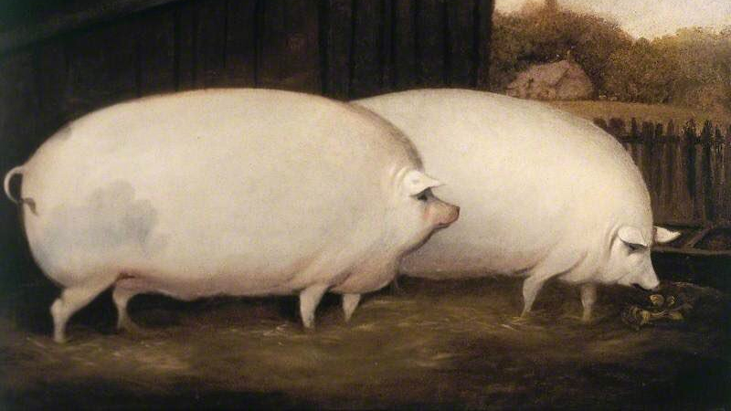

Game: Draw the Pig
Source: Adopted from the Institute of Healthcare Improvement (IHI)

Slide 2
Overview
Game: Draw the Pig | Length: 10-15 minutes
Type of Game: An interactive drawing game that teaches standardization. | Target Audience: Staff, quality improvement team members, people with HIV, etc.
Learning Objectives Engage participants in a creative way to demonstrate the importance of listening. Learn about how to best document action steps. Understand how added tools and provisions can encourage standardization. Demonstrate the importance of following instructions.
Agenda Setting the stage for the interactive exercise. Playing the Draw the Pig game. Debrief and discussion on what lessons learned are and how they apply to HIV care. Feedback and close.
For more information | Check out the CQII Virtual Game Guide (2021) at www.CQII.org, including additional games, resources and the corresponding facilitator guide

Slide 3
Game: Draw the Pig
Individual drawings: Each participant draws a pig within 1 minute.
Instructed drawings: Participants follow the provided instructions to draw a pig.

Slide 4
Individual Drawings of a Pig
Step 1: Take out paper and draw a pig within 1 minute.
Step 2: Ask participants to share their drawings.

Slide 5
Instructed Drawings of a Pig
N
Step 1: Pull out a second piece of paper and draw a grid as shown here.
Step 2: Follow the instructions as provided by the facilitator.
Step 3: Show your drawing again.
W
E
S

Slide 6
Let’s Try Again!
1. Draw a capital M, so the tip of the middle V of the M touches the intersection of the grid lines in the NW quadrant.
2. Draw a capital W, so the tip of the middle V of the W touches the intersection of the grid lines in the SW quadrant.
3. Draw a capital W, so the tip of the middle V of the W touches the intersection of the grid lines in the SE quadrant.
4. Go back to the M you drew in Step 1, and draw a slightly upwardly bowed line that runs from the most eastern point of the M, to the intersection of the grid lines in the NE quadrant.
5. Continue that line from the intersection of the grid lines in the NE quadrant to the most easterly point of the W that you constructed in the 3rd step.
6. Draw a downwardly bowed line from the most western point of the W in the SE quadrant, to the most easterly point of the W in the SW quadrant.
7. In the exact middle of the box between the NW quadrant and the SW quadrant, draw a circle the size of a dime.
8. Draw an inwardly bowed line from the most westerly point of the M created in Step 1, to the top of the circle you just drew in Step 7.
9. Draw an inwardly bowed line from the most westerly point of the W created in Step 2, to the bottom of the circle you drew in Step 7.
10. Draw a horizontal straight line about ½ inch in length starting from the middle of the line you created in Step 8.
11. Draw a horizontal straight line about 1/3 inch in length starting from the middle of the line you drew in step 9.
12. Draw a curly-cue about 1 inch in length starting at the upper third of the line you created in Step 5, extending in an easterly direction.
13. Put two dots in middle of the circle you drew in Step 7, arranged horizontally, and about ¼ of an inch apart.

Slide 7
How’d We Do?
1
4
8
12
10
7
5
11
13
9
6
2
3

Slide 8
Debriefing
What did you observe? Any trends? Comments? Reflections?
What behavior helped the group to accomplish the task? What behavior hindered the group in completing the task?
How does this game apply to HIV care and/or your HIV program?

Slide 9
Center for Quality Improvement & Innovation
212-417-4730 (phone)
212-417-4684 (fax)
www.CQII.org
Info@CQII.org
This project is supported by the Health Resources and Services Administration (HRSA) of the U.S. Department of Health and Human Services (HHS) as part of an award totaling $1.5M. The contents are those of the author(s) and do not necessarily represent the official views of, nor an endorsement, by HRSA, HHS or the U.S. Government.

