Slide 1

Game: Scavenger Hunt
Source: This game comes from “Games Trainers Play, by Edward E. Scannell and John W. Newstrom (“New York: McGrawHill, 1980, p. 51).

Slide 2
Overview
Game: Scavenger Hunt | Length: 15-30 minutes
Type of Game: A team-based game that emphasizes interaction and teamwork. | Target Audience: Anyone, whether it is clinical and administrative staff, quality improvement team members, managers, people with HIV.
Learning Objectives Learn that working as a team can be a different experience, even for people who previously have worked together. Introduce participants or team members to each other. Help people understand their own team working styles. Learn more about a specific content area (e.g., quality improvement, HIV).
Agenda Setting the stage for the interactive exercise. Playing the Scavenger Hunt game. Debrief and discussion on what lessons learned are and how they apply to HIV care. Feedback and close.
For more information | Check out the CQII Virtual Game Guide (2021) at www.CQII.org, including additional games, resources and the corresponding facilitator guide

Slide 3
Scavenger Hunt
Goal: To find all items on a provided picture related to a specific question.
Step 1: Teams are formed and active collaboration is encouraged.
Step 2: A specific question is posted by the facilitator and each team is asked to find all relevant pictures on the scavenger hunt picture.
Step 3: You have 2 minutes per question.
Step 4: Each team shares how many items they found and presents the items found.
Step 5: Proceed to the next question using the same the scavenger hunt picture.
Step 6: Identify the winning team!

Slide 4
Scavenger Hunt Question
Find CQII sponsored publications

Slide 5



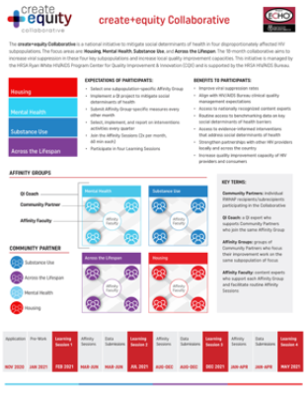

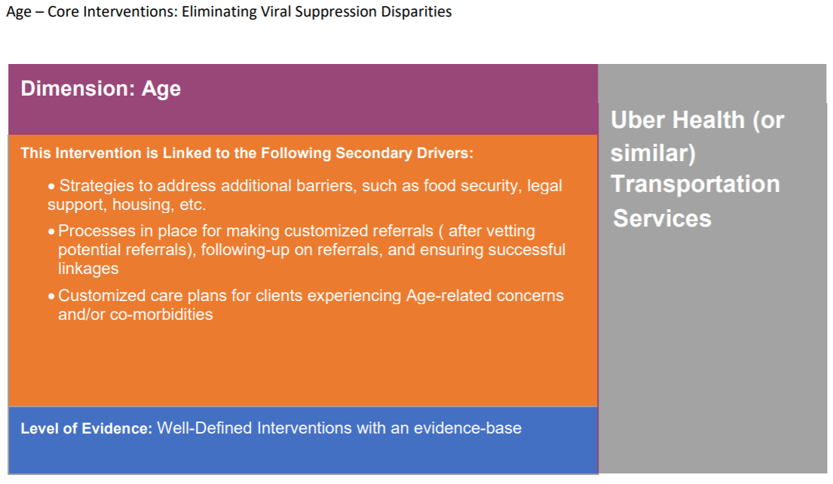



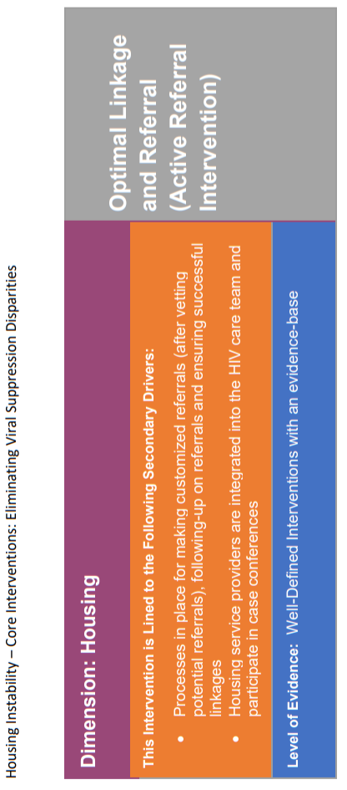



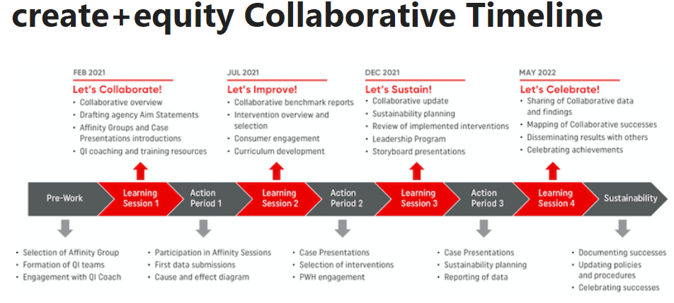






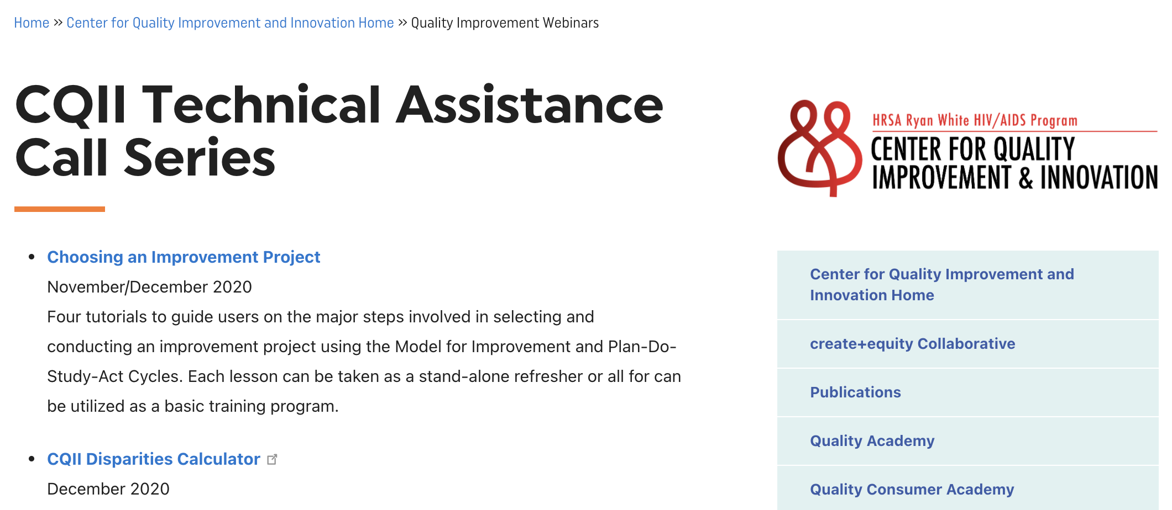
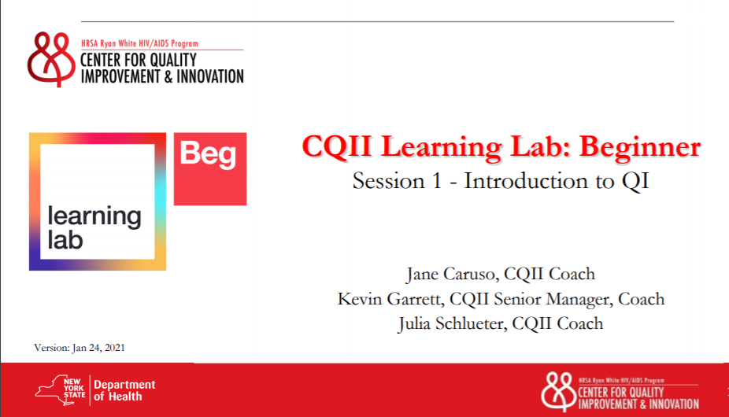


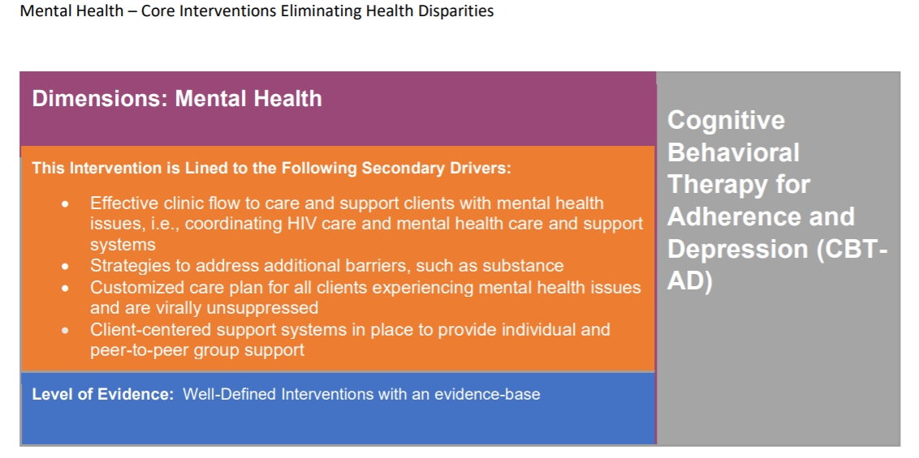



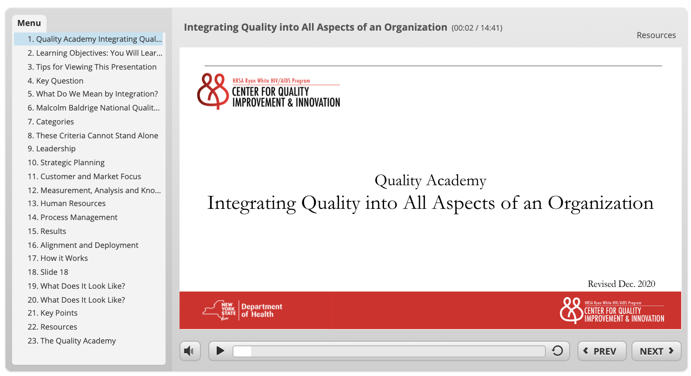
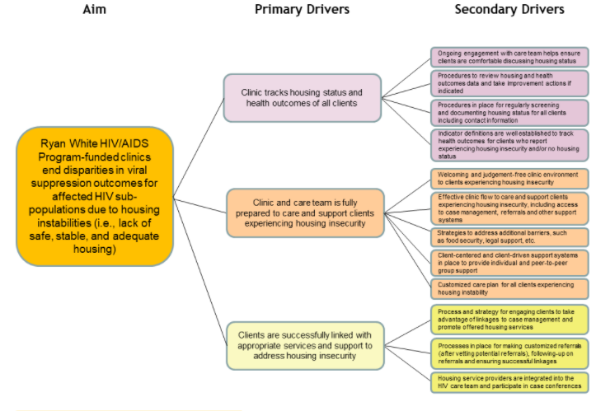



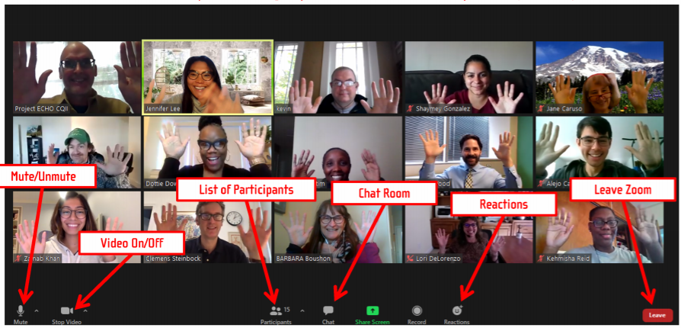





Slide 6
CQII Guides = 10

Slide 7
Scavenger Hunt Question
Find quality improvement training-related items

Slide 9
QI Training Resources = 12

Slide 10
Scavenger Hunt Question
Find items related to the create+equity Collaborative

Slide 12
create+equity Collaborative = 10

Slide 13
Scavenger Hunt Question
Find logos for organizations and collaboratives

Slide 15
Organizational and Collaborative Logos = 20

Slide 16
Debriefing
What did you observe? Any trends? Thoughtful comments?
How did your team go about carrying out the task? On reflection, did this method work well?
What did you learn about how they work as a team? How will what they learned affect your work on your next team task?
How can the conclusions of this process/game be applied to your HIV care and/or HIV program?

Slide 17
Center for Quality Improvement & Innovation
212-417-4730 (phone)
212-417-4684 (fax)
www.CQII.org
Info@CQII.org
This project is supported by the Health Resources and Services Administration (HRSA) of the U.S. Department of Health and Human Services (HHS) as part of an award totaling $1.5M. The contents are those of the author(s) and do not necessarily represent the official views of, nor an endorsement, by HRSA, HHS or the U.S. Government.

