Slide 1
The Bottom-Up Project
Leveraging Health Information Exchanges to Help Re-Engage People Living with HIV who are Lost to Follow-Up
Pete Gordon, MD
Medical Director
Comprehensive Health Program

Slide 2
Re-Engagement of PLWH who are Lost-To-Follow-Up (LTFU)
Many HIV interventions show strong evidence of efficacy for improving linkage to care, subsequent retention in care and viral suppression
Limited interventions have found strong evidence of efficacy for improving care re-engagement following a prolonged lapse in care
Data-to-care represents a promising approach but often fails due to lack of basic or up to date contact information

Slide 3
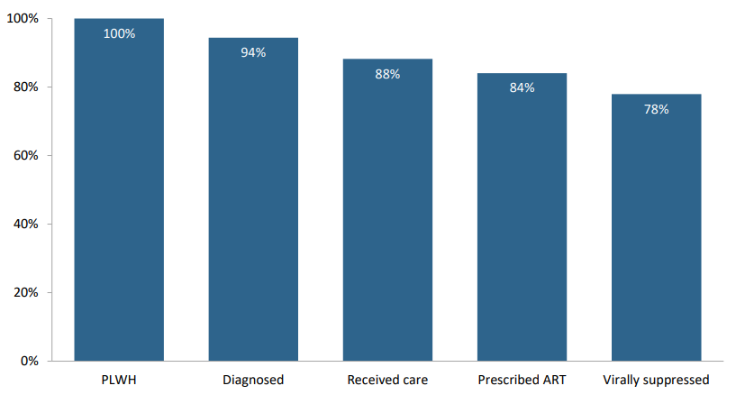
The Importance of PLWH who are LTFU to EHE Efforts
N=98,000
>10,000 PLWH LTFU
2020 NYC HIV Care Cascade
Notes:
About 7000 individuals not yet diagnosed

Slide 4
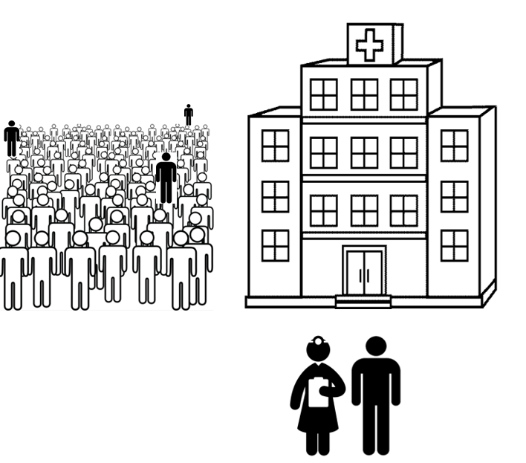
Identifying, Outreaching, and Engaging PLWH who are LTFU at the Population (or Community) Level is Challenging
Difficult to accurately and efficiently identify PLWH falling out of care
Outreach can be very resource dependent and often fails due to lack of accurate contact information
Missed opportunities to re-engage PLWH to care occur frequently

Slide 5
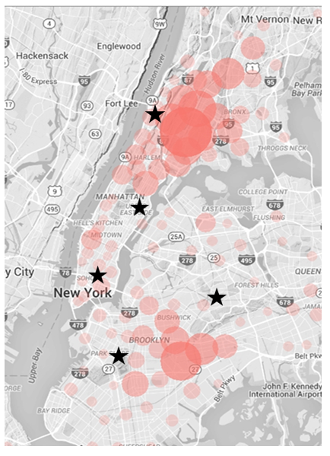
We do know that PLWH who are LTFU are Touching the Healthcare System Frequently
Depending on how you define the size of the NYC HIV Epidemic (98,000 – 128,000) and definition of Out-Of-Care (OOC) or LTFU, re-engagement opportunities abound but are generally missed.
Of the 10,000 – 13,000 PLWH who are out of care (OOC) many live or seek services in neighborhoods in close proximity to NYP hospitals and the CBOs that collaborate on the Bottom-Up project.

Slide 6
The HASA/Healthix Bottom-Up Project
Utilizes three, basic processes to try to re-link PLWH to care who have out of care (OOC) or are lost-to-follow-up (LTFU)
A monthly Lost-To-Follow-Up (LTFU) ‘subscription’ list
A Health Information Exchange (HIE) that receives the LTFU list and generates real-time alerts when registration events occur
A CBO partner that receives the alerts (in addition to the parent program) and responds with care coordination staff

Slide 7
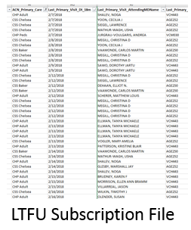
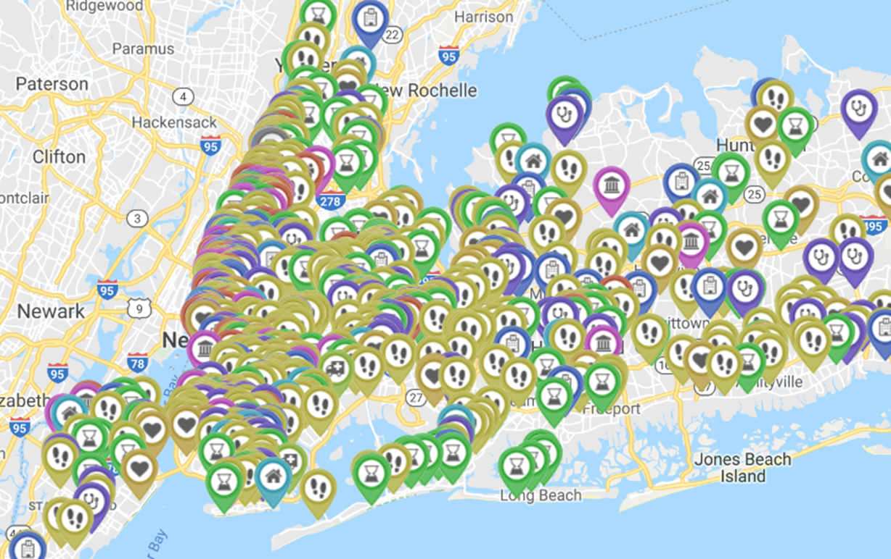
Healthix Clinical Alert Notifications
How it works…
Clinical Alert
Registration event
ED
Inpatient
Outpatient
HASA
- Navigator
- Care Coordinator
- MDCT Lead

Slide 8
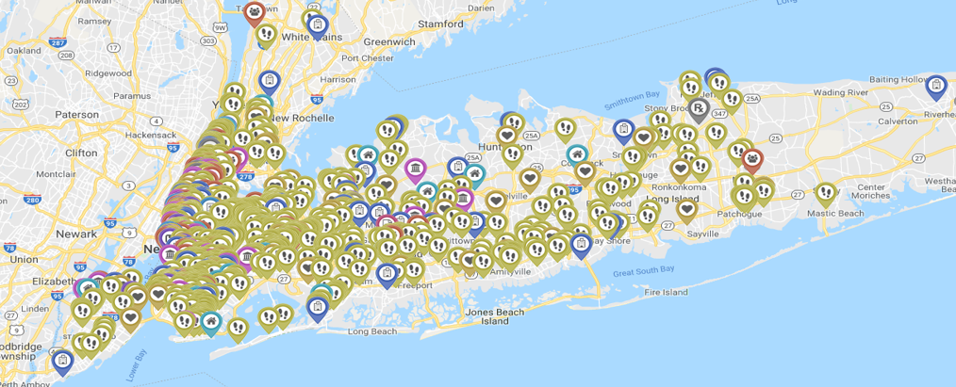
Health Information Exchanges (HIEs)
HIEs aggregate data in ways that no single institution, or EMR, can match
Healthix
> 20,000,000 patient records
> 8,000 contributing organizations

Slide 9
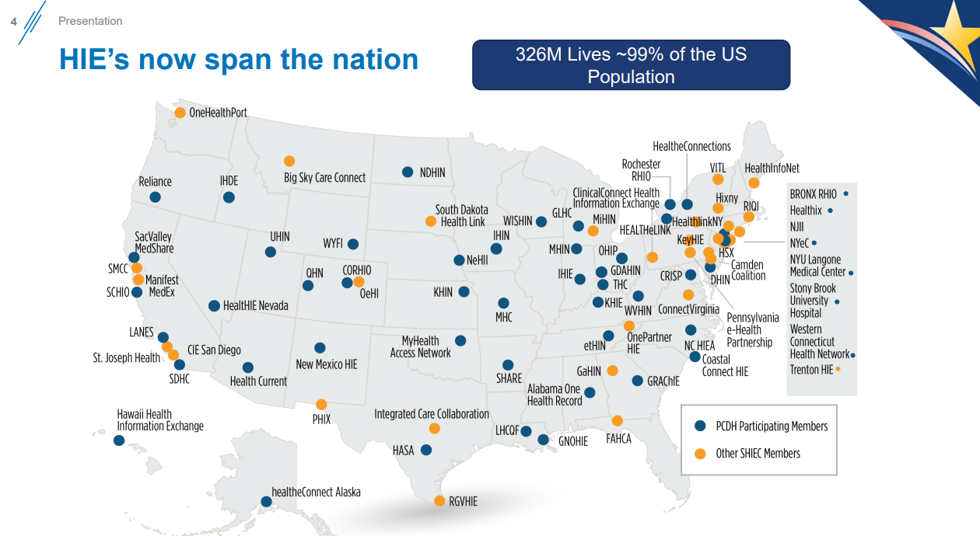
David C. Kendrick,
2019 SHIEC Survey Results

Slide 10
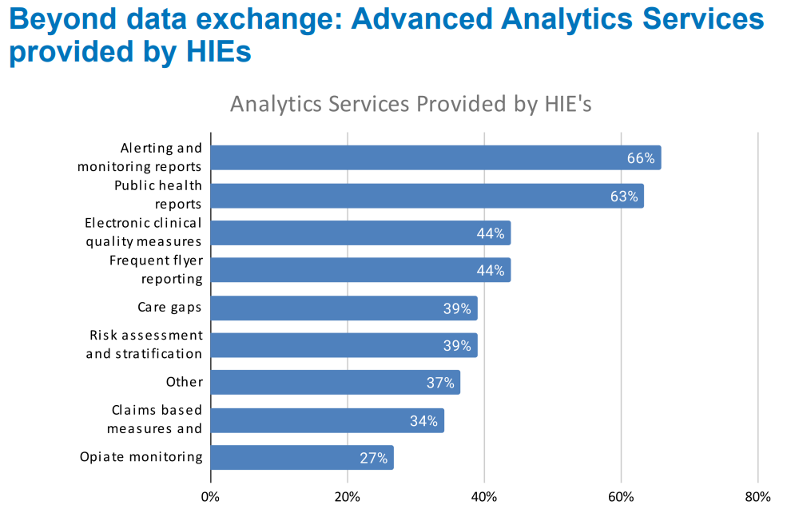
https://www.healthit.gov/sites/default/files/page/2020-02/DavidKendrickSHIEC.pdf

Slide 11
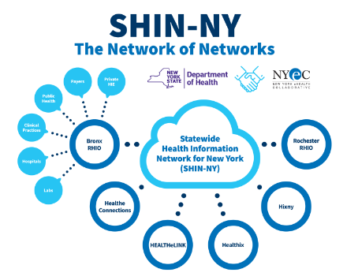
HIEs fit into the larger national HIT strategy of SHINs and NHINs

Slide 12
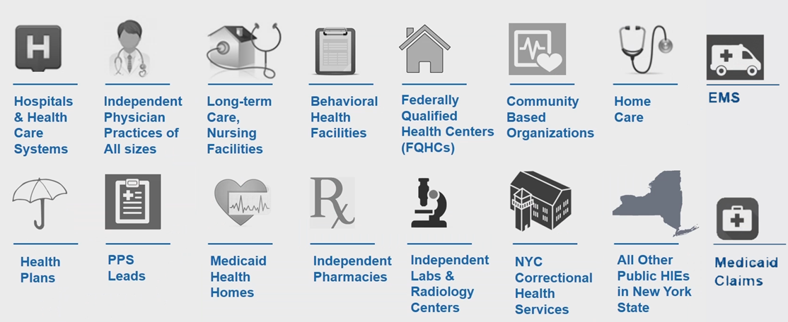
Healthix Data Sources

Slide 13
A Critical HIE Data Source Addition in NYC: HASA
NYC HIV/AIDS Service Administration (HASA)
Services the majority of PLWH in NYC (benefits, housing, case management)
Often the first, or only, ‘touch’ PLWH who are LTFU make
A source of the most important information to effect care re-engagement activities at scale -> accurate, up to date address and current phone number
Challenge: Clients are not formally ‘registered’, how do you include ‘touches’ in a HIE w/o a registration event? Necessary to trigger (alert) knowledge that relevant, often critical data has been added – such as a PLWH who is LTFU has been seen and new, updated contact information is likely available

Slide 14
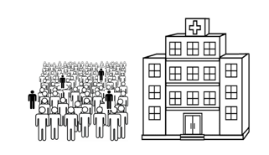
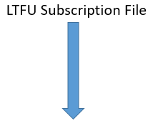
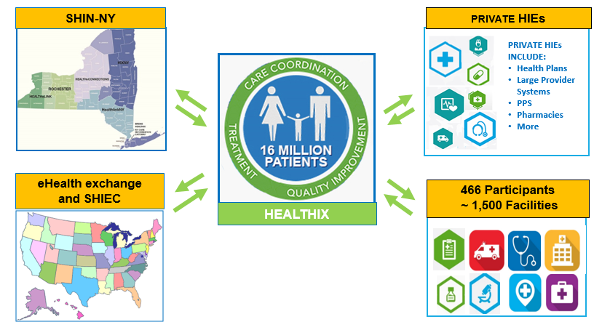
HASA Healthix Bottom-Up Project

Slide 15
Drilling Down: The Monthly LTFU Subscription List aka the challenge of developing useful community and population IT health tools
Must be as accurate as possible
Must be relatively easy to produce
‘off the shelf’ IT software can be really helpful
Most EMR systems are not yet all that helpful

Slide 16
Creating a Monthly LTFU Subscription file
Inclusion criteria = all HIV positive patients seen in NYP/Columbia’s HIV Center in the last 24 months but no evidence of care engagement in 9 months or greater
How do you define someone as HIV positive?
What constitutes Care Engagement in our post-Covid, post-MPV world?
An in-person visit?
A telemedicine visit?
A telephone visit?
An interaction with a care coordinator?
Evidence that a lab (CD4, HIV viral load) has been resulted?
Medication (ART) prescription sent?
Notes:
Remember, accuracy here is of critical importance
We made a decision to go for specificity

Slide 17
Creating a Monthly LTFU Subscription file
1. Generate PLWH Master File
6. Review LTFU list with Providers
2. Extract all Epic institutional encounters for cohort x 24 months
3. Subtract all HIV care site Epic Department codes visits x 9 months
5. Submit list to NYC DOHMH for CSR check
4. Check LTFU list for medication refills

Slide 18
Drilling down: Step 1. Generate PLWH Master File
Some considerations:
For some purposes, you are going for maximum specificity (Bottom-Up), for others (HIV Engagement Dashboard) maximum sensitivity
NYP has a 40-year history of caring for PLWH
Retired and changing codes, labs, HL7 segments
Stand alone processes and systems (SPARCs, Billing Systems, Registration Systems)
How do you deal with False Positives?
Lab results vs. database false positives

Slide 19
Drilling down: Step 1. Generate PLWH Master File
Identify all historic patients at NYP (30 years)
Include all: (Going for PPV or Precision here)
Prior positive HIV Serology result
Positive nucleic acid amplification test (NAAT)
Two or more negative NAATs
Positive ICD9/10 from one of institutional multiple database tables (PMHx, Problem List, Billing, Scheduling, Registration, Reporting)
Medications (ART)
Exclude: Serologic FPs, DBFPs, single ICD9/10 episodes w/o a confirmatory Ab or NAAT or Meds

Slide 20
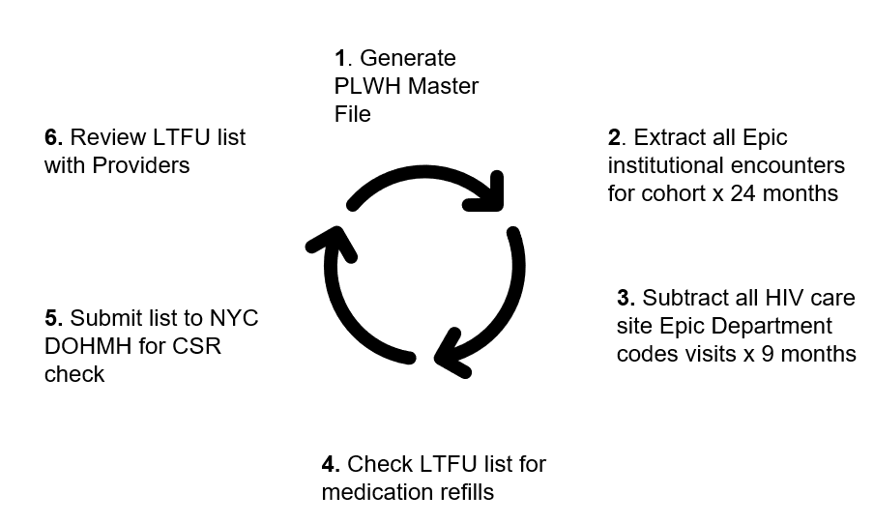
Put it all together….

Slide 21
The Bottom-Up Project Partners
New York-Presbyterian
Alliance for Positive Change
Housing Works
Healthix
NYC HIV AIDS Service Administration (HASA)
CUNY Institute for Implementation Science in Population Health (CUNY ISPH)

Slide 22
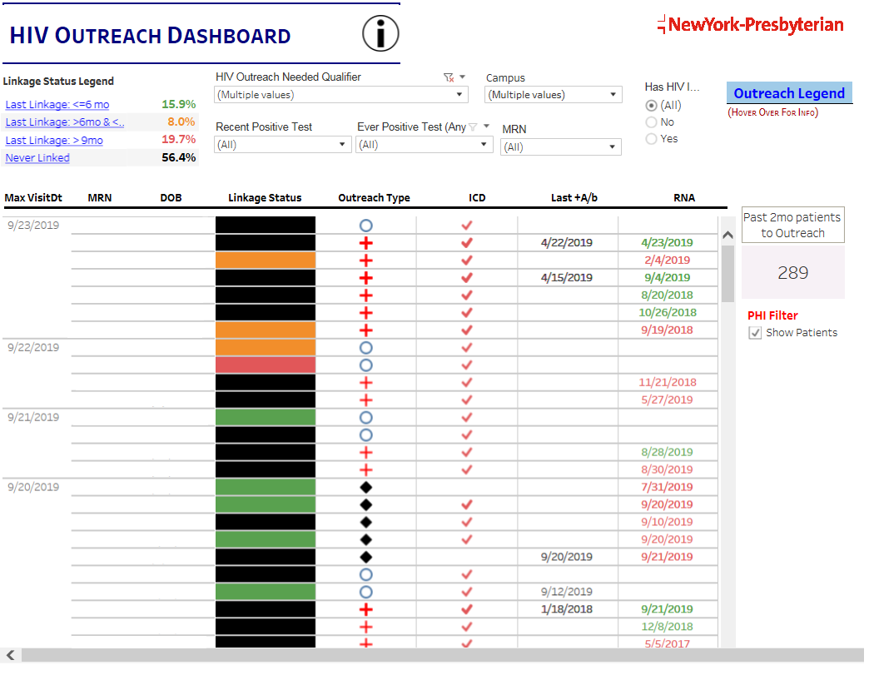
Multi-Institutional HIV Care Engagement Dashboards
Dashboard Pilot
Notes:
A different form of the LTFU challenge is not only looking for folks who you have lost from your HIV programs but also individuals who may touch you hospital care systems who are out of care and perhaps no-one is really looking for them?
This is different than constructing a monthly LTFU from patients you believe to be part of your program (actually, they are excluded), rather as you’ll see on the next slide they are part of the 665,000 unique patiennts who touch our healthcare system each year, some of whom may be LTFU but of uncertain engagement status
I previously described how we construct a Master HIV file that utilizes data that in some cases is up to 30 years old, old codes, tables, etc. I also mentioned that for the Bottom-Up project we tuned the monthly LTFU file sent to Healthix for maximum Specificity… we are only including cases we are ‘sure’ of their HIV Serostatus
For our HIV Dashboard program we tune the inclusion criteria to be broader, more sensitive, at some cost to specificity.

Slide 23
And our Healthcare Systems are Complex Entities
NewYork-Presbyterian
2 major academic medical centers (Columbia and Cornell)
5 hospital sites in NYC
13 community ambulatory care sites, 7 school based clinics
665,517 unique patients seen in 2021
2,162,052 ambulatory care visits in 2021
105,000 inpatient visits
24,586 staff
7,145 clinicians
Operating budget: 5.6 billion
64,108 HIV tests (last 12 months)
64,741 HCV tests (last 12 months)

Slide 24
Multi-Institutional HIV Care Engagement Dashboards
An in-reach versus outreach strategy for assisting PLWH who may be LTFU
Looks for everyone with a prior diagnosis of HIV who touches anywhere within the NYP care system
An opportunity to navigate to care before complications ensue
A very large number of individuals…..nearly 1700/yr just on the NYP/Columbia campus

Slide 25
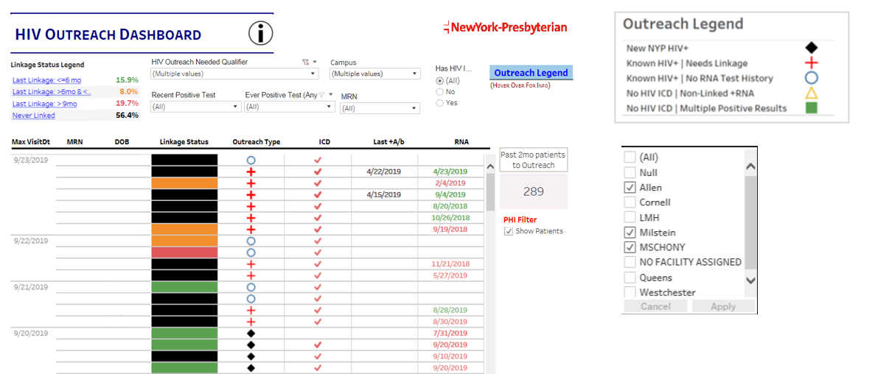
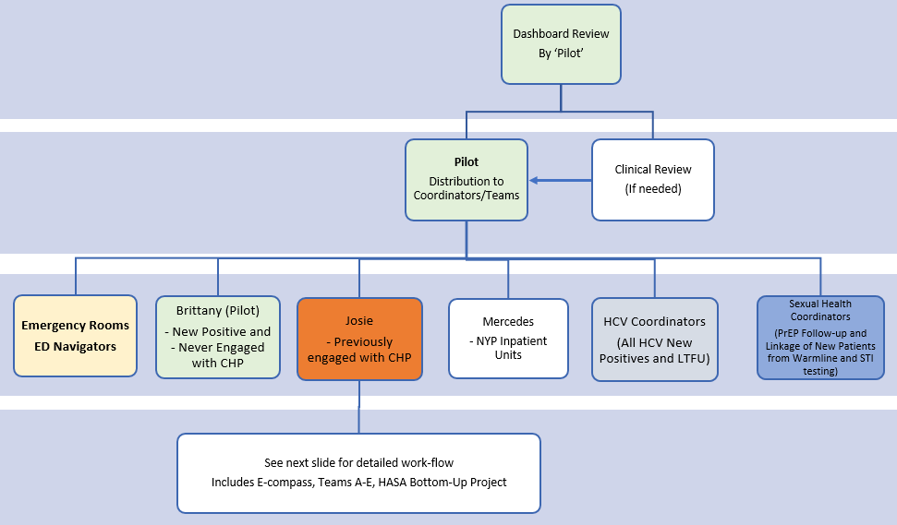
Multi-Institutional Outreach Dashboards - Workflow

Slide 26
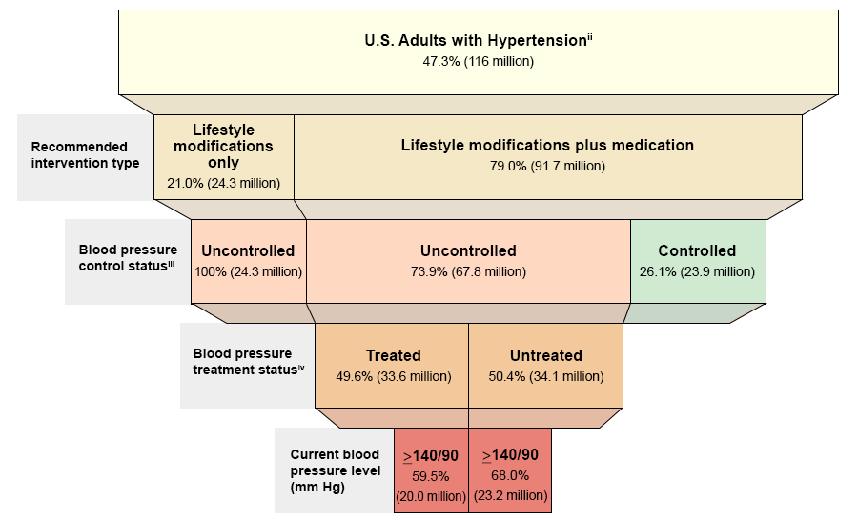

Slide 27
Questions?
Pete Gordon, MD
Medical Director
Comprehensive Health Program
Columbia University
pgg2@cumc.columbia.edu

