Slide 1
AETC Training Webinar The Ryan White HIV/AIDS Program’s (RWHAP) Part F AIDS Education and Training Center 04/13/2023
Hilary Mitchell Senior Research Associate | Ruchi Mehta, MPH Project Director | Latoya Goncalves, MPH Health Statistician

Slide 2
Outline
Overview of AETC Submission Process
Data Quality Workshop
Open Q&A Session
Data Quality Overview
Missing Data & Priority Data Elements

Slide 3
Overview of AETC Submission Process
3

Slide 4
Overview of AETC Submission Process
Data are submitted annually through the EHBs beginning July 12
Agencies will indicate the Regional Partner Sites they collaborated with
Upload a separate CSV file for your:
Event Record (ER) data
AETC Participant Information Form (PIF) data
Event Participant List (PL) data
Validate the AETC Report
Errors – Must be corrected to submit
Warnings – Revise data or enter a comment
Attend the training on June 27, for a deeper dive!
4

Slide 5
Use of ER & PIF Data
Describe AETC training activities and reach:
Event Record (ER) – number and characteristics of events & trainings provided by AETCs
Participant Information Form (PIF) – number and characteristics of participants reached through AETC events and trainings
Analyzed annually and trended over time
Inform training needs & emerging topics
5

Slide 6
TA Contact Information
TA Resource | Type of TA
Ryan White Data Support 888-640-9356 | RyanWhiteDataSupport@wrma.com | AETC-related content and submission questions Interpretation of the AETC Instruction Manual & Codebook and HAB’s reporting requirements Instructions for completing the AETC Report Data validation questions
The Data Integration, Systems, & Quality (DISQ) Team Data.TA@caiglobal.org Sign up for the DISQ listserv Submit a DISQ TA Request | Data reporting requirements Extracting data from systems and reporting it using the required CSV schema Working with data systems to improve data management processes Data quality issues
EHBs Customer Support Center 877-464-4772 | Submit an EHBs TA Request | Electronic Handbooks (EHBs) navigation EHBs registration EHBs access and permissions EHB’s Navigation
Target HIV https://targethiv.org/library/aids-education-and-training-centers | AETC Data Collection Manual, Codebook, and Forms Contact information for each of these technical assistance resources
6

Slide 7
Data Quality Overview
7

Slide 8
What do the data show?
Between 2019-2021, AETCs led 19,845 unique training events which reached 119,425 participants.
Among training attendees:
56% provide services to clients with HIV
67% have direct interaction with clients
38% do not provide HIV treatment care, but provide behavioral, support, or other clinical services
5% provide advanced HIV care
AETC training attendees were:
41% White
19% Black or African American
17% Hispanic/Latinx
65% Female
Missing data also impacts findings:
14% on race/ethnicity
11% on gender
8

Slide 9
Thank you for completing DISQ’s AETC Data Practices Survey!
9

Slide 10
Why does data quality matter?
Missing/inaccurate data can distort program outcomes
Only high-quality data can:
Accurately portray the work of the AETCs
Be used to improve services
10

Slide 11
How are AETCs using data?
To track progress on workplan goals
To learn more about participants
In reports for regional partners
To locate areas of need (needs assessment)
Our AETC Rocks!
In event marketing
For trainer preparation & feedback
To analyze training reach

Slide 12
Missing Data & Priority Data Elements
12

Slide 13
Missing Data in 2019-2021 PIFs

Slide 14
What Data do AETCs Require?
AETCs vary significantly on which PIF data elements are required
Most commonly-required variables:
Profession/Discipline (PIF #3)
Primary Role (PIF #4)
Principal Employment Setting (PIF #8)
HIV Care/Treatment Provided at Principal Employment Setting (PIF #14)
Example 1
All PIF fields required
Example 3
Required fields:
Profession/Discipline
Primary Role
Gender Identity
Principal Employment Setting
Example 4
All fields required except:
Profession/Discipline
Primary Role
Race/Ethnicity
Example 2
No PIF fields required
14

Slide 15
Priority Data Elements for HRSA
Profession/Discipline (PIF #3)
Primary Role (PIF #4)
Hispanic/Latinx Origin (PIF #5)
Racial Background (PIF #6)
Gender Identity (PIF #7)
Principal Employment (PIF #8)
15

Slide 16
Missing Data on Priority Data Elements
 | HAB Priority Data Elements
16

Slide 17
Profession/Discipline and Primary Role
Profession/Discipline | % |  | Primary Role | %
Social Worker or Case Manager | 14% |  | Other | 15%
Nurse Professional (non-prescriber) | 13% |  | Care Provider/Clinician (non-prescriber) | 13%
Other Public Health Professional | 12% |  | Case Manager | 12%
Physician | 10% |  | Missing | 11%
Missing | 9% |  | Student/Graduate Student | 10%
Other non-clinical professional | 9% |  | Administrator | 9%
Community Health Worker | 7% |  | Care Provider/Clinician (prescriber) | 9%
Nurse Professional (prescriber) | 5% |  | Client/Patient Educator | 5%
Pharmacist | 5%
17

Slide 18
Understanding Barriers to Requiring Data
Barrier | Solution
AETCs may not want to require participants to report any sensitive personal information. | Participants can select “Choose not to disclose” for race, ethnicity, and gender, and still be included in complete data.
AETCs may feel it is a burden to participants to complete all required fields. | Based on the Data Practices Survey data, most AETCs have easy processes to complete the PIF and update it only if needed, and there are only six priority data elements for HAB. The burden to participants is low compared to the benefits of having complete data!
18

Slide 19
Data Quality Workshop
19

Slide 20
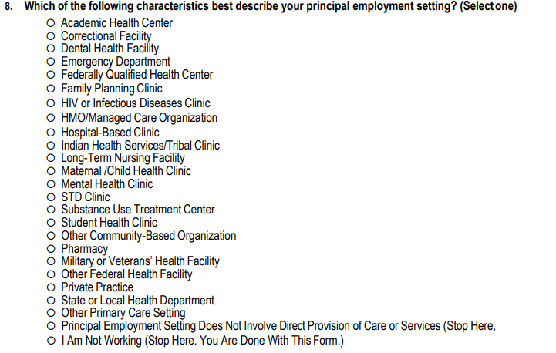
Survey Skip Patterns
20

Slide 21
Impact
PIF 8 contradictions
The following answered that they were not working or their employment setting does not provide care to clients but
173 said "yes" to employer receiving Ryan White funding
171 said "yes" to HIV care provided by employment setting
315 said "yes" to having direct interaction with clients
126 said "yes" to having direct interaction with PLWH clients
PIF 15 contradictions
92 answered “No” or “Null” to PIF15 do you have direct interaction with clients but said “Yes” to PIF16 direct interaction with PLWH clients
PIF 16 contradictions
The following answered “No” or “Null” to PIF16 if they have direct interaction with PLWH clients but
135 provided a number of PLWH clients in the past year that is >=1
231 provided years of experience caring for PLWH clients that is >=1
11,797 provided an answer to PIF19 “Which of the following best describes the way you provide services to clients with HIV”

Slide 22
Potential Fix
Implement skip pattern into survey system
Review and test skip patterns often
Less likely to receive errors/warnings during submission
22

Slide 23
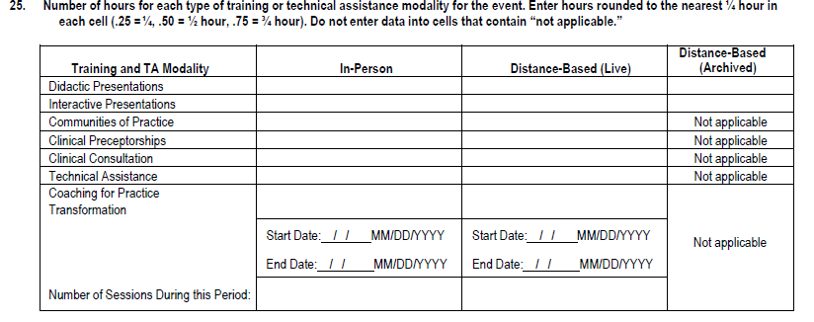
Hours Questions
We currently receive a wide range of hours to ER25
ER25_04 (Interactive presentations, in-person) ranging from 0-800
ER25_08 (Communities of practice, distance-based (live)) ranging from 0-1776
ER25_11 (Clinical consultation, in-person) ranging from 0-465
23

Slide 24
Potential Fix
Implement valid ranges within survey system, especially the max ranges
Modality | Min (Hours for a single event) | Max (Hours for a single event)
Didactic Presentations | 0.5 | 40
Interactive Presentations | 0.5 | 40
Communities of Practice | 0.5 | 8
Clinical Preceptorships | 1 | 40
Clinical Consultations | 0.25 | 8
Coaching for Organizational Capacity Building | 1 | 25
24

Slide 25
Event ZIP Code
We received ~150 events with invalid event zip code
AETCs should review event ZIP codes and ensure 100% valid responses
AETCs should be able to overwrite any invalid responses since event location is known
A validation during submission will be added to ensure valid ZIP code range
25

Slide 26
Potential Fix
Review and ensure event ZIP codes are within the valid ZIP code range 00501-99950
Update invalid ZIP codes
Making updates now will submission to run more smoothly, less likelihood to receive error/warnings
26

Slide 27
ER Multi Session Questions
Session Number (ER11) should be >=1
In 2021, 259 records where session number=0
If “yes” is responded to multi session question (ER9) then number of sessions planned (ER10) should be >=2
In 2021, 63 records where number of sessions=1 when muti session event was indicated
Session number (ER11) should be equal to or less than total number of sessions planned (ER10)
In 2021, 168 records where session number is greater than the total number of sessions planned
27

Slide 28
Potential Fix
Implement session number must be greater than 1 in survey system for single session events
Implement session number must be greater than 2 in survey system for multi session events
Provide instruction that the session number should be equal to or less than total number of sessions planned
28

Slide 29
General Tips
“Less is more” when it comes to data cleaning
try to maintain the survey options as it looks in the forms
Implement skip patterns, valid hour ranges, valid ZIP code range, and other instructions in the survey into your systems
The more you are able to build into your systems the less manipulation is needed prior to submission
Have system prompt for PIF data to be updated yearly
Ensures the most up to date PIF data
Make sure not to use ‘0’ in “Specify” fields
If system gives an error for blanks, it is best to enter ‘Null’ rather than 0
29

Slide 30
Questions?
30

Slide 31
TA Contact Information
TA Resource | Type of TA
Ryan White Data Support 888-640-9356 | RyanWhiteDataSupport@wrma.com | AETC-related content and submission questions Interpretation of the AETC Instruction Manual & Codebook and HAB’s reporting requirements Instructions for completing the AETC Report Data validation questions
The Data Integration, Systems, & Quality (DISQ) Team Data.TA@caiglobal.org Sign up for the DISQ listserv Submit a DISQ TA Request | Data reporting requirements Extracting data from systems and reporting it using the required CSV schema Working with data systems to improve data management processes Data quality issues
EHBs Customer Support Center 877-464-4772 | Submit an EHBs TA Request | Electronic Handbooks (EHBs) navigation EHBs registration EHBs access and permissions EHB’s Navigation
Target HIV https://targethiv.org/library/aids-education-and-training-centers | AETC Data Collection Manual, Codebook, and Forms Contact information for each of these technical assistance resources
31

Slide 32
Connect with HRSA
Learn more about our agency at:
www.HRSA.gov
Sign up for the HRSA eNews
FOLLOW US:

