Slide 1
Reducing Hospital Readmissions: Methods, Process Evaluation and Preliminary Outcomes
2012 All grantee meeting
Washington, D.c.
November 27, 2012
Richard C. Smith, MSW
Program Manager
Jewish Healthcare Foundation
Jennifer Condel, SCT(ASCP)MT
Senior Quality Improvement Specialist
Pittsburgh Regional Health Initiative
Sara Luby, MPH
Data Analyst
Positive Health Clinic
Judy Adams, MSN, RN
Administrative Director
Positive Health Clinic
Cindy Powers Magrini, PharmD, BCPS
Clinical Pharmacy Specialist
Positive Health Clinic

Slide 2
Objectives
Describe the Perfecting Patient Care℠/ Lean Healthcare Methodology
Discuss the application of Lean Healthcare Methodology to reducing hospital readmissions
[Describe the steps to investigate if HIV/AIDS Readmissions are in issue in other regions]

Slide 3

Jewish Healthcare Foundation’s commitment to the HIV/AIDS community
Fiscal agent for southwestern PA since 1992
  Manages more than $3 million annually from multiple government funding sources
  15 subgrantees
  Monitoring, data reporting, quality management, technical assistance, and payment
Foundation grants to support community
  Quality improvement and capacity building
  Needs assessment
  Seed funding

Slide 4

PRHI: Who Are We?
Pittsburgh Regional Health Initiative (PRHI)
  A not-for-profit, regional, multi-stakeholder coalition formed in 1997
  An initiative of a business group, the Allegheny Conference on Community Development
PRHI’s message
  Dramatic quality improvement (approaching zero deficiencies) is the best cost-containment strategy for health care

Slide 5
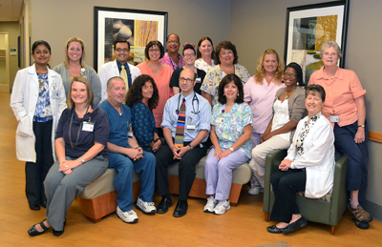
PHC: Who are We?
Positive Health Clinic (PHC)
  An HIV Clinic that offers early HIV intervention and treatment using a harm reduction model
  Funded through a Part C Grant under the Ryan White CARE Act of 1990
  Total patient population is ~750 HIV-positive patients

Slide 6


Outline of Readmission Reduction Initiative
Opportunity
Strategy
Challenges and Lessons
High hospital readmission rates among HIV+ population
Introduce Lean Healthcare methodology
Partnerships
Activating a network of providers, hospital and community

Slide 7
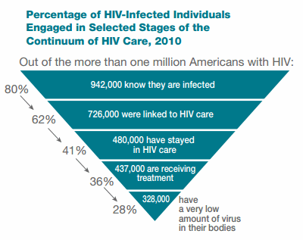
HIV/AIDS national portrait: Why this is important
Source: Centers for Disease Control and Prevention, Today’s HIV/AIDS Epidemic, June 2012

Slide 8
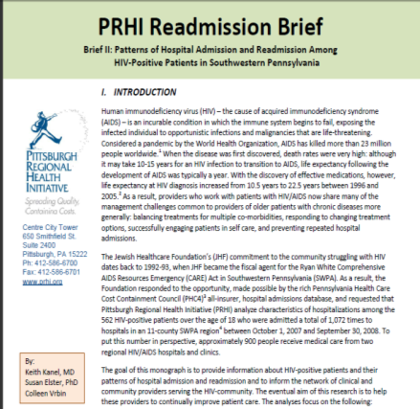
In 2010, PRHI completed extensive research on readmission trends of HIV-positive patients
562 HIV-positive patients
1072 discrete admissions
Study found 1 in 4 HIV-positive patients returned to the hospital within 30 days of discharge.
Source: PHC4 study of the 11-county area of SW Pennsylvania, 2007-2008.
Notes:
Our understanding of clinical trends in the HIV community is built on seminal work conducted by PRHI based upon all-payer discharge data from the PHC4. From this data, we learned that 1 in 4 HIV positive discharges was readmitted within 30 days – a striking figure, rivaled only by some of the most notable chronic diseases like CHF or COPD.
In this analysis we focused on who the patients were, the diseases they were coming in with, and whether they clustered within certain facilities.

Slide 9
Conclusions from data analysis on
HIV/AIDS readmissions
Notes:
As our researchers delved into the PHC4 Data, we found that among chronic conditions, people living with HIV/AIDS had one of the highest hospital readmission rates. <click> This launched deeper exploration into the data that found:
Not only did this population have high rates of co-morbid depression and substance abuse, but those with substance abuse disorders were significantly more likely to be readmitted to the hospital within 30 days.
The readmission rate for those who were discharged to skilled nursing facility was 35%, the highest among the discharge options and even higher than “left against medical advice.”
These patterns are similar to other chronic diseases on which we have worked, namely COPD….

Slide 10

Conclusions from data analysis on
HIV/AIDS readmissions
High rates of co-morbid depression and/or substance abuse
High rates of other chronic diseases, including hypertension and diabetes
HIV/AIDS is similar to other chronic conditions with which PRHI has been successful
www.amazon.com
Notes:
As our researchers delved into the PHC4 Data, we found that among chronic conditions, people living with HIV/AIDS had one of the highest hospital readmission rates. <click> This launched deeper exploration into the data that found:
Not only did this population have high rates of co-morbid depression and substance abuse, but those with substance abuse disorders were significantly more likely to be readmitted to the hospital within 30 days.
The readmission rate for those who were discharged to skilled nursing facility was 35%, the highest among the discharge options and even higher than “left against medical advice.”
These patterns are similar to other chronic diseases on which we have worked, namely COPD….

Slide 11
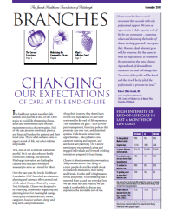
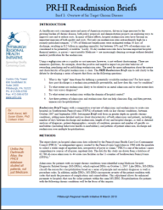
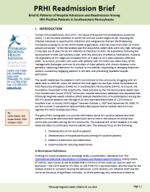
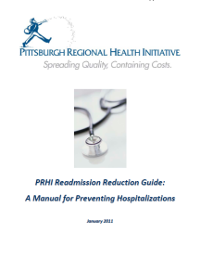
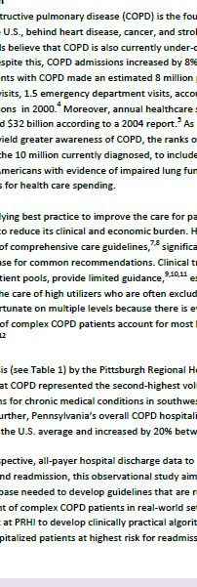
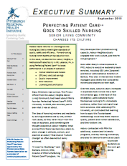
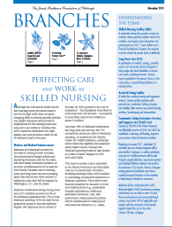
Let the Data Guide Our Work
The Complex Patient
End of Life
Behavioral Health and Substance Abuse
Chronic Disease
HIV/AIDS
Skilled Nursing
COPD

Slide 12
What factors contribute to high readmission rates?
Patient’s lack of knowledge of who to contact for follow-up
Poor communication channels across care settings
Lack of patient and provider accountability
Lack of care coordination
Lack of physician involvement in the discharge process
Inconsistencies or absent discharge teaching
Lack of medication reconciliation and medication teaching
Poor handoff and/or transfers of care from hospital setting to home
Linked to patients that are chronically ill and socially disfranchised
Source: Boutwell, A., Jenks, S., Nielsen, G. A., & Rutherford, P. (2009). STate action on avoidable rehospitalizations initiative: Applying early evidence and experience in front-line improvements to develop a state-based strategy.

Slide 13

Our question…
Can we reduce unnecessary hospital readmissions by applying Lean process improvement principles with federally funded AIDS service organizations?
Hospital-based Clinic
Hospital-based Clinic
2 HIV/AIDS Clinics
+
ASO
ASO
ASO
ASO
ASO
ASO
ASO
ASO
8 Federally Funded AIDS Service Organizations

Slide 14
A Two-Pronged Strategy
On-site coaching to HIV/AIDS clinic to restructure processes
Activating the Ryan White Part B Network
  Improve outpatient care to patients
  Free up time to work with hospitalized patients
  Establish tracking and communication processes regarding hospitalized patients
  Create a cross-agency workgroup to coordinate services
  Provide training and support to realign resources
  Develop communication and data sharing systems

Slide 15
The Perfecting Patient CareSM /
Lean Healthcare Methodology
Framework of the Toyota Production System and its Pittsburgh spin-off, the Alcoa Business System was adapted to health care
Method of systems re-design in which the patient is the focus
Share knowledge and learning; apply regularly in the everyday course of work
Ultimate goal is perfection
Notes:
You may or may not know that Perfecting Patient Care is based on the Toyota Production System as well as the Alcoa Business System.
Paul O’Neill, the former Secretary of the Treasury and former CEO of Alcoa, was one of the founders of PRHI where he brought his knowledge of the Toyota Production System to help create a model of process improvement for healthcare.
Perfecting Patient Care is a model of system redesign where the patient is the focus of improvement.
Through continuous and cyclic improvements, you are able to apply improvement tools in the regular course of work.
The ultimate goal is perfection, but will we ever reach it? Who in here is perfect? No one. So should we just be satisfied with being average? No. We want to work toward the ideal and even when we reach our goals, there will always be more work to be done. Remember that this is “perfecting” patient care and not “perfect” patient care. We always want to strive to be better than what we are.

Slide 16
Perfection Defined
“ I needed to touch down with the wings exactly level. I needed to touch down with the nose slightly up. I needed to touch down at a decent rate that was survivable. And I needed to touch down just above our minimum flying speed, but not below it. And I needed to make all these things happen simultaneously.”
- Captain Chelsey Sullenberger
US Airways Flight 1549
© 2012 Jewish Healthcare Foundation

Slide 17



Why Lean Healthcare Methodology?
Patients have a right to have their needs met with evidence-based care
Healthcare workers have a right to be set up to give excellent care
The system can be redesigned to support both objectives
Notes:
Patients have the right to have their needs met
And so do healthcare workers.
Both of these goals can be accomplished through redesigning our systems.
Go back to the video.
Did the patients (mother and child) have their needs met?
What happened to nurse Betty?
Did she have her needs met?
If patient needs had been met, would Betty’s professional life have been better too?
The goal of the system is to help people be successful.
What kind of outcomes do you get from crappy systems?
Crappy ones.

Slide 18
This is Why We Need Lean Healthcare Methodology
A patient’s story:
WT: 60 y.o. AA Male
Admitted for 23 hour observation after short-stay procedure secondary to increased sedation
  Possibly secondary to drug interaction of midazolam with protease inhibitors

Slide 19
Communication at Transitions of Care is Necessary
Many drug-related problems have occurred because physicians, nurses, and pharmacists have inadequate access to complete medication profiles¹
Lack of communication between healthcare providers leads to adverse drug events (ADEs)²
  ADEs are estimated to increase hospital length of stay by about 2 days and cost of admission by about $2600 per day³, with preventable ADEs occurring at points of transition about 46-56% of the time²
¹Paquette-Lamontagne N et al. Evaluation of a New Integrated Discharge Prescription Form. Ann Pharmacother 2001; 35: 953-8.
²Trettin KW. Medication Reconciliation. Topics in Patient Safety. Sept/Oct 2007; 10(5): 1 and 4.

Slide 20
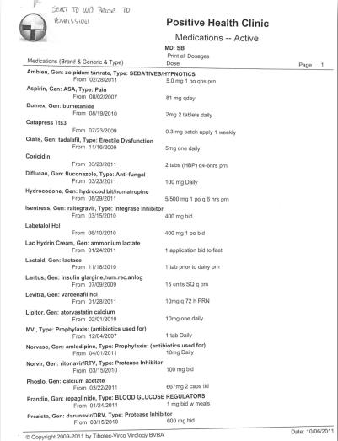
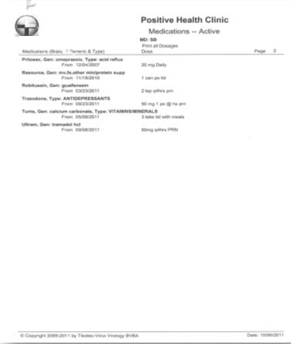
Medication List Sent to MD Prior to Admission

Slide 21
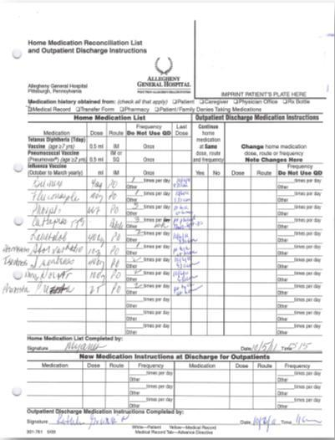
Home Medication Reconciliation List
Phos Lo dose incorrect
Catapress frequency incorrect
Prezista dose incorrect
Aspirin, Amlodipine, Omeprazole omitted

Slide 22
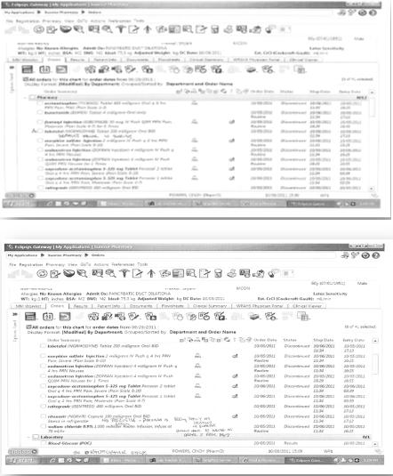
Hospital Orders
Labetalol dose different from home dose
  May have been changed secondary to hypotension
  200mg BID dose is default in Sunrise
Prezista was not ordered only Norvir was ordered
  Prezista 600mg is non-formulary
  Prezista 800mg dose is default in Sunrise

Slide 23
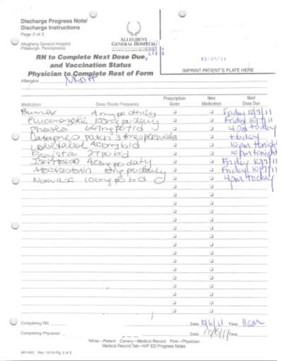
Discharge Orders
Phos Lo dose is incorrect
Catapress frequency is incorrect
Prezista dose is incorrect
Isentress dose is incorrect
Norvasc dose is incorrect
Norvir is missing from list and should be given with Prezista
Aspirin and Omeprazole also omitted

Slide 24
Administration Record
Medications that were given the morning of 10/6/11 were written on a paper towel and documented in MAR.
Prezista was not given because it was not ordered.

Slide 25
When Things Go Wrong
Patients suffer
Families suffer
Staff suffer
Community suffers
Costs increase
Notes:
Ask: How do we feel when things go wrong with patient care?
Frustrated
Shocked
Patient and family are negatively impacted
Costs increase
No one gets up in the morning and hopes they’ll make a mistake. But our processes often set us up for failure.
When things go wrong, it does not just impact the patients who may be directly harmed or have negative health effects stemming from the impact of stress surrounding the mistake. It also impacts
Their families
Our staff who are trying to care for the patient to the best of their ability. High error rates result in turnover or miserable employees who feel set up for failure.
Our community who may then have concerns about the care our hospital is providing
Ours costs, not just in terms of lawsuits but also the cost of replacing unhappy staff. The cost to replace one nurse is $60,000!

Slide 26

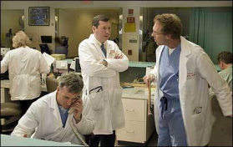
Toyota Lean Production System:
Beyond the Assembly Line
Root cause analysis (“5 Whys”)
Organize the work area (“5-S”)
Concise communication (“A-3”)
Active involvement of managers
    “Go and see”
    “Gemba walk”
Intense respect for the employee:
    Every employee has what they need, when they need it
    Career development
    “No-layoff” policy
Team problem solving (kaizen)

Slide 27
Meeting Needs in an Ideal Way
Defect free: exactly what the patient needs
1 x 1: customized to each individual patient
On demand
Delivered immediately
No waste
Safe for patients, staff and providers
  Physically, Emotionally, & Professionally
Every patient, every time
© 2012 Jewish Healthcare Foundation
Notes:
What does “Ideal Way” mean. Explain how each bullet relates to primary care.
Add specific notes for primary care.

Slide 28
Rules in Use: Work Design Principles
Based on Toyota’s organizational culture and operations
Focus on the system’s inter-workings
Description of the secret recipe of TPS
  DNA: a strong internal culture
  Unwritten rules that govern work
  “It’s about people being successful”.
    Perfecting Patient Care℠/ Lean Healthcare Methodology
2 jobs:
Perform the job
Improve the job
© 2012 Jewish Healthcare Foundation

Slide 29

Four Rules of Work Design
Rule 1 – Activities- Highly specified work of a position (content, sequence, timing, location)
Rule 2 - Connections – direct relationship between people or processes (unambiguous)
Rule 3 - Pathways – process is defined & simple
Rule 4 – Improvement- Respond to problems immediately, where they occur, design an experiment, with those doing the work, with a teacher
Pull the ‘Andon Cord’
Source: S.Spear and H. Kent Bowen, “Decoding the DNA of the Toyota Production System”,
Harvard Business Review, Sept.-Oct., 1999, p. 96.

Slide 30
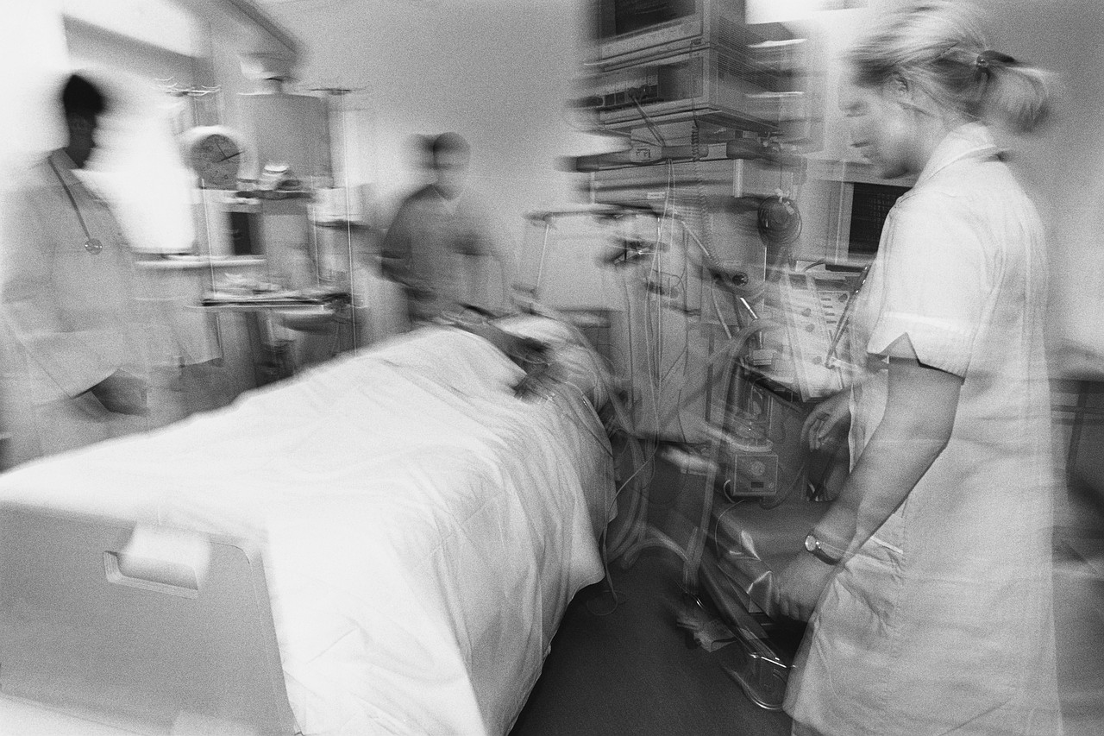
First, What is the Problem?
Second, What is the Current Condition?
What does the patient need?
How does the organization deliver it?
Current
Condition
What are the associated activities, connections and pathways?
Notes:
Ask: How do we feel when things go wrong with patient care?
Frustrated
Shocked
Patient and family are negatively impacted
Costs increase
No one gets up in the morning and hopes they’ll make a mistake. But our processes often set us up for failure.
When things go wrong, it does not just impact the patients who may be directly harmed or have negative health effects stemming from the impact of stress surrounding the mistake. It also impacts
Their families
Our staff who are trying to care for the patient to the best of their ability. High error rates result in turnover or miserable employees who feel set up for failure.
Our community who may then have concerns about the care our hospital is providing
Ours costs, not just in terms of lawsuits but also the cost of replacing unhappy staff. The cost to replace one nurse is $60,000!

Slide 31
“The significant problems we have cannot be solved at the same level of thinking with which we created them.”
- Albert Einstein
Notes:
Deming said it best…what will you do???

Slide 32
Problem Solving Thinking
 | “Traditional” | Lean
Perspective | Work around problems, especially small ones | Set up the system to address problems (REAL TIME), especially when they are small
Focus | Corporate initiatives, programs, organizational units | Address one problem at a time to meet the customers’ needs
When | Scheduled monthly meetings, planned events | Close to problem occurrence, frequently as part of work
Where | Meeting rooms | Where the work is done
Who | External consultants, internal quality department | People doing the work

Slide 33
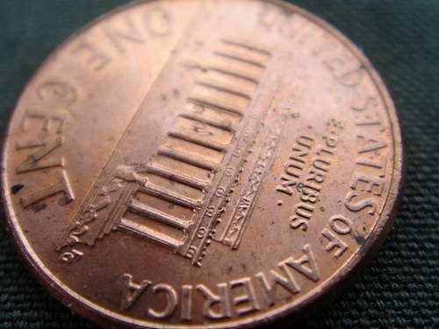
What is getting in the way?
30-40 cents of every healthcare dollar
is wasted on non-value added activities.
Notes:
30-40 cents of each healthcare dollar is wasted on non-value added activities, things that don’t add value to the patient. (The Joint Commission)
This is equivalent to $760 billion per year!

Slide 34
Value Added Work vs. Non-Value Added Work
Value added work:
  Work that adds value to your patient
  Anything your patient would pay for you to do
Non-Value added work:
  Anything that costs time and/or money and does not add value - WASTE
Non-Value added but necessary work:
  Work that must be completed but the patient doesn’t view as value added
© 2012 Jewish Healthcare Foundation
Notes:
What we often see in our current state is a lot of waste.
Waste falls into the category of “non value-added” work, work that does not add value to the customer or patient. We’re all customers at some point. What kind of “waste” have you experienced in your work?
In order to assess whether a particular activity is waste, we might ask ourselves whether our patients would be willing to pay for those activities.
For example, patients would not be willing to pay for the time they spend waiting in a waiting room. They also would likely not want to pay for the process of billing, however some non-value added activities are still necessary.
Our goal is to eliminate any unnecessary non-value added activities and reduce the necessary non-value added activities as much as possible.

Slide 35

Eight Types of Waste
WASTE
Unnecessary Transport
Unnecessary Motion
Inventory
Defects
Waiting
Redundant Work
Over or Incorrect Processing
© 2012 Jewish Healthcare Foundation

Slide 36
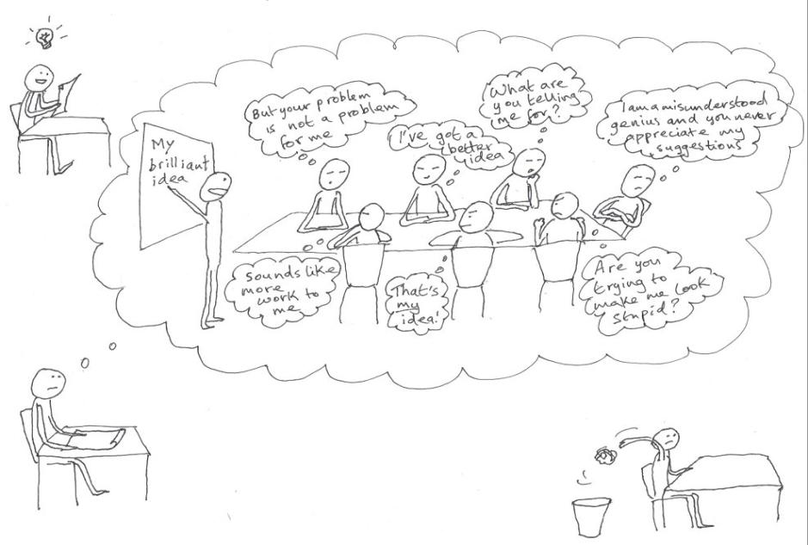
http://1000sensations.com/2007/07/28/cartooning-and-creative-problem-solving/
© 2012 Jewish Healthcare Foundation

Slide 37

“Go and See”
Objective not judgmental
  Understand the care delivery system from both the patient and staff perspective
Separate people from problems (respect not blame)
  Establish a common understanding (based on data) of the way work is done today (current condition)
Authentic not veiled
  “Starting block,” from which to design an improvement.
Deep not superficial
  Identify strengths of existing delivery system and opportunities for improvement

Slide 38
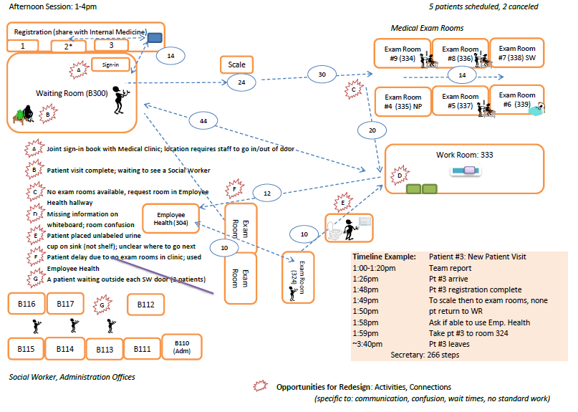

Slide 39
Absence of Standardization
Randomness
Chaos
Multiple versions of how the work is done: VARIATION
My way
Your way
His way
Her way
Their way
What is the “best” way?

Slide 40
Standardization is:
Defining, clarifying & consistently utilizing the methods that will ensure the best possible results
Baseline for continuous improvement
  Improved process becomes the new standard
Not done to people but rather driven by people
This is what the patient wants!

Slide 41
Building Blocks for Improvement
Problem Solving
Involvement
Teamwork
Valuing
Contribution
Respect
© 2012 Jewish Healthcare Foundation
Notes:
This is a much more realistic view of the path to problem solving teams. It takes time and hard work to get the team to the level needed to solve problems and address those changes needed to be made.
Building Blocks for Improvement
EXPLAIN the graphic on the slide:
Everything is based on respect—how one person treats another person.
You need to respect a person to value their contribution.
By valuing their contribution, you will achieve better teamwork.
More teamwork means more involvement.
The more involvement, the more successful problem solving can be in the course of work.
ASK:
Why do you think that respect is shown as the foundation in this graphic?
FACILITATE a brief discussion about the importance of mutual respect as the foundation for our improvement efforts.
Why does teamwork matter for quality improvement?
Carefully trained and assigned team members may contribute unique talents that
enhance the skill mix of the practice.

Slide 42

Perspectives
Different ways of seeing the same thing due to differences in:
  Experiences in life and work
  Positions
  Roles and responsibilities
  Knowledge
  Perceptions
© 2012 Jewish Healthcare Foundation
Notes:
42
We are human and we have to consider that our team mates will be viewing the same situation with a different perspective, which can have a great influence their reaction and suggestions to an issue. Understanding perspective is a key component to communicating well with another person and creating a clear message.
Perspectives
EXPLAIN the concept of perspective:
Perspective (cognitive) is one’s “point of view.”
It is based on our opinions, beliefs, and experiences.
This is why three witnesses of the same event will see three different things. (*Insert health care example)
TRANSITION:
Let’s look at a couple of examples.

Slide 43

© 2012 Jewish Healthcare Foundation
Notes:
43
What is the point of this written message? How clear is our written communication? Our team processes? What is the main point of the message that we send to our fellow team members, our consumers? Is the message received that the sign has sharp edges, or more importantly that the bridge is out ahead?
General review of forms of communication, hidden messages, body language etc…
What messages are we sending to our teammates and to our patients? It is important to take steps to ensure our message isn’t clouded by other distractions. Thinking back to our rules in use, we want to make sure our connections with other people are clear and direct, with little ambiguity.

Slide 44


© 2012 Jewish Healthcare Foundation
Notes:
44
Perception
DISPLAY the slide and ASK:
What do you see?
Expected answers are: a face and a person in a parka (knocking on a door or entering a cave). For the image on the left, could be a woman or a man playing the saxophone.
ASK:
Why don’t we see the same thing?
Does it happen at work that someone “can’t see” what is obvious to you?
How can we try to understand other people’s perspectives?
STATE:
When there is a communication problem, we often do not take the time to resolve the lack of understanding or understand the perspectives of those other team members.
Teams can offer different perspectives and a complement of knowledge and skills for the benefit of a particular individual patient’s or a population’s care (Bodenheimer, 2007; Wagner, 2000).

Slide 45
Plan-Do-Study-Act Cycle
Identify your goal
Understand the current
state
Design experiment
Identify metrics
Predict results
Plan
Do
Study
Act
Take action based on
what you learned
Adopt, Adapt,
Abandon
Review the test
Analyze results
Assess learnings
Test the change
Carry out a small-scale
experiment
Notes:
How do we improve – we need a process to guide us. PDSA is the process we can use.
Most of you are likely familiar with the PDSA cycle, but let’s briefly review it.

Slide 46
Toward the Ideal
Ideal
Experiment
Experiment
PDSA
Experiment
PDSA
Problem
Each improvement moves the organization closer to the ideal
PDSA
Notes:
Each improvement is a leap toward the ideal. Not aiming for a 50% improvement or satisfied with an arbitrary benchmark.
For example, “Our unit only had 13 central line infections last year, and according to the national average, we could have expected to have 18. So we’re doing pretty well.”
If the Ideal is ZERO, each improvement is made with that as the GOAL.

Slide 47
Keys to Quality Improvement and Problem Solving
Use data to understand the current state
Make incremental improvements to move closer to the ideal
Measure success of the improvements—do the improvements to move you closer to the ideal
Use tools to make work easier and processes flow more smoothly
Involve the people who do the work– “the experts”—in work redesign
© 2012 Jewish Healthcare Foundation
Notes:
This slide depicts some fundamental principles of quality improvement.
Click again for Jim Collins quote from “Good to Great”

Slide 48

Create a Learning Organization
Create a community of scientists
  Everyone on the team is responsible for change everyday
Look at work with a new perspective
Perform continual experiments
that improve the system
Challenge the most basic assumptions about what can and cannot be changed
Learn by doing
“ Quality is never an accident; it is always the result of high intention, sincere effort, intelligent direction and skillful execution; it represents the wise choice of many alternatives.”
- William Foster

Slide 49

Improvement is Everyone’s Job!
© 2012 Jewish Healthcare Foundation

Slide 50
QUALITY IMPROVEMENT MILESTONES STORYBOARD
Utilizing the FOCUS-PDSA process
QUARTER 1 July 1, 2011 - September 30, 2011 |  | Due Date: October 5, 2011
TASK | Process/tools | Results
Find a process to improve or a problem to solve | Develop decision matrix to prioritize QI projects. | Matrix developed. Staff suggested 12 different projects which were rated on scales of 1 to 5 to assess importance, reality of scope, feasibility and potential impact. Staff voted to design a process by which we follow-up with hospitalized patients after discharge in order to improve health outcomes.
Organize a team | QM committee functions as a multidisciplinary team. All staff are able to contribute through regularly held meetings. | All staff solicited for QI project suggestions. All staff partook in rating system. QM committee was charged with selecting the project based on results.
Clarify the Current Situation as it Exists Now: | Review existing procedures to identify gaps, causes and challenges. Define problem/process to be improved. Understand appropriate measures. Assess resources and data collection needs. | Hospital admissions were monitored for a brief time several years ago in the EMR; however, this process was not streamlined and thereby abandoned. According to the literature, it is valuable to follow-up with patients within 24 hours of discharge to prevent readmissions and troubleshoot new clinical issues. We collect basic systems data that identify patient names, dates, diagnoses, etc. which is accessible to all staff.
Review the process – map the process | Produce template for tracking process/measurable outcomes. | Process was mapped via a tracking template that identified the problem, measures, goals, root causes, action plan, staff responsibilities, time frame and evaluation process.
Identify customers and their expectations | Discuss with staff responsible for follow-up. | Staff expects the follow-up process to be time-sensitive, comprehensive, user-friendly, and formatted for consistent monitoring.
Determine indicators that measure the effectiveness of the process | Include in template for tracking process/measurable outcomes. | Process evaluation indicators included developing a standard telephone script to deliver follow-up, expanding the census to develop electronic tracking system, and establishing baseline data within 2 months of start date.
Collect baseline data from the process | Review documented hospitalization data and readmission information. | We reviewed our current system for collecting data on hospitalizations and familiarized ourselves with local hospital admission data which are inclusive of readmissions.

Slide 51
QUALITY IMPROVEMENT MILESTONES STORYBOARD
Utilizing the FOCUS-PDSA process
QUARTER 2 October 1, 2011 - December 30, 2011 |  | Due Date: January 5, 2012
TASK | Process/tools | Results
Strengthen Problem Statement by quantifying the Problem Statement | Use West Penn Allegheny Health System data to identify baseline admission rates of patients with HIV. | Data accessed. West Penn system director conducted a 2 year analysis between 07/09 and 06/11. The data definition was any patient with a diagnosis of HIV disease or asymptomatic HIV status during this time frame and any subsequent visits with any diagnosis.
Understand and Analyze Root Causes: ID issues, factors or barriers that reduce quality or lead to inefficiencies in the process | Use 5 whys root cause analysis. | Determined the challenges/issues include inadequate info about hospitalizations and discharge procedures (process), delayed access to discharge summary and lack of communication between systems/providers.
Select a Process to Change: | Identify process within our control that is proven to reduce readmission rates. | Both clinical and social staff will have contact with the patient during his/her stay and a clinical staff person will conduct a 24 hour follow-up post discharge.
Based on data - determine which element(s) is(are) the leading contributor(s) to the problem | Identify missing data elements to understand contributing factors. | Based on qualitative data, the leading problematic factor is a lack of site specific follow-up in order to control as best as possible for missing information due to lack of communication between systems.
Determine which element will be changed or improved | QM committee functions as a multidisciplinary team and will decide the process for improvement. | QM committee decided to conduct 24 hour follow-ups which was ranked the highest priority among all staff.
Plan the change: | Develop improvement project tracking template. | Tracking template was developed.
Develop a “change plan” that address barriers | Identify actions to reconcile barriers. | Actions to reduce barriers include contact with patient during inpatient stay, communication with West Penn to access admission data. File containing patient hospitalization information will be set up on a network server.
Determine dates, task assignments, etc. | Include actions, responsibilities and time frame in tracking temple. | Actions, responsibilities, time frame and process evaluation elements were identified in tracking template.

Slide 52
QUALITY IMPROVEMENT MILESTONES STORYBOARD
Utilizing the FOCUS-PDSA process
QUARTER 3 January 1, 2012 - March 31, 2012 |  | Due Date: April 13, 2012
TASK | Process/tools | Results
Do the change: Agencies will be expected to execute the change plan | Create process map. Use process map to implement protocol. Identify challenges and successes. Adapt where necessary. | Data analyst created process map. The nurse practitioner enters patient info in the census. Staff read the census daily through shared network access. Staff self-assign patients they will be responsible for following. Staff person follows patient in-house and documents interactions in LT under “Hospital Admission” visit type. Staff troubleshoots pre-discharge issues and documents interactions in LT. When the patient is discharged, the assigned nurse conducts a 24 hour f/u via telephone or clinic appointment. The nurse assess whether a 7 day f/u is necessary. Staff person initials and dates census and documents details in of the f/u in LT. We continually identify challenges and revise the process as necessary. For example, we abandoned formal telephone scripts in favor of a visit type. To catch patients who do not get picked up through self-assignment, the nurse practitioner makes an assignment within 48 hours of admission. On average, we have been reaching 80% of our hospitalized patients for f/u. The data analyst met with the physicians to engage them in this coordination of care. The physicians now have access to the census so they can give us updates we might not otherwise receive.

Slide 53
QUALITY IMPROVEMENT MILESTONES STORYBOARD
Utilizing the FOCUS-PDSA process
QUARTER 4 April 1, 2012 - June 30, 2012 |  | Due Date: July 5, 2012
TASK | Process/tools | Results
Study the Change: | Collect and analyze process evaluation data. | Collection and preliminary analysis completed.
Collect data & compare it to baseline to determine whether the change plan is working | Spreadsheet created with performance measures parameters. | Data collected monthly over a 6 month period. The number of patients receiving a 24 hour f/u increased from 19% to 87% in 6 months. Readmissions reduced 50% compared to 14-month baseline.
Determine whether further issues or opportunities need to be address (future QIs) | SWOT Analysis | Discussed strengths, weaknesses and opportunities. Identified several areas for improvement. Lack of physician involvement was met with giving each doc access to the census. Patients going without an assigned nurse were met with a procedure for assignment via the nurse practitioner. Documentation was determined for patients not needing a 7 day f/u.
Act: Standardize and implement the improvements or select different process if no improvement seen | Roles and responsibilities clarified and improvements carried out. | Data analyst gave physicians access to census. Nurse practitioner identifies in house patients and assigns a nurse if patient is not picked up within 48 hours of admission. Hospital admissions brought up in report to strengthen physician involvement.
Act: Communicate the change throughout your organization | Changes incorporated into process map. | Process map, minutes and explicit procedural instructions distributed to all staff.

Slide 54
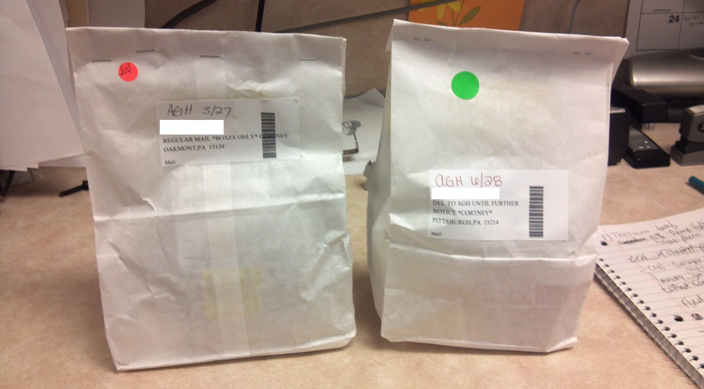
Standardization Improvements in the Clinic

Slide 55
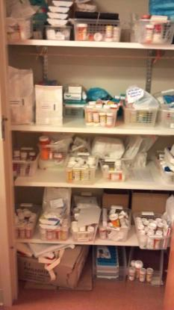
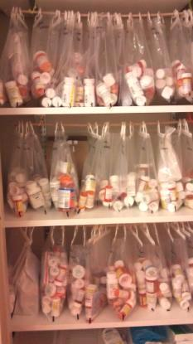
5S Improvements in the Clinic
Before
After!

Slide 56
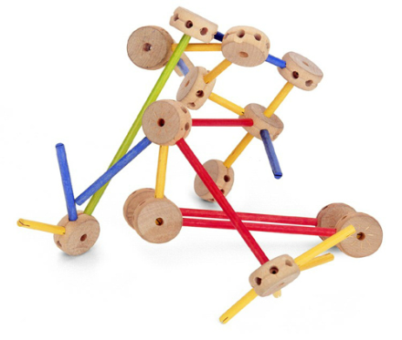
Tinker Toys Activity

Slide 57
Tinker Toys Activity Instructions
Each team will have 4 members/roles:
  Assembler
  Supervisor
  Supplier
  Observer
Goal: Build a high quality, complete product according to specifications in the shortest amount of time.

Slide 58

Assembler Role
Identify needed parts
Talk to supervisor about which part is needed. You may communicate verbally, but only with the supervisor.
Only request one part at a time
Receive requested parts from the supervisor
Assemble the product

Slide 59

Supervisor Role
Communicate verbally with the assembler to find out which parts are needed
Complete “Part Request” form
Deliver form to supplier. The only communication permitted with the supplier is via the form. NO verbal communication!
Obtain requested part from the supplier and deliver to the assembler
Parts may NOT be returned

Slide 60

Supplier Role
Organize the parts
Accept “Part Request” form from the supervisor
Provide supervisor with requested part
  If it is unclear which part is being requested, return the form without providing a part.
  NO VERBAL COMMUNICATION with supervisor!

Slide 61

Observer Role
Identify and document any observed problems
Record comments made by the assembler, supervisor and supplier
  Shadow the supervisor
Observe work flow and pace
NO talking to team members

Slide 62

Get Ready!
Your supplier will be in the hall (make sure you know who they are).
Go ahead suppliers…

Slide 63

Assembler and Supervisor

Slide 64

Debrief
Notes:
How was your experience?
Did you feel you could be successful? Could your team be successful?
What challenges did you face?
What opportunities for improvement would you suggest?
What would happen if you don’t include everyone or make changes without realizing the effect they may have on someone else’s work?

Slide 65
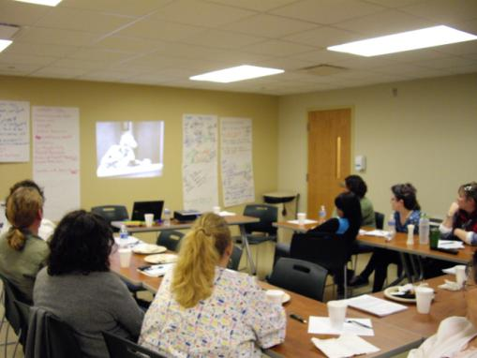
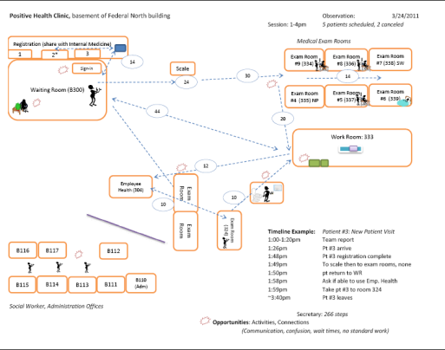
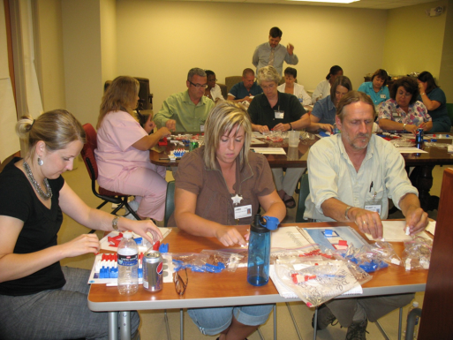
First steps: Initial engagement with clinic
Brainstorming session
Observations
Identification of engagement areas
Process improvement training
Notes:
Possibly use smart art pictures with this…

Slide 66
What is a Process Map?
Graphic representation of steps that occur within a specific process
Helps to explore a process across departmental boundaries
Provides ability to identify opportunities to reduce waste
Easily identifies where there are problems
Guides toward the future desired state
“A picture is worth a thousand words”.
Notes:
A process map is a visual diagram of the steps that occur within a specific process. Have you ever thought about drawing out the steps within your processes? How would you go about doing this? Would you write it out? What is the average number of bullets a person will read before tuning out? (3) Most adults are visual learners. Graphically displaying the process will capture their attention and engage them more in the process. “A picture is worth a thousand words.”
Through mapping processes we can learn about the work that is done in each step and the connections that occur within our processes.
We can take this a step further to explore the ways we connect with other departments and their processes.
Through mapping, we can examine problem areas within our work, identify improvement opportunities, and have a better idea of what we need to work to improve in order to provide ideal care.

Slide 68
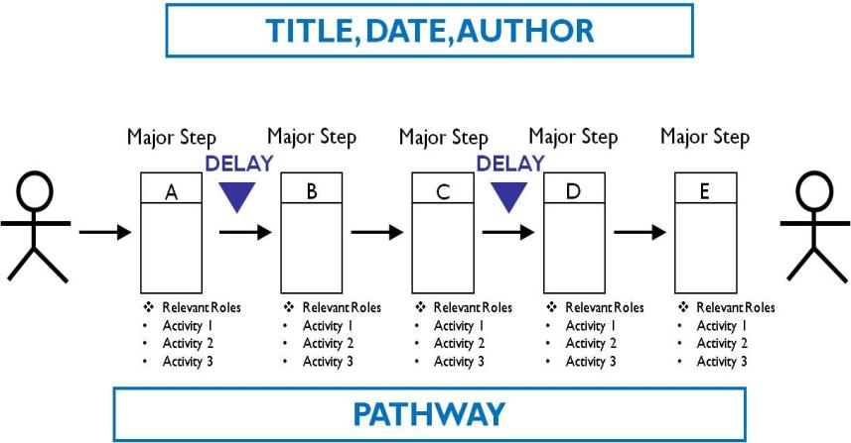
Drawing a Process Map
Improvement
Opportunity
Well-functioning aspect of work
Improvement
Opportunity
Notes:
So let’s walk through the steps of drawing the map.
Be sure to include the title, date, and author at the top of the page. Why do we do this? This helps other staff to know what is being worked on and who to go to with questions or suggestions. A good tip to remember is to create any diagram in such a way that it can stand alone without you present to answer questions. If you do not provide critical information, people tend to make assumptions. You want to avoid this.
In order to draw the map, you will first need to identify the major steps of your process. These are the major “chunks” of work. Consider the admission process in an Emergency Room. Typically, the patient gets registered, triaged, assessed by a Nurse, assessed by an MD, has testing done, an MD provides a diagnosis and the patient is either admitted or discharged. These are the major steps in the process. So what about all the little activities included in each of these larger pieces – do you forget these? No. You group them together under the major processes.
Along with each major step, include information on who is involved in the step and what activities occur during that step.
How do we define where one step ends and the next begins?
Remember that this is a broad view of work and each step is going to include several activities that can be grouped together.

Slide 69
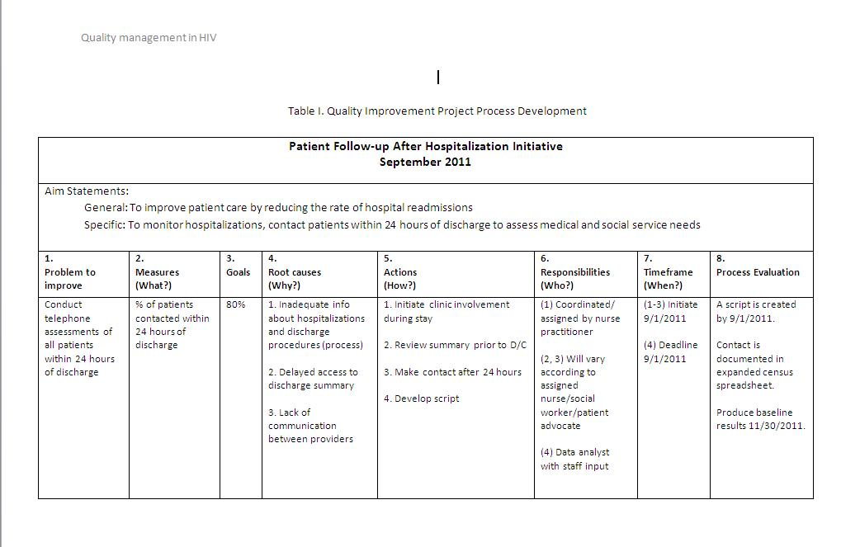
Process Monitoring Template

Slide 70
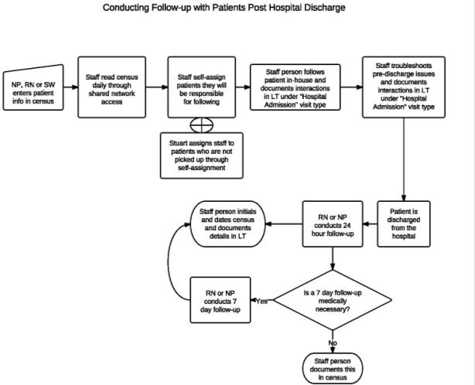
Seeing with new eyes:
Training leads to new and improved processes
New patient rooming process established at clinic
  August 2011
New process during hospitalization
  September 2011
Notes:
With each bullet, bring in other visual
New patient rooming process, opened their eyes into what was possible, what they could do internally to fix themselves…

Slide 71
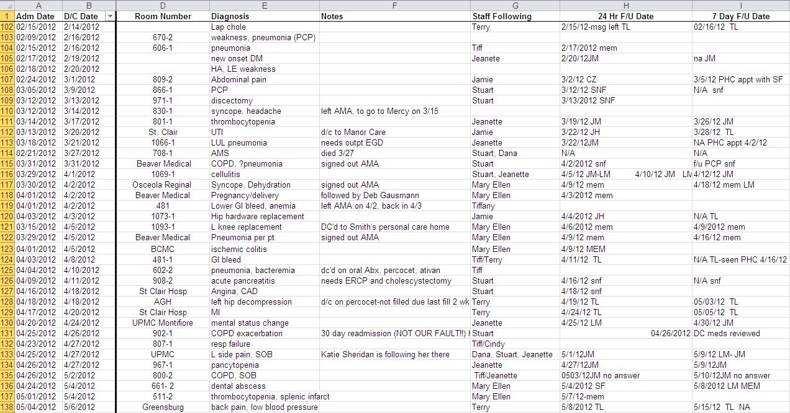
Hospital Census Database

Slide 72
Telephone Follow-Up Prompt

Slide 73
What needs should be assessed?
Perception of overall condition
Patient’s knowledge of who to contact in case of an emergency or problem
Medication discrepancies
Follow-up appointments
Review of essential equipment needs
Caregiver status
Living situation
Emergency plan
Source: Henriksen, K., Battles, J. B., & Marks, E. S. (Eds.). (2005). Seamless care: Safe patient transitions from hospital to home. Advances in patient safety: From research to implementation (pp. 79-98).

Slide 74
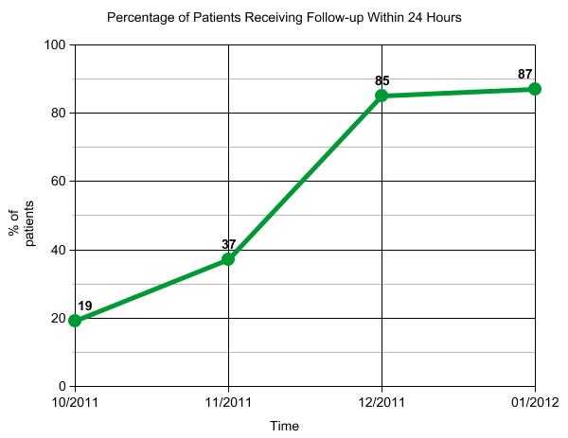
Process Results

Slide 75
Encouraging results through March 2012

Slide 76

New Opportunities: The Social Worker Role
Social Workers as a catalyst for change
  As a care manager/peer leader
  As a connection to the community
Micro and Macro level
  Bridging the patient to care
    Lost to Care
  Linking the hospital to the community
Case Management
  Defining role and organizational structure
Social Work Team
  Work flow redesign
  Interdisciplinary teams

Slide 77

Challenges tackled
Communicated the value of the Lean approach
Developed leadership in the clinic
Created contacts and connections to the hospital

Slide 78
Challenges Activating the Network
Accomplishments
Challenges
Focused brainstorming sessions
ASOs working together and communicating in new ways
  Consent to share information
  Communication networks
  Data sharing pilots
Engagement among competing priorities
Varied comfort with data sharing
Creating an
open/non-competitive atmosphere
Notes:
Engagement among competing priorities
Varied comfort with data sharing
Creating an open atmosphere
Add challenges here? And delete last slide….

Slide 79
Continuous learning,
Continuous quality improvement
Continued QI training
New opportunity: Patient flow in the social work clinic
Current challenge: Effectively incorporating EHRs, i.e. meaningful use
The Lean Journey
Never Ends!
Notes:
Really tried to listen to what their need was now…
Integrate the two parts of the clinic
Overcome resistance, training opportunities building on eachother
Bring pictures in smaller

Slide 80
Lessons Learned
It’s possible to reduce hospital readmissions even among very challenging patient populations.
Organizations may have the necessary resources, but need to be challenged and coached to restructure operations.
Lean methodology adapted to health care works!
Quality improvement does not require expensive innovations to bring creativity to life!

Slide 81
References
3. Rozich JD and Resar RK. Medication Safety: One Organization’s Approach to the Challenge. J Clin Outcomes Manag 2001; 8(10): 27-34

Slide 82
Thank you!
Questions?

Slide 83
Contact Us
Richard Smith 412-560-0490 smith@jhf.org
Jennifer Condel 412-594-2589 jcondel@prhi.org
Sara Luby 412-359-3528 sluby@wpahs.org
Judy Adams 412-359-5286 jadams2@wpahs.org
Cindy Powers Magrini 412-359-6423 cpowers@wpahs.org

