Slide 1
Are you on TARGET? How to help your agency, yourself, and the Ryan White Community online TARGETHIV.org

Slide 2
Presenters
E. Michael Reyes, MD TARGET Center Principal Investigator, UCSF
Nicolé Mandel TARGET Center Project Director, UCSF
Alan Gambrell TARGET Center Communications Specialist, Public Ink
With help from
Nancy Warren, Evaluator, Pacific AETC
Brian Feit, HRSA Project Officer

Slide 3
Learning Objectives
Participants will be able to:
Find high-value resources on the TARGET Center to support Ryan White Program administrative, fiscal, and clinical activities
Identify 5 different ways to keep themselves and their providers informed about the Ryan White Program
Describe at least one new way that they can contribute to the Ryan White Community online

Slide 4
TARGET Objectives
To build a community of TARGET Center “Super Users”
To learn about your:
experience with online training and technical assistance
experience with the TARGET Center

Slide 5
Overview of the Session
Who’s here?
What are your program’s training and TA needs?
What is available to you in the RW Program?
What’s on TARGET?
Top resources for administration and fiscal concerns
Top resources for clinical care and quality improvement
How to stay informed and keep in touch
How to be a Super User

Slide 6
Who is in the room?
Part A - Hard Hit Urban Areas
Part B – State/Territory Formula Grants
Part C - Community-Based
Part D - Women, Infants, Children, Youth
Part F - Dental Programs
Part F - SPNS Models of Care
Part F - Clinical Training (AETC)
Technical assistance provider/contractor
HRSA
Other or N/A

Slide 7
What is your role in the RW program?
Clinic manager
Clinician
Data manager or coordinator
Case manager
Planning council member
Program manager or coordinator
Project officer
TA provider
Other
Notes:
ARS

Slide 8
How long have you been part of the Ryan White Program?
Less than 1 year
1-4 years
5-10 years
11-15 years
16+ years
Don’t know
Notes:
ARS

Slide 9
Exercise: What information and tools does your program need in 2013?
Notes:
Write out on index cards and hand up

Slide 10
Where do you turn to solve clinical care problems?
Project officer
RW Program TA Provider (NQC, NCCC, AETC Network)
TARGET Center
Colleagues
Other online resources

Slide 11
Where do you turn for to solve grant and program management problems with your Ryan White program?
Supervisor
Project officer
HRSA Contact Center
Colleagues
TARGET Center
Other online resources
Notes:
ARS – give examples

Slide 12
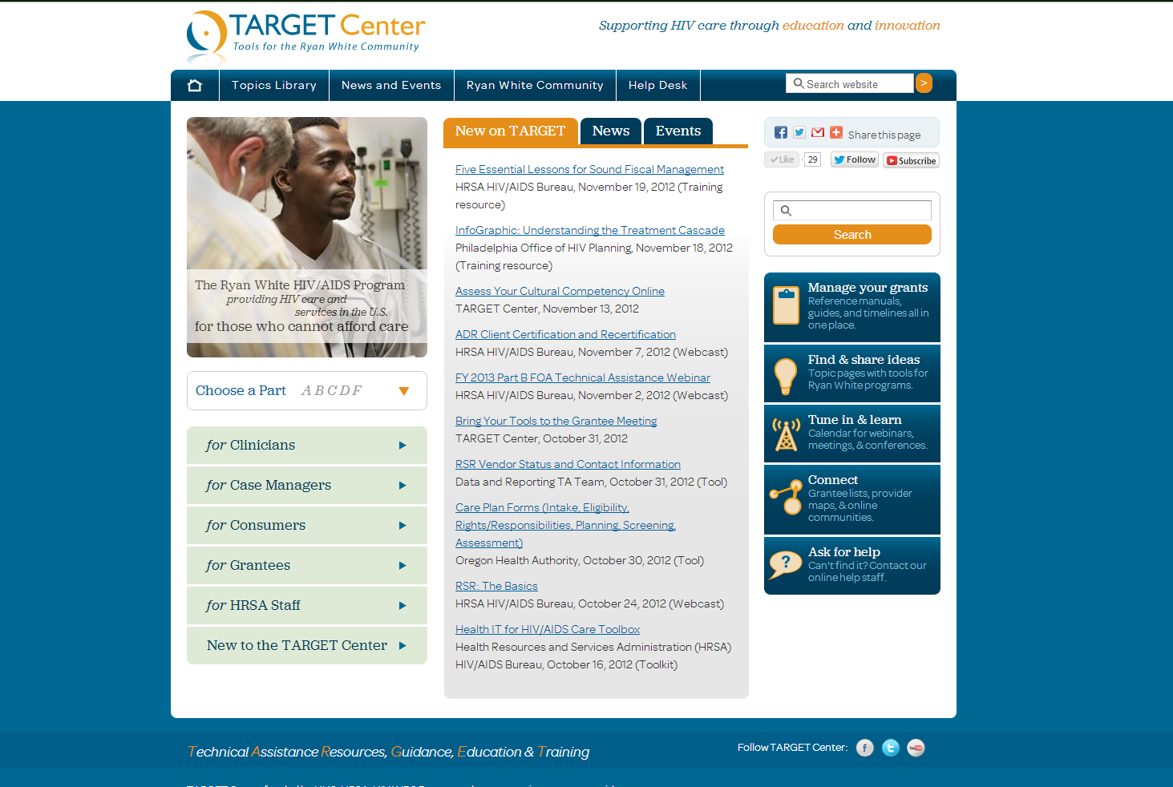
TARGETHIV.org

Slide 13
TARGET = Technical Assistance Resources, Guidance, Education, & Training

Slide 14
Where do TARGET resources come from?
HRSA HIV/AIDS Bureau
TA Contractors, Cooperative Agreements, and Grantees (past and present)
Grantees and providers (the Ryan White Community)
Other HRSA and Federal resources (on a very limited basis)

Slide 15
HRSA HIV/AIDS Bureau

Slide 16
Training & TA Programs

Slide 17
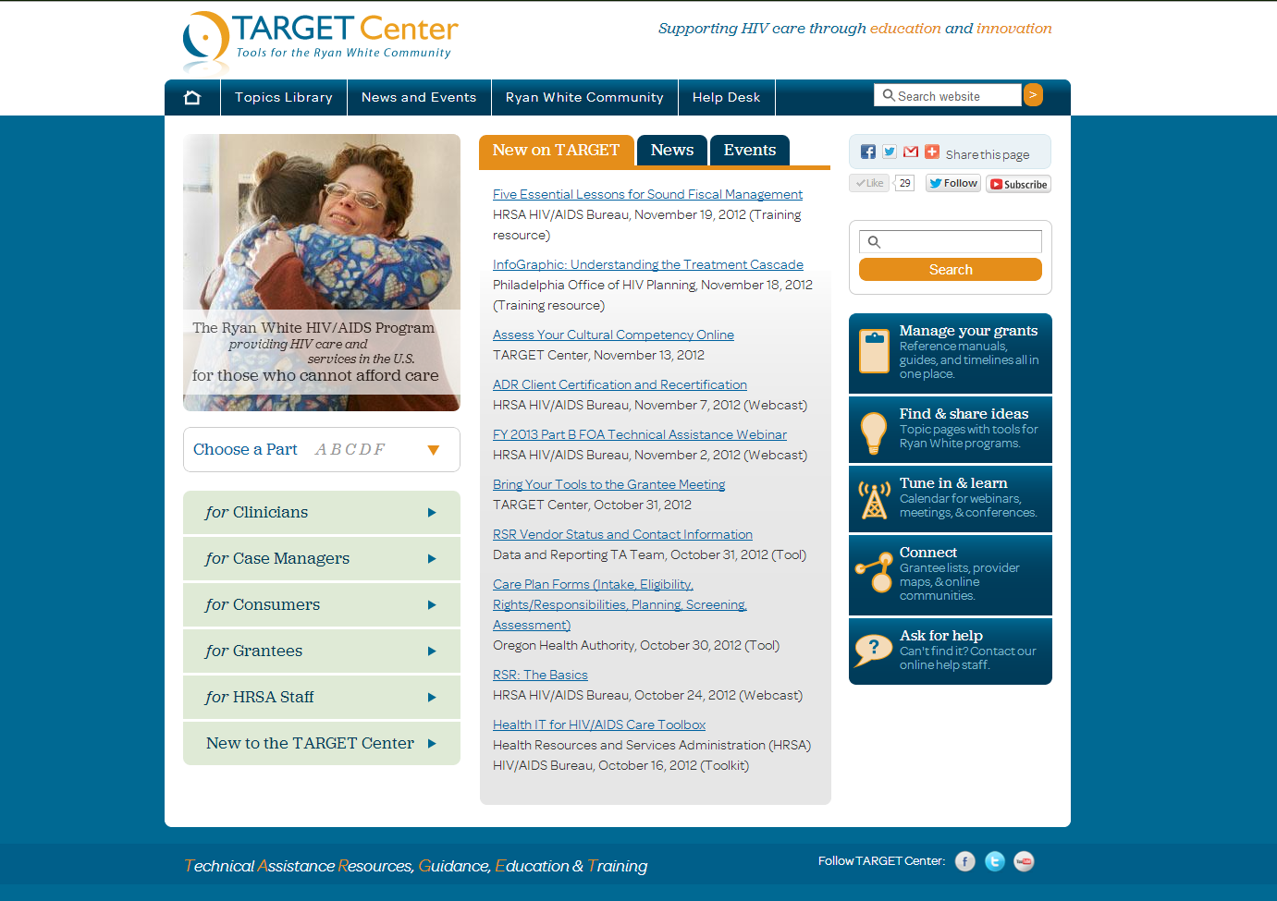
TARGETHIV.ORG

Slide 18
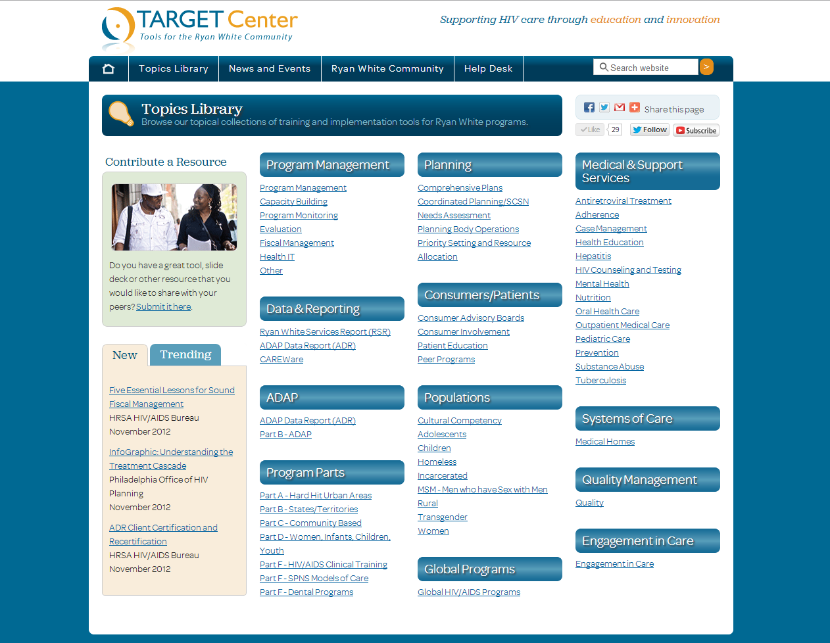
Topics Library

Slide 19
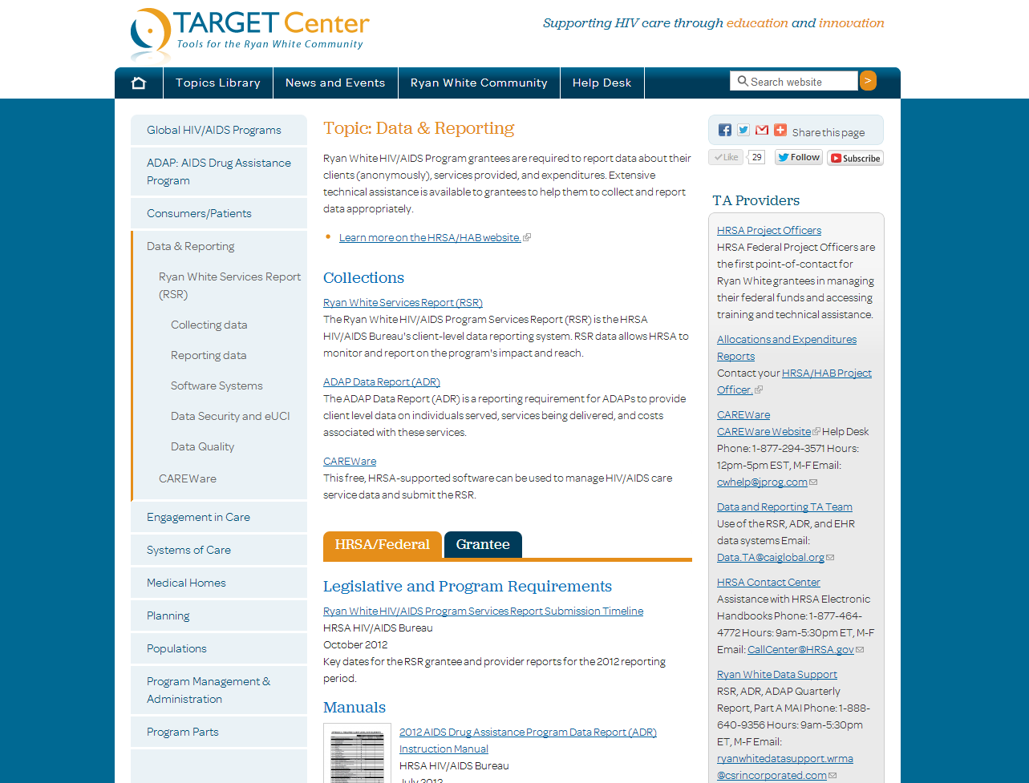

Slide 20
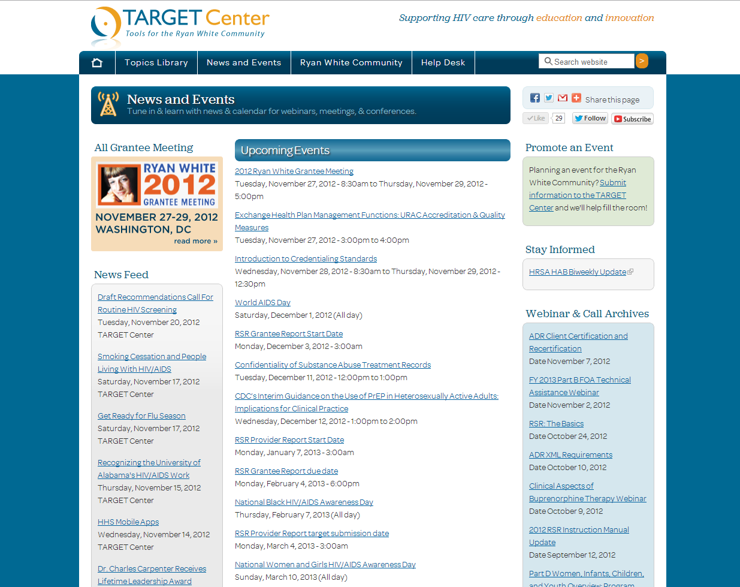
News and Events

Slide 21
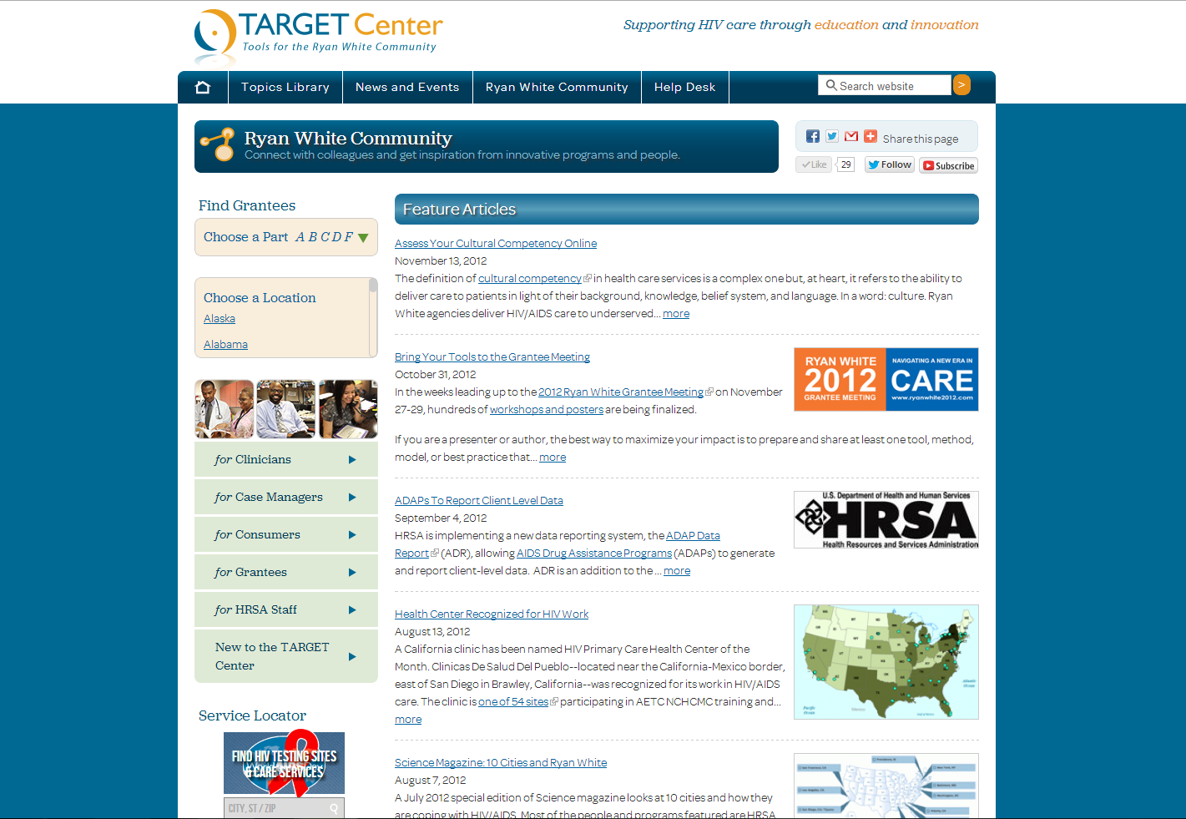
Ryan White Community

Slide 22
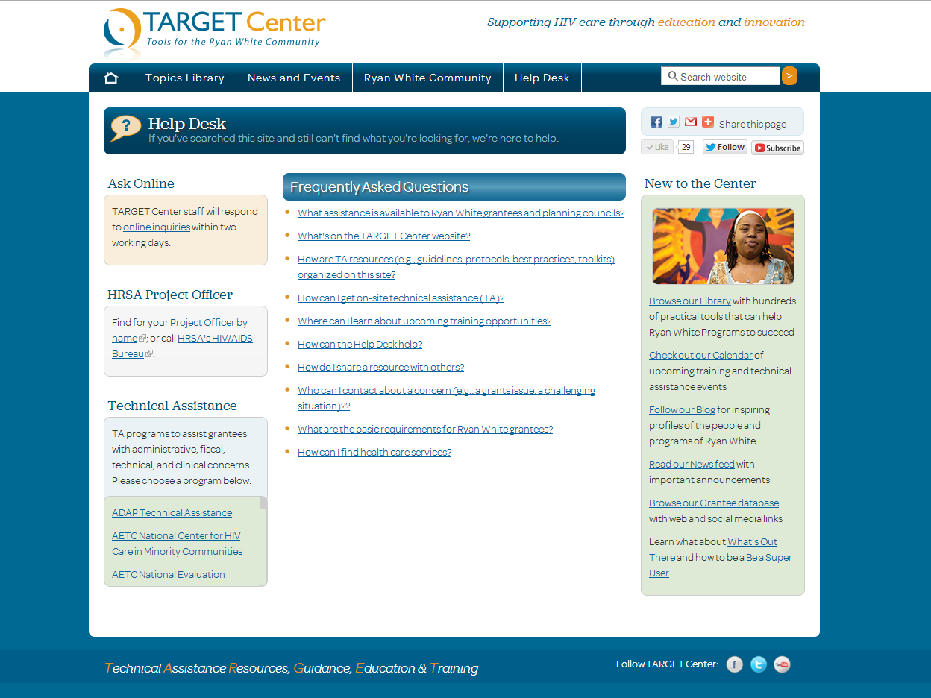
Help Desk

Slide 23
Tools for Administrative
I am a new to Ryan White planning.
Data reporting is overwhelming me.
My state does a really good job at this.
Notes:
Let’s zoom in on what the TARGET Center can offer under the track Administrative.
And let’s make it real by taking on some personas.

Slide 24
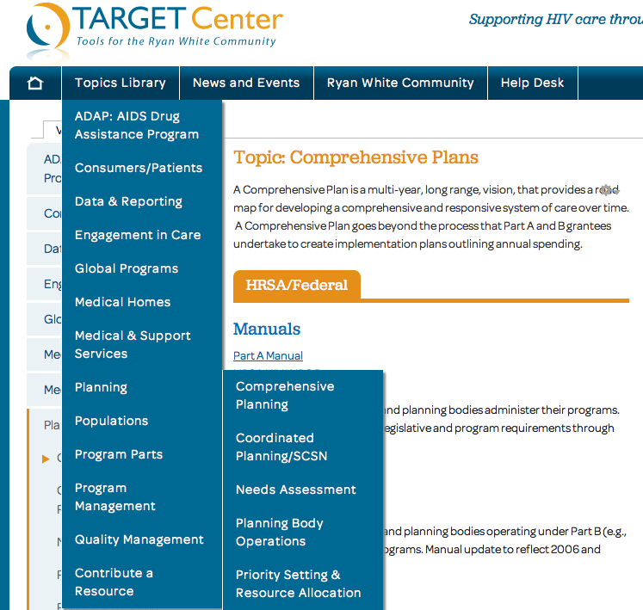
I am new to Ryan White planning.

Slide 25
Planning: Drilling Down
Sub Topics Under Planning
Comprehensive Plans
Coordinated Planning/SCSN
Needs Assessment
Planning Body Operations
Priority Setting and Resource Allocation
Types of Tools You Will Find
Part A Manual
Part B Manual
Sample Plans
Unmet Need Resources
Priority Setting Excel Sheet
Self Assessment Modules

Slide 26
Planning: Drilling Down Deeper
Insert link to PC orientation video
Insert screen shot of listing of PC sites. This is under development? Only one PC is listed.

Slide 27
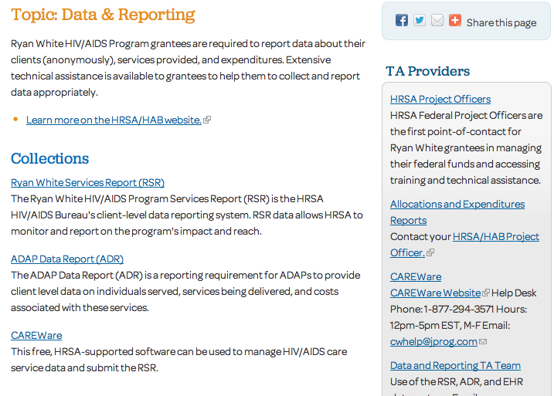
Data reporting is overwhelming me.
Notes:
Here’s the landing page for Data Topics. And there’s a lot here.
First, we make a cross-link to the HRSA/HAB site as we coordinate content across those pages.
Second, we’ve catalogued materials into 3 broad areas.
Third, we provide cross-links to the front-line TA providers who can give you hands-on help, like the DART team for the RSR.
Or access to the most vibrant listserv within Ryan White: the CAREWare listserv.

Slide 28
Data: Drilling Down Into the RSR
Collections
Collecting data
Reporting data
Software Systems
Data Security and eUCI
Data Quality
Notes:
The RSR alone has 5 collections, reflecting the incredible array of TA resources available.
Notably, these resources span the spectrum--from the ever-popular Ryan White HIV/AIDS Program Services Report (RSR) Instruction Manual to countless webcasts, like the Data Academy, which was prepared several years ago but is still the go-to place for basics about topics like data quality and HIPAA/confidentiality of data.

Slide 29
Data: CAREWare Community
Large membership; in operations for many years.
Free form format of Questions.
Lots of answers.
TARGET Center’s best online source of TA tools (e.g., care plans, protocols).

Slide 30
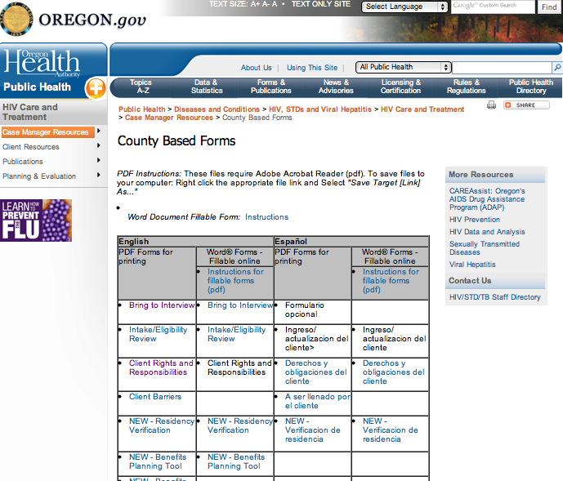
Data: CAREWare Uncovers Tools
Question From Mississippi
Can anyone send me their Care Plan for Part C services? I want to redo ours and want some fresh ideas.
Answer From Oregon

Slide 31
Tools for Fiscal
I need clarity on client eligibility.
What are all these federal rules and forms?
Notes:
Let’s zoom in on what the TARGET Center can offer under the track Administrative.
And let’s make it real by taking on some personas.

Slide 32
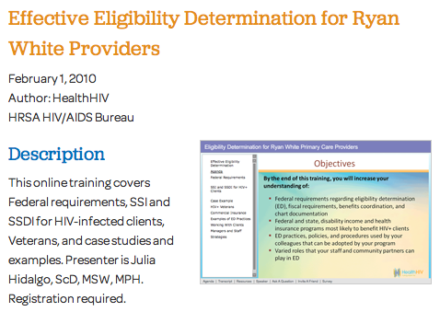
Fiscal: I need clarity on client eligibility.
SSI?
SSDI?
Veterans?
Medicaid?
Medicare?

Slide 33
Fiscal: What are all these federal rules and forms?
Questions About:
What’s Available
OMB Circulars
Sliding Fee Scales
Caps on Patient Charges
Draw Down Restrictions
Payer of Last Resort
Etc.
HealthHIV Fiscal TA Webcasts and Training Curricula
HRSA/HAB Web Casts
HAB Fiscal Monitoring Standards (Parts A and B)

Slide 34
Tools for Clinical Care
HRSA Standards
Community Resources
TA and Training Providers

Slide 35
Stay Informed and Keep in Touch
Visit TARGET Center often ☺
Subscribe to email newsletters
HAB biweekly email
Sign up: paulajones1@hrsa.gov
Access TA providers
See: http://www.careacttarget.org/content/ta-providers
Join listservs, blogs, etc.

Slide 36
Go Social
Like TARGET and others on Facebook
https://www.facebook.com/TARGETHIV
Follow us on Twitter
https://twitter.com/ryanwhitecare
Subscribe on YouTube
http://www.youtube.com/user/targethiv

Slide 37
How to be a Superuser
Rate resources
Share your opinion in the Comments area
Contribute tools, news, & events
Ask for help at the HELP Desk
Share our updates on Facebook, Twitter, & YouTube

Slide 38
Discussion of needs
Review audience questions
Notes:
20 min,

