Slide 1
Improving Accessing to HIV Care through Health Care Reform
Ryan White All Grantee Meeting
November 28, 2012
Robert Greenwald, Treatment Access Expansion Project
Andrea Weddle, HIV Medicine Association
Anne Donnelly, Project Inform

Slide 2
PRESENTATION OUTLINE
Part 1: Where We Are, Where We Are Headed
Part 2: Federal Implementation Update
Part 3: Keys to Success: Lessons Learned from California

Slide 3
Where We Are:
Status Quo = Access to Care Crisis
The Current Crisis
42-59% of low-income people living with HIV not in regular care
29% of people living with HIV uninsured
Impossible to obtain individual insurance and few insured through employer system
Medicaid/ Medicare are lifelines to care, but disability standard means they are very limited
Demand for Ryan White care and services > funding
Thousands on ADAP waitlists

Slide 4
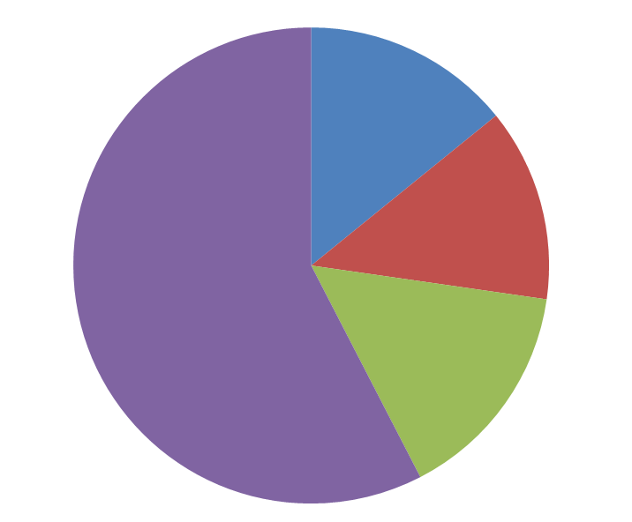
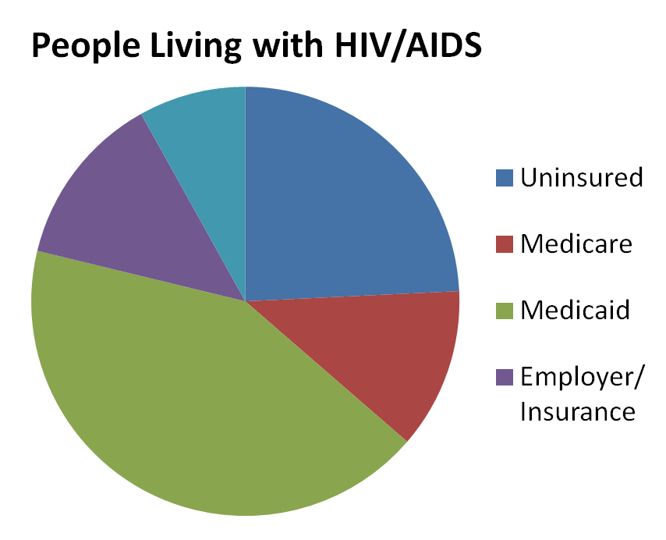
Health Care Coverage:
HIV/AIDS v. General Population
General Population
SOURCE: KFF based on Fleishman JA et al., Hospital and Outpatient Health Services Utilization Among HIV-Infected Adults in Care 2000-2002, Medical Care, Vol 43 No 9, Supplement, September 2005.; Fleishman JA, Personal Communication, July 2006 and KFF based on Gebo and Fleishman, In IOM, HIV Screening and Access to Care: Exploring the Impact of Policies on Access to and Provision of HIV Care, 2011.

Slide 5
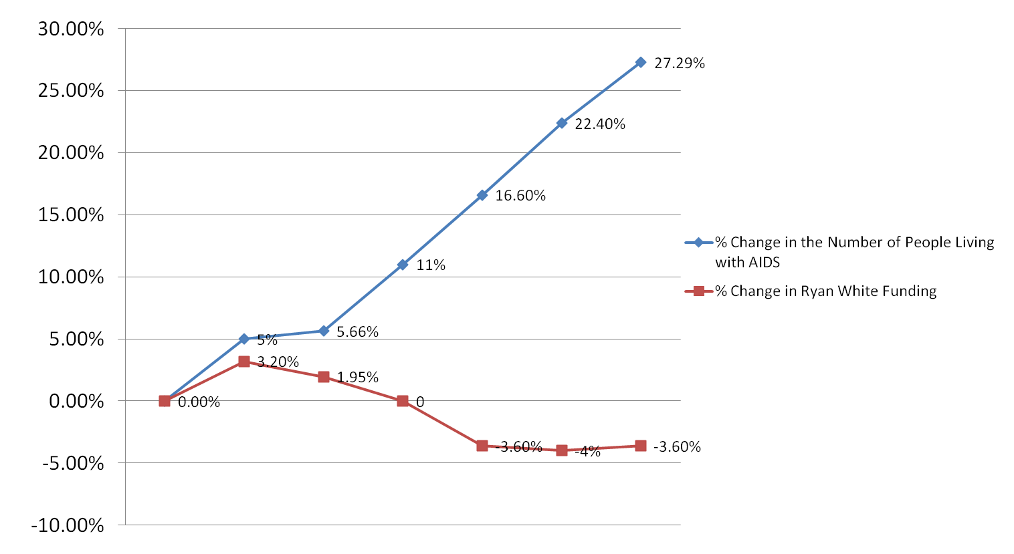
Ryan White Program Not Keeping Pace with Increased Need
Number of People Living with AIDS in the US vs. Ryan White Funding (adjusted for inflation)
2002
2003
2004
2005
2006
2007
2008
Sources: “Estimated Number of Persons Living with AIDS,” Centers for Disease Control and Prevention, http://www.cdc.gov/hiv/topics/surveillance/resources/reports/2007report/table12.htm; Ryan White Appropriations History, Heath Resources and Services Administration, ftp://ftp.hrsa.gov/hab/fundinghis06.xls. Inflation calculated using http://www.usinflationcalculator.com; www.cdc.gov/hiv/surveillance/resources/reports/2009report/pdf/table16a.pdf; “Funding, FY2007-FY2010 Appropriations by Program, hab.hrsa.gov/reports/funding.html

Slide 6
Number of Uninsured Americans
Sources: Center on Budget Policies and Priorities, The Number of Uninsured Americans is at an All-Time High (2006), Kaiser Family Foundation, The Uninsured: A Primer (2010).
Notes:
6

Slide 7
Where We Are Going: Key ACA Reforms
Improves Medicaid: Expands eligibility (optional); provides essential health benefits (EHB) (varies by state); improves reimbursement for PCPs (only 2013-14); includes health home (optional)
Creates Private Insurance Exchanges (varies by state): Provides subsidies up to 400%FPL; eliminates premiums based on health/gender; and includes EHB (varies by state)
Increases Access to Medicare Rx: 50% discount on brand-name drugs; “donut hole”phased-out; ADAP counts toward TrOOP
Reduces Discriminatory Private Insurance Practices: Eliminates pre-existing condition exclusions; lifetime and annual caps; promotes continuity of coverage
  Invests in Prevention, Wellness, Workforce and Innovation: Creates Prevention and Public Health Fund; funds CHCs; provides free preventive services (optional for Medicaid)

Slide 8

Massachusetts as a Case Study of
Successful Health Reform Implementation

Slide 9
Massachusetts: A Post Health Care Reform
State in a Pre-Reform Country
Expanded Medicaid coverage to pre-disabled people living with HIV with an income up to 200% FPL (2001)
Enacted private health insurance reform (“RomneyCare”) with a heavily subsidized insurance plan for those with income up to 300% FPL (2006)
Re-tooled Ryan White Program
  ADAP funding largely spent on insurance not Rx (2006)
  Ryan White Program 75/25 rule waived to allow for increased support of essential support services (2007)
  Maintaining unrestricted formulary and 500% FPL eligibility (2006 - present)

Slide 10
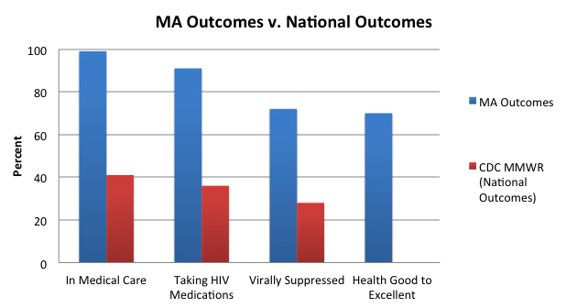
Massachusetts’ Successful Reform Implementation
Improves Health Outcomes and Meets NHAS Goals
Source: Massachusetts and Southern New Hampshire HIV/AIDS Consumer Study Final Report, December 2011, JSI Research and Training, Inc. Note: MA Outcomes N = 1,004
Source: Cohen, Stacy M., et. al., Vital Signs: HIV Prevention Through Care and Treatment — United States, CDC MMWR, 60(47);1618-1623 (December 2, 2011); Note: National Outcomes HIV-infected, N = 1,178,350; HIV-diagnosed, n=941,950

Slide 11
MA Reform Demonstrates Successful Implementation
Reduces New Infections and AIDS Mortality
Between 2006 & 2009, Massachusetts new HIV diagnoses rates fell by 25% compared to a 2% national increase
Current MA new HIV diagnoses rates have fallen by 46%
Between 2002 & 2008, Massachusetts AIDS mortality rates decreased by 44% compared to 33% nationally
Sources: MA Dept of Public Health, Regional HIV/AIDS Epidemiologic Profile of Mass: 2011, Table 3; CDC, Diagnoses of HIV infection and AIDS in the United States and Dependent Areas, 2010, HIV Surveillance Report, Vol. 22, Table 1A; CDC, Diagnoses of HIV infection and AIDS in the United States and Dependent Areas, 2008, HIV Surveillance Report, Vol. 20, Table 1A.

Slide 12
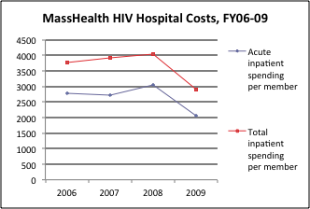
MA Reform Demonstrates Successful Implementation
Reduces Costs
Massachusetts cost per Medicaid beneficiary living with HIV has decreased, particularly the amount spent on inpatient hospital care
Massachusetts DPH estimates reforms reduced HIV health care expenditures by ~$1.5 billion
Source: MA Office of Medicaid, data request

Slide 13
ADAP Utilization:
A Post Reform State Needs Full RWP Funding
YEAR | Full Pay | Co-Pay | Premiums | Total Cost | Enrolled
FY02 | $ 7,947,832 | $ 648,030 | $ 1,120,512 | $ 9,716,375 | 2301
FY03 | $ 7,961,862 | $ 963,205 | $ 1,778,272 | $ 10,703,342 | 2716
FY04 | $ 11,174,879 | $ 1,553,758 | $ 3,159,200 | $ 15,887,838 | 4399
FY05 | $ 9,756,201 | $ 1,839,807 | $ 6,112,132 | $ 17,708,142 | 4738
FY06 | $ 4,634,683 | $ 1,893,206 | $ 7,015,306 | $ 13,543,197 | 4668
FY07 | $ 4,147,713 | $ 2,071,118 | $ 8,366,273 | $ 14,585,106 | 5141
FY08 | $ 4,184,279 | $ 2,083,431 | $ 9,323,821 | $ 15,591,533 | 5601
FY09 | $ 4,695,780 | $ 2,567,789 | $ 8,835,835 | $ 16,099,405 | 5882
FY10 | $ 4,635,751 | $ 2,930,016 | $ 9,320,425 | $ 16,886,192 | 6543
FY11 | $ 4,467,727 | $ 3,175,917 | $ 10,990,818 | $ 18,634,462 | 7009

Slide 14
Part 2: ACA federal implementation Update

Slide 15

The Decision: In Brief
Upheld requirement to purchase insurance (“individual mandate”)
  Exchanges, new insurer rules, etc. move forward
Found Medicaid expansion “coercive”
  States can opt out of the Medicaid expansion without risking all of their federal Medicaid $
Left other provisions in intact - applies only to authority to enforce Medicaid expansion

Slide 16
The Impact of the Decision:
Estimated Coverage in 2022
In Millions
Source: Congressional Budget Office. Estimates for the Insurance Coverage Provisions of the Affordable Care Act Updated for the Recent Supreme Court Decision. July 2012.

Slide 17
Undocumented
Immigrants Left Out
Barred from state-based exchanges
Not eligible for non-emergency Medicaid
Eligible for restricted “emergency” Medicaid
Eligible for services through community health centers and/or safety-net providers

Slide 18
Key Implementation Issues
Medicaid Expansion
Essential Health Benefits
Affordability
State Exchange Rules

Slide 19
Medicaid Expansion Update
CBO lowered enrollment estimate by 6 million
No deadline for states to opt in
100% federal match applies 2014 to 2016
States required to maintain eligibility for enhanced rates (“MOE requirement”)
Notes:
Only est. 1/3 eligible for subsidies in the exchange

Slide 20
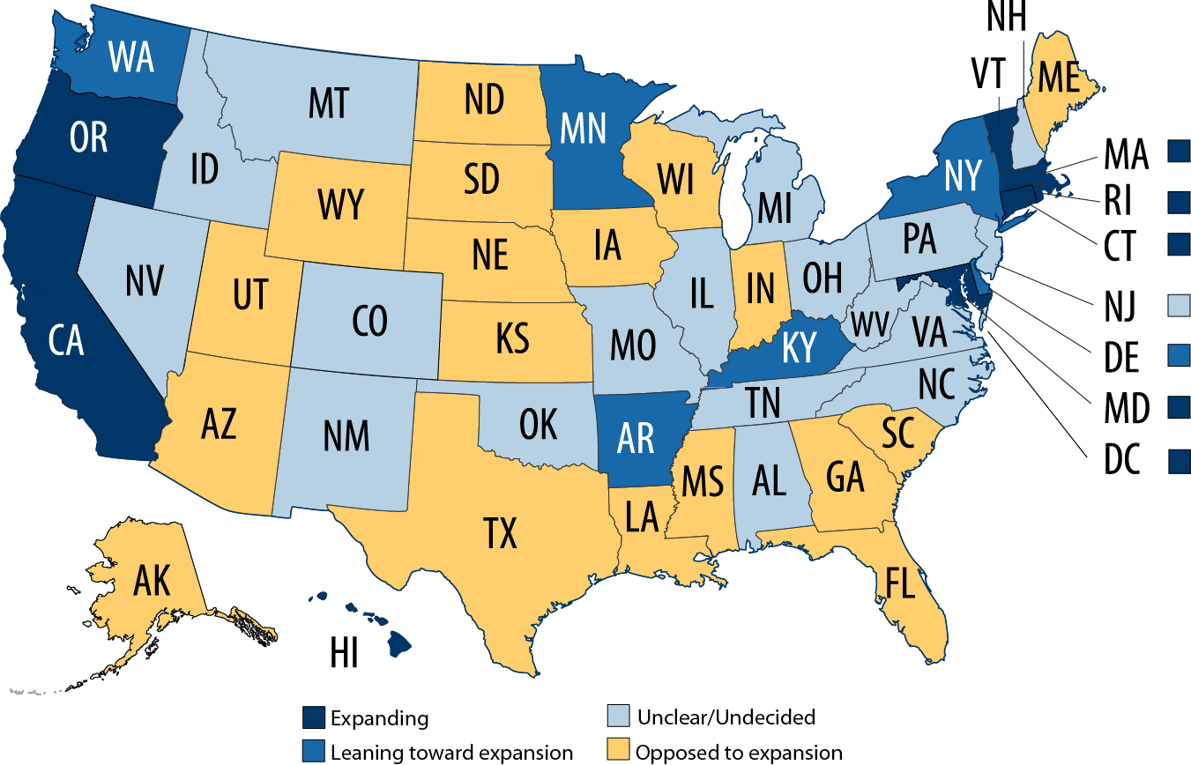
Medicaid Expansion: Where Do the States Stand?
Center on Budget and Policy Priorities. September 2012.

Slide 21
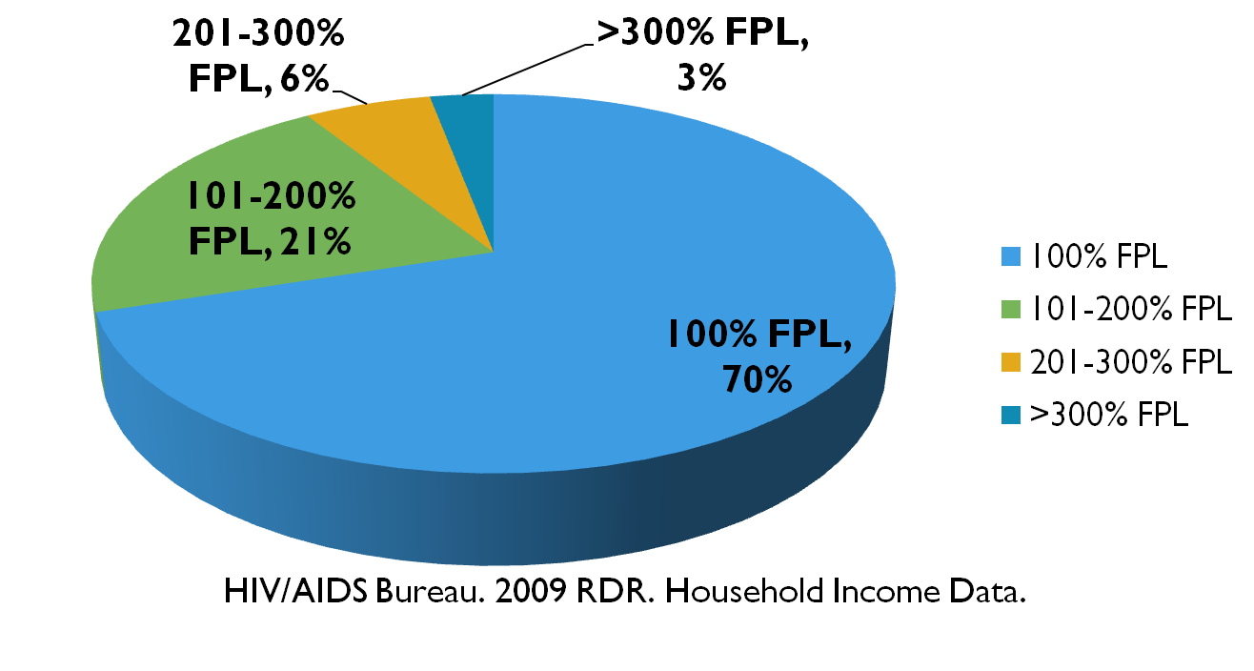
Income Status of Individuals Who Receive
Ryan White-funded Services

Slide 22
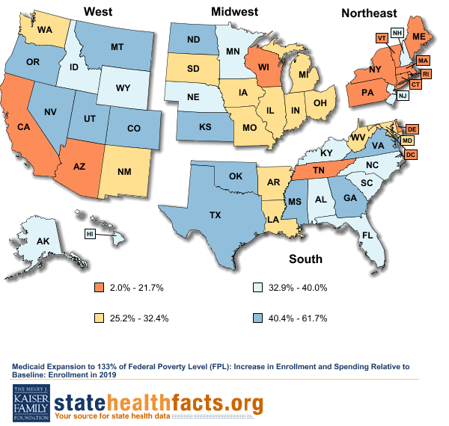
Medicaid Expansion:
Estimated Increase in Enrollment by State

Slide 23
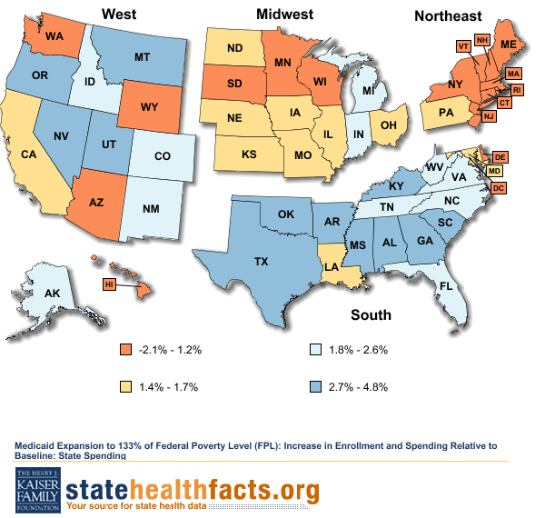
Medicaid Expansion:
Estimated Increase in State Spending

Slide 24

Making the Expansion Work:
Medicaid Primary Care Rate Increase in 2013 & 2014
Internists, family medicine and pediatricians and NPs/PAs they supervise eligible for enhanced rates for primary care services
No minimum billing requirement
Specialists trained in IM, FM, and Pediatrics, including infectious diseases, eligible

Slide 25

Essential Health Benefits
States selected “benchmark” plan to set
coverage standard for the 10 EHB categories
May select different benchmark for Medicaid expansion
INSERT UPDATE ON FEDERAL RULES AND PROCESS

Slide 26
Ryan White Core Services vs. EHB
Ryan White Core Services
Ambulatory and outpatient care
AIDS pharmaceutical assistance
Mental health services
Substance abuse outpatient care
Home health care
Medical nutrition therapy
Hospice services
Home and community-based health services
Medical case management, including treatment adherence services
Oral health care (not standard)
ACA “Essential Health Benefits”*
Ambulatory patient services
Emergency services
Hospitalization
Maternity and newborn care
Mental health and substance use disorder services, including behavioral health treatment
Prescription drugs
Rehabilitative and habilitative services and devices
Laboratory services
Preventive and wellness services and chronic disease management, and
Pediatric services, including oral and vision care

Slide 27
State Benchmark Selections
NOTE:
Will Insert Map with State Benchmark Selections

Slide 28

New Preventive Services Benefits –
Effective in New Plans August 2012
HIV screening and counseling
Well-woman visits
Screening for gestational diabetes
HPV testing for women 30 years and older
STI counseling
FDA-approved contraception methods and contraceptive counseling
Breastfeeding support, supplies, and counseling
Domestic violence screening and counseling

Slide 29
Affordability
Exchanges
100% FPL up to 400% FPL
  Sliding scale premium credits
  Adjusted out of pocket max
100 to 250% FPL
  Cost sharing subsidies
Medicaid
<100% FPL – none
100 -150% FPL
  No premiums
  Up to 10% cost or nominal depending on service
What’s Covered? What’s Not Covered?

Slide 30
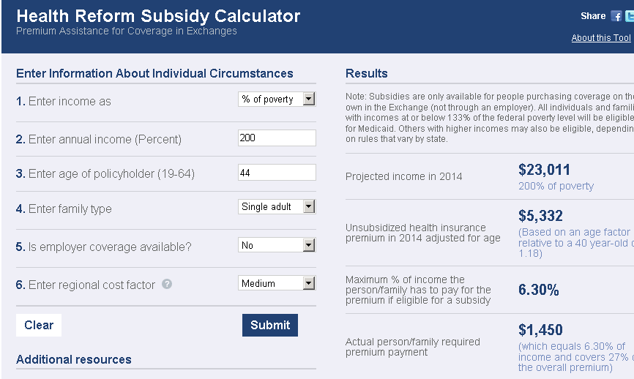
ANNUAL OUT OF POCKET MAXIMUM*: $2,083
Subsidy Calculator from www.kff.org
*In addition to premium payments

Slide 31
The Role of the Exchanges: Federal Rules
Certify “qualified health plans”
Educate consumers
  Must establish call center, website, navigators (at least one nonprofit group), premium calculator
Conduct or contract eligibility and enrollment
  Streamlined “no wrong door” application process
Set standards for provider networks
  Required to contract with “sufficient number and geographic distribution of essential community providers”
  Ryan White providers identified as essential

Slide 32
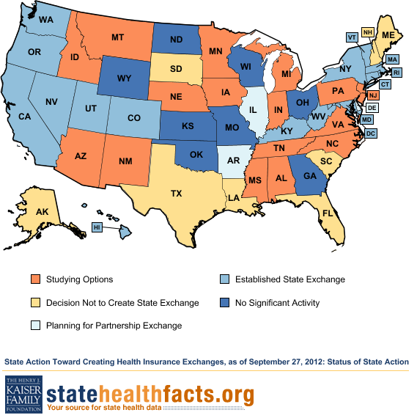
State Exchange Activity

Slide 33


Medicaid Health Homes
For Medicaid beneficiaries with 2 or more chronic conditions
HIV health homes - Oregon and New York
Supports comprehensive care management, care coordination, patient and family support….
States develop reimbursement models
HIV Medical Homes Resource Center
http://www.careacttarget.org/mhrc

Slide 34
Part 3: Keys to Success: Lessons learned from California

Slide 35
Three Top CA Advocacy Priorities
  Ensure full Medi-Cal Expansion with Medi-Cal “plus” benefits package that meets the needs of people with HIV in 2014
      Ensuring continuity of care and formulary protections
  Ensure that the benefits packages offered through QHPs in the CA Exchange meet HIV prevention, care, and treatment needs
      Working on formulary protections
  Ensure that exchanges are designed and implemented in ways that incorporate HIV providers and expertise and ensure continuity of care
      Guaranteed referral to “specialists”
      Continuity of care protections
      Training for “assisters” to help with navigation for PLWHA

Slide 36
Local Community Involvement & Preparation
Involvement in ongoing state implementation issues
Continuity of care and payer of last resort compliance
Planning infrastructure to serve an insured and uninsured population
Community Health Centers
Private physicians
Public hospitals (DSH, county, state)
HIV System
of Care
Community-based organizations
Non-physician providers
University hospitals

Slide 37
Key Decision “Tables” In California
Medicaid Expansion ---> Governor, Legislature & Department of Health Care Services
July 2011 - partial and temporary Medicaid expansion
Full expansion is a new program
A lot of work has been done on expansion but key issues like the EHB package are not decided
  Waiting for federal regulations
  Proposition 30 on November ballot
  Governor has called a special session in December to finish legislation
Notes:
*

Slide 38
Key Decision “Tables” In California
CA State Health Benefit Exchange ---> Governor, Legislature, CA Exchange Board, Department of Managed Health Care & Department of Insurance
Exchange established and working; active purchaser
Benchmark plan chosen – Kaiser small employer plan
  RFP for plans will be sent this month
  Ongoing concerns:
    Formulary adequacy – federal protections are weak; advocating Medicare standard and tiering protections
    Network adequacy – advocating for requirement for referral to out of network HIV providers, if necessary
    Continuity of care standards – advocating for clear responsibility for receiving plan

Slide 39
Key Decision “Tables” In California
Governor’s office and Legislature ---> State statute necessary to establish the Exchange, Medicaid expansion, responsible for costs
EHB benchmark for the Exchange – legislation signed
Prohibition on pre-existing conditions vetoed
Medi-Cal expansion benefits package not completed
Various Medi-Cal eligibility and notification legislation passed
Special legislative session called for December for Medicaid expansion
Implementing changes in HIV care delivery system ---> no one currently charged with this
Implementation planning for 2014 hasn’t really begun
Working with State Office of AIDS to take leadership
  They are not currently funded or staffed to take this on
Even less implementation planning has occurred at the local level

Slide 40
Lessons Learned – State Advocacy & Planning
We have to start now
  We can’t do this alone: essential to partner with other low income and disease specific advocates & state administrators
  We can’t wait for guidance from HRSA, CMS, CCIIO, HHS etc.
There are multiple and interrelated decision “tables”
People with HIV, their providers and advocates will likely not be invited to the discussion
  It won’t always be clear where or how decisions are being made
There is no one person or agency in charge of these changes for people with HIV
  Will require new “roles” for all
    Including people with HIV , advocates, providers, agencies
If one approach doesn’t work try another

Slide 41
Lessons Learned – State Advocacy & Planning
HIV specific state entities need to be supported in taking on new roles
The voice of people with HIV in state processes
  Medicaid & Exchanges unlikely to have HIV expertise
Collaborate with colleagues in Medicaid services and at the Exchanges
  For most this is a new way of working – breaking thru silos
  Monitor implementation of Medicaid expansion and Exchanges
    Engage with implementation decisions
Develop new programs to secure safe transitions and continuity of quality HIV care

Slide 42
Role of Local Communities
Federal and state agencies will not provide a road map for local areas
Now is the time for everyone to get involved!
  Can’t afford to wait for guidance and answers; have to move forward in spite of unknowns
One example, SF forming a HCR task force – goals:
  Develop a transition plan for individual, providers and services
  Plan for comprehensive service delivery post transition
  Plan for clients left out of health care reform
Be strategic - set purpose and goals
  Identify client populations and their needs
  Identify HIV provider needs
  Prioritize the most vulnerable clients and/or providers

Slide 43
How HIV Care is Paid For Today &
How It Will Change in 2014
Notes: Based on Patients with HIV Attending Medical Offices Participating in HIVRN; N=19,235. Medicaid includes those with Medicare coverage. Source: Data from K. Gebo and J. Fleishman, in Institute of Medicine, HIV Screening and Access to Care: Exploring the Impact of Policies on Access to and Provision of HIV Care, 2011. Excludes 8% “unknown” coverage.

Slide 44
What services may be reimbursed by Medicaid or private insurance?
Today – but there may be limits to these services
Mental health
Substance abuse
Case management or Care coordination
HIV testing
Prevention counseling
Perhaps as part of a medical home:
Peer services
Outreach & engagement
But advocacy, agency infrastructure, program development and possibly new certifications will be needed to ensure ASOs get reimbursed

Slide 45
Questions about How Ryan White will integrate with other payers
Mental Health & Substance Use Treatment
Private insurance and Medi-Cal will have limits on visits
Ryan White funds may be able to be used for the rest of the year
Case management
Medicaid: accompany clients to medical visits, treatment adherence education
Ryan White Program can pay for referral to a food pantry or Food Stamps enrollment assistance
Can the same provider bill both?
Will services be discrete enough to allow RW payment?
Will those type of services be co-located with others
Not all substance use needs are covered currently

Slide 46
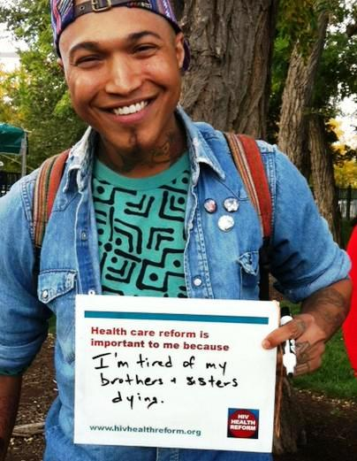
Resources
www.statereforum.org
Health Access
  www.health-access.org
Center for Budget and Policy Priorities
  www.cbpp.org
Treatment Access Expansion Project – www.taepusa.org
Families USA – www.familiesusa.org
National Health Law Program – www.nhelp.org

Slide 47
Health Care Reform Planning
“If we wait for governments, it’ll be too little, too late. If we act as individuals, it’ll be too little. But if we act as communities, it might just be enough, just in time.”
Transition network
Notes:
*

Slide 48
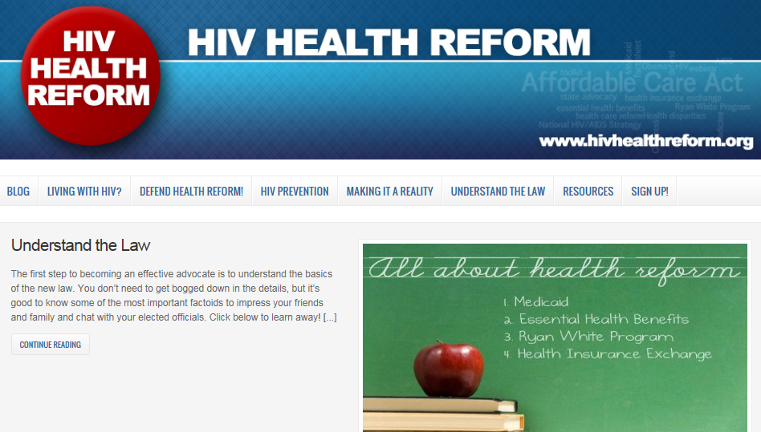

Slide 49

Contact Us
Anne Donnelly, Project Inform
Ph 415.558.8669x208 adonnelly@projectinform.org
Robert Greenwald, Treatment Access Expansion Project
Ph (617) 390-2584 rgreenwa@law.harvard.edu
Andrea Weddle, HIV Medicine Association
Ph (703) 299-0915 aweddle@hivma.org

