Slide 1
Minority AIDS Initiative Peer Re-Engagement Project
Nancy Daniels, PATH Center
Carmen Rivera, PR CoNCRA
Patty Valdez, Care Resource
Mariana Sarango, Boston University School of Public Health

Slide 2
Background and Significance
Intervention Goals
Increase retention in care for out-of care PLWHA
Link at-risk newly diagnosed PLWHA into HIV care
Increase the percentage of PLWHA with viral load suppression
Increase knowledge of HIV treatment
Improve self-efficacy
Improve health-related quality of life
Targeted intervention:
3 identified target areas where HIV epidemic is growing: Miami, Puerto Rico, and New York City
Communities of color
Populations that require support with housing, mental health, or substance abuse problems

Slide 3
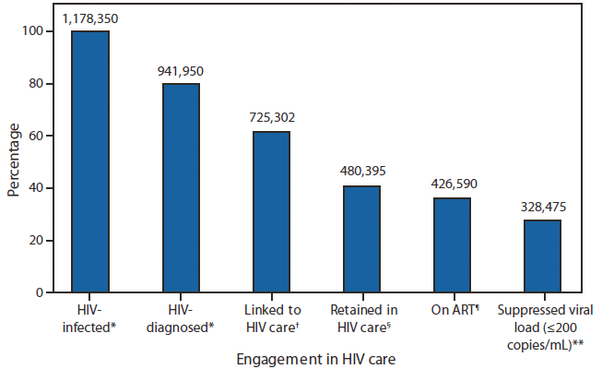
Missed Opportunities in the Continuum of HIV Care
Source: Cohen et al., MMRW, 2011

Slide 4
Study Design Overview
Multi-Site Evaluation
Randomized clinical trial
Peer Intervention
Standard of Care
Significance:
Limited research and formal evaluation, which focuses on peer program and treatment adherence outcomes
Filling the gap: peer interventions and retention in HIV care

Slide 5
Intervention Model
Identification of target populations:
Out of care
New patients and newly-diagnosed patients at risk for falling out of care
Outreach to target populations to bring into care, enroll and randomize to study arm:
Peer Intervention
Standard of care
Peer Intervention Training:
Peer Core Competency Training
Interdisciplinary Team Training
Peer Supervision Training
On-going Support (e.g. Peer Conference Calls, refresher and follow-up trainings for peer and intervention staff, as needed)
Integrating peers into health care team
Structured Peer-Client sessions to promote behavioral change and increase retention

Slide 6
Implementing the Peer Intervention
Nancy Daniels, Program Coordinator
Re-Engagement Project (R.E.P.)
PATH Center

Slide 7
Identifying Peers
A collaborative effort
Staff members try to identify clients that:
Exhibit responsible behavior (e.g. are adherent to their medication regimens)
Desire to obtain employment
Have been able to maintain viral load suppression,
Possess desire to help others.
Useful to consider clients who may already work part-time and would like to transition to a full-time position.
The transition peers have made from client to employee has been a positive occurrence observed by other clients.

Slide 8
Assessing Peer Readiness
Things to Consider:
Is this individual ready to become fully employed if he or she has not been for some time?
Is this job likely to bring negative consequences to the individual such as straying from treatment regimens, relapse (for those with history of substance abuse), or mental health problems?
Does individual feel comfortable disclosing his or her HIV status?
Does the candidate demonstrate empathy and compassion?
Does this individual seem motivated to serve as a role model to others living with HIV?
Will this individuals benefits package be affected?

Slide 9
“The transition from part-time to full time has been difficult. The time constraints, decrease in flexibility, having to consistently rearrange the children’s appointments as to coordinate with family members has created a more complex family dynamic. There has been loss of friendships based on the change in work schedule. Friends may feel like you don’t have time to talk or hangout with them. This is the price I have to pay for my personal growth.”
- R.E.P. Peer

Slide 10
Peer Training
5 Day Core Competency Training
Peer Roles
Peer Communication Skills
HIV Basics
HIV Life Cycle
HIV Medications
Peer Disclosure and Supporting Clients with Disclosure
Assessing Adherence
Drug Resistance
Understanding Lab Values
Values and HIV Stigma
Motivational Interviewing
Depression and HIV
Harm Reduction
Sexual Health
Documentation
Confidentiality & Boundaries
Peer-Case Manager Sessions

Slide 11
“The training prepared us for the work that we currently do. It really prepared us for interacting with clients.”
- R.E.P. Peer

Slide 12
Hiring Process
Organizational challenges
Extremely rigorous hiring process at The Brooklyn Hospital Center
Numerous clearances, background checks, and require absolute transparency about past history
It is important to reassure peers that all staff must go through this process and they can do it too
Should provide support to peers and advocacy on their behalf

Slide 13
Implementing Peer-Client Sessions
Structured educational sessions, in addition to informal check-ins and support, are the meat and bones of the intervention. The topics covered:
Introduction and Assessment
HIV transmission & Viral life cycle
Effective Communication and Self-Advocacy
Understanding Lab Values
HIV Medications
Drug Resistance & Adherence; Understanding and Managing Side Effects
Disclosure and Stigma
Harm & Risk Reduction
Peers are provided a Peer-Client Sessions Manual that was developed using materials from the Core Competency Training.
Also do additional research to provide information to clients from reliable sources.

Slide 14
Intervention Implementation Challenges
Securing physical space to conduct peer-client sessions
Scheduling with clients
Operationalizing program across two sites

Slide 15
Overcoming Challenges
Flexibility in scheduling location and times with clients
Availability across both sites
Meeting clients where they are
Coordinating session times with medical appointments
Coordinating with other staff and partner agencies to locate clients (e.g. verifying contact information)
Reaching clients via communication means that are convenient for them (e.g. home visits, Facebook, etc.)

Slide 16
Role of Peer Within Health Care Team
Carmen M. Rivera, Study Coordinator
Project Acércate
PR CoNCRA

Slide 17
Defining peer roles and responsibilities
Peers serve many roles as part of the medical care team and within the social support systems needed by participants.
Their roles and functions are aimed at improving and enhancing the lives of those living with HIV.

Slide 18
Defining peer roles and responsibilities
Defining roles and responsibilities of the peer is critical to program success.
Avoids overlapping or duplication of responsibilities with other members of the clinic (particularly case managers).
Job description should be developed and shared with members of the management team, external consultants, and representatives from funding sources.
Review job description closely with peers; this can be done as part of the recruitment process.
Job description is useful in different instances: to clarify expectation, as a tool to provide feedback at regular supervision meetings, and as an evaluation tool for job performance, among other things.

Slide 19
Boundaries
Defining peer roles is critical in order to establish boundaries peer role vs. the role of other staff members. Similarly, it is important to:
Explicitly state how other staff members (physician, nurse, case manager, etc.)will be expected to work with the peer.
Identify and training staff who will be supervising the peers.
Establishing boundaries between the peer and clients is also essential.
Peer supervisor should clearly define when exceptions can or can not be made, and why.
The peer should be prepared to respond to clients in a way that honors the nature of the relationship without compromising the role of the peer or the Organization.

Slide 20
Peer Supervision
Three different styles are required:
Administrative Supervision
Supportive Supervision
Clinical Supervision

Slide 21
Administrative Supervision
Setting clear job description and expectations.
Developing action plans, goals, objectives and activities aligned with mission statement.
Supporting team integration efforts.
Managing logistics (administrative and programmatic).
Evaluating effectiveness of peer intervention and activities.
Assessing training and mentoring needs.
Monitoring peer caseloads.
Problem solving.

Slide 22
Supportive Supervision
General principals:
Create a safe space where the peer is encouraged to share concerns.
Provides individualized training and support to each peer.
Monitor cases loads.
Help peers manage feelings that may arise about or towards clients.
Assist peers in maintaining appropriate expectations for themselves and the clients.
Help peer identify and build on what works or is effective with participants.
Ensure that peers stay within the scope of work and make appropriate referrals when necessary.
Takes into consideration the different experiences of the peers who may be working for the first time in a highly professional health setting and who are bringing their personal wisdom, information and knowledge from their own lives.

Slide 23
Clinical supervision
Provides opportunity for peers to:
Learn about transference/countertransference issues and how to manage them.
Job related stressors and how they might impact on their own health and well being. Supports development of client care plans
Ensures that peers work with scope of their role and make appropriate referrals if needed.
Supports the peer in understanding how the work affects him/her at an emotional level.
This supervision needs to be provided by a licensed professional because it requires specialized training and skills in psychological theory.

Slide 24
Integrating Peers into the Health Care Team
Initial assessment:
Review of standing operations, protocols, and procedures.
Identification of specific areas where the peers can contribute.
Work with Case Managers and CM Supervisor
Design specific mechanisms and procedures for peers support facilitate provision of services as part of a holistic multidisciplinary team.
Promote case conferencing meetings with case managers.
Peers should participate in relevant staff and team meetings, educational and training activities, and other activities in which they may provide support and/or learn from the experience.

Slide 25
Promoting the Peer Program
Involve different staff members in Program design and implementation.
Share work plan, goals, objectives and activities, and peer job description with key staff.
Make presentations on the status of the program and work of the peers during personnel meetings.
Provide peers with opportunities to present to the multidisciplinary team about their work.
Use all modes of communication available to keep the multidisciplinary team informed of program progress.
Carefully professionalize the Peer program without compromising the essence.
Always strive to maintain credibility and integrity of the peer intervention and activities.

Slide 26
Managing Peers Who Are Clients
Several considerations need to be addressed during the recruitment and hiring process (some may need to be revisited), including:
The effect of salaries and compensation on benefits or entitlements such as: Food Stamp program, Housing program, health benefits, among others.
HR and managers should be informed about state benefit requirements and refer peers to a benefits counselor, as needed.
Peer needs clear information on Human Resources Manual, personnel policies and other institutional policies within the Organization.
Supervision should provide flexibility in order to manage health issues and social support needs of peers.

Slide 27
Challenges
Integrating peers into the healthcare team has presented some challenges:
Impact on the culture of the Organization
Gaining trust and credibility within the multidisciplinary team
Professionalizing the Peer Program without losing essence

Slide 28
Overcoming Challenges
Provide trainings for peers, Early Intervention workers, case managers, nurses and other medical staff.
Ensuring peer participation in multidisciplinary team and case management meetings.
Consistency in building trust, credibility and professionalizing the Peer Program.
Build on the common commitment and passion of all members of the multidisciplinary team.

Slide 29
Methods to Identify Out-of-Care Patients
Patty Valdez, Program Coordinator
Peer Re-Engagement Project for Men (PREP-M)
Care Resource

Slide 30
Initial Strategies of Identification
Initial list generated from Ryan White database – CaseWatch – of out-of-care patients. Two major inaccuracies were discovered:
Outdated contact information
Patients appearing on list that had not actually fallen out of care
Newly diagnosed patients identified through
Referrals from the Department of Health
Internally through testing department, Health Promotions

Slide 31
Back-Up and Revised Strategies of Identification
Peers worked closely with staff across the agency to identify patients that were truly out of care. Constant communication and meetings with the following personnel facilitated this process:
Medical case managers
Medical providers (e.g. nurses, physicians)
Outreach specialists
Close review of medical
Transition to new Electronic Medical Records (EMR) software, Intergy, which facilitated in generating a more accurate list with updated contact information and information regarding last missed appointment

Slide 32
Peer Role in Identification Process
Peers play an integral role in the process of identifying out of care patients
Constant communication with medical case managers, outreach specialists, and other providers at the agency
Intensive outreach to clients via phone calls, fieldwork at partner organizations (e.g. residential treatment agencies, homeless shelters), and home visits

Slide 33
Other Staff Members Roles in Identification Process
Identifying out of care and newly diagnosed patients is a collaborative effort that requires cooperation between many staff members, including:
Outreach supervisor and specialists who receive referrals
Medical case managers and other providers who identify and refer patients who have not been in care
Data managers who generate lists

Slide 34
Tracking and Documentation of Outreach
A great level of effort is require in the process of identifying, locating and connecting clients to care
Identifying strategies that are most useful in identifying patients has been successful as a result of trial and error, and intensive documentation of contact attempts and resulting outcomes of these contacts

Slide 35
Challenges
Inaccurate lists that were generated initially via CaseWatch
Outdated contact information for an often transient and hard-to-reach population

Slide 36
Overcoming Challenges
Collaboration across the agency
Promotion of program across the site to secure buy-in and awareness of other staff
Intensive outreach to locate clients
Transition to new EMR software that captures more accurate client information

Slide 37
Evaluation
Methodology
Longitudinal (Baseline, 6- and 12-month follow up)
Enrollment and Randomization
Process Measures
Methods of identification of target population
Organizational and structural characteristics of successful interventions
Level of effort to engage or re-engage in care
Outcome Measures
Clinical: CD4 and viral load, medical visits, quality of care
Intervention: HIV knowledge, self-efficacy, quality of life, stigma, dose-response

Slide 38
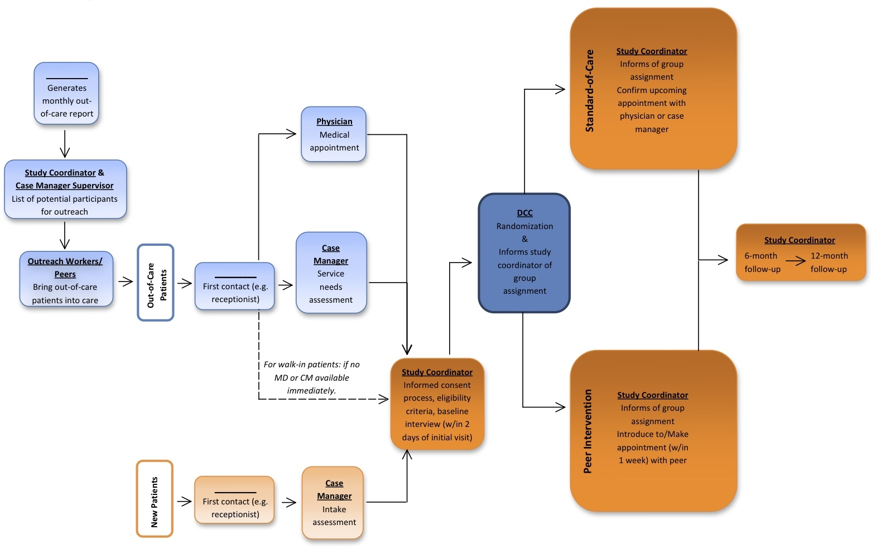
Multi-Site Enrollment and Randomization Process

Slide 39
Evaluation
Data Collection
Web-based data collection
Audio Computer Assisted Self Interview (ACASI)
Tele-forms
Evaluation Instruments
Client surveys
Chart review tool
Peer encounter forms
Out-of-care summary forms

Slide 40
Questions?

