Slide 1
Outreach Team to Engage New and Existing Patients in Care and Build Partnerships with the Community
Zsofia Szep, MD, MSCE, Outreach Program Director
Amy Althoff, MD, Outreach Program Co-Director
Taneesa Franks, Program Manager
Rhonda Ferguson, Outreach Specialist
Brian Aarons, Outreach Specialist
Partnership Comprehensive Care Practice, Drexel University College of Medicine, Philadelphia, PA

Slide 2
Disclosures
Presenters have no financial interest to disclose.
This continuing education activity is managed and accredited by AffinityCE/Professional Education Services Group in cooperation with HRSA and LRG. PESG, HRSA, LRG and all accrediting organization do not support or endorse any product or service mentioned in this activity.
PESG, HRSA, and LRG staff as well as planners and reviewers have no relevant financial or nonfinancial interest to disclose.
Commercial Support was not received for this activity.

Slide 3
Learning Objectives
At the conclusion of this activity, the participant will be able to:
To describe the role of the Outreach Team in engaging new patients in care.
To discuss the role of the Outreach Team in engaging existing patients in care who “no show” for follow up appointments.
To describe ways the Outreach Team ensures follow up for hospitalized patients.
To describe the role of the Outreach Team in building and facilitating the Consumer Advisory Board.
To discuss role of the Outreach Team in building relationships within our community.

Slide 4
Obtaining CME/CE Credit
If you would like to receive continuing education credit for this activity, please visit:
http://ryanwhite.cds.pesgce.com

Slide 5
Outline
Overview of Partnership Comprehensive Care Practice and Outreach Team
Role of Outreach Team in engaging New Patients in Care
Facilitating follow up and addressing barriers for patients who “no show”
Tracking hospitalized patients and ensuring follow up
Building our Consumer Advisory Board
Community Outreach

Slide 6
Partnership Outreach Team
The Partnership, which was established 25 years ago, is a large urban HIV Clinic serving 1700 patients in Philadelphia.
The Outreach Team started in October 2017.
Modeled after Path Peer Program, Brooklyn Hospital Center
Team overseen by 2 medical providers one with focus on new patients and Outreach and one with focus on “no show” events and patients who are lost to care.
1 Outreach Team Supervisor
2 Outreach Specialists
One with focus on New Patients
One with focus on Existing Patients

Slide 7
Outreach Team
Objective: To improve access to healthcare and health outcomes for Partnership patients.

Slide 8
The Team
Dr. Zsofia Szep
New Patient Engagement
Partnership Outreach
Dr. Amy Althoff
Identifying barriers to retention in care
“No Show” Events
Taneesa Franks
Patient Navigation/Linkage Coordinator
Rhonda Ferguson
Outreach Specialist
Brian Aarons
Outreach Specialist

Slide 9
Criteria for getting Outreach services
All newly diagnosed patients
Poor engagement in care, out of care > 6months
Hospitalized patients
Unsuppressed HIV viral load
Needs assistance connecting with medical care/has complex medical needs
Needs assistance attending a specialty appointment

Slide 10
New Patient Protocol
Time Line | Action
2 days before first appointment | 1st Pre-session on phone
Day of appointment | Initial meeting and assessment
2 days after new patient visit | 1st Care Call
1 day before second appointment | 2nd Pre-session on phone
Day of second appointment | 2nd meeting and education
2 days after second appointment | 2nd Care Call
1 day before third appointment | 3rd Pre-session on phone
Day of 3rd appointment | 3rd Meeting and final check in

Slide 11
“No Show” Events
Contact all patients who “no show” for their appointment within 24-48 hours of their missed visit.
Identify and address barriers to appointment adherence and schedule next visit within 1-2 weeks.
If unable to reach patients by phone, attempt to contact patient via portal, emergency contact or mail.
Note outcome of rescheduled visit.

Slide 12
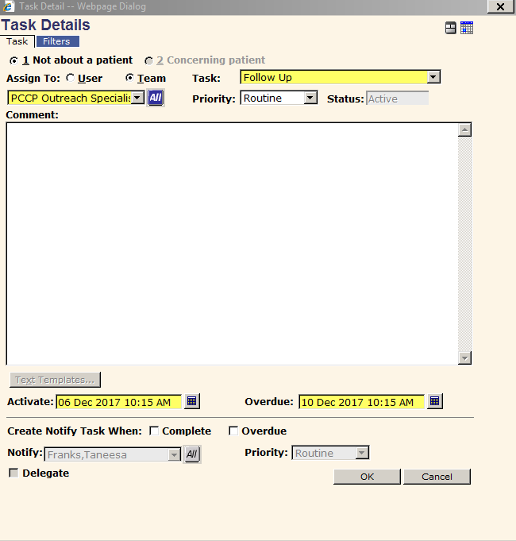
Referral Process

Slide 13
Hospitalized Patients
Track all hospitalized HIV positive patients by collaborating with Infectious Disease Consult Team and Hospital Pharmacist who tracks patients on ART
Ensure engagement in care for all newly diagnosed patients by walking them to the Partnership after hospitalization for their initial appointment
Ensure follow up for current Partnership patients who are hospitalized within 1 week
Facilitate engagement in care for patients who have been out of care and or have a low CD4 count (<200)

Slide 14
Consumer Advisory Board
The Consumer Advisory Board is also known as CAB.
CAB is a small group of consumers and Partnership staff.
The meetings are held every 3rd Thursday.

Slide 15
CAB Recruitment
Consumers actively engaged in medical care for 6 months or more.
Identifying consumers dedicated to enhance the patient experience.
Increasing membership by flyer, peer, clinical and provider referrals.

Slide 16
CAB Initiatives
Community Bulletin Board
Voter Registration Drive
Community Track for Partnership’s 25th Anniversary
Patient Satisfaction Survey

Slide 17
Community Outreach

Slide 18
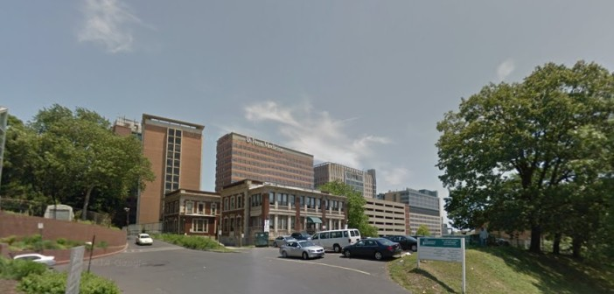
Community Outreach

