Slide 2
Recruiting & Engaging HIV-Positive Latino MSM to promote entry into primary medical care
Jeff Bailey MPH, Principal Investigator
Carlos Aguas-Pinzon, Project Coordinator
Jorge Montoya PhD, Evaluator

Slide 3
Acknowledgement
This project is/was supported by the Health Resources and Services Administration (HRSA) of the U.S. Department of Health and Human Services (HHS) under grant number U90HA26507, Special Projects of National Significance (SPNS) Culturally Appropriate Interventions of Outreach, Access and Retention Among Latino/a Populations, 2013-2018, in the amount of $1.489.000, to APLA Health.
Disclaimer
This information or content and conclusions are those of the author and should not be construed as the official position or policy of, nor should any endorsements be inferred by HRSA, HHS or the U.S. Government.

Slide 4
Intervention Overview
Site Location: Los Angeles, CA
Target Population: HIV-Positive Latino MSM of Mexican Origin
Agency: At the time of the funding award, APLA was a traditional CBO but became an FQHC in 2014; however, the clinic is not a Ryan White provider.

Slide 5
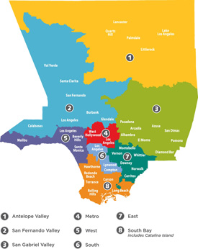
Background
10.2 Million People Live in LA County.
48% are Latino
77% of Identify as Mexican
LACDHSP estimates over 60k
PLWH – 48K diagnosed.
42% of PLWH in LAC identify as Latino
84% of infections among MSM
77% of Latino MSM are of Mexican origin

Slide 6
8,500
Number of LAC residents at the
end of 2016 who had HIV
and didn’t know it.

Slide 7
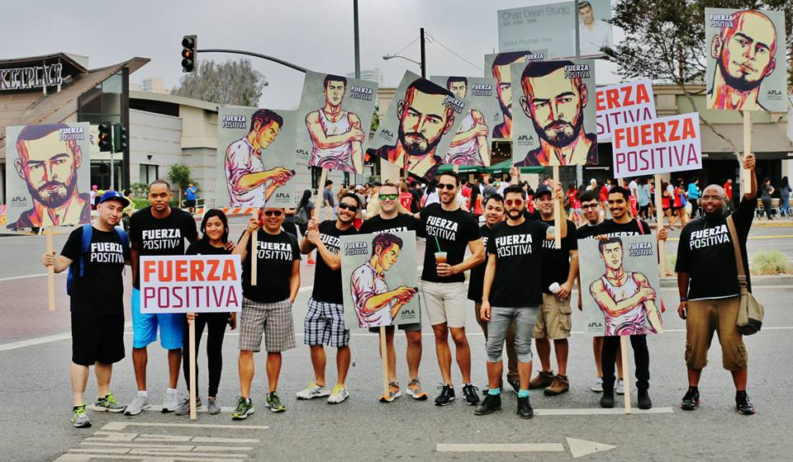
As of December 31, 2016,
in Los Angeles County, 59.7% of Latinos engaged
in HIV medical care were virally suppressed.

Slide 8
Intervention Overview
Recruitment & Engagement
Patient Navigation
Emotional Support
Initial Contact - Encounter
Enrollment
Individual Service Plan
Linkage to care
Retention in care
In-Reach
Venue-based outreach
Community Partnerships
Social Marketing
ARTAS 2.0
Crisis intervention
Social support
Supportive Services
Flexibility
Confianza

Slide 9
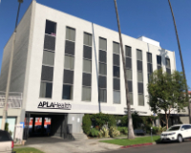
In-Reach
Educate all staff about the program…repeatedly!
Analyze client-level data to determine potential participants
Engage clients
Registration
Re-enrollment
Recruitment events

Slide 10
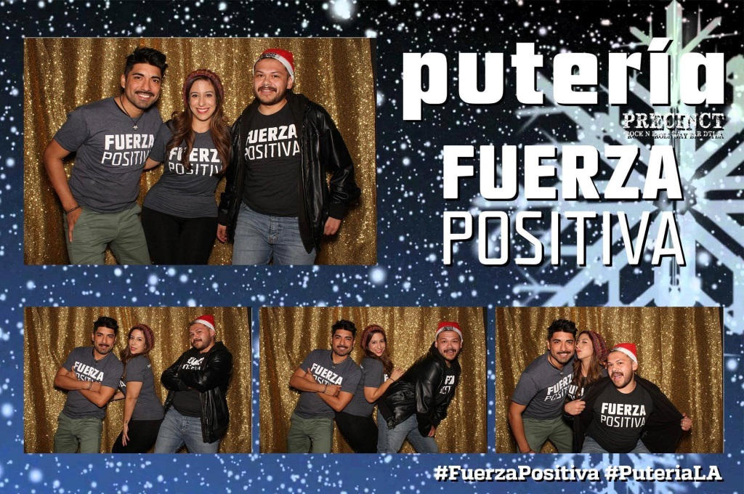
Venue-Based
The goal is to promote the program. Recruitment should not be the goal.
Consistency
Cost v. outcome

Slide 11
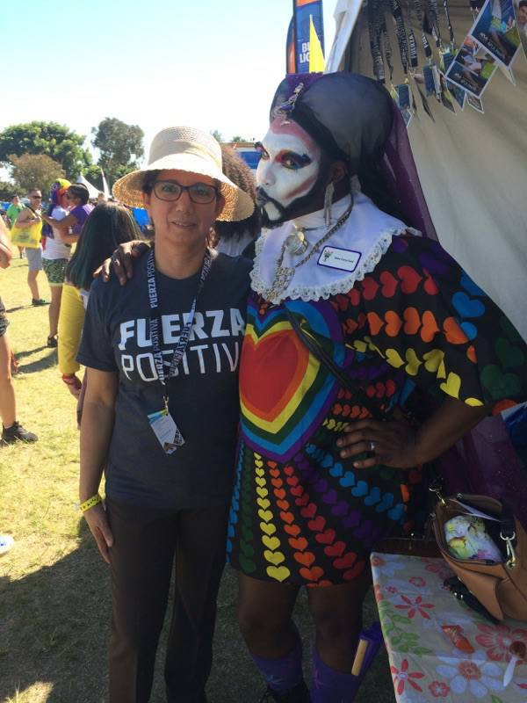
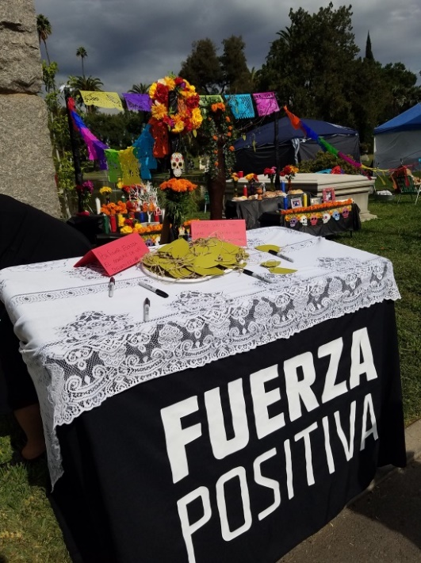
Community Events
Program promotion
Expand partnerships
Reduce stigma
Social outlet for participants

Slide 12
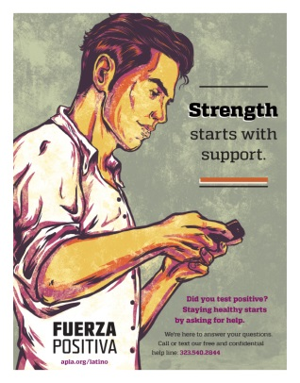
Social/Print Media
Program promotion/recruitment
Cultural affirmation
Incorporate transnational themes

Slide 13
Findings (N=66)
Outreach Modality | # Recruited
In- Reach | 25
Venue Based | 0
Community-Events | 0
Print/Social Media | 18
Referral from community partner | 8
Other | 15

Slide 14
Findings N = 66
Participant Demographics
Mean Age | 37
Ethnicity | Total | %
Mexican | 50 | 76
Mexican American | 14 | 21
Chicano | 2 | 3
Country of Origin | Total | %
Mexico | 36 | 54
USA | 25 | 38
Other (One or both parents are Mexican origin) | 5 | 8

Slide 15
Findings N = 66
Care Status at Enrollment | Total | %
Newly Dx – Never in Care | 21 | 32
Fallen out of care A: (HIV+, no care visit last 6 months, last viral load >200 copies/mL) | 16 | 24
Fallen out of care B: (no HIV primary care visits in 12 months) | 29 | 44
Are you seeking a new HIV medical provider? | Yes | No
Fallen out of care A: (HIV+, no care visit last 6 months, last viral load >200 copies/mL) | 12 | 4
Fallen out of care B: (no HIV primary care visits in 12 months) | 17 | 10

Slide 16
Acknowledgements
Participants enrolled in Fuerza Positiva
Intervention Staff
Carlos Aguas-Pinzon
Erika Alfaro
Ernesto Ayala
Ruben Garcia
Vanessa Jacuinde
Ruben Martinez
Carlos Reynoso
Adrian Rodriguiez
Elvis Rosales
Evaluation
Jorge Montoya PhD
Emerald Green MSPH, MA
Graphic Design
Mike Lucas

