Slide 2
This project was supported by the Health Resources and Services Administration HRSA) of the U.S. Department of Health and Human Services (HHS) under H97HA26498 under the Special Projects of National Significance Latino Access Initiative 2013-2018 for $1,200,000 with no portion financed with non-governmental sources.
This information or content and conclusions are those of the author and should not be construed as the official position or policy of, nor should any endorsements be inferred by HRSA, HHS or the U.S. Government.

Slide 3

Group Workshop Session ID: 11048
Individual Session ID: 11048
Qualitative exploration of barriers and facilitators to retention in care for Mexican men
Román Buenrostro, Banita McCarn, MEd
AIDS Foundation of Chicago

Slide 4
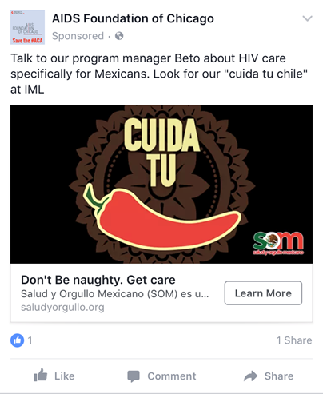
Program Overview
SOM is a peer navigation program
Includes 5 individual level standardized sessions
Goal is linkage and retention of clients in HIV primary care, increase support, decrease stigma
Peer (promotors) role is to provide peer education, support and navigation services
  Referral to Ryan White case manager as needed for other services/referrals (e.g., housing, employment, etc.)
Notes:
In 2013, AFC signed on to participate in a Special Project of National Significance (SPNS) demonstration project with HRSA. This particular initiative called for sites across the country to use culturally-appropriate interventions with a transnational approach to improve health outcomes for Latinos and Latinas living with HIV. Sites either focused on Mexican or Puerto Rican populations; our project is focused on HIV+ Mexican Men and is called Salud Y Orgullo Mexicano (or SOM for short)– which translates as “Mexican Health and Pride.”
SOM is a peer-navigation program, providing peer education and peer support to HIV+ Mexican Men. The program seeks to increase Mexican Men’s access to HIV testing, link and retain positive Mexican men in HIV medical care, and to reduce HIV-related stigma in the Mexican community in Chicago. We do though through a peer education model that addresses the transnational realities of clients lives and that seeks to provide culturally-appropriate information, materials, and delivery. Participants go through a series of sessions with their peers [EXPLAIN PEERS] that provides everything from HIV education, medication adherence, and appointment adherence, to navigating dating, social support, and making decisions about disclosure, to addressing HIV care options in Mexico, budgeting for HIV-care with the added expense of remittances, not letting herbal home remedies interfere with medication, and opportunities for affordable care for clients who are undocumented. The whole time they receive peer support in helping them navigate case management and medical care at Erie.

Slide 5
Intervention
Peer Navigation Services
  Individualized health education
  Skills building around patient-provider relationship
  Communication
  Accompanying participants to medical appointments
  Navigating available resources: housing, substance use, employment services
Notes:
SOM Promotores are trained in various stages. The first stage of training involves a four-day People-to- People training facilitated by the AIDS Foundation of Chicago (AFC). People to People is a peer-to-peer education program that supports individuals living with HIV and AIDS. People to People is intended to improve the health of those living with HIV/AIDS by providing trained, quality peers to the community and building local organizations’ capacity to use peers. The program targets HIV-positive individuals who reflect the epidemic in each local area. Training includes HIV transmission, disease progression, treatment adherence, and clinical preceptorships to address identified needs. As a peer-oriented popular education program, this training captures crucial elements of AFC’s SOM Project by informing peer navigation services for Promotores.

Slide 6

Cultural Tailoring- Transnationalism
Focus group activities and work with marketing company led us to the use of Lotería within marketing campaign
  To evoke sense of shared familial and common experience
  To trigger recall of culturally-specific game played in Mexico and in Chicago

Slide 7

Cultural Tailoring- Ejemplos vivos
Real-life scenarios impacting care
  Pedro’s Story
  Pedro was diagnosed with HIV within the past 6 months and currently not on HIV treatment yet. He has a high CD4 count and does not want to start treatment because he is concerned with the side effects. However, he does not want an HIV diagnosis.
  What are the benefits of understanding the importance of treatment for HIV? Can you relate to Pedro’s story? How?
Notes:
The scenarios serve as a safe third party to project concerns or issues on and attempt to create solutions to HIV care barriers
Important to gauge the knowledge and understanding of the participant, which cultural or transnational elements may be facilitators or barriers to HIV care and HIV healthy decision making
Case studies deal with issues of identity, health and wellness, and stigma
SOM created a manual for supporting and training Promotor on structured disclosure during the education sessions

Slide 8
Anti-immigrant rhetoric
I’m opposed to new people coming in. We have to take care of the people who are here. Source: nytimes.com/library/politics , Dec 10, 1999
Mexico is beating us economically. They are not our friend, believe me. But they're killing us economically. The U.S. has become a dumping ground for everybody else's problems. When Mexico sends its people, they're not sending their best. They're sending people that have lots of problems, and they're bringing those problems. They're bringing drugs. They're bringing crime. They're rapists. And some, I assume, are good people. Source: 2015 announcement speeches of 2016 presidential hopefuls , Jun 16, 2015
How crazy - 7.5% of all births in U.S. are to illegal immigrants, over 300,000 babies per year. This must stop. Unaffordable and not right! — Donald J. Trump (@realDonaldTrump) August 21, 2015

Slide 9
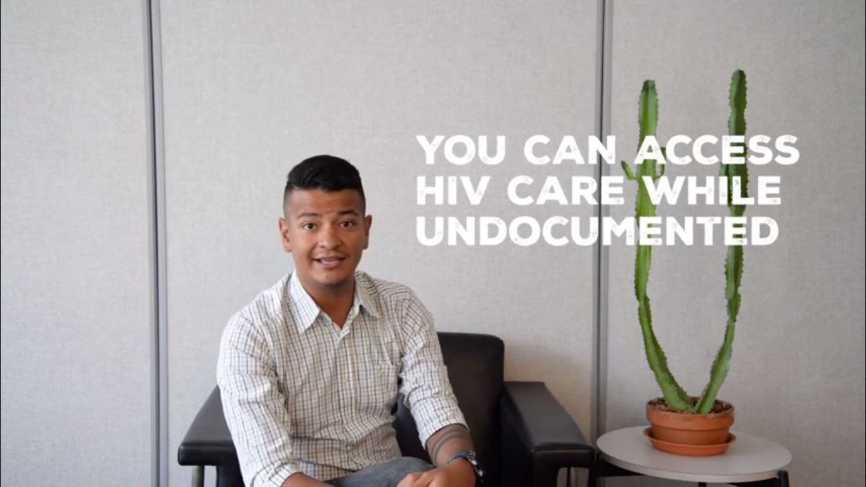
Addressing our political environment
As recruitment evolved and our social environment changed we focused on immigration narratives
  Infused information on obtaining services throughout intervention
  Used language throughout marketing/website that affirms HIV care despite immigration status

Slide 10
Meeting our clients’ needs
SOM staff conducted one round of focus groups and participant interviews to assess several areas:
Client needs
Satisfaction with the intervention
Relevance of the intervention
Barriers to care

Slide 11
Adaptations
Surprises:
  Influences of Mexico not as strong as we anticipated
  Less connected to family/traditions of Mexico
  More concerned about relationships and disclosure/stigma issues
Changes over time:
  Began to assess transnationalism as a construct and address degrees of transnationalism within individual sessions
    For example, how to access HIV care and medication while in Mexico
  Continue to attend significant cultural festivals and celebrations
  Focus on out of care individuals
Current incorporation:
  Promotores share their experiences and tailor sessions to meet clients where they are at in terms of transnationalism
  Strength of peer-model→ promotores add cultural components as they have experienced them

Slide 12
Lessons learned
Give time and money to support promotores LWH
Lots of training is needed for promotores
Be flexible and adaptable
Offer options for clients to select what they learn
Notes:
In developing and implementing a peer-based navigation program it is critical to ensure proper start up time and staff supervision structure.
A large amount of training is needed for peer health workers, which pays off in terms of skills developed and participant outcomes in the long view. Having a peer with a similar Mexican background as clients helps facilitate relationships and trust.
In developing a culturally appropriate intervention it is important to be flexible and adaptable.
Our program team conducted three rounds of qualitative research in order to continue to refine our approach. We also learned that including a wide range of topics in education sessions allowed clients to focus on what was important to them, rather than having project staff dictate what is important.

Slide 13
Contact us:
Román Buenrostro
Director of Special Projects and Planning
rbuenrostro@aidschicago.org
Direct: 312-334-0960
Banita M. McCarn, Med
Sr. Research & Evaluation Manager
Bmccarn@aidschicago.org
Direct: 312-784-9098

