Slide 1
Improving Linkage and Retention in HIV Care: Insights from Community Health Workers
Savanna Bailey
Community Health Worker, Legacy Community Health Services, Inc.
Dareen Berniard
Community Health Worker, Crescent Care
Allyson Baughman
Program Director, Center for Innovation in Social Work and Health, Boston University
Keanu Medina-Rascon
Community Health Worker, Southern Nevada Health District
Evelyn Nicholson
Community Health Worker, JACQUES Initiative, University of Maryland
Peter Williams
Community Health Worker-Support Specialist, East Carolina University

Slide 2
Disclosures
Presenters have no financial interest to disclose.
This continuing education activity is managed and accredited by AffinityCE/Professional Education Services Group in cooperation with HRSA and LRG. PESG, HRSA, LRG and all accrediting organization do not support or endorse any product or service mentioned in this activity.
PESG, HRSA, and LRG staff as well as planners and reviewers have no relevant financial or nonfinancial interest to disclose.
Commercial Support was not received for this activity.

Slide 3
Learning Objectives
At the conclusion of this activity, the participant will be able to:
Identify services provided by CHWs to improve engagement and retention in HIV care.
Describe the role of CHWs in a sample of Ryan White program funded medical provider sites from across the United States.
Learn about the role of CHWs in improving linkage and retention in HIV care from CHWs themselves.
Compare and contrast the roles of CHWs working in rural and urban areas.

Slide 4
Obtaining CME/CE Credit
If you would like to receive continuing education credit for this activity, please visit:
http://ryanwhite.cds.pesgce.com

Slide 5
About the Initiative FY 2016-2019
Improving Access to Care: Using Community Health Workers to Improve Linkage and Retention in HIV Care
Funded through the Secretary’s Minority AIDS Initiative Fund (SMAIF)
Administered by HRSA, HIV/AIDS Bureau, Division of Community HIV/AIDS Programs (DCHAP)
Boston University funded as the Technical Assistance and Evaluation Center (TAEC) for the initiative.

Slide 6
Key Initiative Components
10 Ryan White-funded provider sites to contract with Boston University
Technical Assistance and Training
Learning Sessions
Multi-site Evaluation
Notes:
Distribute the CHW fact sheet here

Slide 7
Framework
CHW Workforce
HIV/AIDS
Notes:
Distribute the CHW fact sheet here

Slide 8
RWHAP sites

Slide 9
Tell Me about Your Agency

Slide 10
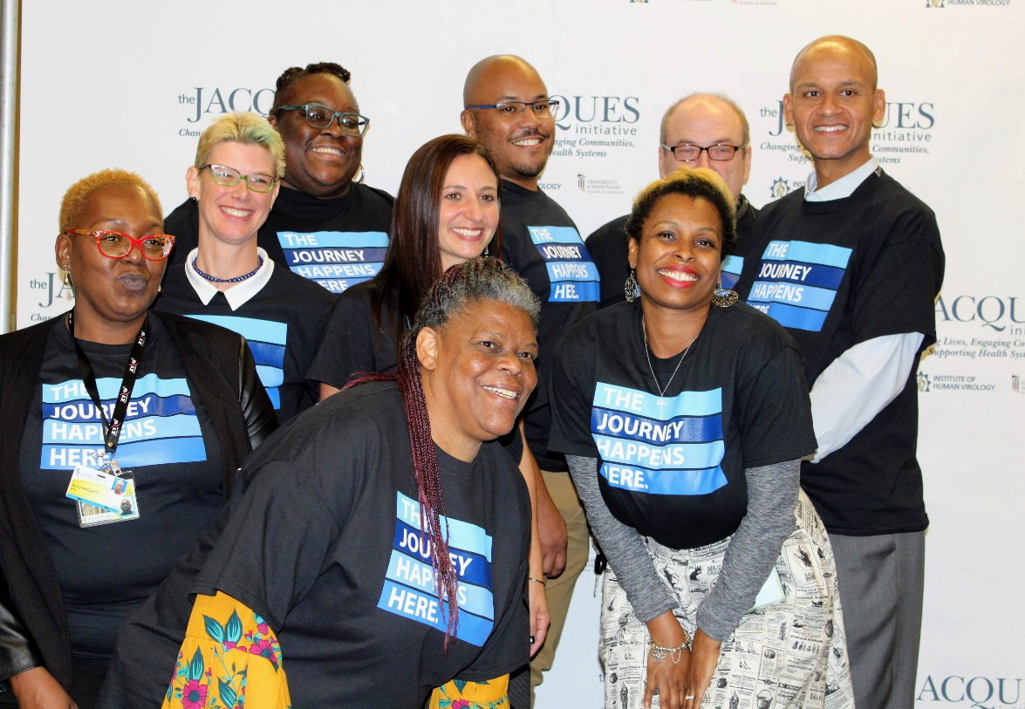
JACQUES Initiative
From in-patient routine HIV testing to linkage to care and beyond.
Team of 10
2 Nurse coordinators, Social Worker,
3 Community Health Workers, Therapist, Administrative Assistant, Psychiatrist, volunteer marketing and graphics individual
We serve about 75 clients per year
We serve ages 21+
Located at the U of Maryland hospital in the heart of downtown Baltimore, MD

Slide 11
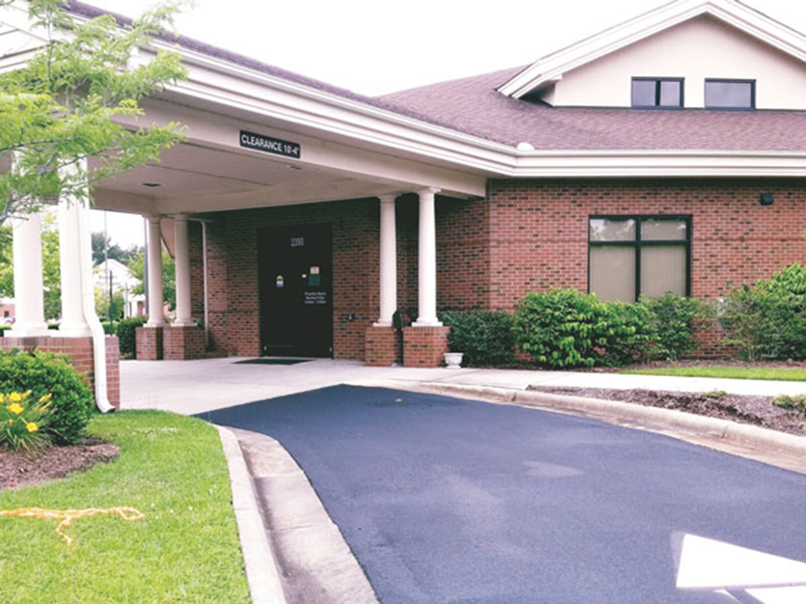
East Carolina University (ECU) Adult Specialty Care Clinic
Hours: Monday- Friday, 8 am to 5 pm
Staff: 50
CHWs: 3
Serve 1500 clients from 30 rural counties
Clinic serves ages 18+

Slide 12
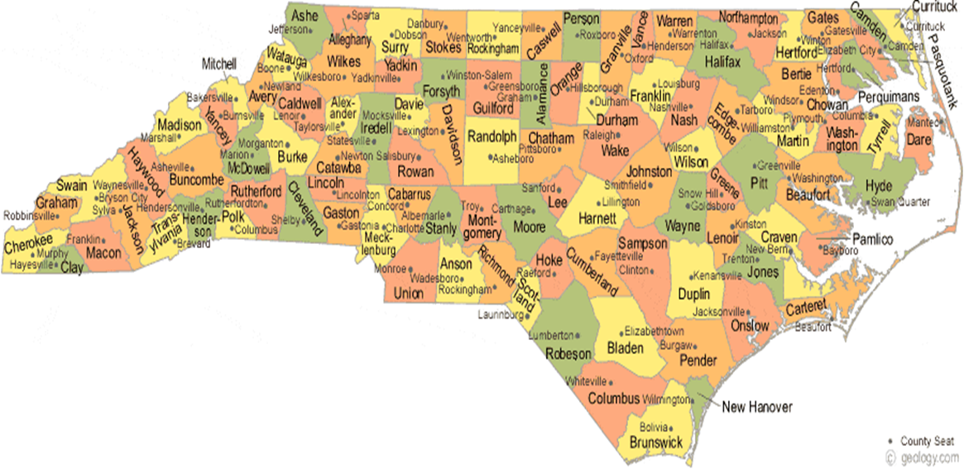
ECU Adult Specialty Care Clinic

Slide 13
Crescent Care New Orleans, LA
Primary Care
Health Education
Dental Care
Behavioral Health
PrEP and PEP services
Hep C services
LGBTQ Health and Wellness
Transgender Health services
Legal services
Harm Reduction
STI Testing and Treatment

Slide 14
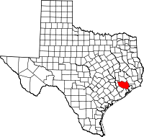
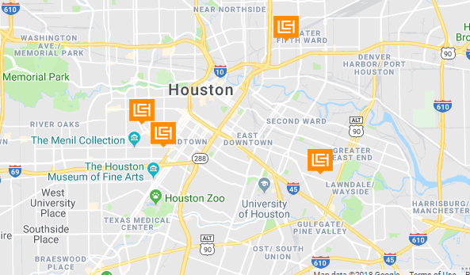
Legacy Community Health, Inc.
Federally Qualified Health Center (FQHC) in Houston, TX.
Legacy originally started as an STD testing and treatment center for gay and bisexual men.
Services now include adult medicine, OB/GYN, behavioral health, pediatrics, dental, vision, nutrition, fitness, STD testing, gender care, and pharmacy services.
Serves over 4,000 clients who are HIV positive.
More than 2,000 clients on Ryan White funding (2017) with Parts A, B, C, D, and State Services.
Notes:
Agency, agency location

Slide 15
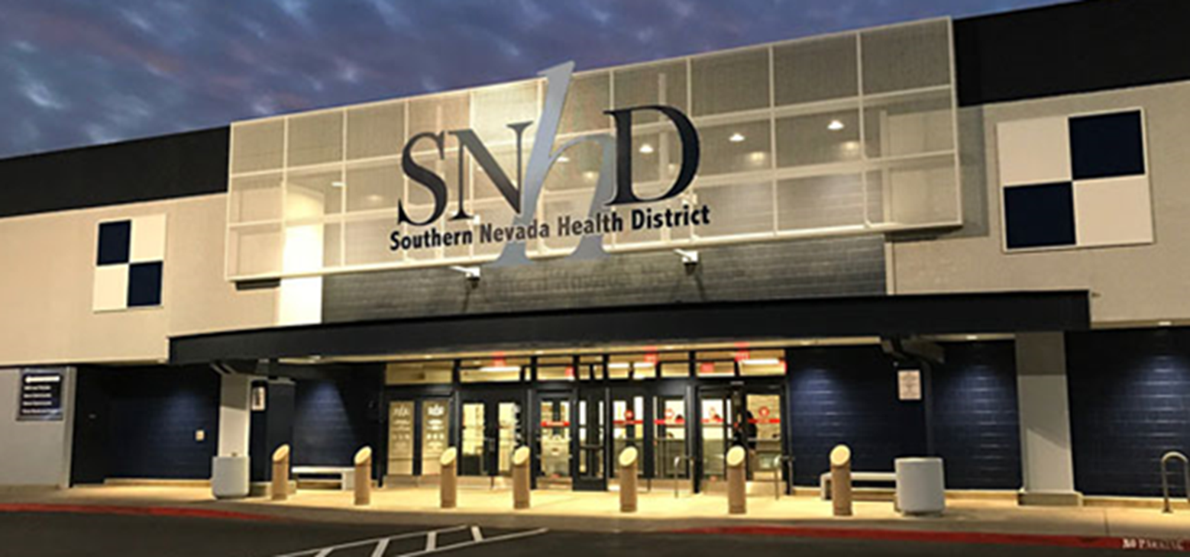
Southern Nevada Health District
Mission: To assess, protect, and promote the health, the environment, and the well-being of Southern Nevada communities, residents, and visitors.
Serves more than 2 million residents and 40 million visitors a year
Offers clinical services, surveillance,
and regulatory oversight that impact public health
Receives Ryan White Parts A and B funding
http://www.southernnevadahealthdistrict.org

Slide 16
Southern Nevada Health District
Clinical Services
Primary Care
Immunizations
TB Clinic
Family Planning
Pharmacy
Sexual Health Clinic
STD screening, evaluation, treatment, and referrals; PrEP; Hepatitis screening and medical management
Ryan White Care Services
Community Health Worker; medical case management; linkage coordination; HIV clinic; eligibility and enrollment; detention center care coordination; collaboration with disease investigators and prevention programs; collaboration with community partners

Slide 17
Tell Me about Your CHW Program

Slide 18
ECU CHW Program- Care Team Approach
Provider
Evaluates medical and health care needs, lab results, prescribes medications
Provide medical advice and referrals to other medical specialists (e.g., Primary Care, Dental, Vision)
Medical Case Manager (MCM)
Support & assist clients with understanding the HIV disease spectrum
Assist client in navigating medical services (e.g., RWE, HMAP, medical referrals)
Community Health Worker-Support Specialist (CHW)
Engage in partnership with providers, MCM, & other team members to ensure quality health services
Assist client with non-medical services to increase retention and engagement with care
Outreach & build relationships with clients and community
Recognize & address challenges/barriers that impact care
Client
Provider
MCM
CHW

Slide 19
Legacy Community Health, Inc. Referral Sources
CHW
Case Managers
Service Linkage Workers
mSociety
Other CHWs
EMR
Notes:
This slide will be used to show the multiple ways in which I work with other internal sources to receive referrals and coordinate care. This and the next slide will also incorporate how I fit in with the care continuum.

Slide 20
Legacy Community Health, Inc.
By The NUMBERS (February 2018-September 2018)
500+ individuals contacted
100+ individuals reached
90+ patients actively monitored (calls, in-person meetings, team care coordination)
46 patients completed a medical appointment
9 patients enrolled in evaluation
Clients:
Out of care
Not virally suppressed
Newly diagnosed (new qualification)
Notes:
These are my current numbers and client qualifications. This shows clients I serve and the success rate so far.

Slide 21
Crescent Care
Target population- clients that are out of care and/or non-virally suppressed
Clients can be referred by Case Manager, Nurse, Provider, etc.
Clients are consented into the program
Goals are set
At the end of 90 days clients are re-assessed for further services

Slide 22
JACQUES Initiative
We start in the hospital
We follow individuals through their continuum of care:
Home
Nursing home
Transitional living
Wherever you go after the hospital, we are there.
We do holistic care.
Where ever you want to go for your HIV care, we will help you get there, and we will do whatever it takes to keep you in care.

Slide 23
Southern Nevada Health District
Program Manager
Supervisor
CHW
CHW Program
Focus Population
Newly diagnosed
Not virally suppressed
Missed ≥2 medical appointments
Experiencing homelessness/unstably housed
Substance use disorders
Mental health disorders
Recent incarceration
Spanish-speaking only and unable to represent themselves in English
Notes:
Use a “Team Approach” to coordinate patient care
CHW works with case managers (nurses or social workers) and eligibility workers
CHW meets with a Clinical Supervisor once/month or more, if needed

Slide 24
Energizer Activity

Slide 25
How Do You Do Your Work?

Slide 26
ECU CHW-Support Services
Outreach
Education Modules
Motivational Interviewing
Support Services
Home visits
Transportation services (Medicaid, gas vouchers, bus passes, taxi, clinic van)
Housing (HOPWA)
Emergency Financial Assistance (EFA)
HIV 101; Communicating with providers; Understanding CD4, VL, OI, STI; HIV medication and adherence; Goal setting; Social support and disclosure
Mental health services
Substance Abuse services
Transition to Assisted Living
Coaching
Emotional Support
Trauma-Informed Care (early initiative)

Slide 27
JACQUES Initiative
Meet clients at the hospital
Get to know them and where they are at with their HIV status
Assess their knowledge of HIV
Make conversation
Find out what they like to do
Find out their goals
Hold them accountable for what they need to do “to get from point A to point B”
Talk about substance use
Organize and hold a retreat for clients 3 times per year
Events to address and prevent isolation
Accompany clients to appointments (medical, social services, etc.)
Make referrals to meet their needs
Provide emotional support
Be an ear, Be someone they can talk to
Become a friend

Slide 28
“What do you need help with?”
Legacy Community Health, Inc.
I don’t understand my lab results.
I didn’t know I missed an appointment.
I’m having trouble getting my medication.
Notes:
In this slide I will touch on my position within the care continuum and how I can assist with patients concerns. I will also discuss how I form unique relationships with clients as I get to know them better. One of my client loves to talk about his puppy, so I always bring that up when we’re on the phone. Another is working to design and create his outfit for his wedding, so I ask how that is going.

Slide 29
Community Connections
Legacy Community Health, Inc.
Member of the Quality Improvement Committee of the Houston Ryan White Planning Council
Graduate of Project LEAP 2018
Notes:
Here I will discuss some of the ways I interact with community members through the council and committee. I will also discuss how this information is beneficial to my clients and my job.

Slide 30
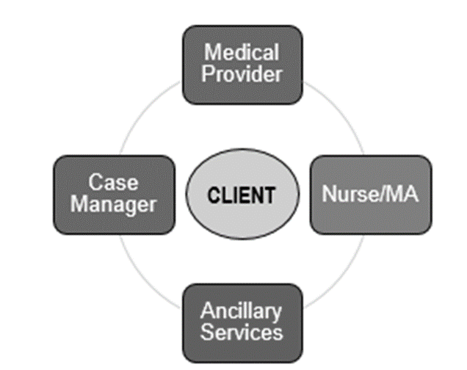
Crescent Care CHW Services
Medication Adherence
Medication Assistance
Scheduling Appointments
Linkage to care
Education
Support
Housing
Transportation & More!

Slide 31
Southern Nevada Health District
Dr. Fermin Leguen (Medical Director)
Lourdes Yapjoco (Program Supervisor)
Data and Evaluation
Merylyn Yegon (Admin Supervisor)
Rebecca Reyes (Clinical Supervisor)
Keanu Medina- Rascon (CHW)
Angela Smith (CHW)
Keanu, Angela, Lourdes, Rebecca, Merylyn

Slide 32
Southern Nevada Health District
Focus Population
Newly diagnosed
Not virally suppressed
Missed ≥2 medical appointments
Experiencing homelessness/unstably housed
Substance use disorders
Mental health disorders
Recent incarceration
Spanish-speaking only and unable to represent themselves in English
Notes:
After HIV Diagnosis: One-on-one sessions to establish rapport, warm handoff, share personal life experiences; phone calls and/or home visits to follow up on referrals.
Linkage: Work with client and care team to choose a provider; accompany patients to appointments and translate.
Engagement: Teach clients life skills to stay in care (e.g., medication management skills and adherence techniques); modeling and coaching clients (e.g., how to make an appointment and follow-through, how to ride the bus to appointments, etc.).
ART: Assist client in developing medication schedule; help monitor adherence and side effects; provide guidance or referral to see provider; referral to medication resources (e.g., ADAP or other pay source).
Viral Suppression: Focus on adherence and retention in care; coach/support client in lifelong commitment to ART; promote development of self-efficacy; give clients positive reinforcement for achieving viral suppression and goals.

Slide 33
What Does Self-Care Look Like for You? Why is it Important?

Slide 34
Self-care!
Legacy Community Health, Inc.

Slide 35
Crescent Care Self-care

Slide 36
SELF CARE – RETAIL THERAPY

Slide 37
JACQUES Initiative
Self-care is important so that you don’t become overwhelmed or burned out
You have to find things to release the pressure
If don’t take care of yourself, you aren’t good to anyone
Working in the community
Me time

Slide 38
Acknowledgements
We want to thank our partners and colleagues for their help and support
Brian Fitzsimmons, HRSA Project Officer
Crescent Care (Stephanie and Lucy)
East Carolina University (Karter, Karen, LaSean, LaWanda, and Dr. Campbell)
JACQUES Initiative (Alicia, Gene, Jamie, Marik, and Nikki)
Legacy Community Health (Amy, Jason, and Kiah)
Southern Nevada Health District (Angela, Lourdes, Merylyn, Rebecca, and Dr. Leguen)
Center for Innovation in Social Work and Health (Linda, Maria, Marena, Mari-Lynn, Rachel, Sally, and Serena)

Slide 40
Energizer Activity

Slide 41
Southern Nevada Health District
After HIV Diagnosis: One-on-one sessions to establish rapport, warm handoff, share personal life experiences; phone calls and/or home visits to follow up on referrals.
Linkage: Work with client and care team to choose a provider; accompany patients to appointments and translate.
Engagement: Teach clients life skills to stay in care (e.g., medication management skills and adherence techniques); modeling and coaching clients (e.g., how to make an appointment and follow-through, how to ride the bus to appointments, etc.).
ART: Assist client in developing medication schedule; help monitor adherence and side effects; provide guidance or referral to see provider; referral to medication resources (e.g., ADAP or other pay source).
Viral Suppression: Focus on adherence and retention in care; coach/support client in lifelong commitment to ART; promote development of self-efficacy; give clients positive reinforcement for achieving viral suppression and goals.
Notes:
*OLD SLIDE*

Slide 42
Southern Nevada Health District
Referral
Team Leader
CHW
CHW program receives a referral (from Health District programs/community partners)
Reviews referral for CHW program
Assigns to CHW if appropriate
Contacts the client
Collaborates with the client on a service plan
Makes referrals to meet clients needs
Notes:
Partners include SNHD leadership, RW & SHC Staff, RW funders, OEDS, community partners; Action Planning Group meetings; frequently reinforcing role definitions; engaging other staff in streamlining roles to minimize duplications and optimize effectiveness
Obtaining SNHD leadership support was important in bringing in CHW’s into SNHD. This was the first time for Clinical Services.
We are now looking into expanding the roles to other Clinical Services, as a result, the CHW position was added to SNHD employment category in August 2018.
Additionally, NV State (RW Part B recipient) is helping fund the current program. For sustainability plan, both NV State and Clark County Social Services (Part A recipient) have expressed interest in ongoing funding beyond this grant period.

Slide 43
Southern Nevada Health District
Notes:
After HIV Diagnosis: One-on-one sessions to establish rapport, warm handoff, share personal life experiences; phone calls and/or home visits to follow up on referrals.
Linkage: Work with client and care team to choose a provider; accompany patients to appointments and translate.
Engagement: Teach clients life skills to stay in care (e.g., medication management skills and adherence techniques); modeling and coaching clients (e.g., how to make an appointment and follow-through, how to ride the bus to appointments, etc.).
ART: Assist client in developing medication schedule; help monitor adherence and side effects; provide guidance or referral to see provider; referral to medication resources (e.g., ADAP or other pay source).
Viral Suppression: Focus on adherence and retention in care; coach/support client in lifelong commitment to ART; promote development of self-efficacy; give clients positive reinforcement for achieving viral suppression and goals.

Slide 44
Crescent Care-Ryan White Funding
PART A
PART B
PART C
PART D
PART F
Funds about 21 programs including:
Case management
Peer Support
Health Education
Case Management
Supportive Services
Medical Case Management
Patient Navigation
Transportation
Family AIDS Clinic and Education Services (FACES): Provides services for families
Case Management
Mental Health for African-American MSM

