Slide 2
Enrollment & Eligibility: From Insurance to Discounted Fee Schedule to Caps on Charges
Latasha Jones, MPH & Jana Collins, MS
University of Kentucky
Bluegrass Care Clinic

Slide 3
Learning Objectives
Identify the steps in client management: enrollment and eligibility, sliding fee scale and discount schedule, and cap on out of pocket charges
Describe the Ryan White HIV/AIDs Program (RWHAP) legislative requirements and program expectations as it relates to enrollment and eligibility, sliding fee scale and discount schedule, and cap on out of pocket charges
Create educational tools that can be provided to patients to assist in managing the sliding fee scale and cap on out of pocket charges
Notes:
UPDATED SLIDE

Slide 4
The Circle of Assessing Client Charges
Enrollment and Eligibility
Schedule of Charges
Caps on Charges
Notes:
Provide an overview of presentation and components before moving onto requirements
UPDATED SLIDE

Slide 5
Enrollment & Eligibility
Enrollment and Eligibility
Schedule of Charges
Caps on Charges

Slide 6
Ryan White Eligibility
Ryan White legislation requires that individuals receiving Ryan White services must:
  Have a diagnosis of HIV/AIDS and
  Be low-income as defined by the recipient
  Parts A & B Planning Bodies/Consortia may define eligibility more precisely (specified income cap) but may not broaden the definition (PCN 13-02)
  HRSA/HAB Policy Clarification Notice 13-02

Slide 7
Enrollment & Eligibility
HRSA expects clients’ eligibility be assessed during the initial eligibility determination and recertified at least every six months
At least once a year (12-month period or calendar year), the recertification procedures should include the collection of more in-depth information, similar to that collected at the initial eligibility determination.
Recipients and subrecipients are required to vigorously pursue and rigorously document enrollment into, and subsequent reimbursement from, health care coverage for which their clients may be eligible (e.g., Medicaid, Medicare, Children's Health Insurance Program (CHIP), state-funded HIV/AIDS programs, employer-sponsored health insurance coverage, health plans offered through, other private health insurance) to extend finite RWHAP grant resources to uninsured and underinsured, low income PLWH.
Ryan White Part C Notice of Funding Award FY 2018

Slide 8
Enrollment & Eligibility, cont.
The enrollment and eligibility process:
Ensures a client is enrolled in all eligible third party payer sources
Ensures Ryan White serves as the payer of last resort
Facilitates the recipient’s determination regarding imposition of charges for services (slide fee scale)
Identifies the patient’s placement on the discounted schedule of charges
Determines the patient’s cap on out-of-pocket charges

Slide 9
PCN 13-02 - Clarifications on Ryan White Program Client Eligibility Determination and Recertification Requirements
 | Initial Eligibility Determination & Once a Year/12 Month Period Recertification | Recertification (minimum of every six months)
HIV Status | HIV Status Documentation required for Initial Eligibility Determination Documentation is not required for the once a year/12 month period recertification | No documentation required
Income | Documentation Required | Grantee may choose to require a full application and associated documentation Self-attestation of no change Self-attestation of change - grantee must require documentation

Slide 10
PCN 13-02 - Clarifications on Ryan White Program Client Eligibility Determinations and Recertification Requirements
 | Initial Eligibility Determination & Once a Year/12 Month Period Recertification | Recertification (minimum of every six months)
Residency | Documentation Required | Grantee may choose to require a full application and associated documentation Self-attestation of no change Self-attestation of change - grantee must require documentation
Insurance Status | Grantee must verify if the applicant is enrolled in other health coverage and document status in client file | Grantee must verify if the applicant is enrolled in other health coverage Self-attestation of no change Self-attestation of change - grantee must require documentation

Slide 11
Example Ryan White Enrollment Process
Patient completes enrollment paperwork
Patient provides income and residency information
Patient is assessed and enrolled in Medicaid/Marketplace insurance as eligible
Patient is assigned a level/cap on charges based on income provided
Insurance information and schedule of charges placement information is entered into billing system
All charges are billed to insurance initially (as applicable)
Discounted schedule of charges is applied on amount owed by patient after insurance has assisted (if applicable)

Slide 12
Example Ryan White Enrollment Process
Patient is billed for amount owed based on the schedule of charges
Patient charge is applied to patient’s cap on out of pocket charges
Program should check in with patient at a maximum of 6 months after enrollment to ensure nothing (insurance eligibility/income) has changed via self-attestation or documentation; patient recertifies
Income from insurance/patient payment (if applicable) is applied to program income and reinvested back into the Ryan White program
Notes:
#8 said “Recipient assists with the difference between the amount owed and the patient’s responsibility”

Slide 13
Sliding Fee Scale/Discount Schedule of Charges
Enrollment and Eligibility
Schedule of Charges
Caps on Charges
Notes:
UPDATED SLIDE

Slide 14
Important Definitions
Schedule of fees: complete listing of Ryan White billable services and their associated fees
Schedule of charges: a listing of reduced fees for services based on ability to pay. A schedule of charges may take the form of a sliding fee scale, discount on charges or a nominal fee
Nominal fee: a type of charge that is a fixed/flat fee greater than zero for the provision of a Ryan White service
Discount on charges: a type of charge that is a percentage of the full fee per the schedule
Notes:
Note: “A schedule of fees/fee schedule is not required by the RWHAP legislation, but having one in place would be considered a best practice. Medicaid and insurance plans use a Fee Schedule containing a comprehensive list of maximum fees used to reimburse a physician and/or other providers on a fee-for-service basis.”
UPDATED SLIDE

Slide 15
RWHAP Expectations: Schedule of Charges
Each program is responsible for creating its own schedule of charges in accordance with Ryan White statutory requirements
Federal Poverty Guidelines are updated each year in late winter and are available on the HHS website
https://aspe.hhs.gov/poverty-guidelines

Slide 16
Income Calculations
Ryan White eligibility and schedule of charges both require proof of income; however
  Ryan White program eligibility can be based on household income
  Schedule of charges and cap on charges is based in individual income
Notes:
Note: Annual income is based on the calendar year.
UPDATED SLIDE

Slide 17
Ryan White Legislation: Patient Charges for Services
Ryan White legislation mandates that the provider:
  Will not impose a charge on individuals with incomes at or below 100% of the federal poverty level (FPL) for the provision of Ryan White services
  Will impose a charge on individuals with incomes above 100% FPL for the provision of Ryan White services according to a schedule of charges that is made available to the public
Public Health Service Act Sec. 2605(e)
Notes:
UPDATED SLIDE
For DCHAP presentation, the citation should say 2664(e)

Slide 18
Schedule of Charges: Recipient/Sub-recipient Responsibility
  Establish, document, and have available for review:
    Policy for a schedule of charges
    Current schedule of charges (based on current FPL)
    Evidence of client eligibility determination in client records
    Evidence of fees charged by the provider and the payments made to that provider by clients
    Process for obtaining and documenting client charges and payments made during the calendar year (January – December)
Notes:
UPDATED SLIDE

Slide 19
Clients Above 100% FPL: Service Provider Responsibility
  Establish and maintain a schedule of charges policy that includes a cap on charges and the following:
    Policy for schedule of charges that ensures clients above 100% of FPL are charged for services
    Responsibility for client eligibility determination to establish individual fees and cap on out of pocket charges
    Tracking of charges or medical expenses inclusive of enrollment fees, deductibles, co-payments, etc. towards the cap on charges
    A process for alerting the billing system that the client has reached the cap and should not be further charged for the remainder of the calendar year
    Personnel are aware of and consistently following the policy for schedule of charges and cap on charges
Notes:
Not written in FMS, but providers must track charges across parts. To be discussed more later in the presentation.
UPDATED SLIDE

Slide 20
2018 Federal Poverty Guidelines
2018 Poverty Guidelines for the 48 Contiguous States and the District of Columbia
Persons in Family/Household | Poverty Guideline
1 | $12,140
2 | 16,460
3 | 20,780
4 | 25,100
5 | 29,420
6 | 33,740
7 | 38,060
8 | 42,380
Notes:
Add source and make table compliant

Slide 21
Schedule of Charges – Nominal Fee (Example)
Federal Poverty Level | Nominal Fee*
<100% FPL | $0
101-150% FPL | $5
151-200% FPL | $10
201-250% FPL | $15
251-300% FPL | $20
300% - 400% FPL | $25
>400% FPL | Full charge (up to cap)
* Up to the patient’s assigned cap on charges
Notes:
Assumes the cap is 400% -- could be higher or lower.

Slide 22
Nominal Fee - Example
Person living with HIV
Annualized income = $15,075
FPL = 125%
Patient has Medicare
Patient attends HIV-related medical appointment
Patient responsibility after Medicare
  Patient balance after Medicare = $51.25
  Patient is charged nominal fee of $5
Federal Poverty Level | Nominal Fee
101-150% FPL | $5

Slide 23
Schedule of Charges – Percentage (Example)
Federal Poverty Level | Percentage Responsibility*
<100% FPL | 0%
101-150% FPL | 10%
151-200% FPL | 20%
201-250% FPL | 40%
251-300% FPL | 60%
300% - 400% FPL | 80%
>400% FPL | No discount (up to the cap)*
* Up to the patient’s assigned cap on charges
Notes:
Assumes cap is at 400% - could be higher or lower

Slide 24
Percentage Fee - Example
Person living with HIV
  Annualized income = $18,814
  FPL = 156%
  Patient has private insurance
Completes HIV-related medical appointment
  Insurance requires co-pay of $50
  Patient is charged nominal fee = $10 (20%)
  Grant assists patient with remainder of the co-payment = $40 (80%)
Federal Poverty Level | Percentage Responsibility
151-200% FPL | 20%
Notes:
FPL = ?
Cap on Charges = ?

Slide 25
Ryan White & Other Schedule of Charges
Some organizations already have a defined schedule of charges, i.e. Federally Qualified Health Centers, but there are several important distinctions:
FQHC Schedule of Charges | RWHAP Schedule of Charges
Charges allowed for persons with income <100% FPL | No charges allowed for persons with income <100% FPL
Caps discount to persons with incomes at or below 200% | No cap on discount

Slide 26
Ryan White & Other Schedule of Charges
If the organization’s existing schedule of charges is in line with Ryan White legislation and program requirements then recipients can utilize the existing schedule of charges
However, if the schedule of charges is not in compliance then the recipient will need to adopt a schedule of charges specific to the Ryan White program
  E.g. persons with incomes <100% of FPL cannot be charged for services

Slide 27
Caps on Charges
Enrollment and Eligibility
Schedule of Charges
Caps on Charges

Slide 28
Ryan White Legislation: Patient Cap on Charges
Each Ryan White program must have a system in place to ensure that defined annual (calendar year) caps on charges to patients are not exceeded
Organization must track the patient’s annual gross income and charges imposed (cap on charges)
The patient tracks charges imposed across programs
Public Health Service Act Section 2605e

Slide 29
Cap on Charges – Legislatively Defined
Individual Income | Maximum Charge
At or Below 100% of Federal Poverty Level (FPL) | $0
101 to 200% of FPL | No more than 5% of annual gross income
201 to 300% of FPL | No more than 7% of annual gross income
Over 300% of FPL | No more than 10% of annual gross income

Slide 30
Calculating Patient Cap on Charges
According to legislation, patient caps on charges are:
  Based on an individual’s FPL
  Calculated and updated annually
  Based on charges imposed, not on payments made
  Applied to both insured and uninsured patients (remember payer of last resort policy)
Caps on charges should consider the annual aggregate of charges imposed without regard to whether they are characterized as enrollment fees, premiums, deductibles, copayments and coinsurance (PCN 13-05, 13-06, 14-01)

Slide 31
Cap on Charges - Example
Person living with HIV
Annualized income = $26,450
FPL = 223%
Cap on out of pocket charges (7%) : $1,851.50
Patient is assessed for insurance and does not currently have insurance options
Federal Poverty Level | Nominal Fee
201-250% FPL | $15
Individual Income | Maximum Charge
At or Below 100% of Federal Poverty Level (FPL) | $0
101 to 200% of FPL | No more than 5% of annual gross income
201 to 300% of FPL | No more than 7% of annual gross income
Over 300% of FPL | No more than 10% of annual gross income

Slide 32
Cap on Charges – Example Nominal Fee
Referred to specialty provider at another health center
Completes HIV-related specialty medical appointment
Full charge of appointment (per schedule of fees) is $150
Patient is charged nominal fee of $15
Ryan White assists with co-pays and remaining balance of $135 by paying specialty provider
$15 is applied to patients cap on out of pocket charges on $1,851.50
Federal Poverty Level | Nominal Fee
201-250% FPL | $15

Slide 33
Cap on Charges – Example Percentage
Referred to specialty provider at another health center
Completes HIV-related specialty medical appointment
Full charge of appointment (per schedule of fees) is $150
Patient is charged $60, based on 40% discount per schedule of charges
Program assists with remaining balance of $90 by paying specialty provider
$60 is applied to patients cap on out of pocket charges on $1,851.50
Federal Poverty Level | Percentage Responsibility
201-250% FPL | 40%

Slide 34
RW Enrollment and Eligibility in Action
ACA impact on Enrollment and Eligibility
Case Studies
Patient Educational Tools

Slide 35
Background Info for Case Studies

Slide 36

Bluegrass Care Clinic (BCC)
Jennifer Edwards (2011)
The mission of the Bluegrass Care Clinic is to provide a continuum of high quality, state-of-the-art, multi-disciplinary HIV primary care in a compassionate, culturally sensitive manner.

Slide 37
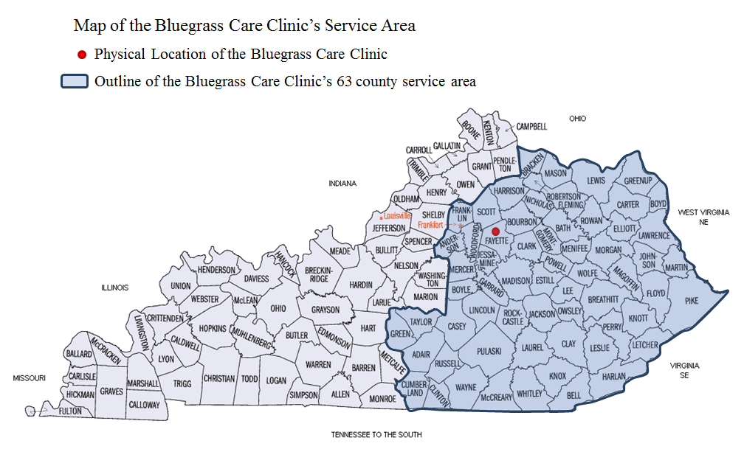
BCC Service Area

Slide 38
Bluegrass Care Clinic
University of Kentucky Healthcare – KY Clinic – College of Medicine - Division of Infectious Diseases (Academic Medical Center)
Lexington, KY ( 2nd largest city in KY) – Urban area – Population: 321,959 (2017)
2018 YTD serve over 1600 PLWHA
RWHAP: Part B, Part C, Part D, Part F (Dental-separate program located within UK Healthcare)
KY Clinic Pharmacy- Location for KY ADAP program
KYAETC – Kentucky Aids Education and Training Center
Prevention for Positives
Other Special Projects: REPREIVE, Au Buprenorphine, CHOICES
Notes:
60th Largest city in the U.S.

Slide 39
2018-2019 Bluegrass Care Clinic Grant Funding – HIV Care $4,209,775
AIDS
Education
Training Center
(AETC)
$190,151
Ryan White Part D
Women, Infant, Children
$403,201
Ryan White
Part C
Early Intervention
Services
$654,268
Prevention for
Positives
$56,900
Other Projects:
REPREIVE
AU Buprenorphine
CHOICES
Ryan White Part B
Social Services
$2,905,255
Notes:
Use this or slide 37?

Slide 40
ACA Impact on Ryan White Program Enrollment and Eligibility
The U.S. Patient Protection and Affordable Care Act (ACA)- expands healthcare access and provides protection for people living with HIV/AIDS (PLWHA)
Ryan White Programs are last resort payers and its important to vigorously pursue clients in obtaining access to affordable health insurance when applicable.
Assist in providing seamless support for access to affordable private health insurance and expansion of Medicaid enrollment and eligibility
Important for Ryan White programs to train staff and educate patients on access to affordable health insurance and how it can improve their health outcomes

Slide 41
ACA Impact on Ryan White Program Enrollment and Eligibility (continued)
Key Provisions of the Affordable Care Act Important to PLWHA
Provision | Impact to PLWHA
Insurance companies prohibited from denying coverage on the basis of pre-existing conditions | More PLWHA will be able to purchase private insurance; fewer will have no insurance
End to annual, lifetime spending caps | Treatment on the basis of standard of care
Full coverage of preventative care such as HIV testing and cancer screening | People will be able to get an HIV test and screened for cancer without copay
Expansion of eligibility for Medicaid to non-disabled individuals with income below 138% of the FPL | The Ryan White Program model will be adopted by health care system in general
Prescription drugs substance use, and mental health services guaranteed as essential health benefits | PLWHA without dependent children and with an AIDS diagnosis will be eligible for Medicaid in many states.
 | Expanded access to critical counseling services and medications
Source. Patient Protection and Affordable Care Act, Pub. L. No. 111-148, 124 Stat. 855 (March 2010).

Slide 42
FPL and ACA Patient Education Tool: Eligibility Chart
Ryan White HIV/AIDS Program
2018 Federal Poverty Level Guidelines
Annual Guidelines
LEVEL 1
LEVEL 2
LEVEL 3
LEVEL 4
LEVEL 5
LEVEL 6
ADAP &
HCCP
Family
138%
Size
≤ 100%
Medicaid
150%
200%
250%
300%
> 301%
≤ 500%
Eligibility
1
$12,140
$16,753
$18,210
$24,280
$30,350
$36,420
$36,421
$60,700
2
$16,460
$22,715
$24,690
$32,920
$41,150
$49,380
$49,381
$82,300
3
$20,780
$28,676
$31,170
$41,560
$51,950
$62,340
$62,341
$103,900
4
$25,100
$34,638
$37,650
$50,200
$62,750
$75,300
$75,301
$125,500
5
$29,420
$40,600
$44,130
$58,840
$73,550
$88,260
$88,261
$147,100
6
$33,740
$46,561
$50,610
$67,480
$84,350
$101,220
$101,221
$168,700
7
$38,060
$52,523
$57,090
$76,120
$95,150
$114,180
$114,181
$190,300
8
$42,380
$58,484
$63,570
$84,760
$105,950
$127,140
$127,141
$211,900
Notes:
ADAP- State AIDS DRUG Assistance Program
HCCP – State HIV/AIDS Care Coordination Program
Reference for Case Study Examples

Slide 43
FPL and ACA Patient Education Tool: Eligibility Chart
Monthly Guidelines
ADAP &
LEVEL 1
LEVEL 2
LEVEL 3
LEVEL 4
LEVEL 5
LEVEL 6
HCCP
138%
Family
≤ 100%
Medicaid
150%
200%
250%
300%
> 301%
≤ 500%
Size
Eligibility
1
$1,012
$1,396
$1,518
$2,023
$2,529
$3,035
$3,035
$5,058
2
$1,372
$1,893
$2,058
$2,743
$3,429
$4,115
$4,115
$6,858
3
$1,732
$2,390
$2,598
$3,463
$4,329
$5,195
$5,195
$8,658
4
$2,092
$2,887
$3,138
$4,183
$5,229
$6,275
$6,275
$10,458
5
$2,452
$3,383
$3,678
$4,903
$6,129
$7,355
$7,355
$12,258
6
$2,812
$3,880
$4,218
$5,623
$7,029
$8,435
$8,435
$14,058
7
$3,172
$4,377
$4,758
$6,343
$7,929
$9,515
$9,515
$15,858
8
$3,532
$4,874
$5,298
$7,063
$8,829
$10,595
$10,595
$17,658

Slide 44
Case Studies
Intake
Annual Recert
Sixth Month Attestation
Report A Change

Slide 45
Schedule of Charges – Percentage (Example)
Federal Poverty Level | Percentage Responsibility * | Sliding Fee Scale Level
< 100% FPL | 0% | 1
101-150% FPL | 20% | 2
151-200% FPL | 40% | 3
201-250% FPL | 60% | 4
251%-300% FPL | 80% | 5
>301% FPL | No Discount (up to the Cap)* | 6
* Up to the patient’s assigned cap on charges
Notes:
Assumes cap is at 300% - could be higher or lower

Slide 46
RWHAP Patient Caps on Charges
Public Health Service Act Section 2605e
FPL:
≤100%,
Cap 0%
FPL: 201-300%,
Cap: 7%
FPL: >300%,
Cap: 10%
FPL: 101-200%,
Cap: 5%

Slide 47
Case Study 1: Intake (Setting)
Two Intake Sessions per day Mon.-Thurs. at 9:30am-11am and 1:00pm – 2:30 pm held within ID Clinic
Fridays are open for urgent patient cases ( i.e. pregnant women, youth, infants and children, inpatient f/u etc.)
Pt referred to ID Clinic and Nursing Staff Coordinator Schedules Appointment for client
Patient may be contacted by RW Staff Health Educators, Benefit Manager, and/or Medical Case Manager before scheduled appointment ( for prevention and per client needs and barriers to care)
Client meets with Benefit Manager first to establish enrollment and eligibility for all eligible programs for 30 minutes or less
The remaining time in the intake the client will then meet with Nurse Coordinator, Medical Case Manager, and if needed Health Educator/Prevention Specialist to complete clinical intake assessment.

Slide 48
Case Study 1: Intake (During Intake)
Client will complete necessary applications and submit verification for income, residency, health and Rx insurance, and verify household size
Benefit Manager will copy and electronically file all items in the clients assigned e-chart on RWHAP shared drive
If/when enrollment is complete the client will receive enrollment verification letter and all patient education tools
Benefit Manager will notify clinical (RWHAP Nurse Coordinator and Medical Case Manager)staff of clients enrollment and eligibility before completing the clinical intake assessment
Benefit Manager will assist client to enroll in Affordable Health insurance if applicable
Benefit Manager responsible to update clients registration, program enrollment, all insurance information, and f/u for any missing items needed to complete enrollment

Slide 49
Case Study 1: Intake (Establishing Eligibility)
Newly Diagnosed Person Living with HIV
Household Size: 1
Annual Gross Income: $11,280
No Insurance at time of intake
Client presents with Medical bills from recent ER visits/Inpatient stay
Client works part time as waitress at local restaurant
Benefit Manager Certified to complete Hospital Financial Assistance application, state Medicaid application, State Presumptive Eligibility Medicaid application, and Federal Health Insurance Marketplace Application
Client is eligible for State Medicaid, Application was initiated during intake and client was approved for full coverage on a state Medicaid plan
Benefit Manager will assist client to retrieve insurance cards, educate on coverage and assist client to update insurance information for recent medical bills and future care
FPL
<100%
Sliding Fee Scale
Level 1
Cap On Charges
0%
$0
Patient Responsibility
$0

Slide 50
Case Study 1: After Intake
Patient meets with RWHAP Benefit Manager at first ID appointment to address any changes or issues with enrollment and eligibility or client billings concerns and advocates for the patient
Completes Annual RWHAP recertification- during birth month
Completes 6-month Attestation - six months after intake or birth month which ever is sooner
Benefit manager updates facility registration, RWHAP master enrollment tracking spreadsheet and program files for clients enrollment
Benefit manager will notify clients assigned Medical Case Manager of any changes to report and documents clients has submitted and vice versa

Slide 51
Case Study 2: 6-Month Attestation
Person Living with HIV
Clients Previous Annual Gross Income: $19,180
Client Current Annual Gross Income: $48,769
Household Size: 2 (one adult, one minor child recently adopted)
Patient has Employer Based Private Health Insurance: Specialist Copay $50/visit
Today marks 6-months after clients birth month according to RWHAP Master Enrollment Tracking Spreadsheet
FPL
296%
Sliding Fee Scale
Level 5
Cap On Charges
$40
Patient Responsibility
$3,414
80%

Slide 52
Case Study 2: 6-Month Attestation
Completed HIV-related medical appointment
Benefit Manager screened client for update today and met with client in clinic after ID Physician appointment to complete 6-month attestation and retrieve verification for changes
Benefit Manager educated client on enrollment changes, new level, and cap on charges
Benefit Manger completed with client updated Cap on Charges Tracking Sheet and gave patient a copy along with self addressed and stamped envelope for client to return any necessary paperwork or additional items to add towards their cap on charges
Benefit Manager e-filed all documents and updated program enrollment files and notified Medical Case Manager of changes
Client given new Enrollment Verification Letter with updated enrollment, cap on charges, and sliding fee scale.

Slide 53
Case Study 2: Annual Recertification
Person living with HIV
Walk-in to complete Annual Recertification during RWHAP walk-in hours, clients birth month is this month
Benefit Manager and Medical Case Manager met with client to complete all RWHAP recertification's
Client brought in all verification for enrollment and Benefit Manager electronically copied and filed all clients documents and completed application with client
Household size: 1
Annual Gross Income: $16,090
Primary Insurance: Anthem Medicare Replacement plan, Secondary: AARP Senior Supplement plan
Client pays $134/month Medicare Part B Insurance Premium.
Client brought in recent inpatient stay visit bills, ER visit bills, copay receipts for non-HIV meds totaling $3,404.
Client brought in insurance premium booklet for Medicare Supplement plan through Humana to receive health insurance premium assistance from RWHAP insurance continuation program.
FPL
133%
Sliding Fee Scale
Level 1
Cap On Charges
0%
Patient Responsibility
$805
$0
Cap Met

Slide 54
Case Study 2: Annual Recertification
Benefit Manager educated client on enrollment and eligibility, sliding fee scale level, and cap on charges being met today at annual recertification and client providing documentation.
Client given new Enrollment Verification letter with updated enrollment, cap on charges, and sliding fee scale.
Benefit Manger completed and gave copies of updated Cap on Charges Tracking Sheet, RWHAP Enrollment Verification Sheet.
Client has met cap as of last week
Benefit Manager e-filed all documents and updated program enrollment files and notified Medical Case Manager of changes and to meet with client to complete annual RW Care Coordination and ADAP enrollment paperwork today.

Slide 55
Case Study 2: Billings/Registration Update
Benefit Managers are trained and certified by healthcare facility to access all points of registration, medical records, and patient scheduling.
Benefit Managers are trained to complete healthcare facility Financial Assistance Application and Disproportionate Share Hospital Services program application (DSH)
RWHAP program has program enrollment feature built into patient accounts for facility and physician charges to be directly billed to the grant program as a last resort payer for client services received at healthcare facility
Notes:
Client reported changes and has met , so this will effect clients registration and patient accounts for billings and Benefit Manager must be proactive to prevent errors and wrongful billing so client doesn’t have accounts billed to old slide fee scale, accounts transferred to collections, or pay out of pocket charges by mistake.
-One way to do this it to work with facility billings department to set up an account to seamless billing practices while maintaining client confidentiality.
-Requires High Level of Communication with Facility Patient Accounts and Physician Billings.

Slide 56
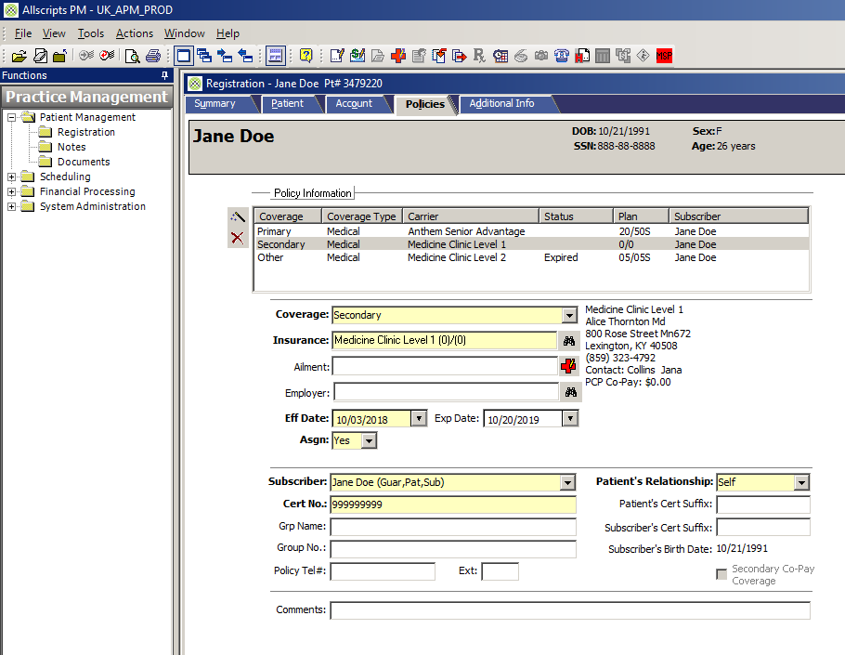
Notes:
Example 1: Registration/Billings Account with RWHAP For case study client

Slide 57
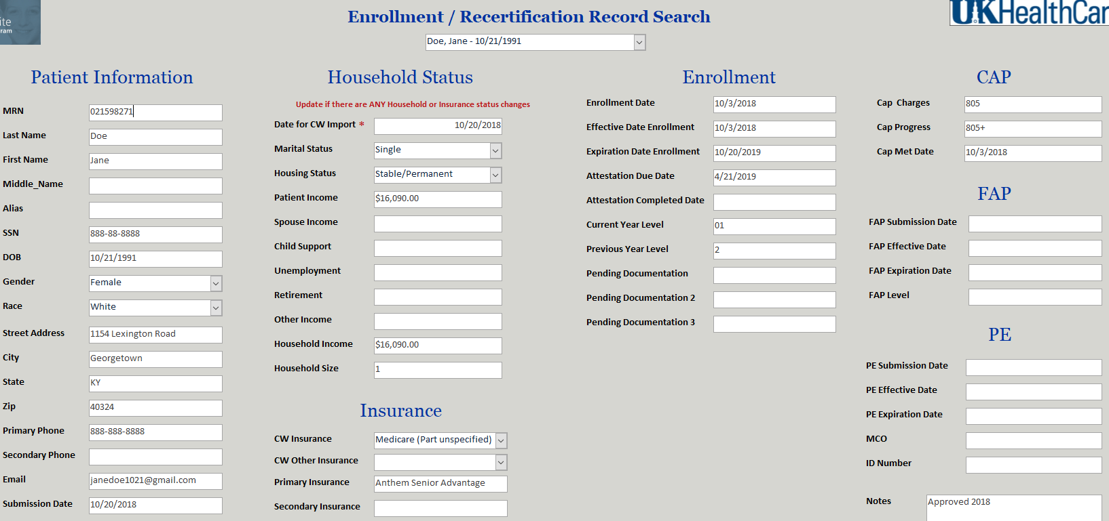
Notes:
Example 2: Enrollment tracking tool database: how to update program files to reflect new enrollment

Slide 58
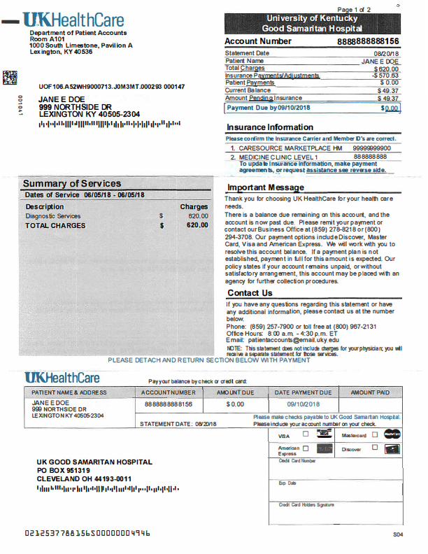
Case Study 2: Patient Billings Example A
Notes:
Example: Hospital Billings- Laboratory charges hospital based clinic, Private Insurance, Pt Cap Met, No pt. Responsibility

Slide 59
Case Study 2: Patient Billings Example B
Notes:
Example: Physician Billings, Medicare, Sliding fee scale level 3, ≤40% patient responsibility, Balance will be applied to clients Cap on Charges, Update COT tracking tool and mail/give to patient

Slide 60
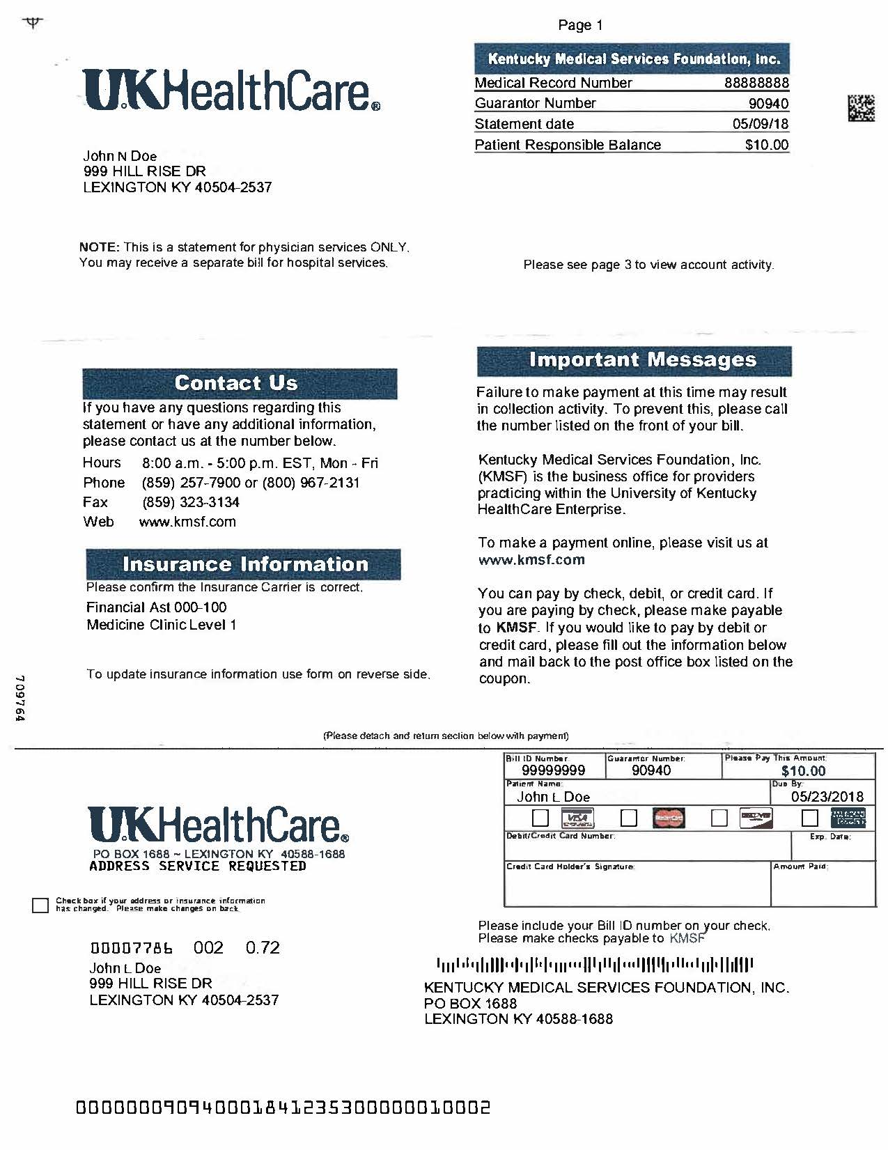
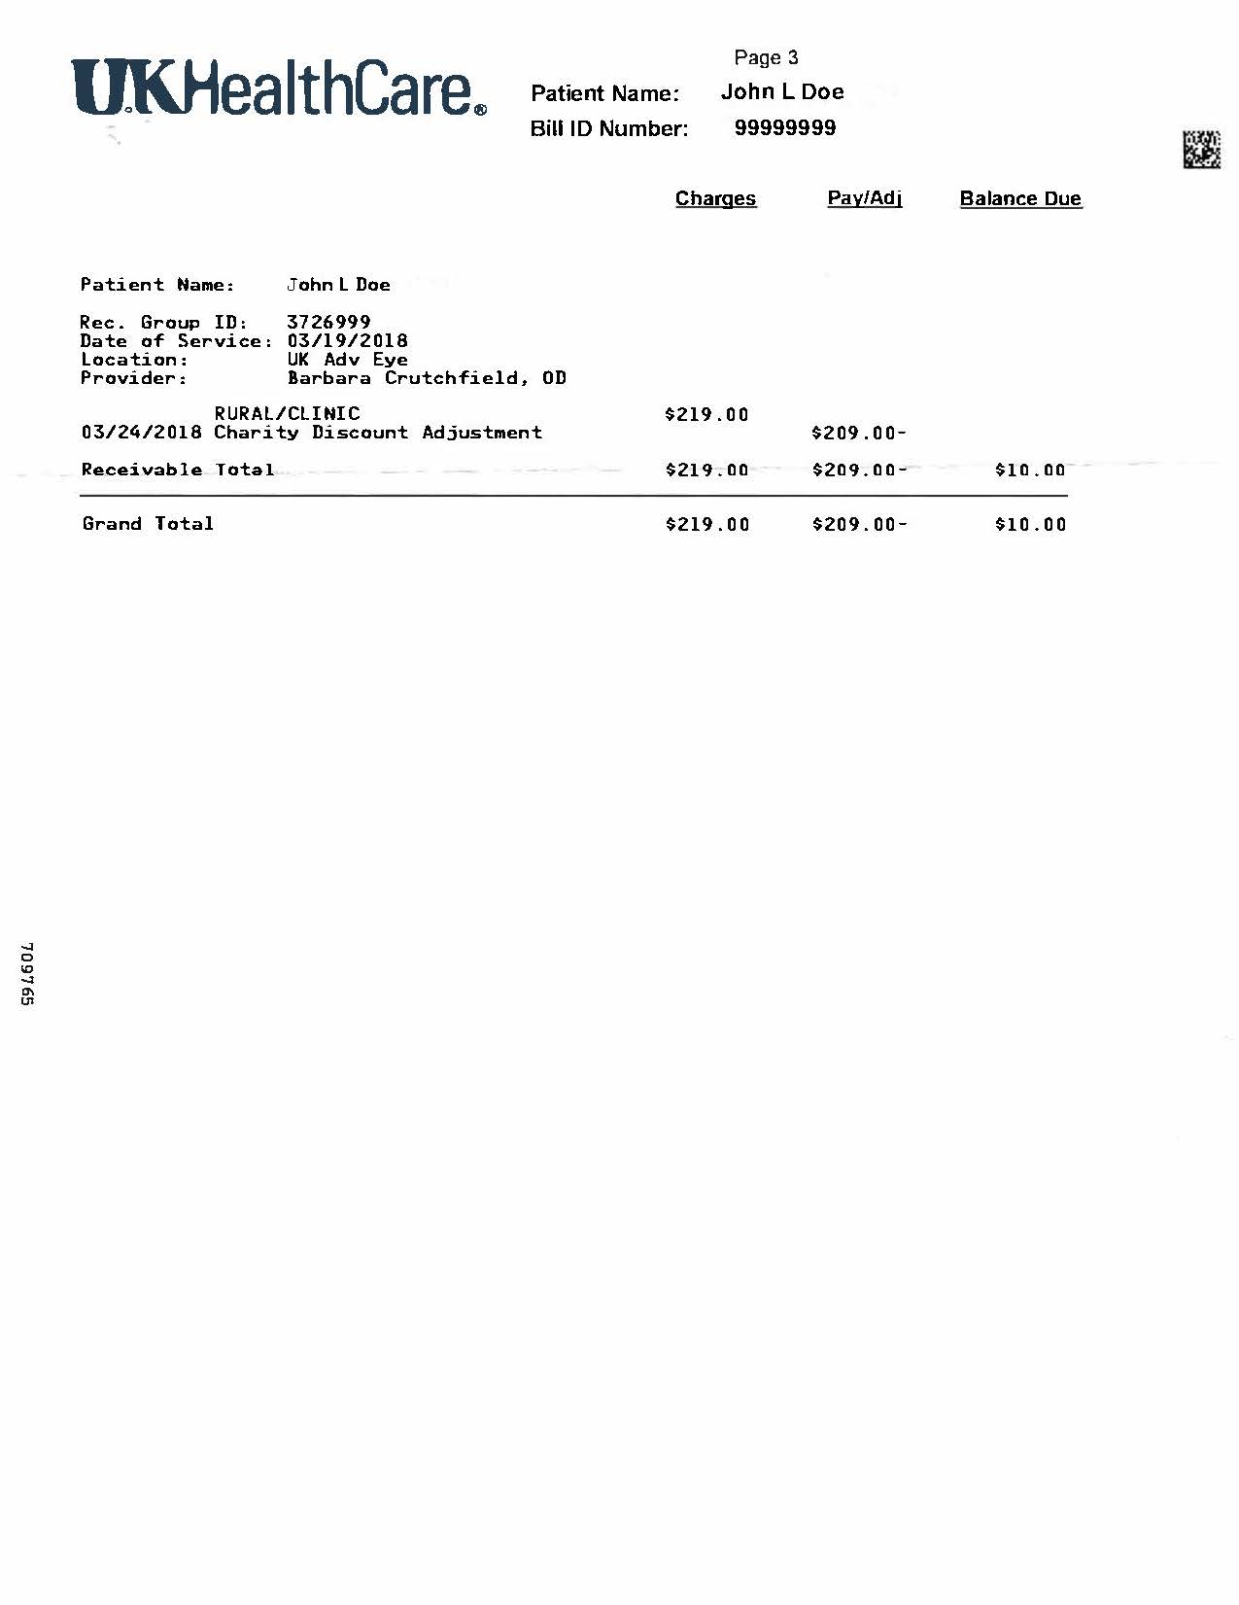
Case Study 2: Patient Billings Example C
Notes:
Example: <100% FPL, NO INSURANCE, Enrolled on facility FAP/DSH program, Not U.S. Citizen or Permanent Resident, not eligible for Federal Marketplace Insurance, $0 patient responsibility, Shows balance after UK FAP and balance that will be billed to the RWHAP and Benefit Manager will advocate for client for account to be adjusted to zero balance.

Slide 61
Case Study 4: Report A Change
Person Living With HIV, in clinic today for primary HIV medical appointment
Client reports just lost job yesterday and has no income at this time, and will lose employer based insurance at the end of this pay period
Previous Annual Gross Income: $14,340 Current Income: $0.00 Household Size: 1
Client not due for annual recert or 6-month attestation, Benefit Manager will complete RWHAP Report a Change form and have client complete no income statement
After clinical visit Benefit Manager will assist client to complete Medicaid enrollment application that will be effective the first day of the month and a secondary payer until clients employer insurance is cancelled.
Benefit manager will educate patient on new RWHAP enrollment, Medicaid Insurance, and have client meet with Medical Case Manager to address other support services and barriers to care due to job loss
Client given new Enrollment Verification letter with updated enrollment starting day of job loss, cap on charges, and sliding fee scale.
FPL
<100%
Sliding Fee Scale
Level 1
Cap On Charges
Patient Responsibility
$0
0%
$0

Slide 62
Case Study 5: No Insurance
Person Living With HIV
In clinic today as walk-in to report change loss of insurance
Client not US. Citizen or Permanent Resident, and not eligible for state Medicaid health plan
Previous Annual Gross Income: $0.00 Current Income: $19,980 Household Size: 1
At this time, client not due for annual recert or 6-month Attestation, therefore Benefit Manager will complete RWHAP Report a Change form and have client submit proof of income change
Benefit Manager will have client meet with walk-in Medical Case Manager to refer client to Insurance agent to enroll on a Federal Health Insurance Marketplace plan, and follow-up with clients enrollment and payment for insurance premium through RWHAP-HCCP
Benefit manager will educate patient on new RWHAP enrollment and client is given new Enrollment Verification Letter with updated enrollment starting day of income change, cap on charges, and sliding fee scale.
FPL
164%
Sliding Fee Scale
Level 3
Cap On Charges
Patient Responsibility
$999
40%

Slide 63
Case Study 6: Declination of RWHAP Enrollment
Person Living With HIV
In clinic today for Primary HIV medical appointment
Client reports he has new job and doesn’t feel he needs RWHAP services anymore
Client is over income for ADAP and HCCP
Annual Gross Income: $148,000 Household Size: 1
Eligible but not enrolled, Client agreed to sign declination of RWHAP enrollment, client continues to receive ID specialist care but understands they will be 100% responsible for any services after insurance
Benefit manager updates clients enrollment and revisits enrollment and eligibility with the client annually or in the event of changes to see if client would like to enroll at another time.
Client is counseled on how to receive co-pay assistance for medications through pharmaceutical companies
FPL
1217%
Sliding Fee Scale
Level 6
Cap On Charges
Patient Responsibility
$14,800
100%

Slide 64
Patient Education Tools
After-Enrollment Letter to identify the patient’s:
  Placement of the program’s schedule of charges
  Cap on out of pocket charges
  Type of bills/charges that apply to the cap on charges
  6-month recertification date (required information)
  Annual enrollment date (required Information)

Slide 65
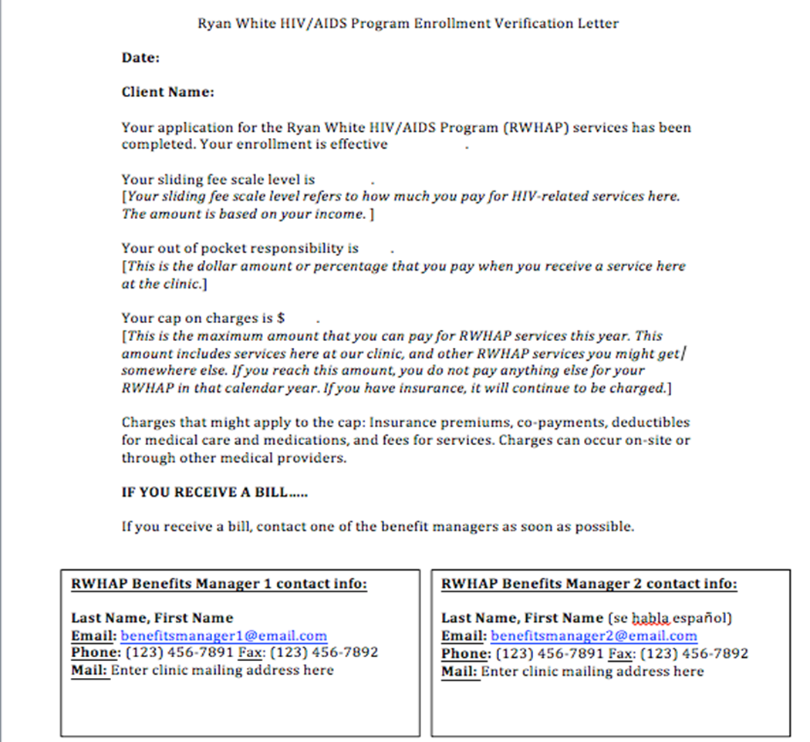
Patient Education Tool: Enrollment Verification Sheet

Slide 66
Patient Education Tool: Excel Cap on Charges Tracking Sheet

Slide 67
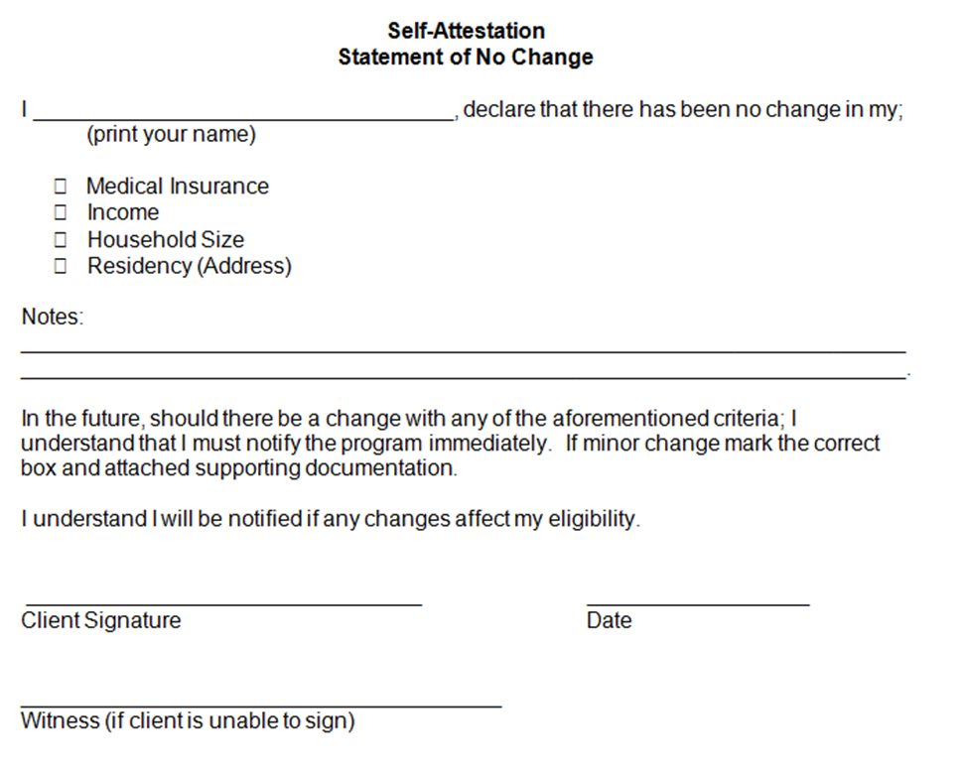
Staff/Patient Tool: 6-month Attestation Form

Slide 68
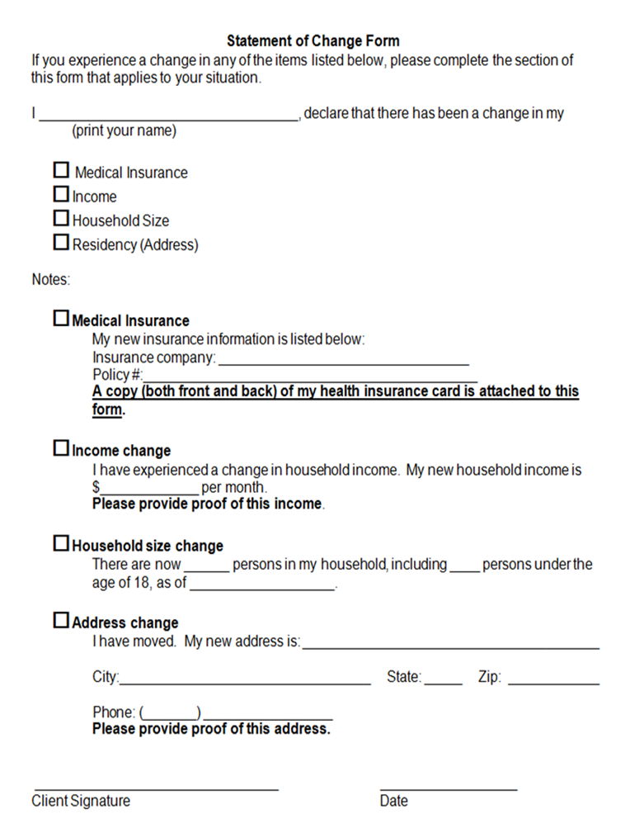
Patient Tool: Report A Change Form

Slide 69
Other Helpful RWHAP Enrollment Tools and Tracking Systems

Slide 70
RWHAP Tool: Excel Enrollment Calculators and Charts

Slide 71
Patient Education Tool: Sliding Fee Scale

Slide 72
Patient Education Tool: Cap on Charges

Slide 73
Annual Enrollment Form

Slide 74
Master Enrollment Tracking Spreadsheet Tool

Slide 75
RWHAP Tool: Declination Forms
RWHAP Form
Ryan White Part C/D Declination of Enrollment
I, ______________________________________, (Print Your Name)
have been offered enrollment (in the Ryan White Grant Program Part C & D. The benefits of this program have been explained to me. I decline to enroll at this time but know I am free to change my mind and enroll at any time.
________________________ _________
Client Signature Date
Statement of Declination of Insurance Form
I, ____________declare that I currently decline insurance
(print your name)
(Medicare, Medicaid, or Private Insurance) due to
______________________________________________.
In the future, should I enroll in insurance either through Benefind, an employer, Medicare, Medicaid or other means I understand that I must notify a staff member of my RWHAP. Also, I understand I will be notified by a RWHAP staff member if changes in my insurance affect my RWHAP enrollment status.
______________________________ __________
Client Signature Date
______________________________ __________ RWHAP Staff Member Signature Date

Slide 76
RWHAP Intake Process: Benefit Manager Guide

Slide 77
Schedule of Charges & Caps on Charges FAQ 1
Q: Does the schedule of charges apply to only uninsured patients?
A: No. The policy applies to all patients; those with insurance can pay a nominal fee at the time service is provided or be sent a bill after insurance reimbursement with the discount schedule applied.

Slide 78
Schedule of Charges & Caps on Charges FAQ 2
Q. RWHAP discourages us from turning delinquent accounts over to collection agencies. After reasonable efforts have been made to collect payments, could unpaid patient balances be transferred to the RWHAP? If yes, would the cost be at full or discounted rates?
A. Unpaid patient balances cannot be transferred to the RWHAP. If a client is charged but the agency does not collect payment, the charge is to be written off; grant funds cannot be drawn down to cover the remaining cost, which is considered balance billing and an unallowable use of RWHAP funds.

Slide 79
Schedule of Charges & Caps on Charges FAQ 3
Q. We never charge for RWHAP services. Do we still need to charge a nominal fee?
Source: National Monitoring Standards Frequently Asked Questions
http://hab.hrsa.gov/sites/default/files/hab/Global/programmonitoringfaq.pdf
A. If none of your services are billable, you do not need to charge RWHAP clients. If you bill non-RWHAP clients, but not RWHAP clients, you must bill RWHAP clients for the same services and then apply the schedule of charges.

Slide 80
Schedule of Charges & Caps on Charges FAQ 4
Q. We have patients with employer-based insurance which requires that they use a specialty mail-order pharmacy. They have $150 medication co-pays and can only fill 30 days supply at a time. Can we count the full year’s cost of 12 expected copays towards their cap at the beginning of the year in order to help them get to their cap? If we don’t, their out of pockets by the end of the year may exceed the cap.
A. No, charges must be monitored and assessed as they are incurred, which would be monthly. Depending on available funding and jurisdictional requirements, your organization could help the client with medication co-pays before or after the cap has been reached.

Slide 81
Schedule of Charges & Caps on Charges FAQ 5
Q. If patients below 100% FPL are not allowed to be charged for services, does this mean we cannot charge them co-pays? If so, how do we reconcile that with insurance claims?
A. If a client’s individual income is below 100% FPL, they cannot be charged co-pays. The schedule of charges applies to all out-of-pocket charges related to HIV care, including co-pays. The organization might be required to charge a co-pay, but they discount the co-pay based on income, so it could be discounted to zero. Additionally, RWHAP legislation supersedes contracts with insurers.

