Slide 2
Planning CHATT:
Capacity Building for RWHAP Part A Planning Councils and Planning Bodies
Mira Levinson, Aisha Moore, Chris La Rose, Deborah Dean, and Emily Gantz McKay*
JSI Research & Training Institute, Inc. (JSI)
* EGM Consulting

Slide 3
Agenda Learning Objectives
Project overview
What we provide
Training Guide activity
What’s next?
Questions and answers
By the end of this session, participants will be able to:
Discuss the important role RWHAP Part A planning councils/planning bodies (PC/PB) play in the RWHAP, including the importance of representation by people living with HIV
Explain how Planning CHATT supports the work of planning council/planning body members, staff and RWHAP Part A recipients
Locate and share Planning CHATT resources with their local planning council/planning body

Slide 4
Introducing Planning CHATT
Community HIV/AIDS TA and Training for Planning (Planning CHATT)
Planning CHATT builds the capacity of Ryan White HIV/AIDS Program (RWHAP) Part A planning councils and planning bodies (PC/PB) across the U.S.
Our goal is to help PC/PBs meet legislative requirements, strengthen consumer engagement, and increase the involvement of community providers in HIV service delivery planning

Slide 5
Why Planning Councils?
Why are you involved in your planning council/ planning body?
Why do you stay involved?
What do you tell other people about planning councils/planning bodies?

Slide 6
Uniqueness and Value of Planning Councils¹
Focus on community health planning for HIV care and treatment
A deliberate effort to involve diverse community members in “an open public process designed to improve the availability, accessibility, and quality of healthcare services in their community”
This process involves “identifying community needs, assessing capacity to meet those needs, allocating resources, and resolving conflicts”
People who serve as planning council members make a vital contribution to their communities by helping to strengthen and improve the service system for people living with HIV
  1. Planning Council Primer, 2018

Slide 7
Uniqueness and Value of Planning Councils¹ (cont.)
The only federal health or human services program with a legislatively required planning body that is the decision maker about how funds will be used
Uniquely well-defined membership composition, and high level of consumer participation (at least 33 percent) results in:
  Community involvement in decision making about HIV services
  A consumer voice in decisions about services
  Collaboration among diverse stakeholders
  Positive impact on the service system
  1. Planning Council Primer, 2018

Slide 8
Activity: What is Your Role?
Chair/Co-Chair
Member
Planning Council Support (PCS) staff
CEO
Something else?
Notes:
There are a number of roles that you can play on a planning council including:
Recipient
Chair/Co-Chair
Member
Planning Council Support (PCS) staff
As a quick exercise, please stand if you play this role in your planning council.
Are there any other roles that we’ve missed?

Slide 9
Planning CHATT

Slide 10
Questions for Participants:
Have you heard of Planning CHATT?
Are you on the Planning CHATT email list?
Have you participated in any of our webinars?
Is your planning council or planning body using any of the print materials from the targethiv.org library?
Have you shared any of these resources with others in your EMA or TGA?
Notes:
By show of hands, how many of you have downloaded and are using the updated Primer?
How many of you have participated in one of our webinars?
How many of you are on our email list?

Slide 11
Written Materials and Resources

Slide 12

Planning Council Primer
Updated May 2018
A basic reference to help prepare members to actively engage in planning council activities, and effectively carry out their legislatively defined community health planning duties
TargetHIV.org/planning-CHATT
Available in English and Spanish

Slide 13
Training Guide for RWHAP Planning Councils/Planning Bodies: Selected Modules Available Now
Intended to help prepare new PC/PB members for full participation in RWHAP Part A planning and decision-making
For use by PC/PB support staff, leaders, and recipient personnel who provide PC/PB orientation and training – ultimate audience is PC/PB members and committee members
Ten modules, designed to impart basic “101” knowledge and skills every PC/PB member needs to participate effectively in his/her first annual planning cycle

Slide 14
Training Guide: Module Topics
Understanding the Legislation
Roles and Responsibilities of PC/PBs and Recipients
Overview of the Annual Planning Cycle
Needs Assessment
Integrated/Comprehensive Planning
Priority Setting and Resource Allocation
Other PC/PB Roles for Maintaining and Improving a System of Care
PC/PB Structure and Governance
Working Together: Effective Committees and PC/PB Meetings
Data-based Decision Making: Understanding, Assessing, and Using Data

Slide 15
Major Components of a Module
Each module – and for modules covering multiple topics, each major topic – includes:
  Notes for trainers
  Sample PowerPoint slides
  At least one experiential activity
  At least one reference handout

Slide 16
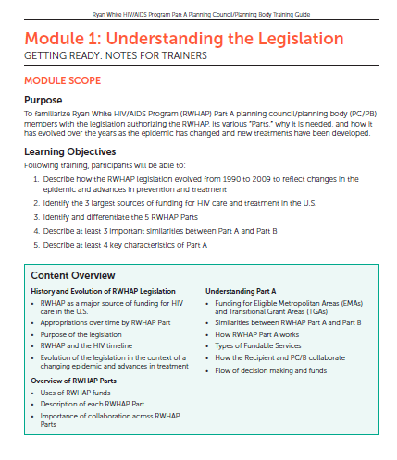
Module Component: Notes for Trainers

Slide 17
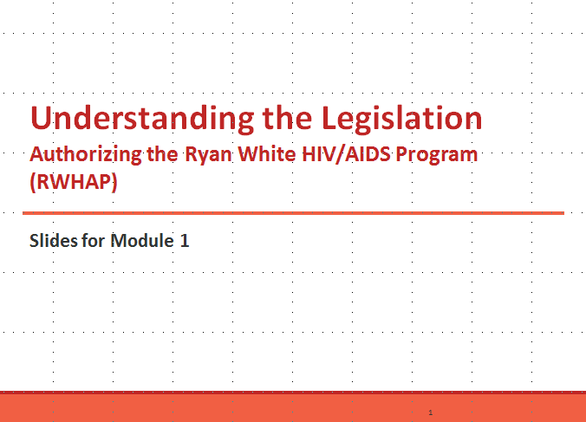
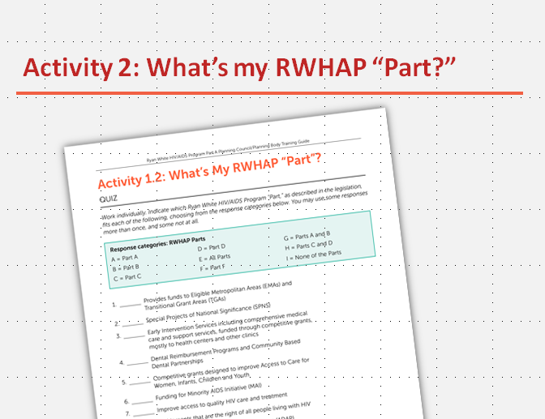
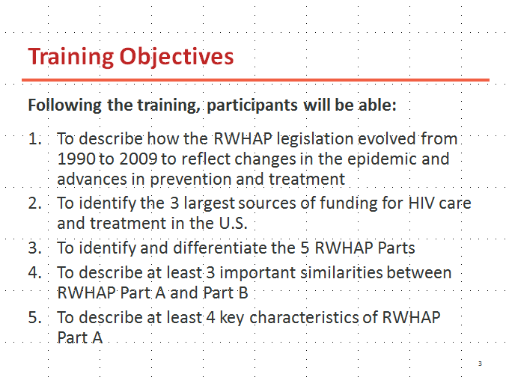
Module Component: Customizable PowerPoint Presentation

Slide 18
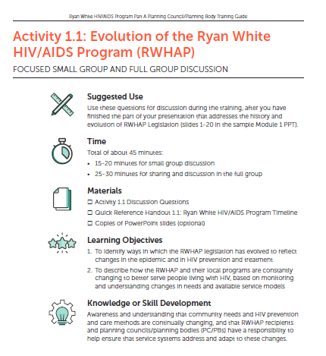
Module Component: Experiential Activity

Slide 19
Types of Activities
Pre- and post-tests to self-assess knowledge gained
Multiple-choice quizzes
Brainstorming
Quick review scenarios and discussion questions embedded within presentations
In-depth case studies
Work sheets – for problem solving or planning
Role plays
Mock assignments – e.g., establishing service priorities based on a set of data

Slide 20
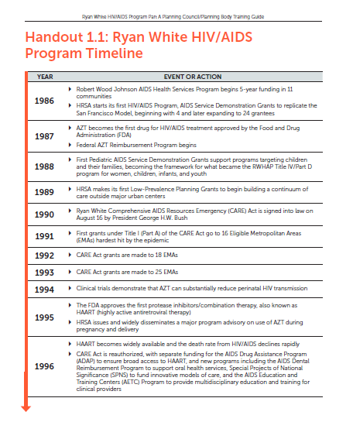
Module Component: Reference Handout

Slide 21
Trainer Resources Included in All Modules
Trainer Notes provide:
  Module purpose and learning objectives
  Suggestions for how to use module components
  Suggestions for localizing content
  Background information: key concepts, terms, and references
Activities include:
  Trainer and participant instructions
  All needed handouts and materials

Slide 22
Training Guide Activity:
Try out an activity from the Training Guide.

Slide 23

www.TargetHIV.org/planning-chatt/pcs-compendium
Designed to help Planning Council Support (PCS) staff carry out their duties supporting the work of RWHAP Part A PC/PBs
Provides tools and templates, model orientation and training materials, and offers tips and sound practices from PC/PBs
Developed by EGM Consulting with help from PSC managers Sandra Vincent of Atlanta, GA and Marvin Krieger of Hudson County, NJ, and placed online by Planning CHATT

Slide 24
Introduction and Use of the Compendium
Legislative Requirements
Planning Council Support: Structure, Staffing, and Responsibilities
Membership
Implementing Legislative Requirements
Relationships: Planning Council/Body, Recipient and Chief Elected Official
Orientation and Training for Members and Potential Members
Planning Council/Body Operations
Resources

Slide 25
Webinars

Slide 26
Recent webinars
Building Strong Planning Councils/Planning Bodies
  Part I: Roles and Responsibilities
  Part II: Tools and Strategies for Building and Maintaining Strong Relationships
Needs Assessment
Priority Setting and Resource Allocation
Find webinar videos at: targethiv.org/planning-chatt/webinars
Notes:
Please note that the last two webinars have not yet been delivered but are expected to have been delivered by the time this presentation is delivered in December

Slide 27
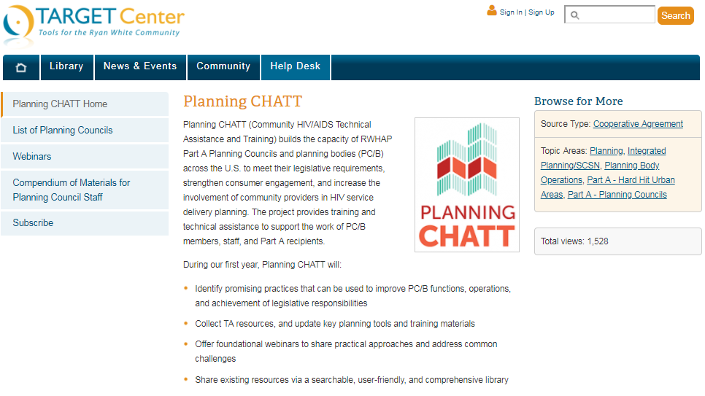
rgethiv.org/
planning-CHATT
targethiv.org/
planning-CHATT

Slide 28
Targeted TA and Training (T/TA)

Slide 29
Targeted T/TA
Targeted T/TA builds capacity in a select number of jurisdictions where needs align with project objectives
TA is delivered both remotely and in-person
Lessons learned from these engagements will inform development of nationally-focused resources
TA requests are initiated by Project Officers, who submit requests for TA to CHATT Project Officer
  Contact your Project Officer with any questions

Slide 30
What’s Next?

Slide 31
Webinars

Slide 32
Upcoming Webinars
Winter 2019
  Strategies and Promising Practices to Recruit and Retain Members
  Setting the Foundation for a Good Relationship between PC/PB and Recipient
Spring 2019
  Using Data for Decision-Making (series of 2 webinars)
  Making PC/PBs youth and young-adult friendly (series of 2 webinars)
Notes:
* We need to revise this since all the Y2 webinars have yet to occur

Slide 33
Peer-to-Peer Discussion
PC/PB Membership: Challenges and Strategies

Slide 34
Join a Small Group Discussion
Recruiting and retaining youth/young adults to be PC/PB members
Recruiting and retaining other underrepresented groups to be PC/PB members (to be reflective of local HIV epidemic)
Recruiting and retaining provider representatives and other non-consumer stakeholders (e.g. state agency representatives)
Orientation and training of new PC/PB members

Slide 35
Small Group Discussion Questions
What are your PC/PB’s greatest challenges in this area?
What are some strategies your PC/PB has tried to address these challenges? Were they successful?
What additional resources and support might be helpful in addressing these challenges?

Slide 36
Questions and Discussion

Slide 37
To Find Out More:
Visit Our Booth
Attend our other upcoming sessions
  Engaging a New Generation of Consumers in RWHAP Planning: Innovations that Work - Wednesday, December 12, 2018 at 4:00 p.m.
  Subpopulation-based Needs Assessment: A Hands-on Design Session for Non-Experts - Friday, December 14, 2018 at 10:15am
Attend the Planning CHATT PCS staff Information Sharing Session - Thursday, December 13, 2018 at 5:00 p.m.
Notes:
Hopefully you were able to attend our earlier session at 10:30am today on Teachable Moments for Planning Councils/Planning Bodies: Providing Low-Cost/High-Benefit Mini-Training
Locations to be added once available

Slide 38
Thank You and Contact Information
targethiv.org/planning-CHATT
Sign up for the mailing list, download tools and resources, view archived webinars and more…
Contact the project: planningCHATT@jsi.com

Slide 39


