Slide 1
PARTNERSHIPS FOR CARE
PARK WEST HEALTH SYSTEM, INC.

Slide 2
MISSION
The mission of Park West Health System is to provide quality and comprehensive healthcare services to individuals residing in our neighboring communities in an efficient and effective manner while improving access to primary care services to medically underserved groups.

Slide 3
A Proven and Effective Model
Park West Health System has been providing holistic healthcare and dental services for more than 45 years to the whole patient, organizing care and managing chronic diseases through its network of providers, social workers, behavioral health and community outreach workers.

Slide 4
A Federal Qualified Health Center
PWHS is a Federally-qualified, community-based health center that provide accessible primary and preventative care to all individuals regardless of their ability to pay.
All patients receive support from a Certified Application Specialist to apply for health insurance

Slide 5
Services
Adult Medicine
HIV/AIDS Treatment
Women’s Health
Pediatrics
Dentistry
Pharmacy
Sliding Fee Discount Program

Slide 6
Hidden Garden HIV/AIDS Program
Park West’s Hidden Garden HIV/AIDS Program offers effective HIV education, CTR, core medical, and other health and support services with funding made possible by the Ryan White HIV/AIDS Treatment Modernization Act through the Baltimore City Health Department.

Slide 7
HIV/AIDS Categories
Outreach Services
Outpatient Ambulatory Health Services/Specialty Care Referrals
Medical Case Management/Treatment Adherence
Non Medical Case Management/Peer Counseling
Outpatient Substance Use Treatment & Groups
Mental Health Treatment and Group
Housing Services
Emergency Financial Assistance
Medical Transportation

Slide 8
Partnerships For Care (P4C)
Technical assistance partner, Mayatech conducted an HIV TAC Workforce/ Infrastructure Readiness Review
Project Director
P4C HIV Project Lead
HIV Care Team Lead
Other key P4C project staff

Slide 9
Partnerships For Care (P4C)
P4C Training, Technical Assistance (TTA) Plan and Workforce Development
Multiple webinars
Integrated HIV Prevention and Care
History of Sexual Health
Routine testing
Medication Management
PrEP
Multi-Disciplinary Team Based Care
Moving Patients Along the HIV Care Continuum and Beyond
Collaborative meetings/peer to peer learning sessions with the other 3 health centers and MDH.

Slide 10
Partnerships For Care (P4C)
Data Sharing Agreement with MDH
Round 1: Initial patient list sent to MDH
Round 2: List sent to PWHS to fill in the additional data fields on the HIV patients plus adding any new/recent HIV patients that were added.
Review differences found between the matched HIV patient list identified in Round 1and the dataset provided by PWHS in Round 2.

Slide 11
Partnerships For Care (P4C)
Results From Data Sharing
MDH provided a list of ID numbers for 20 missing patients from Round 1and 47 new ones that were added in Round 2.
Out of the 20 missing patients, EMR identified 19 as being deceased and 1 identified after updating the report time period.
The MDH surveillance system was able to determine how many of the 47 patients new to Park West had been initially diagnosed at other health centers.

Slide 12
Partnerships For Care (P4C)
Case Conference Team
Park West medical providers, outreach team, IT/data staff
Baltimore City Health Department linkage-to-care coordinators
HIV Surveillance and HIV Partner Services from MDH

Slide 13
Partnerships For Care (P4C)
Case Conference Tables
Total 452 patients broken down into their separate P4C category tabs: active, lost to care, virally suppressed, deceased
Updated lab data from
MDH eHARS lab surveillance data
Park West EMR, Park West Hidden Garden case closure info, and
MDH/BCHD linkage to care data.

Slide 14
Partnerships For Care (P4C)
‘Dashboard' Page
Compiled cases to focus on and any cases who changed 'categories
Cases of higher-priority to focus
Case Conference Meetings
Every 3 months, file sharing continue ongoing

Slide 15
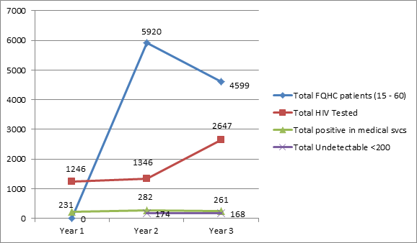
Partnerships For Care (P4C)

Slide 16
Partnerships For Care (P4C)
HIV/AIDS Policies Developed
Routine Testing
Performance Improvement tracked
PrEP Referrals
Treatment and Case management
HIV Linkage to Care
Medical and support services

Slide 17
Questions?
Cleo L. Edmonds, MS
Park West Health System
Hidden Garden Program
4151 Park Heights Avenue
Baltimore, MD 21215
Office: 443-884-7642
Email: cedmonds@parkwestmed.org

