Slide 2
Actuating Care in Iowa, Dallas, TX, and Paterson, NJ Using Multilingual, Audio-Assisted, Evidence-Based Needs Assessments
Milagros Izquierdo, Program Director, Paterson-Bergen-Passaic TGA
Justin Henry, Health Planner, Ryan White Planning Council Dallas, TX
Katie Herting, Ryan White Quality Coordinator, Iowa Department of Public Health
Nancy Erickson, Principal, New Solutions Inc.
Jesse Thomas, RDE System Support Group, LLC

Slide 3
Disclosures
Paterson-Bergen-Passaic TGA, Dallas, TX Ryan White Planning Council and Iowa Department of Public Health have no financial interest to disclose.
Jesse Thomas works as Project Director for RDE System Support Group, LLC.
Nancy Erickson is principal of New Solutions Inc.
This continuing education activity is managed and accredited by Professional Education Services Group in cooperation with HSRA and LRG. PESG, HSRA, LRG and all accrediting organization do not support or endorse any product or service mentioned in this activity.
PESG, HRSA, and LRG staff has no financial interest to disclose.
Notes:
Required slide. Please complete section under Presenter

Slide 4
Introductions
Jesse Thomas, Project Director, RDE Systems
Serving public health for over 20 years, HIV/AIDS programs 14+ years (HRSA, CDC, HUD, NIH)
RDE Systems: First team to build custom web-based consumer needs assessment surveys for PLWH.
Technical Manager for over 18 HRSA Special Projects of National Significance

Slide 5
Learning Objectives
At the conclusion of this activity, the participant will be able to:
Recognize how a paradigm of improved data collection strengthens grant applications, provides answers to community planning bodies, illuminates counterintuitive insights important for the description of barriers and helps positively to influence health planning and policy recommendations
Describe how to adopt and adapt strategies and tools to deliver web-based technology to the community and planning bodies while overcoming digital divides and perceptions of digital divides.
Identify, analyze and evaluate the challenges and benefits of an innovative program for mobile / web-based, audio-assisted, multilingual Needs Assessments and Client Satisfaction Surveys.

Slide 6
National HIV/AIDS Strategy
Goals:
Reducing new HIV infections
Increasing access to care and improving health outcomes for people living with HIV
Reducing HIV related disparities
(Implementation Plan: Achieving a more coordinated National response to the HIV/AIDS epidemic in the U.S.)

Slide 7
How Do We Know What Services to Provide?
Evidence-based planning for HIV prevention and care services begins with:
DATA-DRIVEN NEEDS ASSESSMENT
The “Justification of Need” is included in every grant application that you write.
Developing an effective needs assessment process is vital to organizational sustainability and delivering high quality, effective programs.

Slide 8
Traditional Needs Assessment Process

Slide 9
Problem Statement
Too much time spent managing paperwork
Delay from data collection to action
Validating surveys a challenge
Too costly and inefficient
Paper reports are not interactive
Questions people have about the data result in health planners having to manually re-analyze the data

Slide 10
Our Vision

Slide 11
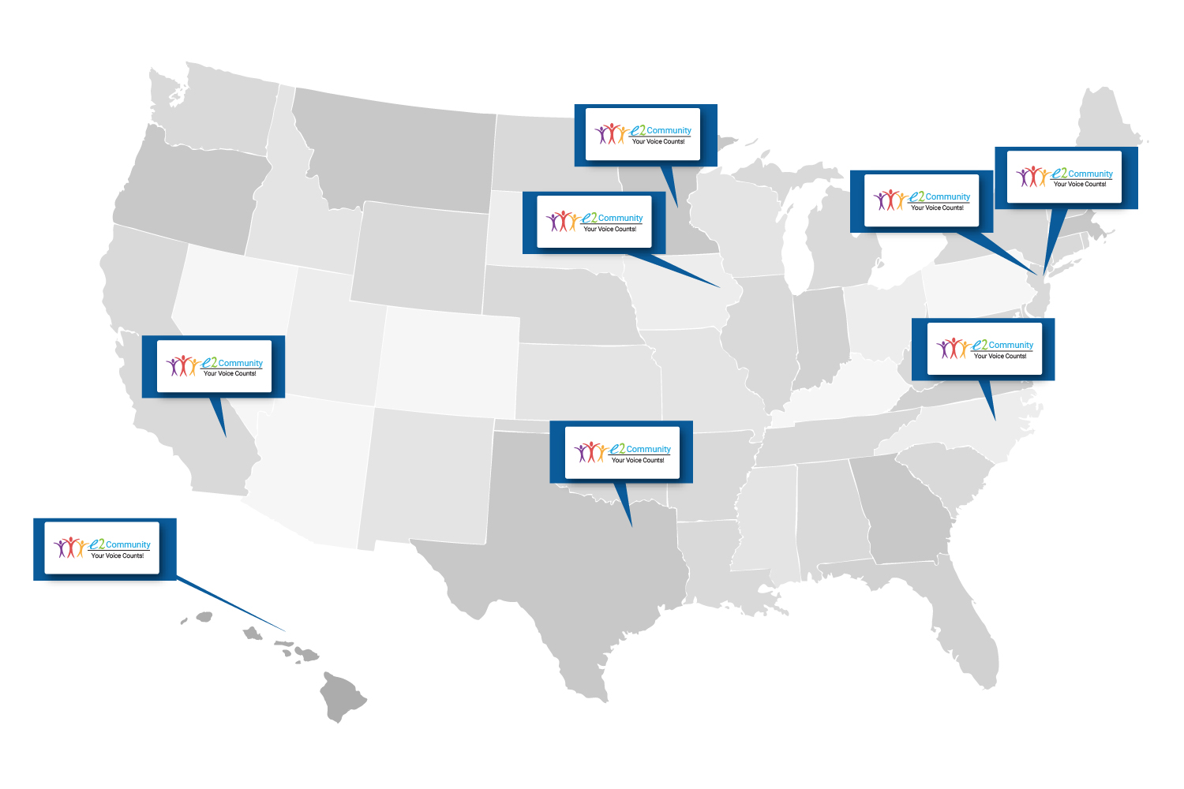
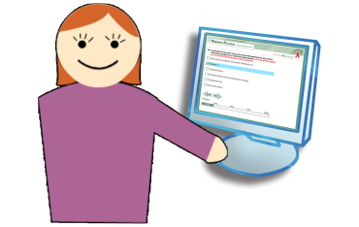
National Context

Slide 12
Over 8,500 Total Consumers

Slide 13
Covering Urban, Suburban, and Rural Regions.

Slide 14
Survey Complexity: Over 9,800 Q & A Fields

Slide 15
Over 6 Million Data Points

Slide 16
Diversity of Size of Regions: PLHWA

Slide 17
Over $43,000 in Client Incentives Distributed

Slide 18
Over 17,000 Staff Hours Saved!

Slide 19
Hennepin County / Minnesota’s Comprehensive Needs Assessment Web-Audio Surveys

Slide 20
Double the Response Rate

Slide 21
Innovative Use of Inexpensive Netbooks

Slide 22
Before Netbooks and eCOMPAS
After
Netbooks and eCOMPAS
2010: Majority of respondents (69%) did so from a private/public computer.
The remaining 31% participated in a session led by one of six volunteer consumer ambassadors
2003: Survey required
6 interviewers to conduct
face-to-face interviews

Slide 23
Unanticipated Benefit:
Needed to do translation only once on the web.
Instead of needing a translator for each consumer who needed it.

Slide 24
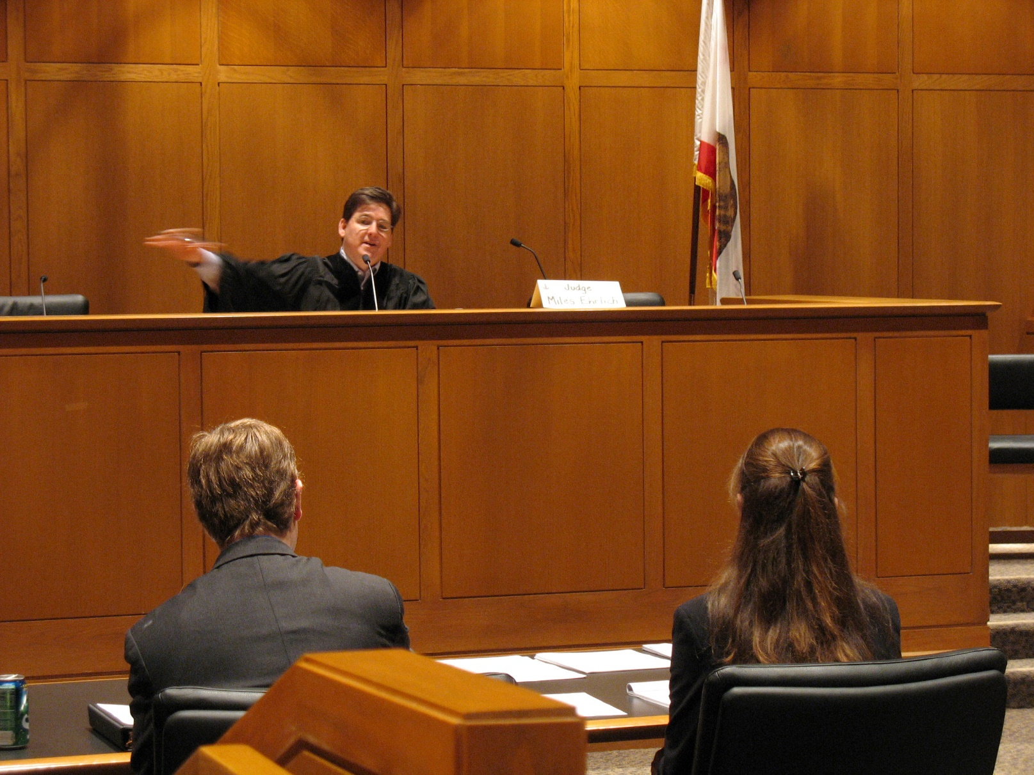
How are Interpreters Seen by Clients?

Slide 25
Quarter the Time Per Response
8% Survey Size Increase
72% Response
Time Decrease

Slide 26
Case Study: African-Born Population

Slide 27
MHSPC Cost Savings Analysis
> 64% Cost Savings Using
Web (e2Community)

Slide 28
New York City

Slide 29
Case Study: NYC Client Satisfaction & IRB Surveys
Better Consumer Experience: “We have found, anecdotally, that many clients enjoy the experience of taking the survey as well as the ability to provide feedback on different aspects of the Care Coordination program. Clients have reported that the survey platform is easy to use, with many clients having taken it on smartphones, tablets, and computers.”
Proactive TA: “Because of the way survey IDs were set up, even for anonymous surveys, we could figure out which service category and agency a person was being surveyed about. This allowed us to look at the types of responses received by service category and agency and to use that information to provide technical assistance to agencies regarding particular problem areas, and to identify particular facilitators and barriers to receiving services by agency and service category.”
Real-time Analysis: “Electronic extract of survey data made real-time analysis of survey data possible and could be used to regularly track survey’s progress and any survey issues.”

Slide 30
More qualitative data with web (e2)
22% improvement over paper surveys.

Slide 31
Region 6, North Carolina

Slide 32
Wake County Results

Slide 34
Summary of Three Regions In-Depth Today
Number of consumers surveyed: 2,131
Languages used: English, Spanish
Number of municipalities covered: 1,079
Number of Q&A fields in real-time: 4,169
Number of staff hours saved: 1,910
Grants written using needs assessment data: 3

Slide 35
Journey to Paterson, NJ

Slide 36
Bergen-Passaic TGA: Pioneer in Web Tools for Health Planning
Notes:
36

Slide 37
Introduction
Milagros Izquierdo, Program Director, Paterson-Bergen-Passaic TGA
Jesse Thomas, Project Director, RDE Systems

Slide 38
A Long Partnership
Partnered with RDE in needs assessment & client satisfaction surveying cycles since 2005.
Impact of digital surveying vs paper-based processes immediate.
The Story of Consumer Accessibility and the Voices Committee

Slide 39
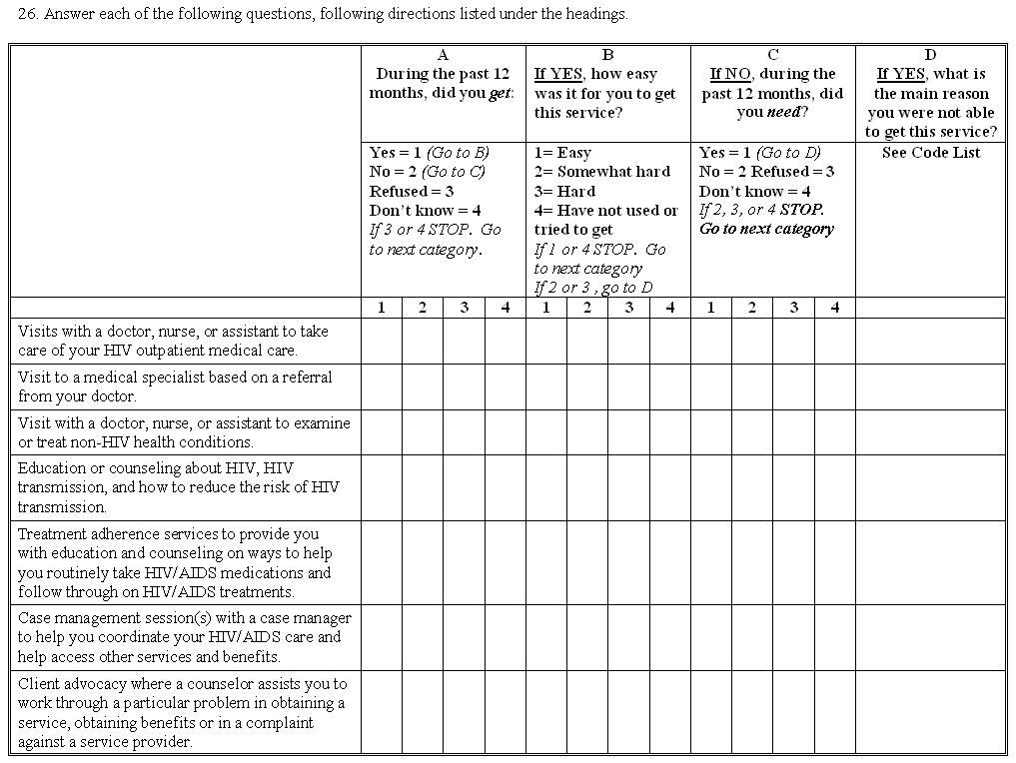
The Old Way

Slide 40
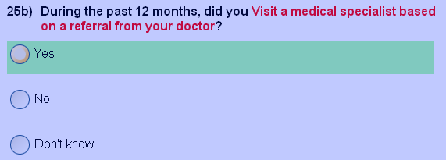
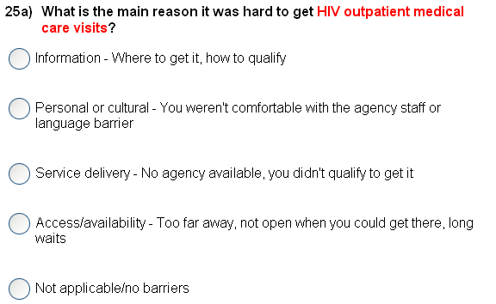
Next
Question
Next
Question
The New Way The System does all the work behind the scenes.

Slide 41
A Long Partnership – Immediate Impact
We were expecting response rates to drop in moving from paper-based to web-based surveys. Instead going web-based produced a surprising increase in response rates for a primarily urban, disadvantaged population, making internet access barriers a myth.

Slide 42
2005 Consumer Access Points
St. Paul’s CDC

Slide 43
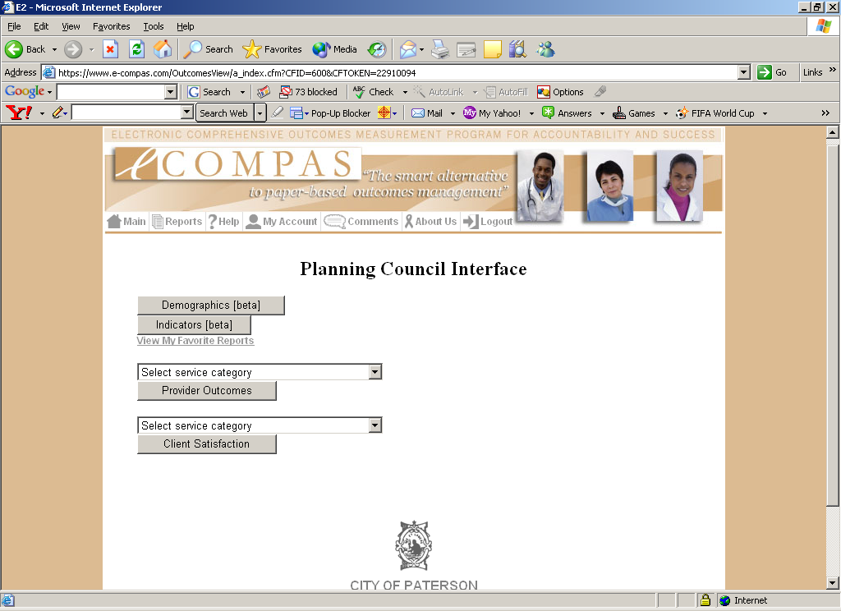
Planning Council Interface

Slide 44
Demographics & Utilization

Slide 45
Building the Big Picture
Long-term goal of partnership is to integrate CLD and other client data in order to build a big picture about PLWHA and the HIV/AIDS Epidemic in the TGA.
Combining CLD with needs assessment responses.
Interlinking data from disparate medical providers and funding sources through Special Project of National Significance.
Recording and comparing outcomes across the TGA’s 3 major medical service providers.
Notes:
SPNS Care Continuum Project
e2StJoseph’s
3 major: Hackensack, Paterson Counseling Center, St. Mary’s

Slide 46
Building the Big Picture - Timeline
Complete SPNS SPNS HIT Electronic Networks of Care Project
First needs client satisfaction survey wave.
Begin SPNS HIT Electronic Networks of Care Project
2008
2016
2005
2014
2017
Implement eCOMPAS Client Level Data (CLD) system.
Second needs assessment wave.

Slide 47
Cumulative Gains – 2017 3-Clinic Statistics
31.6% Increase in
VL Suppression
10.0% Increase in
ARV Therapy Rx

Slide 48
How We Did It

Slide 49
How We Did It - Innovations
Visual Analytics
Real-Time Feedback
Broad Access to Data
Linkage to CLD Systems
Goal-Attainment Tracking
SPNS and Capacity Development Grants
Tight Integration with QM

Slide 50
How We Did It
Make sure your client base’s service needs are met.
13+ years of working with digital client satisfaction & needs assessment data simplifies this process.
According to 2016 needs assessment, majority of PLWHA in the TGA can easily get services that they need.

Slide 51
How We Did It
Notes:
2016 needs assessment results.

Slide 52
How We Did It – Record Linkage
eCOMPAS CLD Data
e2Community Needs Assessment Data
e2id / Survey Code Mapping
e2id Client Identifier
Randomly-Generated Survey Identification Code
Notes:
A pre-determined mapping between EMR and needs assessment data can be built by pairing EMR client record identifiers with survey code identifiers.

Slide 53
How We Did It – Record Linkage
CD4 values
Viral load counts
Services received
Medications
Screenings
Medical Care
Notes:
Created linkage can be used to make the following useful correlations to EMR data.

Slide 54
How We Did It – MyCareContinuum
e2id / Survey Code Mapping
Grantee Client Data
Medical Provider Data
MyCare
Continuum

Slide 55
Future Planning – Using Assessment Data
Goal: Bridge gaps of knowledge about client base.
Problem: Current data shows that majority of new clients in TGA were not diagnosed there. It is unknown where they came from.
Solution: Add place of diagnosis as a needs assessment question for the next survey wave.
Notes:
Decrease in incidence, increase in number of new clients. Clients are coming from elsewhere.

Slide 56
Future Planning – Using Assessment Data
Goal: Identify and better serve populations of need.
Focus: The needs assessment helped identify three populations of need across the PLWHA in the TGA: African American females, heterosexual Hispanic males, and gay/bi-sexual male youth.
Plan: Further study and planning is needed to address these issues.
Notes:
Further study & panning: outreach to those communities, needs assessment targeting those communities.

Slide 57
Future Planning
Further integration of digital needs assessment tool e2Community with eCOMPAS CLD platform and MyCareContinuum.
Outreach to and study of identified under-served populations.
Using MyCareContinuum to identify under-served populations.
Notes:
Continue using and comparing data from all sources in order to make educated health planning decisions.

Slide 58
Future Planning
Continue using an integrated, collaborative process to study needs assessment data, derive useful findings from said data, and plan for future needs assessment processes.
Increase collaboration between:
Planning council
Providers
Consumers
Quality management team
Health policy experts

Slide 59
Milagros Izquierdo mizquierdo@patersonnj.gov Jesse Thomas Jesse@rde.org

Slide 60
Journey to Des Moines, Iowa

Slide 61
Des Moines, Iowa

Slide 62
Introduction
Katie Herting, Ryan White Quality Coordinator, Iowa Department of Public Health
Notes:
Katie’s disclaimer: I am presenting on behalf of Holly Hanson, Iowa RW Part B Program Manager. I am not the staff who managed or administer the consumer needs assessment. I was tangentially involved. So if I can’t answer your questions today, I’ll be sure to find the answer and reach out to you at a later date.

Slide 63
Consumer Needs Assessment History
2005 – Paper survey
Original survey developed
Managed by program manager
Hired consulting agency to enter raw data – took 4 weeks to receive
Data analysis conducted in Excel by program staff
2011 – Paper and online survey
Managed by temp
Paper survey data entered into Survey Monkey (110 hours)
Paper and online results displayed in Survey Monkey (separately)
Other data analysis conducted in Excel by contractor
2008 – Paper survey
Managed by intern/temp
Hired consulting agency to enter raw data – took 4 weeks to receive
Data analysis conducted in Excel by contractor
2016 – Online survey
Managed by RDE Systems and long-term contract employee
Data available in real-time
Data analyses conducted by RDE Systems
Other data analysis conducted by program staff
Notes:
2011:
110 hours = 219 paper surveys entered into Survey Monkey x 30 min/survey.
Using temporary employees was not ideal, survey’s were poorly managed.

Slide 64
Consumer Needs Assessment Process
Survey development
Survey pilot
Correspondence with contractors
Survey preparation and distribution
Data collection
Incentive tracking and distribution
Data analysis
Survey report
Notes:
Big differences in survey management between paper and online surveys highlighted in red
Survey development
Draft survey developed with a group of IDPH staff from HIV care and prevention programs.
Survey pilot
Correspondence with contractors
Provide rationale for the survey and directions about distributing the survey
Survey preparation and distribution
Paper survey: print surveys, translate paper document, send materials to contractors, mail surveys
Online survey: print survey letters, translate online survey through RDE systems portal, send materials to contractors, mail survey letters
Data collection
Paper survey: have to receive surveys in the mail from participants, had to hire people to enter the data
Paper/online survey: had to enter the paper survey data into Survey Monkey
Online survey: responses received in real time, data displayed online and available to review in real time
Incentive tracking and distribution
Develop system for tracking incentives
Paper survey: contractors sent incentives to participants upon receiving completed surveys
Online survey: participants called us to request incentive upon completing survey/receiving online instructions to receive their incentive
Data analysis
Paper survey: raw data analyzed in Excel
Paper/online survey: data displayed in Survey Monkey, further analyses conducted in excel with raw data
Online survey: data displayed in RDE system’s online portal with analytics capabilities, analytics specifications developed before survey launch (further raw data analyzed in Excel because we didn’t think to ask for it originally), data crossed in visual analytics portal
Survey report
Able to be disseminated sooner with online survey due to less staff time spent on and delays in receiving data/conducting analyses

Slide 65
Differences Between Paper & Online Survey
Data Collection & Analysis
Paper Survey | Paper & Online Survey | Online Survey
Receive surveys in the mail from participants | Receive surveys in the mail from participants | Responses received in real time
Hire staff to enter the data into Excel | Hired staff to enter the data into Survey Monkey | Data displayed online and available to review in real time
Data analysis in Excel | Data analyses in Excel and Survey Monkey

Slide 66
Outreach Strategy
Partnered with RW Part B subrecipient agencies to reach clients and other people living with HIV.
Clients able to complete the survey using agency PCs & tablets.
Clients provided assistance with the survey by case managers.
Clients were also able to use their own equipment to access the survey tool.

Slide 67
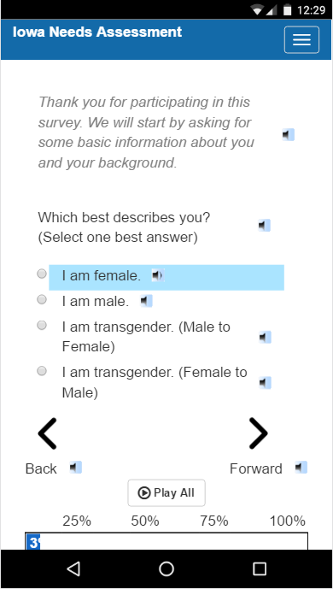
Using RDE Systems
Survey accessibility features:
Mobile and tablet compatibility.
Multi-language compatibility.
Audio playback for all text.
Fully translatable.
Survey progress saving.
Real time data analysis
Able to see results in real time and track trends.

Slide 68
Conclusion about Online Surveys
Save staff time
Do not rely on competence of staff
Reduce burden for clients
Allow for:
Real-time analysis of data
Greater in-depth analysis of data
Faster dissemination of data

Slide 69
Results
Published results in the HIV Consumer Needs Assessment Report: 2016.
Used the results in planning for the 2017-2021 Iowa HIV Comprehensive Plan.
Shared results with our subrecipients, and at other meetings.
Used results when writing grant applications and reports.

Slide 70
Results - Adverse Childhood Experiences (ACEs)
BRFSS - Behavioral Risk Factor Surveillance System

Slide 71
Results - Adverse Childhood Experiences (ACEs)

Slide 72
Results - Adverse Childhood Experiences (ACEs)

Slide 73
Results - Adverse Childhood Experiences (ACEs)

Slide 74
Lessons Learned
Early in the process:
Consider modifications you will need to make to the survey instrument for online use.
Design reporting instruments to dig down to the information you need.
Factor contract procurement into timetable.
Review real-time analytics to adjust population outreach effort.
Start early. Know that the process will probably take much longer than you anticipate.

Slide 75
Katie Herting Katie.Herting@idph.iowa.gov Jesse Thomas Jesse@rde.org

Slide 76
Journey to Dallas, TX

Slide 77
Dallas County, Texas

Slide 78
Introduction
Justin Henry, Health Planner, Ryan White Planning Council Dallas, TX
Nancy Erickson, Principal, New Solutions Inc.

Slide 79
Timeline – Paper-Based Process (2010)
Approve Consumer Survey Instrument, Begin Field Team Training.
Complete main Data Collection Effort. Begin Data Analysis.
Complete Final
Report.
07 21 2010
08 31 2010
11 19 2010
08 16 2010
09 27 2010
01 10 2011
Begin Planning
Process.
Finalize and Mail Surveys. Begin Field Team Activities, Data Entry, and Follow-Up Activities.
Draft Report.
Notes:
However, old process would take many months, while digital would collect the same amount of data in weeks.

Slide 80
Timeline – Digital Process (2016)
Approve Consumer Survey Instrument, Begin Software Development Process.
Begin Data Collection.
Complete Final
Report.
11 16 2016
12 16 2016
02 21 2017
12 08 2016
12 27 2016
03 31 2017
Begin Planning
Process.
Consumer Survey Translation and Voice-Overs Completed.
Collect Sufficient Data.
Notes:
2016 digital survey wave completed in time window that would have been impossible with old paper collection method.

Slide 81
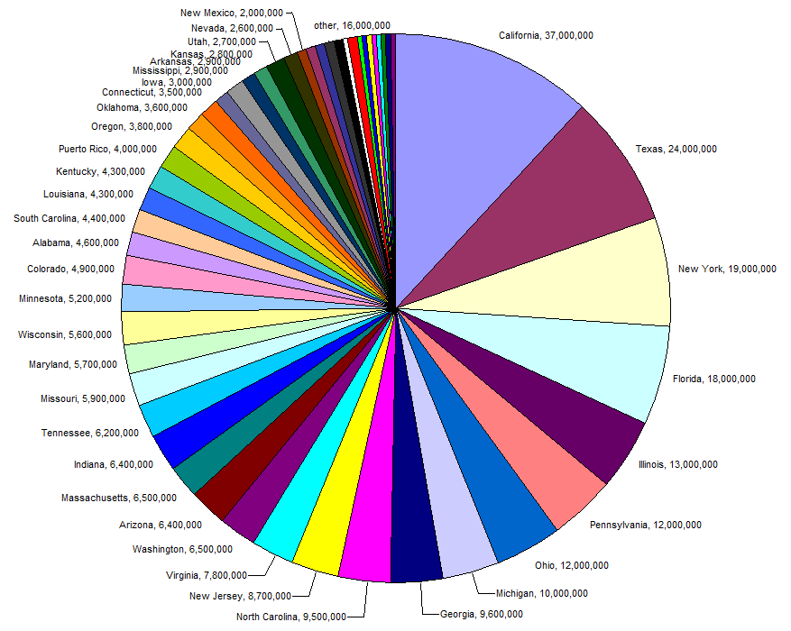
Additional Work
Notes:
Additional work needed for 2010 paper process:
Field staff training.
Fieldwork and survey administration.
Data entry.
Survey printing, collation, and mailing.
Develop data requests & tabulations.
Develop report-ready charts and graphs.
Additional work needed for 2016 digital process:
Recording voice-overs.

Slide 82
Time Savings from Digital Process
Total time savings in 2016: 38 days
Time savings from report writing: 67 days

Slide 83
Low-Literacy Accessibility
69% of completed surveys
35% of completed surveys
Voice assistance utilization:
Usage on mobile device:
Notes:
Voice assistance: 442/640 completed surveys, 69% or 69.0625%
No high school / some high school percentage of population: 16%.
Mobile usage: 227/640 = 35% or 35.46875%
Utilization of voice-assistance combined with availability on clients’ own mobile devices made data collection quick and easy in an environment with a relatively high illiteracy rate. In addition, technological resources outside of the common mobile phone can be difficult to come by.

Slide 84
Consumer Time Savings from Digital Process
47.6% Decrease in Average Time Taken
25 Minutes Saved on Average
Notes:
In 2016, some results were submitted using the paper process.
Digital surveys completed by respondents in nearly half the time on average!

Slide 85
On the 2016 Needs Assessment:
“We did this down to the hour, it wouldn’t have been possible without New Solutions and RDE Systems.”

Slide 86
Goal reached, over 600 complete surveys collected!
Notes:
Despite difficult timeframe.

Slide 87
Using Data from the 2013 and 2016 Digital Survey Waves
Notes:
Continuing trends persisted between the 2013 and 2016 survey waves:
Service categories with lowest satisfaction ratings persisted.
Same groups of greatest need persisted.
Results from these two survey waves prompted strong reaction from the planning council & community.

Slide 88
Continuing Trends – Special Populations
Notes:
Special populations identified in both 2013 and 2016 survey waves:
African-American Females
Youth
Transgendered
Gay / Bi-sexual Men

Slide 89
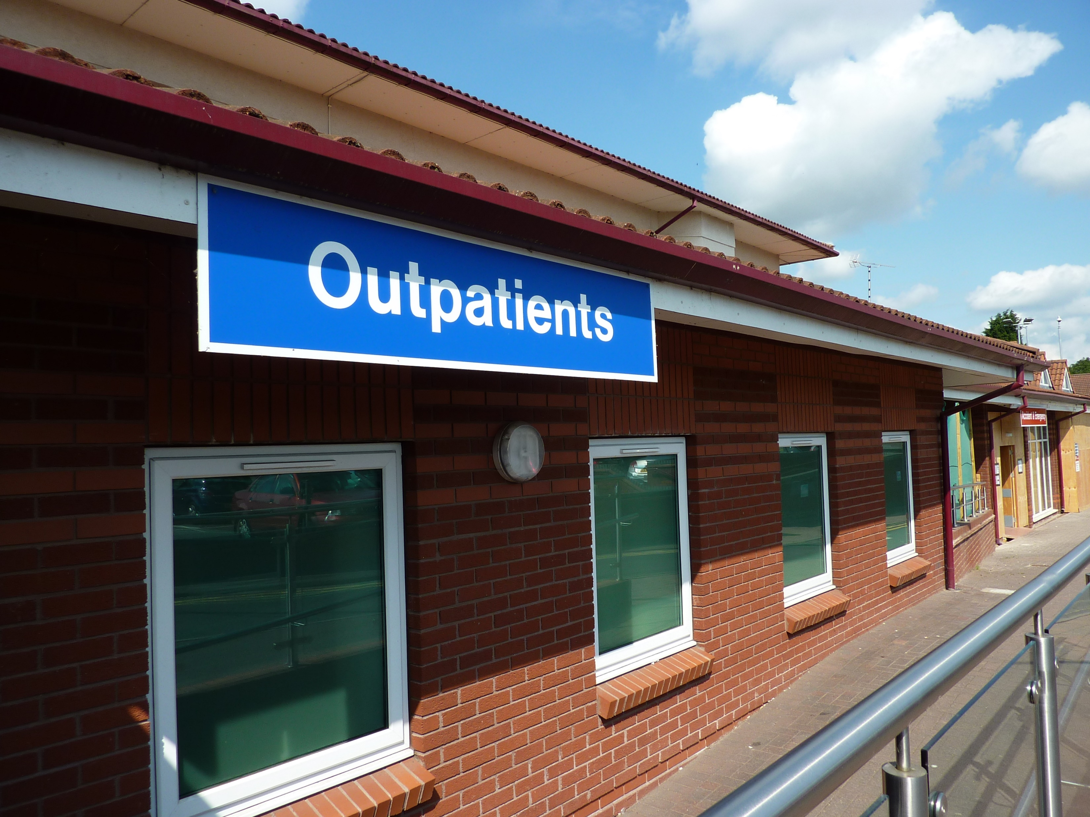
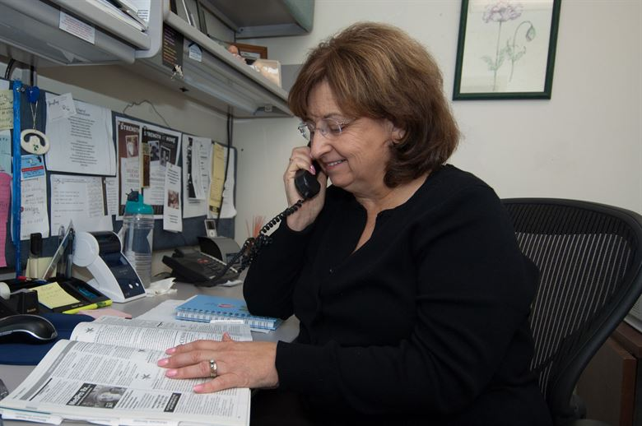
Continuing Trends - Services
Notes:
Service categories with consistent high need across 2013 and 2016 survey waves:
Dentistry
Outpatient Medical
Food Pantry
ADAP
Medical Case Management

Slide 90
Results from Data
Needs assessment results prompted strong action from planning council.
Need for additional effort recognized, Needs Assessment Committee formed.
This committee was written into the bylaws of the planning council.
Notes:
Data from the two needs assessment waves were compelling enough to prompt strong action from the planning council, even reforming it’s governing documents to better address the issues that arose.

Slide 91
Timeline – Digital Process (2019)
End Pilot, Make Survey Adjustments
Finalize Survey Instrument
Finalize Report
03 01 2019
estimated
10 01 2019
estimated
01 16 2018
02 19 2019
estimated
05 01 2019
estimated
02 28 2020
estimated
Begin Planning
Process
Begin Piloting Process
Complete Data Collection
Notes:
Begin Planning Process - First meeting of the Needs Assessment Committee
Other estimated dates were agreed upon by Needs Assessment Committee. More than a year of additional lead-up time than previous survey waves in order to better plan outreach activities and survey content.

Slide 92
Results from Data – Needs Assessment Committee
Outreach planning
Public engagement
Focus group planning
Survey question planning
Notes:
1% ≈ Approximately 150-200 people per special population.

Slide 93
Lesson Learned – Organization & Communications
Make sure all promotion and advertising material is correct.
Make sure that question language is tailored to the expected literacy level of population and that all translations are correct.
Questions written to target a specific special population should be written in language that is common and acceptable to that population.
Make sure that survey instrument is well-tested against general population and each targeted special population.

Slide 94
Lesson Learned – Cont.
Don’t try to do too much in a short timeframe!
Needs assessment is an outreach opportunity.
Additionally, needs assessment helps the planning council reach out to clients who have fallen out-of-care.
Leverage the knowledge of experienced partners like New Solutions, Inc. and RDE Systems.
Use a low-literacy, mobile-friendly platform to help collect data from low-literacy populations with limited access to technological resources.
Notes:
Make sure there is ample time to plan all needs assessment activities: Outreach opportunity - Gives the planning council an additional window to interact with the community.
Out-of-care - The needs assessment is a perfect opportunity to get them back in-care!

Slide 95
Nancy Erickson nerickson@newsolutionsinc.com Justin Henry Justin.Henry@dallascounty.org Jesse Thomas Jesse@rde.org

Slide 96
Q & A

Slide 97
Wrap Up

Slide 98
204,000 pages of paper saved
and counting…
Thanks!
Thanks!

Slide 99
Replication and expansion
Client Satisfaction
Rolling Needs Assessment
Tailored Action Buttons
Statistical Reporting
Online, Interactive Resource Guide

Slide 100
Feedback on e2 approach
“Survey Monkey is an ok tool but only has canned reporting and is not helpful for low-literacy outreach. E2Community has customizable analytics which are very helpful, and the audio playback feature saves many hours of staff time. ”
– Needs Assessment Consultant
“Although many providers seemed to be hesitant and wary of an electronic tool at first, many of them finally opened up to the idea and saw how simple the process actually was. I also anticipate that they will be glad to get reports on client satisfaction back to them sooner than they would have with a paper survey.”
– Field Research Assistant

Slide 101
Feedback on e2 approach
“We do want to commend you guys on the ease of use of your system. This part has been so remarkably easy! Thanks for making this as painless as possible!”
– RW Data Manager
“We are really starting to see the advantages of having an electronic tool for this survey process.” – Research & Evaluation Director

Slide 102
Practical Tips on Replication
Find a few key champions on the planning body, ricipient, and quality team.
Utilize a web-based architecture to minimize management and maintenance headaches and costs. Have automatic linkage with client level data system.
Choose a systems partner and consultant who operates on a human-centered approach (not technical approach) and has experience with surveying special populations.
Just do it. Don’t be paralyzed with logistics. Evolve your apprach and system based on experience. Start as early as you can to avoid time crunches.

Slide 103
Lesson: How did we accomplish this?
One bite at a time.

Slide 104
Thank you for your time!

Slide 105
Jesse Thomas Jesse@rde.org Milagros Izquierdo mizquierdo@patersonnj.gov Katie Herting Katie.Herting@idph.iowa.gov Nancy Erickson nerickson@newsolutionsinc.com Justin Henry Justin.Henry@dallascounty.org

