Slide 1

Advanced Quality Management: Learn about QI Tools You Might Not Have Ever Used Before
Center for Quality Improvement and Innovation: Nanette Magnani, EdD; Julia Schlueter, MPH; Justin Britanik, BS; Charles Kolesar, RN, MPH

Slide 2


CQII Overview
Center for Quality Improvement & Innovation (CQII)
Funded by the HRSA HIV/AIDS Bureau [#U28HA37644]
Timeframe: July 1, 2020 to June 30, 2024 (4 years)
New York State Department of Health AIDS Institute
Center for Program Development, Implementation, Research and Evaluation (CPDIRE)
  “Together, we continue to improve the lives of people with HIV across the United States. CQII provides state-of-the-art technical assistance and training to Ryan White-funded recipients and subrecipients that measurably strengthen local clinical quality management programs and improve patient care, health outcomes, and patient satisfaction.”

Slide 3
Technical Assistance Levels
Communities of Learning
National QI collaboratives with engagement of RWHAP recipients
Annual Quality Award Program to highlight QI leaders
Provision of Technical Assistance
Provision of on/off-site technical assistance
Access to nationally recognized QI content and consumer experts
Tracking all ongoing TA engagements and activities
Communities of Learning
QI Trainings
Face-to-face training sessions to build capacity among providers and consumers
National TA Calls to showcase recipients and QI content
Online tutorials for providers and consumers to learn about QI
Consultation/Coaching
Dissemination of QI Resources
Online presence of CQII on the TargetHIV website
Presence at national conferences, including the 2020 National Ryan White Conference
National announcements to highlight upcoming events and QI resources
Intensity
Training/Educational Fora
Information Dissemination
targethiv.org/cqii | 212-417-4730

Slide 4
Advanced QI Tools
This workshop, facilitated by CQII staff and nationally recognized quality improvement (QI) experts:
Nanette Magnani
Julia Schlueter
Justin Britanik
Charles Kolesar

Slide 5
Agenda
Introductions and Learning Objectives – Charles Kolesar
Case Study QI Project: Rapid Start – A3 Sheet Overview – Nanette Magnani
SIPOC Diagram Overview – Justin Britanik / Julia Schlueter
Flowcharting/Value-Stream Mapping Overview – Justin Britanik / Julia Schlueter
Related QI resources – Julia Schlueter
Additional CQII resources – Charles Kolesar
FAQs - Team

Slide 6
Learning Objectives
At the end of this session, participants will:
Learn about three advanced quality improvement (QI) tools for use in HIV programs
Learn about the application of different advanced tools in busy clinical quality management programs
Understand how to use advanced QI tools in current and future QI projects

Slide 7
Combining Tools For Synergistic Effect
Develop Project Goals
A3 Project Charter
Describe Current Process
SIPOC Diagram
Value Stream – Current State
Develop Improvement Theory
FMEA
Describe Improved Process
Value Stream Map – Future State
Adopt
Kanban
Redesign
Yes
Define
Measure
Analyze
Modify
Design
No
P
D
S
A
Improve
Control

Slide 8
Case Study – QI Project Rapid Start
Note: This Case Study is a composite of FQHC experiences but is inspired by a QI project completed at Crescent Care in New Orleans, an FQHC, RWHAP-funded clinic, presented by Dr. Jason Halperin, MD, MPH. Thus, not all of the information presented here is factual about that project.
For more information specific to the original QI Project please contact, Jason.Halperin@crescent care.org.

Slide 9
Case Study: Rapid Start
Background
  The Parts A and B RWHAP programs have received Federal money to End the HIV Epidemic (EHE) in their state
  Rapid Start is one of the strategies being promoted to EHE
  There is significant senior leadership support across departments
  Research supports same-day treatment resulting in reduced time to viral suppression

Slide 10
Background (cont.)
  The RWAHP team at Neighborhood Health Center (NHC) has had success in its prior QI projects on improving viral suppression and patient retention rates. Team members have participated in CQII collaboratives, TA calls, and some have participated in QI trainings
QI Project Team
  Linkage Coordinator
  Testing Coordinators from NHC
  Patient Navigator
  Front Desk
  Client Services Coordinator
  Nurses and Providers
  PWH

Slide 11
Measures
Outcome Measure
  - Viral suppression (HIV/AIDS Bureau measure)
Process Measures
  - Linkage time in hours from knowledge of diagnosis to medical
  appointment with HIV provider
  - Time in days from diagnosis to first suppressed lab test
Inclusion criteria:
  - Clients enrolled in the EIS program seen between 12/06/2019 – 01/31/2020

Slide 12
Baseline Data
Annual clinic viral suppression rate (10/01/2018 – 9/30/2019)
  82% (1150 patients)
  56% (150 newly diagnosed patients)
Process Measures
  Linkage time – 112 hours; 14 days
  Dx to Viral suppression – 89 days

Slide 13
Combining Tools For Synergistic Effect
Develop Project Goals
A3 Project Charter
Describe Current Process
SIPOC Diagram
Value Stream – Current State
Develop Improvement Theory
FMEA
Describe Improved Process
Value Stream Map – Future State
Adopt
Kanban
Redesign
Yes
Define
Measure
Analyze
Modify
Design
No
P
D
S
A
Improve
Control

Slide 14
A3 Planning, Tracking and Documentation Tool
A3 is a Lean Six Sigma tool to
  continuously track your team’s problem-solving process; it shows the thinking behind your process
  organize your work
  condense work on an 11” x 17” size paper (derivation of A3 name)
  document and report your QI work
  could also be a QI project charter

Slide 15
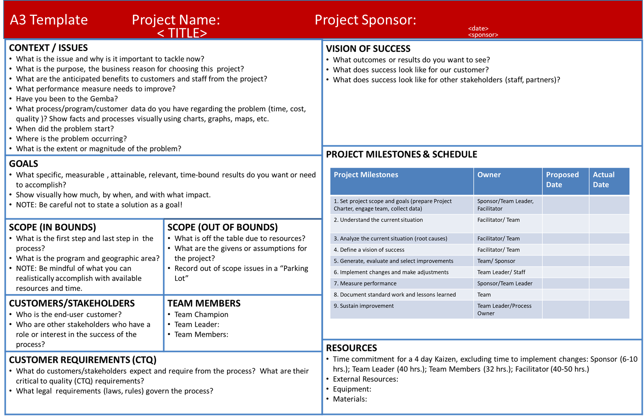

Slide 16
“Rapid Start QI Project” A3 Sheet
Project Title: A3 Rapid Start for Newly Diagnosed
Project Dates: Start: 12/1/2019 Projected Completion: 4/1/2020
Team Leader and Members: Facilitator:
Define Problem From testing to start of medication time consuming Scope: confirmed test to scheduled f/up appt and labs | Plan
Goals and Measures Reduce linkage time from 14 days/112 hours to 5 days/40 hours Reduce time to VL suppression from average 89 days to 30 days | Implementation: Observations/Step Measurement Data
Current State Map | Results: Control/Sustain
Analysis (tools/results) – Future State Map and Gap Analysis | Reporting and Feedback
Tests of Change and Step Measures | Follow-up Actions: Plan to Sustain

Slide 17
Combining Tools For Synergistic Effect
Develop Project Goals
A3 Project Charter
Describe Current Process
SIPOC Diagram
Value Stream – Current State
Develop Improvement Theory
FMEA
Describe Improved Process
Value Stream Map – Future State
Adopt
Kanban
Redesign
Yes
Define
Measure
Analyze
Modify
Design
No
P
D
S
A
Improve
Control

Slide 18
SIPOC Diagram
Stakeholders, Inputs, Process, Outputs, and Customers
When to use it:
When you first start to investigate a process and a team needs to understand the basics that make up the process
  Especially when you need to understand how complex processes work together as a system
When a team needs a way to get the collective knowledge of the team members about a process recorded in an easy to view format
When we need to make a concise communication to others about a process and the parameters that it encompasses

Slide 19
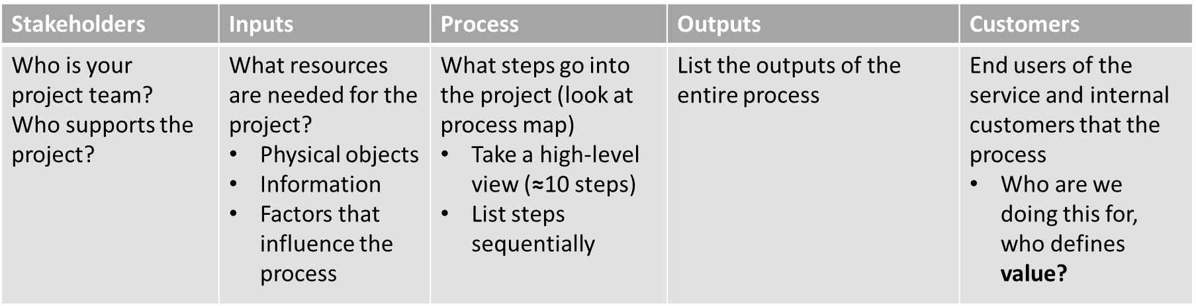
Filling Out a SIPOC
Input Measures:
How do you measure stakeholders generating outputs in terms of goals?
Process & Step Measures:
What are stakeholders doing? How long does it take, how much does it cost, where are the complexities?
Outcome Measures:
How do you measure outputs in terms of goals? Do outputs effectively improve health outcomes, service delivery efficiency, and customer satisfaction?
Notes:
When defining the types of measurement plug the upcoming TA call in September about measurement and specifically will cover how track and measures your QI project using intermediate measures

Slide 20
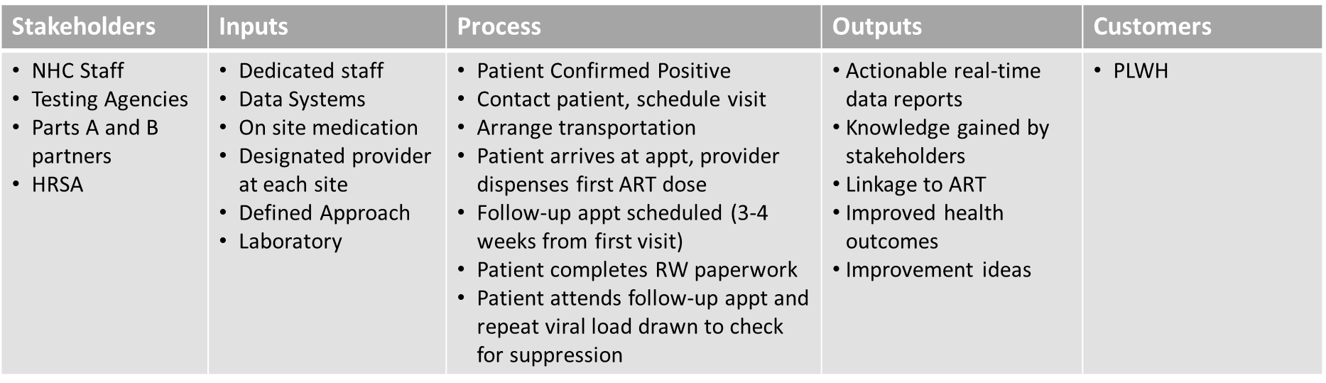
Case Study SIPOC
Input:
# of RS appts
# of meds dispensed
Process:
Cycle Time – 1) linkage to care; 2) diagnosis to viral suppression
Process Complexity – testing and referrals to clinic to provider
Outcomes:
Patient suppressed in <30 days

Slide 21
Combining Tools For Synergistic Effect
Develop Project Goals
A3 Project Charter
Describe Current Process
SIPOC Diagram
Value Stream – Current State
Develop Improvement Theory
FMEA
Describe Improved Process
Value Stream Map – Future State
Adopt
Kanban
Redesign
Yes
Define
Measure
Analyze
Modify
Design
No
P
D
S
A
Improve
Control

Slide 22
Mapping a Process
Process mapping helps us describe a process visually to:
  Understand the process
  Identify potential sources of problems
  Outline the ideal process steps
  Enable communications with others
There are several tools for mapping a process
  Spaghetti Diagrams
  Decision Trees
  Flowcharts - Beginner
  Value Stream Maps – Advanced

Slide 23
Process Flow: Actual vs. Documented
End:
Patient Durably Suppressed
Start: New dx referred to care

Slide 24
Quick Review of Value
Value Added Step - the customer wants it, it fundamentally changes the service experience, AND it has to be done right the first time. All three elements must be present to be Value Added.
Requirements - required by the consumer, required by the organization, or required by law. Challenge requirements--things like policies can be changed and aren't necessarily always requirements!
Non-Value Added - everything else! We can't get rid of all NVA, some of it (sometimes over 50%) is inherent to the process. Also, NVA does NOT mean unimportant, things like data collection are technically NVA, but can be critical to the success and sustainability of the process improvement.

Slide 25

Make an Existing Flowchart into a Value Stream Map
Take an existing flowchart or other process map
Gather a small team that has knowledge of the process
Talk through each step at a time
Use Sticky Notes and markers mark each step:
    Green Mark– value added
    Yellow Mark – requirement
    Red Mark – non-value added
Assign each step accordingly – go for consensus
Brainstorm how to remove waste and add more value
    Use quantitative process data to inform discussion
    Use qualitative consumer data as well – compare to their map or journey map

Slide 26
Creating the Current State Map
Identify the scope of the map for the initiative
    Begin with a high-level map across departments/unit
    Then focus on the level of processes or step that you wish to address
Identify when the consumers requirements are met (success!!)
Inform process owners that the map is created from actually walking and get their input
Agree on icons that will be used
Keep it simple, but good enough

Slide 27
Value Stream Mapping: Data Boxes
Takt Time: the amount of time it takes to complete the process to keep up with demand
  We have 15 min schedules and we double book
  We need to see 30 patients in 7 hours – what is our takt time?
Cycle Time: the amount of time it takes for the step
  Average time to get patients checked out at front desk
Lead Time: Total time from initiation of process to customer
# of People: the number of staff involved in the step
Inventory: the number of patients or items “waiting”
  We’ve seen 20 pts. and have 10 waiting to be seen or currently in the process and we have 2 hours before the last slot, will we be able to see everyone?
TAKT TIME
(7hrs*60min)= 420 min
420min/30pts= 14 min

Slide 28
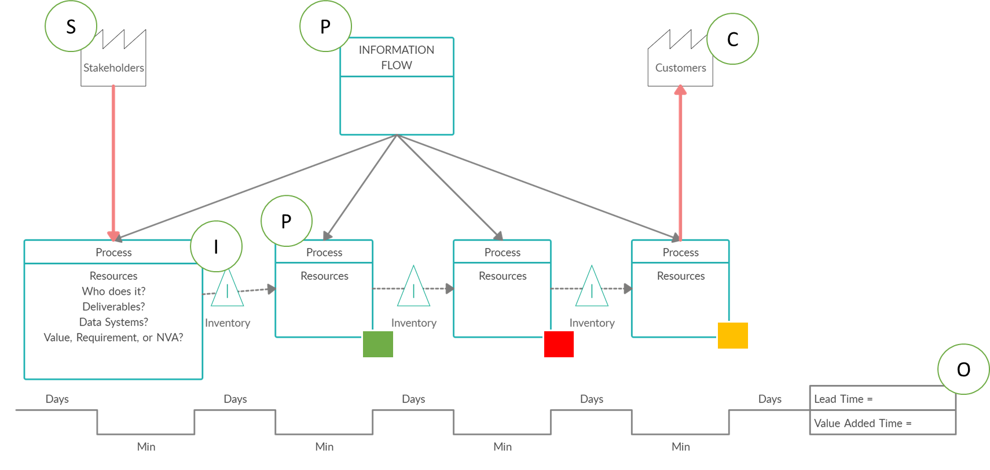
VSM Template
Notes:
https://app.creately.com/

Slide 29
Current State - Value Stream Map Case Study
Patient confirmed positive
PN contacted by cellphone. DOB, First and last name, Phone number, DX date
Appointment scheduled with provider, labs, eligibility.
DIS called to verify that the patient is truly treatment naive/newly dx.
Uber transportation for patient arranged if needed.
Patient completes registration form, fqhc form, signs consents.
If patient has active Medicaid, send rx to Avita and pick it up same day.
Intake labs drawn.
Provider dispenses first dose of ARVs in office and explains the importance of adherence.
Patient completes Ryan White paperwork and Medicaid app/ LAHAP app as needed. Future assessment scheduled with case manager.
Follow-up appt scheduled for 3-4 weeks with HIV-RNA repeated at that time.
Linkage coordinator verifies that the patient attends the follow up provider visit. Then patient is referred to CHWs for future follow up.
Value Added
Required
Non-Value Added
Cycle Times:
Dx to ART = 112 hours; 14 days
Dx to Viral Suppression = 89 days

Slide 30
Future State Value Stream Map: Key Questions
How would the customer draw this map?
What would the ideal process look like?
Look for value added activities (usually the boxes) and seek to eliminate waste (arrows, forms, decisions, rework, transport etc.)
What improvements could be made if there were no constraints on scope or resources?
Where is continuous flow most important?
Where could we employ a creative idea to remove waste?
Which improvements will give us the most juice for the squeeze? (intersection of high impact, high probability, low cost solutions)
Which improvements will best help the process owners sustain?

Slide 31
Creating a Future State –
What would you change?
Patient confirmed positive
PN contacted by cellphone. DOB, First and last name, Phone number, DX date
Appointment scheduled with provider, labs, eligibility.
DIS called to verify that the patient is truly treatment naive/newly dx.
Uber transportation for patient arranged if needed.
Patient completes registration form, fqhc form, signs consents.
If patient has active Medicaid, send rx to Avita and pick it up same day.
Intake labs drawn.
Provider dispenses first dose of ARVs in office and explains the importance of adherence.
Patient completes Ryan White paperwork and Medicaid app/ LAHAP app as needed. Future assessment scheduled with case manager.
Follow-up appt scheduled for 3-4 weeks with HIV-RNA repeated at that time.
Linkage coordinator verifies that the patient attends the follow up provider visit. Then patient is referred to CHWs for future follow up.
Value Added
Required
Non-Value Added
Cycle Times:
Linkage time = 112 hours; 14 days
Dx to Viral Suppression = 89 days
Goals:
Reduce linkage time from 14 days/112 hours to 5 days/40 hours
Reduce time to VL suppression from average 89 days to 30 days
Notes:
I thought we could pause here and have a general discussion of ideas about what could be changed using the questions from slide 29.

Slide 32
Implementing Solutions
How do you prioritize multiple solutions to root cause(s)?
  Sort possible projects
  Collect relevant data
  Analyze relevant technical and experiential data
  Refer to Root Cause Analysis to ensure solution addresses the root cause
  Consider impacts vs. barriers to implementation
There are several tools for prioritization
  PICK Chart or Priority Matrix (Beginner)
  Failure Mode Effects Analysis (Advanced)

Slide 33
Understand Critical Failures
What should we prioritize?
  Think horses, not zebras
FMEA key questions for improvement teams
  What could go or went wrong?
  What would cause it?
  What are the consequences?
  What can we do? (Redesign)
Contingency planning for probable, critical, occurrences
  Designing better interventions could save you several cycles!
    If X, then Y planning

Slide 34
Failure Mode & Effects Analysis (FMEA)
With a long history in private industry and the military, FMEA is a step-by-step approach for identifying all possible failures in a design, a process, or a product or service. It is a common analysis tool for QI projects.
Failure modes: means the ways, in which something might fail. Failures are any errors or deviations from quality, especially ones that affect the consumers, and can be potential or actual
Effects analysis: refers to studying the consequences of those failures, potentially even before they happen

Slide 35
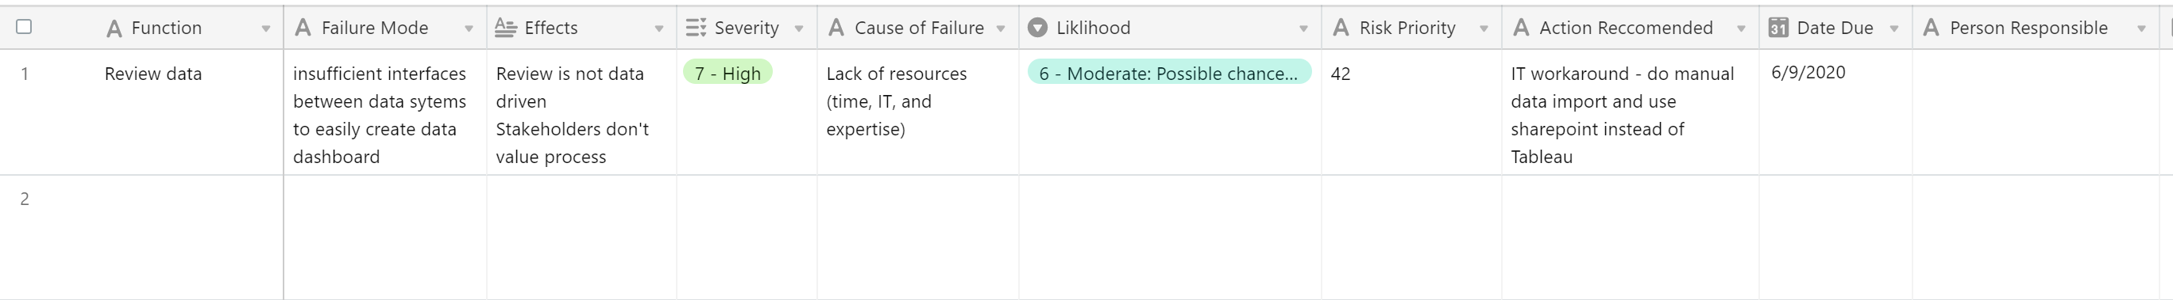
Simplified FMEA example
Multiply Severity X Likelihood of Occurrence
For Risk Priority Number
(RPN)
Develop recommended actions for high RPN functions
1-10 Scale
Use data to confirm
1-10 Scale
Use data to confirm

Slide 36
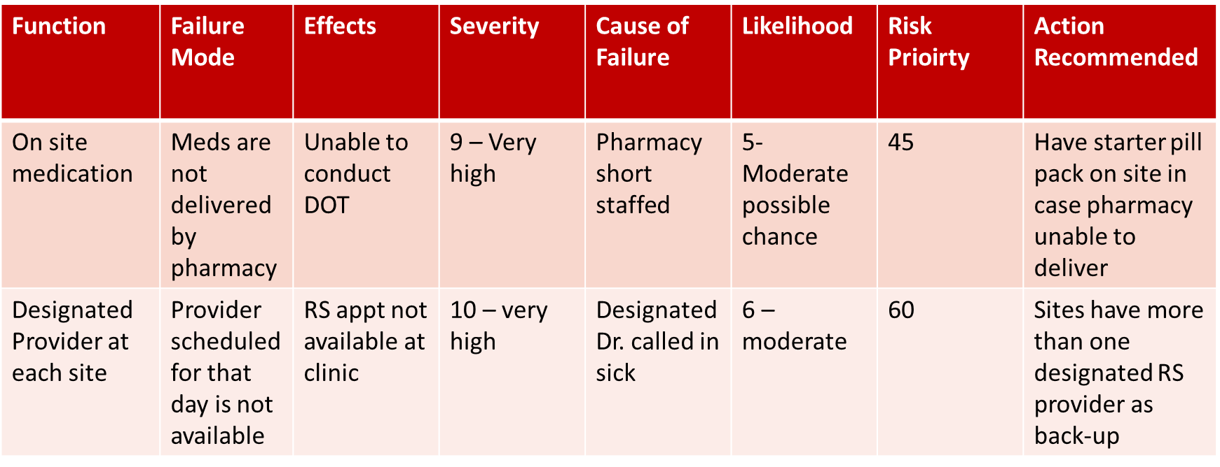
Case Study - FMEA

Slide 37
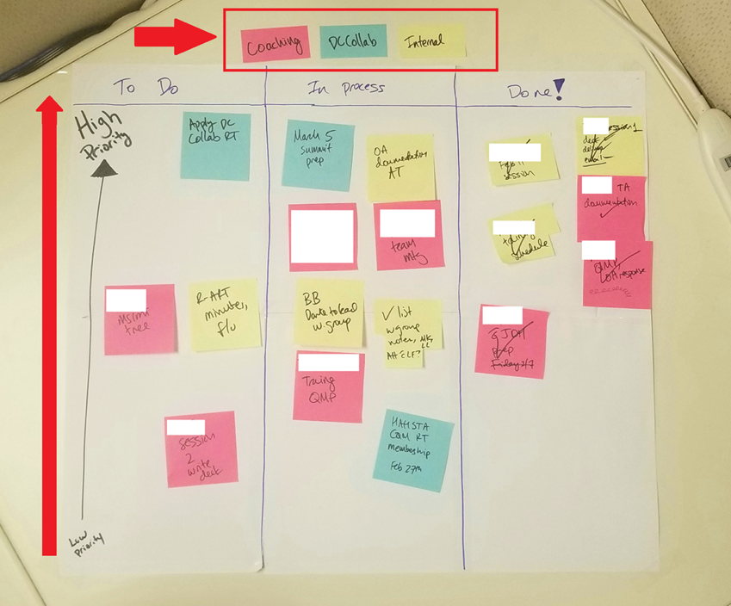
Kanban
Japanese for “signboard”
A visual display that regulates the flow of work
Organized around the different milestones in an improvement project
Clearly indicates what work remains to be done and who is responsible
Colors can represent the state of the work in process
  Example: yellow can mean behind schedule; orange on time; red means immediate attention

Slide 38
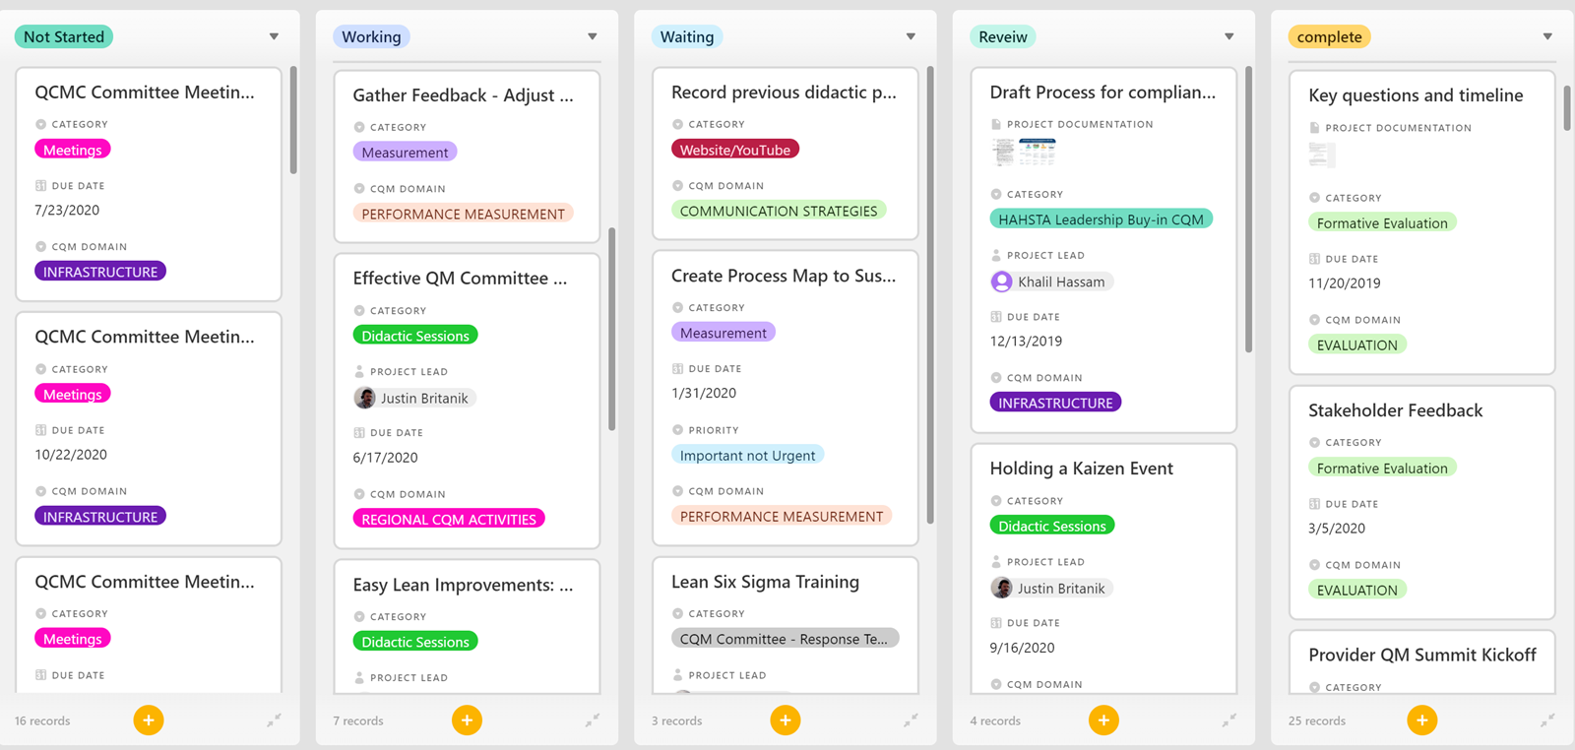
Making a Simple Kanban
Status
Due date
Priority
Task Owner

Slide 39
Using Kanban for Team Huddles
Huddles are:
Brief; 10-15 minutes
Focused; no side conversations, everyone is focused and reviewing the information
Standing meetings
Review of the “vital few”
Engagement focused
  More than just speaking aloud or reading an email, visual boards help everyone see the same thing
  Responsibility for leading the huddle rotates

Slide 40
How to do a Kanban Huddle
It’s easy! Review the information on the board; it’s a conversation piece, not wallpaper
Agenda could look like
  “Glow and Grow”
    Updates on roadblocks, celebrating team members, and opportunities for improvement
  Top 1 (what is the thing we want to get done this week?
    What was our Top 1 last week? Did we do it? Why / why not?
  Metrics – review of data. Color coded red/yellow/green. Improvement ideas flow from data review
  Offers and requests
  Cheer. End with joy, a fun quote, a verbal cheer, anything to smile and unify!

Slide 41
Case Study - Kanban
To-Do
Task: Present 3rd Qtr. performance measures for RS process
Priority: Medium
Due Date: 6/1/20
Person Responsible: Quality Manager, Data Coordinator
In-Process
Task: Train front desk staff on rapid appt scheduling procedures, insurance (RW)
Priority: High
Due Date: 11/15/2019
Person Responsible: Clinic Manager
Done!
Task: Train testing sites on rapid linkage process
Priority: High
Due Date: 10/15/2019
Person Responsible: Linkage Coordinator

Slide 42
Related QI Resources
ASQ - https://asq.org/
  Search their site for information and examples of QI tools
  Colorado Local Public Health & Environmental Resources QI tools -
  https://www.colorado.gov/pacific/cdphe-lpha/tools-and-resources
  EPA Lean Metrics Guide –
  https://www.epa.gov/sites/production/files/2014-
  04/documents/metrics_guide.pdf
Institute for Healthcare Improvement - http://www.ihi.org/
  Quality Improvement Essentials toolkit and a wide variety of tutorials on
  tools

Slide 43
Additional CQII Resources
Center for Quality Improvement & Innovation (CQII)
targethiv.org/cqii:
Information on Advanced Trainings
On site Technical Assistance
Quality Academy
Consumer Quality Improvement Activities
Collaborative Resources

Slide 44
Frequently Asked Questions:
Which tool should we use if we are just getting started with our quality improvement project?
Which tool would we use to help us to capture and document our project?
How do these tools apply to a health department or Ryan White recipient that does not provide direct patient care?

Slide 45
Contact Information

Slide 46

Contact Information
Contact Information
Charles Kolesar RN, MPH
Program Manager
New York State Department of Health
AIDS Institute
90 Church Street, 13th floor
New York, NY 10007-2919
Charles.Kolesar@health.ny.gov
212.417.4730 (main)
212. 417. 4768 (direct)
212.417.4684 (fax)

