Slide 1
Data-based Decision Making: Understanding, Assessing, and Using Data
Module 10.1 Slides
Topic: Understanding Data Types and Sources

Slide 2
Understanding Data Types and Sources
Importance of Data in RWHAP Planning
Terms and Definitions
Data Types and Sources

Slide 3
Training Objectives
Following the training, participants will be able to:
Define “data-based decision making”
Describe at least 3 reasons why it is so important that PC/PBs understand and effectively use data in RWHAP planning and decision making
Describe the role of data in implementing 5 important PC/PB roles

Slide 4
Training Objectives (cont.)
Define and differentiate the epidemiologic terms of incidence and prevalence
Explain the concept and importance of unmet need and of individuals with HIV who are unaware of their HIV status
Describe 4 data-related concepts used in assessing service needs and gaps within the EMA or TGA
Identify and describe 8 types of data PC/PBs should obtain and use in decision making

Slide 5
Importance of Data in RWHAP Planning
“Without data, all anyone has are opinions. Data elevates the probability that you’ll make the right decision.”
—W. Edwards Deming

Slide 6
What Is Data-based Decision Making?
Definition: Decision making that is guided and supported by documented information – data – rather than based primarily or solely on personal experience, observation, anecdotes, or intuition/insight
Some experts prefer the term “data-informed” decision making, since decisions are based on multiple factors
Data used for decision making by PC/PBs should include:
  Quantitative and qualitative information obtained and reviewed systematically, using sound methods
  Information from multiple sources, gathered using several different approaches

Slide 7
Importance of Data
Data-based decision making is essential to establishing, supporting, and improving a system of quality care
Data guide the entire planning process:
  Understanding service needs, barriers, and gaps in your service area – overall and for PLWH subpopulations
  Making sound decisions about use of available funds
  Targeting funds to particular service models, geographic areas, and PLWH subpopulations
  Improving care for disproportionately affected groups

Slide 8
Role of Data in Implementing PC/PB Tasks
PC/PB Task | Role of Data in Implementing PC/PB Tasks
Needs Assessment | Collection and analysis of information about PLWH service needs, barriers, and gaps – a major source of data for decision making
Integrated/ Comprehensive Planning | Development of plan goals, objectives & strategies all based on data of many types and sources
PSRA including Directives | Decisions about priorities, resource allocation, directives, and reallocations all expected to be data-based
System of Care | Many types of data needed to identify and address system of care weaknesses/gaps and improve services
Assessment of the Administrative Mechanism | Data from recipient & subrecipients used to assess whether funds are getting to the community on a timely basis to support services

Slide 9
Importance of Data (cont.)
Data from multiple sources are needed to:
  Provide an understanding of diverse service needs of PLWH with varied characteristics and/or from different parts of the service area
  Highlight service barriers and gaps
  Help identify service models with positive clinical outcomes for all PLWH or particular subgroups
  Help ensure best use of limited resources
  Contribute to fair and objective decisions
Without access to adequate data from multiple sources, decisions are often based on personal experience or “impassioned pleas”

Slide 10
Challenges of Using Data
Everyone uses data in daily life, but people new to community planning may have limited experience in use of data for planning decisions
Most PC/PB members need training on HIV-related data terminology, data sources, and how to assess and use data
Data are not always presented in user-friendly formats
Meaningful discussion and review of data requires time
and effort

Slide 11
Quick Discussion A:
Challenges in Using Data
How do you use data and research in your job or everyday activities?
What do you find most challenging about understanding and using data in HIV planning –
or what was most challenging when you first became involved with the PC/PB?
If you are a “veteran” PC/PB member, what helped you become comfortable using data?
What made it harder?

Slide 12
Terms and Definitions
Epidemiologic Terms
HIV Care Continuum
Unmet Need
Assessing Service Needs and Gaps
Quantitative vs. Qualitative Data

Slide 13
Epidemiologic Terms:
Incidence (New Cases)
Incidence: The number of new cases of a disease in a population during a defined period of time – such as the number of new HIV cases in your EMA or TGA reported during 2018
Incidence rate: The frequency of new cases of a disease that occur per unit of population during a defined period of time – such as the rate of new HIV cases per 100,000 population in your EMA or TGA in 2018

Slide 14
Epidemiologic Terms:
Prevalence (Total Cases)
Prevalence: The total number of people in a defined population diagnosed with a specific disease or condition at a given time—such as the total number of people diagnosed with HIV in your EMA or TGA as of December 31, 2018
  Can refer to all cases diagnosed from the beginning of the epidemic
  More often “total living cases”: the number of people diagnosed and living with the disease
Prevalence rate: The total or cumulative number of cases of a disease per unit of population as of a defined date—such as the rate of HIV cases per 100,000 population diagnosed in your EMA or TGA as of December 31, 2018

Slide 15
Other Common Epi Terms
Sample: A group of people selected from a total population with the expectation that studying this group will provide important information about the total population
Percentage: A proportion of the whole in which the whole is 100
Example: 15 of 60 new cases of HIV were among women
15 divided by 60 = .25 and .25 x 100 = 25%
Trends: Long-term movement of change in frequency, such as 5-year trends in HIV incidence among youth

Slide 16
Other HIV-related Epi Terms
Risk factor: A behavior, condition, or other factor that increases the likelihood of HIV infection
Transmission category: The risk factor most likely to have resulted in HIV transmission
Stage 3 HIV infection: AIDS – CD4 count falls below 200; immune system badly damaged and can no longer fight off serious illnesses (“opportunistic infections”)
Late testers: Individuals who have stage 3 HIV infection (AIDS) when first diagnosed or within 12 months after

Slide 17
HIV Care Continuum
Definition: A model of HIV medical care that shows “the series of steps from the time a person receives a diagnosis of HIV through the successful treatment of their infection with HIV medications”*
Data: Percent of individuals with HIV who are engaged at
each step
Terminology: Sometimes referred to as the “HIV treatment cascade” or Gardner cascade (developed by Dr. Edward Gardner and colleagues in 2011)
* CDC, “Understanding the HIV Care Continuum,” July 2017

Slide 18
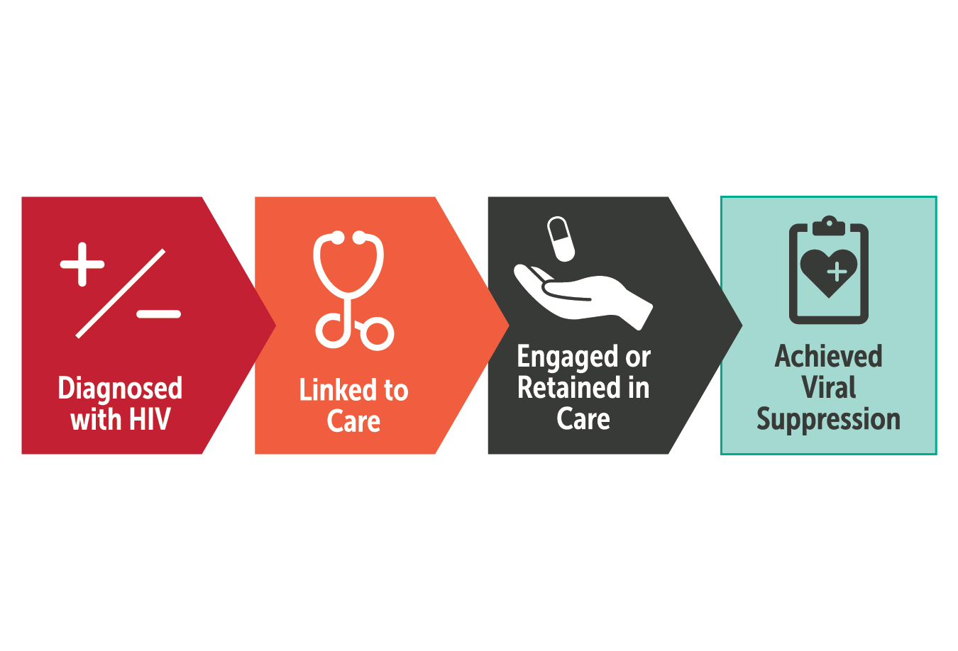
HIV Care Continuum 1

Slide 19
Steps in the HIV Care Continuum
Diagnosed with HIV: received a positive HIV test that was reported to the CDC
Linked to care: visited an HIV-related health care provider
Received or retained in care: received medical care for HIV infection
Virally suppressed: have a very low level of HIV in their blood
Sometimes included in the continuum of a RWHAP program prior to Virally Suppressed: Prescribed antiretroviral therapy (ART)

Slide 20
“Unmet Need” or “Not in Care” Definition
Unmet need refers to individuals with HIV in a jurisdiction who are aware of their HIV status and are not in care – people who have been diagnosed with HIV but are not receiving HIV-related medical care
Estimate of unmet need: Number and percent of all diagnosed PLWH who are not in care

Slide 21
Other Terms Related to Unmet Need
Assessment of unmet need: Analysis of the characteristics of PLWH who are not in care – demographics, geographic location, risk factor – their care history, and barriers to care
Plan for addressing unmet need: Strategies for linking PLWH to care immediately after diagnosis and for finding, relinking, and retaining in care those who dropped out
Service gaps: The identified unfulfilled need for HIV-related services other than primary medical care among individuals who know their HIV status in a specified geographic area

Slide 22
Quick Discussion B: Unmet Need
Why is it important for your PC/PB to understand the concept of unmet need and to estimate, assess, and address it?
What might your PC/PB do to ensure careful consideration of the needs of PLWH who are out of care?

Slide 23
HIV-Positive Unaware Individuals
HIV-positive/unaware: Individuals with HIV who are unaware of their status—they have not received an HIV diagnosis—because they have never been tested, or did not receive their test results
The Early Identification of Individuals with HIV/AIDS (EIIHA) Initiative helps to:
  Identify individuals with HIV who do not know their status
  Make them aware who are unaware of their status and enable them to use health and support services
  Reduce barriers to routine testing and disparities in access and services among affected subpopulations and historically underserved communities [§2603(b)(2)(A)]

Slide 24
Data-Related Concepts in Assessing Service Needs and Gaps
Geographic disparities: Differences in access to needed services based on where an individual lives
Availability of services: Level or number of available “slots” within a service category in a specified geographic area, and whether there are waiting lists
Accessibility of services: Extent to which services in a particular geographic area can be obtained conveniently by PLWH who need them, based on factors like access to public transportation, parking, service hours, and disability access
Appropriateness of services: Extent to which services meet the needs of various PLWH subpopulations, in terms of languages spoken, service models, and cultural competence with regard to race/ethnicity, sexual orientation and identity

Slide 25
Quantitative and Qualitative Data
Quantitative data: Information that can be expressed in numbers, counted, or compared on a scale—such as epi data or PLWH survey data
Qualitative data: Information that cannot easily be measured or expressed in numbers—such as narrative data from a focus group, consumer town hall meeting, open-ended interview, or direct observations
  Usually described in terms of common themes and patterns of response
  Often complement and help explain quantitative data

Slide 26
Measures of “Central Tendency” (Averages)
Mean: the numerical average – the sum of values divided by the total number of values
Median: the middle value in a data set, with about half the values higher and half lower
Mode: the most commonly occurring value
Example: For values 10, 7, 5, 8, and 5:
  Sum is 10+7+5+8+5=35 and total number of values is 5
  Mean is 35÷5=7
  Median is 7 [10, 8, 7, 5, 5]
  Mode is 5 [it occurs twice]

Slide 27
Data Types and Sources
Epidemiologic profile
HIV care continuum data
Needs assessment data
Service expenditure
and cost data
Client characteristics
and service utilization data
HIV tests and diagnoses
Unmet need data (estimate and assessment)
Clinical Quality Management (CQM) data
Recipient monitoring data
Performance measures and clinical outcomes data
Data from other programs

Slide 28
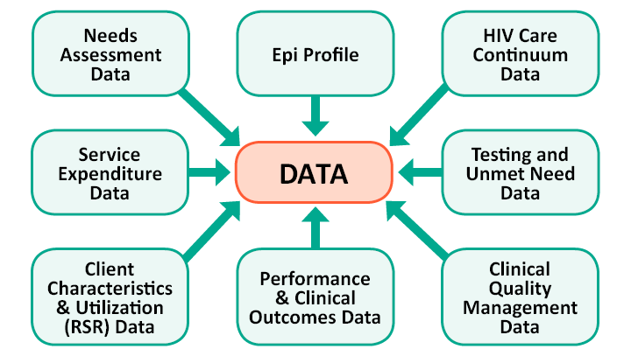
Types of Data Needed for RWHAP Planning
Note: Some data types overlap

Slide 29
Epidemiologic Profile
Source: State or local HIV surveillance staff, from eHARS (enhanced HIV/AIDS Reporting System) data
Frequency: Annual, usually based on a calendar year
Content: The distribution of HIV in various populations in an area in terms of sociodemographic, geographic, behavioral, and clinical characteristics; includes:
  Characteristics of the general population, persons newly diagnosed with HIV infection, persons living with HIV disease, persons at risk for HIV
  Trends in the epidemic
Use: Helps PC/PBs understand the epidemic and implications for service needs and priorities

Slide 30
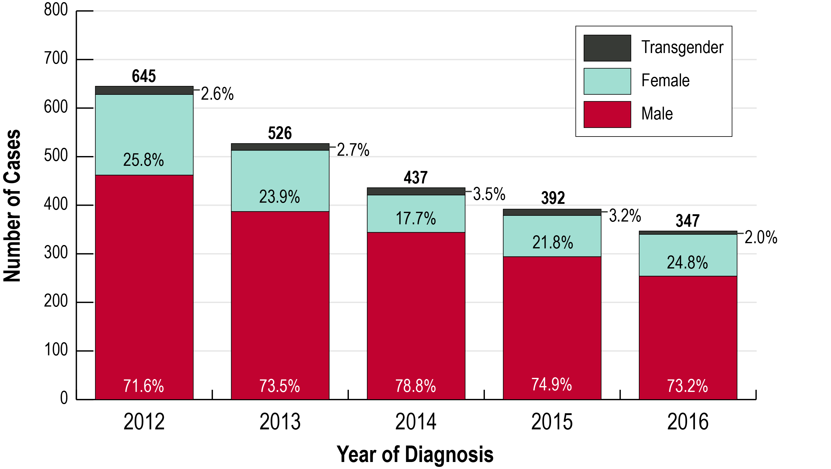
Sample Epi Profile Chart: 5-Year Trends in Newly Diagnosed HIV Cases by Year and Gender Identity, Washington DC
Source: Annual Epidemiology and Surveillance Report: Data through 2016, Washington, DC

Slide 31
HIV Care Continuum 2
Source: State or local HIV surveillance staff
Frequency: Varies; at least annually
Content: Often 2 different continuums
  All PLWH in the service area
  RWHAP clients, often with multiple breakdowns to show both all RWHAP clients and various subpopulations
Use: Helps PC/PB understand strengths and weaknesses in system of care and identify need for additional attention to particular steps (such as retention in care) and PLWH subpopulations

Slide 32
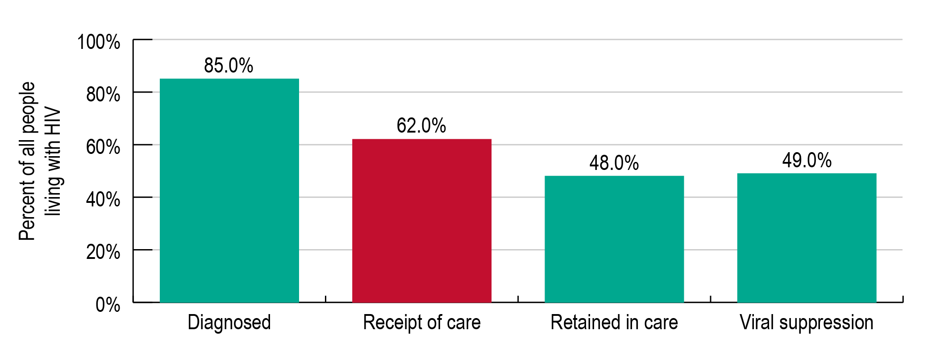
Prevalence-based HIV Care Continuum, U.S., 2014
This is called the prevalence-based HIV care continuum because it shows each step as a percentage of the total number of people living with HIV, including people whose infection has been diagnosed and those who are infected but don’t know it
Source: CDC

Slide 33
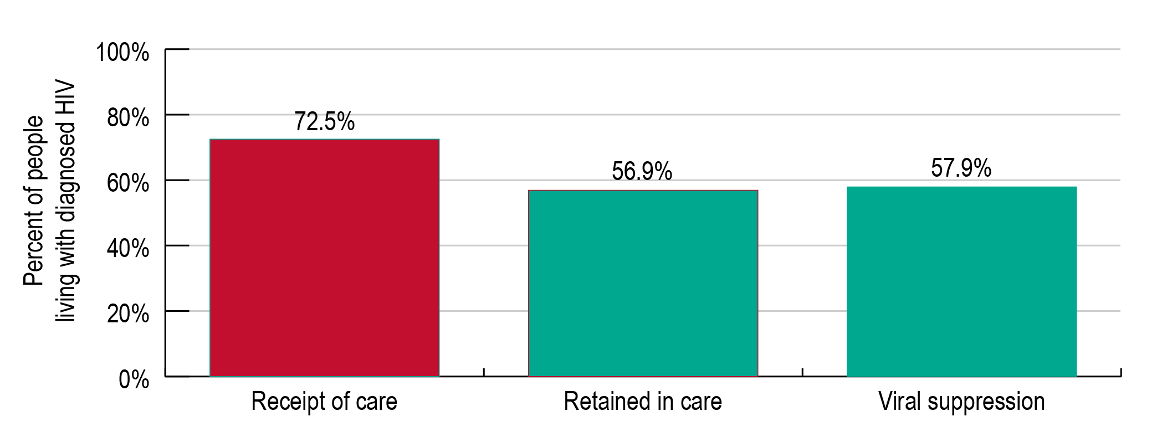
Diagnosis-Based HIV Care Continuum, U.S., 2014
This is called the diagnosis-based HIV care continuum because it shows each step as a percentage of people living with diagnosed HIV
Source: CDC

Slide 34
Quick Discussion C:
Using HIV Care Continuum Data
Which of type of HIV care continuum do you think is most useful for your PC/PB – prevalence-based or diagnosis-based? Why?
Many jurisdictions now receive both an HIV care continuum for all PLWH and a continuum including only RWHAP clients. In addition, separate continuum data are often provided for major PLWH subpopulations. What are the benefits of these multiple continuums – how might the PC/PB use them?

Slide 35
Needs Assessment Data
Source: Collected by PC/PB, including staff and/or consultants
Frequency: Usually a multi-year cycle, with some new data each year
Content:
  Characteristics, service needs and barriers of PLWH, both in and out of care
  Provider resources available to meet those needs
  Service gaps, overall and for various PLWH subpopulations
Use: Helps PC/PB to set priorities, allocate resources, develop directives, and improve service access and quality, overall and for specific populations

Slide 36
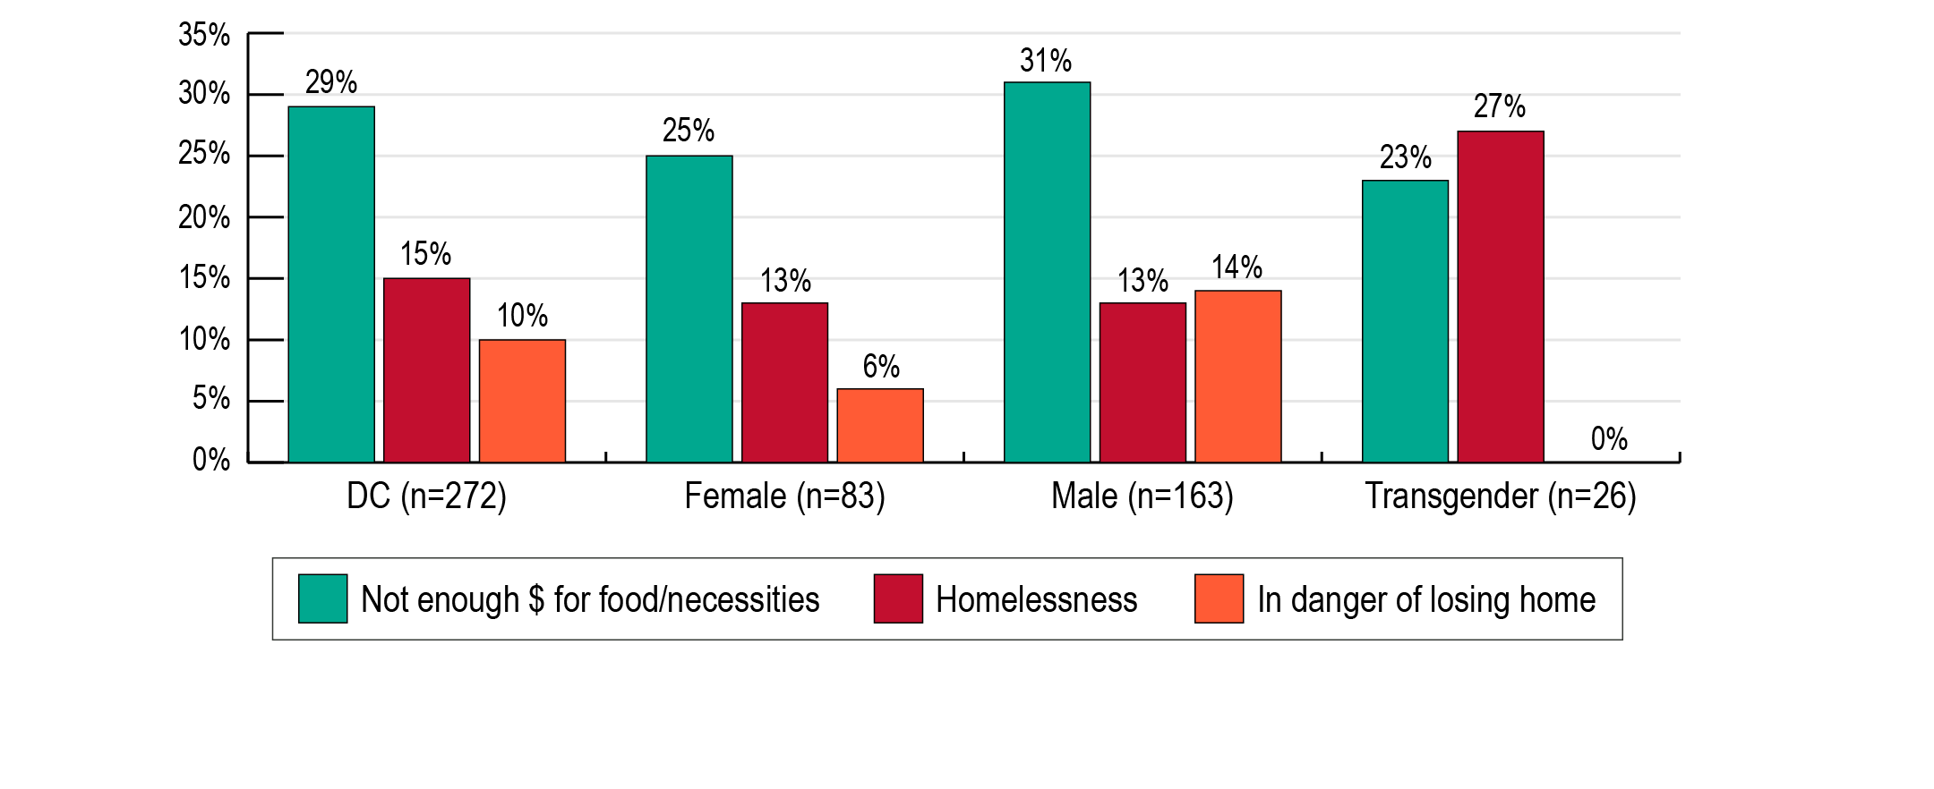
Most Frequently Reported Life Situations Faced by PLWH, by Gender (Percent) – Washington, DC
The most frequently reported life situation PLWH said they dealt with over the past 12 months was not having money for food and other necessities
Male PLWH were the most likely to report not having enough money for food and other necessities and being in danger of losing their home
Transgender PLWH were the most likely to report homelessness

Slide 37
Service Expenditure and Cost Data
Source: Recipient or administrative agency
Frequency: Expenditures usually provided monthly, with an annual summary
Content: Projected and actual expenditures by service category, plus:
  Costs for one unit of service, such as 1 case management visit lasting 30 minutes
  Cost to serve one client for a year
Use: Helps PC/PB make funding decisions, adjust allocations based on actual use of funds and determine costs to serve additional clients

Slide 38
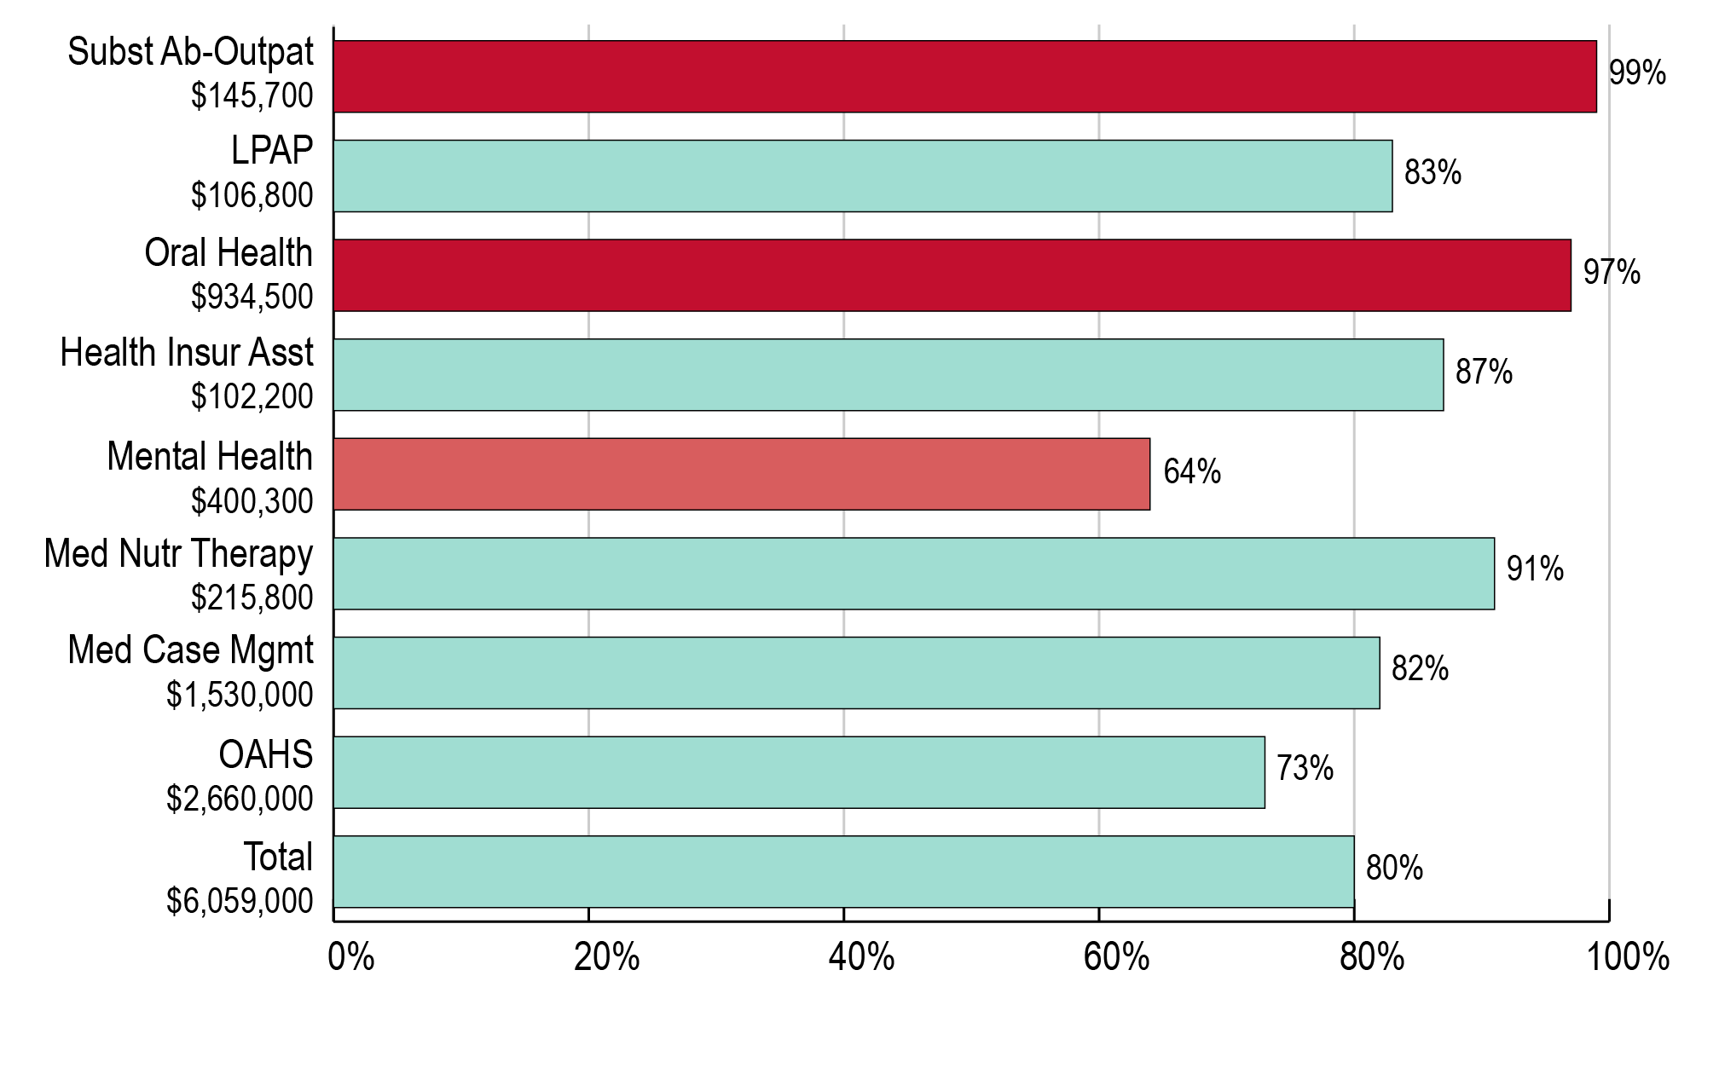
Core Medical Services: Total Allocations and Percent Expended after 10 Months
Service categories more than 10% over- or under-spent compared to the expected level of expenditure at 10 months are highlighted.

Slide 39
Quick Discussion D:
Using Expenditures Data
What percent of funding would you expect to see expended as of the end of the 10th month of the program year?
What concerns does this report raise for the PC/PB?
How might the PC/PB use this information?

Slide 40
Client Characteristics and Service Utilization Data
Source: Recipient, usually gathered through its client-level data system and included in the RWHAP Services Report (RSR)
Frequency: Annual
Content: Information about the use of RWHAP Part A services, including the number and characteristics of clients, overall and by service category, and the amount or units of service provided
Use: Help PC/PBs understand demand for specific services and identify differences in use of services by various PLWH groups

Slide 41
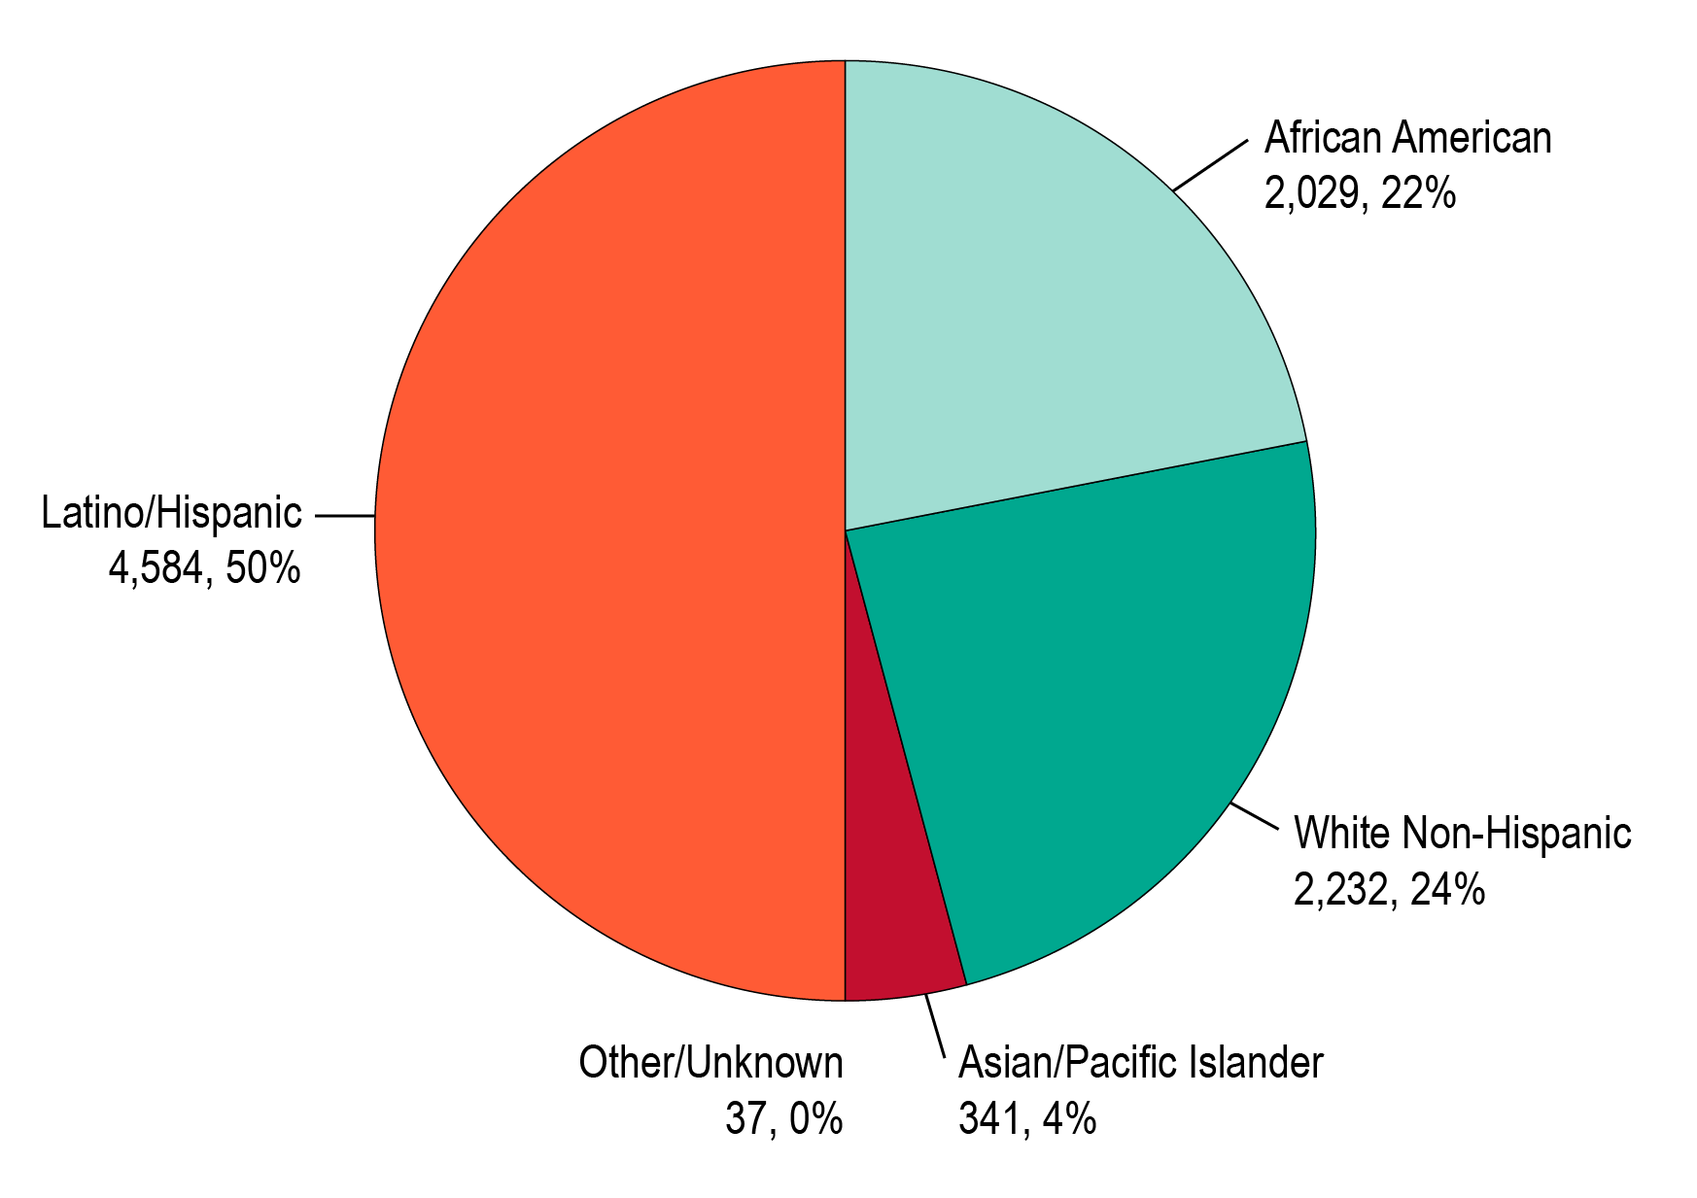
Race/Ethnicity of RWHAP Part A Clients, 2018 [N=9,224

Slide 42
HIV Tests and Diagnoses Data
Source: State/local surveillance and HIV prevention unit staff, as reported by testing sites
Frequency: Ongoing; reported at least annually
Content:
  Number of people who receive HIV tests
  Number and percent testing positive and their characteristics
  Number referred to needed services (care or prevention)
Use: Helps PC/PB predict future demand for care and the need to fund services like Outreach and Early Intervention Services (EIS), which help get people identified, tested, and linked to care if HIV-positive

Slide 43
Newly Diagnosed Positive HIV Test Events Funded with Public HIV Prevention Funds for Key Target Populations, 2017
 | Young MSM | African Immigrants | Hispanic/ Latino Men
a. Number of test events | 1,112 | 203 | 556
b. Number of newly diagnosed positive test events | 17 | 8 | 12
c. Number of positive test events with client linked to HIV medical are within 90 days | 17 | 7 | 8
d. Number of confirmed positive test events | 17 | 8 | 11
e. Number of confirmed positive test events with client interviewed for partner services | 14 | 7 | 9
f. Number of confirmed positive test events with client referred to prevention services | N/A | N/A | N/A
g. Total number of newly diagnosed confirmed positive test events who received CD4 and viral load testing | 17 | 7 | 8
Source: Sample TGA

Slide 44
Unmet Need Data
(Estimate and Assessment)
Source: State or surveillance staff provide estimate; PC/PB may assess unmet need as part of its needs assessment
Frequency: Usually updated/reported annually
Content:
  Estimate of the number of PLWH in the service area who know they are HIV-positive but are not receiving HIV-related medical care
  Assessment of the characteristics, service barriers and gaps of PLWH with unmet need
Use: Helps PC/PBs to understand how many PLWH are out of care and consider ways to find such PLWH, link or relink them to care, and improve retention

Slide 45
Unmet Need Estimate, 2017
Population Sizes | Value | Percent
Number of persons living with HIV disease (PLWH)/aware from 1/1/17-12/31/17 | 3,457 | 100%
Care Patterns – Met Need | Value | Percent
Number of PLWH who received specified HIV primary care services in 2017 | 2,848 | 82.4%
Calculated Results – Unmet Need | Value | Percent
Number of PLWH who did not receive specified HIV primary medical care services in 2017 | 609 | 17.6%
Source: Sample TGA

Slide 46
Clinical Quality Management (CQM) Data
Source: Recipient, based on a CQM program of coordinated activities carried out by recipient and subrecipients
Frequency: Ongoing; data shared with PC/PB at least annually
Content: Data on client care, health outcomes, and client satisfaction, including results of quality improvement activities
Use: Helps PC/PBs identify need for changes in program models or funding to help improve service quality and outcomes

Slide 47
Recipient Monitoring Data
Source: Recipient, based on monitoring of subrecipients, including an annual monitoring visit
Frequency: Ongoing; data shared with PC/PB at least annually
Content: Information on extent to which subrecipients are meeting requirements, including service standards, for their service categories
Use: Helps PC/PBs identify need for changes in program models or funding to improve service quality and outcomes, and possible need to refine service standards

Slide 48
Percent of New Clients Receiving a Mental Health Screening
 | 2015 | 2016 | 2017
Total number of clients receiving HIV-related medical care through RWHAP Part A | 635 | 643 | 652
Percent of clients who received a mental health screening (as required by service standards) | 92.3% | 85.4% | 82.5%
Change from prior year |  | 7.5% | 3.4%
Percent of clients found to have mental health issues | 28.2% | 31.2% | 30.7%
Percent of clients found to need mental health services | 18.7% | 21.2% | 23.2%
Percent of clients needing mental health services who were successfully referred, with at least one mental health visit | 89.9% | 91.3% | 83.4%
Analysis: The percent of clients with HIV who had a mental health screening decreased by 10.6% from 2015 to 2017, and the percent needing mental health services who received them decreased by 7.2%.
Source: Sample TGA

Slide 49
Quick Discussion E:
Using CQM and Monitoring Findings
If your PC/PB received information like that shown in the previous slide, what committee(s) would review it?
How might such information be used by the PC/PB?
What other information might you want to obtain to better understand the situation?

Slide 50
Performance Measures and Clinical Outcomes Data
Source: Usually provided by the recipient, based on various data sources (e.g., HIV care continuum, client-level database, CQM data, monitoring data)
Frequency: At least annually
Content: Percent of all PLWH or RWHAP clients that meet a particular measure or standard, usually chosen from the HRSA Performance Measure Portfolio. May relate to:
  A process, such as development of a case management care plan or a mental health assessment
  A clinical outcome, such as viral suppression
Use: Helps PC/PB identify service strengths and weaknesses and develop directives, improve models of care, and/or revise service standards to improve care

Slide 51
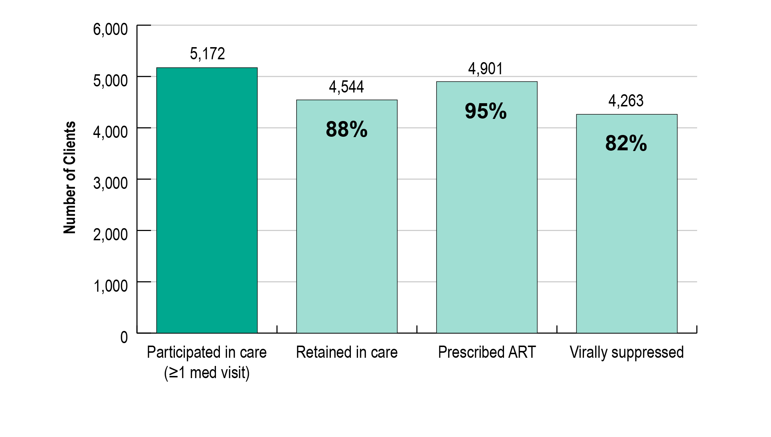
Performance Measures for RWHAP Clients in a Mid-Atlantic EMA, 2016 (Based on an HIV Care Continuum including ART)

Slide 52
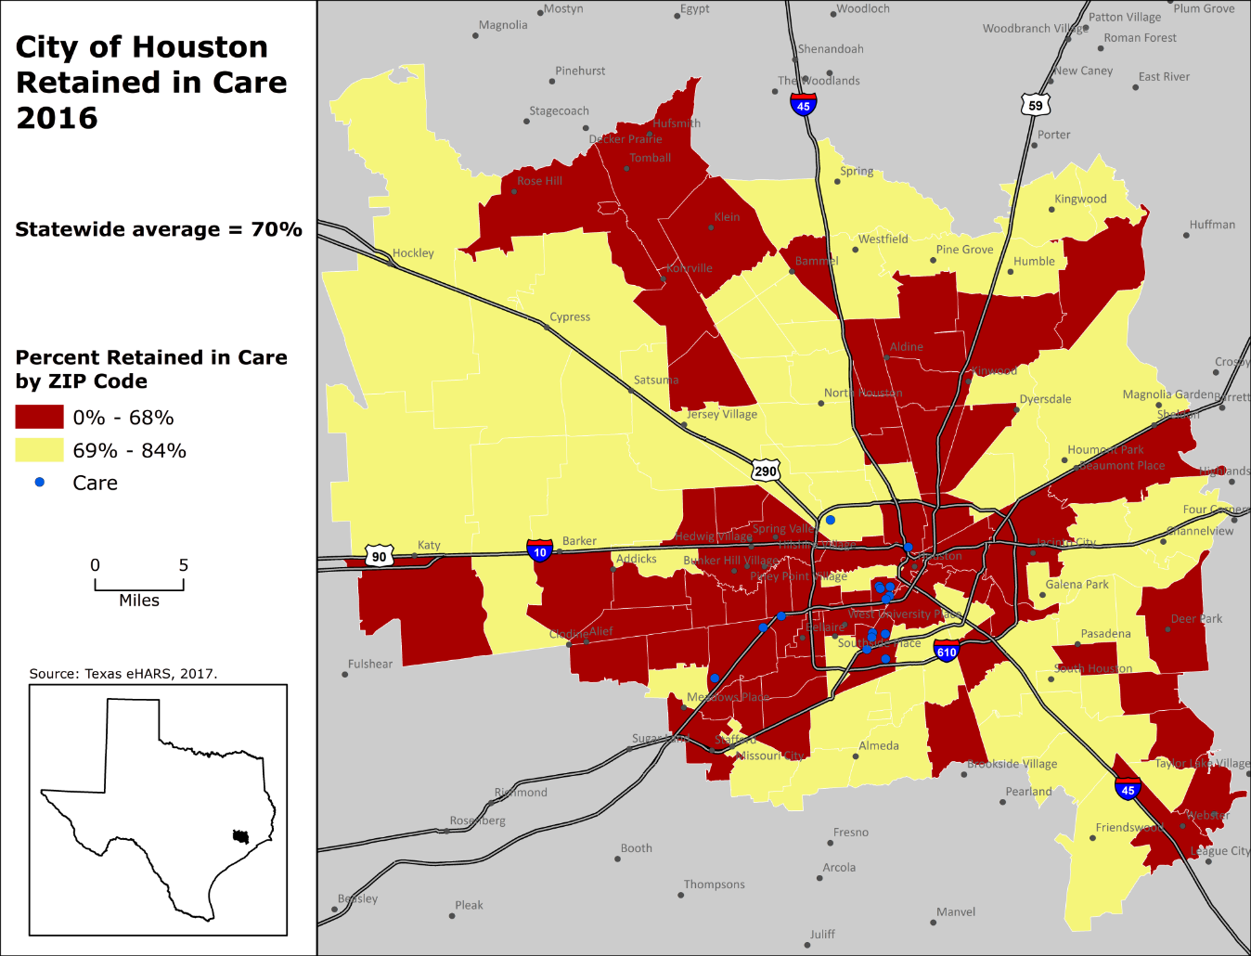
Sample Performance Data: “Heat Map” Showing Percent of Clients Retained in Care by Zip Code, 2016
Source: HIV/STD/TB/Viral Hepatitis Unit, Texas Department of State Health Service, 2018

Slide 53
Quick Discussion F: “Heat Map” Showing Retention in Care by Zip Code
The map on the prior slide shows zip codes with retention rates below and above 68%.
If this kind of map were available to your PC/PB, how might you use the information in decision making?
What other data would you most like to review along with this map?

Slide 54
Data from Other Programs
Sources: Many, including other federal agencies and programs such as CDC HIV prevention funding, Housing Opportunities for Persons With AIDS (HOPWA), Medicaid and Medicare, Substance Abuse and Mental Health Services Administration programs, state and local agencies
Frequency: Usually annual, prior to PSRA
Content: Most often number of clients in the program who are PLWH and their characteristics, services provided to them, and costs overall and/or by type of service
Use: Helps PC/PBs determine the level and sources of other funding for HIV services and avoid duplication of effort

Slide 55
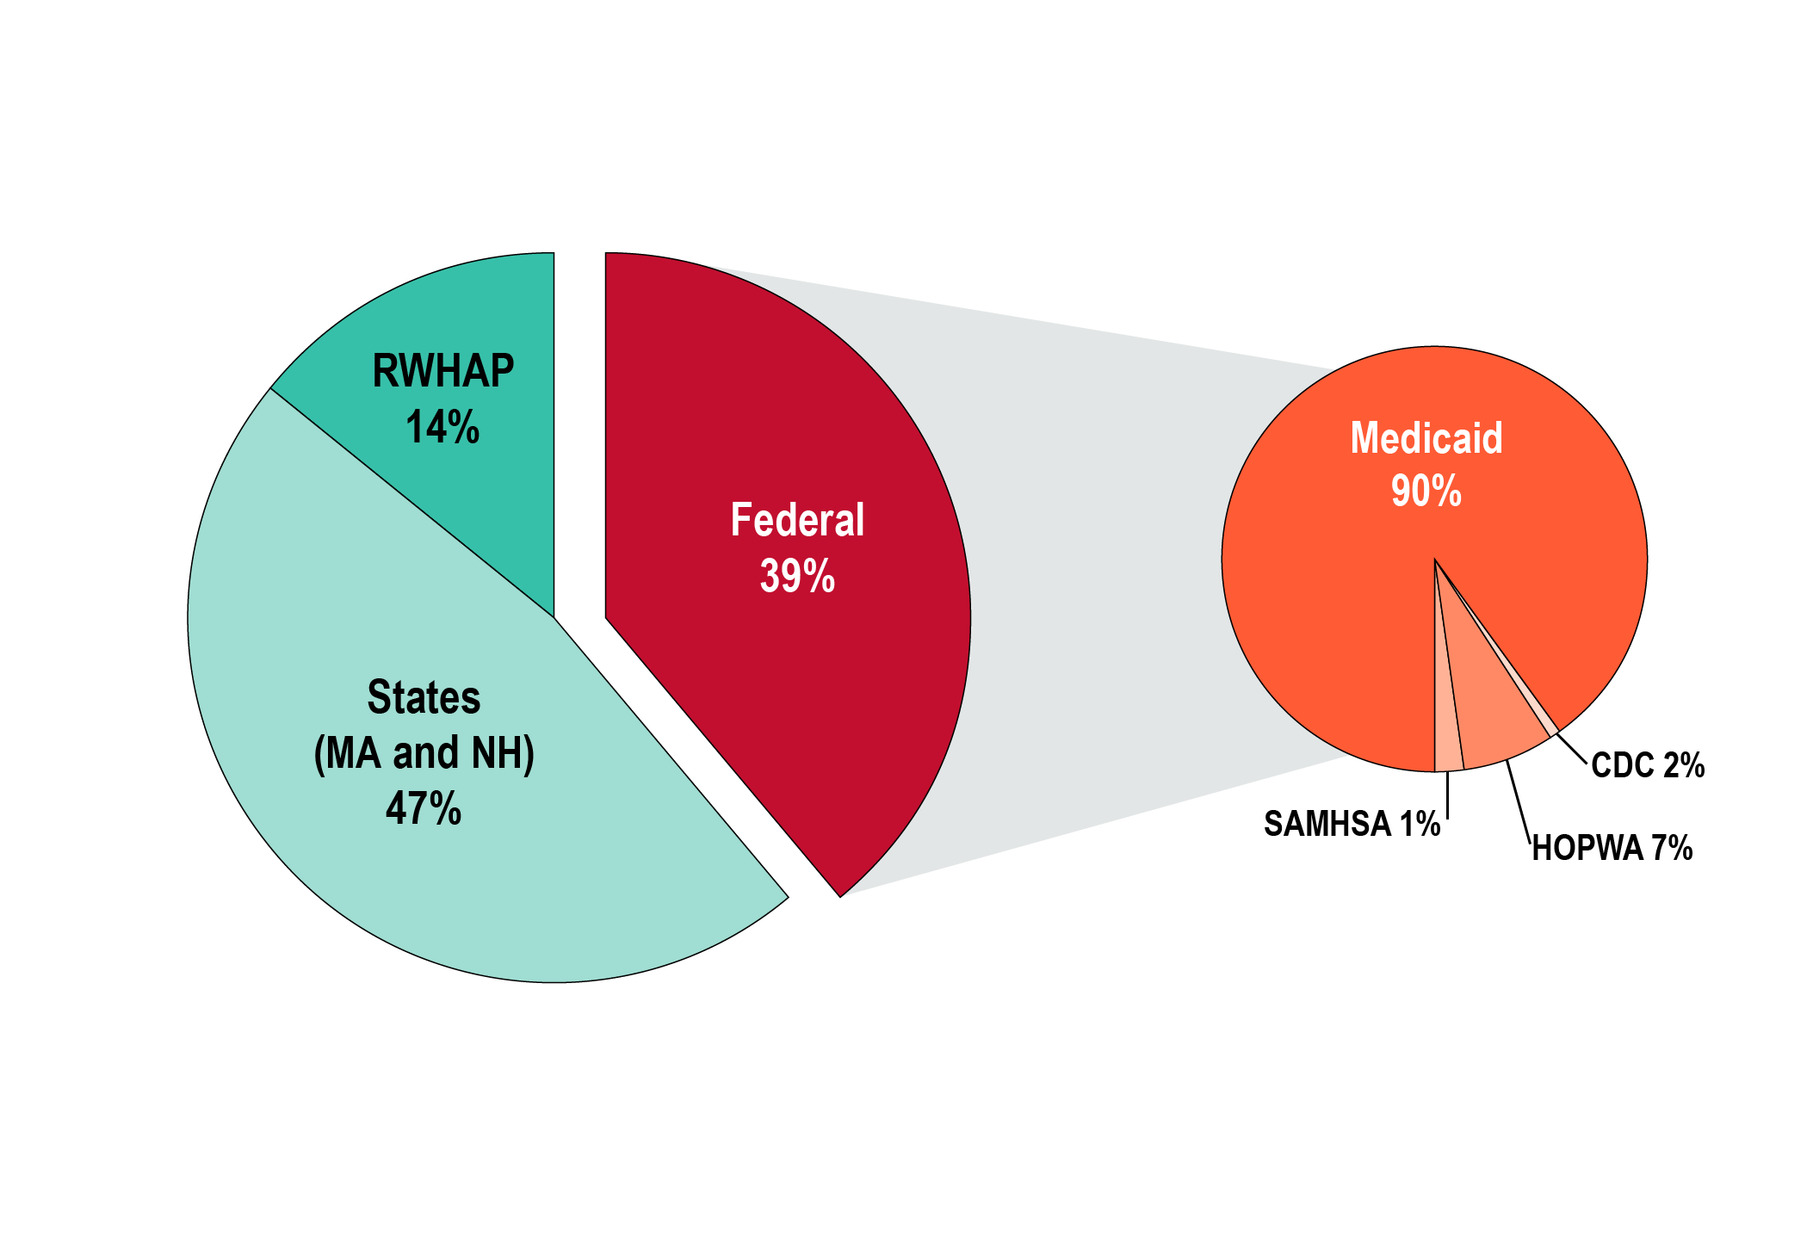
Public Funding Sources for HIV Services, Boston EMA, 2016
Total HIV-related Public Funding: $235 million
Source: 2016 Funding Streams Overview for HIV/AIDS Services in the Boston EMA, Boston Planning Council, May 2016

Slide 56
Obtaining Needed Data: Sound Practices
Be sure responsible committees – including your consumer committee/caucus – and full PC/PB schedule time to receive and discuss data before decision making
Decide how to be sure data are in user-friendly formats
  Negotiate whether recipient will provide its data in appropriate formats or share data sets for PC/PB support staff or consultants to analyze and format

Slide 57
Obtaining Needed Data: Sound Practices (cont.)
Develop and follow an annual work plan that specifies data needs and timing for meeting them
Define data to be provided by the recipient in the Memorandum of Understanding (MOU)
Allocate time and effort to train all – including consumers

Slide 58
Sum Up
RWHAP Part A planning is data-based
PC/PBs need to become familiar with:
  Data-related terms
  Various types of data reports and summaries used in decision making about priorities, allocations, directives, and service models
Each type of data provides important information about some aspect of service needs, barriers, gaps, system of care, and service quality and outcomes
Data now more detailed and useful for directing funds and tailoring services to meet diverse PLWH needs
PC/PBs need to arrange timely access to needed data

Slide 59
Optional Slides for Activities

Slide 60
Instructions for Activity 10.1:
Data Terms and Concepts
You will receive at least 1 definition or 1 term related to data used by RWHAP PCs/PBs for decision making.
Your job is to find the other participant with the definition of your term, or the term that fits your definition.
Warning: A few terms have no matching definition.
If you need a hint, ask one of the assigned resource people, or discuss your term or definition with other participants.
Once you have found your match, take your seat. We will ask you to present your match or to identify any terms for which you couldn’t find a match.
At the end of the session, we will ask you to take the quiz individually.

Slide 61
Instructions for Activity 10.3:
Finding Needed Data
Please work with a small group, choosing a facilitator, recorder, and reporter.
Review the scenario assigned to your group, and identify existing data sources/types that can provide needed information, as well as possible data gaps and how they might be filled.
Have your reporter prepared to summarize your scenario and the types of data and possible data gaps you identified, and share them with the full group.

